Slide 1
March 2024 Booster Club
Meeting

Slide 2
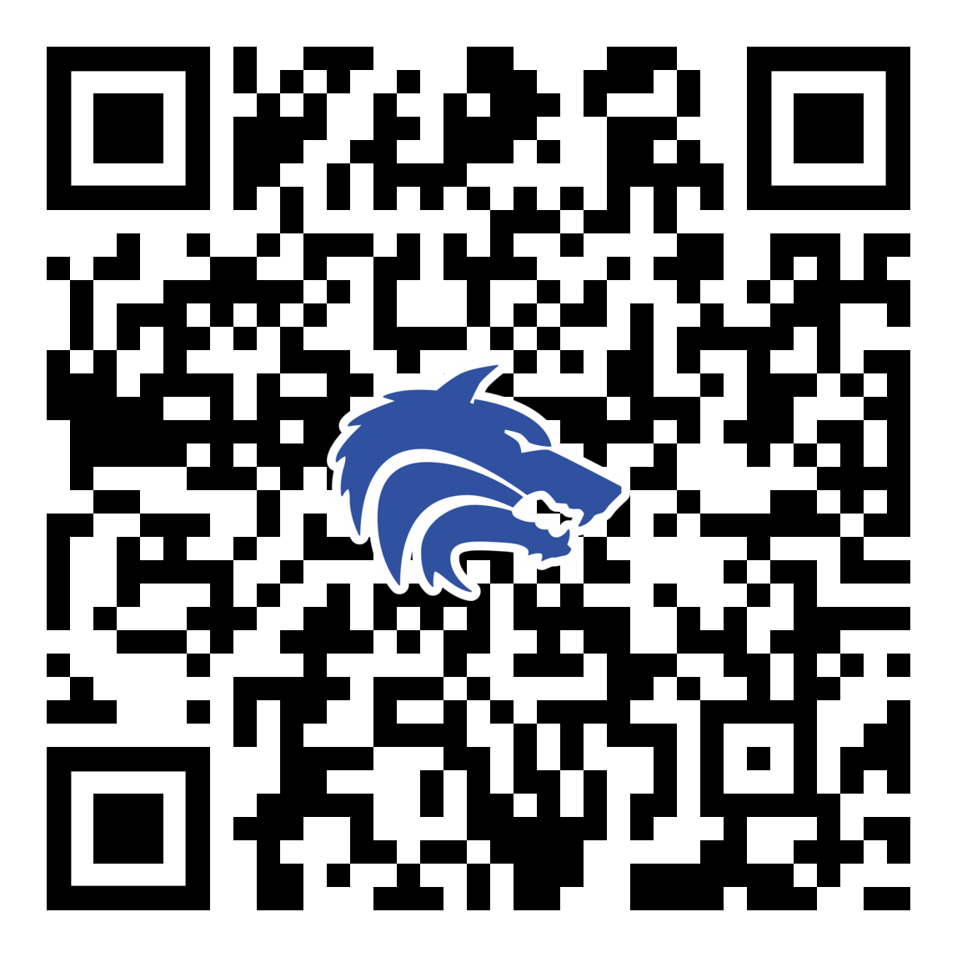
March 2024 Booster Club Meeting

Slide 3
Agenda
Approve January Meeting Minutes
2024 – 2025 Board Positions
Treasurer Report
  Final Packfunding Numbers
Spring Calendar
  Theme Nights
  Team Dinners
  Elementary School Visits
  Committees
Sponsor Recap
Concessions Corner
Coach’s Corner

Slide 4
2024 – 2025 Board Nominations
President:
Vice President:
VP Marketing:
Treasurer:
Secretary:
Email Nominations or Interest to jpaschal01@gmail.com

Slide 5
Treasurer’s Report: March 2024
BEGINNING BALANCE as of 2/8/24:
REVENUE
Booster Club Memberships:
Packfunding Donations (received 2/9- 2/29/24)
Player Yard Signs & Decals
First Pitch Dinner Tickets
Concessions
Booster Club Sponsorships
Total Revenue:
EXPENSE
Rock & Brews – First Pitch Dinner
Concessions (Food, Candy, Supplies)
Videographer (2024 Season)
Insurance Renewal
Uniforms (Nike Pants & Heated Jackets)
Player Yard Signs & Varsity Metal Round Baseball Signs at Ballpark
Field Equipment (Turf Mower & New Speakers)
Field Improvements – January Team Work Days
Hotel & Travel for Coach Convention
Rally Towels
HUDL Expense
Total Expense:
  $21,999.86
$1,547.50
$4,629.50
$722.00
$710.00
$165.00
$5,750.00
$13,164.00
$2,813.00
$306.83
$1,500.00
$455.00
$1,208.45
$1,845.00
$1,060.78
$205.74
$549.70
$1,675.95
$320.00
$11,940.51
ENDING BALANCE as of 2/29/24
$23,223.35

Slide 6
Final Packfunding Update
$16,950 Raised
$ 722 Credit Card Fees
$16,228 Raised After Fees
214 Donations
THANK YOU!!

Slide 7
Spring Calendar
Mon 3/11: Spring Break Week – Games and Practices all week!!!
Wed 3/13: District Games begin vs. Plano Senior High
Thur 3/14: Team Dinners Begin (On Thursdays, Wednesday of Easter week)
Thur 3/21: Elementary School visits before school
Fri 5/3: Playoffs Begin
Sun 5/5: Baseball Banquet (Collin College – Frisco Campus)

Slide 8
Theme Nights
Date
WED 3/13
FRI 3/22
THUR 3/28
TUES 4/2
FRI 4/12
TUES 4/16
SAT 4/20
FRI 4/26
Theme
District Opener
Feeder School Night
Student Council Theme Night
Inclusion Night
PSA Night
Teacher Appreciation Night
Senior Day
Blue Out / Senior Sendoff
Sponsor
Rock & Brews Restaurant
Camp Bow Wow
Reynolds Company
Rudick Construction Group

Slide 9
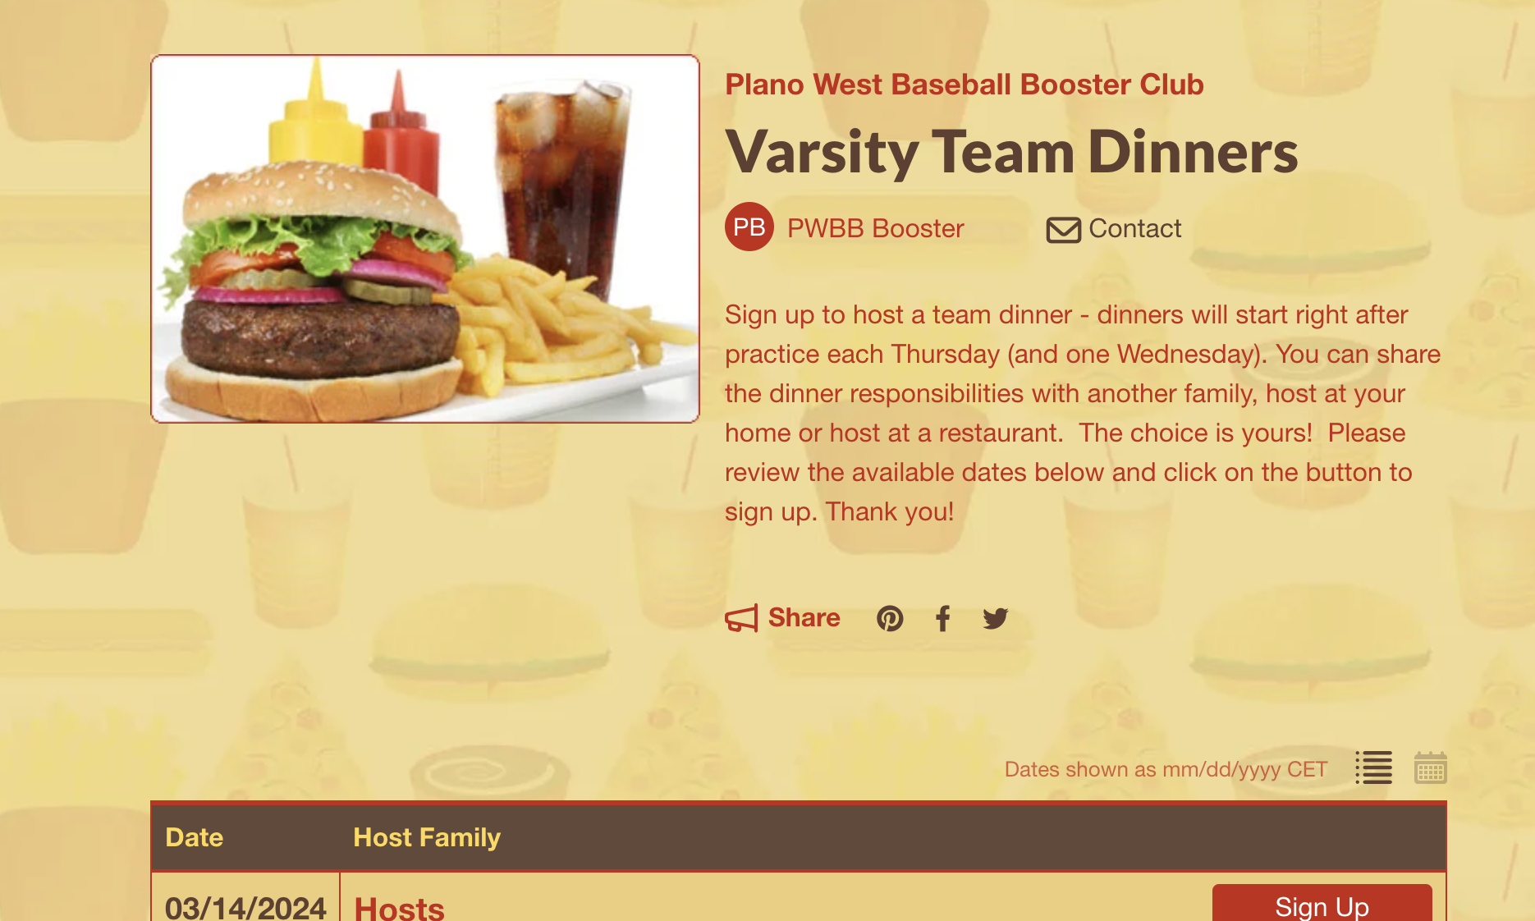
Team Dinners
Starting next week! Please sign up to host.
Each team will receive their own signup link!

Slide 10
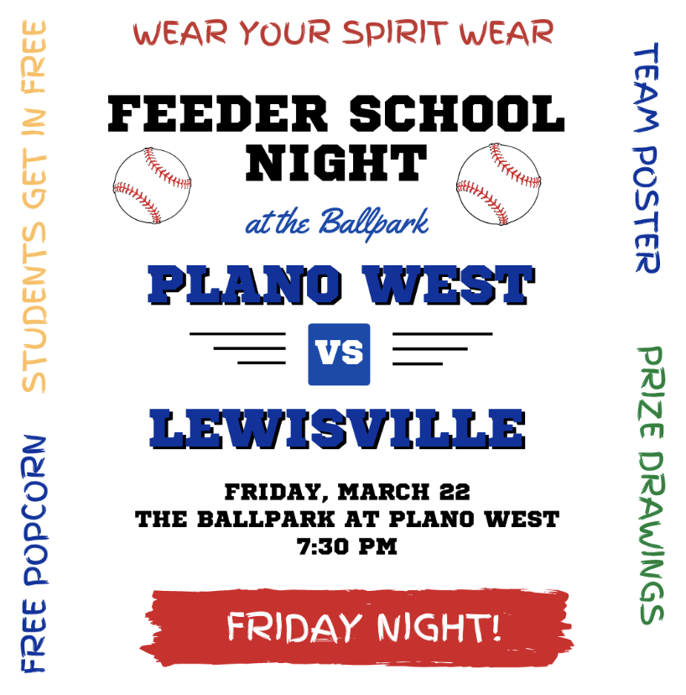
Elementary School Visits
Players will promote event by visiting Elementary Schools on the morning of 3/21. This year we will be combining this event with Softball.
Packets will be given to team leads on 3/20 after practice:
  Flyers and instructions will be included in packets
  Players are assigned to the grade school they attended or to a school that needs coverage if you did not attend one of the feeder schools.
  Players will wear black sweats or shorts and the jersey selected by coaches
March 21 - School visit day
  Players arrive at 7:15 am to work the carpool lane
  Players will distribute flyers, hold doors, greet students
  Parents will be needed to take pics etc.

Slide 11
Sponsors
2024 Sponsors
Name Level Amount ($)
Camp Bow Wow Triple 1,250
Jalin Jewelers Single 350
Full Circle Counseling & Consulting Single 350
The Reynolds Company Triple 1,250
Innerlight Chiropractic Single 350
Hempkins Insurance Single 350
Rudick Construction Group Home Run 2,000
Dilla's Restaurant Single 350
McBride Orthodontics Single 350
Messick Peacock & Associates Double 750
Ms. Kitty's Pet Concierge Single 350
Keller Williams Realty Single 350
First Call Mechanical Double 750
Total $8,800
BIG Thanks to the JV2 parents (especially Britton Lankford!) who have been a great help in bringing in many of these sponsors.
Banners will be up for the Triple and Home Run sponsors by the end of the week.
Team Calendar is finished so we'll go back out deliver some to sponsors and a few prospects.

Slide 12
Concessions Corner
A million thanks to all the volunteers to date!
Thank you specifically for those who leaned in this weekend and to Mary Wade for taking the helm for the weekend!
Volunteers needed for District Games:
  JV2 to work JV2 games
  Varsity to work JV games
  JV to work Varsity games
Two shifts MINIMUM per family (that minimum – don't be shy if you want to sign up for more!)
We have great student volunteers that will help!

Slide 13
Committees / Task Needs
Concessions: Angela Thompson/Ginger Cox/Mary Wade
End of Season Banquet: Julie Raecek (Any volunteer)
Gameday Program: Robin Paschal / Tracy Sievers
Senior Night: Tracy Sievers
Theme Nights: Natalie McDaniel

Slide 14
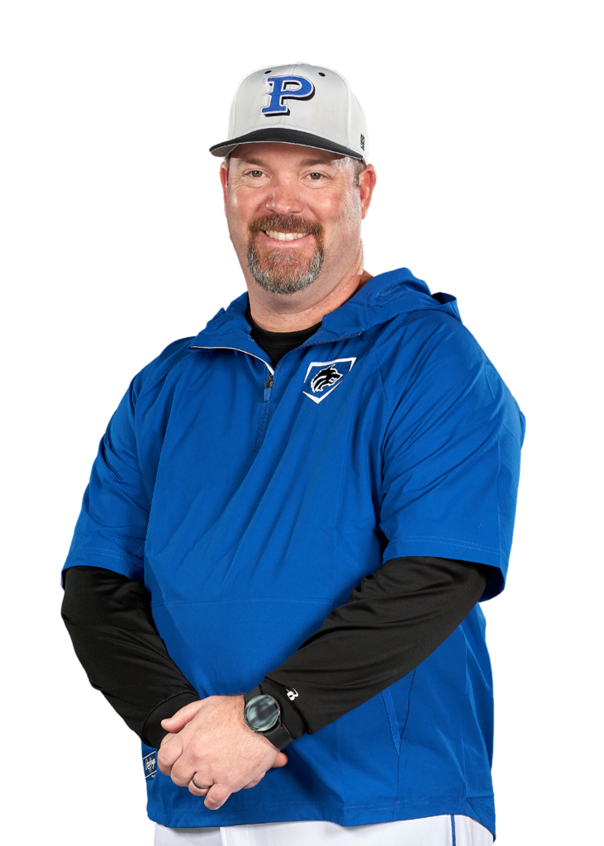
Coach’s Corner

Slide 15

SportsYou
DCMN-ZE9D

Slide 16
March 2024 Booster Club Meeting

Slide 17
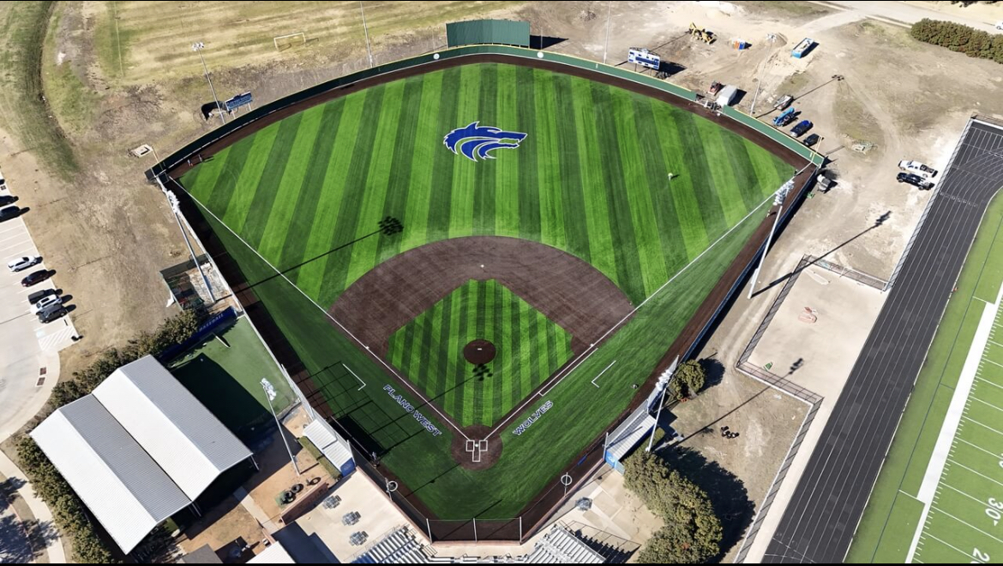
Ballpark Turf

Slide 18
Booster Club Votes
Approve December 2023 Meeting Minutes
JOIN THE BOOSTER CLUB
  26 members (we had 37 member families in 2022-2023 school year)
  $5,150 in membership dues! ($500 increase from prior meeting)
www.planowestbaseball.org/join

Slide 19
Debit Card
Why – recurring payments that must be made via Credit / Debit card
Examples – domain name renewal, Rhapsodo renewal, Coaching conventions and associated hotel stays
New for 2023 – 2024: PISD employees cannot be reimbursed by booster clubs!
Proposal: Booster club obtain a debit card for our checking account. Prior to use, 2 of the 3 booster club designated signees must provide email authorization for the use of the card

Slide 20
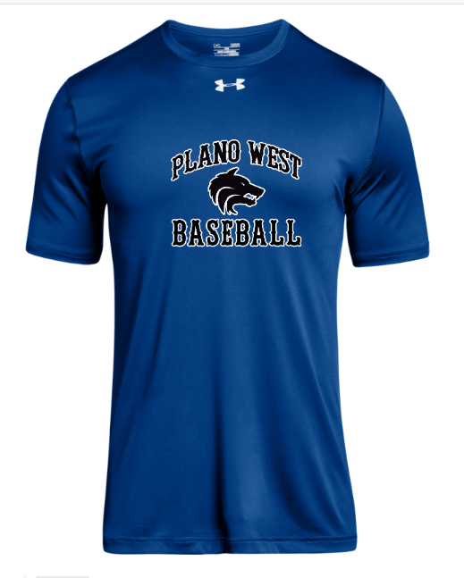
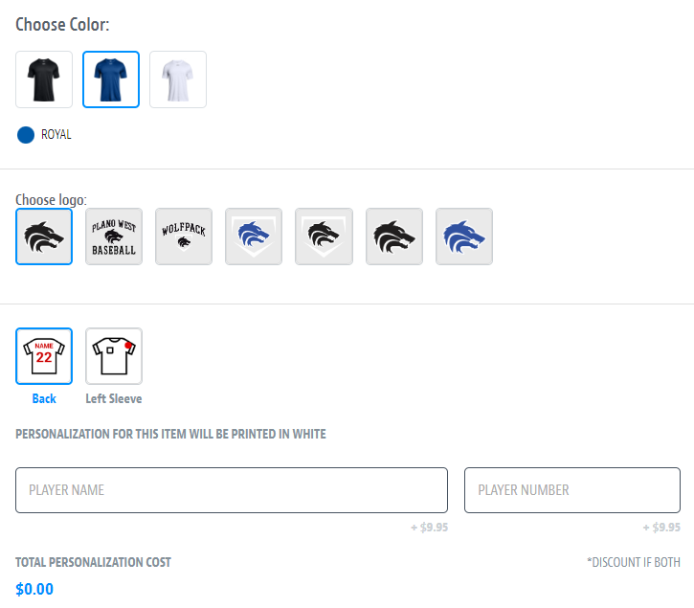
Spirit Wear – powered by SQUADLOCKER
Order your Plano West Baseball gear from Squadlocker via www.planowestbaseball.com

Slide 21
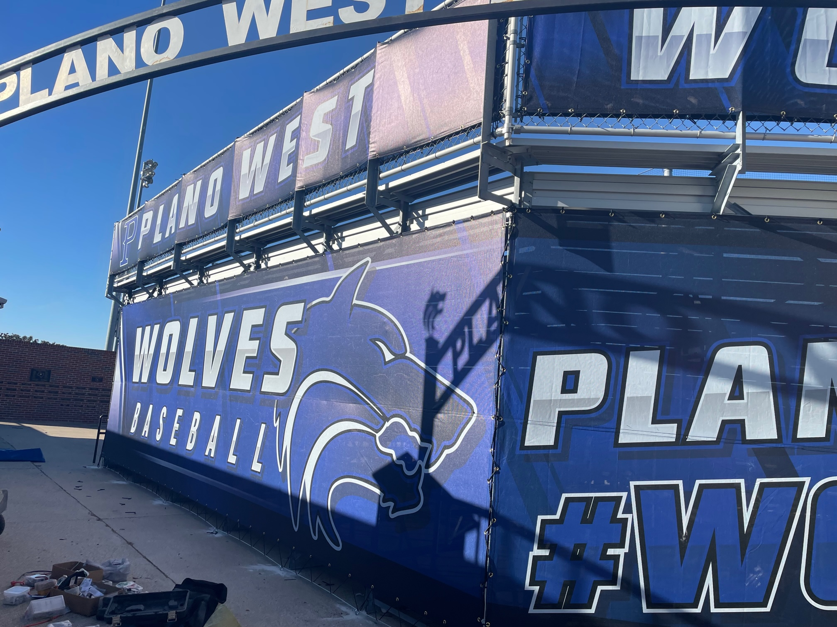
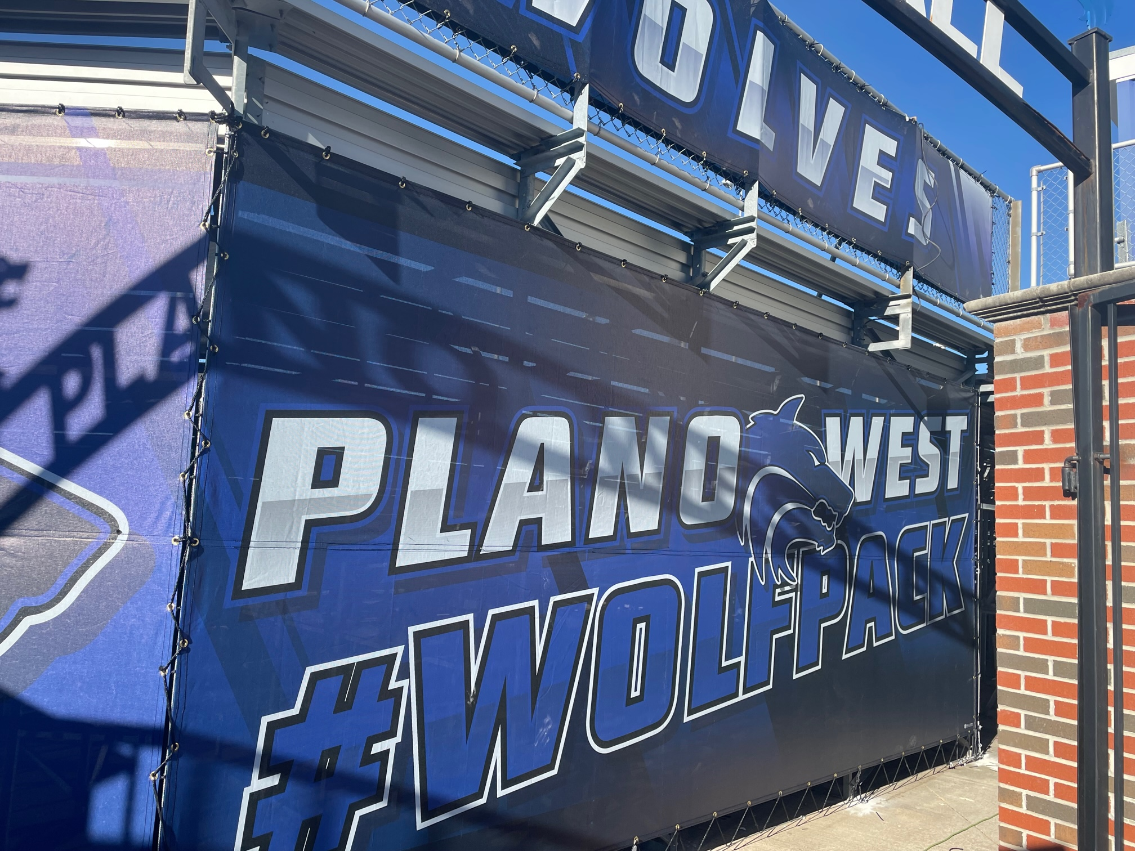

Ballpark Branding Upgrades

Slide 22
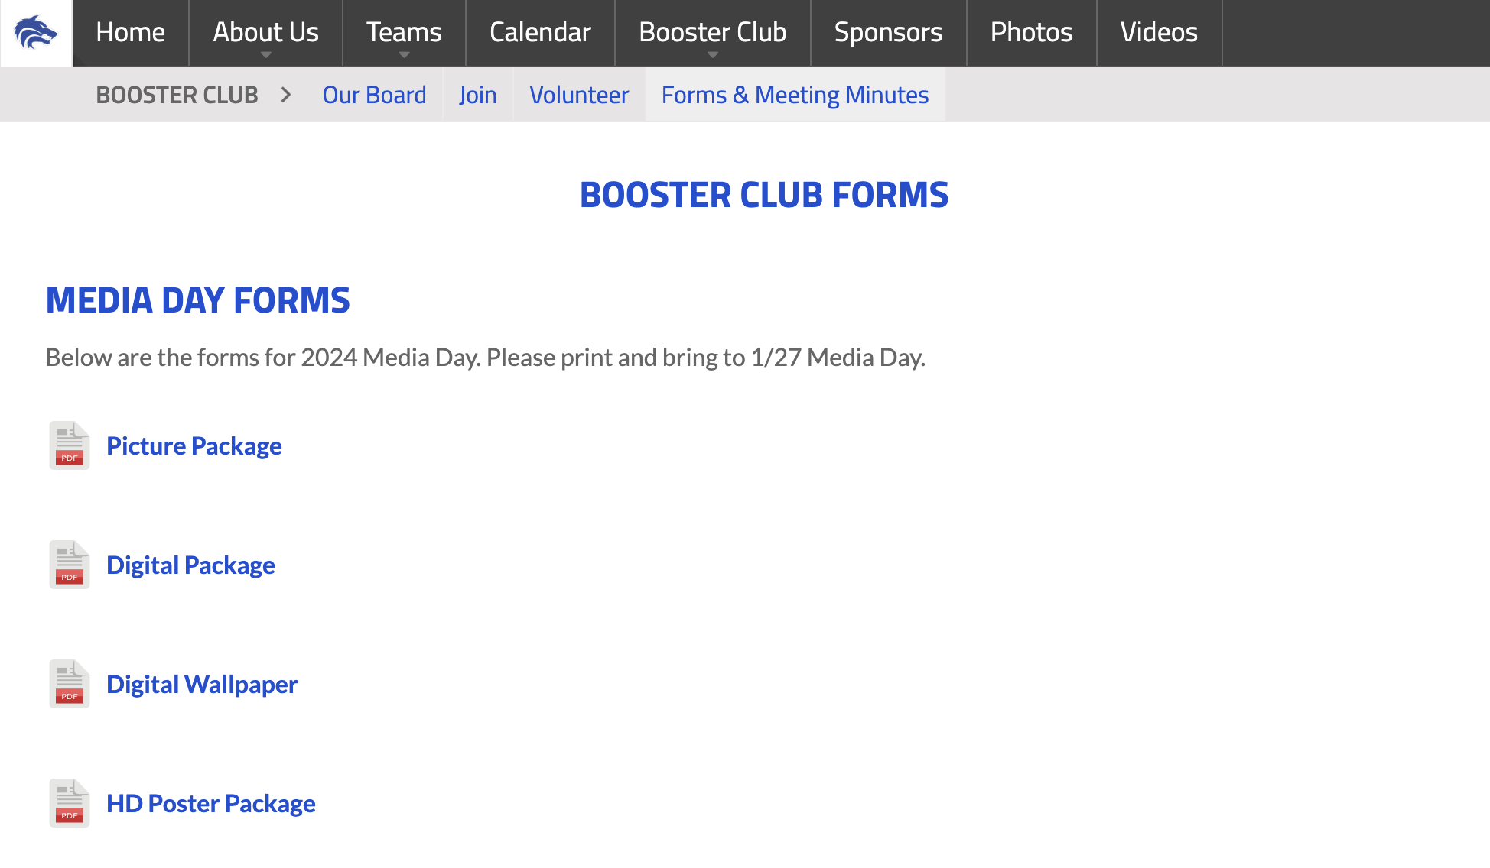
Media Day – 1/27
This Saturday 1/27 in the SAC @ 9 am
Coaches will communicate with players what uniforms they should wear
Parents are welcome to come and join the players as they have pictures taken and learn about Packfunding
Please have your player bring their form(s) and check for the package you want to Media Day
  Forms are found on the site in the Booster Club>Forms & Meeting Minutes>Media Day Forms
  There are several different options so print them all or just the ones you need

Slide 23
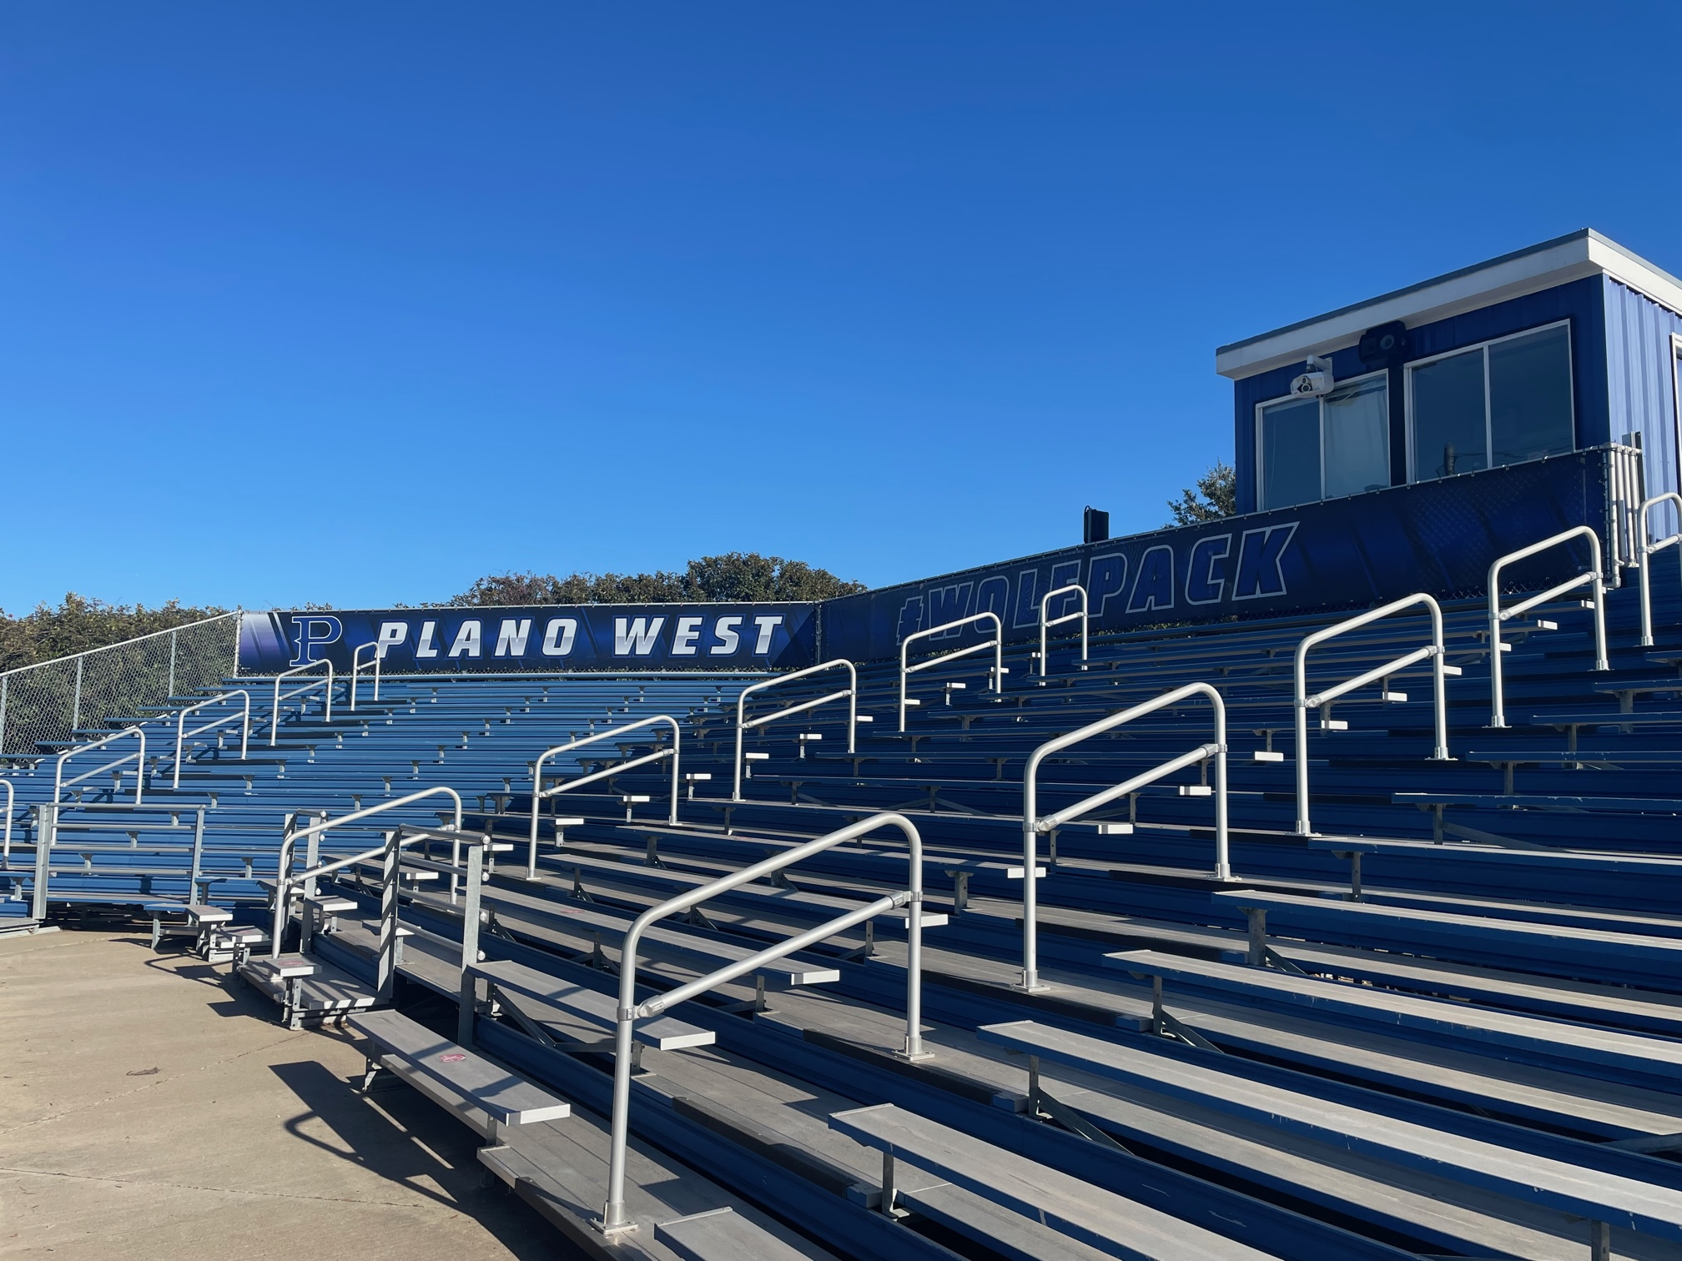
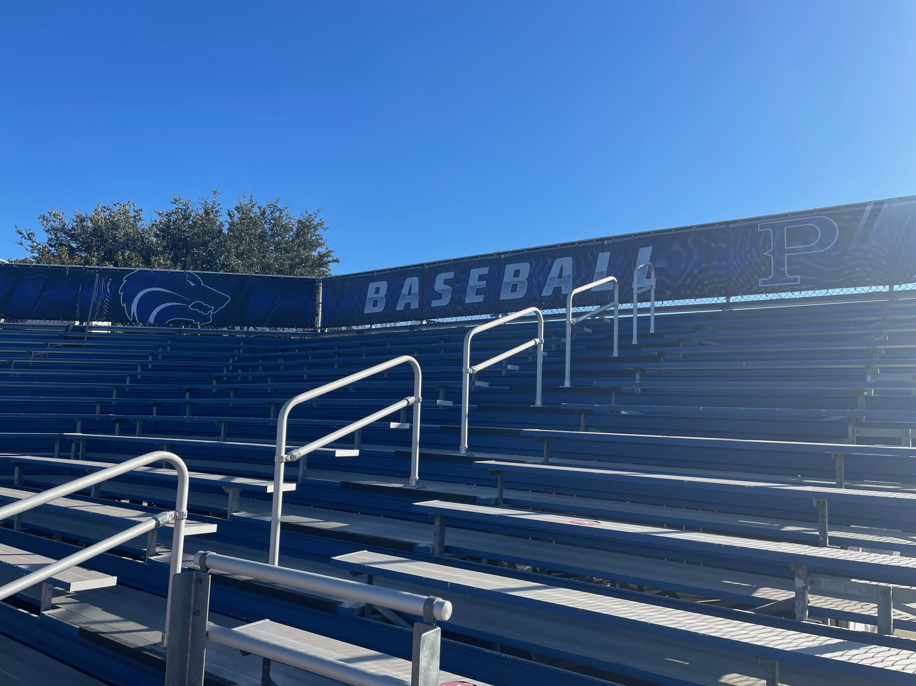
Ballpark Branding Upgrades

Slide 24
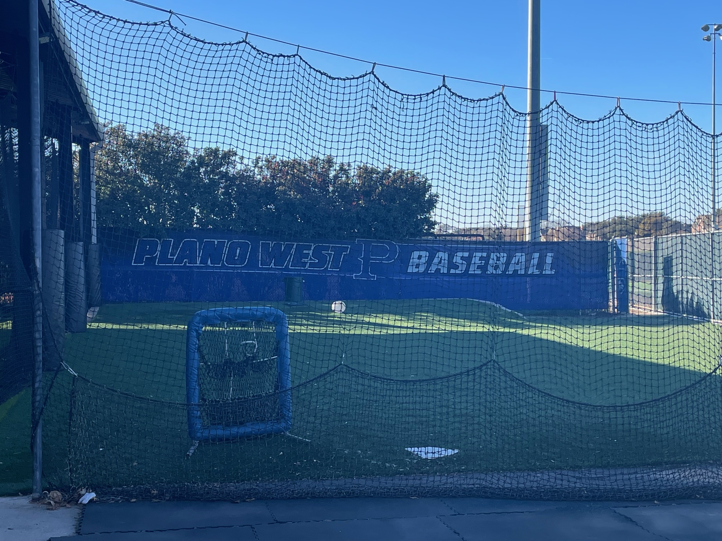
Ballpark Branding Upgrades

Slide 25
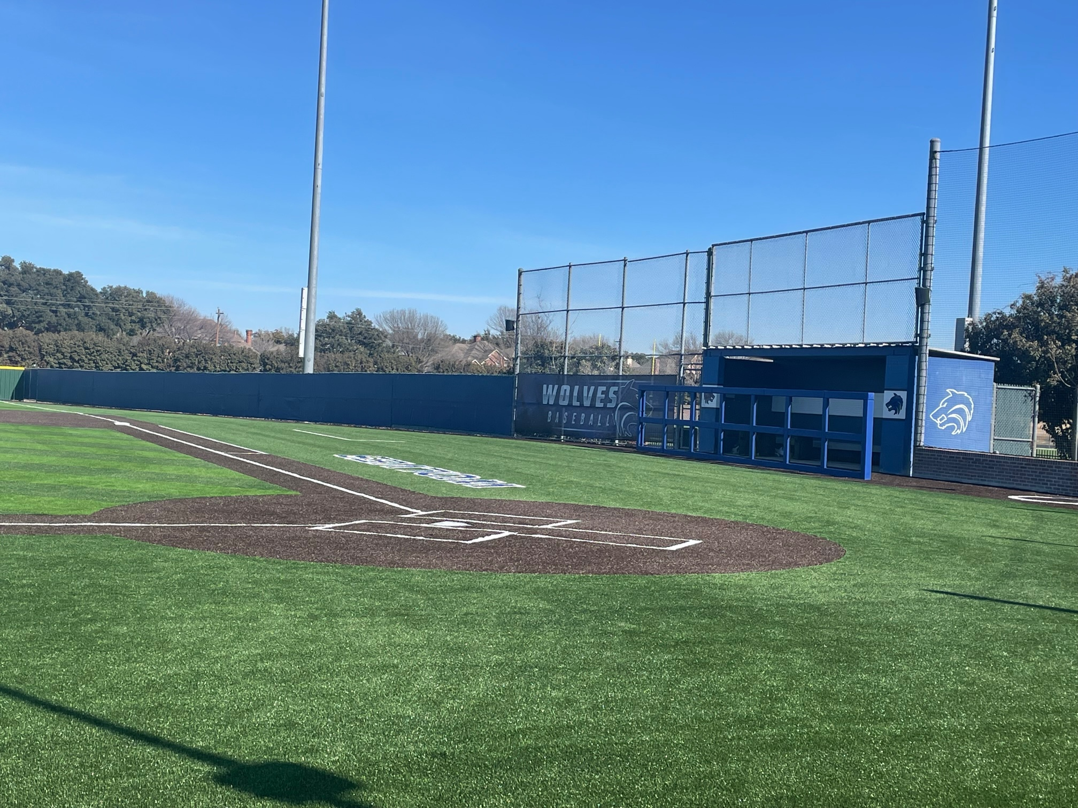
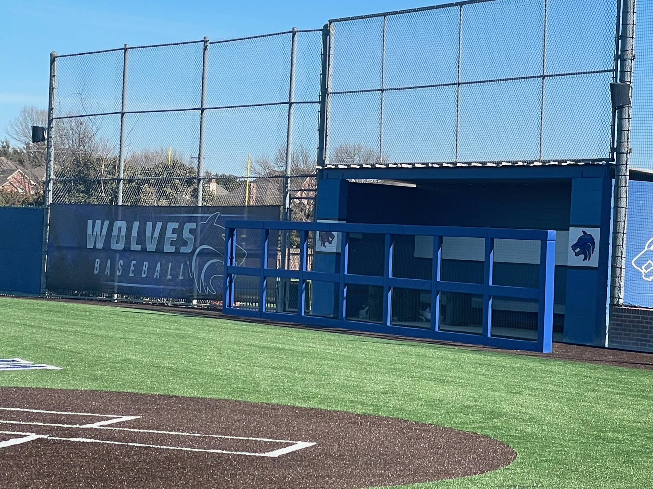
Ballpark Branding Upgrades

Slide 26
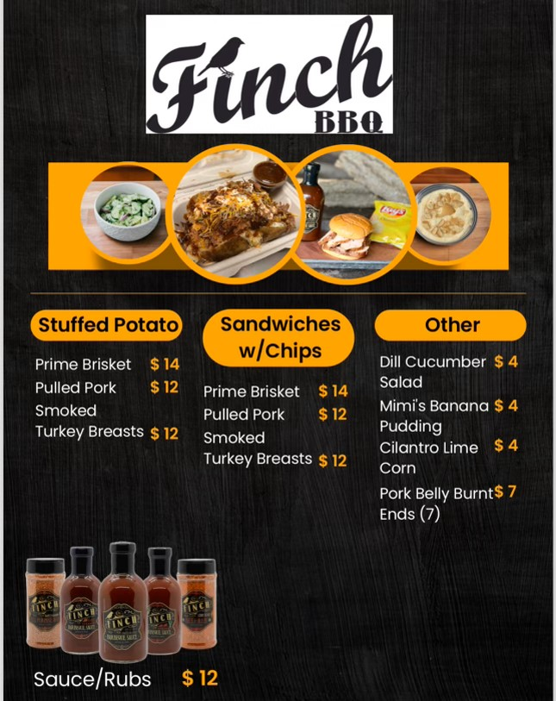
Plano West Baseball Spirit Nights
BBQ Dinner Drive Through
When: Thursday, November 9th
Where: PW Baseball Field Parking Lot
Who: Anyone that orders BBQ ahead of time for pickup
Benefit: 20% back to Plano West Baseball!

Slide 27
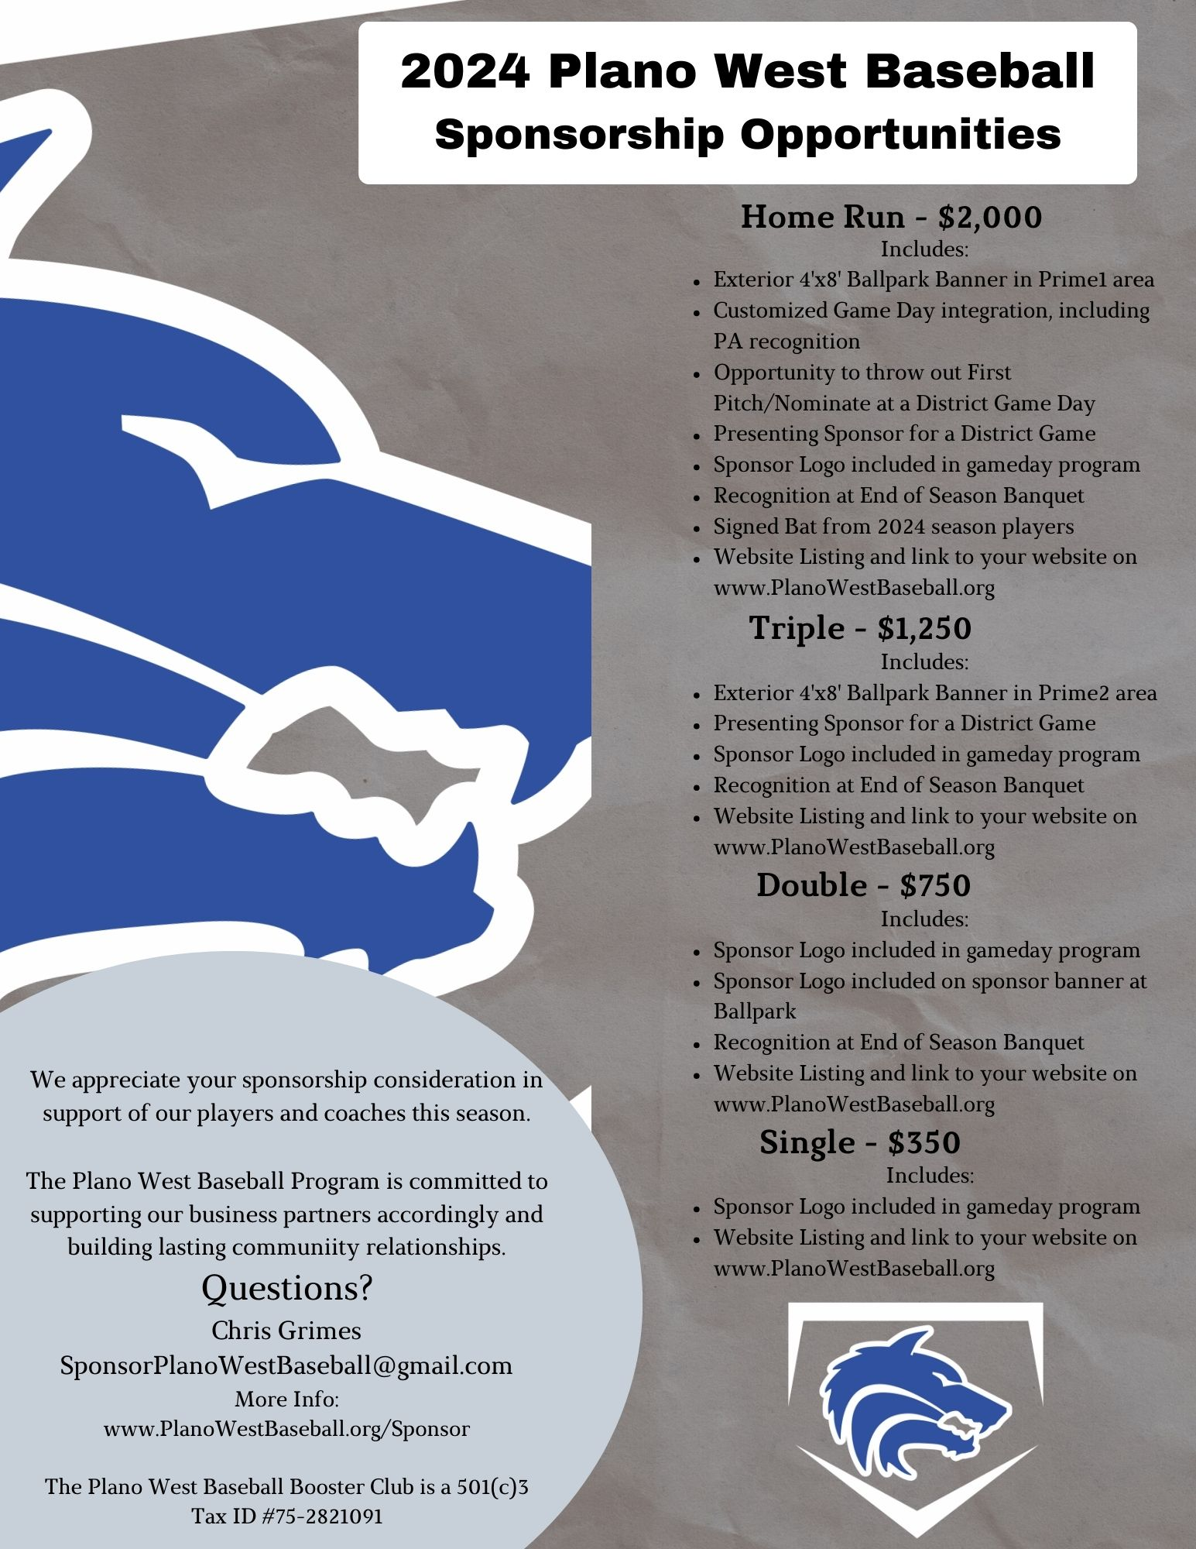
Sponsorships
Sponsor Day Sat – 1/20 @ 12:00
  Thanks to all players and especially the parents
  Contacted at least 100 potential sponsors across 9 areas
  Committee will start calling the prospects this week
Sponsors brought in during the last 2 weeks:
  1 HR, 2 Triples, and 5 Singles (over $6k in sponsorships) Thanks Parents!!
  Board members and Sponsor Committee members are working with each sponsor to get images and websites loaded and to produce banners for HR and Triple sponsors.
Sponsorship Ideas for/from Parents:
  Restaurants, Gyms, Insurance Agents, Car Dealers, Realtors, Baseball Clubs, Contractors, local companies, etc
Team Picture/Calendar
  Leave behind and give to all sponsors as soon as possible after Media Day

Slide 28
2023 – 2024 Booster Club Budget

Slide 29
2023 – 2024 Booster Club Budget

Slide 30
2023 – 2024 Booster Club Budget

Slide 31

Plano West Baseball Spirit Nights
Plano West Baseball Spirit Night!
When: Monday, October 23rd
Where: Coit and Spring Creek Location
Who: Anyone that mentions PW Baseball
Time: 5:00 p.m. - 10:00 p.m.
Benefit: 15% back to Plano West Baseball!

Slide 32
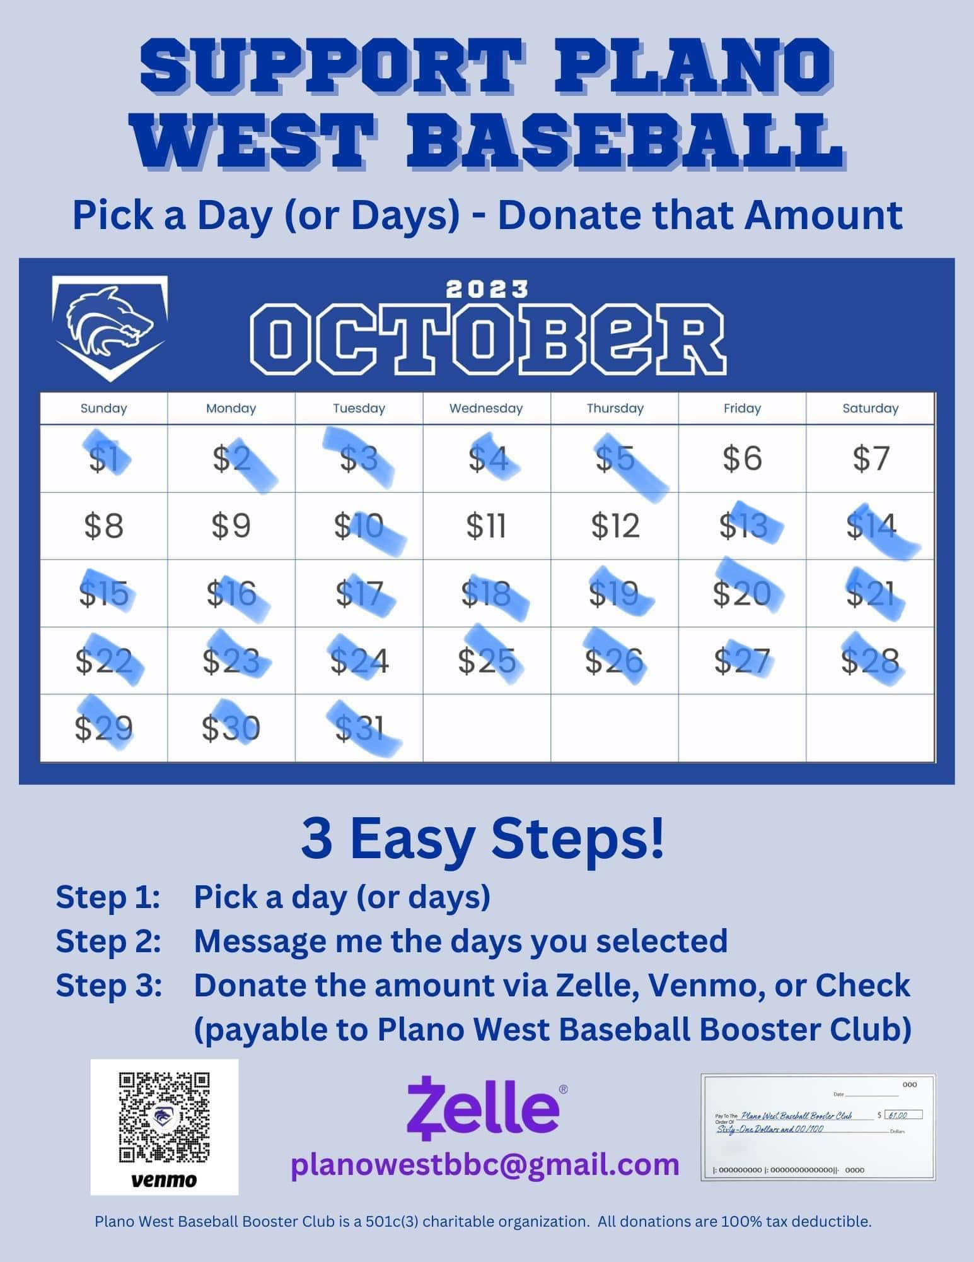
October Fundraiser
Calendar Fundraiser - $3,884 raised

Slide 33
Homecoming Parade
Wednesday, September 20th
Thank you Courtney Donkervoet & Joelle Novick for taking on float!
Candy donations needed!
Plan:
  After practice: decorate & pizza until 5:30 pm
  Make way to staging on Yeary by Brinker 5:40 pm
  Parade starts at 6:30 pm (goes down Yeary and into Plano West Lot)
  Pep Rally after in gym for Students
  Parents please help clean up float etc.
Players wear: fall jersey/shirt, black shorts (or sweatpants) and fall team hat

Slide 34
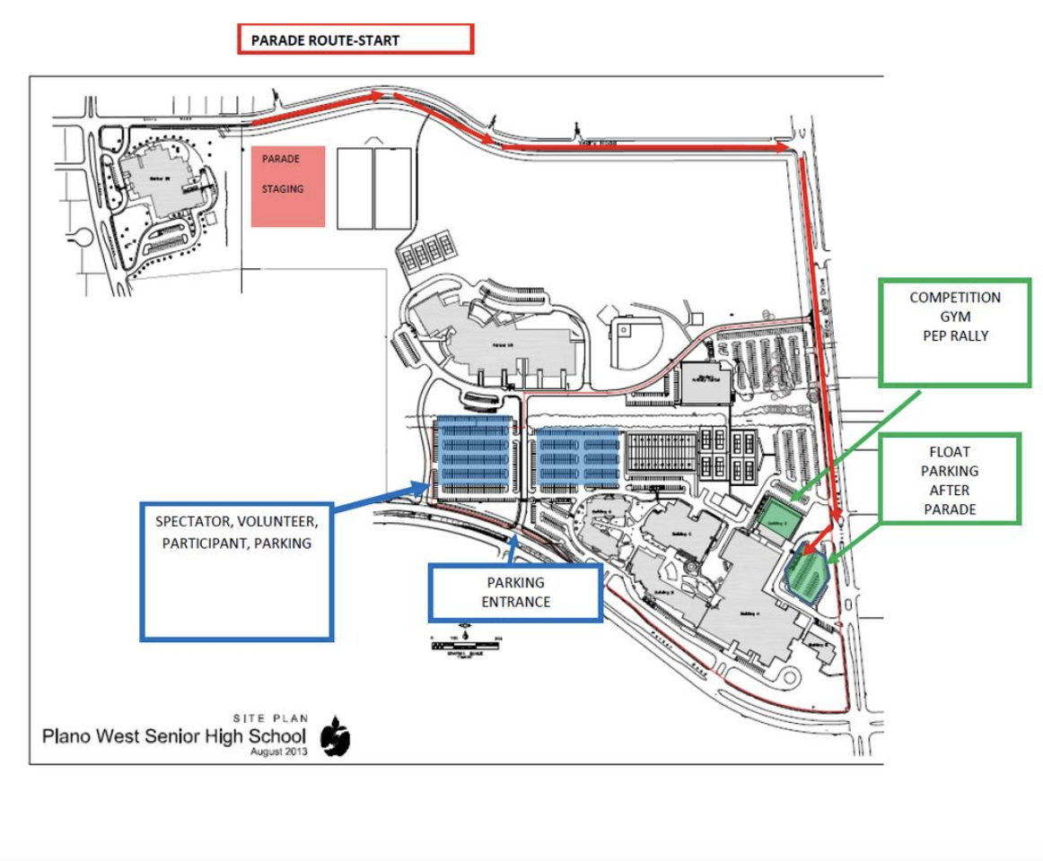
Homecoming Parade Route

Slide 35
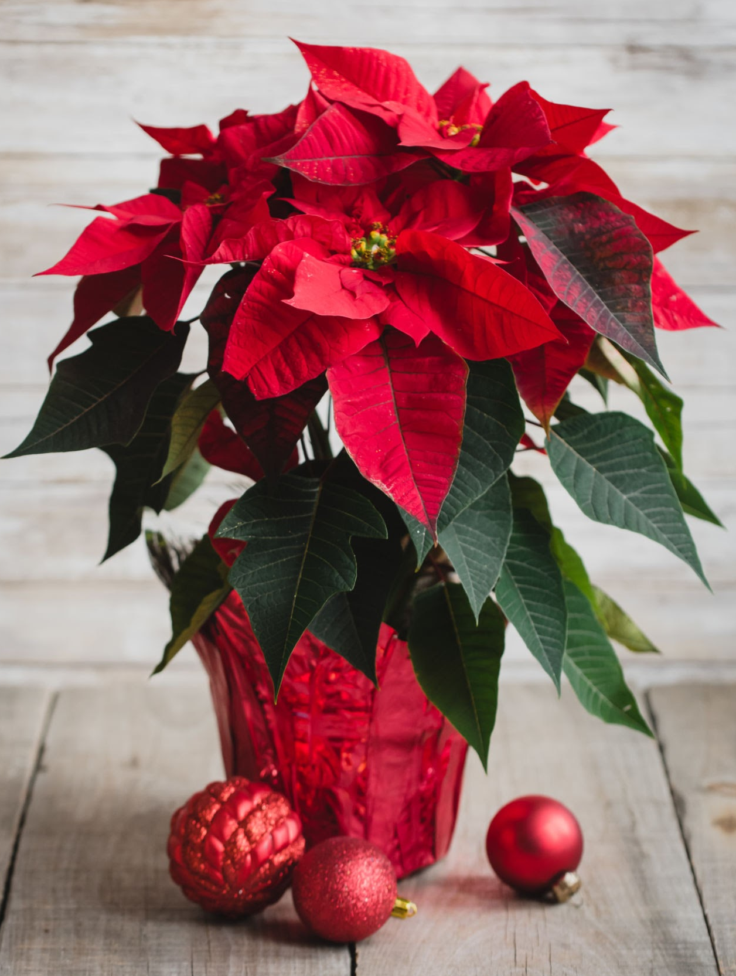
November Fundraiser
Poinsettia Fundraiser
Working with Website provider to have all orders go through website.
Look for ordering link soon!

Slide 36
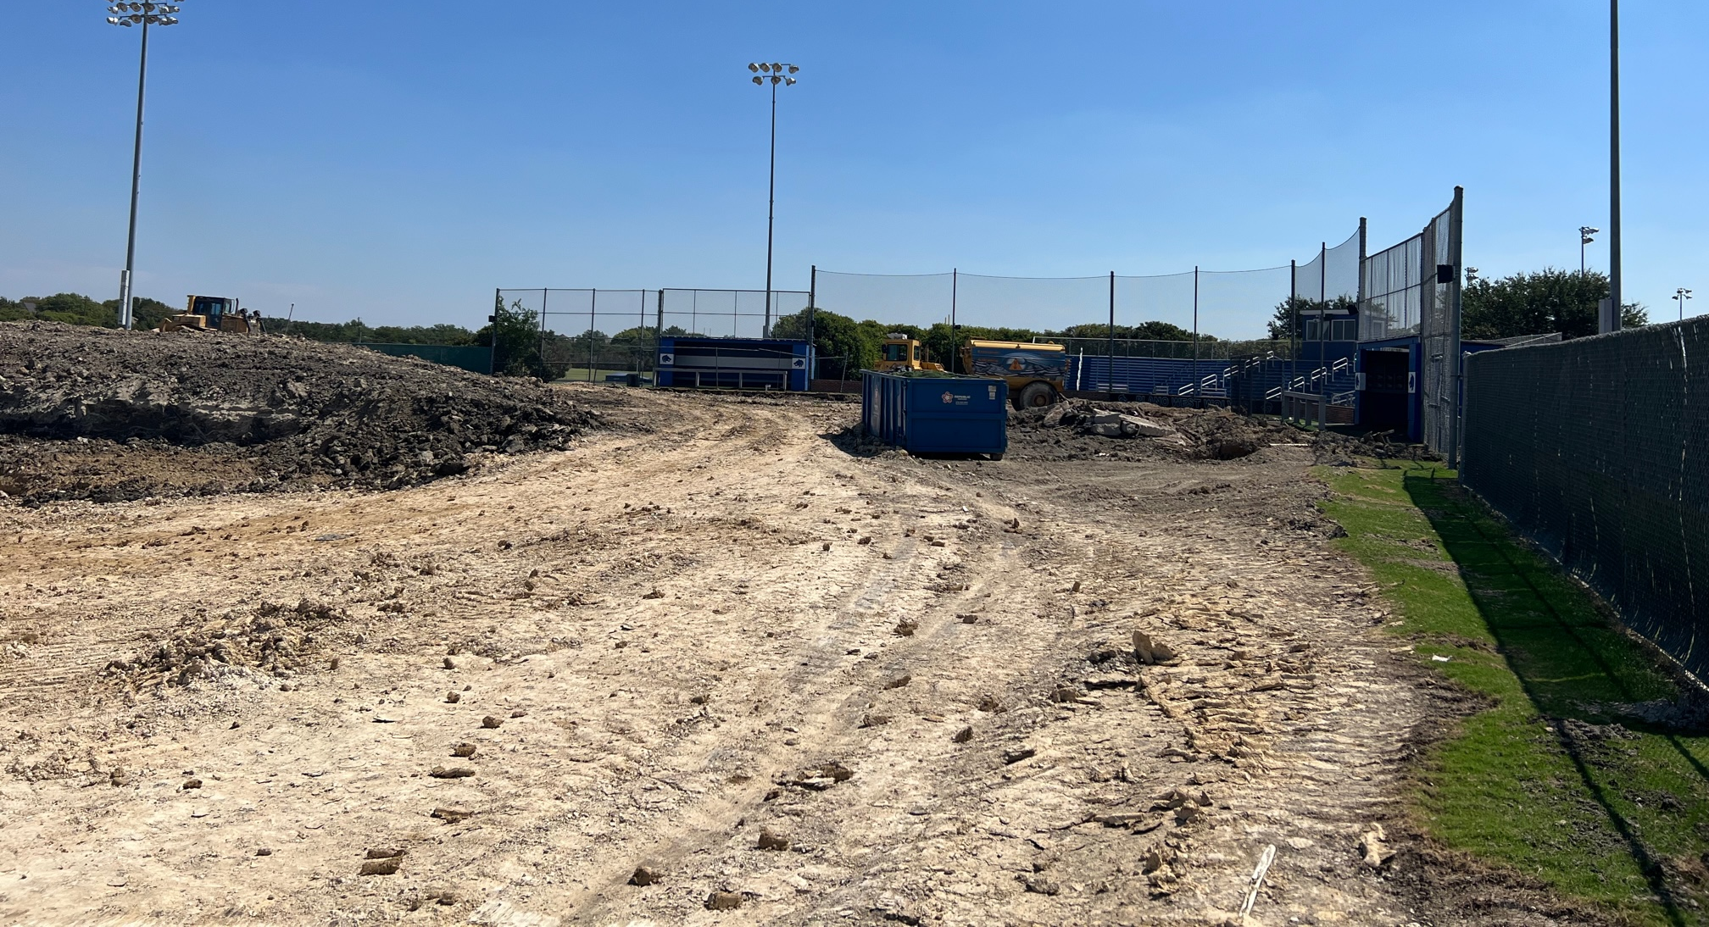
Ballpark Update

Slide 37
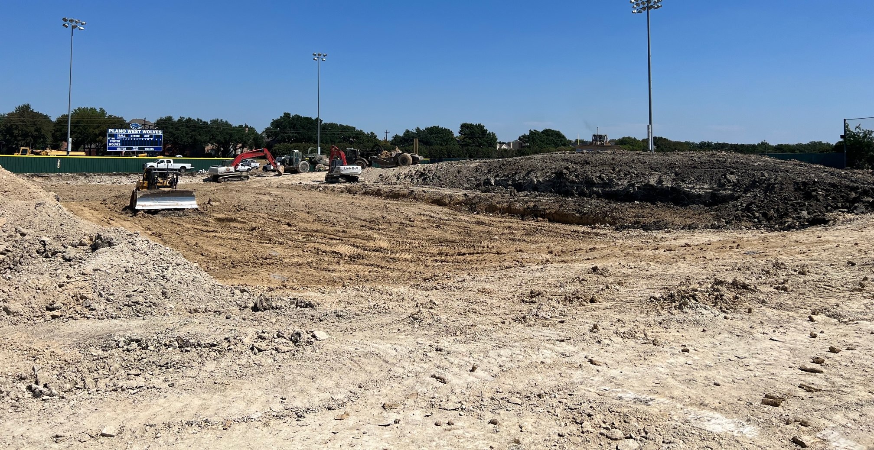
Ballpark Update

Slide 38
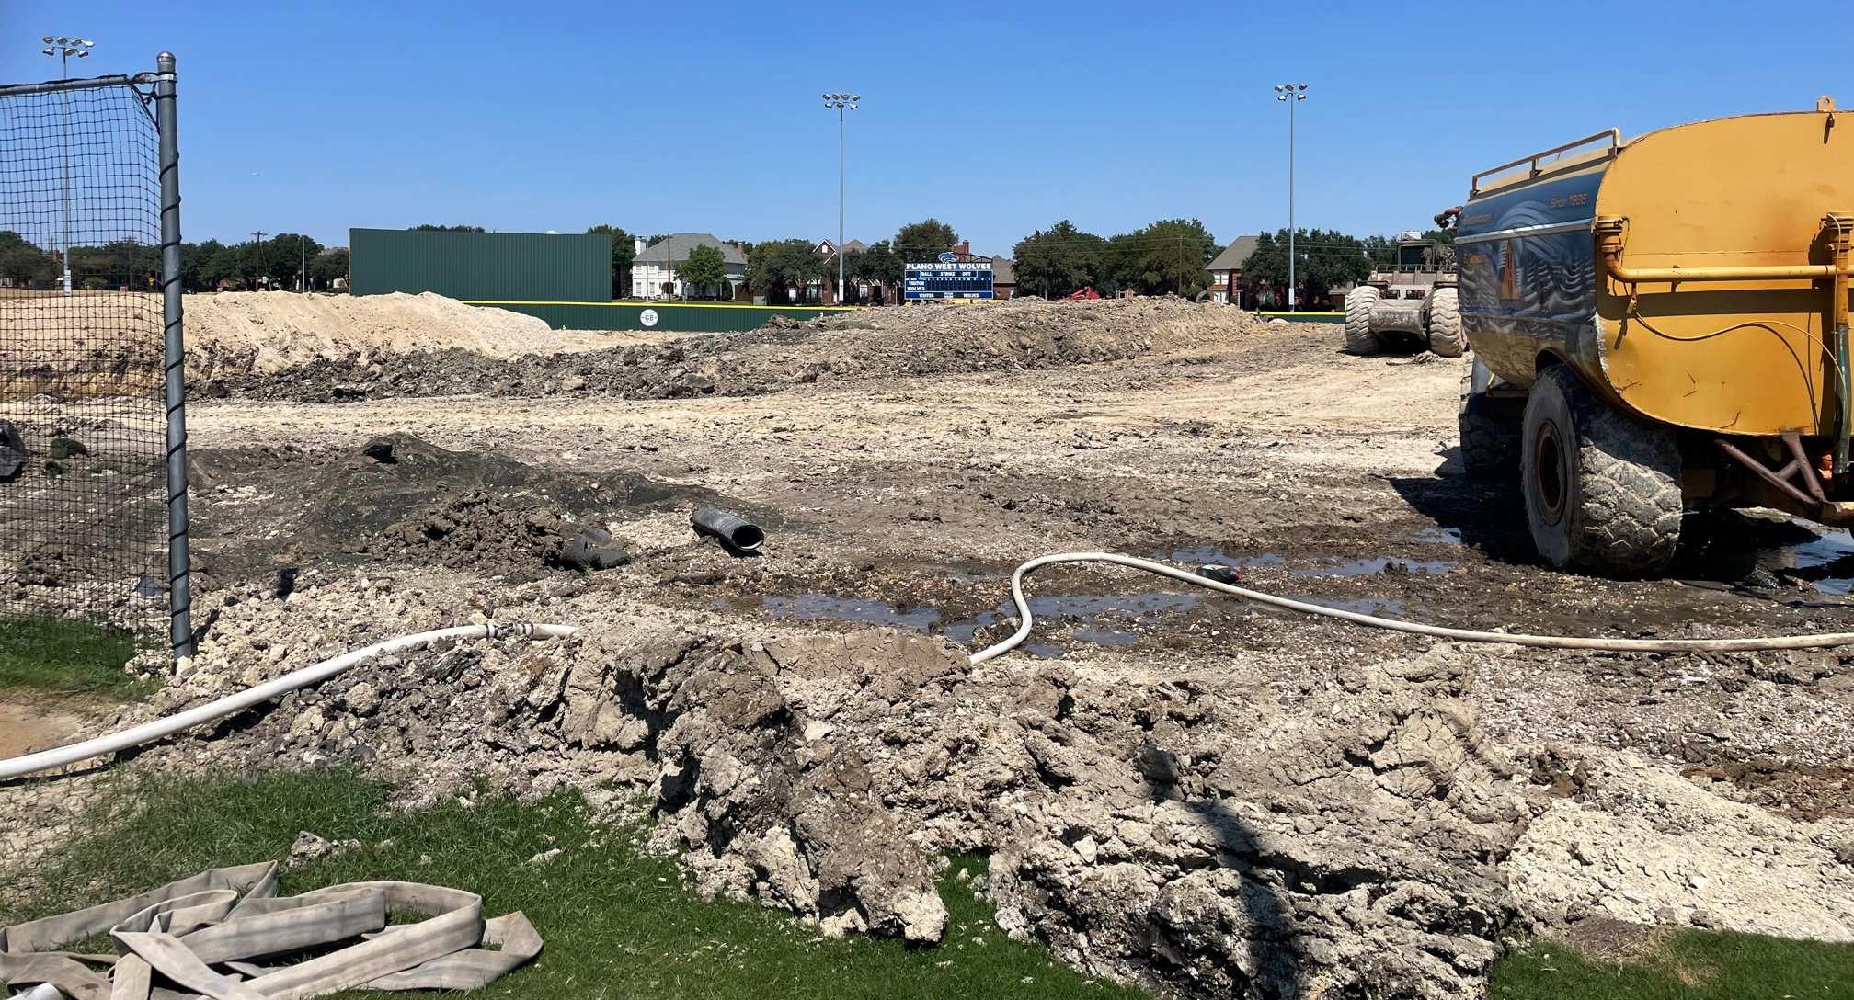
Ballpark Update

Slide 39
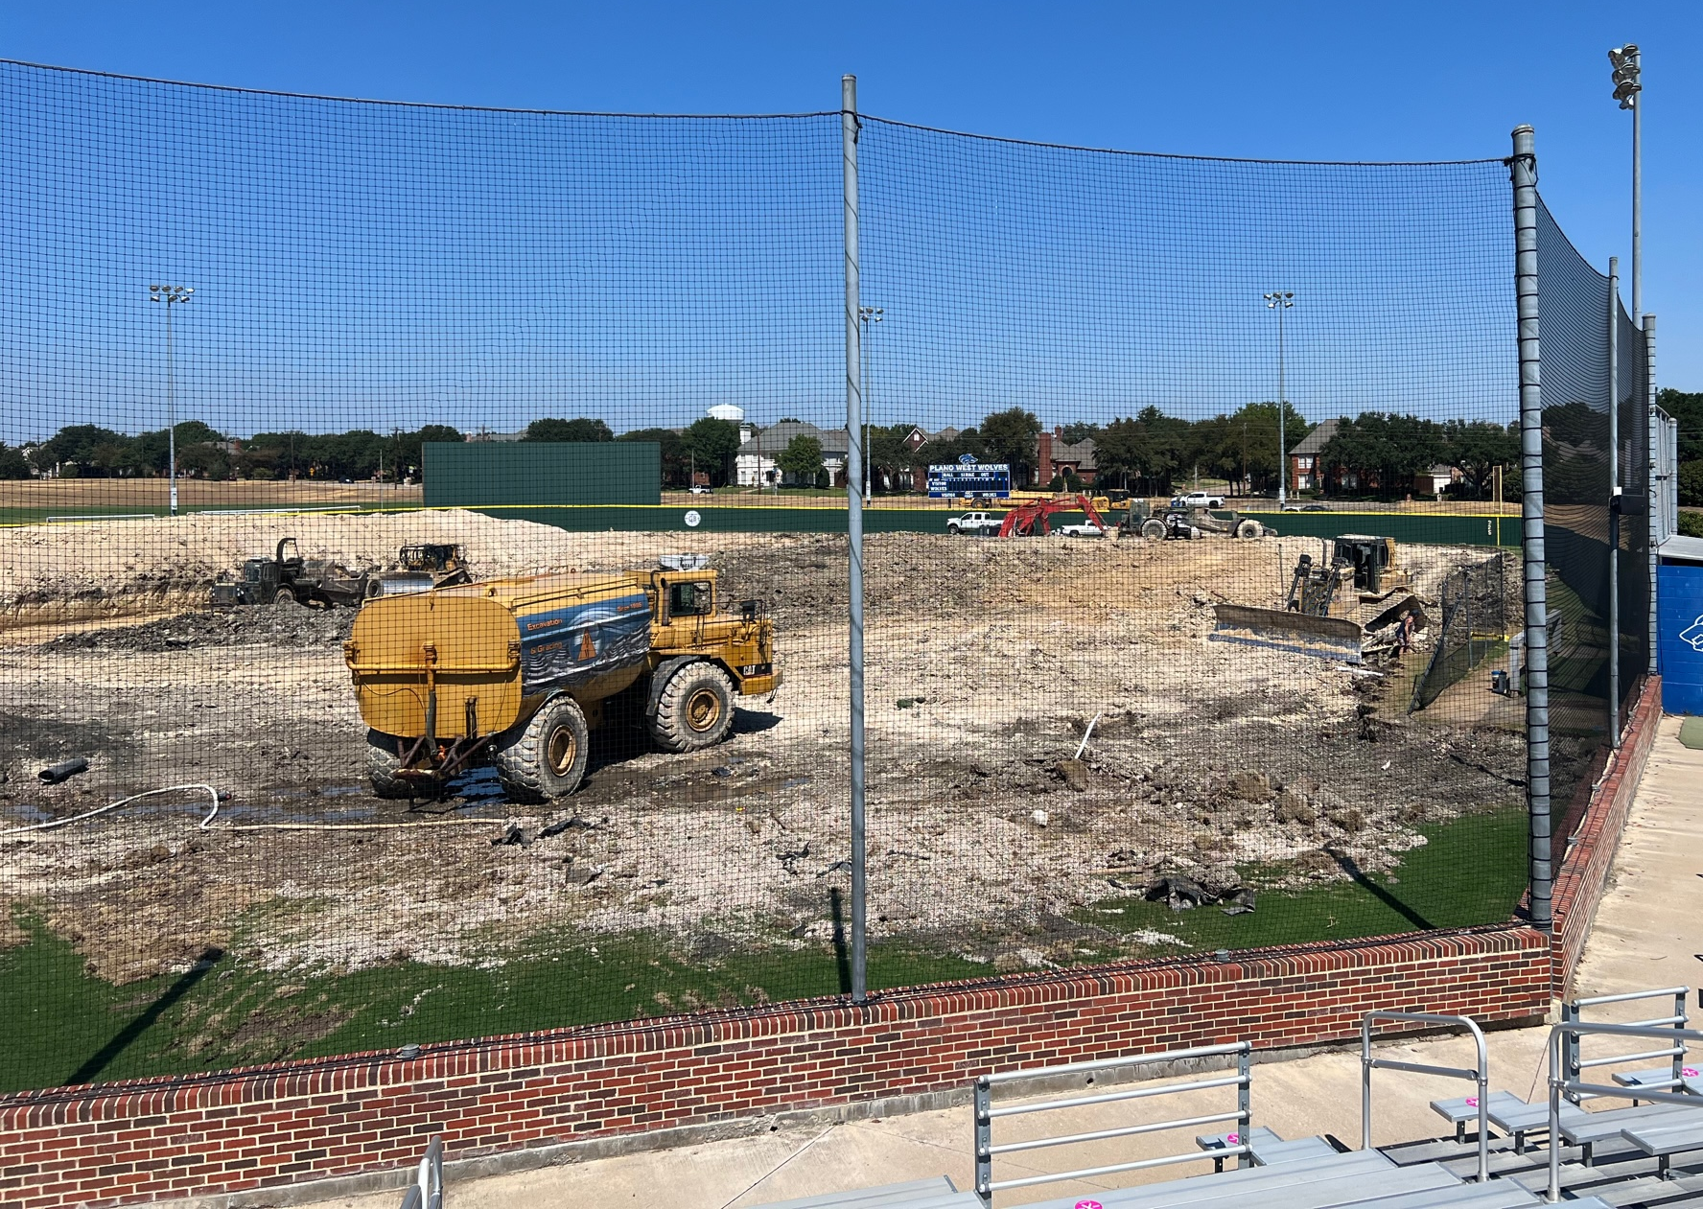
Ballpark Update

