Slide 1

Parent & Player Meeting

Slide 2
Two Rivers Hockey Coaching Staff Brandon Ferraro Mark Leitner Ben Christopherson Jason Platz Ty Tostrud Mike Stone Thank You For Your dedication to this program.

Slide 3
Two Rivers Hockey
Vision
Two Rivers Hockey program creates a safe athletic environment where our student athletes can strive to do their best not only in sport but also the classroom and the community.
Mission
Two Rivers Hockey student athletes will exhibit a positive team environment that demonstrates their understanding of discipline, character and respect.

Slide 4
Respect
It is a privilege to be a part of this team and program.
We expect all players to demonstrate and represent this program in positive manner. Being a Two Rivers Hockey player means that you are a positive role model in the community. How you conduct yourself is always being observed. Your actions and words not only effect you but also your teammates, coaches and your family
Demonstrate respect for your parents, teachers and community.

Slide 5
Preparation
Players will be expected to be on time and be ready to compete during practice and games . The players equipment needs will be planned so there is no last-minute scrambling.

Slide 6
Doing your best
in the classroom
in the community
in competition
in training
as a teammate
being coachable
being positive
will always be good enough

Slide 7
Academics
Academic intervention will be introduced if a Two Rivers Hockey player is
not doing their work
not attending class
and/or not being positive in school
Not making progress towards graduation
Practice and/or game time may be reduced if it means helping the student athlete become more successful in the classroom.
Notes:
We will follow the spps academic policy and the eligible requirements,
that they have set forth. That being said at any time students are not doing their work or not attending class along with not being positive in school. We will put in place an academic intervention.
This may reduce practice /game time if it means helping the student athlete become more successful in the classroom.

Slide 8
Dress Code
Players are expected to wear team black polos with dress pants and a belt along with tennis shoes or dress shoes. Players will then arrive at the rink in team issued warm-ups.
If your in a class that requires student’s to change , you are required to
follow those rules and be prepared for class.
Not following the dress code requirement can lead to loss of ice time
or another consequence made by the coaching staff

Slide 9
Game Day
Home Games
Players should be at the rink 75 minutes prior to the start of the game
Away Games
Players should be on the bus and ready to go 15 minutes before the scheduled bus departure. Bus times will vary so please pay attention to departures.
Notes:
JV vs. Varsity rules?
What are the COVID rules?

Slide 10
Varsity Letter Requirements
Based on following both on ice and off ice conduct expectations.
Coaches discretion may also be used to award a varsity letter.

Slide 11
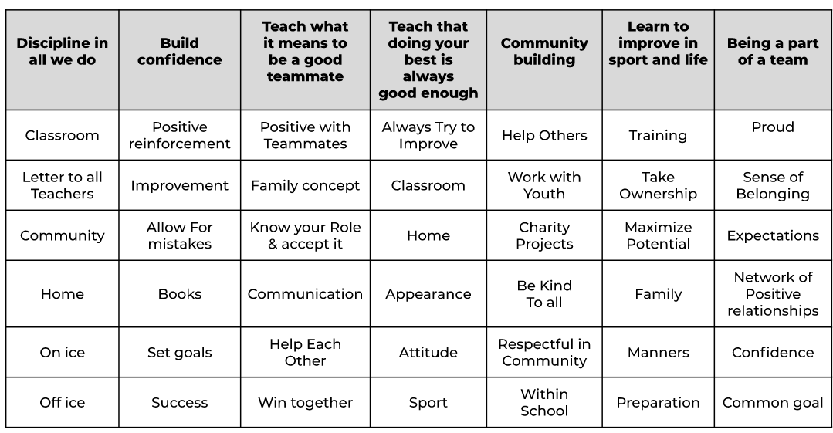
Building a Program Culture
Notes:
Program Culture:
Let me start by saying if we want to really develop a program,
then we need to start with being good teammates. A team can
win short term with non-positive teammates but it will be short lived
and that is not how you develop culture or a program.
That being said at any time us coaches hear, observe or something is reported that demonstrates that we have non-positive teammates.
The options are quite simple players will learn to become better teammates or they will choose not to.
If they don’t learn how to be better teammates consequence will follow .
What coaches are looking for in players
Number one, we are coaching to help mentor these boys
and teach them to be the best they can be through sport.
We want them to know what being a good teammate can do for a team and frankly life in general. We want our players to show up and give their best while being coachable and positive.
This is fun for all and Can make a great experience.

Slide 12
Service Learning
We will strongly encourage our players to earn a minimum
of 10 hours of service learning.
examples
Helping a neighbor with shoveling
Skating with the youth hockey players
Helping with dibs
Help maintain a clean area at the rink where we use the facilities
etc.

Slide 13
Team Communications
COACH
PLAYER
PARENT
Will Be transparent in communications to individual players and the team
Playing/ice time is earned not guaranteed
Address concerns with our teammates and coaches first
Please let a Coach know if you will miss or be late
Open communication is welcomed.
Trust the coaches
Open communication is welcomed however not on player placement or ice time
Be a true team player
Notes:
We as coaches will do our best to be transparent with the Players and the team. Players direct communication of any concerns must go through the coach first, if not satisfied then we welcome open communication with parents. That being said we won’t negotiate or talk about playing time.
Parents will need to trust that as coaches,
We are putting the team first and do what we think that will give us the best chance of success through observation of skill, position, coachability and finally attitude.
I have been coaching for years and the reality
Is most parents say they are team players but from my experience?
A small percentage are and most parents think in their child first, I get it.
Communication will go through email and web page/group chat
Contacts are on the web page
Covid, we learn as we go

Slide 14
Questions Thank You It is a Privilege to be your sons coach

