Slide 1

Grafton Raptors Tournament How To Guide?

Slide 2
Finding and Registering for your Tournament?
The tournament will be available for review or registration on one of the following sites:
https://www.usabracketing.com/events
https://usawrestlingevents.com/events
https://www.trackwrestling.com/Login.jsp?TIM=1757442548558&twSessionId=todgdtwgmm
Registering for your tournament
Select the tournament you want to register for
Follow the registration prompts
Most tournaments will cost $20 - $40
Ensure you get confirmation

Slide 3
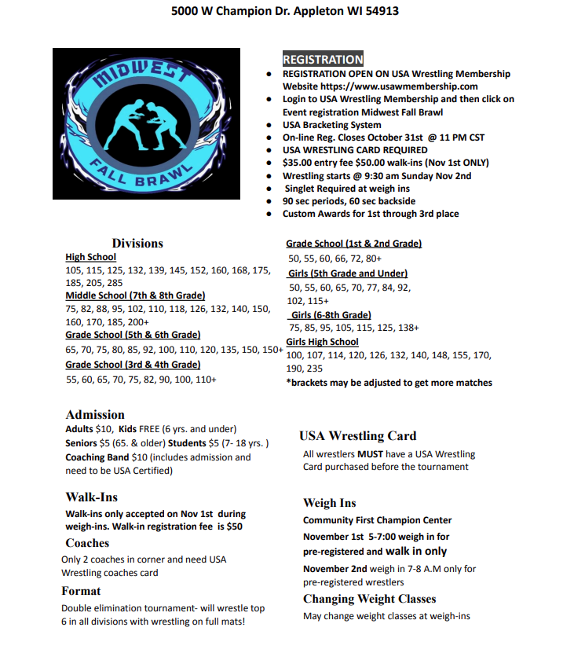
Tournament Day!
Tournaments will have flyer with information found on website you are registering for
Know when your kids wrestling starts
Read for requirements
Head gear, singlets, etc.
Generally arrive at least 60 to 90 minutes before that time period
Weigh Ins, finger nail checks, and check in needs to happen upon arrival
After check in, your kid can typically warm up on mats
Wait for tournament brackets to be released and wrestling to start!

Slide 4
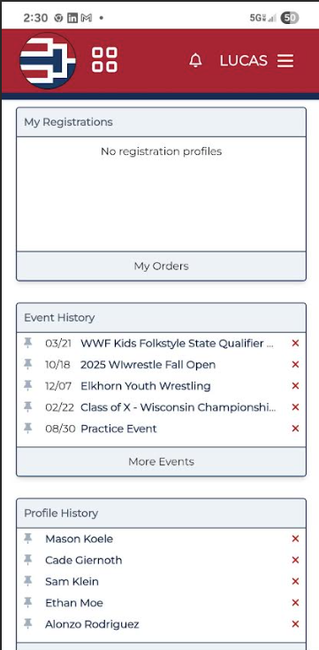
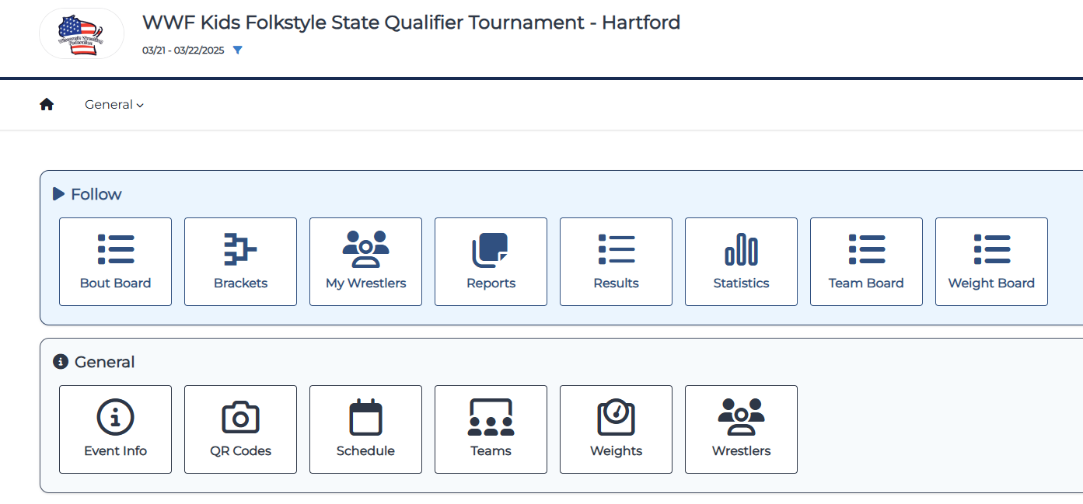
Tournament Day……
There is a USA Bracketing APP
Enter the event that you are participating in on USA Bracketing or Trackwrestling
Add the wrestlers that you want to track under my wrestlers

Slide 5
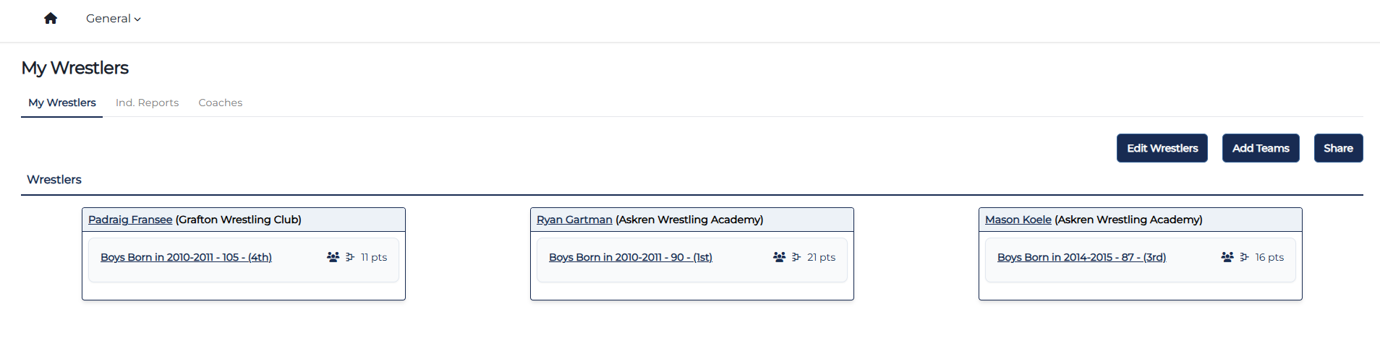
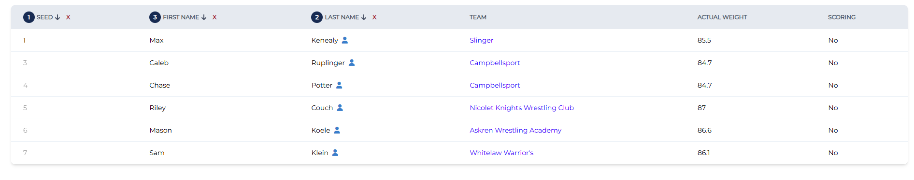
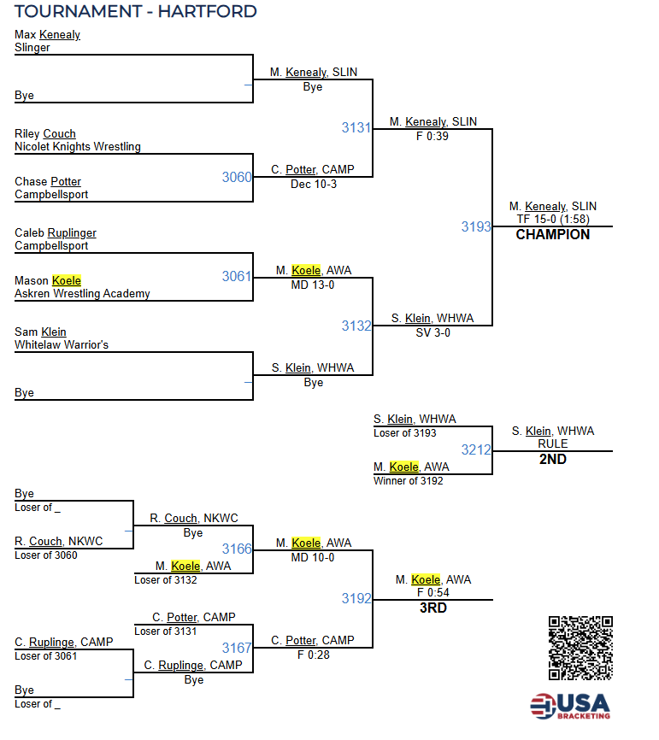
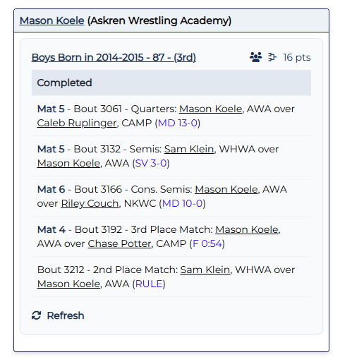
Tournament Day……
Under my wrestlers you will find following information:
Bracket Information
Competitor Information
Next match

Slide 6
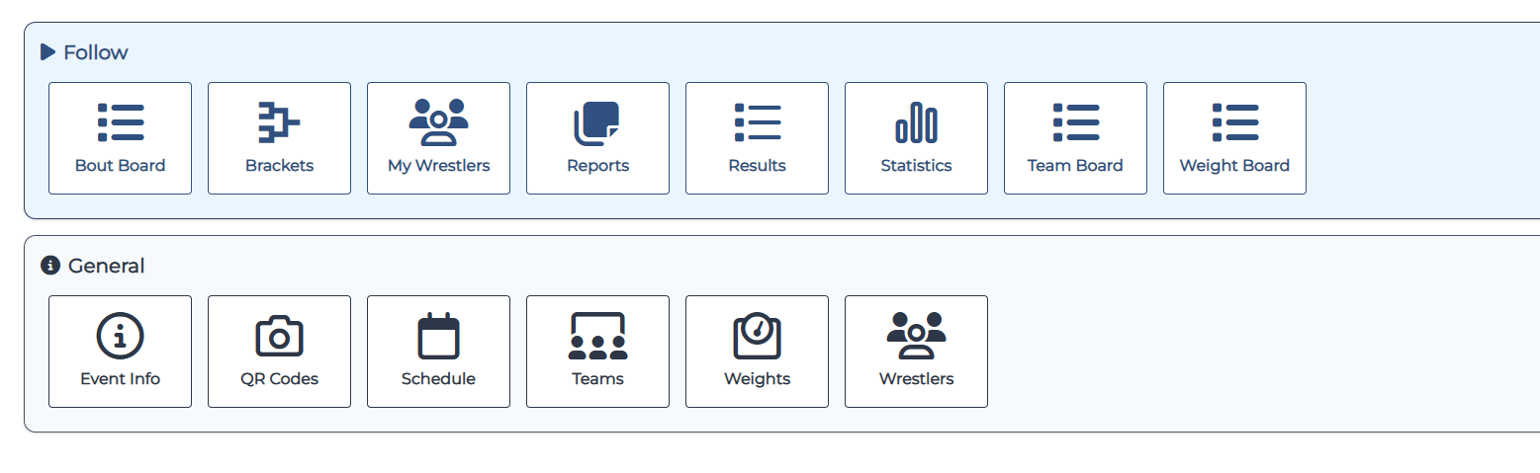
Tournament Day……
Bout Board provides ability to see where and when your son will wrestle
Recommendation is to have your kid to the mat at least two to three matches before your match
Mason Koele is match 3132, be at mat by match 3130.

Slide 7
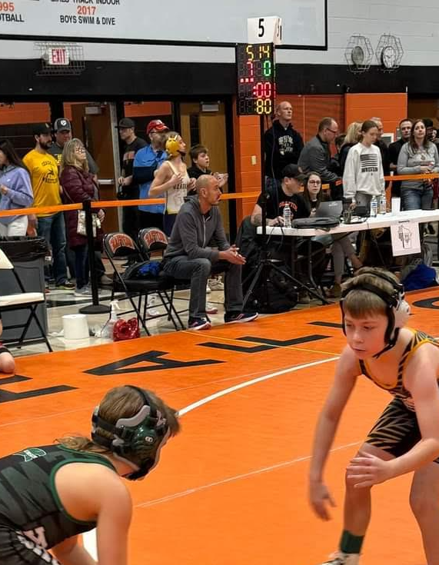
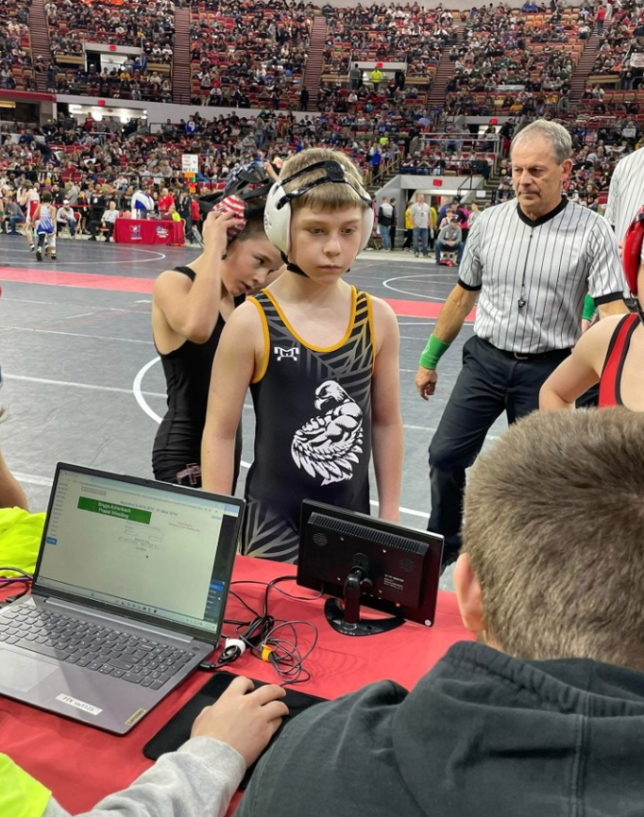
Tournament Day……
Mat Tables will indicate mat number as well as have a scoreboard
Your kid should check in at table before wrestling
Typically, two coaches allowed mat side
If your kid pins opponent, collect a pin at table!!!

Slide 8
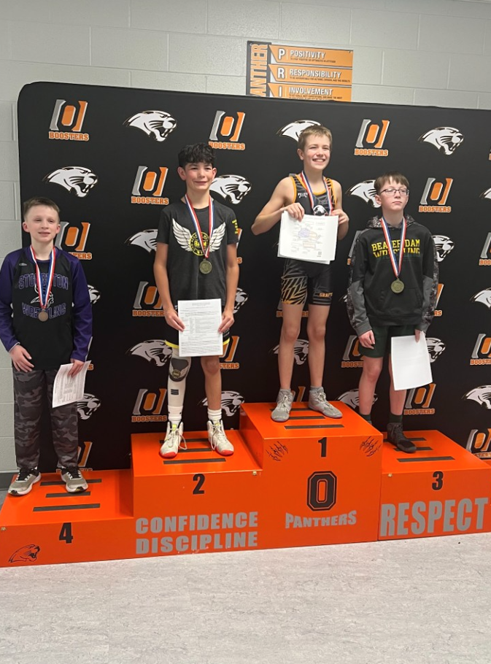
Tournament Day……
Collect your award!!!!

Slide 9


