Slide 1

Omgha Annual Meeting
April 13th, 2021

Slide 2

Agenda
Meeting Called to order
Announcements by the President
Consent Business
Approval of 2020 Annual Meeting Minutes
Reports
2020-2021 Reports
New Business
Elections
Meeting Adjourned

Slide 3
Consent Business
Approval of 2020 Annual Minutes

Slide 4
Board Reports
Report by Covid Safety Officers
Treasurer’s Report
Secretary’s Report
Girls Traveling Report
House Report
Skills Report
Boys Traveling Report
President’s Report

Slide 5

COVID Team Report
Josh & Anna Mueller

Slide 6

COVID Team Report
COVID Team
COVID Safety Officers-Josh & Anna Mueller
3 COVID level leads-Heather Podgorski, Jen Rainerson, Heidi Segedy
82 COVID team contacts
139 positive COVID 19 cases
61 players (44 travel) (33 pre pause, 14 during the pause, 14 after the pause)
21 coaches
57 parents/volunteers
2 likely team outbreaks (2 or more players testing positive within one week without off ice related exposure) – both teams had completed a recent tournament weekend
18 team quarantines (8 pre pause, 11 after the pause)
3 teams in quarantine more than 1 time (BA 3 times)
9 related to opponent exposures
All teams were able to finish their seasons on the ice
Worked with District 3 to make accommodations for 3 teams which were in quarantine during a portion of the District Tournaments.

Slide 7

COVID Team Report
Workflow for the season
Developed a COVID Preparedness plan and general guidelines for teams, coaches, managers using available resources from the CDC, MDH and MN Hockey
Worked closely with MDH on recommendations for isolation and quarantine for positive Members and exposures
The PAUSE
Incorporated new guidelines from MN Hockey and MDH into our general guidelines and worked with coaches, managers and covid team contacts to implement changes
Worked with MN Hockey to collect data on transmission of COVID-19 in the sport of hockey
Worked with District 3, MN Hockey and MDH to develop options to keep kids playing hockey and still continue to limit the spread of COVID-19
Served as a resource for other teams in the District as well as for smaller associations in the state

Slide 8
Treasurer’s Report
Chuck Sawicky

Slide 9

Treasurer Philosophy
OMGHA is a non-profit organization with the financial goals of:
Keeping the cost of hockey low, while investing in our hockey players
Charging current players for the current cost of hockey
Investing in OMGHA assets to ensure viability into future
Providing financial transparency
Creating operational efficiencies where possible
Assistant Treasurers: Brian Pfannenstein, Jason Price
Gambling Manager: Cathy Cheatham
Concessions: Dan Lindberg, Kelly Edlund
Voucher Program: Amy Olson, Nicole Robertson

Slide 10
2020 – 2021 Highlights
Reduced budget to reflect COVID risks
Expenses: Capex, Non-Parent Coaches, Coach Gear, Tourneys
Revenues: Reduced gambling, concessions, higher camp revenue
Continued investment in OMGHA Assets
Limited this year due to COVID
Speakers in Osseo East, Scoreboard in Osseo West, Speakers in Maple Grove Premier
Traveling teams - $125K refunds for ice/tourneys
Record level of gambling profits for OMGHA

Slide 11
Financial Performance
$’s in thousands
Hockey P&L | 20-21 Budget | 20-21 Forecast | H/(L) | Notes
Revenues | 1,834 | 1,950 | 116 | Includes $125K of refunds
Expenses | 1,796 | 1,589 | (207) | Reduced Ice & Tournaments
Total Profits | $38 | $361 | $323 | Gambling +$305K
Charitable Gambling Program Gambling Income Gambling Net Profits OMGHA Donations Gambling Control Board Rating |  | YTD $1.5M $634K $505K 5-Star
End of Year Bank Balance |  | $300 - $400K
Notes:
Gambling Income = $1.5M
Maple Tavern $550K
Malones $563K
Duffys $362K
Donations
$330K – OMGHA
$1500 – Yellow Tree
$1000 – MG Police
$1000 – MG Boys Booster Club
$1000 – Osseo Boys Booster Club
$1000 – Osseo Senior Party

Slide 12
Revenue Breakout
$’s in thousands
Hockey P&L | 20-21 Budget | 20-21 Forecast | H/(L) | Notes
Revenues | $1,834 | $1,951 | $116
Registration | 1,276 | 1,083 | (193) | ($60K) players, ($125K) Refunds
Gambling | 200 | 505 | 305 | Strong business despite closures
Hosted Tournaments | 150 | 97 | (53) | Canceled Peewee/Squirt Tourneys
Other Income | 209 | 266 | 58 | Hockey schools, Sponsorships

Slide 13
Expense Breakout
$’s in thousands
Hockey P&L | 20-21 Budget | 20-21 Forecast | H/(L) | Notes
Expenses | $1,796 | $1,589 | ($207)
Ice Expense | 757 | 657 | (100) | Cancelled ice (10%) / Tourneys
Rink Loans | 196 | 196 | - | Osseo $110K, MG $85K
Traveling Tournaments | 190 | 95 | (95) | Cancelled Tournaments (50%)
District/Region/State | 106 | 91 | (15) | No D3 League Fee this year
Equipment | 105 | 111 | 6 | Jerseys/Socks $92K, Goalies $7K
Skill Development | 100 | 70 | (30) | No velocity dryland
Coaching Costs | 49 | 43 | (6) | Coaches Fees/Reimbursements
Tryouts | 31 | 41 | 10 | Evaluators $33K, Refs/EMT’s $5K
Projects | 10 | 33 | 23 | Osseo Speakers/SB, MG Speakers
Other | 253 | 253 | - | Admin, Tourneys, Registration, Misc
Notes:
BP - $21K
Hours
BP – 92.75 @ ~$225 per hour
MG – 1401 @ $200 per hour
Osseo – 1452 @ $171 per hour
Velocity – 618 @ $240 per hour

Slide 14
Looking to next year
Normal Budget?
New Jerseys
Normal capex spend
Last payment due for Maple Grove West Rink

Slide 15
Questions?

Slide 16

Secretary Report
Nicole Kustermann

Slide 17
Secretary's Report
Registrars—Deanna Henry (Travel), Erin Smith (House)
640 (645) Travel, 470 (500) House players registered 2020/2021 Season
26 Inactive Travel Players, 12 Inactive House
223 (211) Travel, 223 (250) House coaches registered and tracked to make sure requirements were met to be on ice with players
Assisted with registration for expanded options for pre-season skating opportunities
63 (56) Travel, 51 (46) House Managers trained communicated with throughout the season
42 (41) Travel, 36 (38) House teams created and rostered with USA Hockey
20 (30) waivers processed in and out of OMGHA
Assisted with Try Hockey for Free Events (7), New Skater Skills (9), HEP Evals, voucher and T-shirt pick-ups

Slide 18
Secretary's Report
Volunteer Coordinators—Rochelle Giuliani, Tricia Leafblad, Erika Kreye
Challenging year due to uncertainties throughout season
No concessions (1500 hours)
Limitations on rink capacity, # of people allowed around benches
COVID volunteer needs (1200)
These three work with every volunteer aspect of the Association- including tryouts, team pictures, coaches/ managers and tournaments. They managed over 10,000 (11,000) hours this season.
Objective – Insure enough volunteers for OMGHA events. Fairness to OMGHA families.
Policy: 14 hours of volunteer time for one player and 20 hours/credits for two or more players. Adjustments necessary at end of season due to hours not being available.

Slide 19
Secretary's Report
Scholastic Achievement— Bridget Erickson and Kristina Kampa
Virtual Ceremony being planned. 224 applications submitted, 34 travel teams nominated player for character award
Terry Gallagher Scholarship – deadline to apply = April 25. Seniors who have been involved with OMGHA are encouraged to apply.
Pictures - Leah Barber
Clix merger with Kemmetmueller
Able to get photos done in one weekend within COVID limitations
Biggest complaints – cost and product offerings
Post-season download with Kemmetmueller to notify them of issues and expectations
Review of other sourcers – Kemmetmueller remains cost competitive and style of photography is more in line with OMGHA tradition. Plan to use Kemmemueller next year and can re-evaluate after that
Marketing – Laurel Bot and Becky Thoreson- Sponsorships, Apparel, Mouthguards, Social Media and PR

Slide 20
Secretary's Report
Focus for Next year
Exploring options for improving Internal and External distribution lists for communication within OMGHA
Streamlining Registrar roles, which includes adding positions to manage Coach registration and Team Managers
Succession planning for large administrative roles at OMGHA
Making DIBS opportunities more visible and accessible to families
Solidify parameters of partner relationships and do what we can to increase goodwill with partners

Slide 21
VP Girls Traveling Report
Chad Wieneke

Slide 22

VP Girls Traveling Report
Girls Travel Committee
VP – Chad Wieneke
Level Directors
Lisa Albers – U10
Mike Hueller– U12
Jeff Allen– U15
Andy Beissel – Girls Skills Director
Charlie Graves - Girls Goalie Director
Involved in the following:
Tournament selection
Pre-tryout camps
Tryouts/team formation
Communication and oversight throughout the season

Slide 23
VP Girls Traveling Report
2020-2021 Recap
Major accomplishments for this year
We had 312 girls playing hockey in OMGHA this past year!
169 girls at the OMGHA traveling levels, 7% increase over previous year
Overall the season went well with very few significant issues, especially under the pandemic circumstances, which is a credit to our coaches, players and parents

Slide 24
VP Girls Traveling Report
2020-2021 Recap
Region/State Tournaments
U15A – 3rd place at State
U15B White - 3rd place at State
U15B Black – 4th place at State
U12A – Participated in Region Tournament
U12B– Participated in Region Tournament
District Tournament Results
U12B2 Crimson – 1st place
U12B2 Black – 2nd place
U10A – 1st place
U10B1White – 4th place
U10B1 Black – Consolation champs
U10B2 Crimson – 2nd place
U10B2 Orange – Consolation champs

Slide 25
VP Girls Traveling Report
Priorities for next year
Continue to grow the girls program
Partner with Coaching Director on the recruitment of non-parent coaches
Continue to work internally and across D3 to optimize team formation across levels
Team formation decisions are made in what is believed to be the best interest of 50-60 skaters in the level, not 5 players “on the bubble”
Focus on recruiting goalies at all levels, but particularly at U10
Looking ahead to 2021-2022
Projected teams at each level
U10 – ~5 teams
U12 – ~4-5 teams
U15 – ~3-4 teams

Slide 26
VP House Report
Brian Grant

Slide 27

VP House Report
House Committee
VP House – Brian Grant Supermite Director – Dustin Brooks
Mite Director – Jason Rogowski Girls House Director – Scott Poska
Mini-Mite Directors – AJ Stevens/ Derek Peltier Goalie Director – Joe Faust
Recruiting – Jason Bauerly Register – Erin Smith
Level Leaders – Dave Baker/Mitch Helleen/ Troy Fodstad/ Peter McMullin
House Mission – Hockey Culture
Grow the Game
Grow the Passion
Develop Hockey Players
Promote Safety
Maintain current numbers
Retention rates ~89%
Leverage ADM model/provide traveling with skilled players who love hockey
Included in all aspects of program
Growth
Level # Teams
Supermites 12
U8 6
Mite 2 6
Mite 1 6
Girls Mites 4
Mini-Mites 2
Total 36
 | 2014-2015 | 2015-2016 | 2016-2017 | 2017-2018 | 2018-2019 | 2019-2020 | 2019-2020 | 2020-2021
Total Players | 451 | 499 | 530 | 543 | 542 | 521 | 502 | 470

Slide 28

VP House Report
Recruiting
Due to COVID limited. Marketing Road Signs, Rink Posters and School Flyers, door to door.
Try Hockey for Free (5 Events) and New Skater Skills Sessions (7 Events)
Free Hockey for Girls U6 and below
SM (158) / U8 (70) / Mite 2 (67) / Mite 1 (58) / Girl (49) / Mini-Mites (68)
-16 +1 -6 -12 -3 +3
Operations
- Team Designations and Jerseys
- Coach Selection
3 on 3 League (Fall and Spring) – Fall Session and the Spring Session started 4/10 (144)
HEP (228 players SM/U8)
Weekly Communication (Coaches and Managers)
Jamboree – Friday/Saturday/Sunday
Will be bringing the following back for 2021-2022:
Mini-Tin Bin, The “Show”, Wayzata crossover 3v3, Small Area Game Days
High School Game Events & Hockey Day Minnesota Event
Skill Development
Total Ice Time: SM/U8 50 Hours, Mite I/II/Girl Mite 36 Hours, Mini-mites 21 Hours
Practice Planning – ADM Model (station based, small area games), standard practice plans
Goalie Training – New Focus this Year – New pads were a hit!

Slide 29
VP House Report
2021-2022 Initiatives
Grow The Game – Grass Roots Recruiting
Goal of 500 kids for 2021-2022
Formation of Recruiting Committee
Goalie Recruitment and Development
Continue the work to find and train new goalies
Focused Skill Training - MEGA
Coach Training – Coach the Coaches
Reformat Coaches Meeting
Work with Skills Committee
Coach Clinics and Training
Thank you for a Great Season!
13 House Committee Members
257 Coaches
44 Managers
Parents!

Slide 30
VP Skills Team
Matt Margenau

Slide 31

VP Skills Traveling Report
Mission: Provide the Guidance to Develop Hockey Player to Reach their Full Potential
Skills Travel Committee
VP – Matt Margenau
Coaching Director – Andy Hedlund
Level Directors
Erik Kukkonen – Squirts
Jay Picconatto – Pee Wee
Tyler Martin - Bantams
Andy Beissel – Girls Skills Director
Aric Stienessen, Brad Albers, Charlie Graves, Joe Faust – Goalie Directors
On-Ice Skills Team (Coaches)
Involved in the following:
Player Development
Coaching Selection and Development
Tryouts
Special Projects

Slide 32
VP Skills Traveling Report
2020-2021 Recap
Player Development
Weekly On and Off Ice Skills Session
Players Club – 30 players complete
Fall Camp
Focus On Ice – Body Contact, Skating, Position Specific, Small Area Games, Puck Handling
BeFit (Zoom Calls – Mixed Feedback) and Velocity (Partial Season)
Goalie Training Session and Practice Consults (New Partner – Map)
Morning Skates – Alex Skates – Hybrid Leaning
Post Season N1
Coaching Development
Pre-Season Meeting and House Skills
Coach Feedback
Resources – Hockey Share, Youtube Channel, Instagram
Coach Selection

Slide 33

VP Skills Traveling Report
2021-2022 Outlook
Player Development
Continue Weekly On and Off Ice Skills Session with Skills Team and N1 and Velocity Partners
Players Club
Fall Camp
Continue Map Partnership
Off Ice Culture – Re-inforce
Dryland Work-Outs
Pre-Practice Routines
Zoom Call Workouts
Outdoor Ice – House Ownership – Rink Rat Friday
Morning Skates – Skating or Stickhandling
More House Ice Touches – Mariucci/Ridder/BP – Player Skills Clinics (Puck Handling/Shooting/Passing)
Goalie Clinics
Coaching Development – Leaning towards house program
Collaboration
Kick Off
Monthly
House Skills Team (Empowered Energy and Ownership)
Observed Practice Structure (Bi-Weekly Nov/Dec and Monthly Jan/Feb)
Morning Coaches Clinics (Skating/Puck Control/Small Area Games)
Director Monthly
Hockey Habit Communications
Coach/Skills Survey Feedback (Conduct/N1)

Slide 34
Thank You For a Successful Season
Skills Practice Team
Travel Coaches
Managers & Registrars
On and Off-Ice Trainers

Slide 35
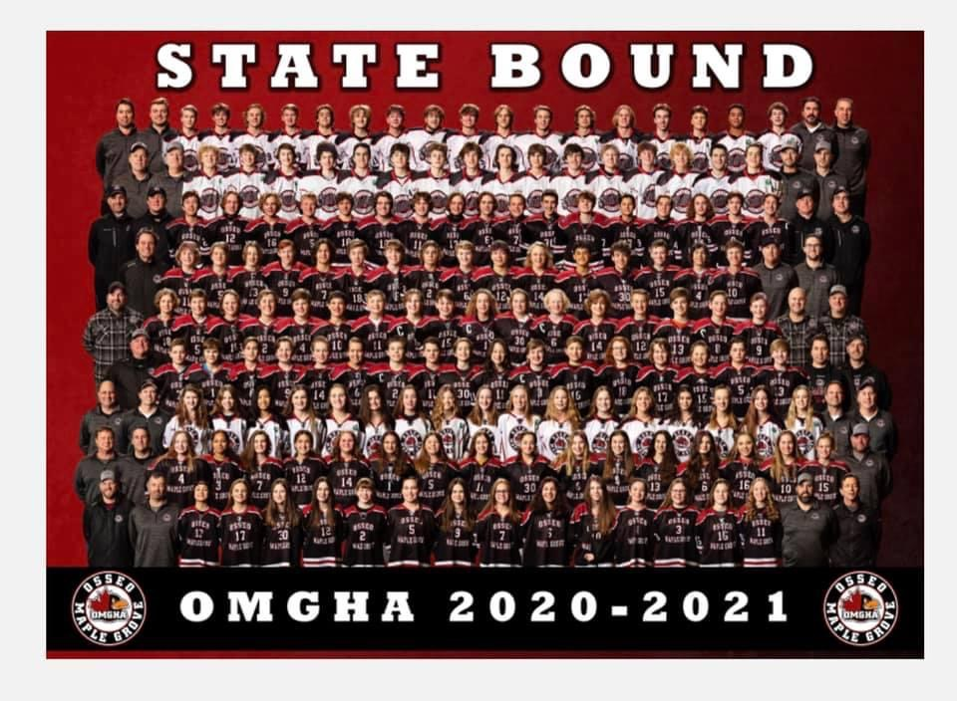
2021 State Teams
Jr. Gold A, Jr. Gold U16, U15A, U15B Black, U15B, Bantam AA, Bantam B1 Black, PWAA, PWB1 Black

Slide 36
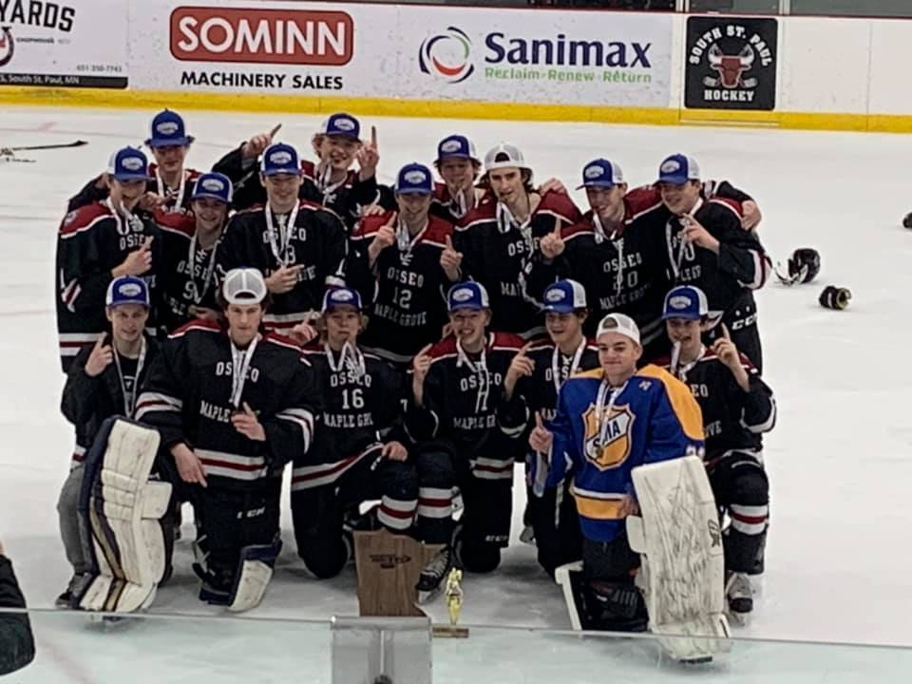
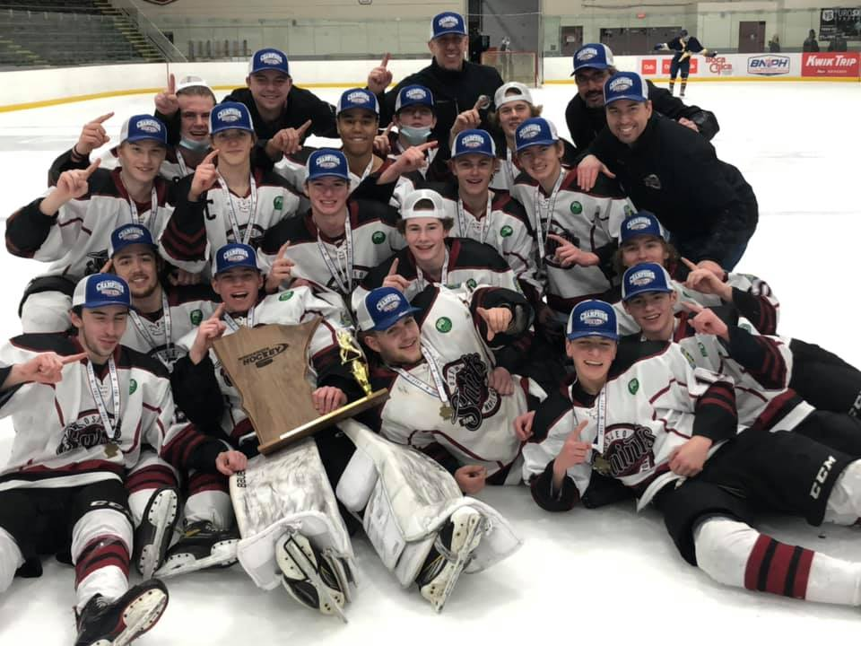

VP Boys Traveling Report
Colin Steen

Slide 37
VP Boys Traveling Report
Travel Committee
Level Directors – Bret Caywood/Squirts, Rich Dean/Peewees, Brian LaFleur/Bantams, Dave Margenau/Jr Gold
Level | # of Players | # of Teams
Squirts | 156 (↑7) | 10 (-)
PeeWees | 146 (↓12) | 9 (-1)
Bantams | 135 (↑21) | 9 (↑ 2)
Junior Gold/JG16 | 33 (↓13) | 2 (↓ 1)
Totals | 470 (↑3) | 31(↑1)
Goals for 2020-2021
Conduct a safe tryout process and keep the teams playing hockey!
Emphasize player/parent code of conduct
Continue building on the Junior Gold program

Slide 38
VP Boys Traveling Report
Re-cap of the 2020-2021 season
Continued success at all levels of play this season
BT B2 teams finished #1 and #2 in districts; Squirt B1 finished #1 and #2 and won season tourneys
PW B2 finished first and third in distrct tourney; Squirt C finished first and third in district tourneys
Code of conduct issues dramatically reduced vs. prior season
Multiple Region/State qualifiers – four teams in the state tournament finals!
Team | Result
Peewee B1 Black | State Qualifier, Region Winner
Peewee B1 White | Region Qualifier
Peewee AA | State 2nd Place, Region 2nd place
Bantam B1 Black | State Qualifier, Region 2nd place
Bantam A | Region Qualifier
Bantam AA | State 2nd Place, Region 2nd place
Junior Gold U16 | STATE CHAMPS!
Junior Gold B Crimson | STATE CHAMPS!

Slide 39

VP Boys Traveling Report
A Look Ahead to the 2021-2022 Season
Focus on ensuring our teams have a full successful hockey season; focusing on strong processes
Continue to work closely with the Skills committee on tryouts, coach development and team formation
Building on the success of the Junior Gold program in 2021
Feedback has been great, how do we ensure we have enough players (goalies) for future
Continue partnership with high school coaches
Coach/Parent/Player Code of Conduct enforcement
Respect the game, the coaches, teammates, and
officials will continue to be a core message
Transparency and openness underpins our actions

Slide 40
President’s Report
Adam Reiter

Slide 41
President’s Report – Year in review
Long-time volunteers
Erik Kukkonen
Bret Caywood
Rochelle Giuliani
Harry Kennedy
Dan Lindberg

Slide 42
President’s Report – Year in review
2020-2021 Season
What a year…Thank you to Players, Parents, Coaches, Board Members, Exec Committee, Josh + Anna Mueller, Volunteers
It took a village!

Slide 43
President’s Report – Year in review
Member Survey
Thank you OMGHA members for the feedback
Themes are present throughout OMGHA’s 2021-2022 focuses. Overall, feedback was extremely positive
+ Navigating COVID
+ House and JRG programs
+ Player Development
+ Communication + Transparency
- Coach behavior + Coach selection + Coach development
- OMGHA’s reaction to survey results
- Code of Conduct + Parent/Player/Coach behavior

Slide 44
President’s Report – Year in review
OMGHA’s notable successes
Financial Discipline
COVID + player safety management
OMGHA leadership and engagement at all levels
Player retention
Skill Development
Communication + transparency
Partnerships with City, School, Core Partners and Rinks
Competitive balance of teams across levels
9 Teams to State
11 D3 league champions
14 D3 tournament champions
Junior Gold Program
12 Girls traveling teams

Slide 45
President’s Report – Looking ahead
Good riddance COVID => Make OMGHA better than ever. 2021-2022 will be about executing a wide rage of initiatives.
Relaunch of Fall Skills camp, dryland, N1, Skill nights, practice to game ratios, Coach’s clinics, house culture, Goalie training
New jerseys + coach, player and parent apparel
Back to basics with safesport, PCA, skill development, baseline testing, Special Hockey
Retrenching and organizing board processes, focuses and responsibilities
Recruitment
OMGHA Culture => Pride, comradery, community, leaders in MN hockey, member involvement
Diversity and Inclusion
Sponsorships/Marketing
MGCC Improvements
Expanding board positions to enable increased focuses and improved execution
Recruit and Develop female coaches for our girls programs
Coach selection, development and investment

Slide 46

New Business
Elections

Slide 47
Elections
Presentation of Election Results – presented by Election Committee
President – Adam Reiter
VP Girls Traveling – Chad Wieneke
VP of House – Brian Grant
Asst. ACE Coordinator / Coaching Director – Andy Hedlund
Boys Level Directors – (3)- Lucas Ahlberg, Ryan Campbell, Rich Dean
Mite Director – Jason Rogowski
Girls Level Directors (1) – Mike Hueller
D3 Representative – Steve Fischer
Motion to Approve Election Results
Board of Directors Vote

Slide 48
Meeting Adjourned
Thanks for attending
the 2021 OMGHA Annual Meeting

