Slide 1

2019-20
East Ridge Girls Hockey
Welcome & Introduction Meeting
Sunday September 22, 2019

Slide 2

2019-20 Welcome & Introductions
Agenda
  Introductions
  Season Kick off commentary
    Finance
    Fundraising
    Communications
    Apparel
    Team Events & Dinners
    Volunteering
    Key dates
Board Introductions
  Dawn Beaubien - President
  Dixie & TJ Scribner – Vice President
  Chrissy Barry - Finance
  Chris & Dawn Radecki – IT/Communications
  Jeanne Bierwerth – Secretary
  Erin Peterfeso - Fundraising
  Kara Spolidoro - -Volunteer Coordinator

Slide 3
Finance Update
PER PLAYER | 2018-19 | 2019-20 (BUDGET) | COMMENTS
Expenses | (855) | (800) | Reduce costs in a few areas
Summit: Powerhouse off-ice training 35-45 hours | - | (95) | Added
Team Warmups: Sweatshirt, joggers, Jacket, T-shirt, etc. | - | (200) | Added
Pancake Breakfast | (100) | (100)
TOTAL: Booster cost | (955) | (1,195)
LESS: Booster fee | (550) | (750) | PAYMENT DUE: November 10 parent party
PER PLAYER (OTHER):
Warmups: pants, shirt, sweatshirt | (150) | Included in Booster | Warm up apparel was paid separately
Total Parent fees: | (700) | (750) | $50 or 7% increase from prior yr
Notes:
Key points:
We have worked hard to reduce the fees in a few areas and include off-ice and warmups in the booster budget.
LY included the state tournament and this year includes the out of town scrimmage fest to GR.
Compared to youth hockey, most of us know this is considerably less expensive.
If there are any financial hardships, please talk to me separately.

Slide 4
Fundraising 2019-2020
Per Player | 2019-20
Revenue: Booster Fee | 750
Booster Expenses | 1,195
ADD’L FUNDRAISING REQUIRED | (445)
ITEM | WHO | TARGET | TIMING | PROFIT
Program Sponsorship | Parents | 1 per family | ASAP thru Oct 15th Contact: Erin Peterfeso erin.peterfeso@outlook.com | Target: $8000
Papa Murphy’s Pizza Card | Players | 10/player *Each player is responsible for 10 *You may sell more than 10 | Sunday, Nov 10th 3-5 pm ^{*Meeting at Stonemill Farms,} *We need parent volunteer drivers, for groups of 4 girls. | 350 x $15 =$5250
Pancake Breakfast | Parents & Players | 10 per player – value 10 included in player fees | Dec 7th (8-10 am) Tickets given out at practice | $3200.00
Bagging Groceries | Players | All players | Dates: 1)Jerry's 10/26 Shifts from 9-3 2)Kowalski's 12/23 Shifts from 10-4 | $1000.00
Concession Stand – Soccer & Volleyball | Parents & Players | 1 Parent Volunteer 3 Player Volunteers | October 10th: Volley Ball 6:30 pm | $250/event
Notes:
Key points:
Player costs higher than booster fee. We need to fundraise to cover the gap.
We are asking families to help with fundraising to help cover the difference.

Slide 5


Fundraising: Pancake Breakfast
Pancake Breakfast
in Woodbury
Saturday Dec 7th from 8-10am
Target:$3200

Slide 6

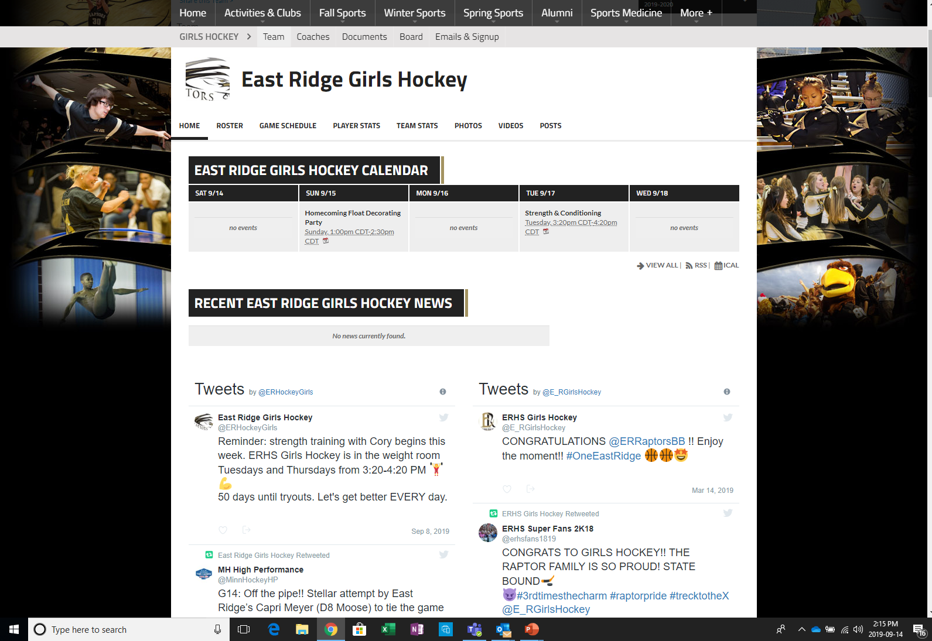
Communications Update
Website - https://www.erhsactivities.com/ghockey
– the source for all email
Calendar download
Twitter handle: @ERHockeyGirls
  Kim will use this to communicate some information to parents, fans, etc.

Slide 7

Apparel Update
4 mandatory pieces included in the player fees
  Joggers (Black)
  Hoodie (White)
  Long sleeve t-shirt (Grey),
  Windbreaker (White)
Optional (Not included in player fee)
  Hockey Bag ($69)
  Warm jacket ($74)
  Short sleeve t-shirt ($21)
  Knit Hat ($13)
  Baseball Hat ($16)
  Backpack Embroidery ($13)
    Player to provide backpack
  Apparel fitting October 6th
  Before captain’s practice
  Optional items pay at fitting

Slide 8
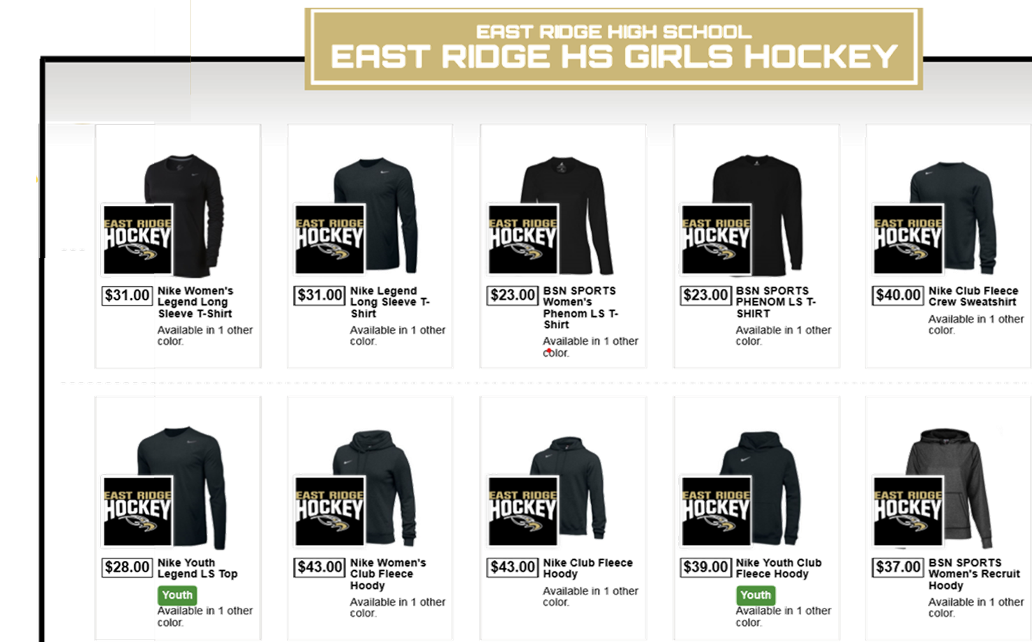
Team Store
ORDER BY Sept 30th
Items Available:
  Long sleeve shirts (M/W/Y)
  Hoodies (M/W/Y)
  ¼ Zip (M/W)
  ½ Zip (M/W)
  Full Zip (M/W)
  Vest (W)
  Pants (M/W)
  Hat (cap & knit)
  Stadium Chair
  Blanket
$5 per item to team
Store open 9/22 – 9/30
Apparel packed per order and shipped to one location to be distributed
Link: https://www.bsnteamsports.com/shop/ERGHockey
  Access Code: ERGHockey

Slide 9

Volunteer Help
Home game day coordination
Team dinner assignments
Youth Day
Senior Night
Banquet
Sign-ups will be November 10th at the Parent Party @ Stonemill Farms (Bring your Calendar & Checkbook!)
11390 Waterview Way

Slide 10


Team Events & Dinners
Team dinner location: Stonemill Community Center
  Dates: See team calendar
  Meal Assignments: Distributed @ Parent Meeting November 10th
Youth Gopher Game: Ridder Arena
  Date: November 16th, 2019 @ 4:07 pm
Team Breakfast: January 4th, 2020 @ the Flynn Residence
Skate with the Raptors
Alumni Game
Senior Day
Team Banquet

Slide 11
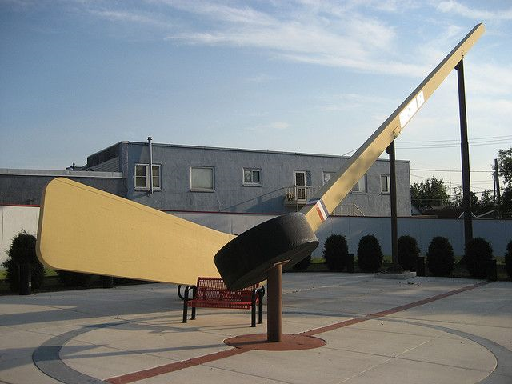
Grand Rapids & Eveleth
Friday, November 1 – Saturday, November 2
Bus departs HESC on Friday @ 8:45 AM (be there by 8:30 AM to load) and returns on Saturday around 7 PM
Must sign field trip form before October 30th – will have these at meeting on 10/22
Scrimmage Schedule:
  Friday – ER vs. Lakeville North @ 3:50 PM
  Friday – ER vs. Grand Rapids @ 4:55 PM
  Friday – ER vs. Hibbing @ 9:15 PM
  Saturday – ER vs. Champlin Park/Coon Rapids @ 8:35 AM
  Saturday – ER vs. Elk River @ 11:30 AM
  Saturday – ER vs. Cloquet @ 1:30 PM
All transportation and meals will be provided for players
  Players may want to bring personal snacks and some spending money
15 rooms blocked for parents at Timberlake Lodge in Grand Rapids
  Must make your own reservation by 10/01/19 (218) 326-2600
11 rooms blocked for parents at Country Inn & Suites in Grand Rapids
  Must make your own reservation by 10/2/19 (218) 327-4960

Slide 12

Mouth Guard Clinic
October 8th- 5pm
Must Bring Signed Waiver
Cannot have braces
Orthodontics By Zirbel (Team Sponsor)
  7729 79th St S
  Cottage Grove, MN 55016

Slide 13

Key Dates* (So far…)
Sept 22
  Kick-off meeting
  Team Store Open
Sept 30th
  Team Store Closes
Oct 1st
  Preseason/captains practices sign up due
  Room Block Deadline for Timberlake Lodge in Grand Rapids
Oct 2nd
  Room block deadline for Country Inn & Suites in Grand Rapids
Oct 6th
  Apparel fitting and Order Placement
  Number selection & 1st Captain’s Practice
Oct 7th
  Registration opens for Schools fee payment w Sports Physical on File
Oct 8th
  Mouth Guard Clinic 5pm (Bring Form)
Oct 15th
  Deadline for Program Ads
Oct 22nd
  Mandatory Coach intro meeting at ERHS
Oct 23rd
  Last Day to Register and paly School fees w/ sports physical on file
Oct 26th
  Grocery Bagging @Jerry’s
Oct 28-29
  Tryouts
Oct 30th
  Practice Starts
  GR Field Trip Form Deadline
Nov 1st
  Grand Rapids bus trip
Nov 10th
  Pizza card sales event 3-5 pm
  Parent potluck/dinner 5-7 pm
Nov 16th
  Youth Gopher Game Ridder Arena
Dec 7th
  Pancake Breakfast @ Applebee’s
Dec 23rd
  Grocery Bagging @ Kowalski’s
Jan 4th
  Team Breakfast @ the Flynn Residence
*Please keep an eye on the team calendar – many items to be added or changed as the season rolls out.

Slide 14
Thank You!
We’re all looking forward to a great season!

