Slide 1
2ND ASSOCIATION MEETING
DECEMBER 3RD, 2024

Slide 2
INTRODUCE THE NEW OFFICIALS
Matt has been working with the new guys to make sure they have everything in order.

Slide 3
STICKERS AND DRAW KITS
Stickers are available for those who did not get at the last meeting.
Draw Kits for new officials only

Slide 4
WHAT’SAPP
If we send out a group message, we prefer if you text back to that individual. Otherwise, stuff we post gets lost in the information.

Slide 5
ELECTION OF OFFICERS
John Andrews

Slide 6
SPORTSMANSHIP AWARDS
Oakland County
Macomb County
Wayne County or Downriver
Special Individual
Can be a coach, AD, or someone who has been a positive person to wrestling!

Slide 7
PAY TO OFFICIALS
To be safe, I would print out a W9 in case they ask for it A small group of schools require one.

Slide 8
MATCHES NEEDING TO FILL
Saturday, 12/7 - We have to trim some schools officials to fill other open slots.

Slide 9
Cancellation & Added Meets
LCN – canceled 1/18 – U of D adding either Sunday 1/12 or Saturday 1/18. Those officials who were at LCN will be assigned to that meet.
Tower moved from 12/14 to 12/7
Groves was our mistake and added to 12/7
Those who are out a match will get another …….Tuesday, Friday or Sunday.

Slide 10
MORE MATCHES TO FILL
We will be publishing February matches by the end of next week. We will also publish district assignments in the next couple of weeks. We are waiting on the list from the MHSAA and should be out after the 4^{th.}

Slide 11
FEE SCHEDULE UPDATE
Wrestling
V Dual (2 schools, 1 mat, 1 dual) | 1 | $100
V Quad (4 schools, 2 mats, 2 duals each) | 2 | $175
V Tri (3 schools, 1 mat, 3 duals) | 1 | $225
*Above includes up to 5 JV matches per official, $3 each additional match
*Above includes onsite weigh-in up to 75 minutes in advance
JV Mat only | 1 | $100
(1 dedicated official during entire V Quad or Tri)
JV Dual (2 schools, 1 mat, 1 dual) | 1 | $80
JV Quad (4 schools, 2 mats, 2 duals each) | 2 | $140
JV Tri (3 schools, 1 mat, 3 duals) | 1 | $180
V Team Tournament |  | $50/round
JV Team Tournament |  | $45/round
V Individual Tournament |  | $275
JV Indiv Tournament |  | $250

Slide 12
HIGH SCHOOL FEES FOR 24-25
V Dual (2 schools, 1 mat, 1 dual) | 1 | $100
V Quad (4 schools, 2 mats, 2 duals each) | 2 | $175
V Tri (3 schools, 1 mat, 3 duals) | 1 | $225
*Above includes up to 5 JV matches per official, $3 each additional match

Slide 13
Paying of Officials
We are asking the school to wait 48 hours to make sure there are no adjustments in the pay you are receiving.

Slide 14
MIDDLE SCHOOL FEES UPDATE
As of now the KLAA is $70 for a dual, up to 26 matches, and $2.00 for every additional match.
The other leagues have not finalized a fee for quads and Tri’s. We have not figured out what to do with the season approaching.
Our proposal to SEMLAC is: $70 dual for up to 26 matches $110 for a quad $150 for a Tri

Slide 15
POST-SEASON REQUIREMENTS
General Requirements (all levels):
Complete/attend the current year rules meeting - Take a rules meeting
Submit a season schedule to the MHSAA - Submit your schedule
Submit your available tournament dates - Availability & conflicts
Be listed as a Member in Good Standing with a Local Approved Association - Check MIGS status
Complete and pass the current year rules exam (≥80%) - Take exam | Exam questions
Have officiated a minimum of 10 contests during the current season
Have compiled at least 75 ratings over the previous three years - View your ratings
District Level:
Have (at minimum) a 3.0 three-year average rating - View your ratings
Regional Level:
Have (at minimum) a 3.2 three-year average rating - View your ratings
Final Level:
Have (at minimum) a 4.25 three-year average rating - View your ratings

Slide 16
POST-SEASON REQUIREMENTS
Go to MHSAA.com
Click Officials
Scroll down to Post-Season Requirements
Click view requirements
Scroll down to Wrestling and click the + symbol

Slide 17
GOLDEN ROD
Old term still used but it is your season Summary. It is your scheduled matches for the year.
This is used to ensure you worked 10 varsity level matches for post season consideration.

Slide 18
FORD FIELD - FEBRUARY 28TH & MARCH 1ST
If any of you are interested in working as Timer/Scorer, contact me. We use 85 t/s for the finals. We feed and house you for the tournament. You will also receive a payment of $150 for working.
You would have to be at the meeting on Thursday evening on Feb. 27th and be available all day on Friday and Saturday.

Slide 19
SINGERS
As mot of you know, I use High School people to sing at Ford Field. I have them sing the National Anthem or God Bless America. If you come across someone you think is that good, let me know, and try to get contact info for the coach or AD. They would need to send me a video of them singing. I will at the beginning of February, sit down and choose the singers for the event.

Slide 20
ROTATION OF OFFICIALS
This seems to be a big issue as many do not follow the rule of thumb.
Ex: When having a 3 officials on 2 mats or 4 officials on 3 mats, you go directly to the next mat and as soon as it becomes open, you move into that mat. The rotation continues until you go off for your break. Once off, the rule is 10 minutes, waiting to go onto mat #1 and start again. Failure to do this causes your fellow officials to be on the mat longer than they should.
If you have a fellow official who does not follow this, let us know when you get done that day.

Slide 21
PRE-SEASON CHECKLIST
Check your bag; Pants (Back up), Stripes (both if you have them, White is the default), Whistle (Back-up), Flip Disk, Draw Kit, Shoes, Belt, Jacket, etc.
Towel and Soap
Stickers
No rule book at the mat, keep it in the bag.

Slide 22
PRE-MEET DUTIES
BE ON TIME - 45 minutes on a weekday, 1 hour on a weekend.
Introduce Yourself - AD, Coaches, Trainer, etc.
May or may not assist with Weigh-In’s.
Check skin, nails, equipment, etc.
Check mat area
Meet with timer, scorer, tapper, etc.
Conduct meeting with Captains and Head Coaches.

Slide 23
DAY OF….
Check arbiter in inclement weather.
DO NOT CALL AD. Call Association/Assigner on the meet, with issues.
Check traffic for commute time.
Check emails for changes/edits
Check WhatApps

Slide 24
WRESTLERS WEARING UNUSUAL ITEMS
Any jewelry, headpiece, or item that is not normal, MUST have a letter from the MHSAA. Otherwise, they don’t wrestle!
The earlier in the season we get on this, the less likely to have issues when the meets start to have more meaning in the post-season.

Slide 25
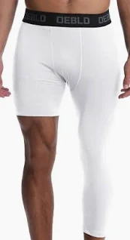
Single Legged Pant
Not Legal

Slide 26
Mercado Headgear
I hope that this note finds you and yours safe. It is my pleasure to introduce BATS-TOI as our newest corporate partner and the Official Headgear of NFHS Wrestling! We will have the pleasure of meeting Mr. Mario Mercado this summer at the NFHS Wrestling Discussion Forum in San Antonio, TX. I have met and worked with Mario and he is committed to interscholastic wrestling and the welfare of the athletes.
Elliot Hopkins National Federation

Slide 27
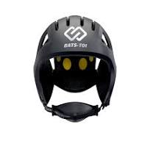
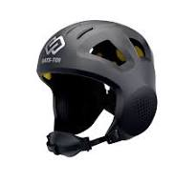
It is Legal
a

Slide 28
RULES VIDEO
https://www.youtube.com/watch?v=7beelNWtH8Y

Slide 29
OFFICIAL’S QUESTION
Could you ask the MHSAA how they handle "unpaid so-called coaches" sitting on the team bench or in the corner? I find 80% of the time these people (mostly alumni or parents) are the biggest problem. You see this more and more. I want to know how they want us to handle if an injury occurs with liabilities and lawsuits.
Answer:
RULE 5. SECTION 30 UNSPORTSMANLIKE CONDUCT
ART. 1 . . . Coaches and Team Personnel. Unsportsmanlike conduct of coaches
and other team personnel is any act which becomes abusive or interferes with
the orderly progress of the match. These acts may occur prior to, during, or after a
match. This includes violations of the bench decorum rule (7-5-2), taunting, acts of
disrespect, or those actions which incite negative reactions by others. The offender
shall be penalized for unsportsmanlike conduct in accordance with the Penalty Chart.

Slide 30
FREE MOVE
Locking hands does not give you a free move.
You get an opportunity to complete the current situation/move.
Blow it as soon as there is no action from the defensive wrestler.

Slide 31
BROOMSTICK (JONSEY TILT)
In both an Olympic year and the Tic Tok era, some different moves are gaining in popularity and visibility. One notable and fairly dangerous example is the Broomstick/Kickout/Jonsey Tilt.
https://www.youtube.com/watch?v=4mEFPhT2Vn8
If the wrestler attempting this move, leaves his feet, this is illegal and highly dangerous.
https://youtu.be/vEunSxfGY18?si=MRpn5wwGBrHMotxR

Slide 32
NEAR FALL CRITERIA VS SITUATION
In situations such as OT or Tech Falls, When do you stop the match with a Near Fall situation either imminent or ongoing.
In most situations, the easiest explanation is that Near Fall points can be earned but not awarded. Allowing wrestling to continue until the Situation has ended. The situation is concluded when the defensive wrestler gets to a defensible position. AKA breaks a cradle, slips a wing out, etc.

Slide 33
NEAR FALL CRITERIA CONTINUED
There seems to be one exception to the previous slide in the new rule book.
When either held NF points or NF points that would be awarded the match is stopped for a Technical Fall, when the defensive wrestler is no longer in Criteria.
They changed the wording in the book from “Situation” to “Criteria”.

Slide 34
NEAR FALL POINTS
RULEBOOK PAGE 24
ART. 2 ... A near fall occurs when the offensive wrestler has control of the opponent in a pinning situation and near-fall criteria are met for a period of two seconds or longer. (Photos 5-8)
Criteria for a near fall occurs when any part of both shoulders or both scapulae of the defensive wrestler are held within 4 inches of the mat or less; or when one shoulder or scapula of the defensive wrestler is touching the mat and the other shoulder or scapula is held at an angle of 45 degrees or less with the mat; or when the defensive wrestler is held in a high bridge or on both elbows.
Only the wrestler with the advantage, who has an opponent in the pinning situation, may score a near fall.
A near-fall is ended when the defensive wrestler gets out of a pinning situation. The referee must not signal the score for a near fall until the situation is ended and only one near fall shall be scored in each pinning situation, regardless of the number of times the offensive wrestler places an opponent in the near-fall position during the pinning situation.

Slide 35
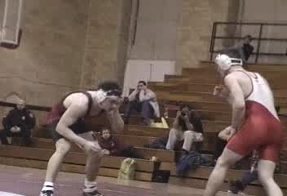
ASSASSIN - CHOKE

Slide 36
DISCUSSION ON GIRLS WRESTLING
One of the local coaches who spends a ton of time with both high and low level Female wrestlers put it best, when discussing Potentially Dangerous and differences between male and females wrestlers.
“their flexibility is both a blessing and a curse. They can put their bodies into positions that a boy just can’t. The curse is a male wrestler has all kinds of muscle strains and light sprains to give you a warning before things “break”. Females don’t.”
https://www.facebook.com/share/v/19ikB2bLyH/

Slide 37
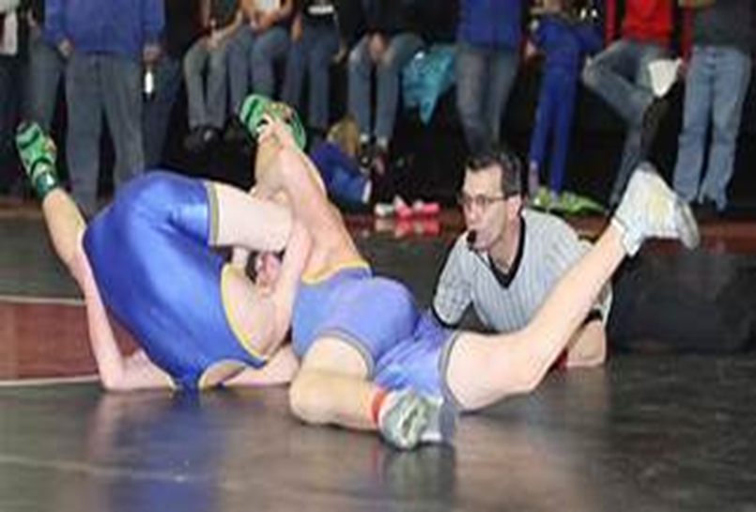
BACK POINTS
Cradle
Too many officials fight trying to see the shoulders or scapula when they need to move to the rear for a better view. This works great in the cradle situation.

Slide 38
IMMINENT DEFINITION
Imminent scoring is typically referred to a situation where one wrestler is on the verge of scoring point(s). This is because either one of the wrestlers is in a position to score a takedown, reversal, escape or near-fall, all available methods to scoring points in a wrestling match.
If a match is stopped for an injury during an imminent scoring situation, the referee will award the points to the non-injured wrestler. The injured wrestler will be charged with an injury timeout.

Slide 39
OFFICIALS QUESTION
Are we still calling it this way? If the defensive man commits a penalty while in NF (pulls headgear, hands in the face repeatedly, etc) then there is a "stoppage point" for lack of a better term. The 3 point NF becomes 4 points PLUS the penalty point. So this year you could get a 6 point total NF situation (5 for the NF plus one for the penalty).
We would call it this way regardless of how the situation ends (goes out of bounds, period ends, defensive guy gets off their back).

Slide 40
ANSWER
5.11.2 SITUATION F: Wrestler A has earned, but the referee has not yet awarded
a two-point near fall while Wrestler A maintains the pinning combination. Wrestler
B, in attempting to escape, grabs the shirt of A and fails to release the grip. Due to
the grabbing action, A loses the pinning combination, which allows B to reverse.
When should this match be stopped and what points shall be awarded? RULING:
As soon as the referee determines the pinning situation has concluded, the match
shall be stopped. Wrestler A would be awarded three points for the near fall and
one point for the penalty for a total of four points. B cannot score points in this
situation. The offending wrestler shall not be allowed to profit from illegal action.
(6-4-6, 7-3-2, 8-1-2e)
I have verified this interpretation with the federation.

Slide 41
DANGEROUS MOVES & MANEUVERS
The defensive wrestler has an arm trapped. Wrestling can continue as long as the wrestlers can protect themselves.
If lifted off the mat, the defensive wrestler must be able to post an arm to protect themselves. If not, it is potentially dangerous. Note: if it happens fast, the offensive wrestler is accountable for the defensive wrestlers safe return to the mat. If not, they are penalized. It is not the officials' choice the offensive wrestler made but we are responsible for calling if not brought back to the mat safely.
Note: If you see the arm trapped and feel it could not end well, blow the whistle and stop immediately. SAFETY FIRST!

Slide 42
NEXT MEETING
Tuesday, January 7th at 7:00 pm

