Slide 1

RISE ATL SPORTS
G.I.G. Initiative
Giving In Georgia Initiative!!
E: contactus@riseatlsports.com
P: 678-707-3968

Slide 2

Giving In Georgia?
What is Giving In Georgia (G.I.G.)?
It is our giving and donation program with local Georgia schools and organizations.
We have given over $700 back to the schools and communities we serve and will continue to do so.

Slide 3
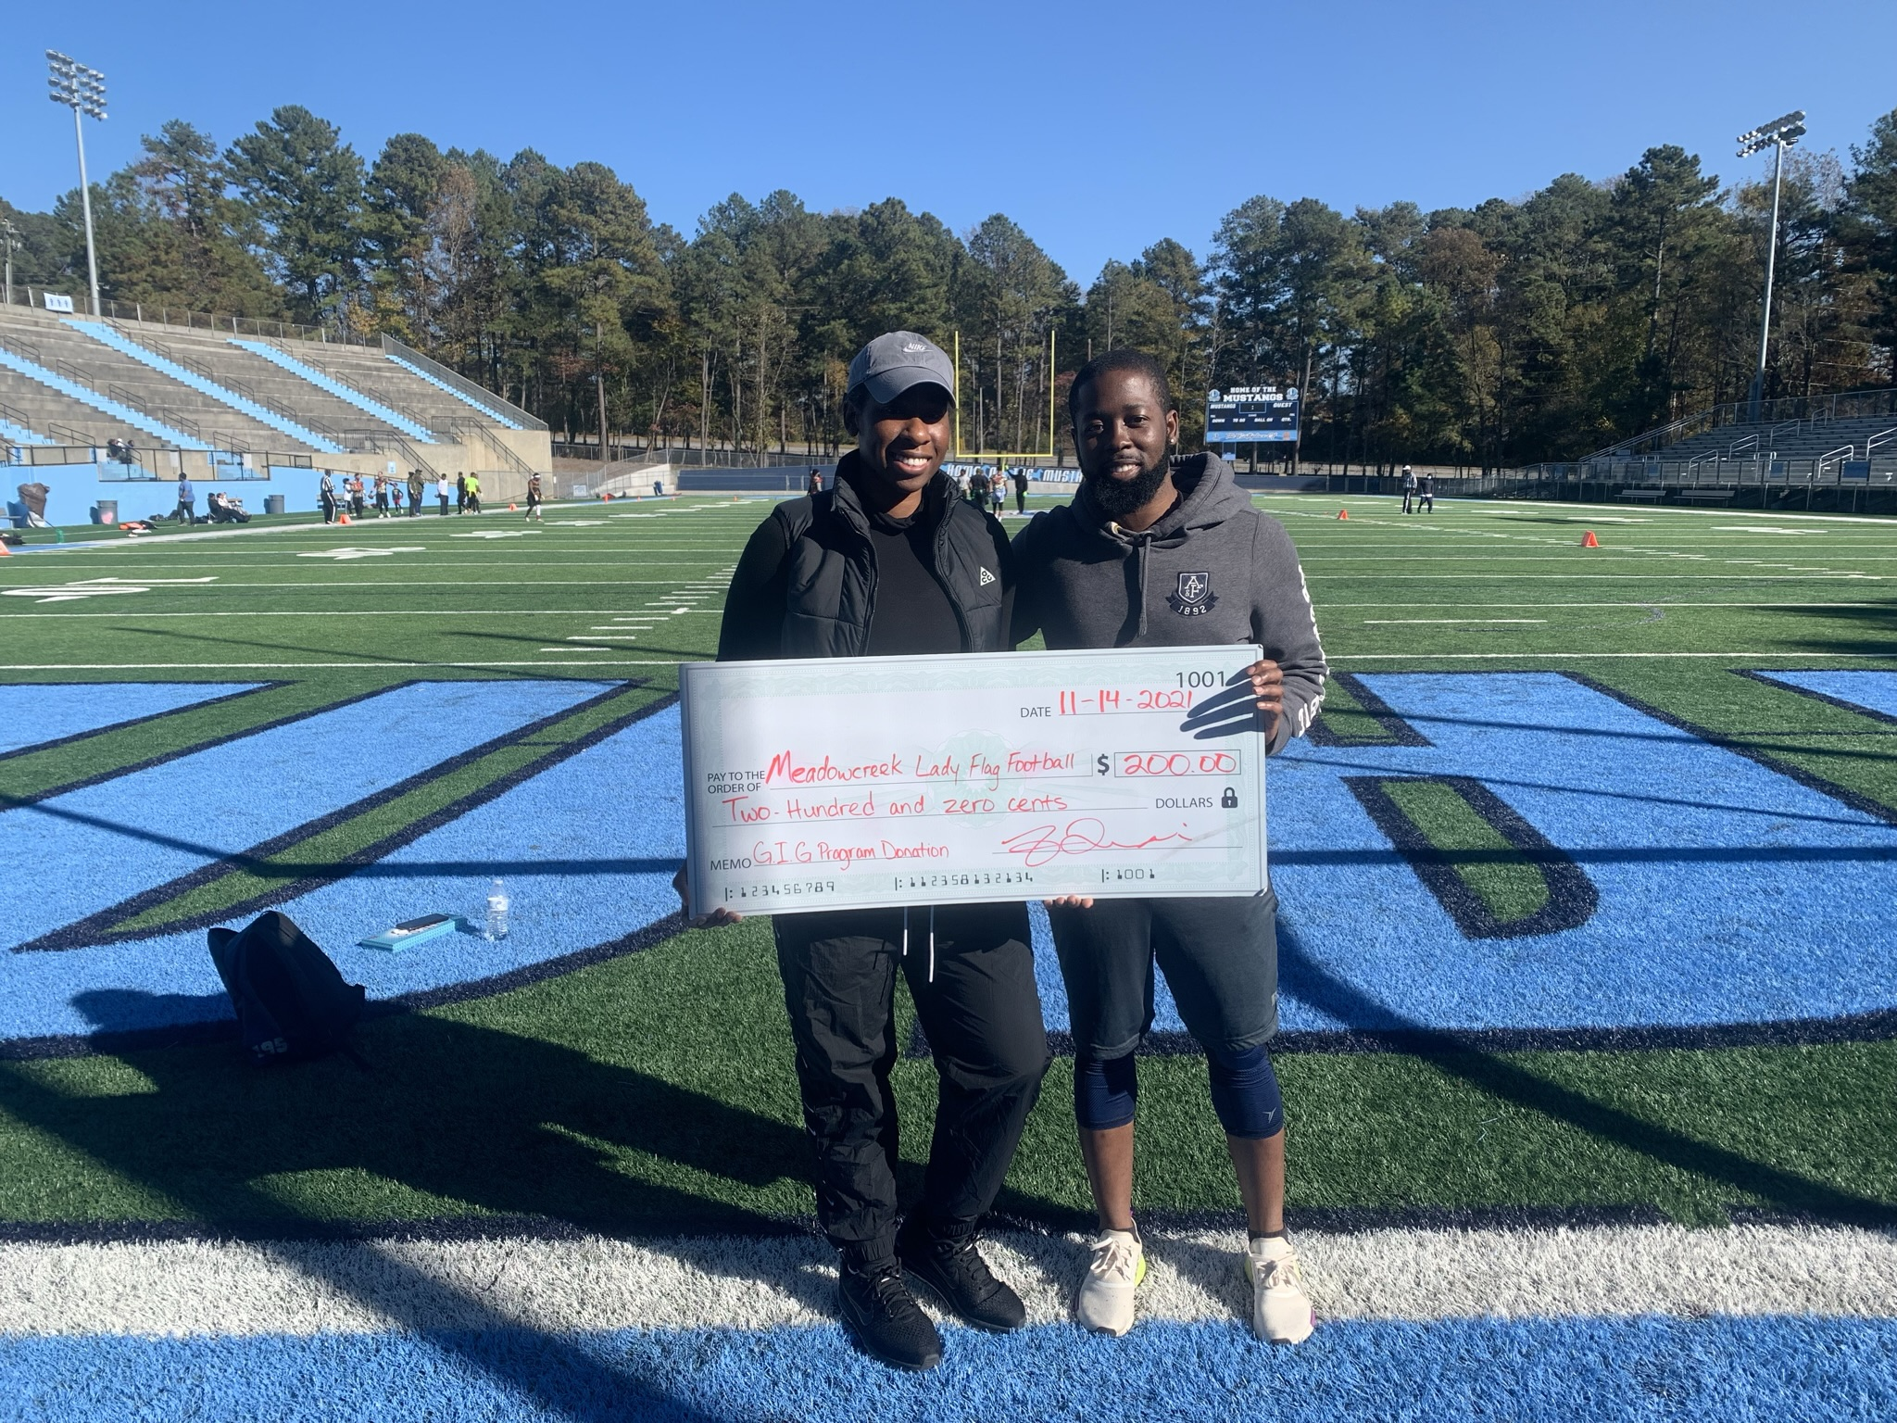
How Can I Help?
You can make a small donation on our giving form and we will add you to our wall of fame (Optional)
Donation of Items (Clothing,food,coupons,school supplies etc.)
An invoice will be created upon request for any items donated
Proceeds will be used for our back to school and holiday giving events as well as other charitable events.
https://www.riseatlsports.com/givingback
* If paying by debit/credit a small processing fee is charged by the card processor.

Slide 4
Upcoming Events/Promotions
School Supplies Donation
Youth Sports Program(R.I.S.E. ATL Sports Youth)

Slide 5
Items Needed
Pencils
Pens
Eraser
Bookbags
Calculators
Notebooks/Notepads
Pen/Pencil Pouch
Kleenex
Bleach Wipes

Slide 6
GOALS OF G.I.G
Helping acquire Uniforms school Girls/Boys teams
Helping Pay for them to go to tournaments/events
Helping schools start programs OR enhance current programs (Flag Football/Basketball)
Scholarships for Students
Clothing and School Supply drives
Tutoring Services

