Slide 1
3rd Association Meeting
January 7th, 2025

Slide 2
Banquet
Do we want to do on a weekday or a Saturday?

Slide 3
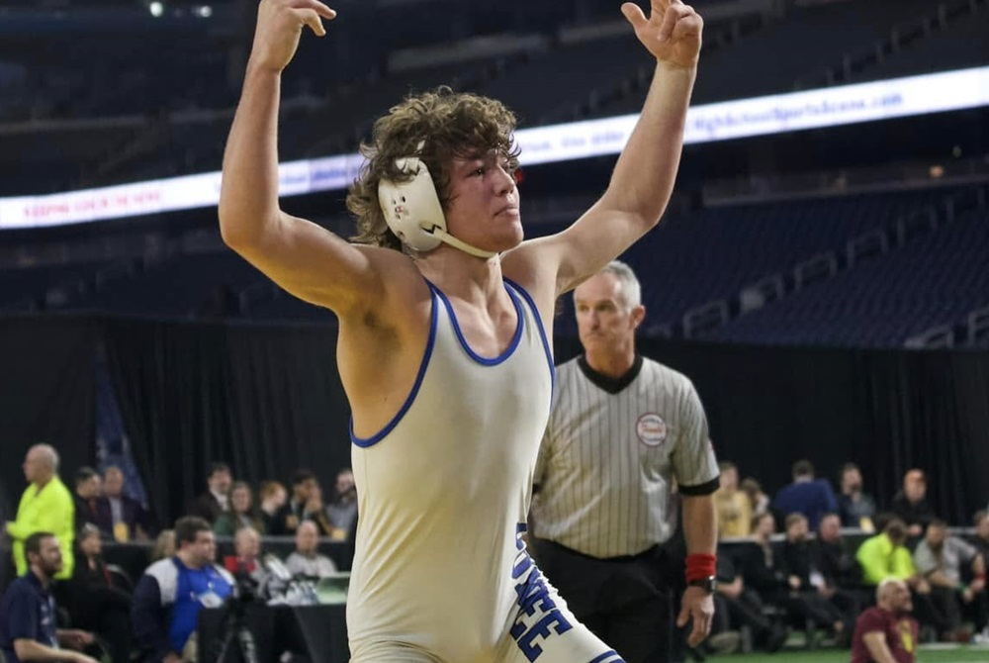
On the MHSAA site

Slide 4
Officials getting sick
This time of the year brings on officials getting sick. It has happened already but with this peaking now, I hope some of you keep your stuff in the car in case we need a last minute official.

Slide 5
Financial Update
Starting Balance - $3,219.87
Payments: - 60.00 Lamphere Fee - 25.00 Association fee to MHSAA
-143.40 Website Internet Fee of 11.95 month
- 46.84 Labels (Ink free)
-240.00 Sportsmanship Awards & Plaques
Balance as of now is: $2,704.63
Deposit 175.00
Total $2,879.63

Slide 6
Scott Strickler
Doing Assignments
Amount of matches assigned to each
Assigning officials to meets and what is involved

Slide 7
The money generated this year
Officials Fees: $219,918.00
Last year was higher. We are down in the number of slots filled

Slide 8
Middle School Fees Accepted
Dual - was $55 or $60 and is now $70 up to 26 matches
Quad – was $67 or $72 and is now $110 up to 42 matches
Tri – was $75 or $85 and is now $150 up to 63 matches
Anything over that is $2.00 per match
Currently, this is supported by the OAA, KLAA / KLM SL, and LVC. More discussions will follow regarding 2026 rates at our next SEMLAC meeting.

Slide 9
When you are done on your mat
Don’t leave your fellow officials. Stay until all are done…

Slide 10
Post-Season Assignments
For some reason, zone 3 has very few regionals. We only have:
Team Regionals – 8 and some are mixed with other zones
Individual Regionals – 3
Division 1 – 1
Division 2 – 1
Division 3 – 1
Division 4 – 0
Some officials from other associations are mixed in so out of the 12 officials needed, only 9 are from our group.

Slide 11
Criteria used
Ratings – Minimum of 75
First cut-off mark – 4.250
Second cut-off mark – 4.125 if we needed
Third cut-off mark – 4.000 not needed
Every zone is required to have 2 officials represented for the finals. If there are enough at the first cut-off, we stop. If not, we keep moving down.

Slide 12
Criteria
In many zones, we had to go to 4.125 but did not have to drop to 4.000.
Zone 3, by far, has the most qualified officials.
Some zones only had 2-3 people qualified to work yet our zone had 23 with a 4.250 or better! We had 4 who did not apply for a final or that would have been higher.
We will be well-represented at the finals.

Slide 13
Criteria
Knowing this, you can tell where you are and where you need to be. Keep working on raising your ratings and making sure you increase your number of ratings.
The hope is to publish Regional and Final information in the next 10 days.

Slide 14
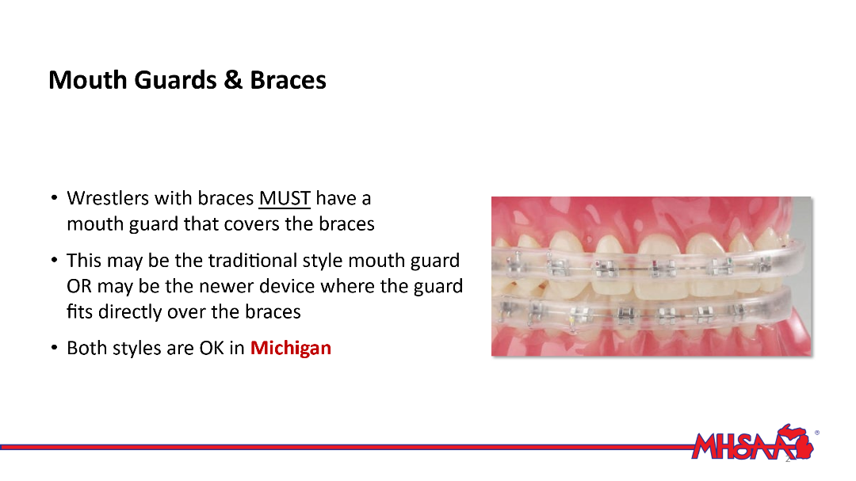
Braces
I have included the slide showing Michigan allowing the mouth covering below. This is a deviation from NFHS rule 4.2.6. the slide is from the 2024-25 rules-specific meeting for wrestling officials.

Slide 15
Rule Clarification
Wrestling near the out-of-bounds with no action ….can you bring back to the middle?
Answer: You can blow the whistle and restart in the center. Usually if nothing is happening, someone should be called for stalling but not always.

Slide 16
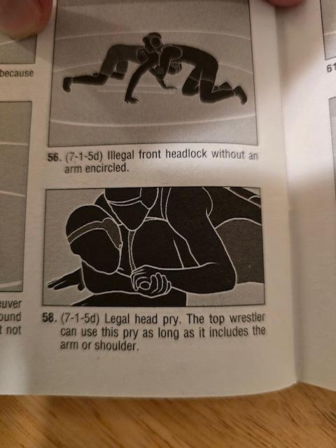
The picture in the book is legal because the shoulder is part of the prying on the head and eliminates the pressure on the neck. The photo is almost the same but if you look close, the arm or shoulder does not stop the prying on the neck, and was called illegal. I feel that call was correct but the coaches do not. Can you answer this for us.

Slide 17
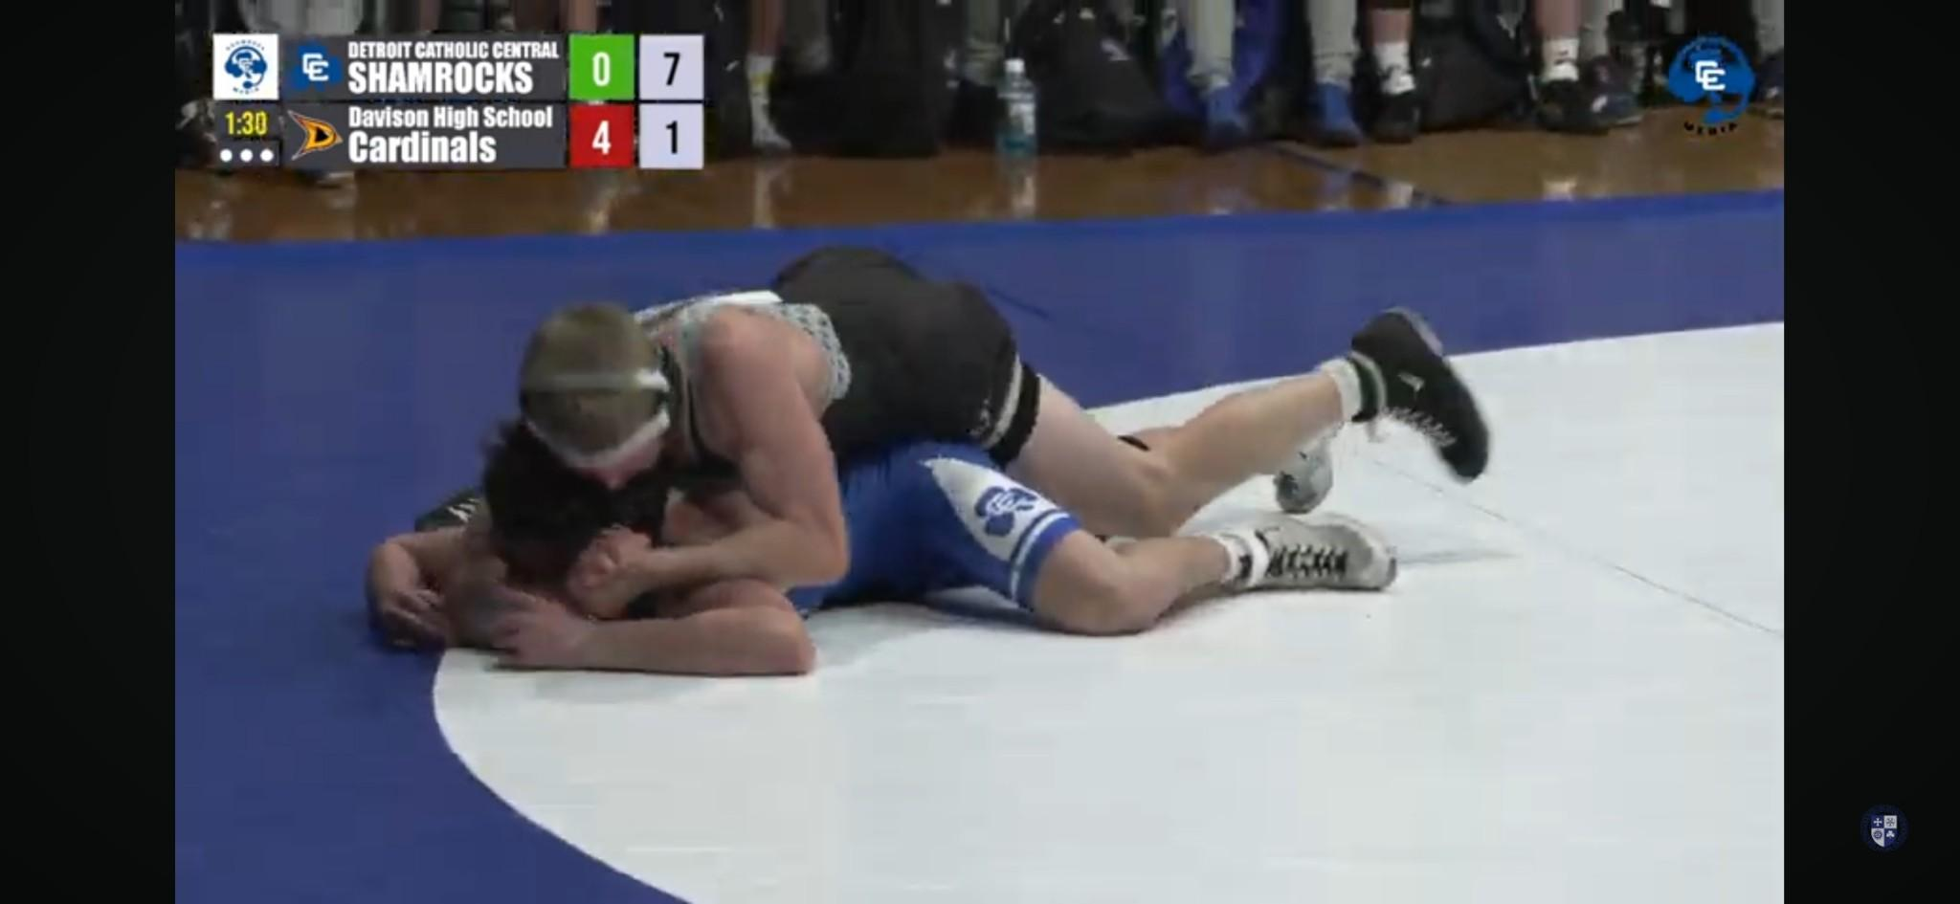
Response
You are correct in your assessment of the situation and the maneuver is illegal.
Sam

Slide 18
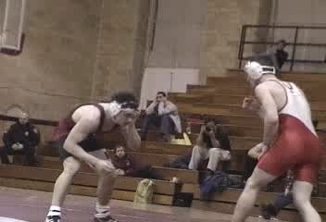
Choke

Slide 19
Stalling needs to be called
Understand that stalling is stalling, because of the action or lack of action, not because of the score or time of match.
Blocking with the arms, forehead or head is stalling.
Moves used to just hold on to their opponent.
Over the years, leg wrestling has had its place in mat wrestling as an effective way of scoring. However, it can also be use for stalling.
Emphasis is now being placed to eliminate stalling with the use of legs. For this reason, the burden to wrestle aggressively and score with the legs is generally put on the top wrestler.
Playing the edge, top man using a 2 on 1 without working to improve.
Dropping to one knee when in the neutral position.

Slide 20
Signaling if in criteria
Using hand signals to show if not in criteria should no be done.
Do Not Make Up Signals: Never make a gesture showing how close the wrestler’s back is to the mat.
➢ Never make a signal to symbolize a degree angle in a near-fall situation.
➢ Never wave an arm/hand back and forth indicating in and out of criteria.
➢ Note: The above-mentioned gestures are not approved NFHS signals, and therefore is a form of coaching.

Slide 21
Top Wrestler
It is stalling when the wrestler in the advantage position:
Does not wrestle aggressively and attempts to secure a fall.
Casebook states: On page 86 which says…In the advantage position, when the top wrestler is content to hold the opponent without moving out to a PERPENDULAR position and working for a fall, it is stalling. Staying parallel means the wrestler is not working to improve which means they are stalling.
Question: Can you score? Sure but the book says it is stalling if not.

Slide 22
Visual count on back points
You should ALWAYS do a visual count so the crowd sees. Exception is when the official is on his feet and wrestler is taken directly to their back. You can do a verbal and then go the visual.

Slide 23
REFEREE MECHANICS IN NEAR-FALL SITUATIONS
Follow the flow of the action. When the back of the defensive wrestler is exposed, (get down on the mat) with a line of sight of the wrestler’s back, which gives the best vantage position of both shoulders/scapulae.
Anticipate a takedown directly to near-fall criteria.
Once in position, maintain a silent count while getting down on the mat.
Do not place or reach a hand under the scapula or shoulders of the defensive wrestler.
Watch for the fall, while also looking for violations happening around the face, e.g., hands in the face, eyes, etc...
The near-fall count only begins when the offensive wrestler controls the defensive wrestler, in a pinning situation and near-fall criteria has been met.

Slide 24
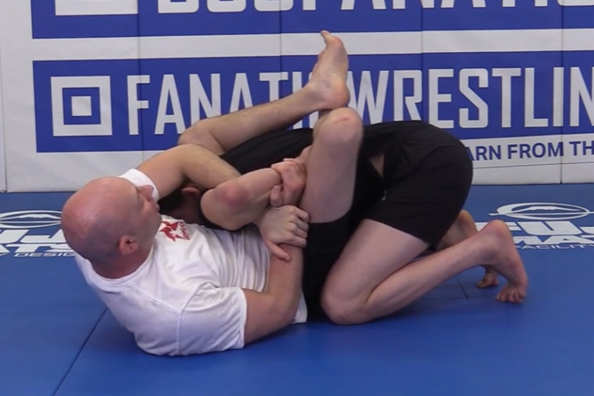
Kimura Lock
ILLEGAL
The Kimura lock is a submission technique in Brazilian Jiu-Jitsu (BJJ) that involves gripping an opponent's wrist and securing it behind their back while applying pressure to their shoulder

Slide 25
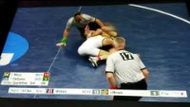
Kimura

Slide 26
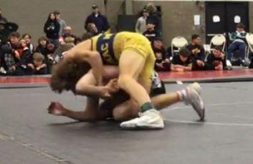
Blair Ride

Slide 27
Knee Sleeves
The National Federation of High Schools (NFHS) rules prohibit wrestlers from wearing leg sleeves during a match unless they contain a pad. The rule states that leg sleeves without a pad are not legal because they do not provide protection and do not fit all wrestlers properly.

Slide 28
When does the hair rule come into play?
The offensive wrestler has to work around the hair.

Slide 29
Stalling vs Fleeing the Mat

Slide 30
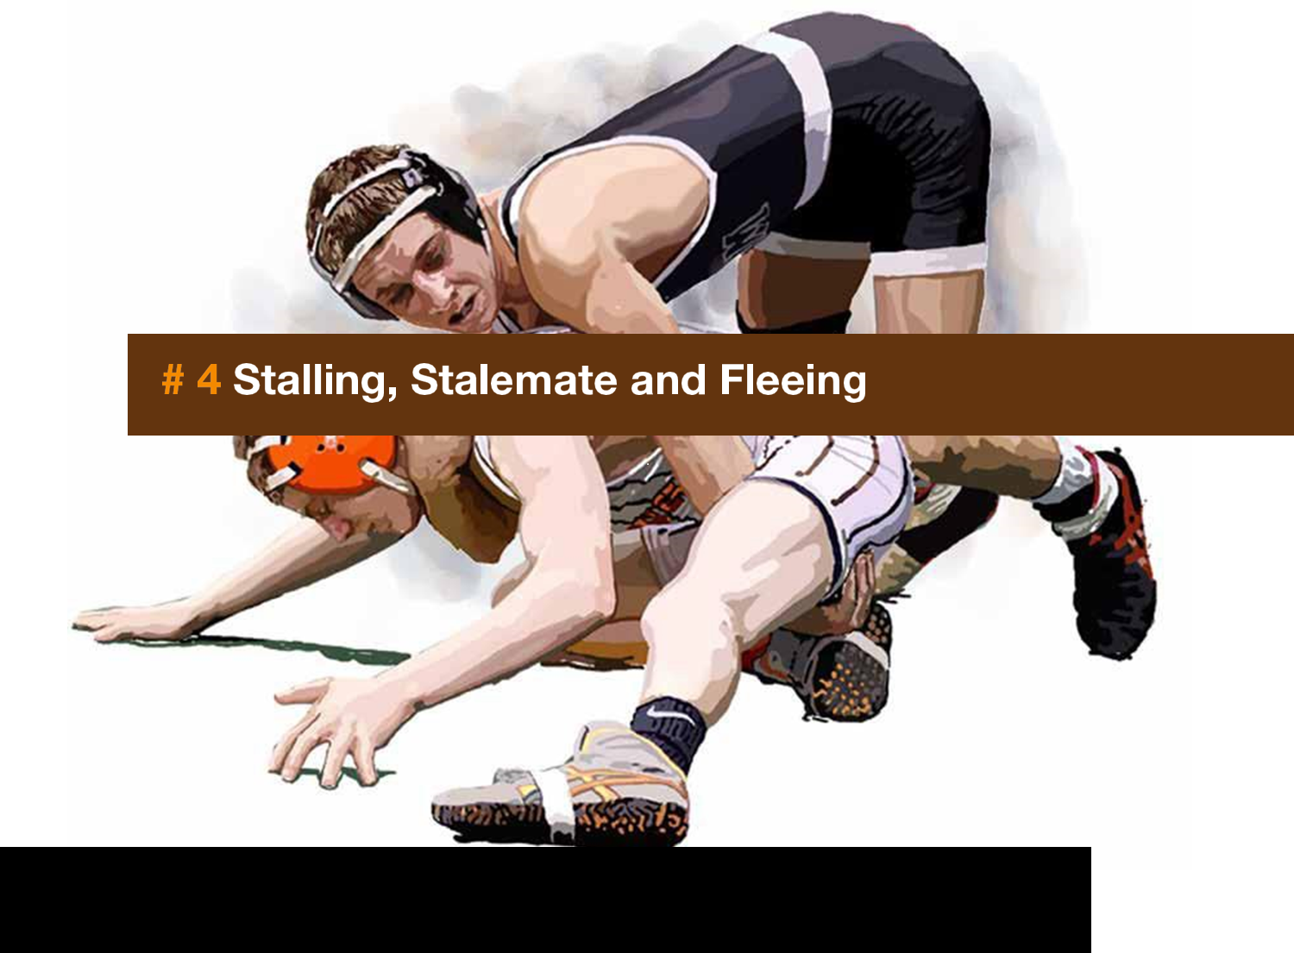

Slide 31
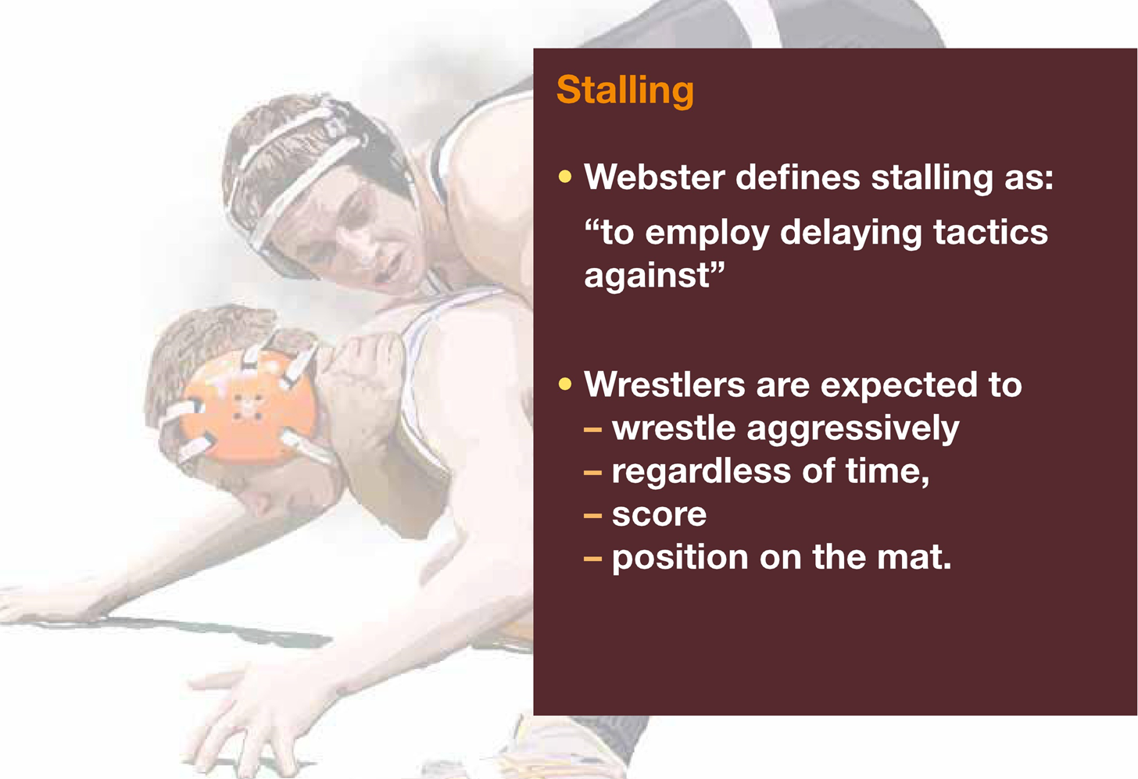

Slide 32
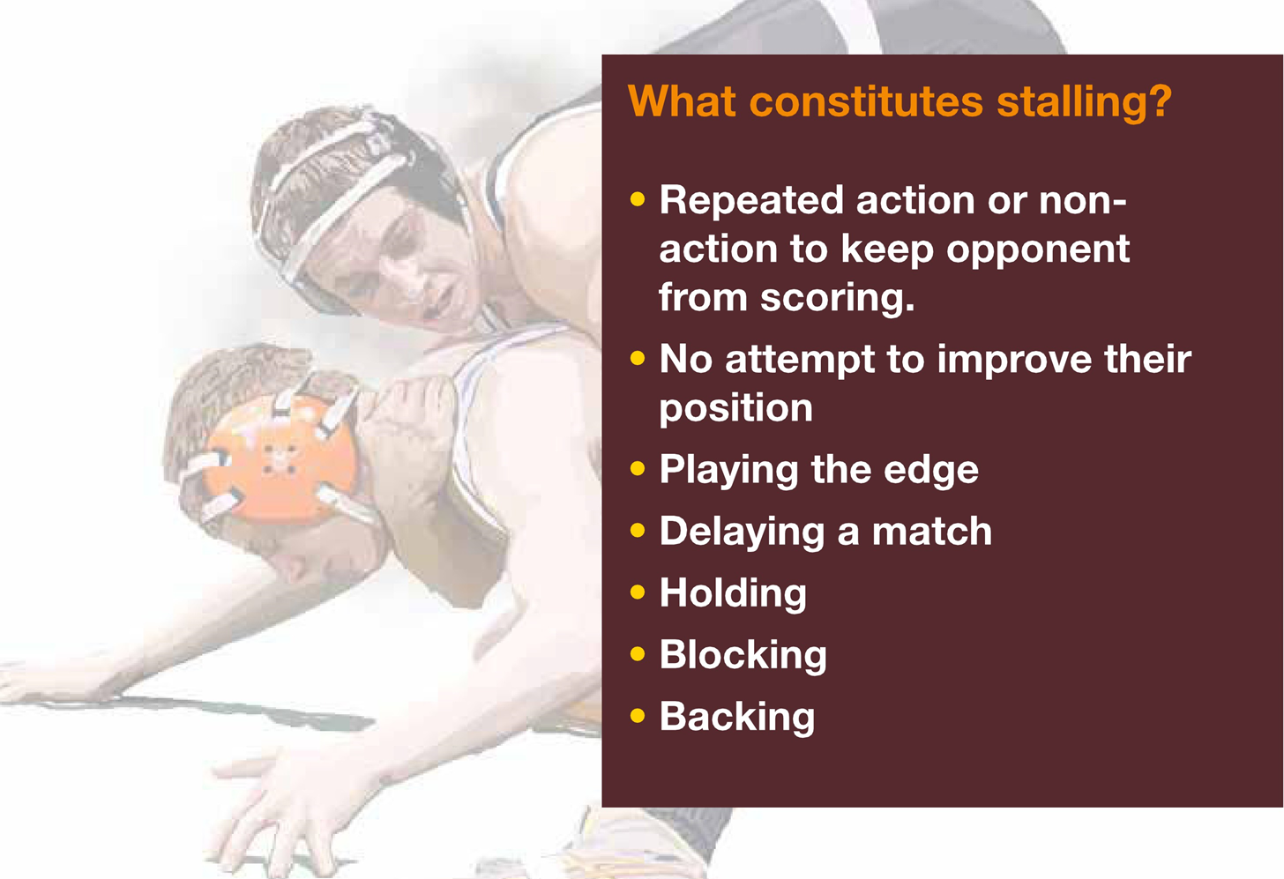

Slide 33
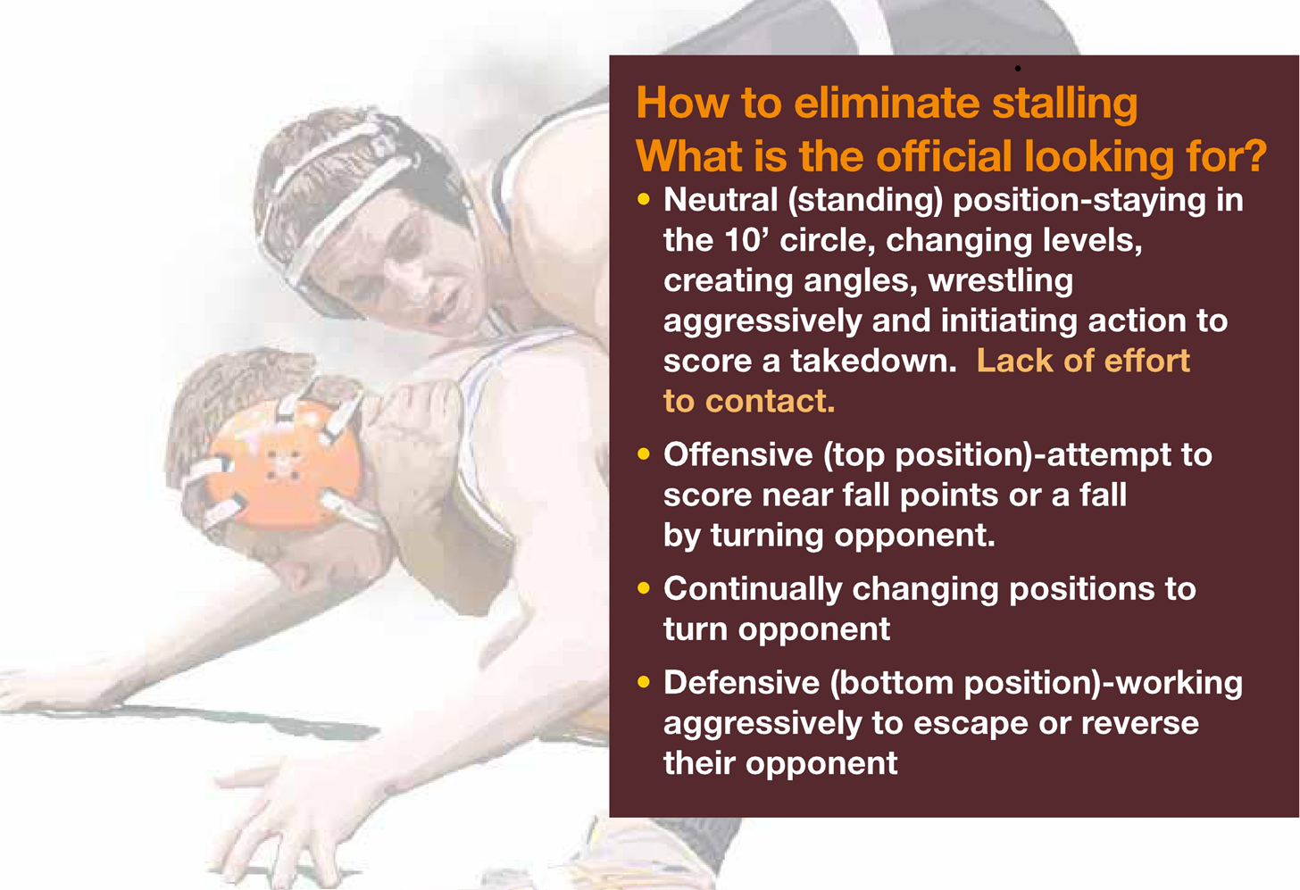

Slide 34
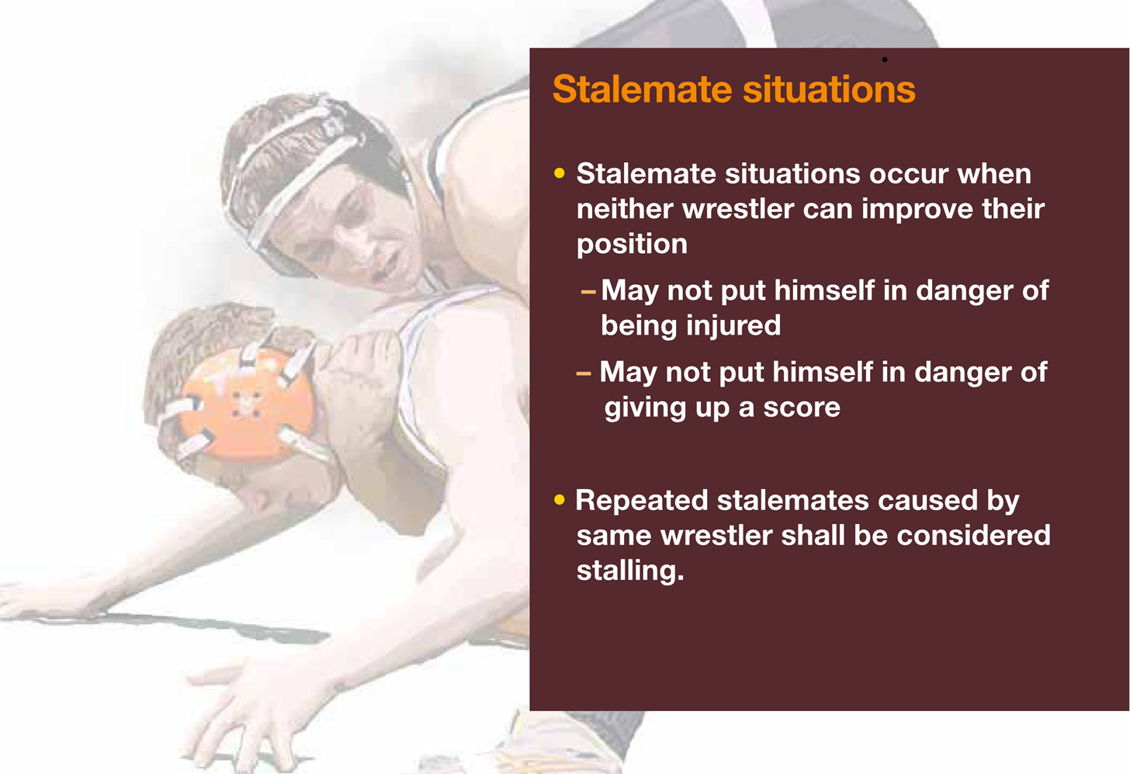

Slide 35
