Slide 1
May 2024
Booster Club
Meeting

Slide 2
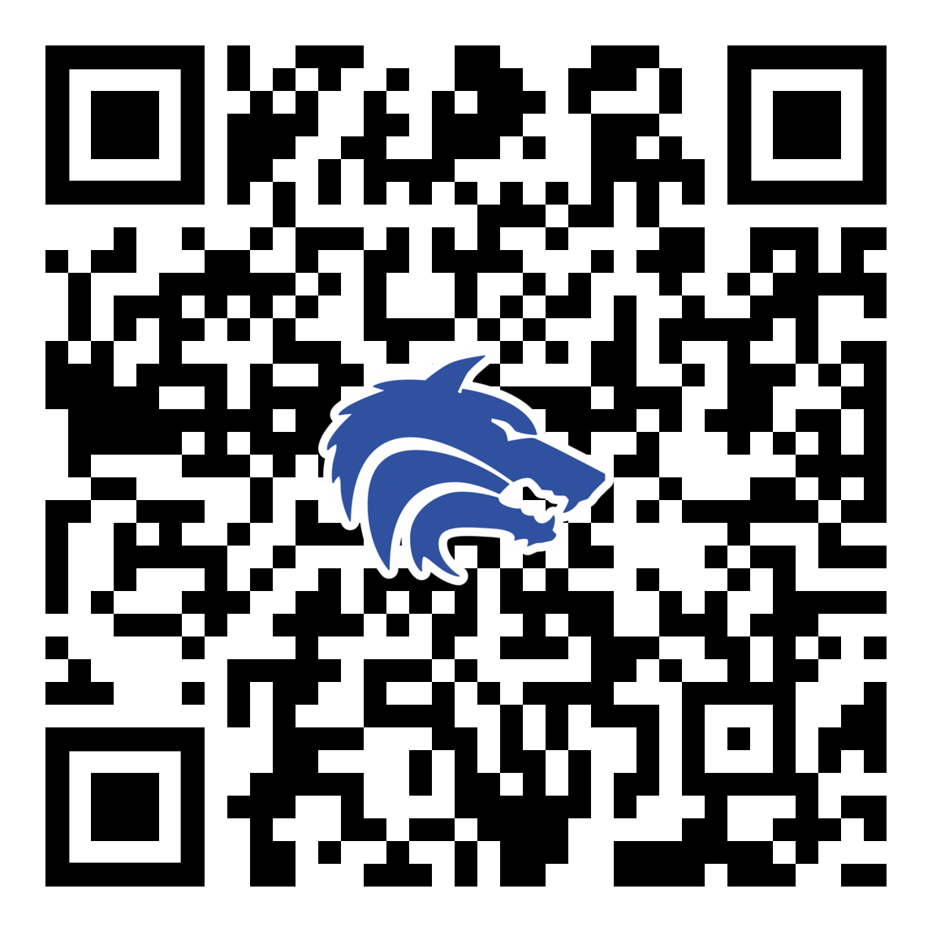
May 2024 Booster Club Meeting

Slide 3
Agenda
Approve March Meeting Minutes
Treasurer Report
2024 – 2025 Board Election
Coach’s Corner
College Recruiting Presentation – Ross Hawley

Slide 4
Treasurer’s Report: May 2024
BEGINNING BALANCE as of 4/05/24
REVENUE
First Pitch Dinner Tickets (paid via venmo)
Concessions
EOS Banquet Tickets
Game Day Meals (extra meals purchased by players)
Total Revenue:
EXPENSE
EOS Banquet Speaker
Concessions (Food, Candy, Popcorn, Drinks, Supplies)
Game Day/EOS video by GigPro Ink Media
Baseball Equipment (new L-Screens for batting cages & nets)
Game Day Program Printing
Theme Night: Elementary School Night
Theme Night: Teacher Appreciation Night
Theme Night: Senior Night
Game Day Meals (Dilla's – 3/26, 4/2, 4/9, 4/16, 4/23 weeks)
Total Expense:
  $19,455.13
$50.00
$5,385.68
$2,925.00
$48.00
$8,408.68
$200.00
$1,965.79
$750.00
$2,275.80
$305.81
$67.50
$103.85
$806.32
$1,711.00
$8,186.07
ENDING BALANCE as of 5/10/24
$19,677.74

Slide 5
Treasurer’s Report: PROJECTED EOY
BALANCE as of 5/10/24
INCOMING REVENUE:
EOS Banquet Tickets (cash collected at the door)
Concessions (hosted 5/9-5/11 playoffs)
Camp Bow Wow (3rd sponsorship payment installment)
Plano West Softball (reimbursement for teacher appreciation meals)
Player Yard Sign (check to deposit)
Total Expected Revenue
OUTSTANDING EXPENSES:
EOS Banquet - Caterer
Concessions (Food, Candy, Popcorn, Drinks, Supplies)
EOS Banquet – Coaches Gifts
EOS Banquet – Senior Player Gifts
Sponsorship Banners
Theme Night: Teacher Appreciation
Plano West Softball (payment for hot dogs for Media Day players lunch)
Prosperity Bank Checks Reordered (5/3/24)
Denny Garver Scholarship Award
Total Outstanding Expenses
  $19,677.74
$45.00
$2,284.04
$400.00
$80.00
$65.00
$2,874.04
$6,826.80
$759.76
$710.00
$299.60
$462.00
$215.49
$91.00
$64.15
$500.00
$9,928.80
PROJECTED ENDING BALANCE (as of 5/14/24)
$12,622.98

Slide 6
2024 – 2025 Board Nominations
Motion:
  Plano West Baseball Booster Club Members wish to vote on and elect the 2024 – 2025 Board with the nominees presented 4 days in advance of the vote instead of the 7 days required in the bylaws.

Slide 7
2024 – 2025 Board Nominations
President: Jeff Moore
Vice President: Erin Wasson
VP Marketing: Chris Grimes
Treasurer: Valerie Morton

Slide 8
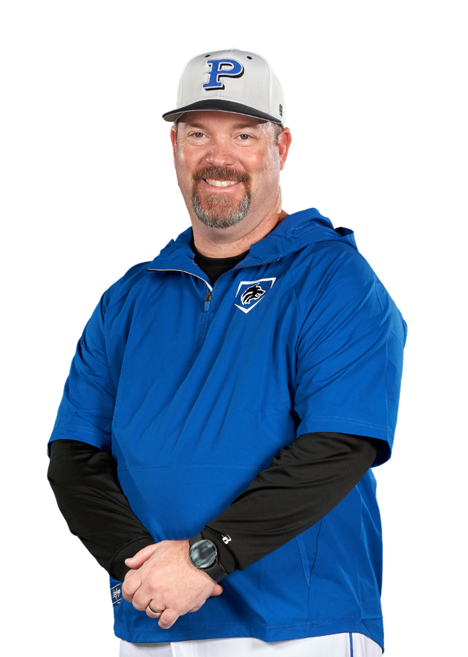
Coach’s Corner

Slide 9

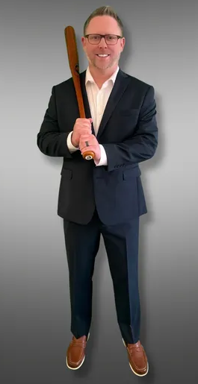

Ross Hawley
www.collegerecruitingprep.com
Local – lives in McKinney
Listen to his podcast!!

Slide 10
College Baseball Recruiting
Approximately 1,700 college baseball programs
Divisions
  NCAA
    D1 – 300 programs (11.7)
    D2 – 253 programs (9)
    D3 – 389 programs (0)
  NAIA – 212 Programs (12)
  NCCAA – 51 Programs
  Junior College
    D1 – 189 programs (24)
    D2 – 129 programs (24)
    D3 – 99 programs (0)
  Post Grad Academies
How do you
find the right fit?

Slide 11
College Baseball Recruiting
Plano West Recent Graduates
  Luke Douthitt 2019 Covid Sr Cisco College (Juco D1) -> Regis University (D2)
  C J Difiglia 2020 Covid Jr Howard College (Juco D1) -> Regis University (D2)
  Chase Spencer 2021 Jr Air Force Academy (NCAA D1)
  Nick Moore 2021 Redshirt So Texas State (NCAA D1) -> Eastfield (Juco D3)
  Brian Hallum 2022 So Dodge City CC (Juco D1) -> Kansas (D1)
  Bryce Farlander 2022 So University of Mary Hardin-Baylor (D3)

Slide 12
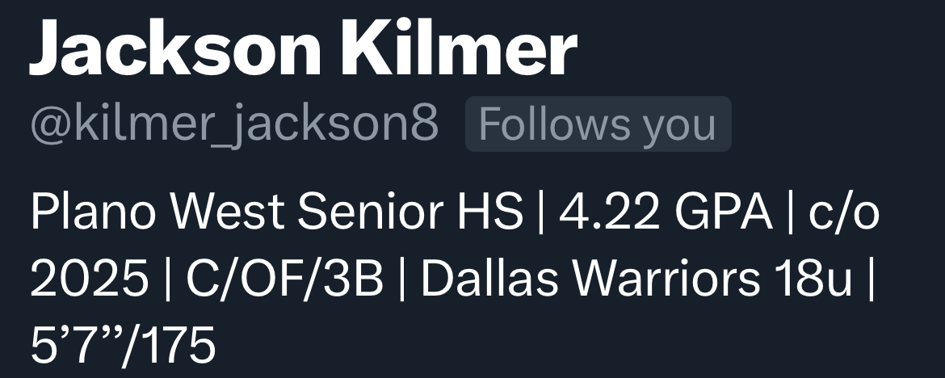
Recruiting Info
Building your own exposure!!
  Twitter / X:
    List in your name and profile:
    Follow coaches at schools of interest
    Short highlight videos
    @ and # (i.e. @FlatgroundApp, @FlatgroundBats, #uncommitted #2025pitcher)
    Don’t tag specific schools or coaches!!!
  Emailing coaches
Camps and Showcases – where do you spend your $$

Slide 13
May 2024 Booster Club Meeting

Slide 14
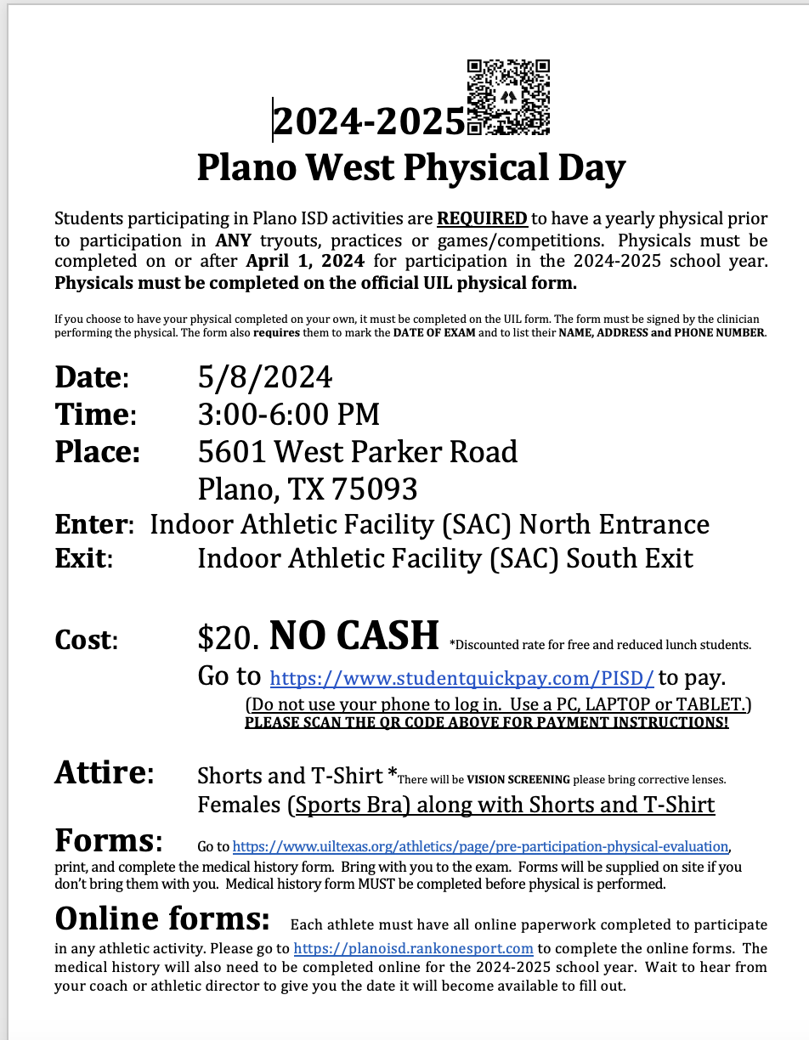
2024-25 Physicals
May 8th
3:00 PM
Forms in Rank1
Payment due in advance

Slide 15

SportsYou
DCMN-ZE9D

Slide 16
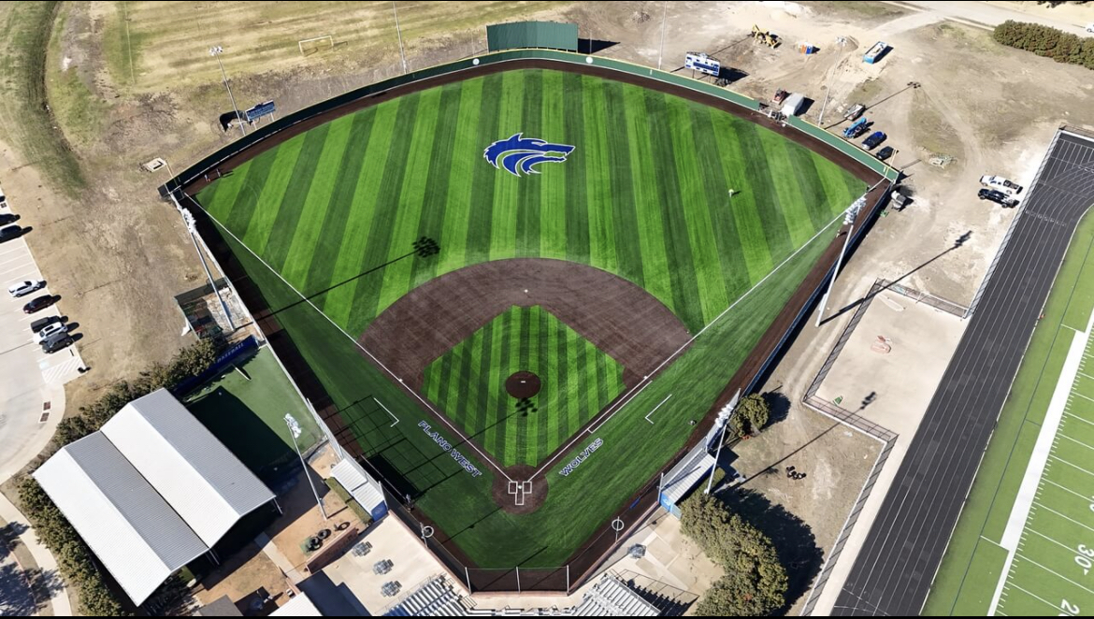
Ballpark Turf

Slide 17
Concessions
A million thanks to all the volunteers to date!
Two shifts MINIMUM per family (that's minimum – don't be shy if you want to sign up for more!)
Openings:
  4/12: Varsity Game (1)
  4/16: Varsity Game (1)
  4/26: JV Game (2)
  4/26: Varsity Game (2)
We have great student volunteers that will help!
We are always up for donations including soda & chips. Please write "baseball" on any donations and drop at concessions on the table in the middle or on the baseball rack

Slide 18
Booster Club Votes
Approve December 2023 Meeting Minutes
JOIN THE BOOSTER CLUB
  26 members (we had 37 member families in 2022-2023 school year)
  $5,150 in membership dues! ($500 increase from prior meeting)
www.planowestbaseball.org/join

Slide 19
Important Spring Dates
Sat 4/20: Senior Day
Non-Senior parent volunteers needed
Sun 5/5: Baseball Banquet
Collin College - Frisco Campus

Slide 20
Debit Card
Why – recurring payments that must be made via Credit / Debit card
Examples – domain name renewal, Rhapsodo renewal, Coaching conventions and associated hotel stays
New for 2023 – 2024: PISD employees cannot be reimbursed by booster clubs!
Proposal: Booster club obtain a debit card for our checking account. Prior to use, 2 of the 3 booster club designated signees must provide email authorization for the use of the card

Slide 21
Theme Nights
Date
FRI 4/12
TUES 4/16
SAT 4/20
FRI 4/26
Theme
PSA Night
Teacher Appreciation Night*
Senior Day*
Blue Out / Senior Sendoff*
Sponsor
Rudick Construction Group
Messick Peacock & Associates
*Help Needed:
If you are available to help drop invitations tomorrow to Teachers at Plano West, Shepton, Barksdale, Rose Haggar, Jasper, Mitchell, etc. Please meet Natalie at the table after this meeting. It's a quick drop and much appreciated.
4/20 Non-Senior Varsity Parent Volunteers needed for help with Senior Day.
4/26 Looking for someone to lead this night

Slide 22
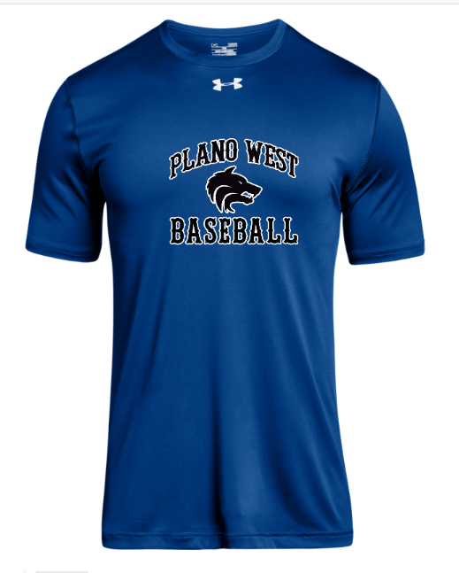
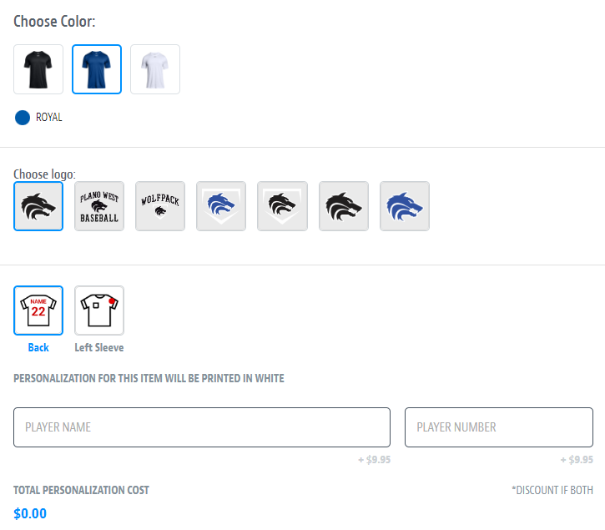
Spirit Wear – powered by SQUADLOCKER
Order your Plano West Baseball gear from Squadlocker via www.planowestbaseball.com

Slide 23
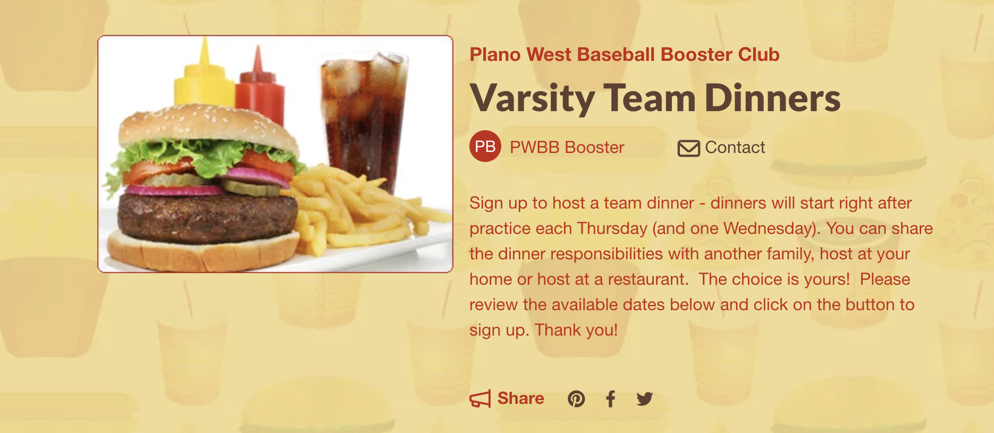
Team Dinners
Thank you for everyone that has hosted or will host!
Only remaining opening is JV2 on April 25!

Slide 24
Committees / Task Needs
Concessions: Angela Thompson/Ginger Cox/Mary Wade
End of Season Banquet: Julie Raecek
Gameday Program: Tracy Sievers
Senior Night: Tracy Sievers
Theme Nights: Natalie McDaniel

Slide 25
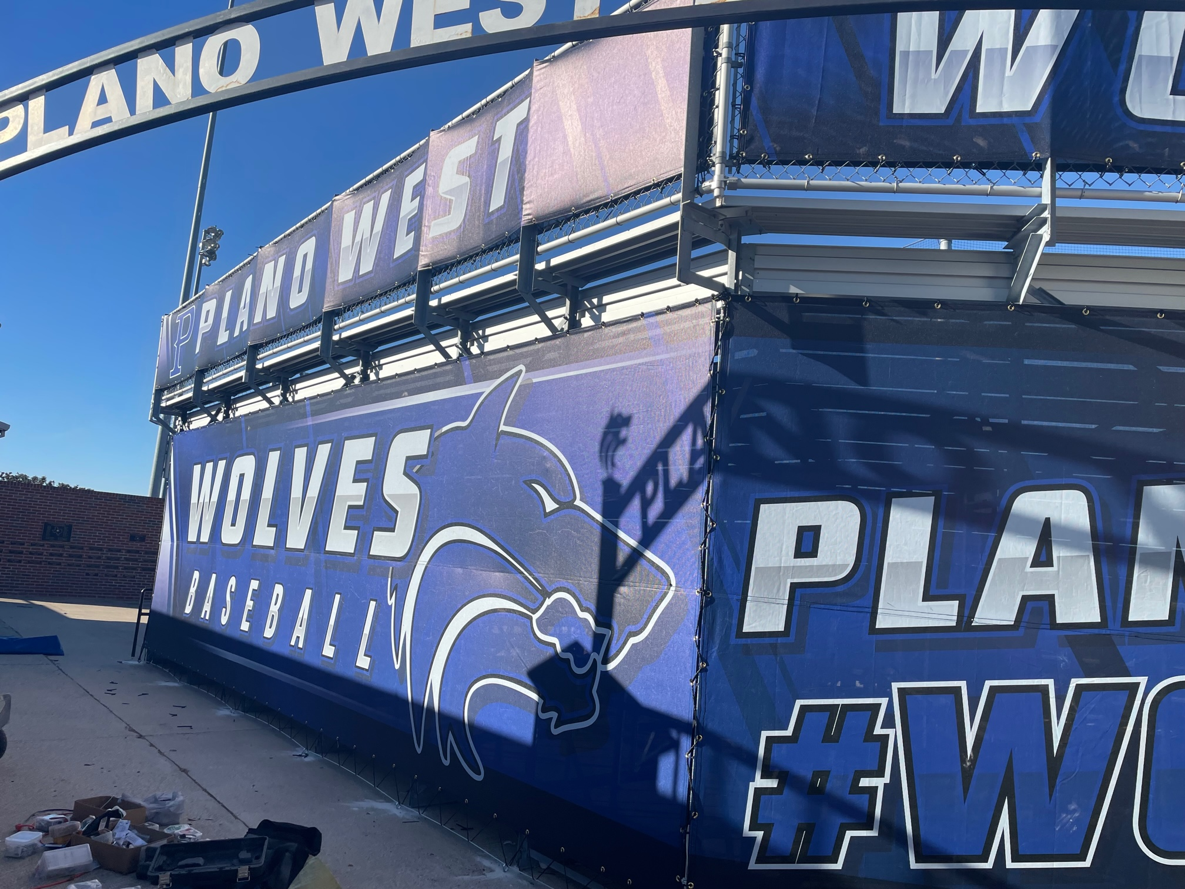
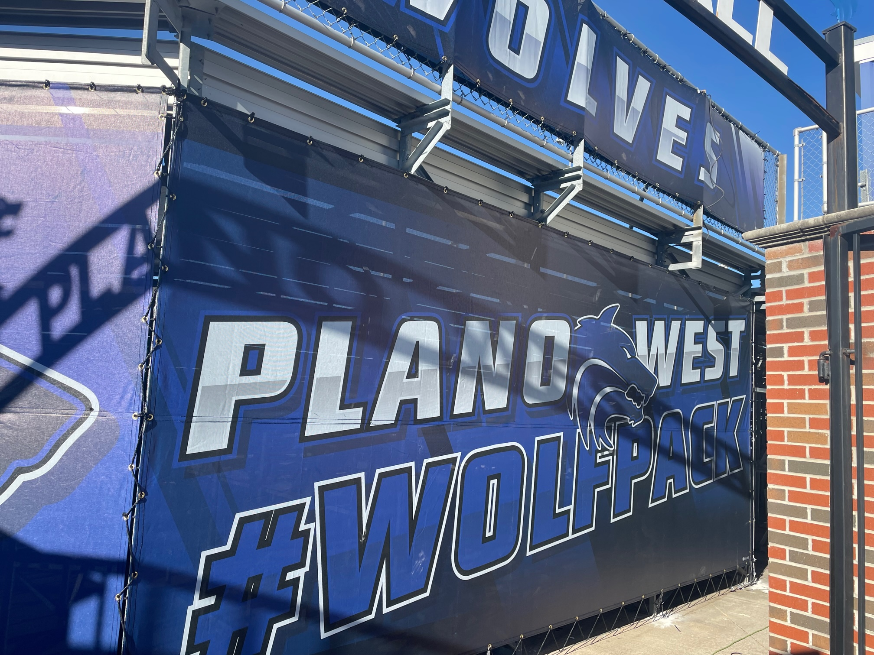

Ballpark Branding Upgrades

Slide 26
Sponsors
2024 Sponsors
Name Level Amount ($)
Camp Bow Wow Triple 1,250
Jalin Jewelers Single 350
Full Circle Counseling & Consulting Single 350
The Reynolds Company Triple 1,250
Innerlight Chiropractic Single 350
Hempkins Insurance Single 350
Rudick Construction Group Home Run 2,000
Dilla's Restaurant Single 350
McBride Orthodontics Single 350
Messick Peacock & Associates Double 750
Ms. Kitty's Pet Concierge Single 350
Keller Williams Realty Single 350
First Call Mechanical Double 750
Total $8,800
BIG Thanks to the JV2 parents (especially Britton Lankford!) who have been a great help in bringing in many of these sponsors.
Banners will be up for the Triple and Home Run sponsors by the end of the week.
Team Calendar is finished so we'll go back out and deliver some to sponsors and a few prospects.

Slide 27
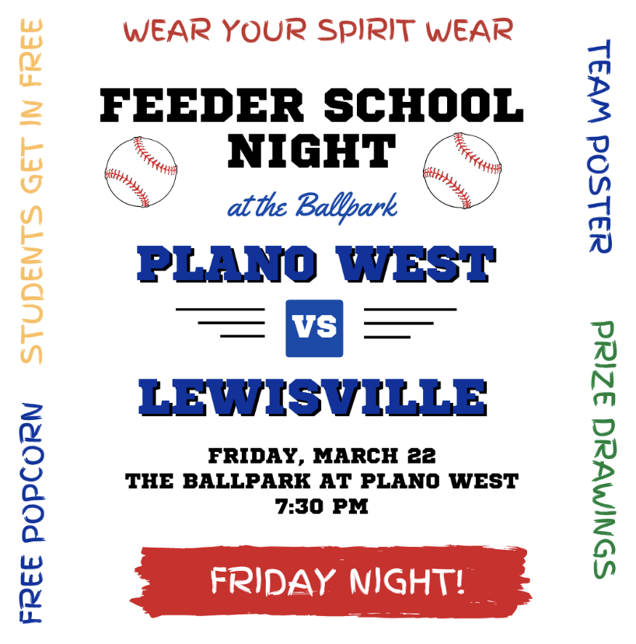
Elementary School Visits
Players will promote event by visiting Elementary Schools on the morning of 3/21. This year we will be combining this event with Softball.
Packets will be given to team leads on 3/20 after practice:
  Flyers and instructions will be included in packets
  Players are assigned to the grade school they attended or to a school that needs coverage if you did not attend one of the feeder schools.
  Players will wear black sweats or shorts and the jersey selected by coaches
March 21 - School visit day
  Players arrive at 7:15 am to work the carpool lane
  Players will distribute flyers, hold doors, greet students
  Parents will be needed to take pics etc.

Slide 28
Final Packfunding Update
$16,950 Raised
$ 722 Credit Card Fees
$16,228 Raised After Fees
214 Donations
THANK YOU!!

Slide 29
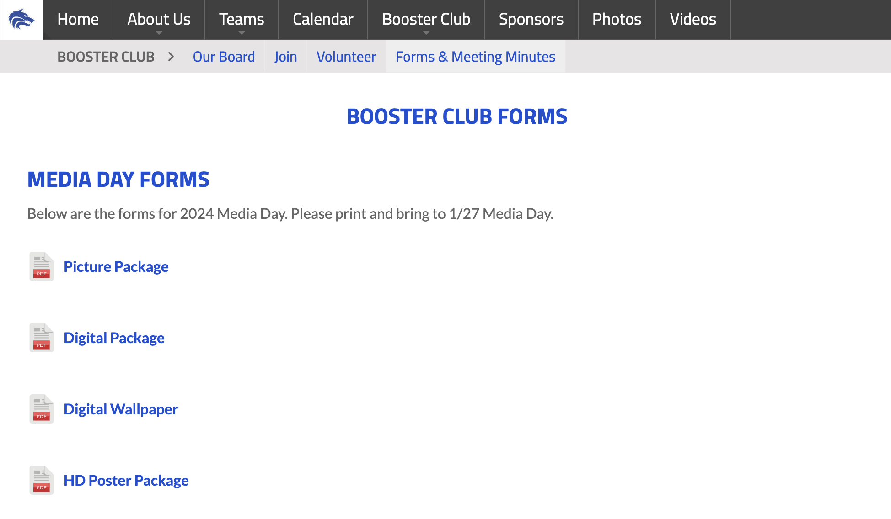
Media Day – 1/27
This Saturday 1/27 in the SAC @ 9 am
Coaches will communicate with players what uniforms they should wear
Parents are welcome to come and join the players as they have pictures taken and learn about Packfunding
Please have your player bring their form(s) and check for the package you want to Media Day
  Forms are found on the site in the Booster Club>Forms & Meeting Minutes>Media Day Forms
  There are several different options so print them all or just the ones you need

Slide 30
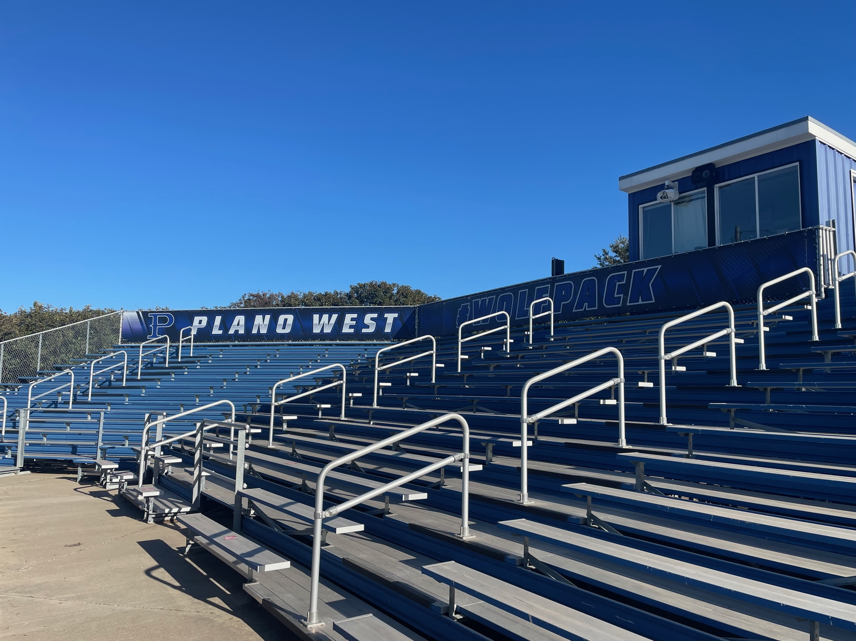
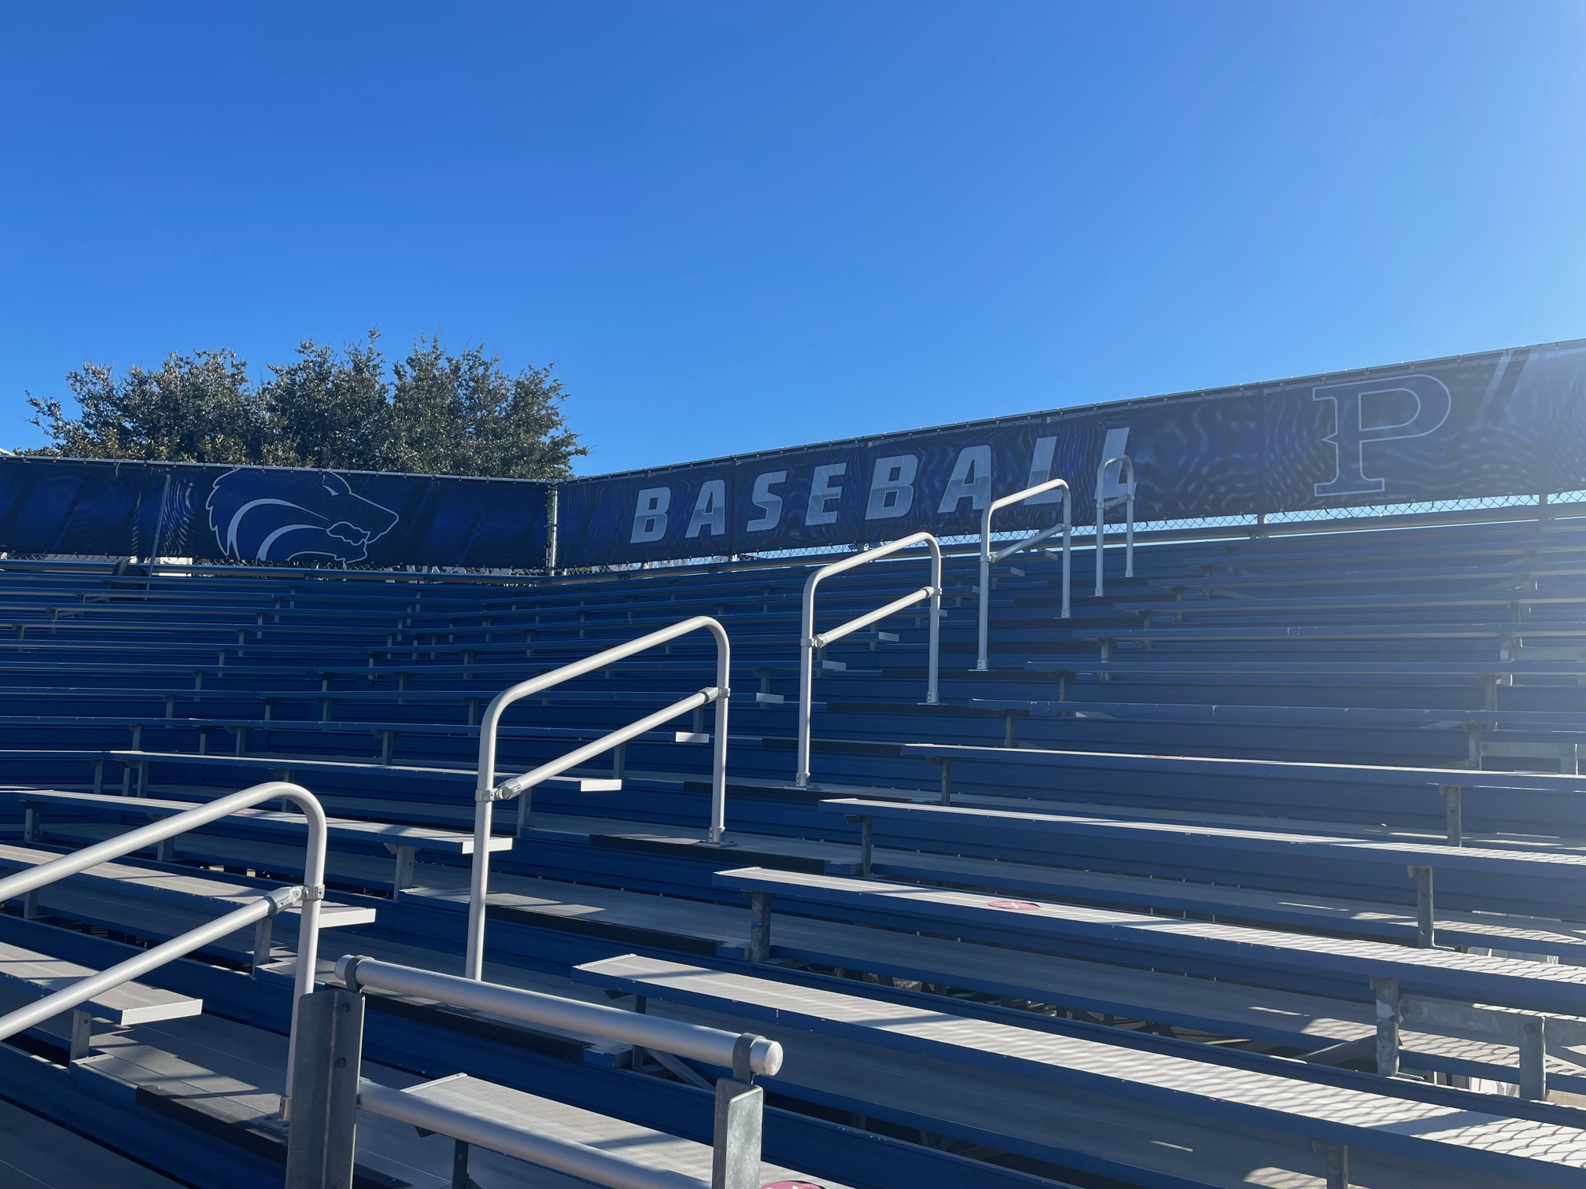
Ballpark Branding Upgrades

Slide 31
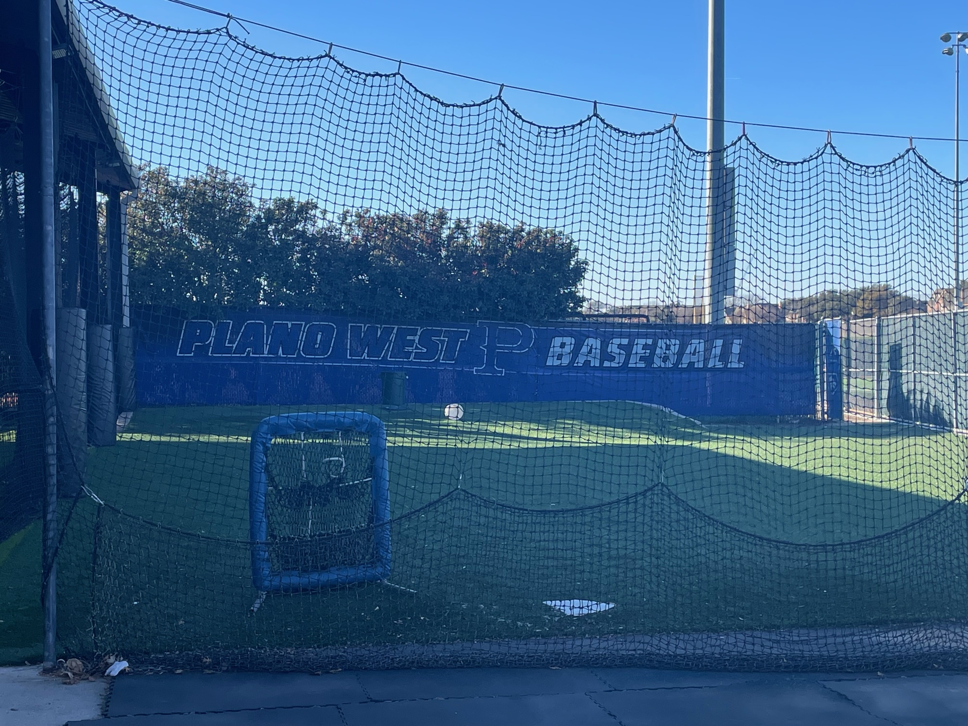
Ballpark Branding Upgrades

Slide 32
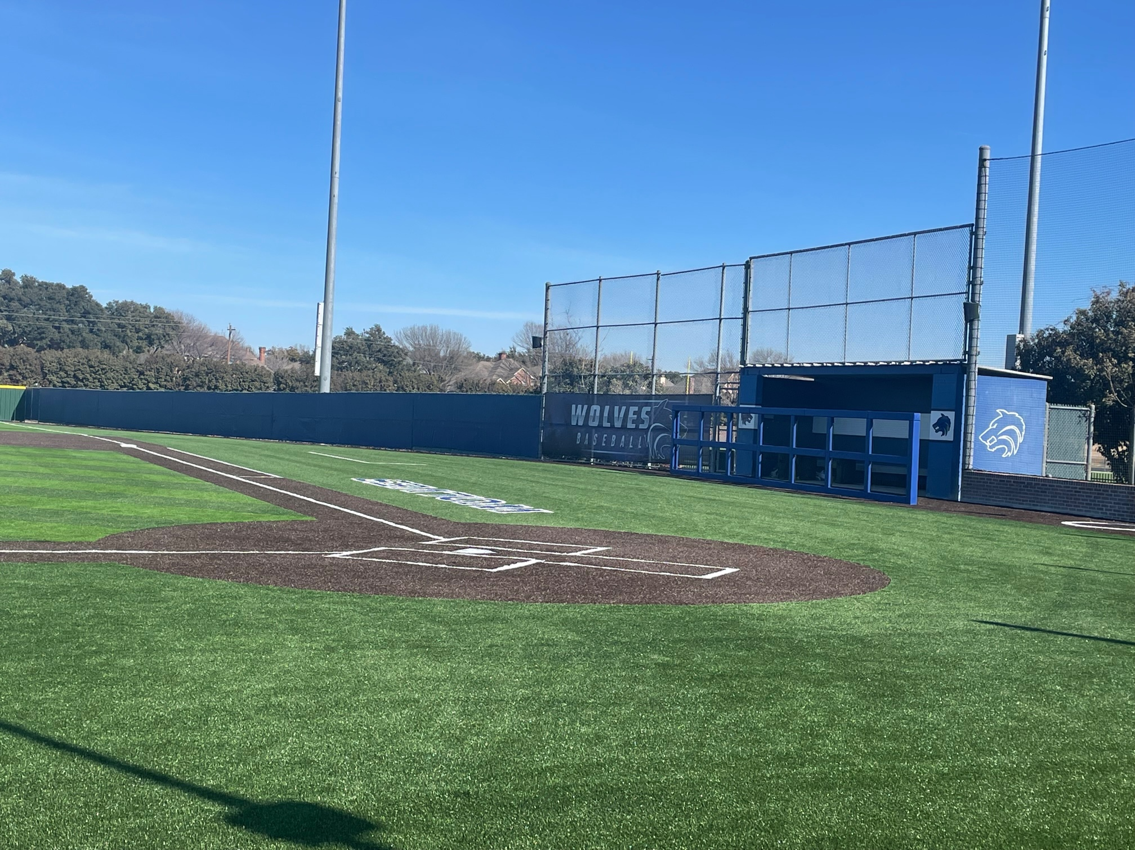
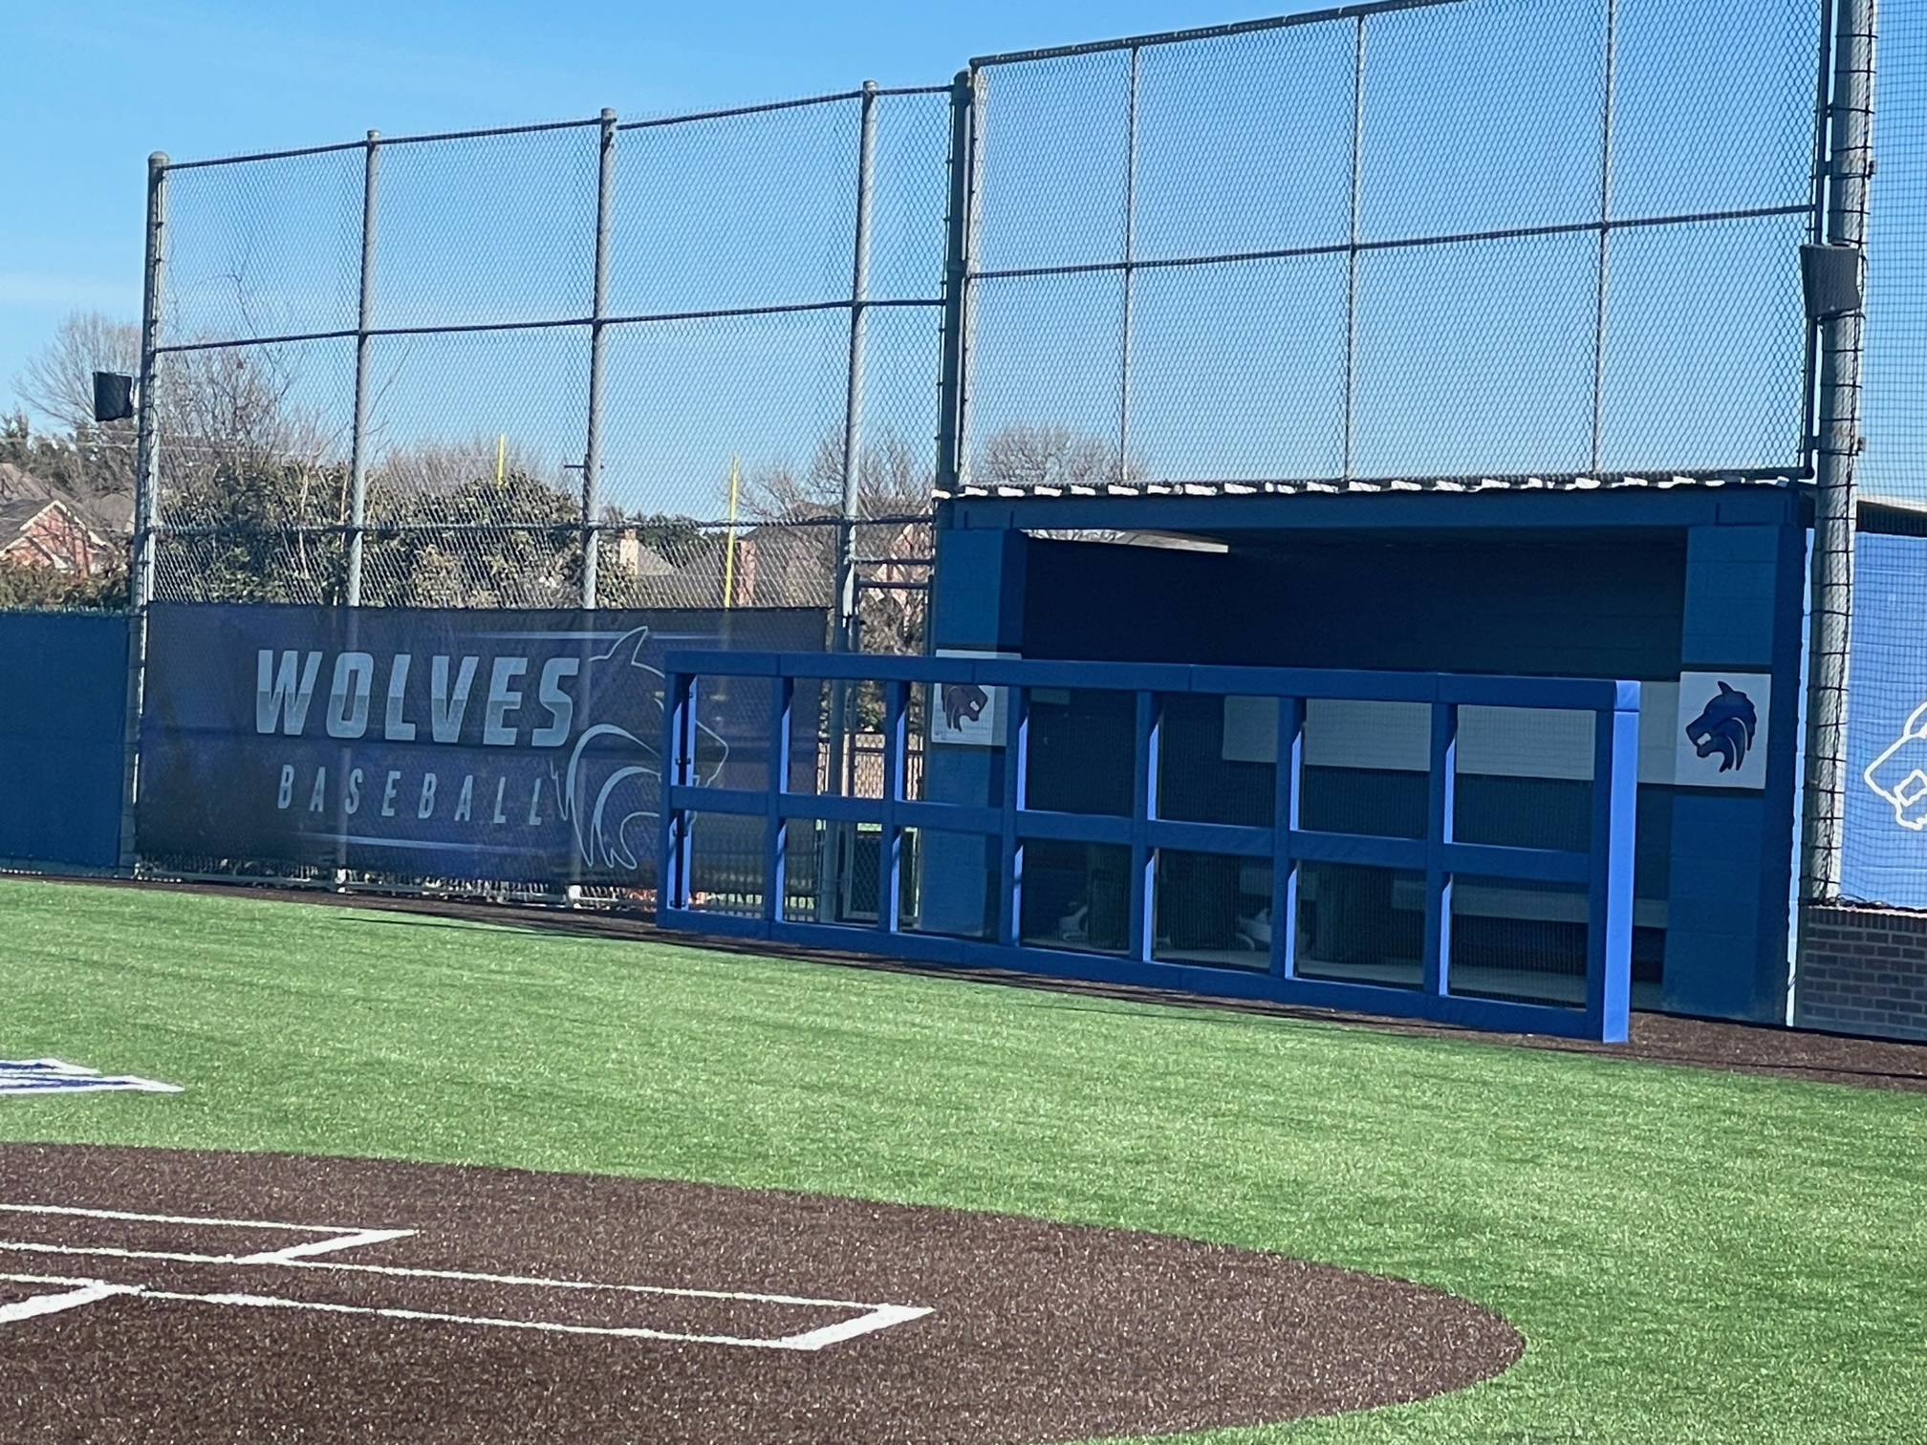
Ballpark Branding Upgrades

Slide 33
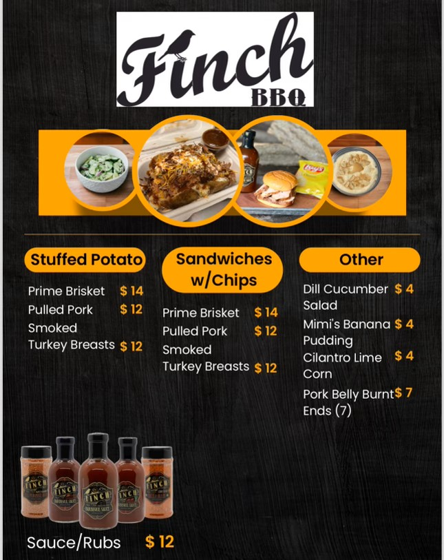
Plano West Baseball Spirit Nights
BBQ Dinner Drive Through
When: Thursday, November 9th
Where: PW Baseball Field Parking Lot
Who: Anyone that orders BBQ ahead of time for pickup
Benefit: 20% back to Plano West Baseball!

Slide 34

Sponsorships
Sponsor Day Sat – 1/20 @ 12:00
  Thanks to all players and especially the parents
  Contacted at least 100 potential sponsors across 9 areas
  Committee will start calling the prospects this week
Sponsors brought in during the last 2 weeks:
  1 HR, 2 Triples, and 5 Singles (over $6k in sponsorships) Thanks Parents!!
  Board members and Sponsor Committee members are working with each sponsor to get images and websites loaded and to produce banners for HR and Triple sponsors.
Sponsorship Ideas for/from Parents:
  Restaurants, Gyms, Insurance Agents, Car Dealers, Realtors, Baseball Clubs, Contractors, local companies, etc
Team Picture/Calendar
  Leave behind and give to all sponsors as soon as possible after Media Day

Slide 35
2023 – 2024 Booster Club Budget

Slide 36
2023 – 2024 Booster Club Budget

Slide 37
2023 – 2024 Booster Club Budget

Slide 38

Plano West Baseball Spirit Nights
Plano West Baseball Spirit Night!
When: Monday, October 23rd
Where: Coit and Spring Creek Location
Who: Anyone that mentions PW Baseball
Time: 5:00 p.m. - 10:00 p.m.
Benefit: 15% back to Plano West Baseball!

Slide 39
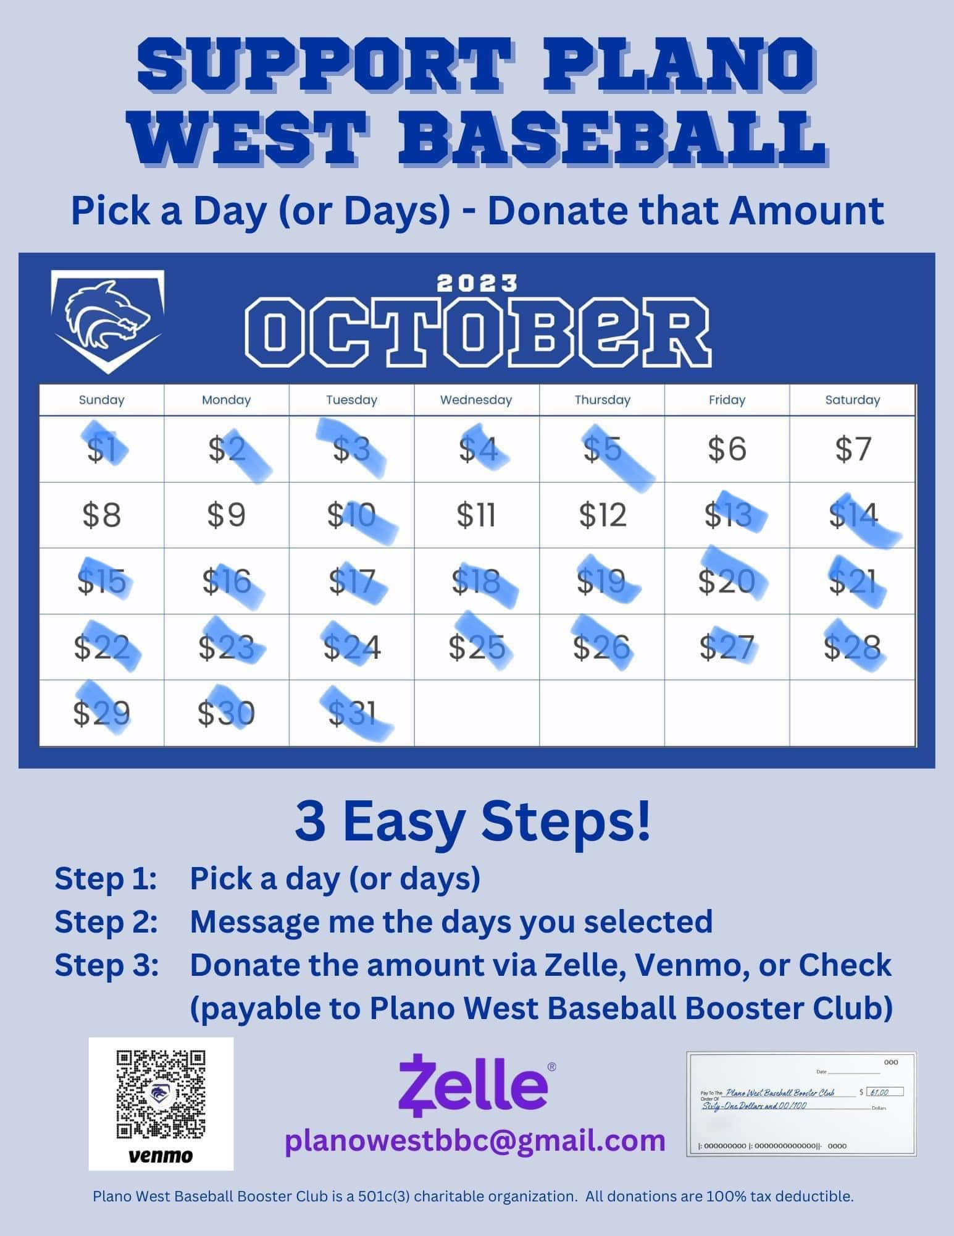
October Fundraiser
Calendar Fundraiser - $3,884 raised

Slide 40
Homecoming Parade
Wednesday, September 20th
Thank you Courtney Donkervoet & Joelle Novick for taking on float!
Candy donations needed!
Plan:
  After practice: decorate & pizza until 5:30 pm
  Make way to staging on Yeary by Brinker 5:40 pm
  Parade starts at 6:30 pm (goes down Yeary and into Plano West Lot)
  Pep Rally after in gym for Students
  Parents please help clean up float etc.
Players wear: fall jersey/shirt, black shorts (or sweatpants) and fall team hat

Slide 41
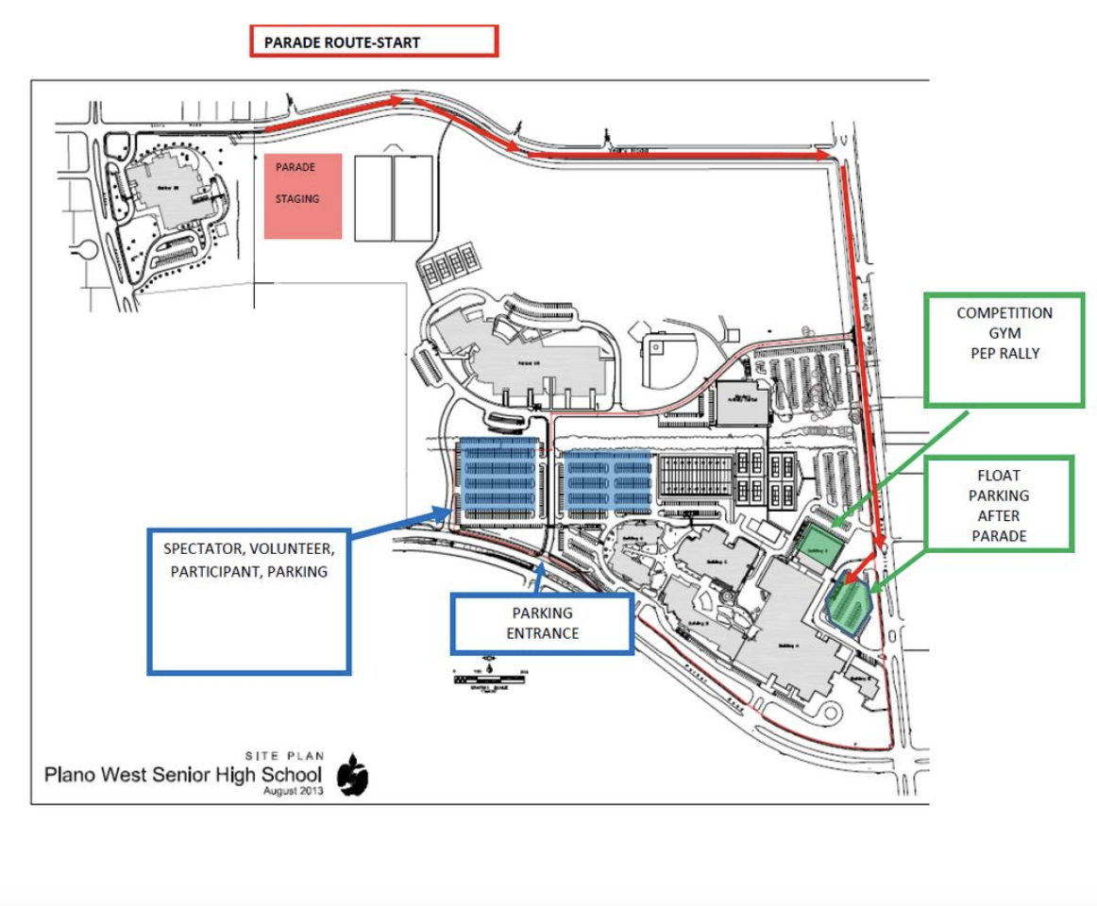
Homecoming Parade Route

Slide 42
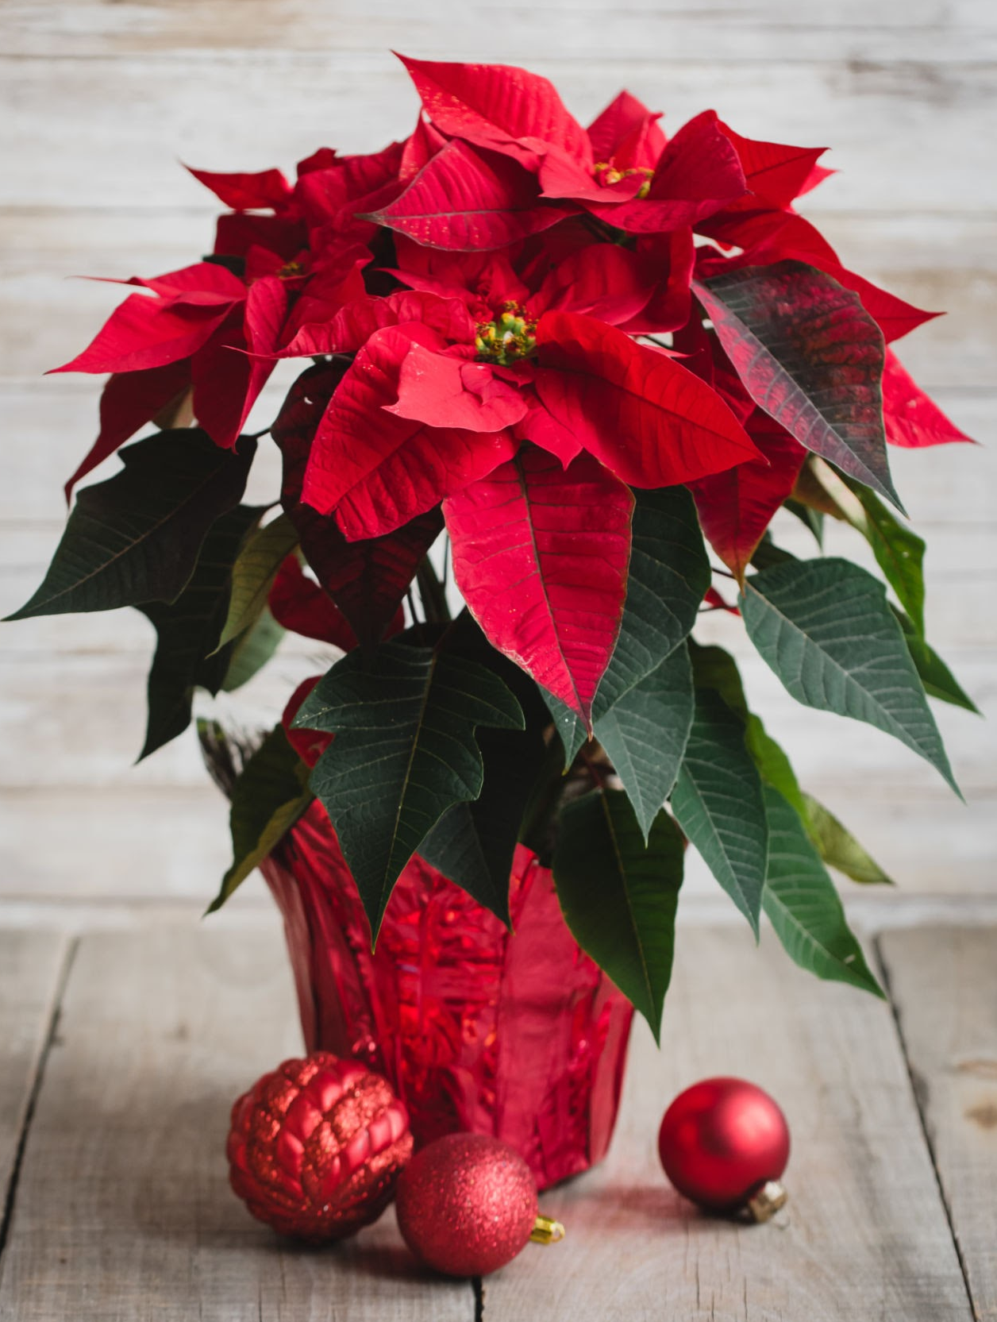
November Fundraiser
Poinsettia Fundraiser
Working with Website provider to have all orders go through website.
Look for ordering link soon!

Slide 43
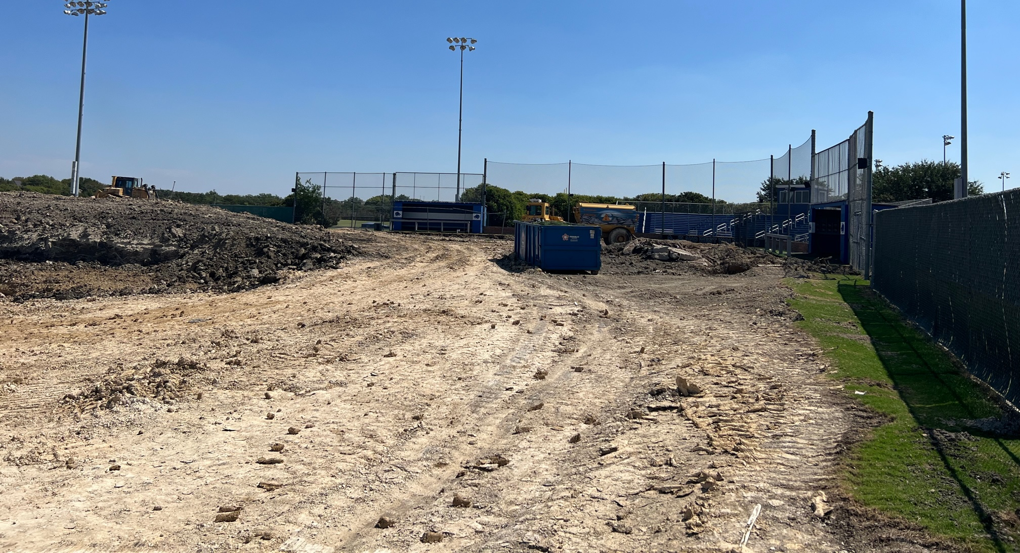
Ballpark Update

Slide 44
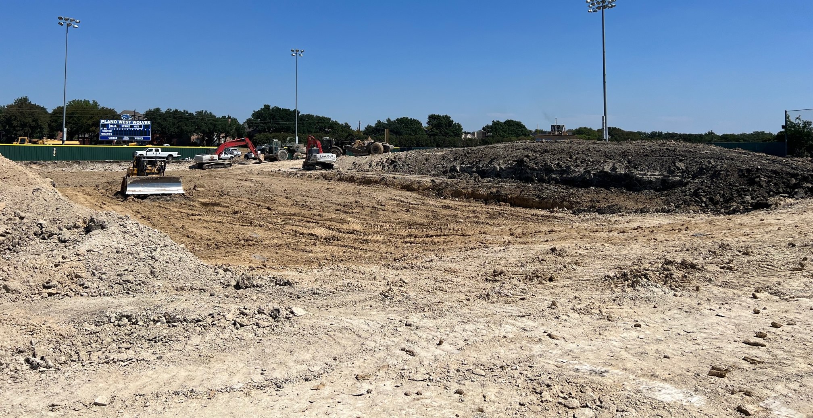
Ballpark Update

Slide 45
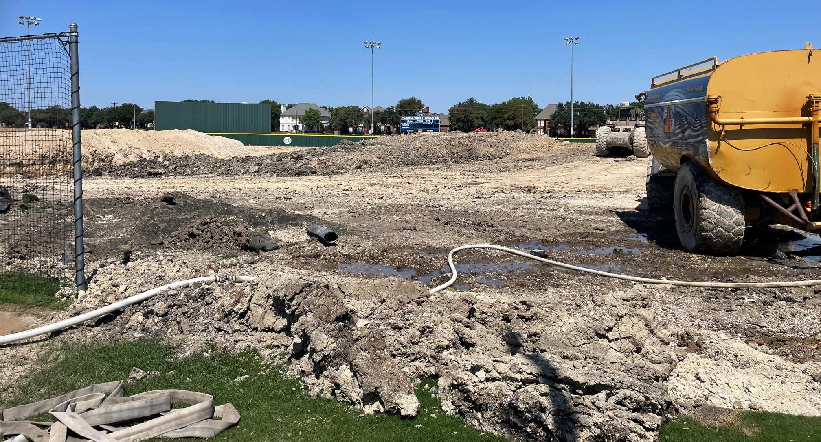
Ballpark Update

Slide 46
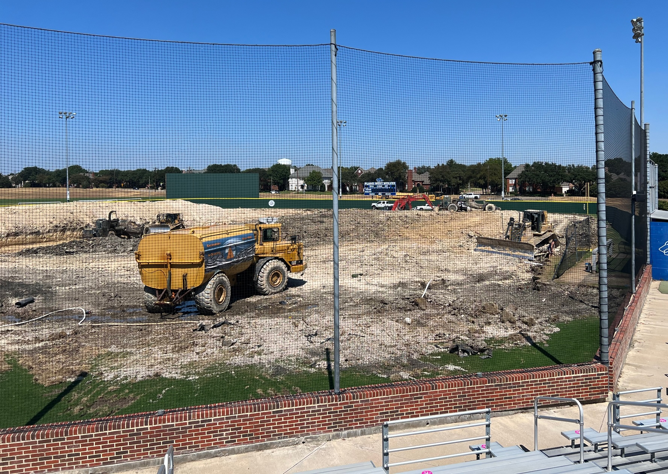
Ballpark Update

