Slide 1

All Aboard: A Parent’s
Introduction to Crew
ADMIT ONE
All Aboard
2nd Thursday each month
7:30-8:30 pm
DEPARTURE:
2nd Thursday each month
SEAT ASSIGNMENT:
meet.google.com/yix-nfqb-hib
SEAT CLASS: Parent
Langley Crew Booster Club
Notes:
Thank you for taking time out of your evening to join us
We won’t be recording this evening, but we will post the slide deck, including the Q&A on the All Aboard page, which you can find on the dropdown menu under the Parents tab and under the Info tab
Just like last month, if you have a question, please type it in the Chat. Once we finish the 15-minute presentation, we’ll spend the rest of our time on questions
All the questions are being noted and we’ll add them to the slide deck before we post it on the website.
Please mute yourself during the presentation, but feel free to unmute once we go to Q&A
This evening, we’ll be talking about four things:
Registration
Interest Meeting
Communication
Parent’s Guide to Crew

Slide 2

Registration
What you need to know:
Registration for the crew team will open on October 25. This is the one and only way you get your kids on the roster.
Registration starts a domino effect. Once we know who/how many are on the roster we can:
Send you info for carpools
Identify the number of boats we need to have for practices and racing
Identify what is needed to make sure we have enough boats
Identify additional coaching needs, if any
Identify how many buses we need for practices
Book the buses for practice
Identify how many GF kids and MC kids we have, to see if we can do a separate GF bus
Notify VASRA as to the number of people on our team so they can start planning regattas, including how may volunteers they need from each school (hint: we’ll have a lot of assignments)
Begin getting you certified as chaperones. FCPS needs to do a basic background check on you
You will be sent a form to fill out and return
You will schedule a trip to their offices to be photographed and fingerprinted
FCPS will run a background check
Once you pass, you will be certified and given a volunteer badge
This is normally done en masse at the school and takes 2 weeks. Last year, it was done one at a time at the FCPS office in Merrifield and took from 4 to 7 weeks to get 11 of 45 parents certified.
We are working with FCPS to not do the one at a time approach, but we have to get this started as soon as humanly possible.
Notes:
Registration for the season will open on October 25th. We will post a link on the main page of the website, on the Join page of the website, and in every newsletter until registration closes.
If you signed up for Learn to Row, you still need to register for the season. Learn to Row is a completely separate program, and registration for one does not apply to the other
As you can see from the list, the roster is all-important when it comes to logistics. It’s the starting point for almost everything we do to manage the season. Registration is how you get on the roster, and the roster tells us
how many coaches we need,
how much equipment we need,
how many buses we need,
if we can do a GF bus, and
gets the chaperone certification process started. We’re expecting it to take longer than normal, due to COVID.
The sooner you register, the more time we have to prepare. We’re expecting a large team this year and are pretty sure we’ll need additional resources. The sooner we start on that, the better an experience your kids will have.

Slide 3
What does this mean for you?
Because of the anticipated size of the team, and the process for chaperoning certifications, we need you to register ASAP if you think your child will want to participate. The cutoff for a refund will remain mid-January, so there is no reason not to register as soon as possible.
What does this mean for your kid?
If we can’t get accurate numbers early, we may be unable to:
Rent additional boats/find repair parts for boats
Hire additional coaches
Rent a third bus
Complete enough certifications for bus chaperones
Get enough chaperones for 171 trips
If we can’t get even one of these things in time for water practice, we can’t guarantee that everyone can participate.
If we don’t have enough coaches or boats for water practice, we can’t all practice at once
If we don’t have enough ergs for winter conditioning, we can’t all practice at once
If we can’t reliably book a third bus, we can’t all get to water practice
If we can’t start chaperone certifications early, we have no idea how many chaperones we will have
If we can’t get enough chaperones each day, we don’t all practice
Notes:
We need you to register as soon as you can. Registration opens on the 25th
You do need to pay when you register, but you also have until mid-January to get a refund, minus a small administration fee that we have to pay to the registration site.
If you’re pretty sure that your student wants to participate, but not 100%, please register and, should you decide not to participate, you’ll get the dues back, minus the registration fee we are charged.
Early registration directly impacts your student’s experience.
We have 65 kids from last year who are still in school. We expect almost all to return
We have 80 LHS students (not counting the 8th graders) in Learn to Row; we normally have well over half our Learn to Row kids join the team – usually, most of them join.
We always have kids who did not go to Learn to Row join during the fall and winter.
We are anticipating anywhere from 100 to 150 kids on the team this year. Logistically, the difference between those numbers is huge.
100 kids is 2 buses; 150 kids is 3 buses
100 kids is 114 chaperone assignments; 150 kids is 171 chaperone assignments
100 kids is workable with our current equipment; 150 kids requires additional equipment
We need to know what we’re looking at as soon as possible, so it’s vitally important that you register as soon as you can

Slide 4
What do you need to do?
Register as soon as you can. During the week of October 23-30, three things happen: registration opens, we hold an Interest Meeting for new parents considering joining the team and Learn to Row ends. There are roughly three weeks between then and the beginning of Winter Conditioning. We sincerely hope that we will get all of you registered during those three weeks, the earlier the better. If you’re not going to join, please let us know. It will help us estimate our numbers. Please. We’re begging you.
What do you need to register?
Register online with the Langley Athletic Office
VHSL physical form, completed after May 1, 2021
COVID-19 vaccination card
Register online with Langley Crew via SportsEngine
Create/renew your US Rowing membership
Have your child complete a swim test prior to February 19, 2022, if they haven’t already done so
What does your kid need to do?
Decide on whether to row with us
Get a physical, using the VHSL form
Get vaccinated
Complete a swim test by February 19, 2022
Make you register them
Notes:
The end of the month is busy for crew:
On October 25, registration opens (have I mentioned that?)
On October 26, we’re holding an interest meeting in the cafeteria, from 7 to 9 pm
On October 30, we’re holding a celebration for the last day of Learn to Row
Winter conditioning begins November 18, and we’ll go deep into that next month, but I mention it now because there are about 3 weeks between the end of Learn to Row and winter conditioning and we would LOVE for you to either sign up during that time frame or let us know that you’ve decided not to join, so we can stop counting your child as a potential team member.
So, how do you register?
You need to go to 3 different websites. Sorry, but we’re not in control of that. We will, however, have instructions and links to all 3 sites on the Join page of the website to walk you through it.

Slide 5
Crew Interest Meeting
What you need to know:
We are holding an Interest Meeting on Tuesday, October 26, at 7 pm at the school for any student and parent interested in joining the team. We’ll talk about what’s involved in registration and how to do it, the logistics of winter and spring practices, and what you and your kids need to do to get the most out of crew.
What does this mean for you?
A chance to learn what you need to know to make your decision regarding crew
A chance to meet the Board and coaches
A chance to ask questions about any aspect of the program
What does this mean for your kid?
Another chance to convince you crew is where they want to be
What do you need to do?
Attend the meeting
Ask questions
What does your kid need to do?
Attend the meeting, if they want
Notes:
If you missed the Open House, or don’t remember what we told you, this is a chance to ask us anything you want to know.
If you went to the Open House, and remember it, but now know more about what you don’t know, this is your chance to ask.
We’ll be talking about the registration process, Winter Conditioning, and again hammering you with how important it is to register ASAP
You can meet with Board members, current team parents, coaches, and current team members

Slide 6
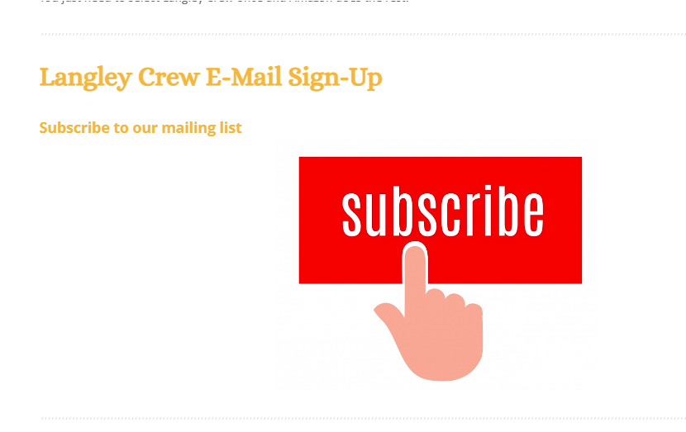
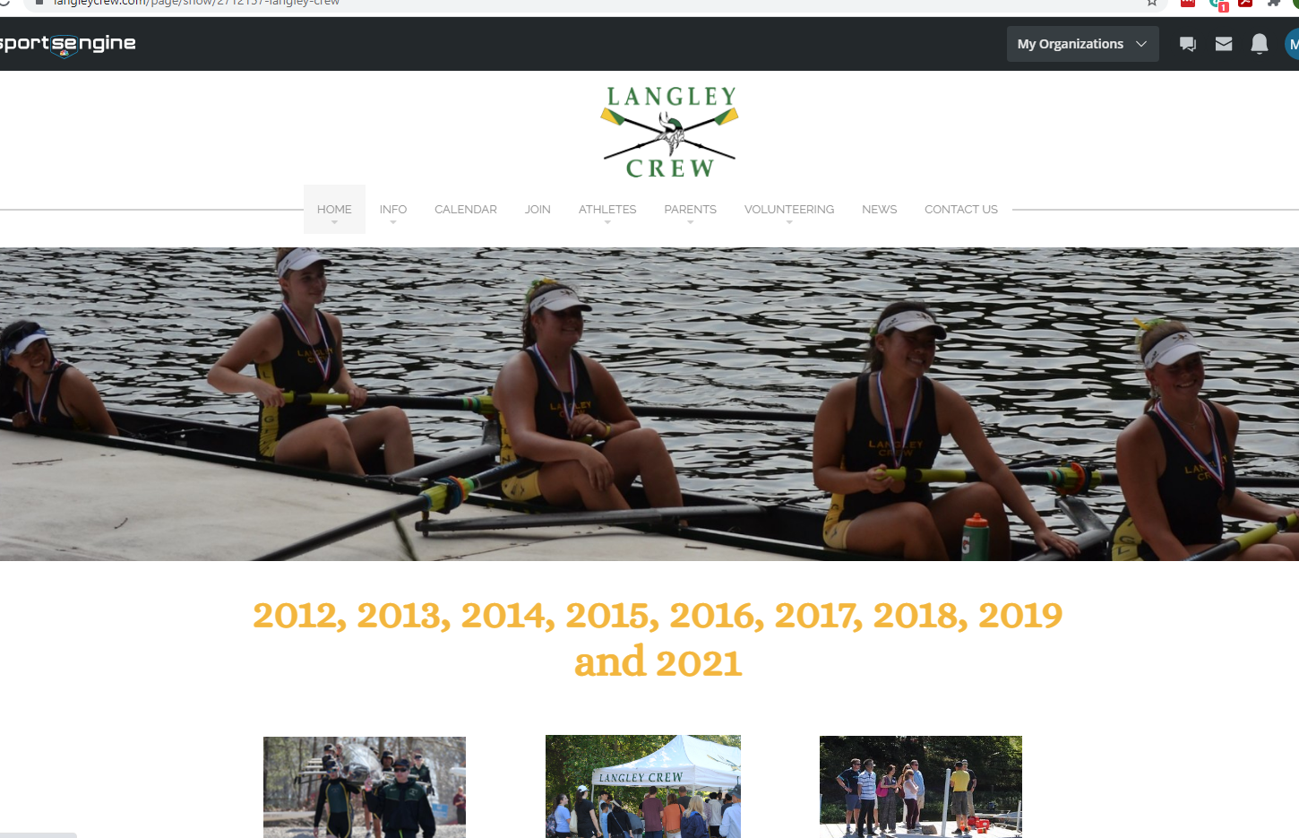
Communication
What you need to know:
We use several methods to communicate with you:
Newsletter – the main means of communication with parents. Number one source of information for what’s going on with the team throughout the season. This is where you’ll find changes to schedules, event news, calls for volunteers, merchandise opportunities, and regatta information.
Emails
From us – any urgent messages, such as weather-related cancellations, will be sent out via email. The distribution list is generated from registrations.
To us – reach out to us at langleyrowing@gmail.com. We’ll get back to you usually within the next 24 hours.
Langley Crew website – we post pretty much everything you need to know about Langley Crew here. The main page contains the most updated information, while the other tabs contain information that doesn’t change frequently.
Notes:
The newsletter is the number one way we keep you up to date. Please, please subscribe. If we have something that you need to know, we will tell you through the newsletter. We may add it to other platforms, but it will definitely be in the newsletter.
Our email address is langleyrowing@gmail.com Make sure you add it to your “safe” addresses so our emails don’t go to spam. The newsletters are sent from this address.
The website has been totally updated and restructured to make it easier to find the information you’re looking for. We think it’s pretty user friendly, but we can do a tutorial on navigating the website if you want.

Slide 7




GroupMe – a chat app we use to provide last-minute weather-related changes and regatta results.
Facebook – we use this as a forum for parent discussions, share successes, and post photos
Flikr – we post our crew photos here
YouTube – we post our crew videos here
What does this mean for you?
You have multiple ways to find out what you need to know without using your teenager.
Sample conversation with teen regarding regatta logistics:
What time are you racing?
I’m not sure. I think around 11
What time do you have to be there?
I don’t know. Probably by 11
Well, what did your coach say?
Be there on time.
Am I supposed to drive you?
I guess
Do I drop you off, or do I need to stay?
I don’t know
Where do I park?
I don’t know. (insert eye roll here)
Why did I have you? (heavy sigh)
I don’t know (teen rolls eyes and leaves the room
Notes:
Social Media: We used GroupMe last year when parents were allowed at the regattas, and when we saw how very bad the drone coverage of the races was. We are not yet sure how, or if, we’ll use it this year. A lot depends on what the season looks like, in terms of restrictions
What this means for you is that you do not have to rely on your teen for information. They are notorious for not providing their parents full, if any, information on what’s happening in their world. One conversation between an anonymous parent and child regarding regatta logistics went like this
Don’t do this to yourself. Use us for information. We’re better at communicating with adults.

Slide 8
What does this mean for your kid?
They are not responsible for keeping you informed. We all know how good they are at that.
What do you need to do?
Subscribe to the newsletter, ask to join the Facebook group if you want, follow the Flickr and YouTube pages, and explore the website. We’ll know more about whether we’re going to use the GroupMe app as we get closer to the season, so no real need to request membership yet.
What does your kid need to do?
Breathe a sigh of relief and be secretly pleased you’re involved
Notes:
Subscribe to the newsletter on the main page of the website, down towards the bottom.
Don’t do anything about GroupMe just yet – we’ll make a decision on that when we get much closer to spring.

Slide 9
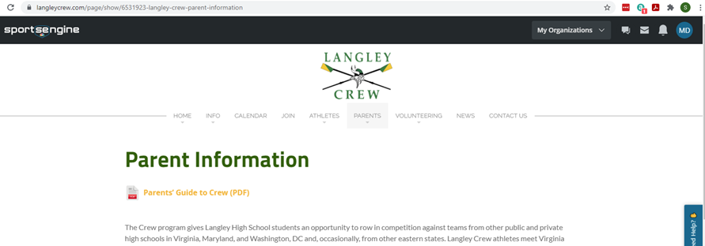
Parent’s Guide to Crew (Crew 101)
What you need to know:
We have consolidated all the information that a crew parent needs to know into one comprehensive PDF. It’s the first thing you see when you go to the Parents page on the website.
Notes:
Our seniors are the only ones who have gone through a normal year, when they were freshman. That leaves us with a lot of parents have little, spotty, or no information on how this all works.
We’ve put together a one-stop shop of information for parents, called the Parent’s Guide to Crew, lovingly called Crew 101, in a PDF format
To find it, go to the website, click on the Parents tab and it’s right under the headline

Slide 10
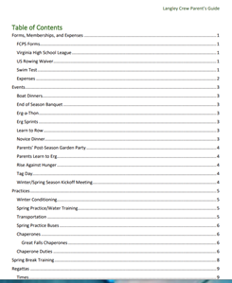
What does this mean for you?
All the information from the PDF is on the website, this just puts it all together in one easily navigated and downloadable document. You can look up pretty much anything you want to know regarding transportation, volunteering, regattas, schedules, and events.
What does this mean for your kid?
They do not have to be your main source of information on how crew works.
What do you need to do?
Check it out and use it as a reference guide.
What does your kid need to do?
Breathe a sigh of relief and be secretly pleased you’re involved.
Notes:
It’s downloadable and easy to navigate. If you click on the page number in the table of contents, you go to that page. You don’t need to scroll through to find what you need.
In the Parent’s Guide, everything on the website that parents need to know, including a guide to the strange new language your student is now speaking, has been compiled into one document.
You can learn things like
What is a boat dinner?
What is tag day?
What do I do on regatta day?

Slide 11
Questions??

Slide 12
Q: Is winter training considered a sport by the school?
A: Yes and no - we are considered a spring sport, and winter conditioning is considered a pre-season activity.
Q: Does the physical form need to be filled out before winter training starts?
A: Yes, it does. We are not allowed to practice without it
Q: Are students required to attend all training sessions? My son has obligations two afternoons a week already.
A: For winter conditioning, no, they do not have to attend all sessions. The point of winter conditioning is two-fold – to get the rowing motion down and to increase their physical fitness. This allows us to focus our water training on technique and synchronicity. If your child is doing a winter sport, they are already getting physical conditioning, and we have several team members involved in non-athletic activities, such as orchestra or drama, during the season. Of course, the more they can attend the winter conditioning practices, the better, as the coaches will use the time to identify and correct any issues with the rowing motion so that it becomes something natural for them.
Once we get on the water, there is less latitude for other extra-curriculars getting in the way, as they really should be focused on crew.

Slide 13
Q: When do they practice for winter conditioning?
A: Winter Conditioning starts on November 18. They practice after school Monday through Friday and Saturday mornings, either in the bus loop if the weather is nice, or in the Science Hallway if not. The practice times haven’t been formalized yet, as the coaches are still working out their schedules, but as of today, the TENTATIVE schedule is for the girls to practice from 4 to 6 pm Monday through Friday and the boys to practice from 5 to 7pm Monday through Friday. Both groups will also likely practice from 9 to 11 Saturday morning, but that has not yet been determined and may be staggered as well.
Once the logistics have been set, we will advertise it in the newsletter and post it on the website, both in the Calendar and on the Training Logistics page, which can be accessed using the dropdown menus under both the Athletes tab and the Parents tab.
Q: I tried to register for winter conditioning on the Langley Athletics Registration site and it says that crew is only a spring sport.
A: It’s a little complicated, mostly because crew is a sport that is officially considered a club. Crew is actually a spring sport, but we – along with all the other schools we compete against – do pre-season training (winter conditioning).
You won’t be able to register for winter conditioning on the Langley site, just for the crew season. Registering here allows your child to participate but doesn’t actually get them on the roster.
There is a second website to register for crew, on the www.langleycrew.com website. This is what will get your child on the team roster, which will have to be completed before they can attend winter conditioning. That registration will open on October 25.

Slide 14
Q: My child is already a member of US Rowing. Do we have to re-register him there?
A: When you renew their annual registration, use our code so we will receive notification of the membership, which is required for us to allow the student to participate.
Q: On the VHSL physical, does the doctor’s signature have to be after May 1, 2021? What if we had a physical done in March or April? Insurance only covers one physical per year.
A: Yes, the signature has to be after May 1, 2021. There are a few different ways of handling that:
Most of the doctors in the area are very familiar with the forms and may be willing to work with you to fill out the form for a lesser charge or during a “I don’t feel well” visit
Some of the urgent care clinics or “Minute Clinics” may provide the physicals for a lesser charge than your pediatrician or family physician.
It won’t help for this season, but generally, Langley Athletics hosts a fundraiser in June during which doctors are on site to perform the physicals for a low charge, which has generally been around $50 in the past
Q: How much is registration? The website says around $1,600, but someone at the Open House said it was $2,600.
A: It’s nowhere near $2,600. The registration fee has generally been around $1,600. For the 2019-2020 season, it was $1,650. This season, bus fees were raised for the first time in a few years, so we have set the fee at $1,750 to accommodate the additional transportation fee.

