Slide 1
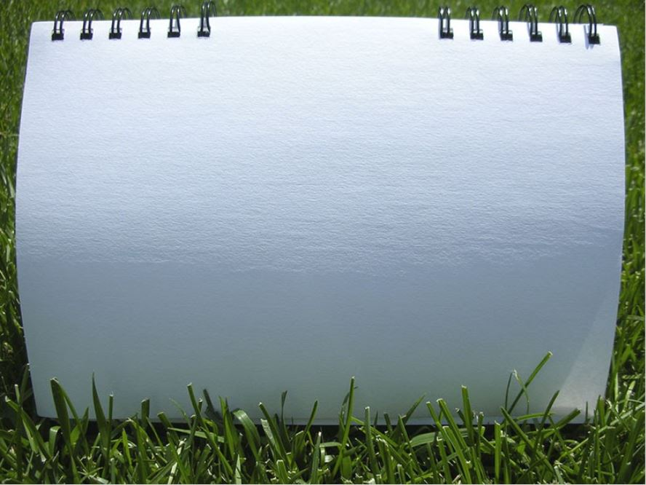


Throwing Drills
Schaumburg Athletic Association - Baseball
Tony Tichy

Slide 2
Throwing drills listed in order of sequence
1. One Knee
2. One knee to follow through
3. Feet in cement
4. Equal and opposite
5. Drag the back foot
6. Three hop drill
7. Hat drill

Slide 3
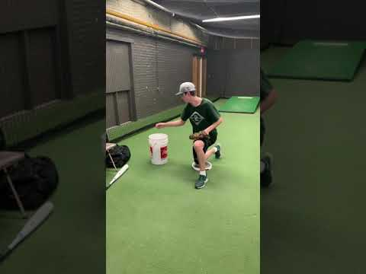
One Knee Drill
Purpose: To work on arm path, quiet head, strong glove and finish.
Notes:
This drill takes out the lower half. Allows the thrower to focus on skills noted above. It is key to finish with your nose over your toes.

Slide 4
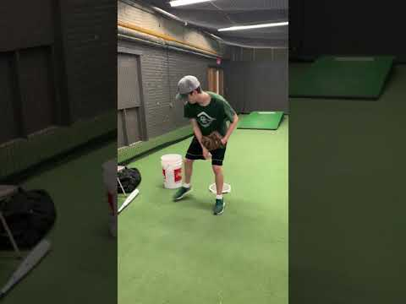
One Knee to Follow Through
Purpose: To teach the feel of a proper finish.
Notes:
This drill combines with the first drill emphasizing finishing square and in a balanced position allowing the finish to provide a solid fielding position square to the catcher.

Slide 5
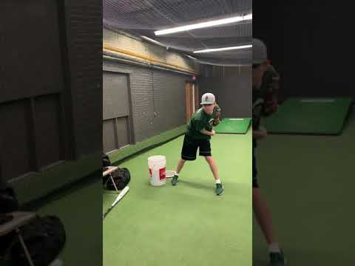
Feet in Concrete
Purpose: A stand up drill to work on concepts from previous two drills!
Notes:
This drill takes out the lower half but in and standing position. Do not let your head get outside of your glove side knee. You can turn your throwing side foot to allow your chin to roll under your chin.

Slide 6
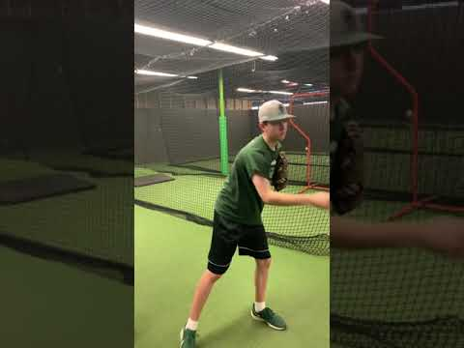
Equal and Opposite
Purpose: To feel the position you would like to be in to throw safely when at foot strike
Notes:
Allows the player to start in a strong arm safe position. This drill puts the player in the proper position to throw by being equal and opposite in position.

Slide 7
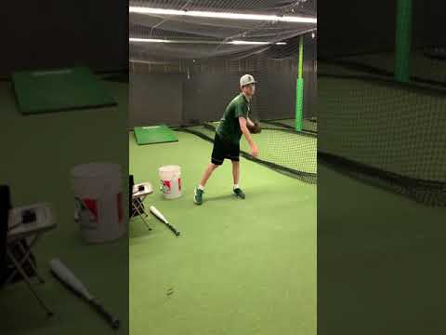
Drag the Back Foot
Purpose: To create a powerful position, maintain direction, and arm safety.
Notes:
Most players pick their foot up before the ball is released. The back foot dragging provides stability and acts like a rudder for our control along with our glove side, plant foot and head.

Slide 8
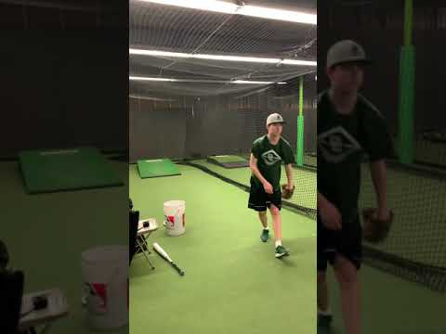
Three hop drill
Purpose: To teach transfer of energy from backside to frontside while being athletic.
Notes:
Teaches weight transfer and balance while being athletic. Be strong and tall on the back side transfer energy and finish squarely.

Slide 9
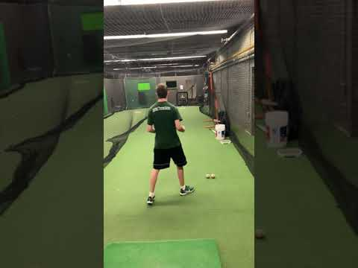
Hat Drill
Purpose: To have fun/compete throwing with a purpose of command and control.
Notes:
This provides a fun way to compete at the end of your throwing. Put your hat on the ground in front of you. This gives the player a target to throw to. Kids love this drill. Build in some sort of reward system if anyone on the team hits the target.

