Slide 1


Schaumburg Athletic Association - Baseball
outfield progression
Tony Tichy

Slide 2
SAA outfield progression
Set up ready position
Dry work as a group
Self toss work
Drop step right and left
45 degree work
Over the shoulder right and left
Wrong way turn
Ground balls go to a knee
Ground balls do or die

Slide 3
Points of emphasis when working outfield progression
Step into your ready position
Catch the ball on the throwing side
Catch the ball moving towards the base you will throw to
Catch step and throw
Catch two hands when stationary
Catch one handed when on the run to promote full extension
Drop step and read the height, speed, and angle of the ball
Communicate mine, mine, mine

Slide 4
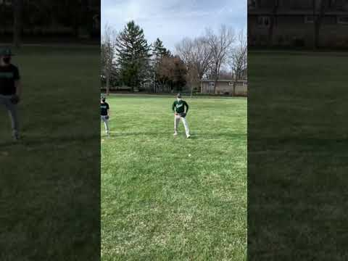
Set up and ready position
Notes:
Take a step as the pitcher pitches into an imaginary circle in front of you with your hands on your thighs.

Slide 5
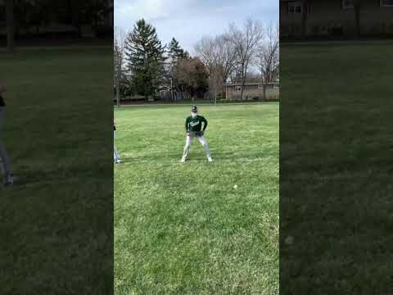
Dry work as a group
Notes:
We will work on dry foot work before adding a ball. The coach will say set up step the drop step right or left. The player should open all the way up like they are in a stealing position and work a straight line. This will be done for both drop step left and right.

Slide 6
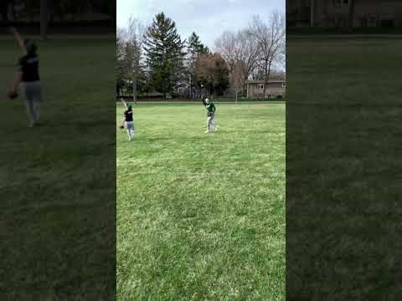
Self Toss Work
Notes:
Now the players will follow the directions of the coach. They will add a self toss to work on catching the ball on the throwing side, thumbs up, and moving forward. They will also work with the model of catch, step, and throw.

Slide 7
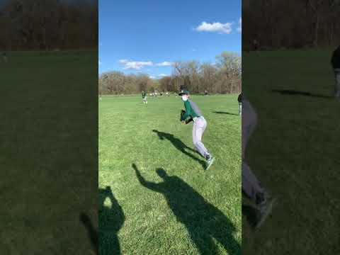
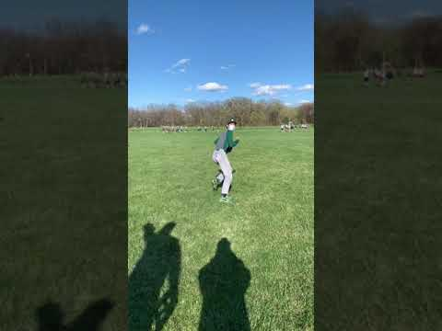
Drop step left and right
Notes:
From here on out the coach will supply the throws. The coach will hold the ball up over his head and the player will take their set up step. They will move the ball to the right or left to let them know drop step right or left.

Slide 8
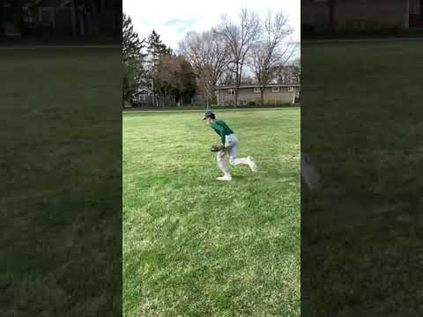
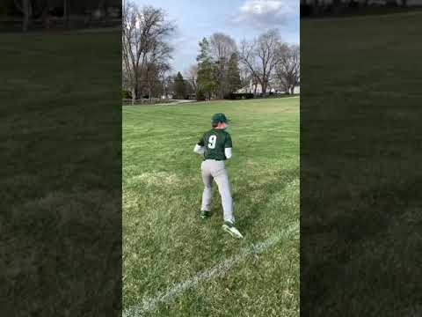
45 degree angle work
Notes:
Players will now work on going to the gap. The drill starts with set up step. Let the players know before the drill starts which direction they will go. Players need to start making catches on the run over long distances.

Slide 9
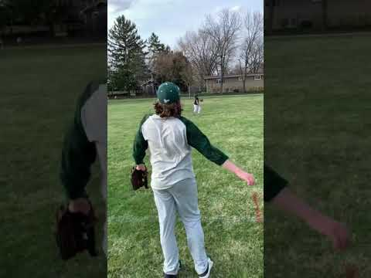
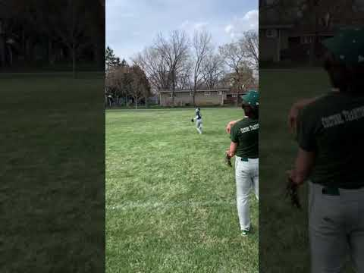
Over the shoulder right and left
Notes:
On this drill the players will start facing away their partner or coach. It is important to start having the kids do some of the throwing to free you up to coach and watch.

Slide 10
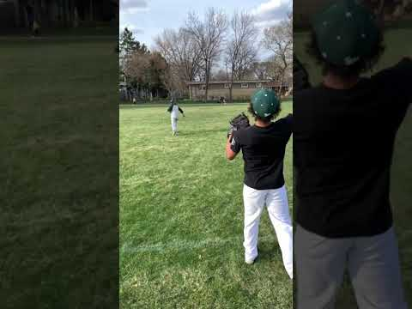
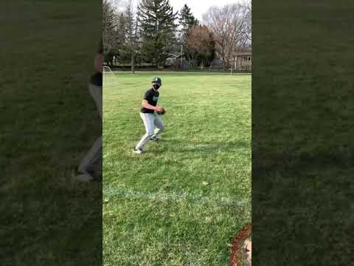
Wrong way turn
Notes:
We practice turning the wrong way and recovering. Every player at some point will read the ball incorrectly. In this drill we will have the player drop step to a certain direction then throw the ball over the other shoulder. It is important that the player turn their head away from the ball not open up and back peddle which will lead to them falling down.

Slide 11
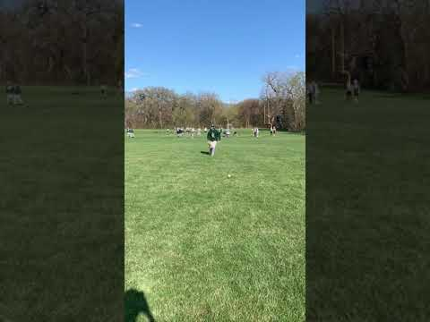
Ground balls go to a knee
Notes:
When there is no one on base we don’t want a base hit to get passed us in the outfield. To accomplish this we drop to a knee as the ball approaches us. If the ball is hit hard , you would go to a knee sooner. If it is hit softly, then you would wait longer to go to a knee. It helps fielding ground balls to count the hops. When on a knee we want our legs close together to provide a back stop. Our attitude when we come up is catch step throw.

Slide 12

Ground balls to crow hop throw
Notes:
On a do or die the outfielder has to attack the ball without going to a knee because the runner is trying to score. Again, count the hops look the ball into the glove showing the palm to the baseball. Field the ball just to the outside of your glove side foot.

Slide 13
Infielders say ball, ball, ball
Outfielders say mine, mine, mine
Outfielders have priority over infielders.
Centerfield has priority over corners
Middle infielders have priority over corners
Communication
Notes:
The best way to practice this is putting infielders and outfielders in close proximity and throwing balls in between them and at them so they can practice their communication. Start with 1 player, then add a second, and then a third. The hardest communication is when three players are involved.

Slide 14
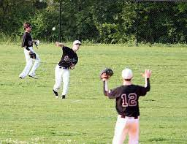
As players get older hitting the cutoff man becomes more and more important.At the younger ages the fundamentals of throwing and catching are very important. As your outfielders progress add a cutoff man to your drills.
Cutoffs
Notes:
Teams that are better can catch and throw the ball. I would incorporate the four corner drill and 5 star drill into every part of your throwing routine. 4 corner drill: players line up at each base throwing around the bases turning to their glove side when they throw the ball. Start counterclockwise then move to clockwise. The 5 star throwing is on the infield. The ball starts with catcher they throw to SS, 1b, 3b, 2b, and back to the catcher

