Slide 1


Boys Swim & Dive
Parent & Family Meeting
2025-26
2025-2026

Slide 2
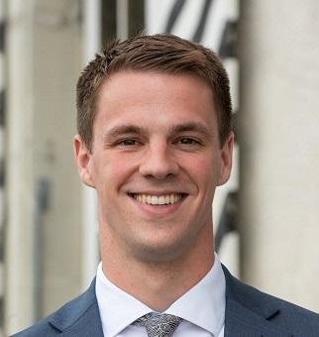
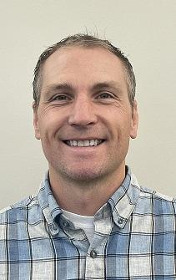
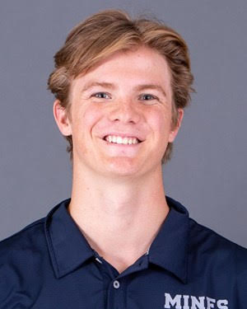
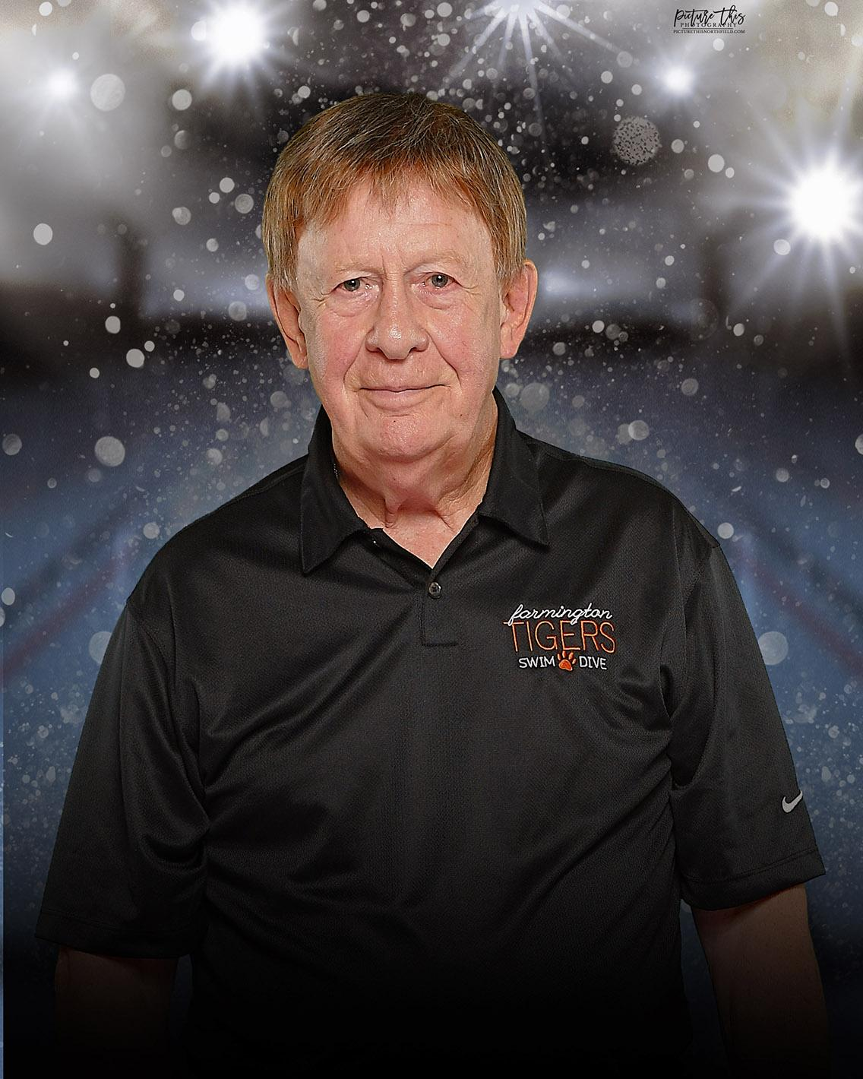
Coaching Staff
Max Hubbard
Head Coach
Brock Vestrum
Assistant Coach
Seth Krause
Assistant Coach
John Tegg
Diving Coach

Slide 3
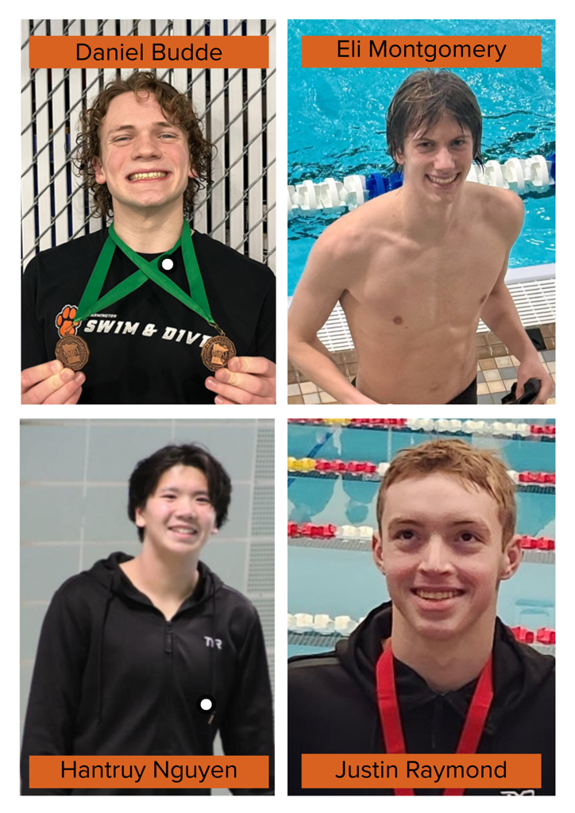

Captains

Slide 4

Booster Club
Jill Hawkins - President
Rachel Gobar - Vice President
Lisa Christiansen - Treasurer
Stacey Montgomery- Secretary
Kris Ziegler - Communications Coordinator
Jessica Boelman - Fundraising Coordinator
Kelsey Roth & Lee West - Members at Large

Slide 5
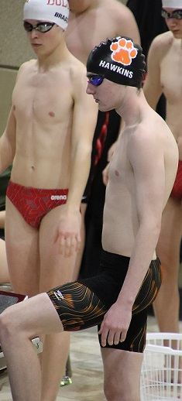
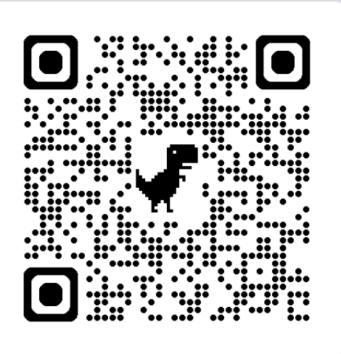
Duluth East Invitational
Team Website
https://www.tigerfanclub.org/boysswimdive
Calendar (Subscribe to: farmingtonboysswimanddive)
Meet Schedule
Pool Addresses
Swim Meets FAQ
Volunteer Sign-Ups
Lettering Policy
Athlete Handbook
Sponsors
Meet Results
January 4, 2025

Slide 6
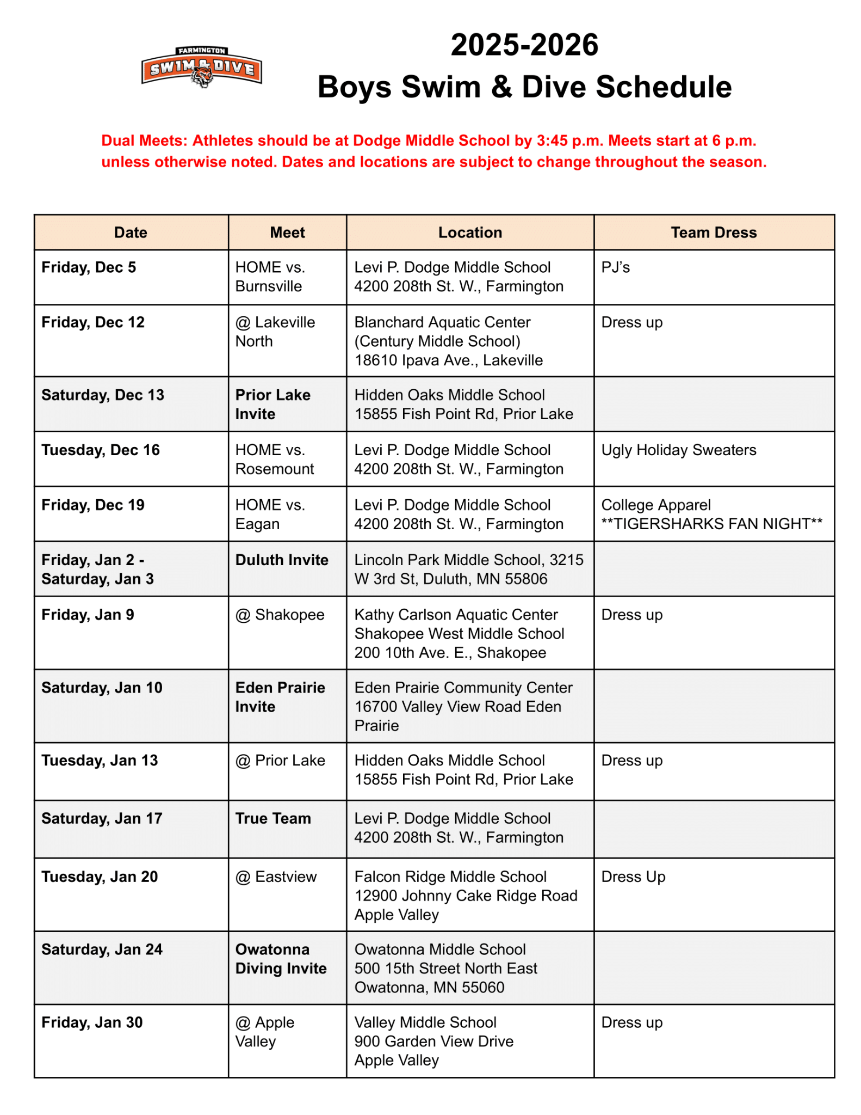
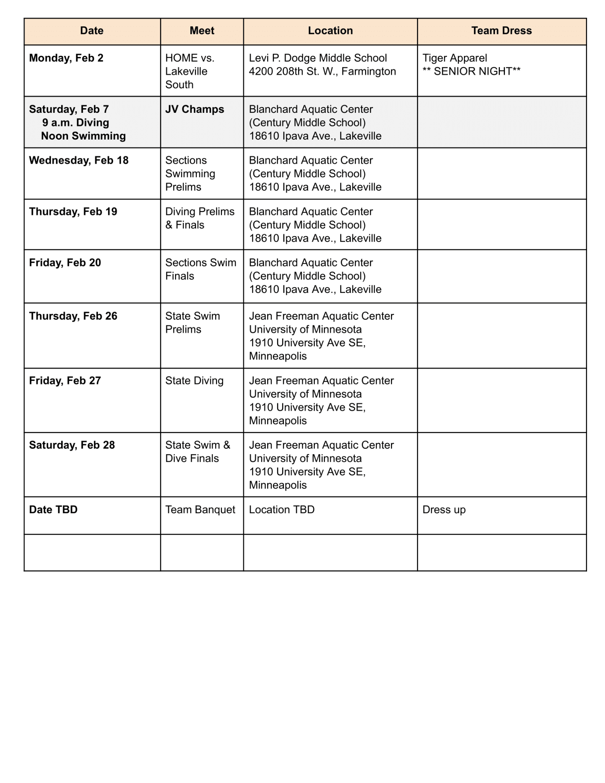
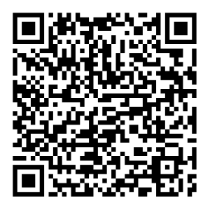
2025-26 Meets at a Glance
Document available on the Team Website or HERE or

Slide 7
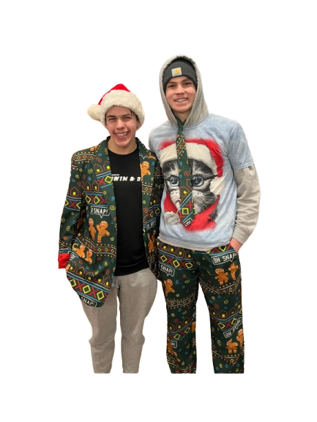
Meet Day Dress Themes
Home Meets
Theme = Pj’s, College, Ugly Holiday Sweaters, etc…
Away Meets
Dress up = shirt & tie
Invites/True Team/Sections
Tiger pride = Farmington Tigers Apparel
Dress theme schedule listed on the 2025-26 Meet at a Glance or
2024 Ugly Holiday Sweaters

Slide 8



Social Media Accounts
Follow, like & share
Facebook
Farmington Boys’ Swim and Dive
Instagram
@fhs_boys_swim_dive
X
@FHS_Swim_Dive

Slide 9
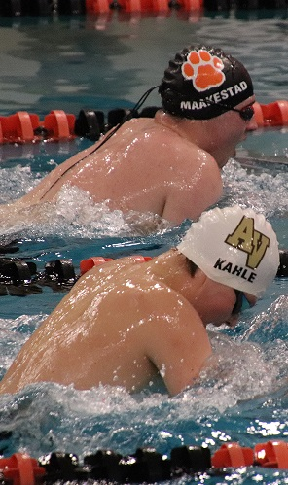
Requirements & Fees
Farmington vs. Apple Valley
7th-12th Grade
Valid sports physical on file with
FHS Athletics Office prior to athletic
registration
FHS Athletic Registration on RevTrak $300
https://farmington-k12.revtrak.net/
January 31, 2025

Slide 10
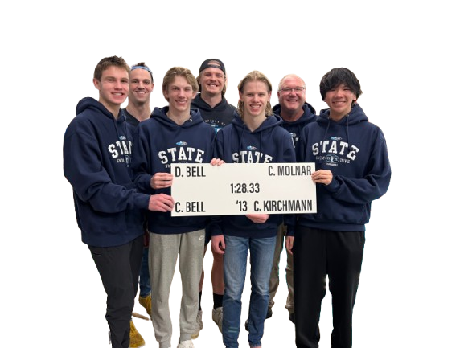
Why Do We Need to Fundraise?
Meals (They eat A LOT!)
Bus upgrade for travel meets, including Sections & State
Hotel for Duluth East Invitational
Senior posters
Athletes’ meals at End of the Season Banquet
(Again…Big eaters!)
Team bonding activities
Championship apparel
Meet support
Team warm ups
Previous purchases: cameras for live stream, diving board, pool ‘tiger eyes’ banner
200 Free Relay School Record - 2024

Slide 11
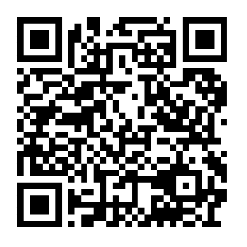
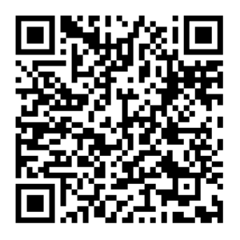
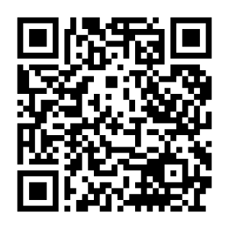
Upcoming Fundraising
Cub Bagging (179th location) - Sun, Dec 7 from 1-6 pm
(3 shifts - Each shift 6 athletes & 1 adult | Must be 14+)
Sign up HERE or
B-52 Burgers & Brew - Mon, Dec 15 from 4 pm - Close
30% of sales on liquor & food for dine-in orders given to the Boosters when you present a Boys Swim & Dive fundraising flyer. You must print out the flyer and give it to your server. They will not accept it on your phone.
GET FLYER HERE or
Spring Concessions - Thurs, May 7 from 7-9:15 pm
(3 volunteers needed/16+ Girls Lacrosse - Tiger Stadium)
Sign up HERE or

Slide 12
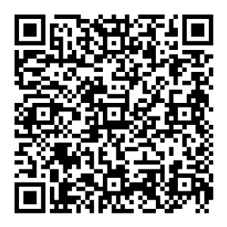
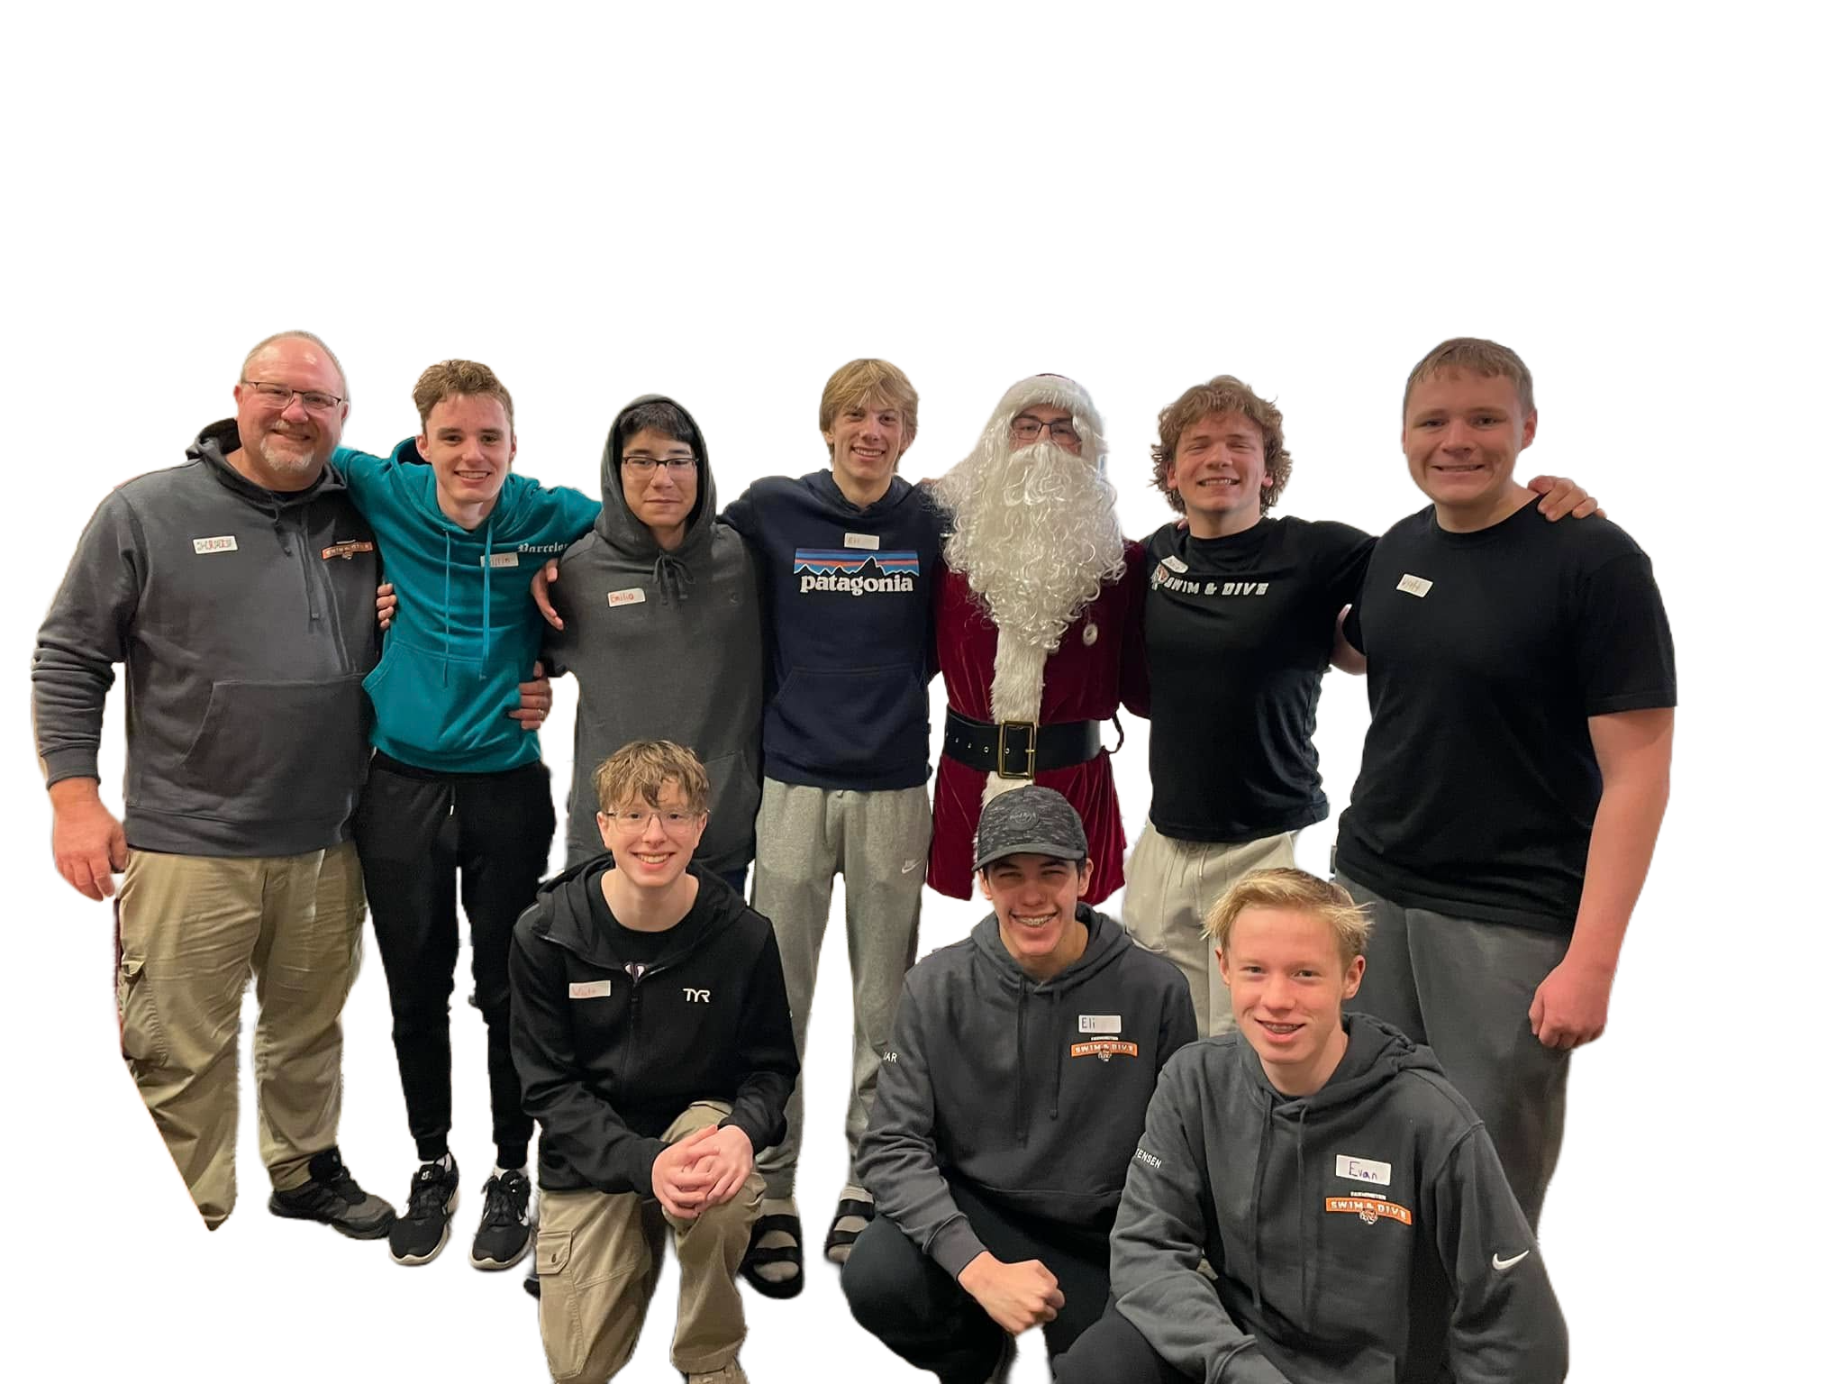
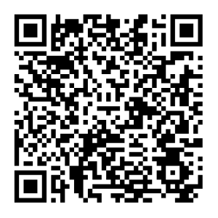
Community Service
Secret Holiday Shop - Sat, Dec 6 from 9 am - Noon
(A fun holiday opportunity to help children (3-12 yrs. old) shop, wrap and label gifts for their families.) Sign up HERE or
Feed My Starving Children - Thurs, Jan 8 from 7:15-8:45 pm
(Families welcome to join | Need 1 adult per 4 students)
Sign up HERE or
2024 Secret Holiday Shop

Slide 13
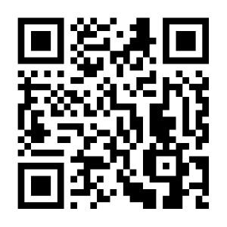
Team Building
Bowling - Mon, Dec 29 | 1-3 pm at Farmington Lanes
RSVP HERE or
Super Bowl Party - Sun, Feb 8 | Time: TBD at Tyler West’s House
(Address, RSVP, potluck sign-up & all other details available closer to date.)
Spaghetti Dinners - Early/Mid Feb | After practice in DMS Cafeteria
Additional Team Building Activity - End of Jan/Feb - TBD

Slide 14
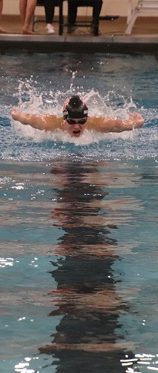
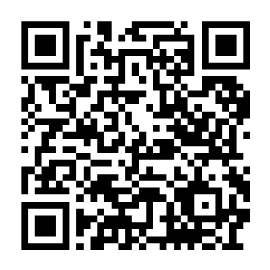
Volunteering
Farmington vs. Northfield
Fundraisers
Morning practice breakfasts
Spaghetti dinners
Home meet snack bags
Home meets
  Lane Timers
  Photographer
Booster Club
December 17, 2024

Slide 15
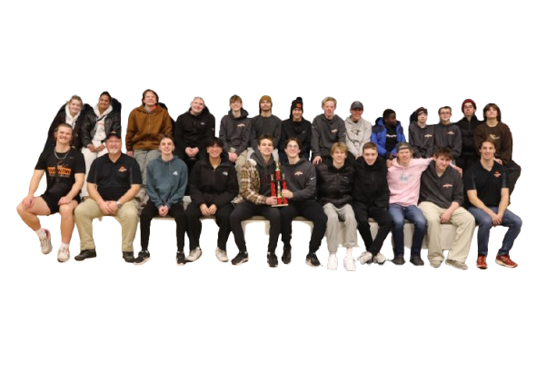
Duluth East Invitational Trip
Jan. 2-3, 2026
Team leaves Fri, Jan. 2 on bus
Team lodges at The Suites Hotel - Waterfront Plaza (Paid by Boosters)
Team dinner Friday night (Paid by Boosters)
Invitational is Sat, Jan. 3 at Lincoln Park MS
Parents are welcome to stay at The Suites Hotel - Waterfront Plaza. Parent block available until Dec. 7. Call 218-727-4663 to reserve your room.
2nd Place Champs 2025 Duluth East Invitational

Slide 16

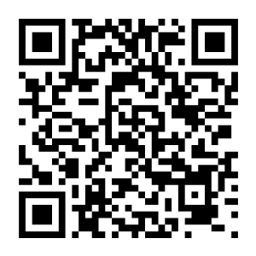
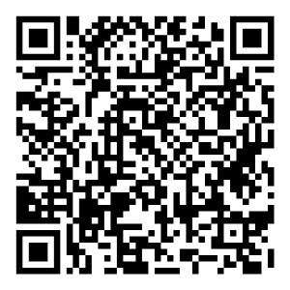
Communication
GroupMe App
Download the GroupMe App and join FHS Boys Swim & Dive Parents to
stay updated on all things team related. Sign Up HERE or
Weekly Emails
Upcoming practices & meets, coach information, volunteer opportunities, team activities, etc…. Not getting the emails? Check your Spam folder. Still no email? Reach out to the Boosters.
Team GroupMe
Coaches & captains utilize the GroupMe App to communication with athletes.
Absence Form
If your athlete will be absent for any reason, complete the Absence Form. Located under the Parents FAQ on the Team website.

Slide 17
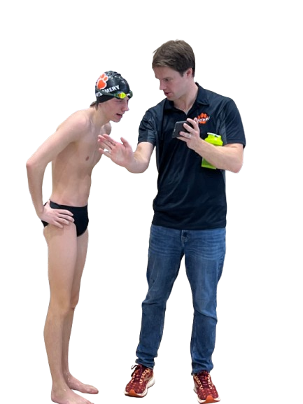
Contact Information
Coach Hubbard
maxahubbard@gmail.com
Boosters
FarmingtonBoysSwimAndDive@gmail.com
Duluth East Invitational - Jan 4, 2025

Slide 18
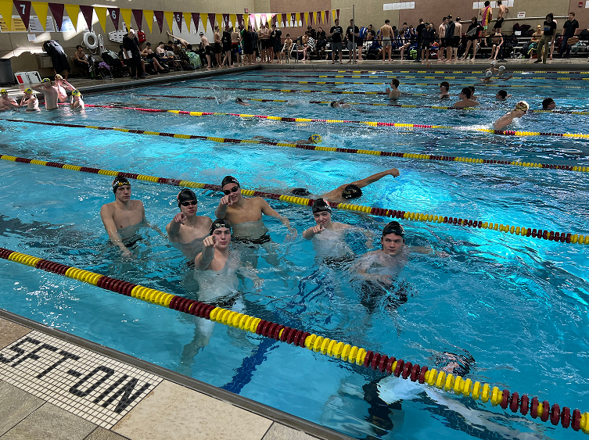
Thank you for attending.
It’s going to be a GREAT SEASON!
Duluth East Invitational - Jan 4, 2025

