Slide 1
Building Teams and Rosters

Slide 2
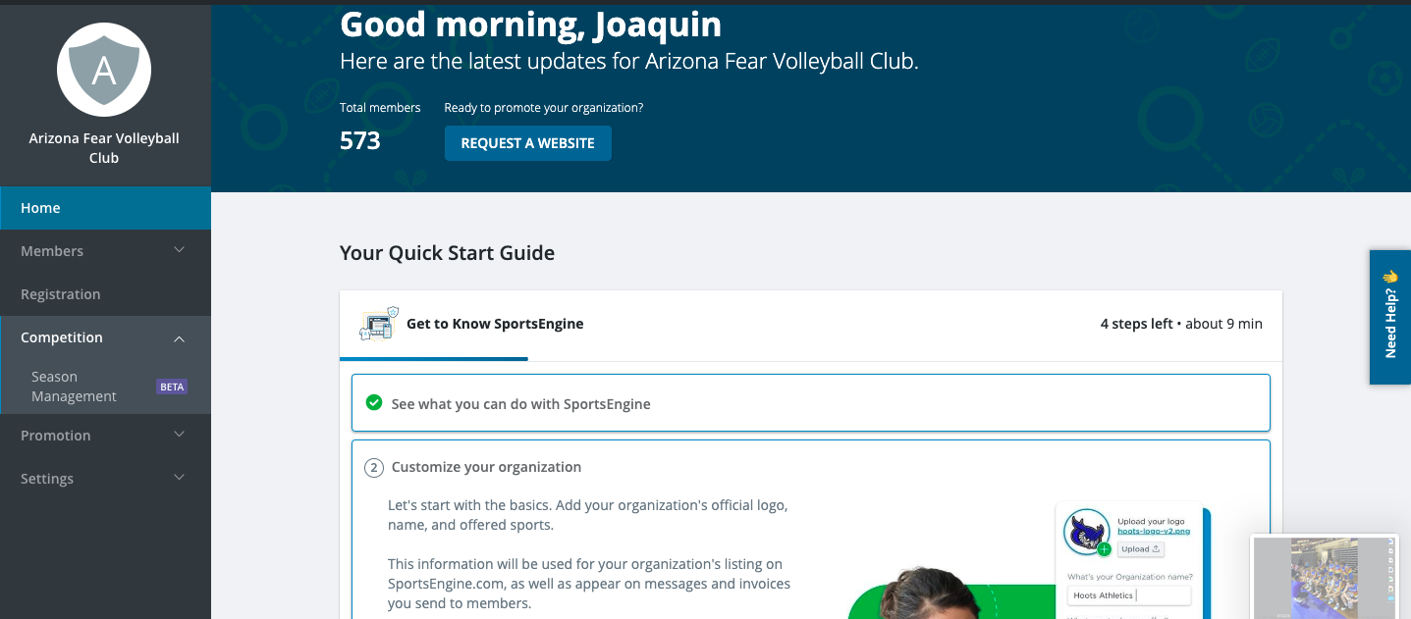
Season Management – Where you will build your teams and rosters.

Slide 3
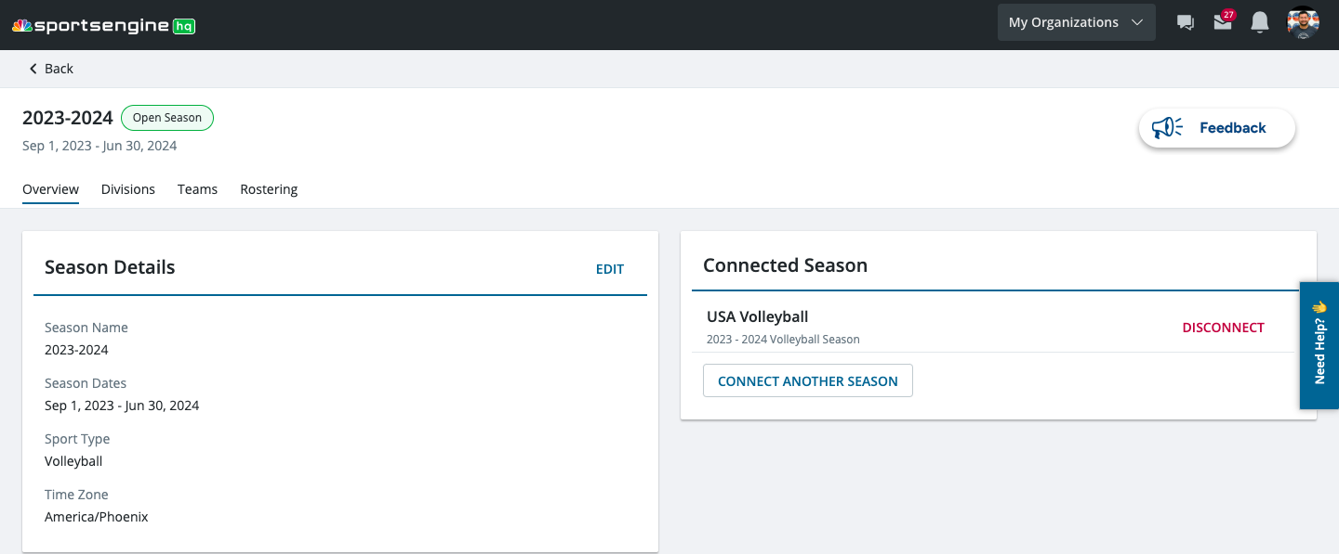
Season Details
Connected Season
Season Name: 2024-2025
Season Dates: Sep 1, 2024 – June 30, 2025
Sport Type: Volleyball
Time Zone: America/Phoenix
USA Volleyball 2024-2025 Season

Slide 4
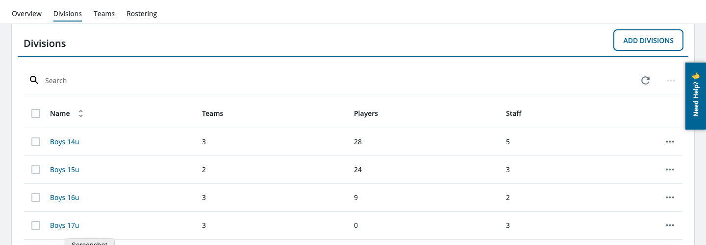
Adding Divisions
Here you will add divisions for your teams.
For example: Boys 14u / Girls 12u

Slide 5
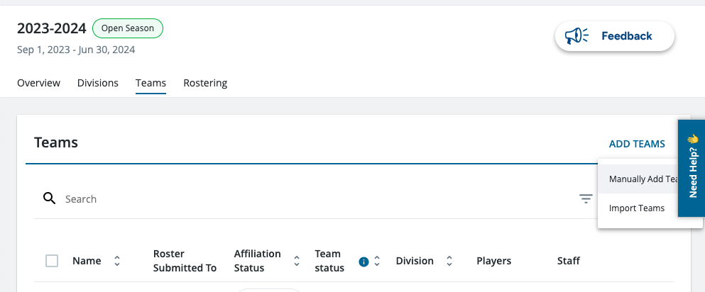
Adding Teams
Here you will add the teams in your club.
Manually add teams: Recommended for clubs with less than 20 teams
Import: This is where you can upload the template (provided when you click this option) as in years past.

Slide 6
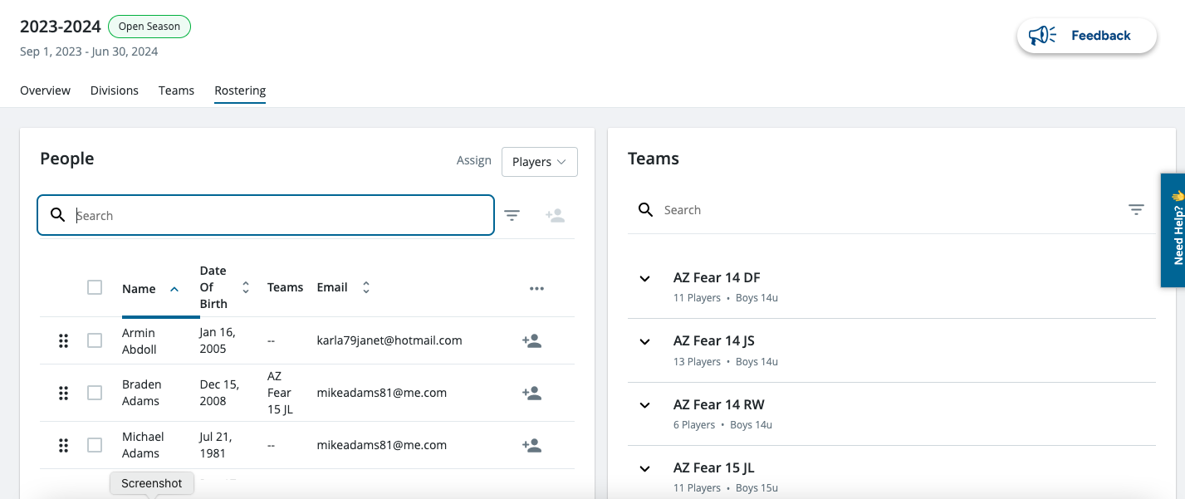
Rostering Teams
New feature is being able to drag and drop players into each team.
You may also filter ( 3 line icon above) players in your directory by age range.
You may also check the boxes next to a players name and add them to a team by using the icon next to the filter.

Slide 7
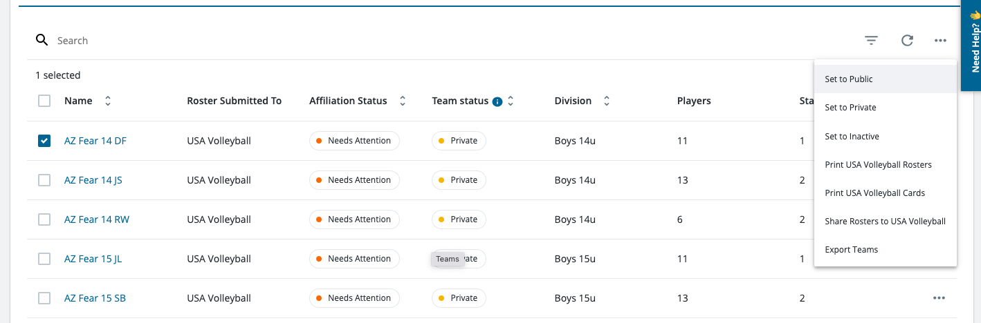
Submitting Rosters to USA Volleyball
In order to see if players are eligible, you must first submit your rosters to USA Volleyball.
Tips:
*Make sure that the box next to the team is checked
*Only 10 rosters may be submitted at once.

Slide 8
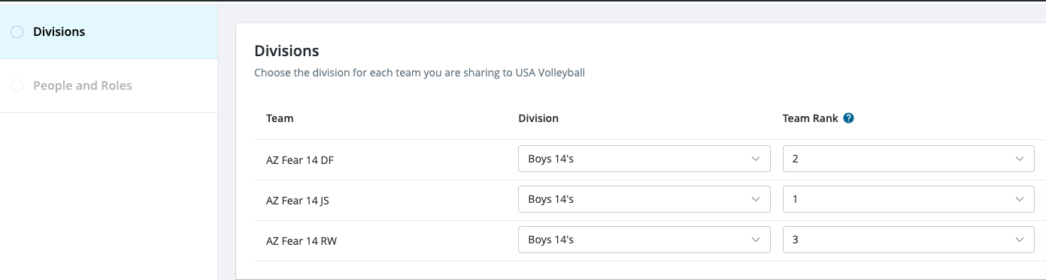
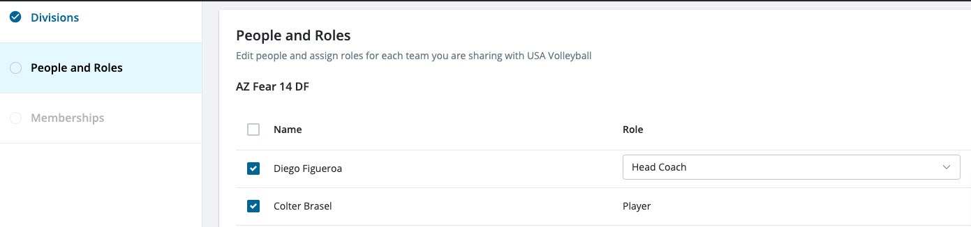
Divisions:
This is where you will put your teams
in the prebuilt divisions and rank them within
your club.
People and Roles:
This is where you will give your coaches their roles,
for each team.

Slide 9
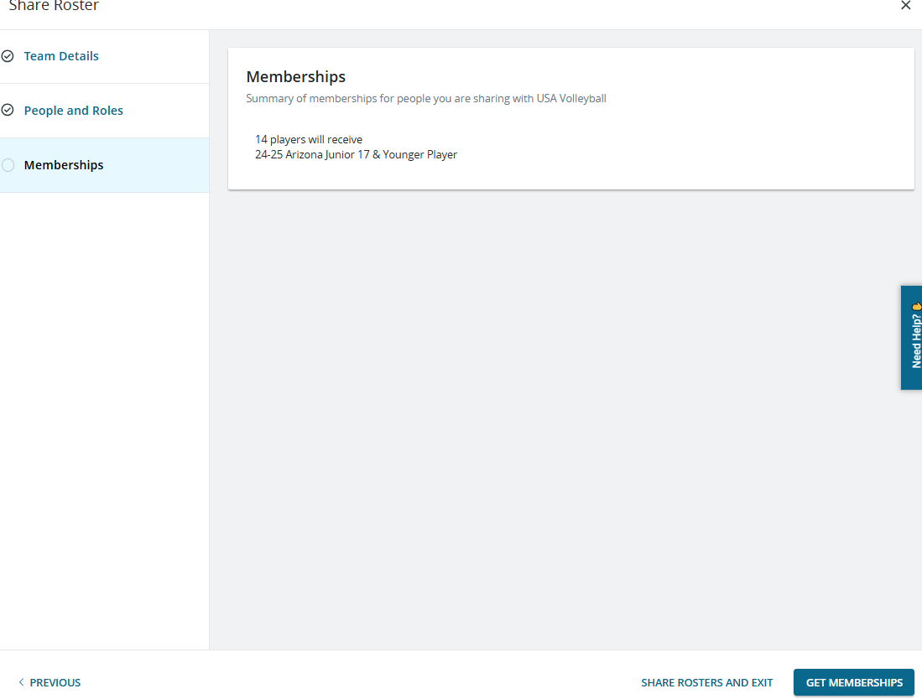
This is going to sync your player memberships with USAV.
Click “Share Rosters and Exit”

Slide 10
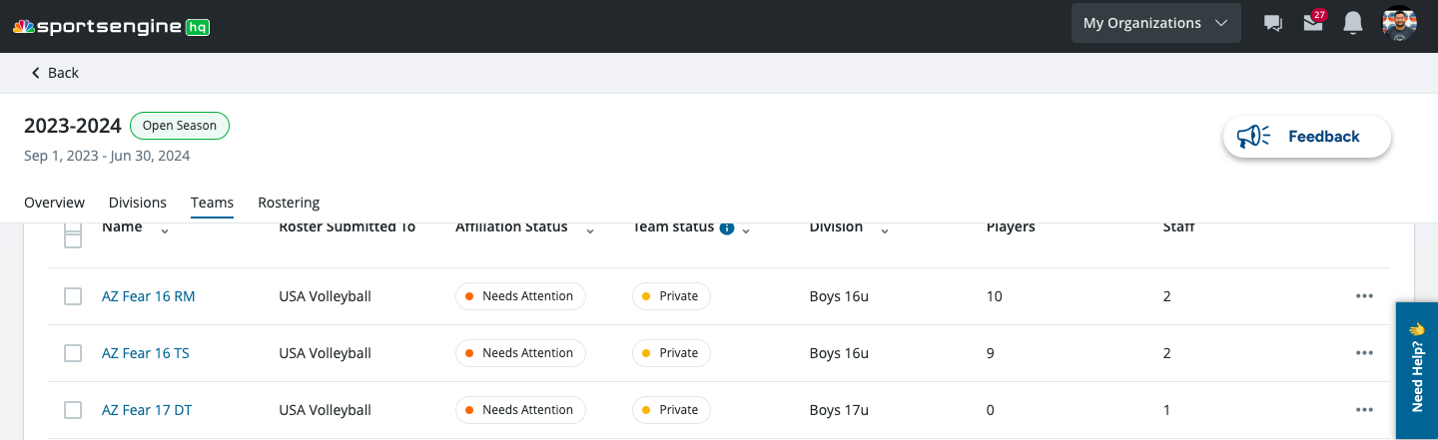
Once rosters are submitted to USAV you will notice either a
“Needs Attention” or “Approved” icon next to each team

Slide 11
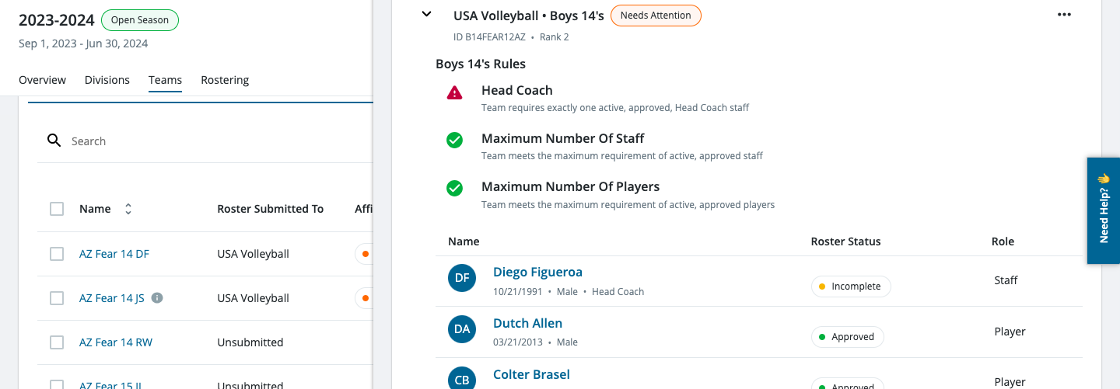
Clicking on a team's name will open the window that tells you what needs attention.
You can go through each staff member and player to see why they are incomplete by clicking their name.
Staff and Players will not print on the official roster until they have the “Approved” icon next to their name.

Slide 12
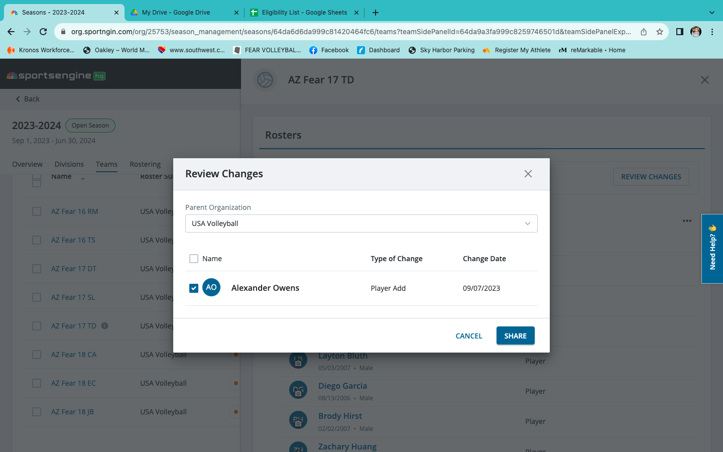
Any changes made to your roster will require you ”SHARE” those changes with USA Volleyball.
If action is required, you will see a small “i” icon next to the team's name.
This includes adding players or staff, changing coaches roles, etc…

Slide 13
Printing Rosters for AZ Region Events
Once rosters are completed. You will click “PRINT USA VOLLEYBALL ROSTERS” from the TEAMS page.
This will print an official roster with all eligible members on it.
Rosters will not print without an eligible Head Coach at minimum.
DO NOT CLICK ANY OTHER PRINT ROSTER BUTTON. THAT IS NOT THE CORRECT ROSTER.
TIP: IF THE ROSTER DOES NOT SAY ELIGIBLE NEXT TO A PLAYERS NAME IT IS NOT AN ACCEPTABLE ROSTER!

