Slide 1
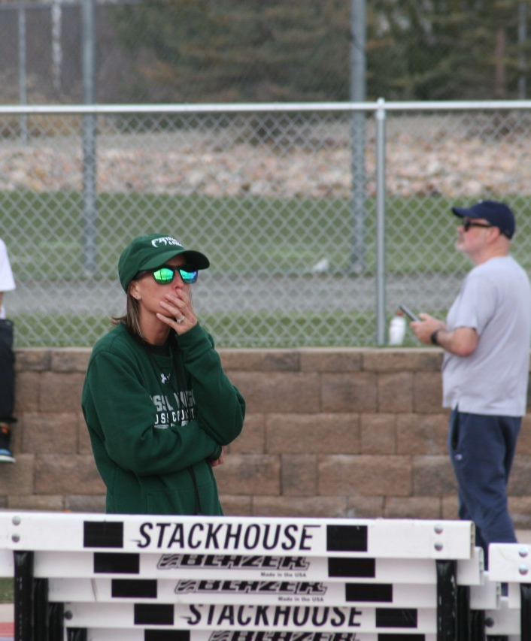
800m Training – The Fossil Ridge Way
Dani Cook

Slide 2
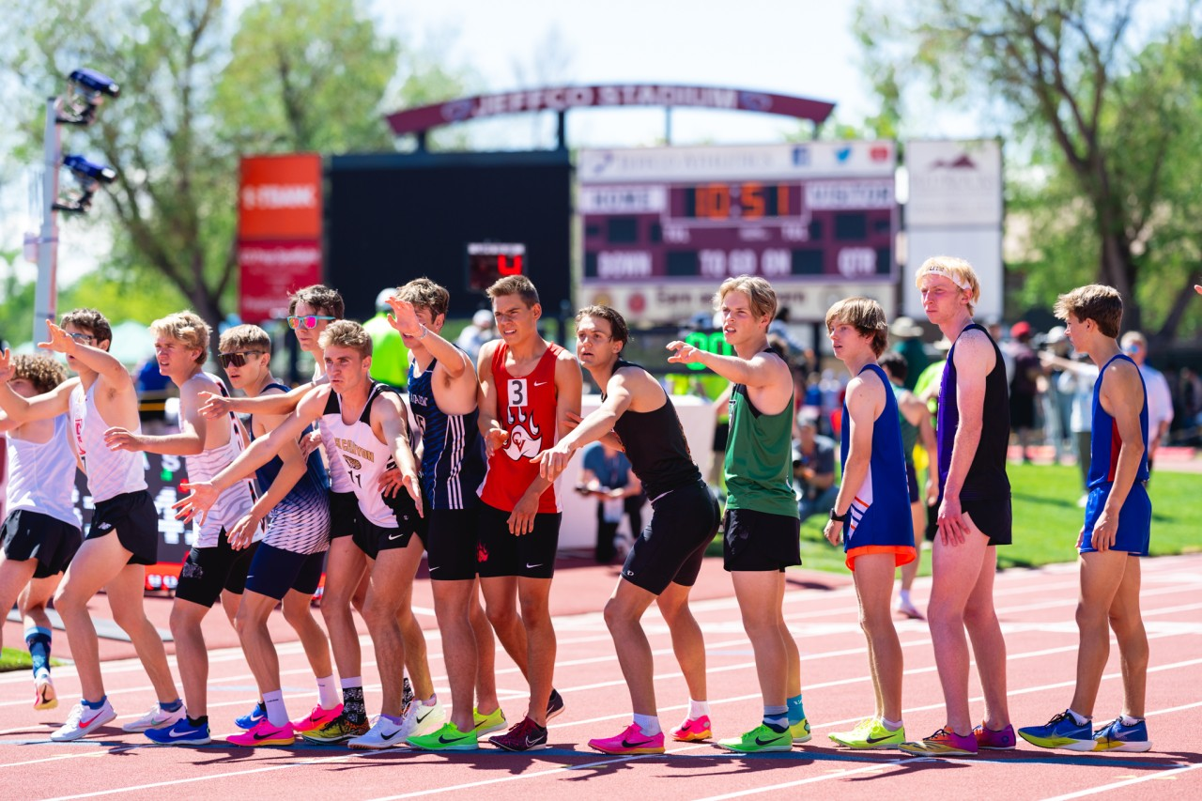
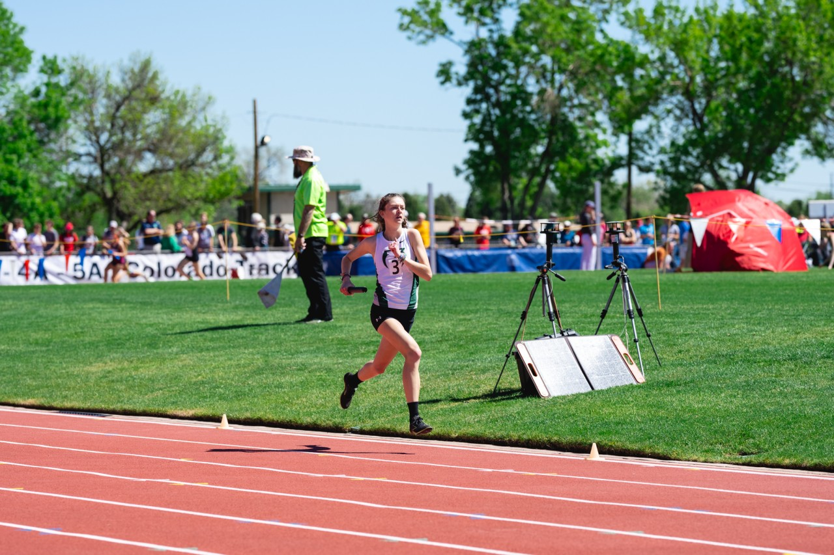
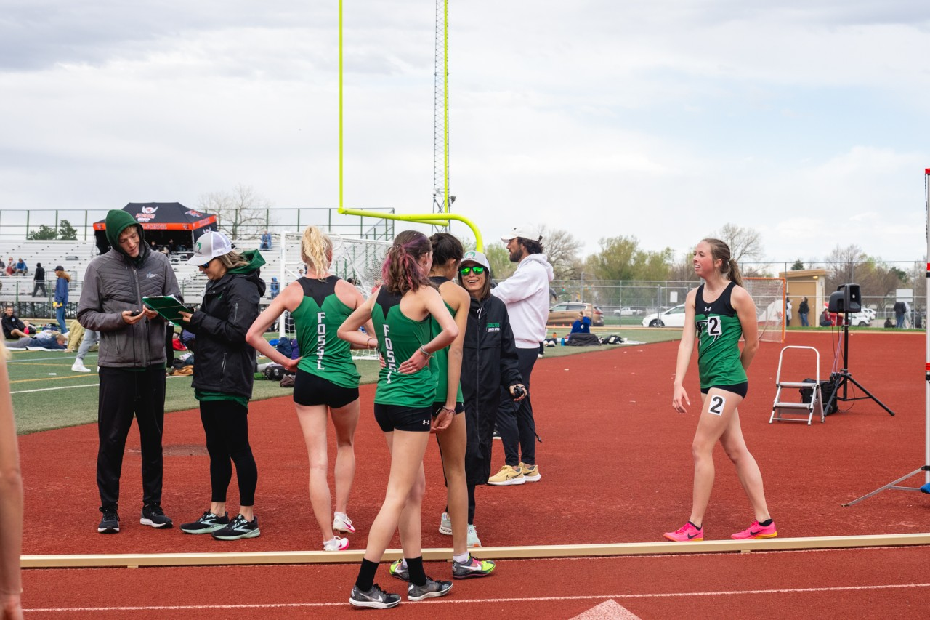
Agenda
Pre-Season Training
Establishing Event Groups & Identifying “Hybrids”
Mid-Season Training
Peak Season Training
Establishing a 4x800 Team
Final Thoughts

Slide 3
Season Progression & Focus Points
Pre-Season
December – February
Post NXR/RunningLane
Recovery Focus
Mental Refocus (joy)
Identify Goals
Early Season
March
Spring Break
Early Meets
Comfort zone
Establish a Race Plan
Specify Event Groups
March/Early April
Balancing Weather
Repetitive Competition
Exposure to different events
Take Risks (race plan / event)
Mid –Season
April
High Competition Load
State Marks
Capitalize on Weather
Primary event focus
Fine Tune Race Plan
End of Season
May
Conference Rosters
Finalize Relay Lineup
Compete
Execute a plan
React to race

Slide 4

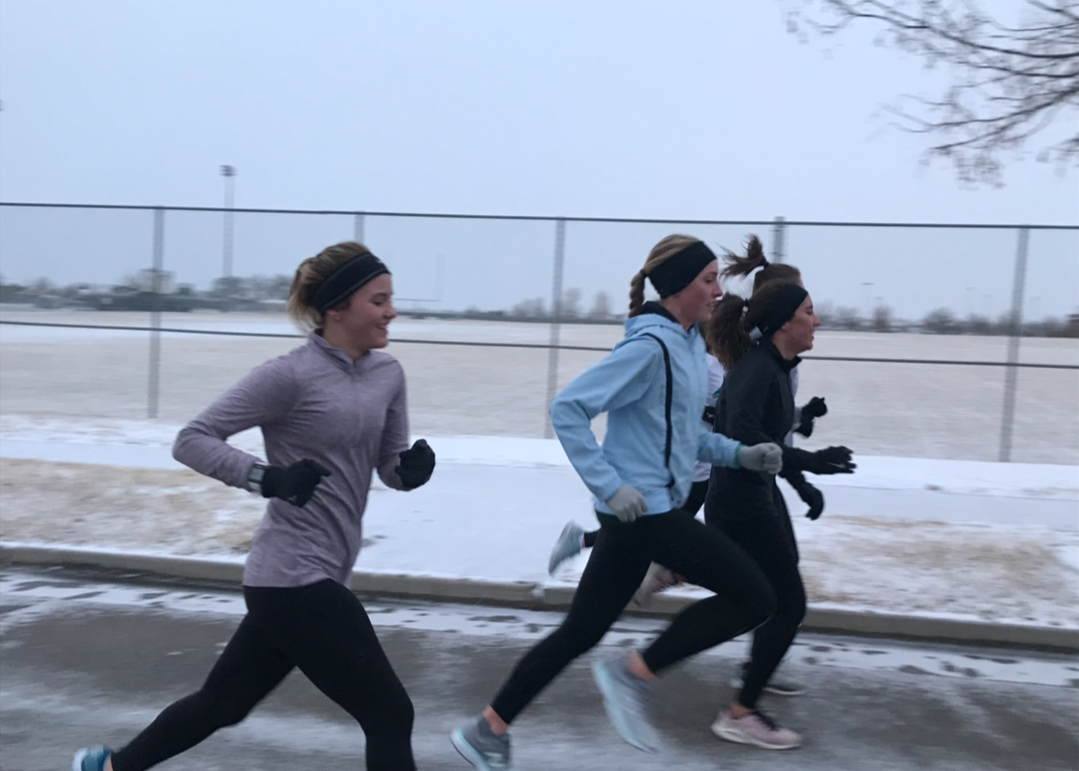
Pre-Season December - February
Coach Focus
Re-Build Routine
Allow training calendar to be flexible
Keep event groups together
Athletes follow training group # from fall
Keep it interesting. Minimal Track Work.
Optional pre-season races

Slide 5
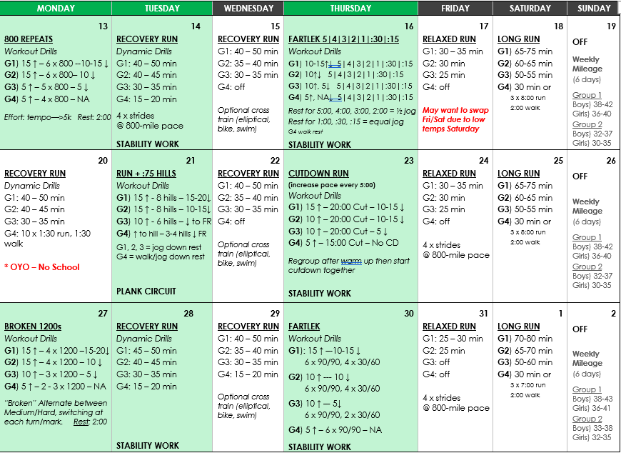
Sample Pre-Season Calendar

Slide 6
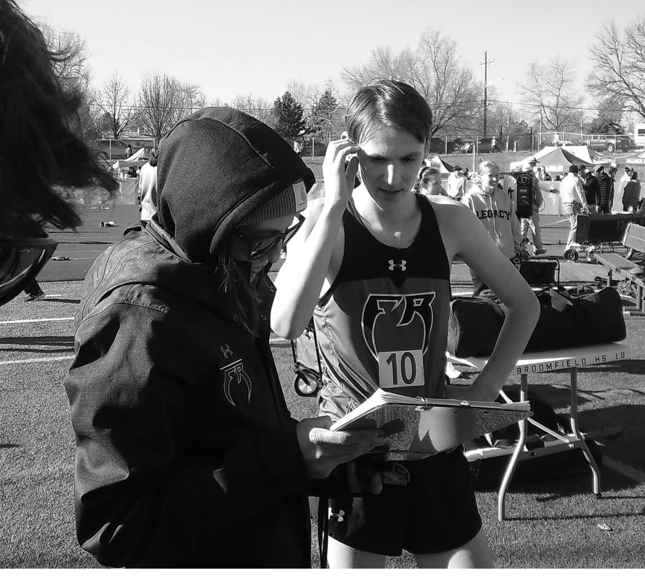
Early Season March
Coach Focus
Keep event groups together
Give a variety of athletes varsity exposure
Single events, not a lot of doubling
4x400s when possible
Athlete Focus
Learn to race and react
Start with comfort zone races, but mix it up

Slide 7
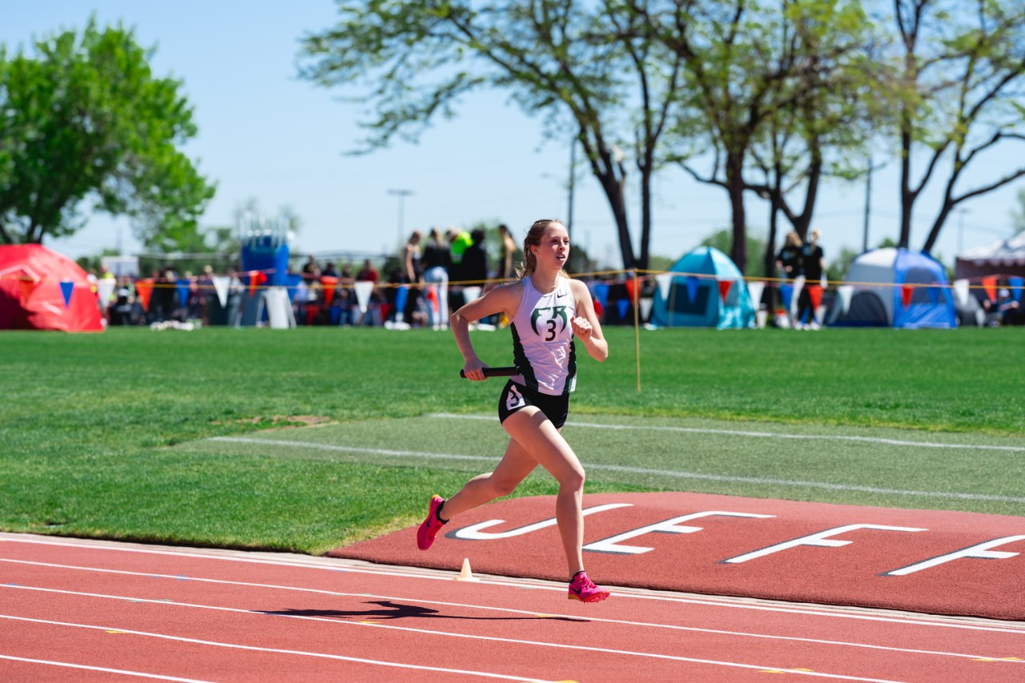
Establishing Event Groups
3200m / 1600m (LD)
800m / 1600m (MD)
400m / 800m (“Hybrids”)
Considerations: Individual needs, strengths, XC kid? 400 potential?

Slide 8
What is a “Hybrid”?
Primarily an 800m runner
More likely to run open 400m than 1600m
Track only kids
Training differences from 800m/1600m runners
Lower overall volume & shorter long run
Occasionally joins sprint group for second workout of the week
May have a separate workout or second half of workout compared to main group
800m/1600m typically shift between 1600m/3200m and Hybrid version of workout. Depends on the workout itself and which is deemed more event specific

Slide 9
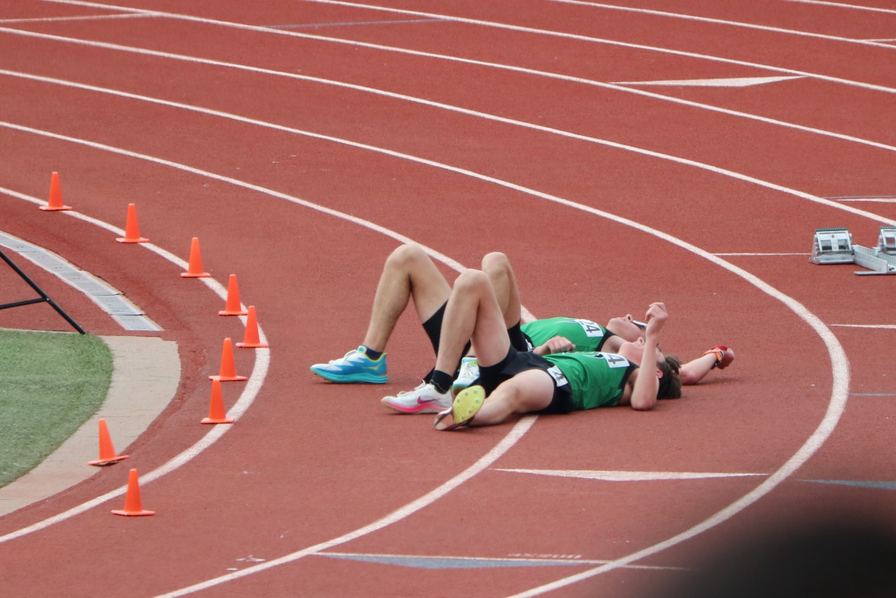
Mid-Season Focus April “Competitive Season”
Coach Focus
Start addressing more specific event group needs
Implement occasional race SIM workouts
Start identifying competitive 4x800 & 4x400 contributors
Take advantage of weather
Athlete Focus
Take intentional risks
Learn to get out
Learn to double & what to do between races

Slide 10
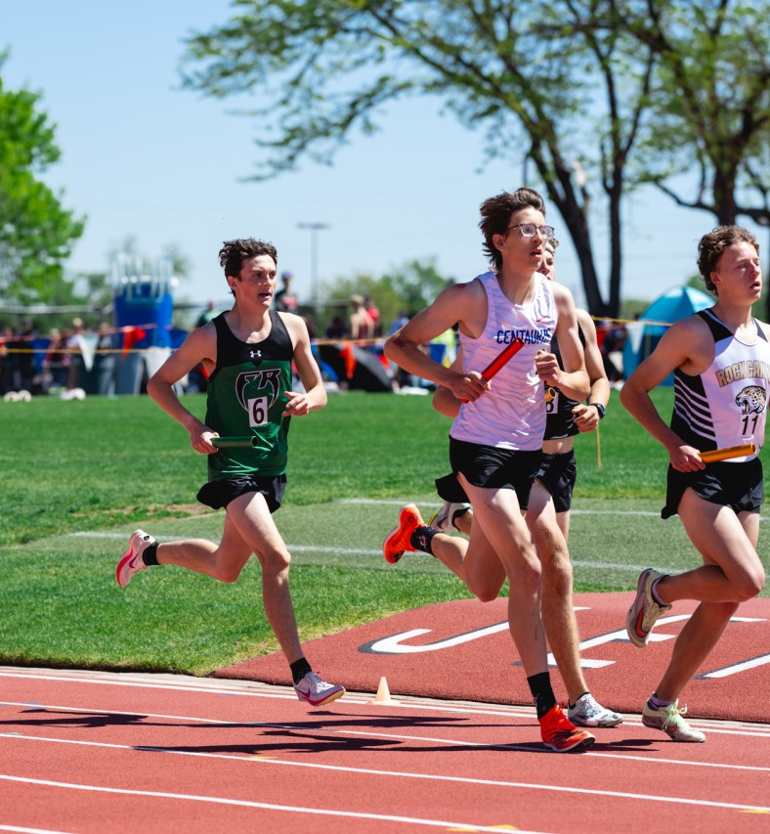
MID SEASON WORKOUTS
LD/MD
3 x (4x400) @ 3200m Rep Rest = 60sec
Set Rest = 4:00 jog
HYBRIDS
6 x 400m
4 @ mile effort
2 @ 800 effort
Rest = 3:00
4 x 150m @ 400 effort
LD
3-4 x Mile
@ McMillan Sheet Rest = 3:00-4:00
MD/HYBRID
1-2 x Mile
4 x 200m @ 800
Rest = 200 jog
LD/MD
Tempo Run
HYBRID
Sprint Group
6 x 40m flys
3 x 250m hard
LD/MD
10-12 x 300m
Rest = 100m walk
HYBRID
8 x 300m
Rest = 100m walk
#1-2 @ 3200 effort. #3-7 @ mile effort. #8-12 @ 800 effort Final rep @ 400 effort
**Long Run is still a focus for all groups

Slide 11
Example Race SIM Workouts
2 x 800m, 4 x 300m
800m @ mile pace
300m (hard, float, hard)
800 Rest: 4:00 standing
300 Rest: 100m walk
Broken 1000m (3-4 reps)
400m @ mile pace
400m @ mile pace
200m @ 800 pace
Rep Rest: 1:00 standing
Set Rest: 4:00 standing
2 – 3 sets of (4x400m)
#1 = 2-3 sec faster than goal mile
#2 = at goal mile
#3 = at goal mile
#4 = 2-3 sec faster than goal mile
Rep Rest: 1:30 standing
Set Rest: 4:00 (standing rest, some will have walk/jog rest)
Descending Reps
600m @ McMillan Sheet
500m @ McMillan Sheet
400m @ McMillan Sheet
300m @ McMillan Sheet
200m @ 400m
100m @ 400m
Rep Rest: Walk back to 400 start
* Pay attention to daily mileage/volume

Slide 12
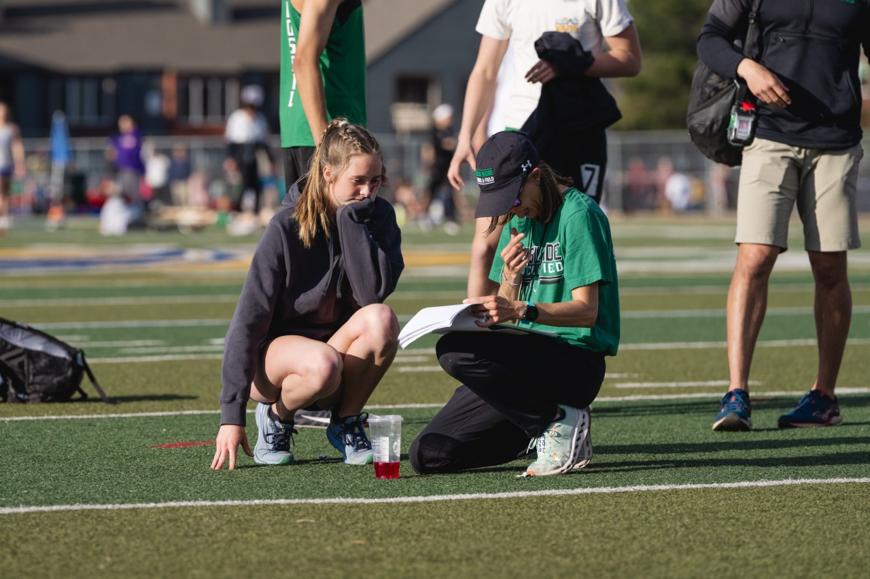
End of Season Late April (JV) – May (Varsity)
Coach Focus
Solidify Conference Roster
State Qualifying Marks (final chances)
Finalize 4x800 teams & 4x400 contributors or back up runners
Athlete Focus
Be confident in race plan (A, B & C)
Have fueling, recovery, and between races plan

Slide 13
End of Season Training Notes for 800m
Main workouts = 800m specific
MD may still overlap with portions of the LD group
Hybrids abandon the long run, LD/MD taper down
Don’t Ignore Recovery
Evaluate Meet Load
Lighter workouts and fartleks

Slide 14
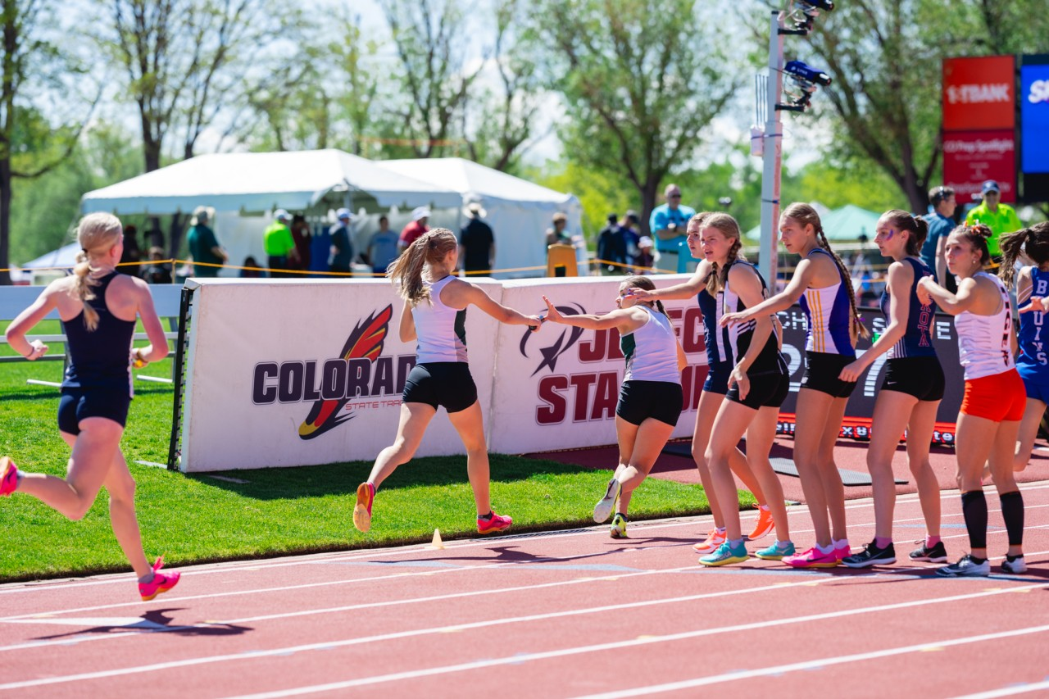

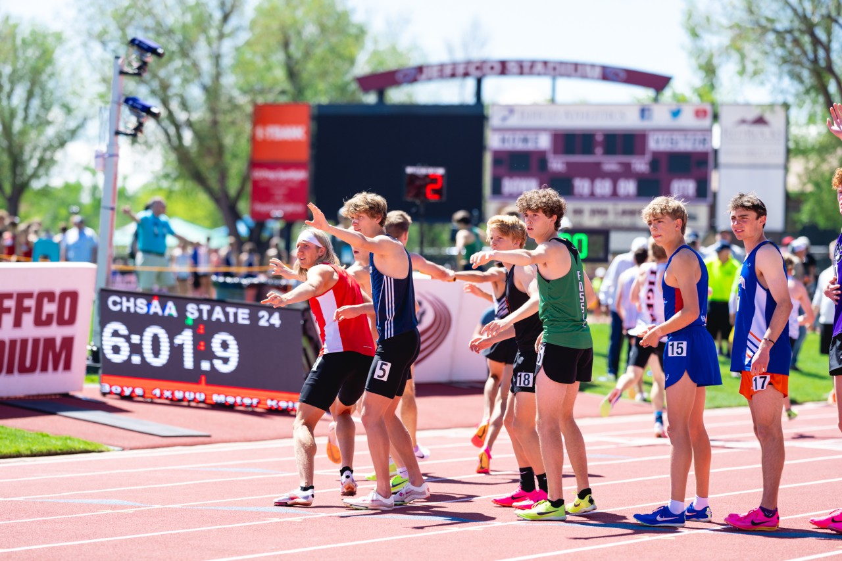
Establishing a Competitive 4x800
What are the strengths of each leg?
Allow athletes to decide the order early on – let them talk it out.
Balance developing a team chemistry with slotting new runners in.
Realistic hand off practice.
Use relays as an opportunity to develop upper JV kids.

Slide 15

Additional Thoughts
800m Strength Training
Wickets for form
Hurdle Drills for mobility
The mental side of progressing throughout the season (comparison game)

