Slide 1
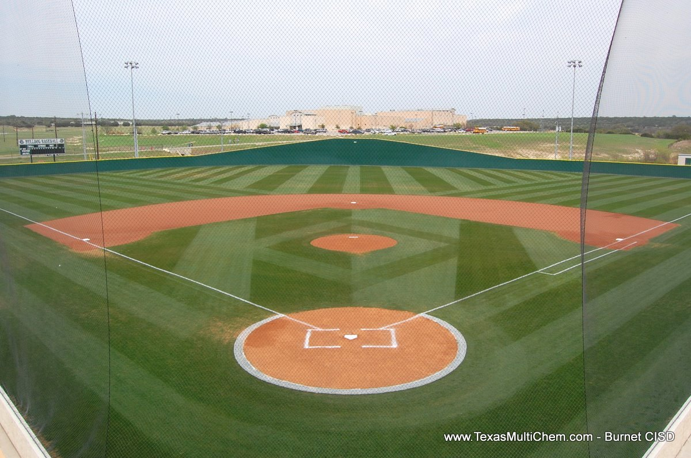
Maximizing Practice
Presented by Coach Tony Tichy

Slide 2
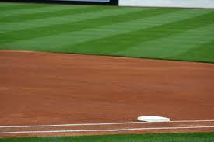
Just a few thoughts to ponder!
Make sure practice is fun!
What are my priorities?
What is my space?
What equipment do I have?
Have A Practice Plan
How long / How often?
Sample Practice Plan

Slide 3
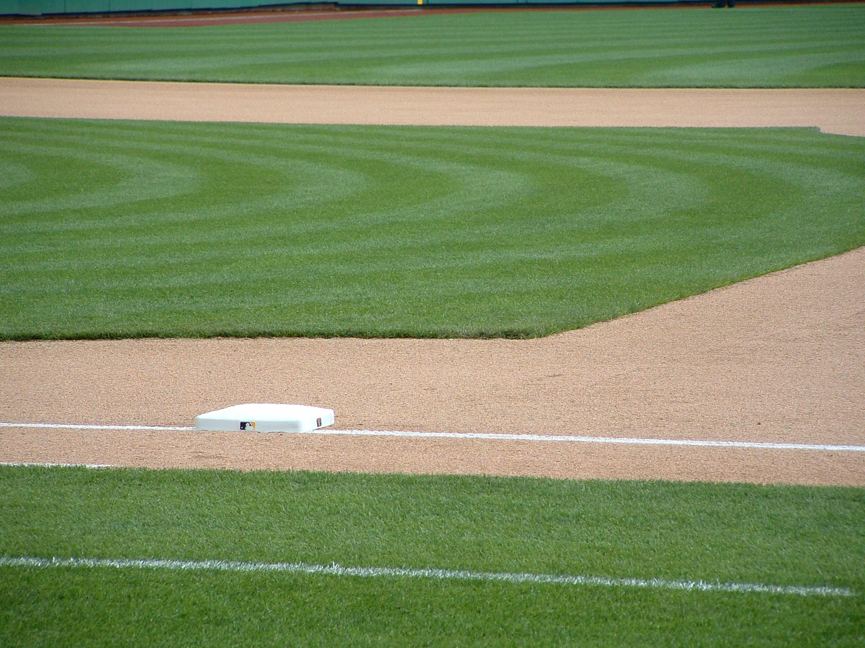
Make sure practice is fun!
Keep the kids moving!
Make practice competitive.
Practice at game speed.
Keep kids involved station to station
Be on time as a coach and a player!
Create opportunities for competition.

Slide 4
What are my priorities?
Throwing?
Hitting?
Defense?
Team concept?
Intro to positions?

Slide 5
What can we do with the space we have?
Indoor space
Outdoor space
Batting cages

Slide 6
What equipment do I have?
Does the team have the equipment needed for an efficient practice?
Is the equipment in good playing shape? (safety of players and coaches)
Examples: whiffle balls, tennis balls, baseballs, gloves, bats, protective equipment

Slide 7
Create stations and expectations.
Have a practice plan.
What am I working on today as a coach?
What should be part of every practice?
How much time is dedicated to each aspect of what’s being worked on?

Slide 8
How long should practice be? / How many practices per week?
1 to 1.5 hours
2x a week then 1 x once games start

Slide 9
SAMPLE PRACTICE PLAN
4:00-4:10 plyometrics (high knees, jumping jacks, light running etc.)
4:10-4:25 throwing mechanics and drills
4:25-4:35 age appropriate base running
4:35-4:50 hitting stations, whiffle balls
4:50-5:05 team concept: offense,defense,baserunning
5:05-5:30 hustle game

