Slide 1

Welcome to the 2018 Lakeville North Volleyball Season

Slide 2
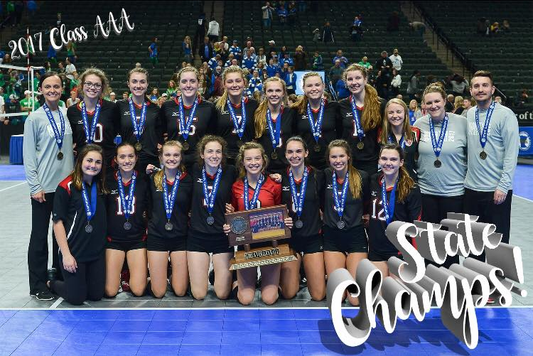
2017
Panther Volleyball
Players, parents and coaches committed to
I Am because We Are
in 2017 and continued transformation and transition become more and more tangible and visible throughout the season in practice….which ultimately then impacted our outcome.

Slide 3

2018
Panther Volleyball

Slide 4
‘Rise’
in…
Culture,
Effort,
Relationships,
Communication,
Your give,
Leadership

Slide 5
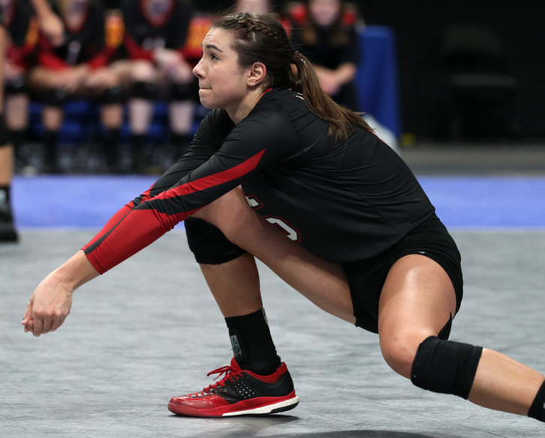
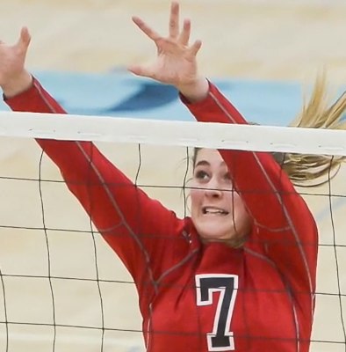
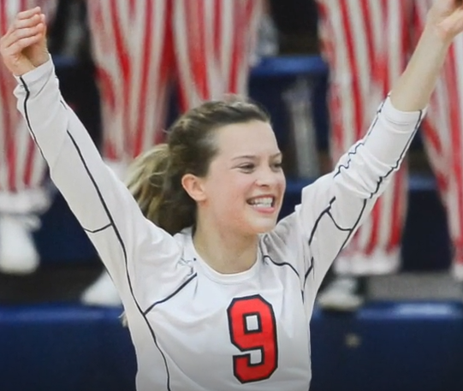
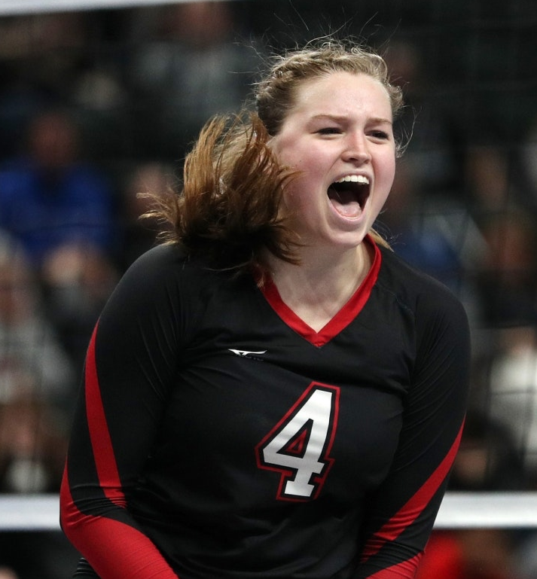
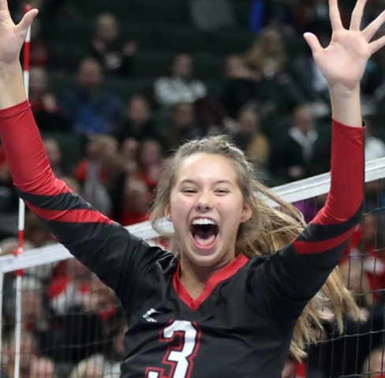
2018
leadership
Macy Winter
Senior, OH
4th year Varsity
Amelia Wherland
Senior, S
3rd year Varsity
Elizabeth Juhnke
Senior, OH
4th year Varsity
Tori Thompson
Senior, MB
3rd year Varsity
Halle Wolfe
Junior, LIB
3rd year Varsity

Slide 6

Year Round Impact
Fall/Spring Saturday youth programs
Leadership Development
Cub Food Fundraisers
Booster Meetings: program development
Summer Opportunities
POP Beach Tournament
Concordia Team Camp (1st/7)
High School Camp
Youth Camp
Strength Training
Breakdown Pre-Season Tournament (2nd/32)

Slide 7
Program Administration
Jackie Richter | Head Varsity | (612) 597.5328 | JackieRichterLNVB@gmail.com
Taylor Hall | Asst Varsity | (612) 599.1996 | Taylor.a.hall6@gmail.com
Nate Erdal | Asst Varsity/JV | (952) 913.2199 | erdal011@gmail.com
Megan Williams | Head JV | (651) 235.8330 | megankathleenw@gmail.com
David Laufenburger | Head 10A | (612) 325.9496 | David.Laufenburger@isd194.org
Lisa Slinde | Head 9A | (612) 839.7451 | slindelisa3@gmail.com
Brett Johnson | Head 9B | (952) 212.3205 | brettjohnson@edinarealty.com
Craig Roberts | Statician | (763) 442.1320 | rober080@Hotmail.com
Mike Zweber | Athletic Director |  | zweb1571@isd194.org
Lisa Heilman | Athletic Administration |  | Lisa.heilman@isd194.org
Heather Bartz | Athletic Trainer |  | hbartz2@Fairview.org
Bryan Schmidt | ETS Trainer |  | Bryan.Schmid@mnsu.edu

Slide 8
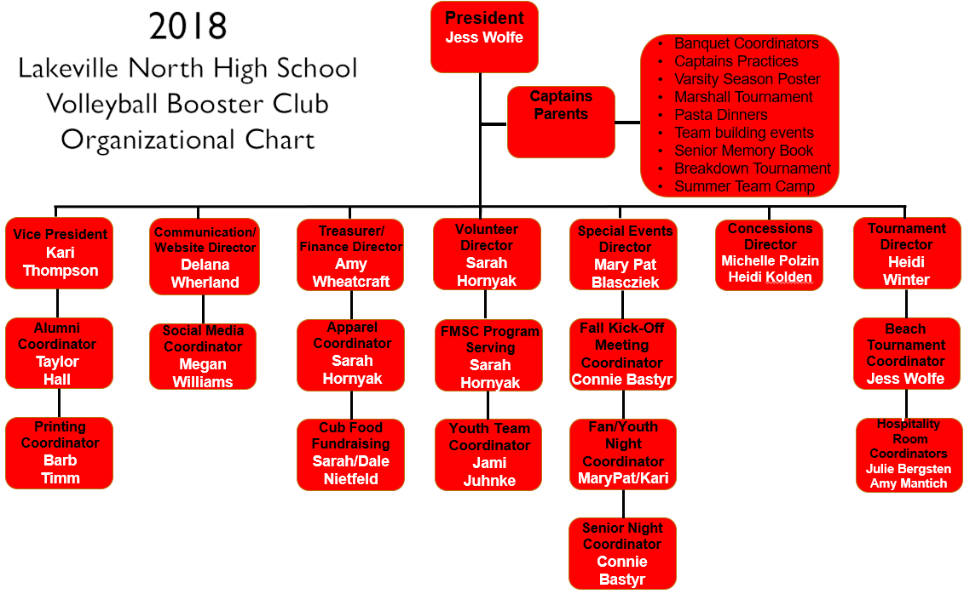
LNHSVB Booster Club

Slide 9
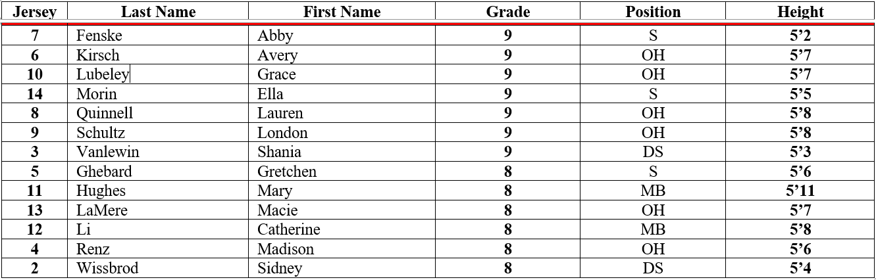
Panther Roster
9B (13)
Head Coach Brett Johnson

Slide 10
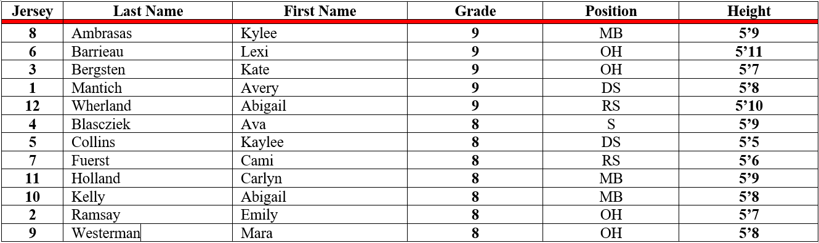
Panther Roster
9A (12)
Head Coach Lisa Slinde

Slide 11
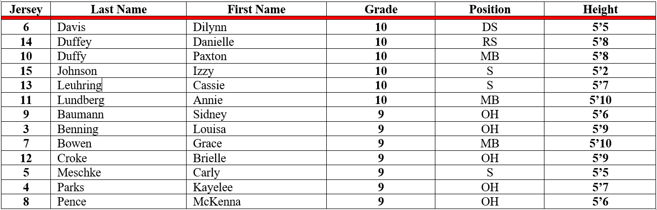
Panther Roster
10A (13)
Head Coach David Laufenburger

Slide 12
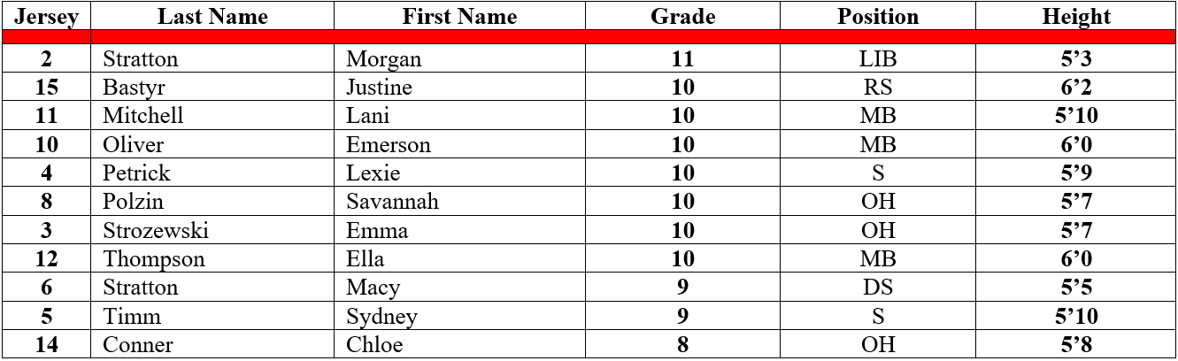
Panther Roster
JV (11)
Head Coach Megan Williams

Slide 13
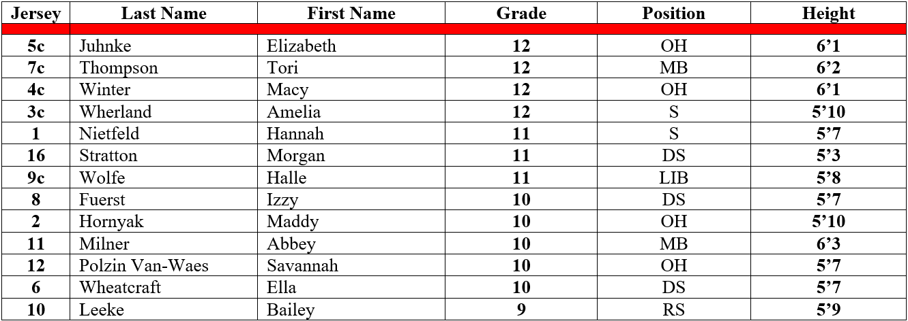
Panther Roster
JV (13)
Jackie Richter, Taylor Hall, Nate Erdal

Slide 14
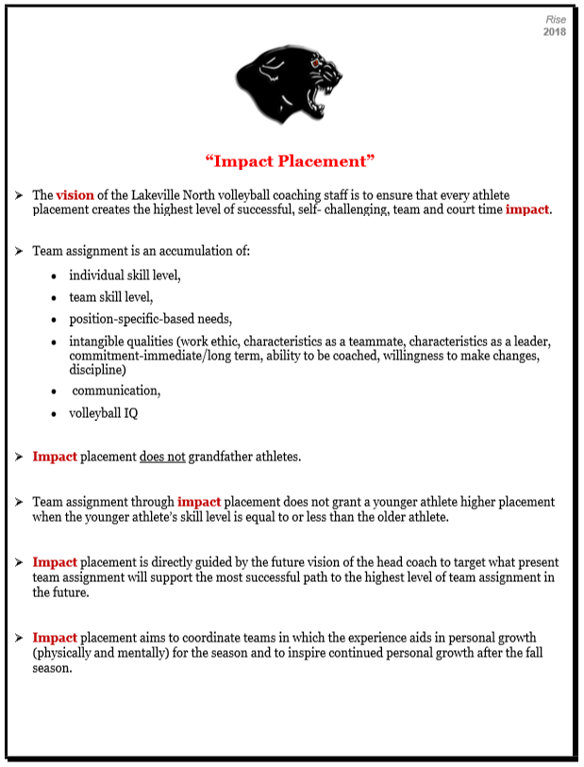
Impact Placement
(review)

Slide 15
Umbrella topics Paving the future with a cohesive program
Schedule
Practices are every day. Players received a schedule of practices prior to the start of school which varies team to team.
Strength Training will be run by ETS for the fall of 2018 and will be after school from 3pm-3:45pm on most Mon/Wed/Fri.
Feed My Starving Children on Monday, August 20th at 6pm.
Teams will leave LNHS at 5:30pm.
Home Match Nights (what does it look like) at LNHS:
Arrival, Net Set-Up, Arm Warm-ups, players are table/line judges for one another's match, supporting one another – stay for home matches (return bus for away matches), teardown
Host Youth teams
Fan/Youth Appreciation Night on September 13th vs Prior Lake (3:15pm/5:00pm)
Parent Appreciation Night on October 2nd vs Apple Valley (6:15pm)
Alumni Appreciation Night on October 9th vs Rosemount
Senior Appreciation Night on October 17th vs Bloomington Jefferson

Slide 16
Schedule (continued)…..
Tournaments (playing and working)
Home 9A tournament on Saturday, September 8th is run by the JV team (coaches, players, parents)
Home 10A tournament on Saturday, September 15th is run by the V team (coaches, players, parents)
Home Bachman tournament on Fri 10/12 and Sat 10/13 is run by our 10/9A/9B teams (coaches, players, parents)
Program-Building Events
Friday, October 5th at Concordia-St Paul vs U-Mary 6pm (this event is our practice for the evening)
Wednesday, October 10th at University of St Thomas vs Gustavus 7pm (this event is our practice for the evening)
Friday, October 19th at University of Minnesota vs Iowa
Boys Post-Homecoming Volleyball Tournament
Monday, October 1st North gymnasium 6pm-9pm
Banquet
Saturday, November 17th at Crystal Lake Golf Course 5pm-9pm

Slide 17
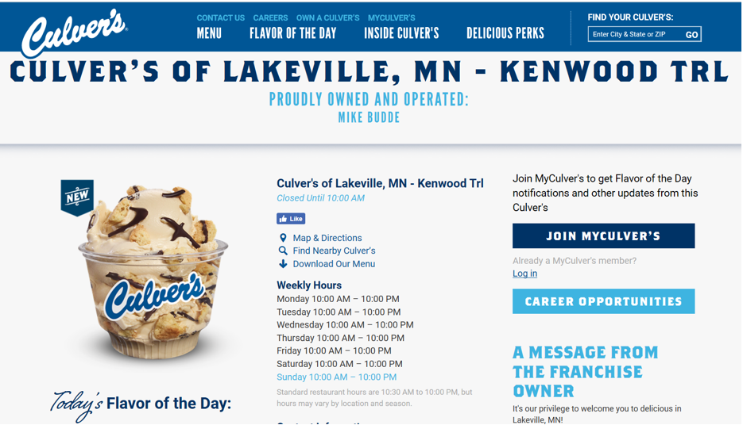
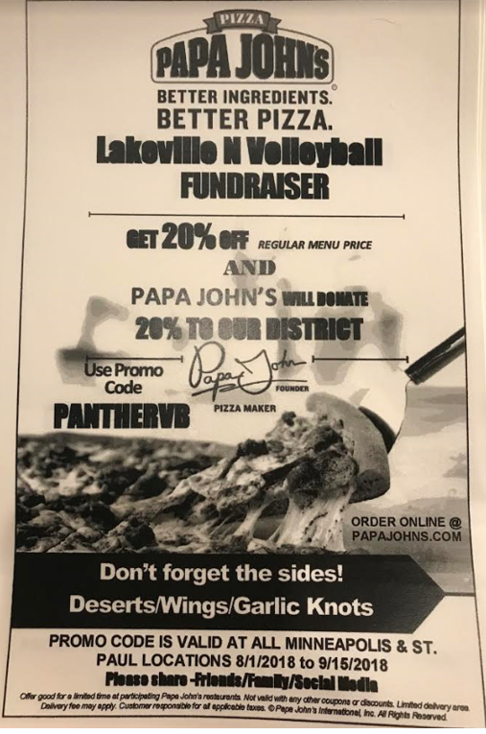
Fundraisers 2018
August 1st – September 15th
Papa Johns
online
“PANTHERVB” entered 20% to program
Tuesday, August 21st from 10am-8pm
Culvers
17800 Kenwood Trail
“LNVB” mentioned 15% to program

Slide 18
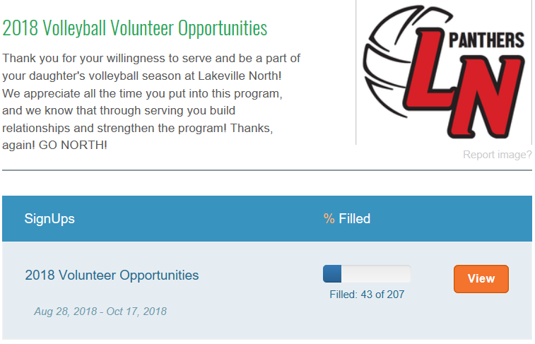
Umbrella topics Paving the future with a cohesive program continued…
Hours per family
12

Slide 19
Umbrella topics Paving the future with a cohesive program continued…
(B) Travel Topics
Bussing/Travel Expectations:
Departure time is prompt and a five-minute pre-departure time is expected.
Away matches scheduled prior to the start of school (Minnetonka and East Ridge), ALL teams will ride the bus to and from the site together. It is expected that each player take the bus to and from the site together.
Away matches scheduled after the start of school will have different buses. Our 9A/9B players will leave and have the option to return on the same bus once their match is done. Our 10A/JV/V players will leave LNHS on the second scheduled bus for each away match. There is no return bus for the second bus.
Families are responsible for providing transportation back to Lakeville for away matches and tournaments.
Bus schedule will be available online.

Slide 20
Umbrella topics Paving the future with a cohesive program continued…
(C) Social Responsibilities
Lines of Communication
Direct from athlete (text for small items, phone call/face-to-face for bigger picture items).
Absences communicated directly to the coach from the athlete.
Office Hours every Monday from 6pm-7pm after the start of school.
24 Hour Rule
Attendance
Excused absence (absences in which you have no control over: weddings, funerals, illness etc.) result in a missed set;
Unexcused absence (absences in which you do have control: concerts, dances, appointments, birthday parties etc) result in a missed match.
All school-related events (field trips, college trips etc.) are excused.

Slide 21
Umbrella topics Paving the future with a cohesive program continued…
“If a student is absent from school for any part of the day without administrative approval, the student is ineligible to practice or participate in a competition on that day.”
-A.D. Mike Zweber

Slide 22
Umbrella topics Paving the future with a cohesive program continued…
(D) Social Media
Facebook, Twitter, Instagram, YouTube (and its implications).
MSHSL policies and your representation of Lakeville North Volleyball.
(E) Substance Abuse Contract
Lakeville North High School in accordance to MSHSL;
Lakeville North High School volleyball program:
Any/all confirmed violations is a result of that seasons competition schedule, expected to complete the seasons practice schedule.
(F) Academic Responsibilities
Attendance
GPA and grades
Coach has access to grades;
Any failing or potential fail should be communicated when the athlete has identified a struggle. The coach/athlete will then solution to identify tools to guide the athlete back on track.
Time Management and organization (Above the Line)

Slide 23
Umbrella topics Paving the future with a cohesive program continued…
(G) Season/Practice Responsibilities
Equipment Setup and Takedown (hence, the 10 minutes prior to expectation);
Strength Training
All teams will strength train together,
Three times a week (unless marked otherwise on calendar),
Begins at 3:00pm.
Player/Parent role
Volunteer hours to make our season successful (12 hours)
Uniforms
School/athletic property-damage or loss results in a charge issued by the athletic department,
Custodial staff will wash/dry uniforms. No player is allowed to personally wash/dry their jerseys at home. Right side out.
Leadership Development on each team.

Slide 24
Umbrella topics Paving the future with a cohesive program continued…
(H) End of Season Responsibilities
Player Season/Coach evaluations.
Varsity Section Support
Dates include: October 24, October 26, October 31, November 3
One-on-One meetings.
Equipment Return.
Team awards in preparation for the banquet.
Banquet information:
Saturday, November 17th, 2018 from 5pm-9pm
Crystal Lake Golf Course, Lakeville

Slide 25
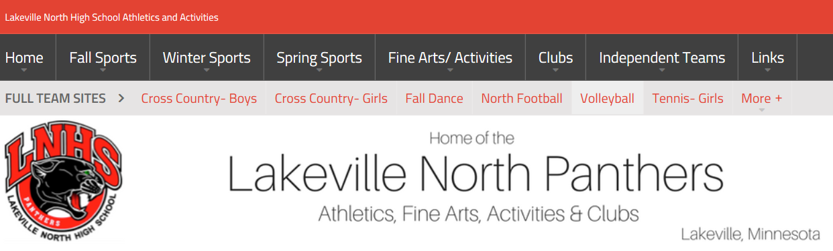


communication Critical for success
Program Communications:
Email (Mail Chimp)
Social Media (Facebook, Twitter)
Website (SportsEngine)
Office Hours (Mondays 6pm-7pm)

Slide 26

Feed My Starving Children
Start and end the season with serving
Feed My Starving Children (FMSC)
Monday, August 20th from 6pm-7:30pm (Teams leave LNHS at 5:30pm)
Sign up on VolunteerSpot (80 spots)
Visit www.lnhspanthers.com –Fall Sports- -Volleyball-
All players, coaches and willing parents needed to drive
FMSC does NOT count toward your season volunteer hours
Meet your team at LNHS door 19 at 5:30pm for departure (carpool)
Carpools will return to LNHS door 19 at approximately 8pm
PLEASE SIGN UP TODAY as our community service is just TWO DAYS AWAY!

Slide 27





Apparel options online orders
www.midwestvolleyballwarehouse.com
Click on ‘Team Gear Store’
Enter: lnhsapparel18

Slide 28
Miscellaneous Items
The Little Things Make a Big Difference
Bachman Hospitality Coaches Suite
Thank you for contribution to this offering.
Pictures
Shutterfly account to be determined
Middle Schools provide bussing to HS practices
Check school for pick-up location and time
“I Play Tonight” yard signs $15.00 and Car Decals $3.00 (or 2 for $5.00) for purchase

Slide 29
Questions?
Break out into individual team meetings

