Slide 1
Eagan Girls Lacrosse Fundraiser
www.flipgive.com

Slide 2
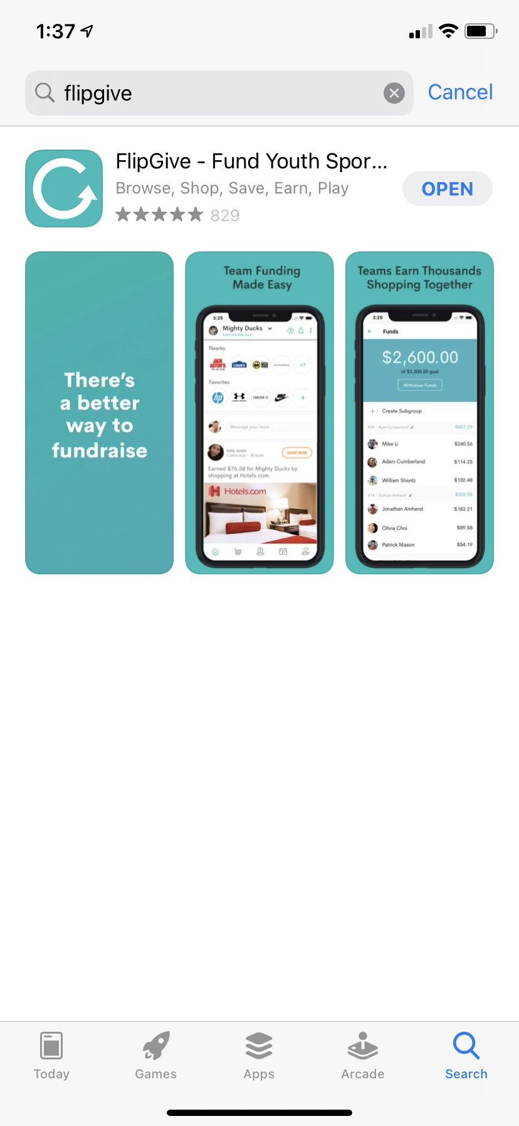
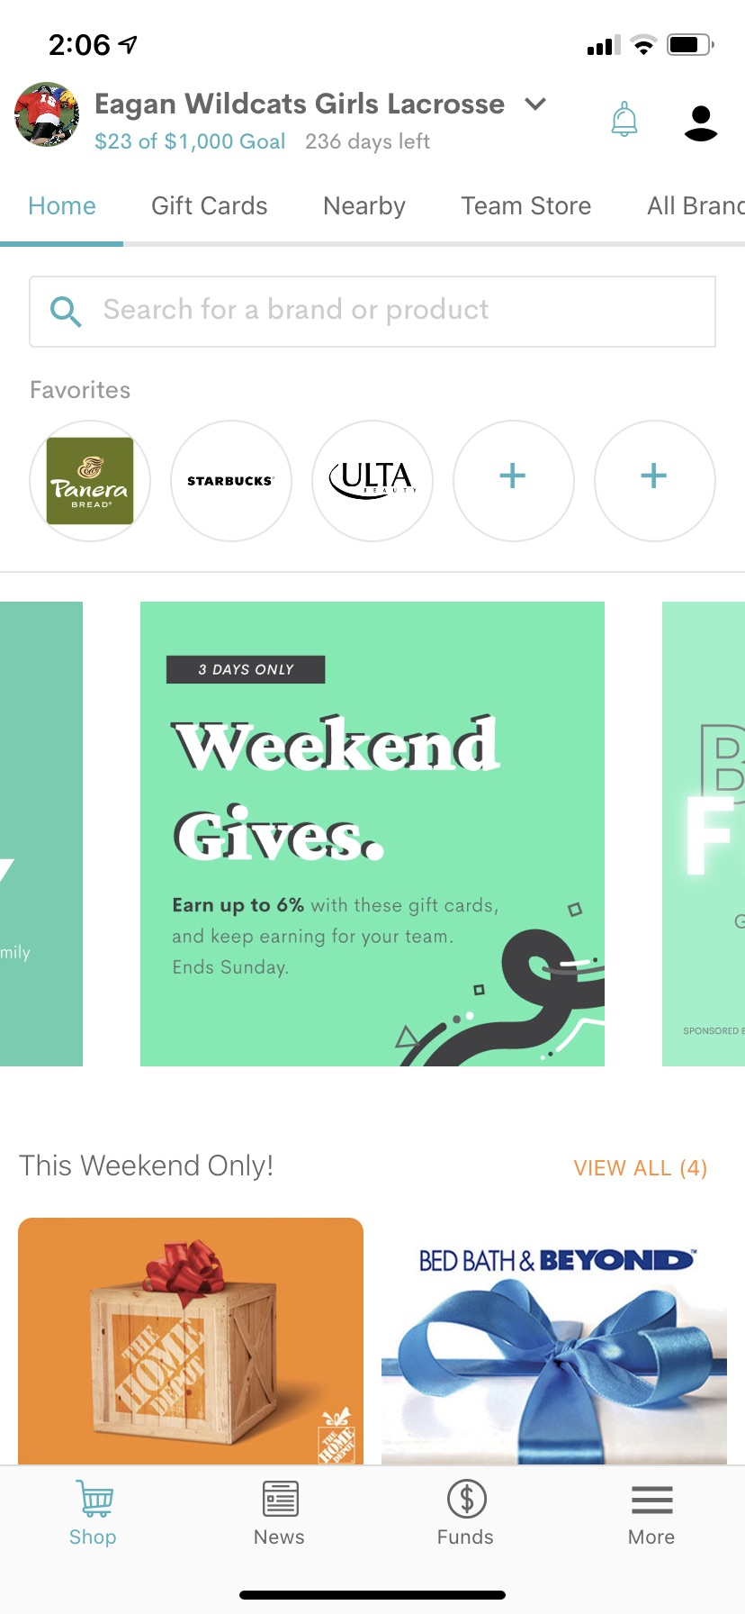
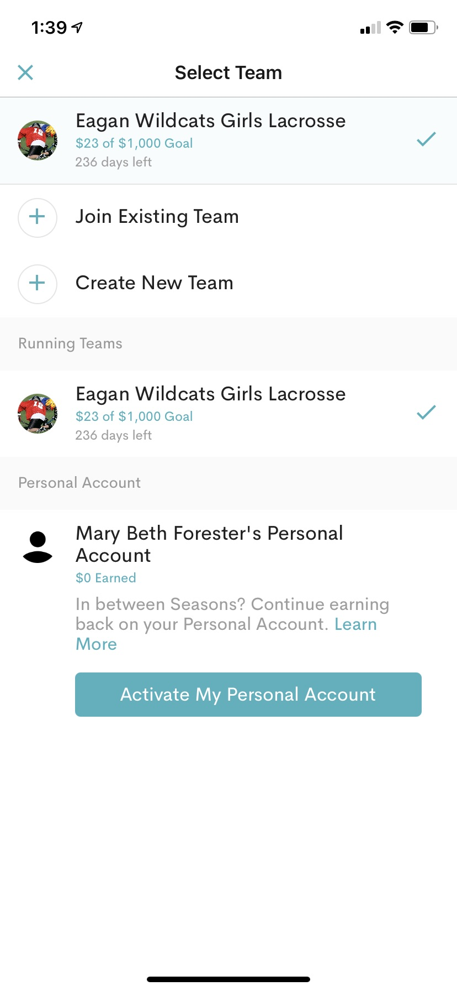
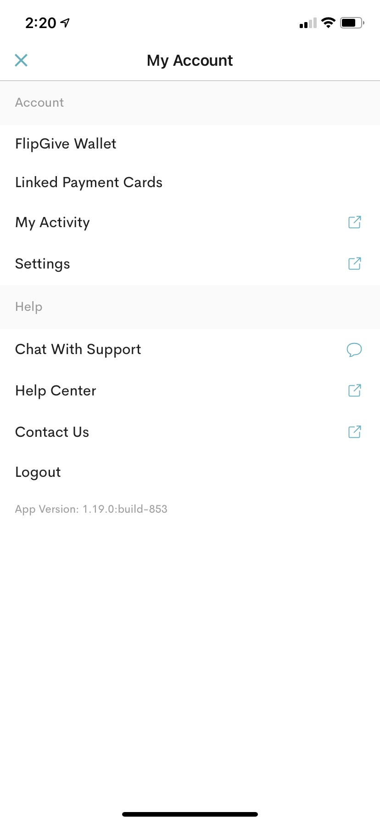
Step 1. Download the flipgive app and create an account
Step 2. Go to the dropdown menu to join a team
Step 3. Join a team
Step 4. Link your credit card. Click on the silhouette.

Slide 3
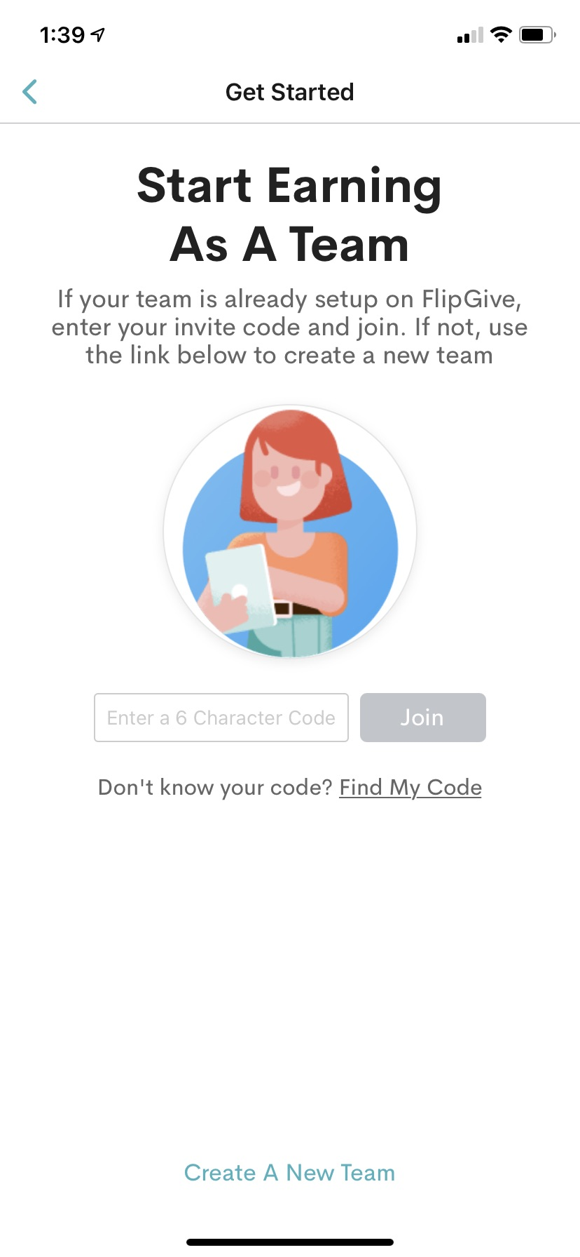
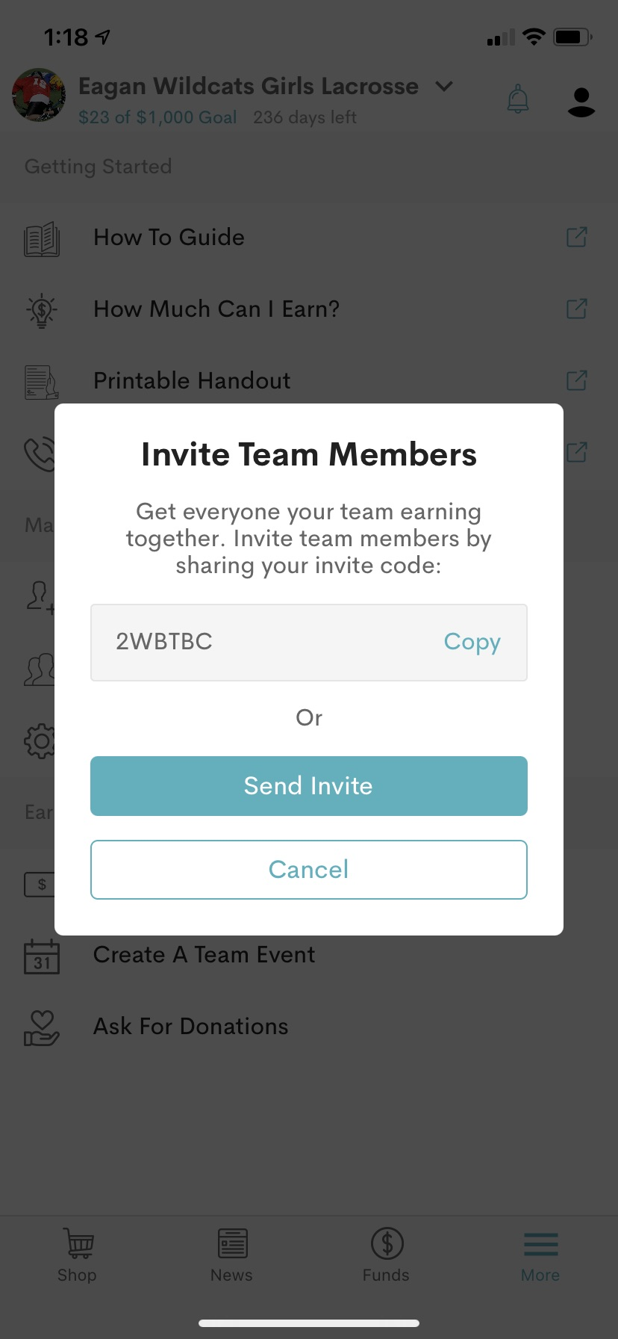
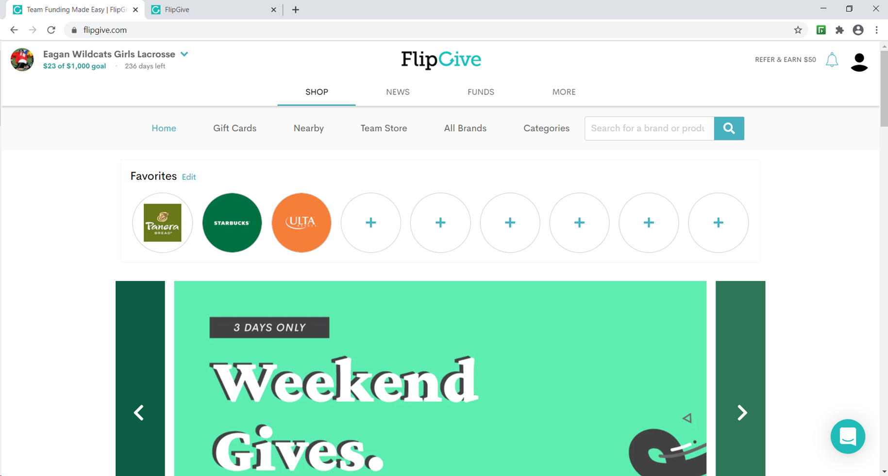
Step 5. Type in the Eagan Girls Lacrosse Boosters Code – 2WBTBC
Step 6. Start shopping! There are several options to get money back for purchasing gift cards and other items. To find local businesses, go to shop and then “nearby”.

Slide 4
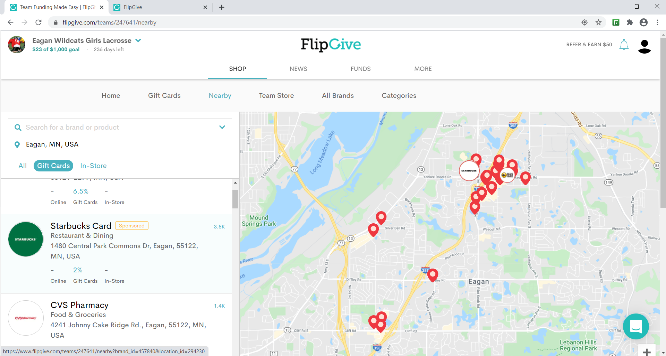
Step 7. The local locations show their reimbursement % and the item that needs to be purchased.

Slide 5
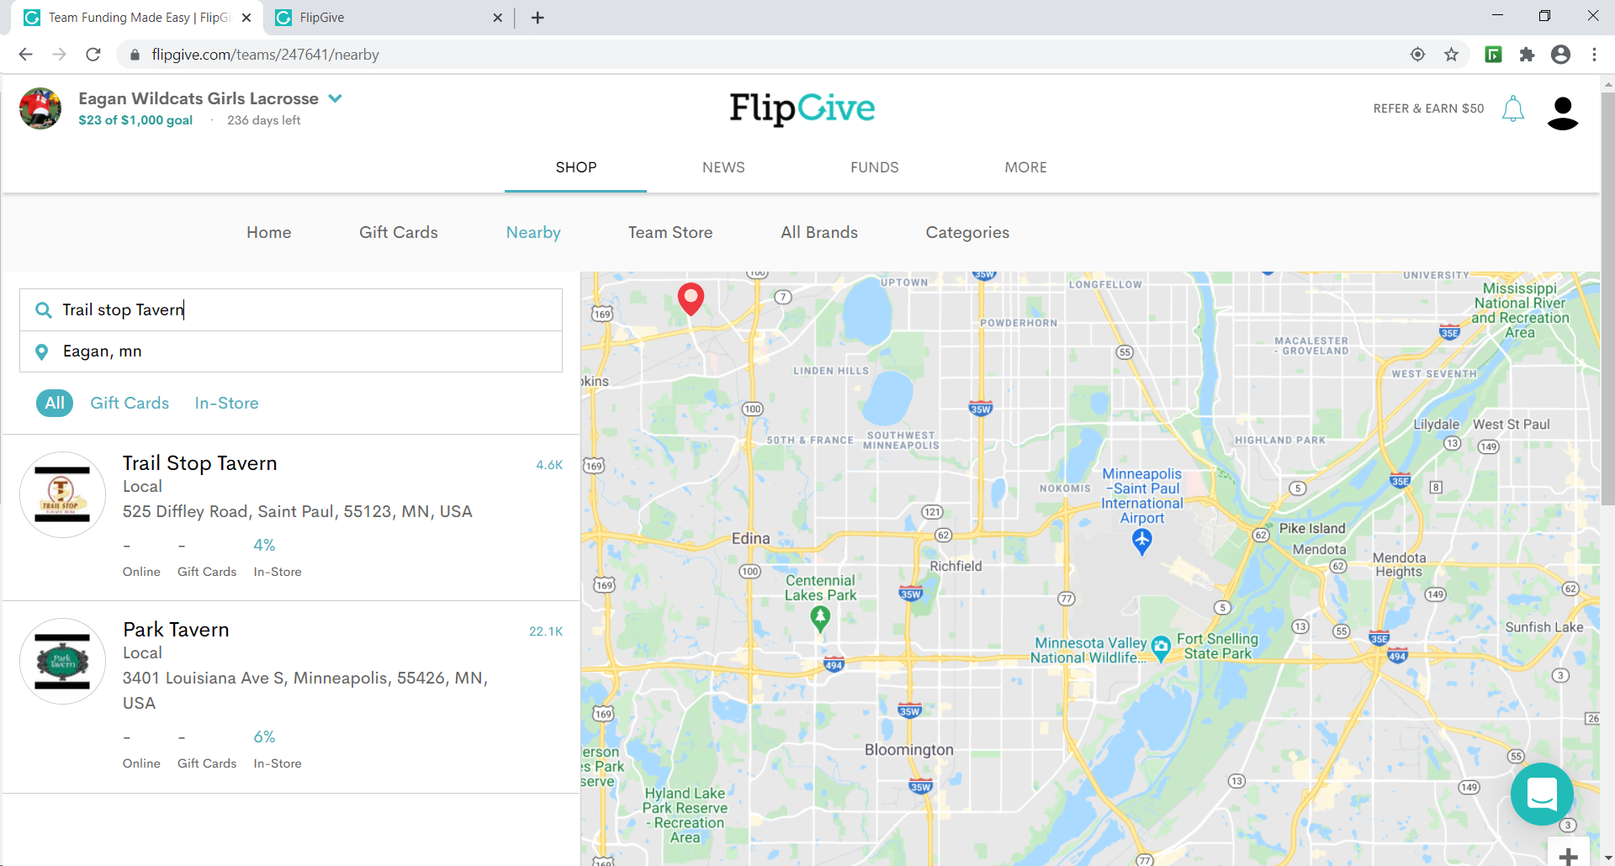
Step 8. Some local locations provide money back on dining in their restaurant. Click on the business to activate the offer.

Slide 6
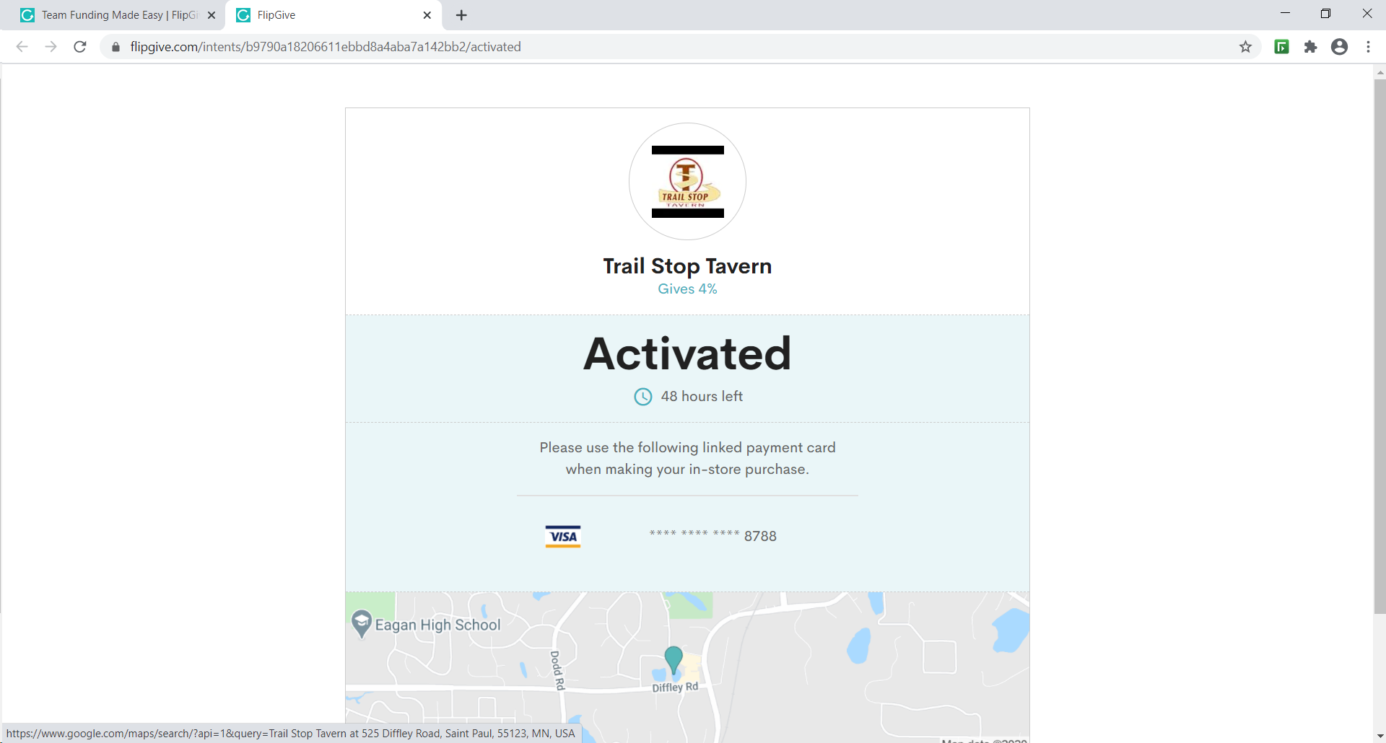
Step 9. Click on “activate” and then your are activated! The offer is active for 48 hours.

Slide 7

There are many brands in flipgive and your team can earn money by using the website for online orders or gift cards. Or, if you are traveling, you can look for local establishments near your destination as well.

Slide 8
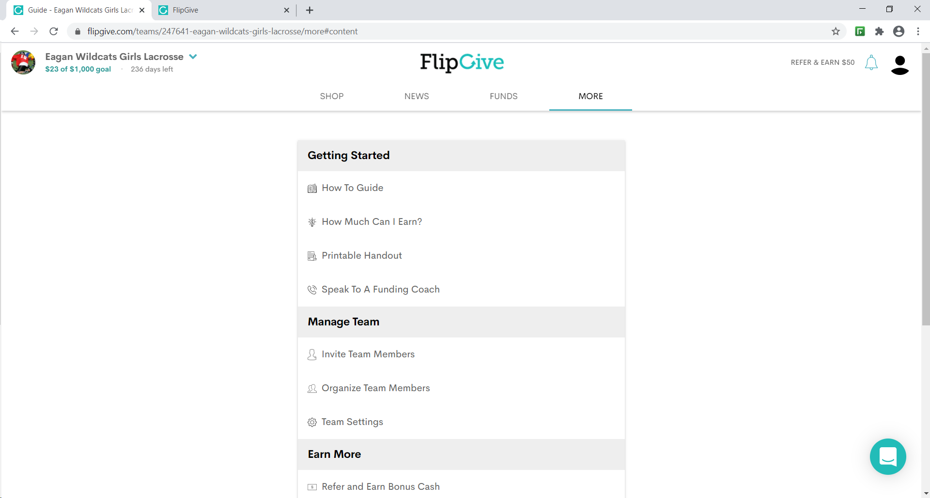
Also, there is a training session and a how to guide available on the website as well. Click on more and then find the guide you need.

