Slide 1


TEA REC. SOCCER U5-U8 (Pre-K – 2nd Grade

Slide 2
IMPORTANT INFO TO REMEMBER FOR U5-U8
FIELD DIMENSIONS: 15 yards X 25 yards (U5 & U6)
30 yards X 40 yards (U7 & U8)
SOCCER BALL SIZE (U5-U8): SIZE 3 (PLAYERS ARE RESPONSIBLE TO BRINGING THEIR SOCCER BALLS TO PRACTICES & GAMES)
NUMBER OF PLAYERS: U5 & U6 – 3 VS. 3 (No Goalie)
U7 & U8 – 4 VS. 4 (No Goalie)
- Each player on the team will receive an equal amount of playing time during each game. A player should not play the entire game unless there are only 3 or 4 players present.

Slide 3
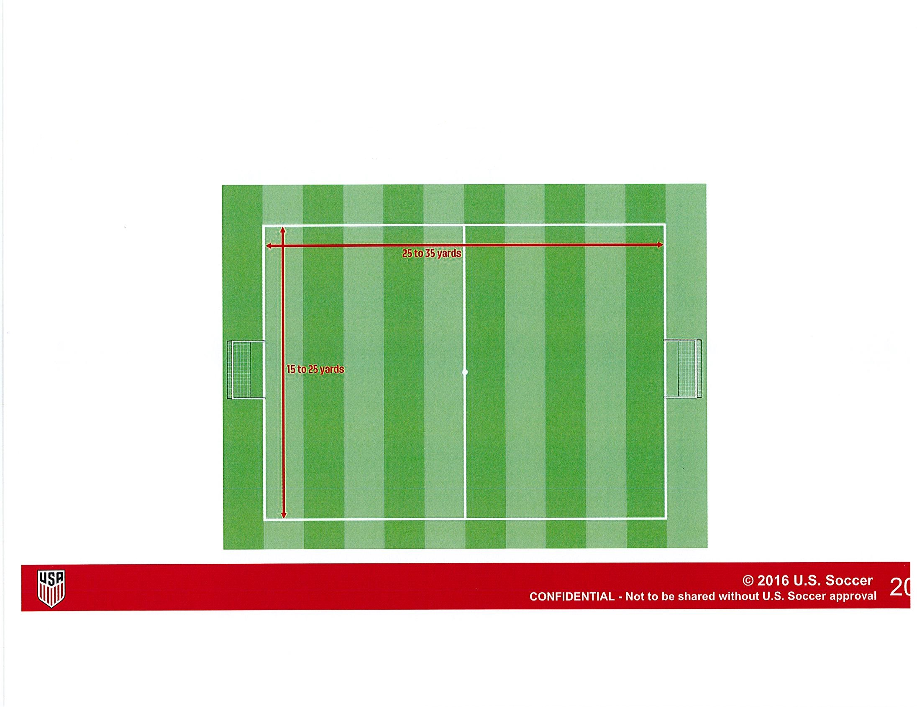
FIELD LAYOUT FOR U5-U8

Slide 4
IMPORTANT INFO TO REMEMBER FOR U5-U8
EQUIPMENT:
Players must wear their team uniforms colors for games. All players are required to wear shin guards, which must be covered by an appropriate sock.
Players are allowed to wear tennis shoes, turf shoes, rubber cleats (no toe cleat), or screw-in cleats (no toe cleat) provided they are deemed safe by the referee/coach. Absolutely no metal cleats or metal tip cleats!
Necklaces, bracelets, watches, earrings, other body pierced jewelry, and other jewelry are NOT allowed.
DURATION OF THE MATCH: U5 & U6 – 12-minute halves (3-minute halftime).
U7 & U8 – 20-minute halves (3-minute halftime).
- Recommend putting a timer on your phone. That way you can hear the timer go off instead if you where you wouldn’t if you put it on stopwatch.

Slide 5
IMPORTANT RULES TO REMEMBER FOR U5-U8
Substitutions will be unlimited. Free substitution will be allowed in all age groups. The substitute players can enter the field only after the replaced player leaves. All players will enter the field at the half line. Players who are being substituted may leave the field of play at the nearest point on the boundary line unless the referee/coach indicates otherwise. Substitutions can only be made with the consent of the referee/coach at the following times:
Prior to either team's throw-in with the consent of the referee.
Prior to a goal kick by either team.
After a goal by either team
After an injury by either team, if allowed by the referee/coach.

Slide 6
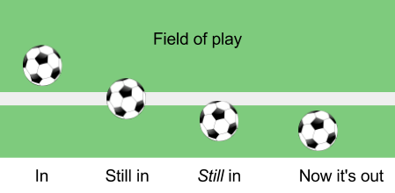
IMPORTANT RULES TO REMEMBER FOR U5 & U6
The lines are considered part of the field of play and part of the area they define on the field. The ball is out of play when the whole ball crosses the entire goal line or the entire touch line either on the ground or in the air.

Slide 7
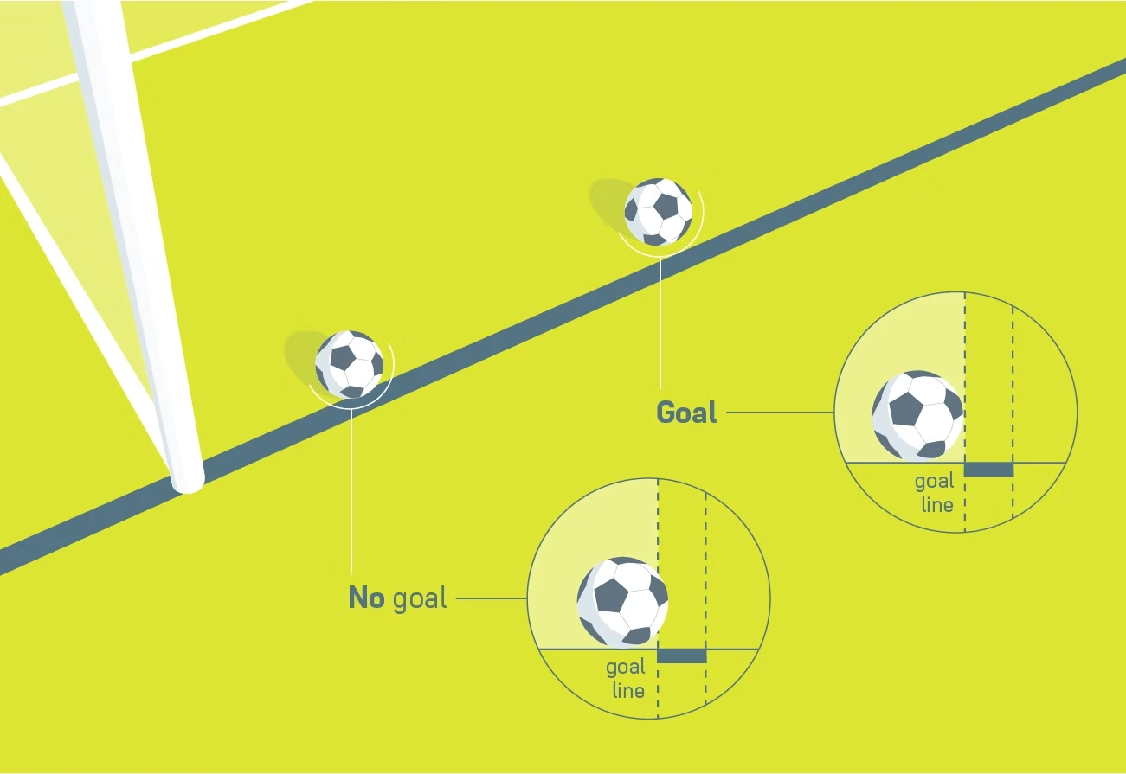
IMPORTANT RULES TO REMEMBER FOR U5 & U6
A goal is scored when the whole ball has passed over the goal line, between the goalposts, and under the crossbar, provided no infringement of the Laws of the Game has been committed previously by the team scoring the goal. Scores are not recorded in U5-U10). We ask that coaches respect the other team and be mindful of the number of goals scored against an opponent)

Slide 8
IMPORTANT RULES TO REMEMBER FOR U5-U8
No Hands, please
First, the rule for a hand ball includes using any part of the body from the tips of the fingers to the shoulder. Second, the proper way to look at this soccer rule is that a player cannot “handle” the ball. A ball that is kicked and hits a player’s hand or arm is not a hand ball. This means that the referee/coach must judge whether or not a hand ball is accidental contact, or the player handled the ball on purpose to gain an advantage.
Fouls
The common rule of thumb on fouls is “If it looks like a foul, it probably is.” A player cannot kick, trip, jump at, charge, strike, push, hold, or spit at an opponent. Bumping, leaning or going shoulder-to-shoulder while competing for a ball is not a foul until the hands or elbows come up. ABSOLUTLEY NO SLIDING FOR U5-U8!

Slide 9
IMPORTANT RULES TO REMEMBER FOR U5-U8
U5-U8 WE WON’T HAVE REFEREES. THE COACHES WILL ACT AS THE REFEREE.
KICKOFF
A kickoff is a way of starting or restarting play:
at the start of the match
after a goal has been scored
at the start of the second half of the game
at the start of each period of extra time if applicable
A goal may be scored directly from a kickoff. (Does not apply U5-U8)
All players must be on their own (defending) half of the field - except the player taking the kickoff.
Opponents must be at least 10 yards away from the ball until it is put in play.
Helpful Tip: Recommend the coach being 10 yards away from the half line, and telling the kids to stand even from where you are. Tell them once they kick it then they can go for the ball.

Slide 10
IMPORTANT RULES TO REMEMBER FOR U5-U8
OFFSIDES: There is no offside violation in U5-U8 play.
For U5-U8 All free kicks will be Indirect Free Kicks.
What’s an Indirect Free Kick?
When an indirect kick is awarded, it is taken from the spot where the foul was committed. The player taking the kick cannot touch the ball again until it has touched another player-- and if the indirect kick goes into the goal before touching another player, a goal kick is awarded
Opponents must be 5 yards away when the indirect kick occurs.
THE PENALTY KICK
For U5-U8 there will be no penalty kicks - in the case of an infringement 5 yards within the goal (coaches’ discretion), the ball will be placed in the center of the field 5 yards for U5/U6 & 10 yards away for U7/U8 from the goal, and play will resume with an indirect free kick.

Slide 11
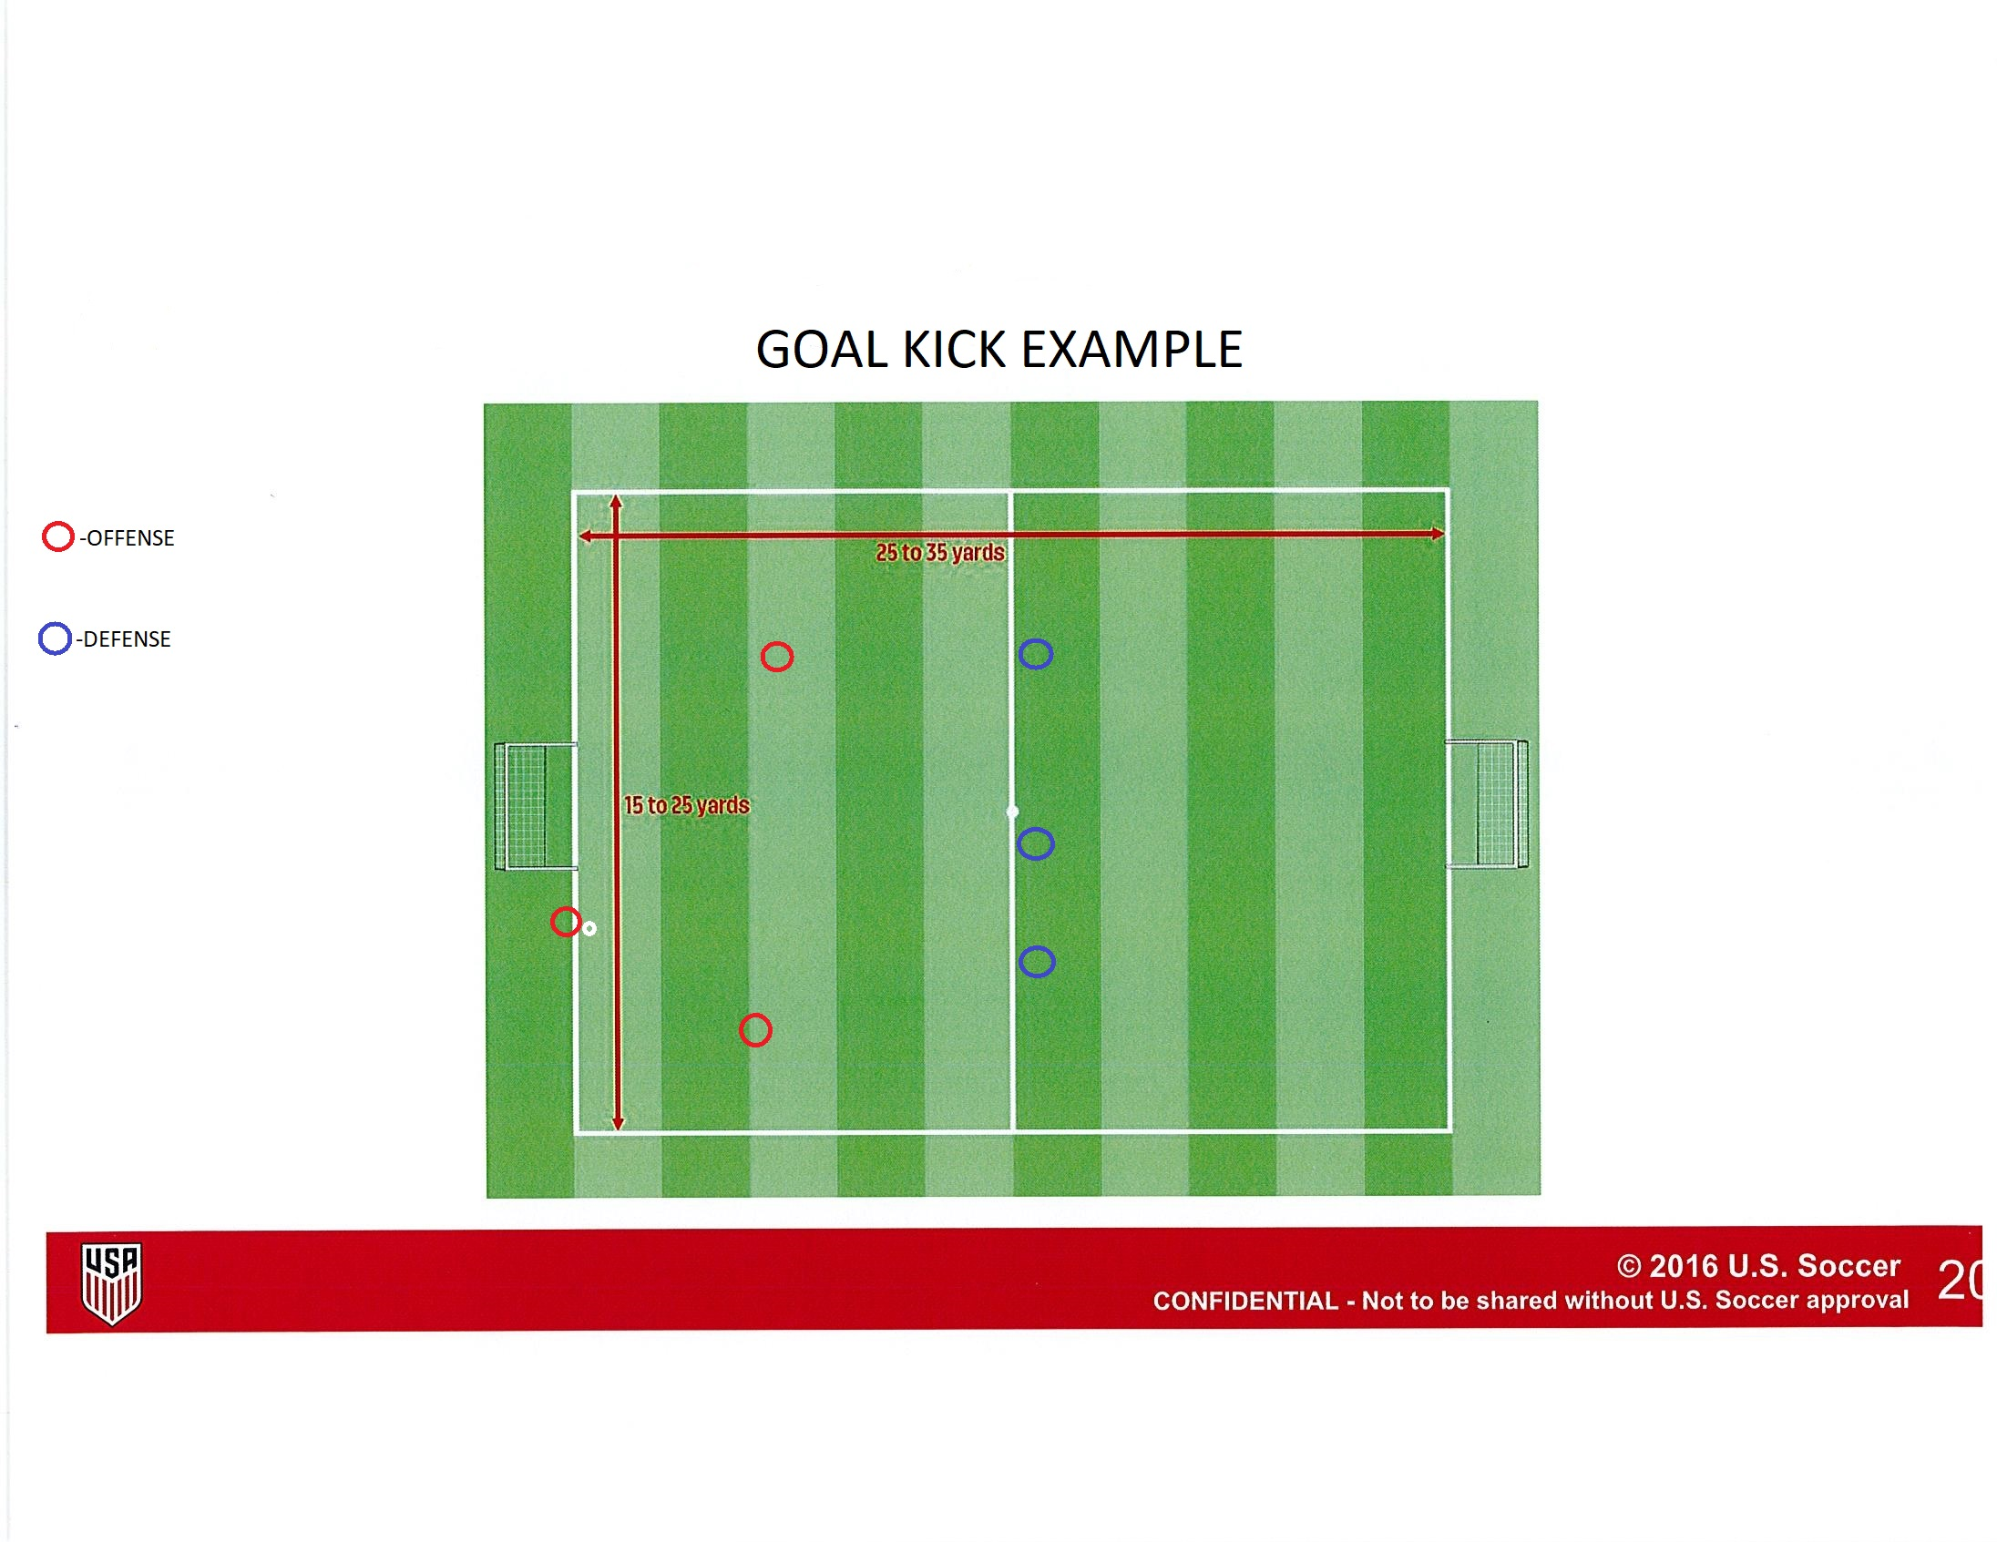
IMPORTANT RULES TO REMEMBER FOR U5-U8
THROW IN:
- For U5-U6 the throw-in will be replaced by the kick-in
- U6-U7 will do a throw-in. Just make sure to let the players know they need both feet on the ground and throw over their head for a throw-in.
GOAL KICK (U5-U8 ONLY): The kick is taken from the goal line or yards in front of the soccer goals and the opposing team should be on their own half. Once the ball kicked into play the opposing team may cross the half line

Slide 12
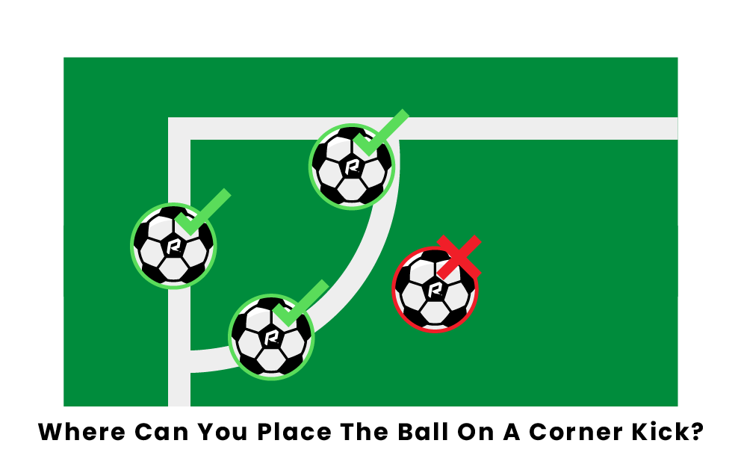
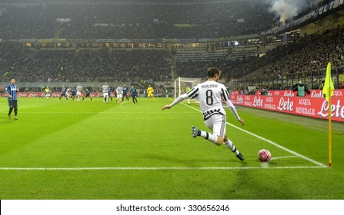
IMPORTANT RULES TO REMEMBER FOR U5-U8
CORNER KICK
A corner kick is a method of restarting a game.
A goal may be scored directly from a corner kick, but only against the opposing team.
A corner kick is awarded when the whole ball, having last touched a member of the defending team, passes over the goal line in the air or on the ground and a goal is not scored

Slide 13
PRACTICE INFORMATION
U5 & U6: will have a 20-minute practice before the start of each game.
U7 & U8: We ask the coaches to provide one practice a week for 1 hour. A google docs. sheets will be provided to coaches to set up date and time that works to practice with your team. Due to schedule conflicts & amount fields we have available there maybe some teams that will have to share a field for practice.
- It’s recommended to try to be consistent with your practice schedule. Also, to have a group text with parents. That way if you must cancel a practice, and you can directly contact the parents on your team.

