Slide 1





Seacoast United/Exeter Hawks
Home Workout Plan -
March 30th - April 4th 2020

Slide 2

Seacoast United - #InThisTogether

Slide 3
Seacoast United DA Home Workout Plan
The Seacoast United Home Workout will consist of a 5-Day Plan to keep our players active in this time away from Team Training Sessions. The activities we have are all designed so players can perform on their own in a limited space, so should be accessible for all our players.
The Seacoast United Home Workout Weekly Plan will consist of the following:
Dynamic Warm Up
Cool Down
Aerobic Workout
Technical Based Workout
Core Workout
Upper Body Workout
Lower Body Workout
Yoga Workout
Tactical Homework
This presentation will include a weekly schedule, plus descriptions of the activities we would like the players to perform in each of the workouts

Slide 4
Weekly Schedule (3/28-4/8)
Monday 23rd March | Tuesday 24th March | Wednesday 25th March | Thursday 26th March | Friday 27th March
Dynamic Warm Up | Dynamic Warm Up | Yoga Workout | Dynamic Warm Up | Dynamic Warm Up
Technical Workout | Technical Workout | Soccer Homework | Technical Workout | Technical Workout
12 Min Cooper Test | Core Workout |  | Aerobic Workout Sprint Exercises | Core Workout
Cool Down | Upper Body Workout |  | Cool Down | Lower Body Workout
 | Cool Down |  |  | Cool Down

Slide 5
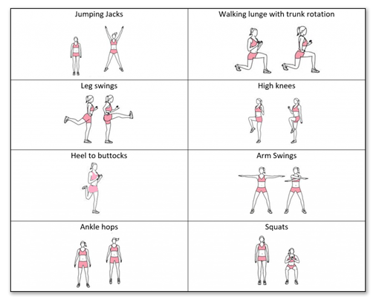
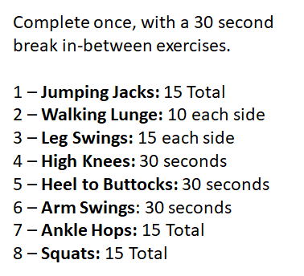
Dynamic Warm Up
~ Mon, Tues, Thurs and Fri ~

Slide 6
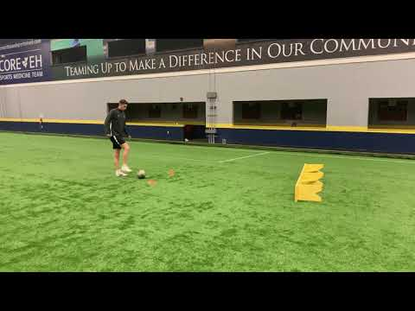
Technical Workout
~ Monday, Tuesday, Thursday, Friday ~

Slide 7
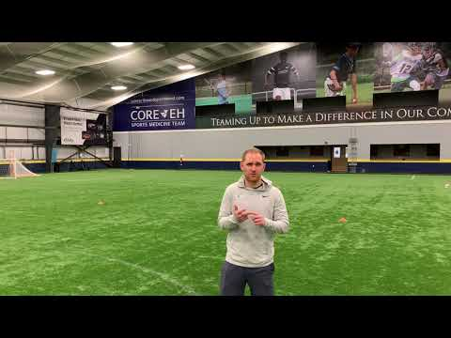
12 Minute Cooper Test
~ Monday ~

Slide 8
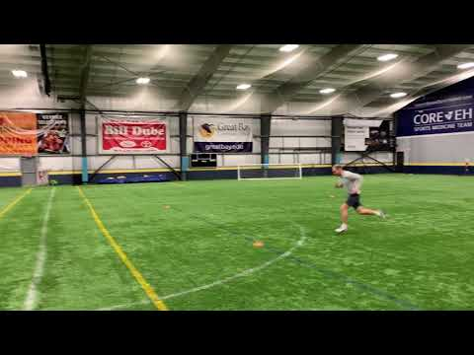
Aerobic Workout
~ Thursday ~

Slide 9
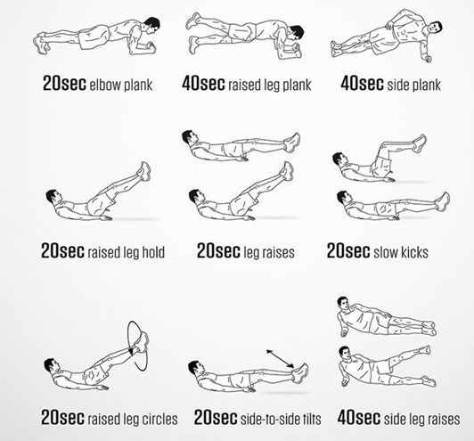
Core Workout
~ Tuesday & Thursday ~
***Players should complete 1 set of all 9 activities, before taking a 2 minute rest.
Repeat this process for a total of 3 times**

Slide 10
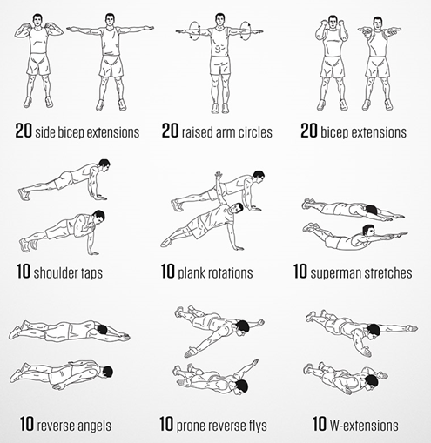
Upper Body Workout
~ Tuesday ~
***Players should complete 1 set of all 3 activities, before taking a 2 minute rest.
Repeat this process for a total of 3 times***

Slide 11
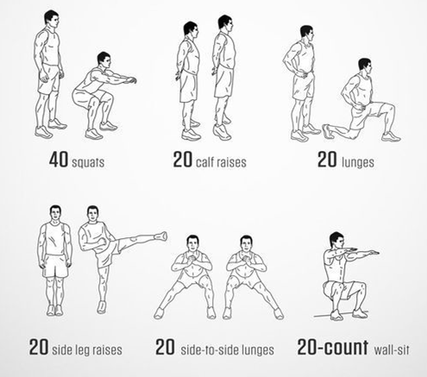
Lower Body Workout
~ Thursday ~
***Players should complete 1 set of all 6 activities, before taking a 2 minute rest.
Repeat this process for a total of 3-4 times***

Slide 12
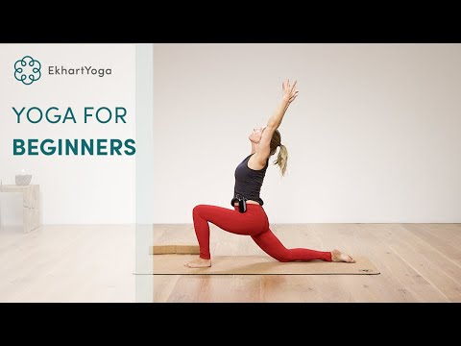
Yoga Workout
~ Wednesday ~

Slide 13
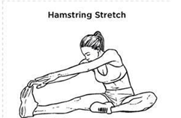
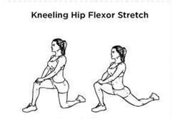
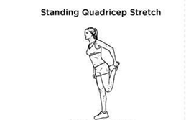
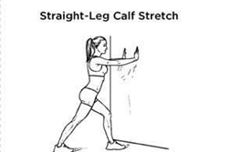
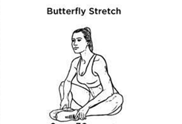
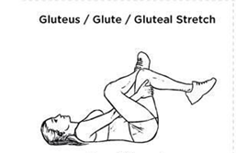

Cool Down
~ Mon, Tues, Thurs and Fri ~

Slide 14

Soccer Homework
~ Wednesday ~
Pick your favourite soccer team - this can be from any country you want!
Explain their style of play
Key players
Typical formation they play
Current top scorer
Your favorite player for that team of all time and why
Please email your answers, along with your Cooper Run test score to your Head Coach by Friday.

Slide 15

Stay Safe & Stay Fit

