Slide 1

Girls Lax Stats
INGLA 2025

Slide 2


Agenda
--How to Prepare --
--Field Players Stats--
--Goalie Stats--

Slide 3
How to Prepare - before the game starts
Learn the role - stats guidelines, shadowing
Physical items you need - pencil, stat sheets, roster
Helpful items - clipboard, stats spotter
What your coach should provide - starting line up, full roster, preferred stat sheets
What the other coach should provide - roster is nice to have - essential if home to stats recorder also is responsible for tracking game yellow/red cards (may be separate role)
What can the referee provide

Slide 4
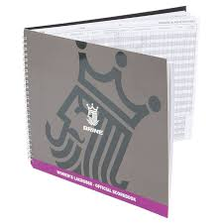
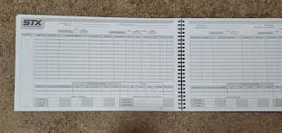
“The Book”
Different teams use different books
Different books have different stats listed/order
The sport has changed faster than the books
Work with your coaching staff to identify the tools used by your specific team. There is no one right tool, just ensure stats are communicated with the standard categories in mind.

Slide 5
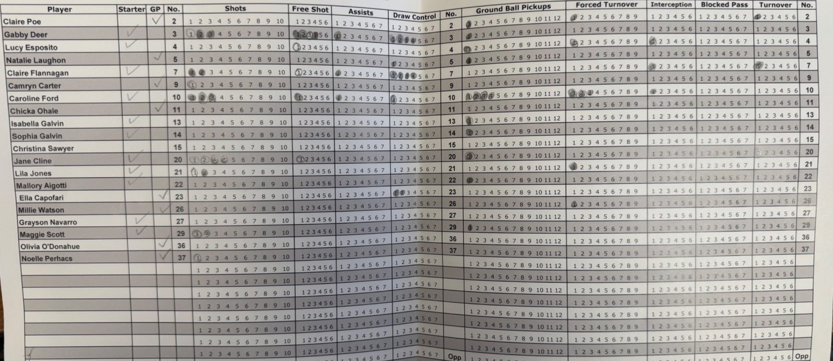
GC STATS SHEET example

Slide 6
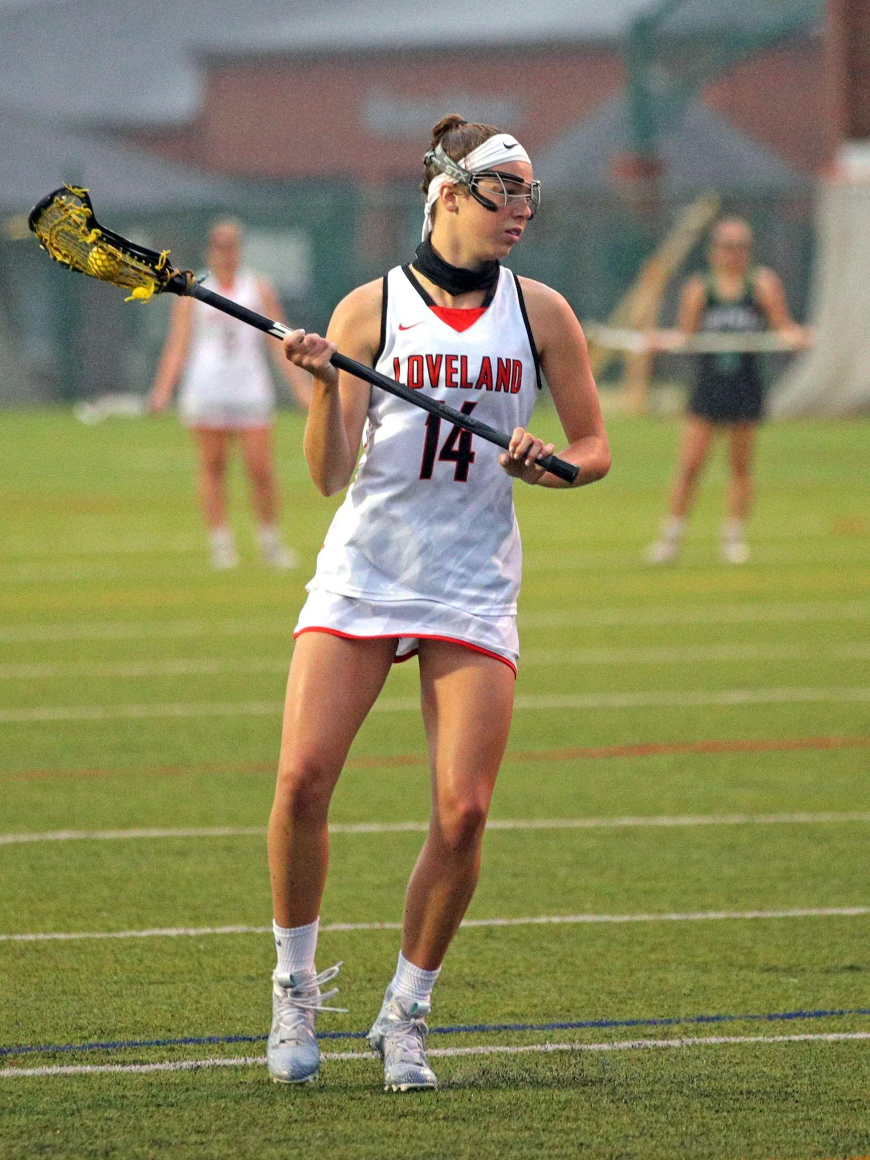
Field Player Stats
Field Player Stats Tracked by INGLA
Games Played (GP)
Goals (G)
Assists (A)
Shots of Goal (SOG)
Ground Balls (GB)
Turnovers (TO) - loss of possession
Caused Turnovers, Forced Turnovers, Interceptions (FT)
Draw Controls (DC)
Yellow Cards (INF) and Red Cards (PIM)

Slide 7
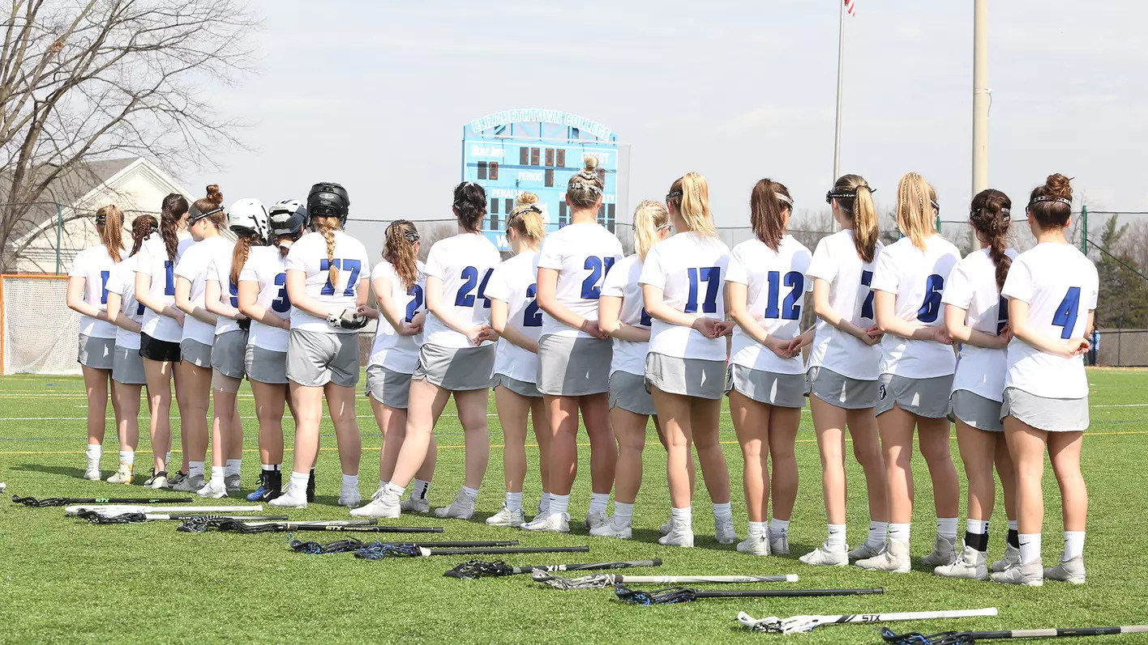
Games
Played
(GP)
-Easy to start
- List with starters - When to look for subbing
-Clock running= game played, regardless of if they get a stat
-Quarters (INGLA isn’t that granular)

Slide 8
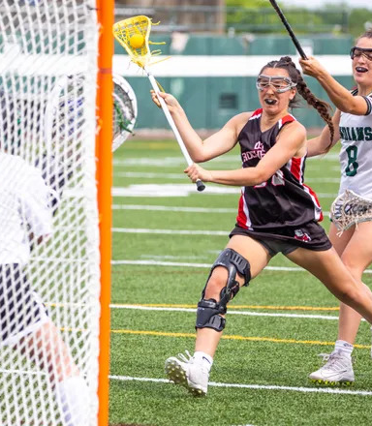
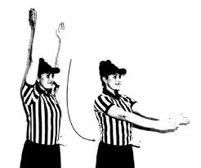
Goal (G)
Every goal results from a recorded shot
Own goals (goal inadvertently scored by the defensive team should be recorded as a turnover for the defensive player and credit to last offensive player to have possession of the ball)
Be watchful for disallowed goals

Slide 9
Assist (A)
A pass to a teammate who then scores a goal without having to evade EXCESSIVE defensive pressure (except the goalie)
Only one assist per goal
Player A must intentionally pass the ball to Player B and Player B must intentionally take a shot
Shooter must not have to maneuver significantly around defenders (is a judgement call)
No Time or Step Limit
No assist for a shot rebounded off the goal
Long Clears Can Count as Goals

Slide 10
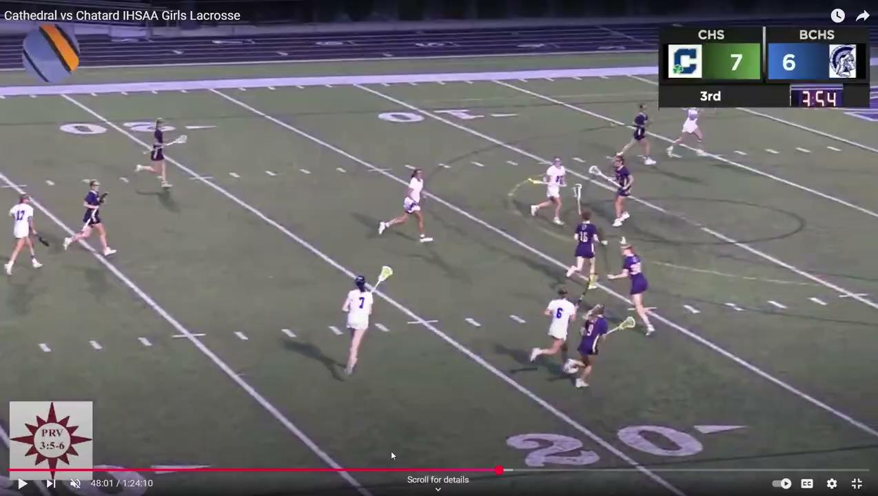
Assist (A)
#7 white starts with the ball
Is this an assist? You make the call?
Answer: Yes

Slide 11
Shots (SOG) - FIELD PLAYER
Although the abbreviation SOG (Shots on Goal) is used on the INGLA system, this stat reflects shots taken by a field player that are either scored or saved. You team might track both “regular” shots and FPSOG (Free Position Shots on Goal)
Teams may track “regular” shots and FPSOG separately
SportsEngine only tracks SOG
All goals will have a recorded SOG attempt
All goalie saves will have a recorded SOG attempt
If a shots goes wide or shot attempts blocked by a defender it is not an SOG

Slide 12
Ground Balls (GB)
Ground ball is recorded when the ball changes possession during live-ball play. A shot returned to the field of play is considered a change of possession regardless of which team shot or gains possession.
When to award a ground ball:
Shot (either team) is deflected/blocked/pipe/wide - player who gains possession
Goalie/field player intercepts a pass (both FT & GB stat earned)
Player forces a turnover (FT) and gains possession (FT & GB earned)
Player A forces a turnover and Teammate B gains possession (FT A, GB B)
Player is fouled in attempt to possess ball and stick is in contact with ball
Only if this is also a change in possession

Slide 13
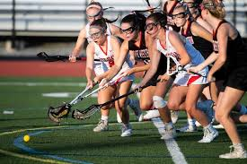
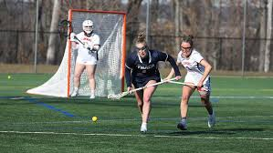
Ground Balls (GB) continued
When NOT to award a ground ball:
Ball goes out of bounds
Ground ball is not credited when possession is simply maintained
When recording a draw control - DC & GB are mutually exclusive
Goalie makes a save but doesn’t control ball - no ground ball if uncontested

Slide 14
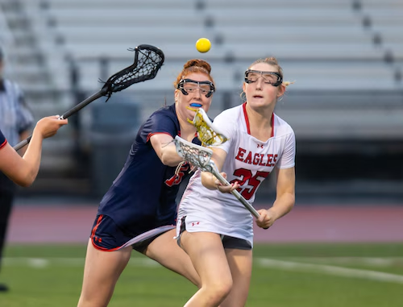
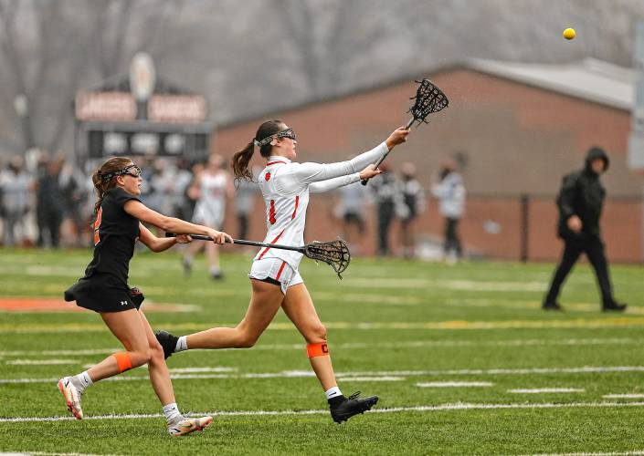
Turnover (TO)
-When a player loses possession of the ball
Judgement call on which player is “responsible”
Missed shot ≠ turnover
Dropped ball or errant pass recovered by
teammate ≠ turnover
-FT/CTO/INT by Team A player = TO by Team B player
-Turnover ≠ forced turnover - a dropped ball or errant pass by a player without defensive pressure does not result in a FT/CTO

Slide 15
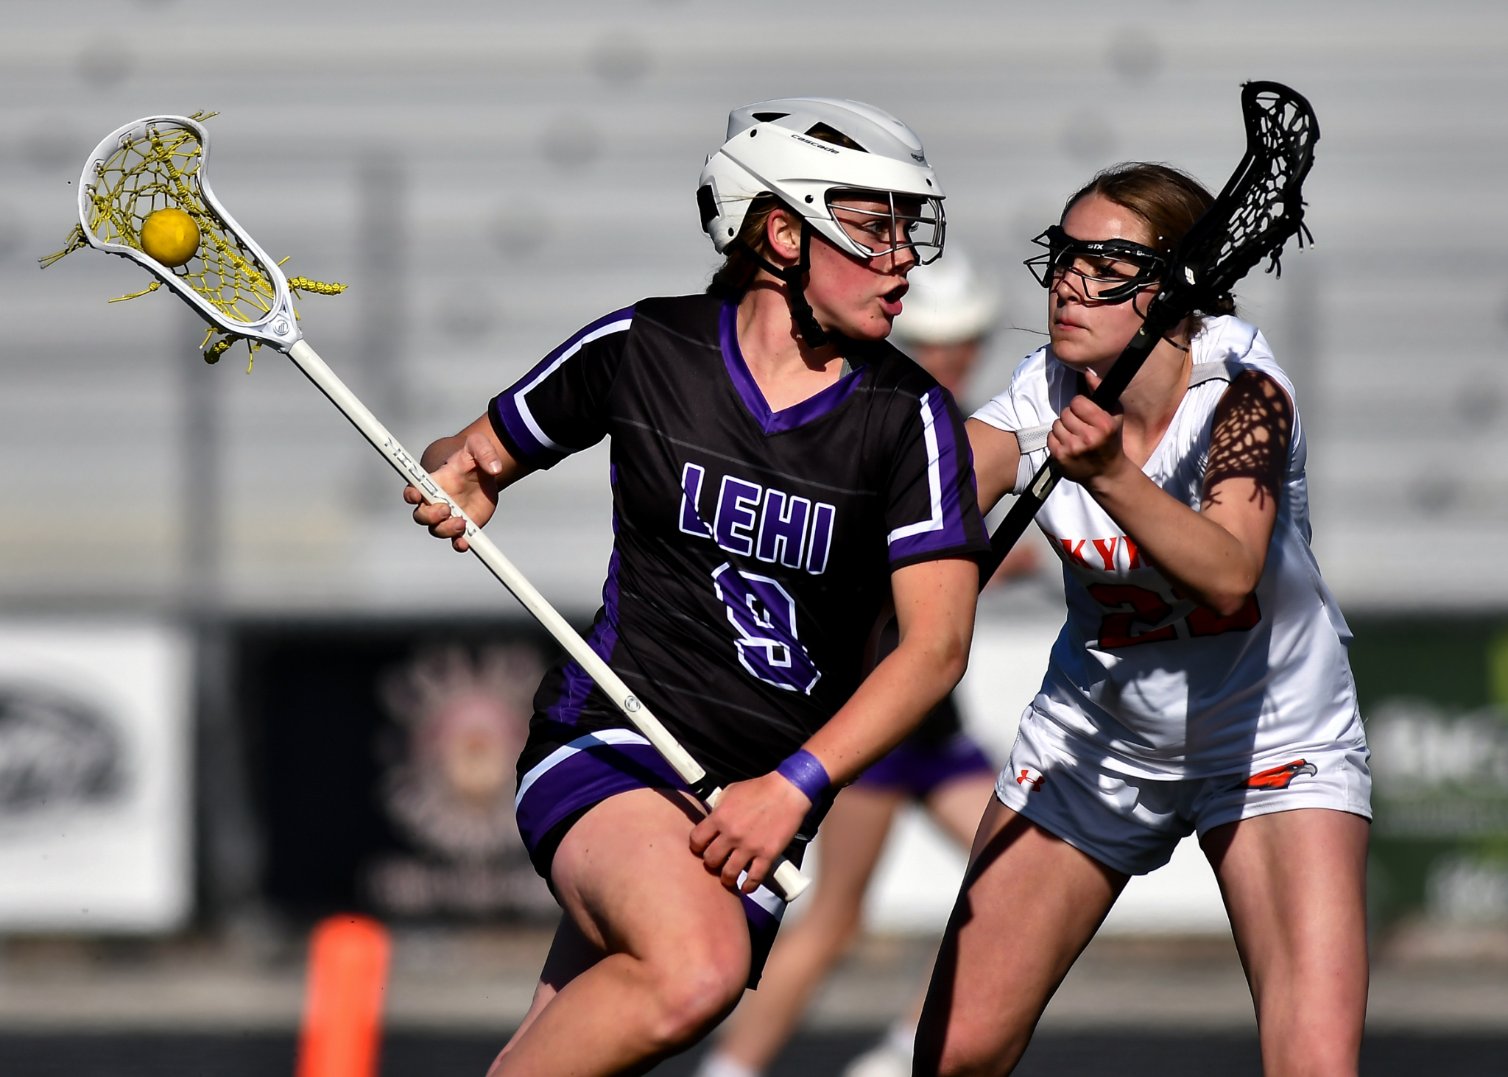
Forced Turnover (FT)
Forced Turnovers may also be known as Caused Turnover (CTO) and Interceptions (INT). Teams use different terminology and may track FT/CTO separate from INT but in SportsEngine FT/CTO/INT are all recorded as FT
Credit to defensive players for disrupting the opponent’s possession and creating a change of possession for their team

Slide 16
Forced Turnover (FT)
When to award a FT:
Checks resulting in change of possession
Blocked pass or shot resulting change of possession
Draws a charge which results in a change of possession
Intercepts a pass which results in a change of possession (INT, FTO & GB stat)
KEY - must be change of possession
When NOT to award a FT:
Opponent turnover without defensive pressure
Team attempting FT does not gain possession (although possession does NOT need to be player causing FT)
All FTs will result in a GB but not necessarily the player causing the FT

Slide 17
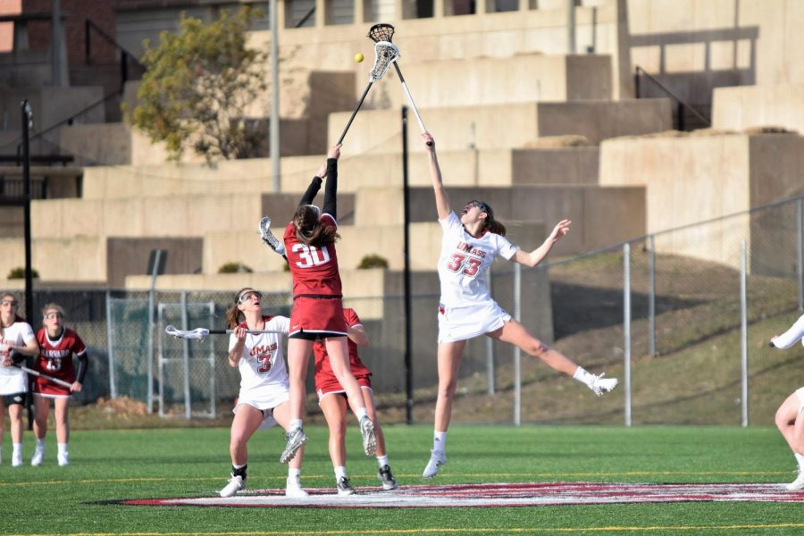
Draw Control (DC)
Awarded to the player who gains possession of the ball or creates an opportunity for her team to gain possession after the draw is taken.
Only one DC stat is recorded for each draw control
DC stat is NOT necessarily for player taking the draw, but player possessing the draw
Foul called before possession gained? Player awarded ball by official is credited DC
False start, early entry, AP, redraw? No DC awarded
Draw control ≠ Ground ball (even if picked up off the ground)
Watch for referee signal to know when it is determined that possession has been gained

Slide 18


Slide 19
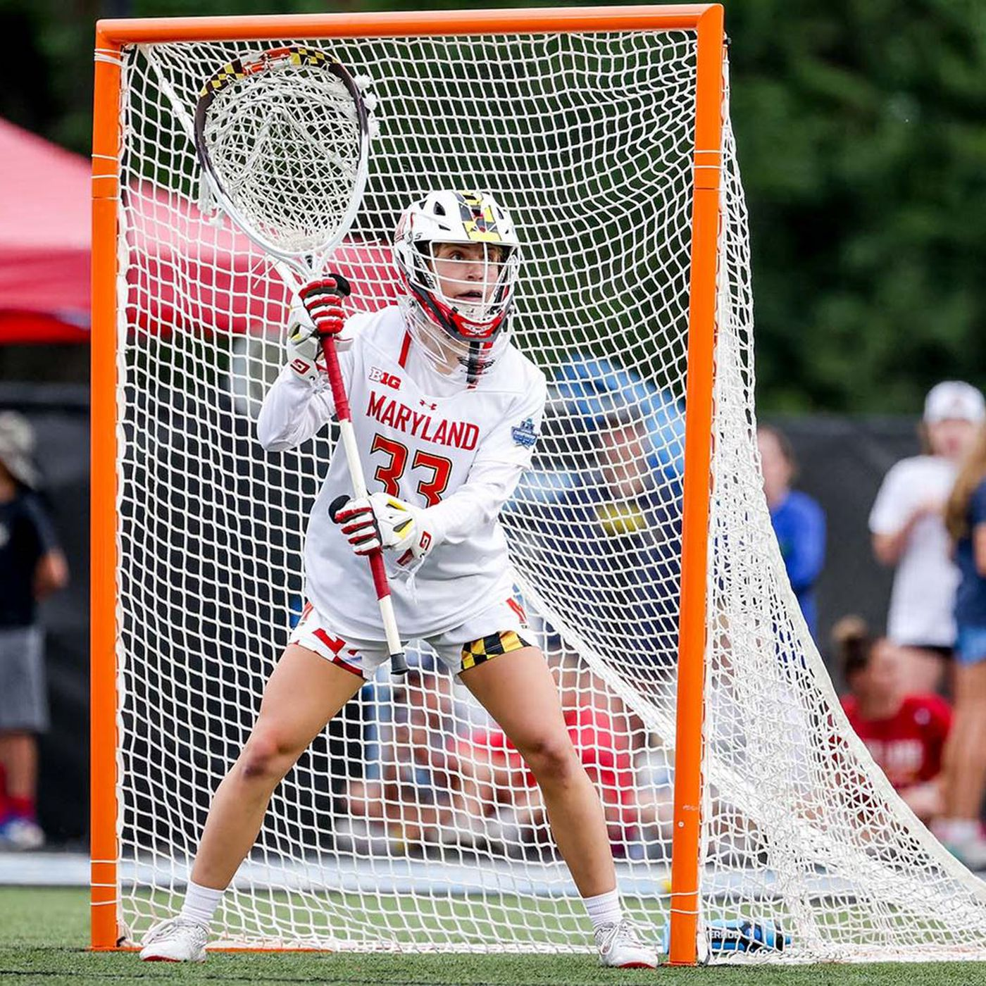
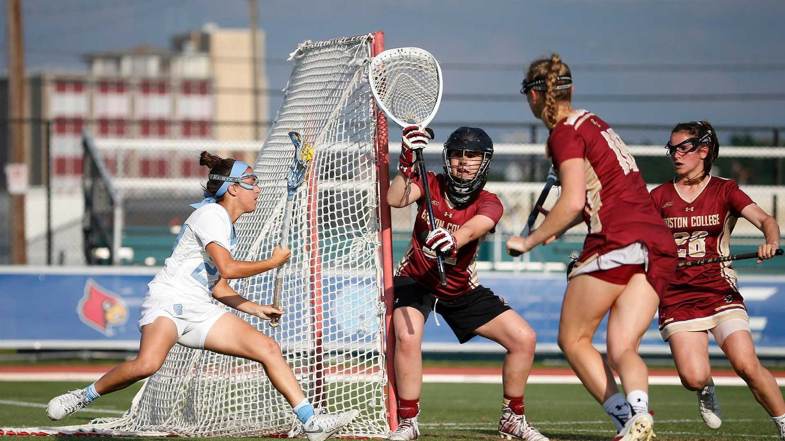
Goalie Stats

Slide 20
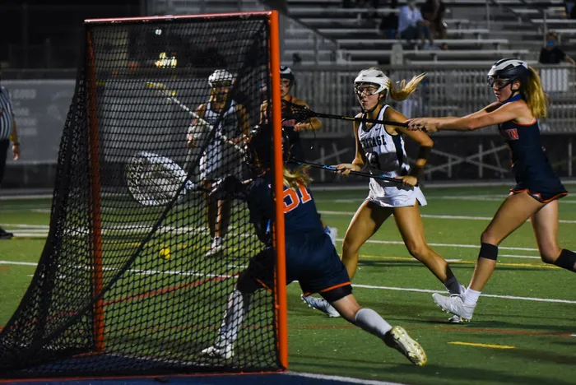
Shots on Goal (SOG)
For GOALIES shots on goal (SOG) are the sum of goals allowed and saves
A shot by a player that goes wide, high, hits the pipe or is deflected by a teammate does not count as a SOG

Slide 21
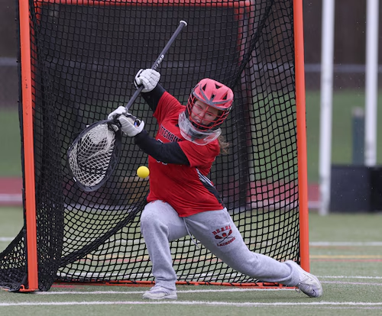
Goals Allowed
(GA)
Goal scored by the other team
Goals allowed + Saves = SOG

Slide 22
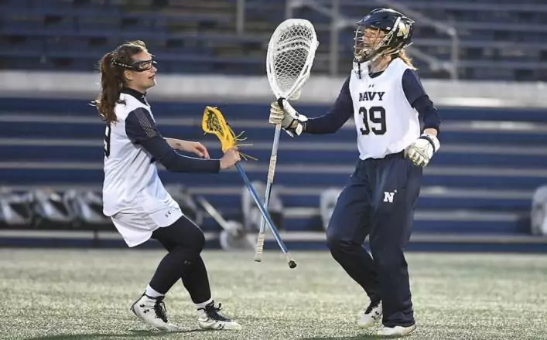
SAVES (SV)
A save is recorded when a goalie prevents a goal by stopping a shot (with any part of her body or stick) that would have otherwise entered the net
Shots that hit the pipe or go wide of net are NOT saves
If a goalie stops a shot and then recovers the loose ball, she is awarded both a save AND a GB

Slide 23
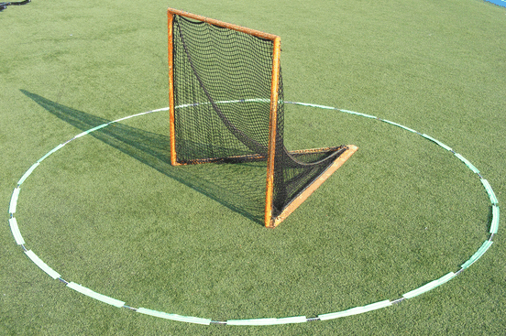
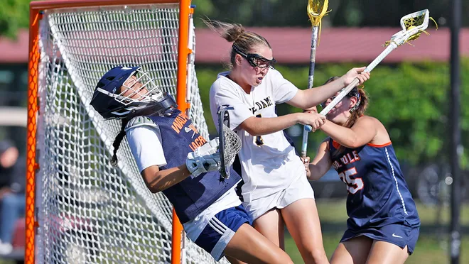
Ground Balls (GB) - GOALIE
Off the ground? Ball must be outside goal circle
Off an interception?
Yes- count it as aGround ball
Inside circle or outside
Can a goalie get a forced turnover?
Recorded as GB in SE for goalie stat
FT not tracked in SE as goalie stat
Teams may opt to track this for
internal use

Slide 24
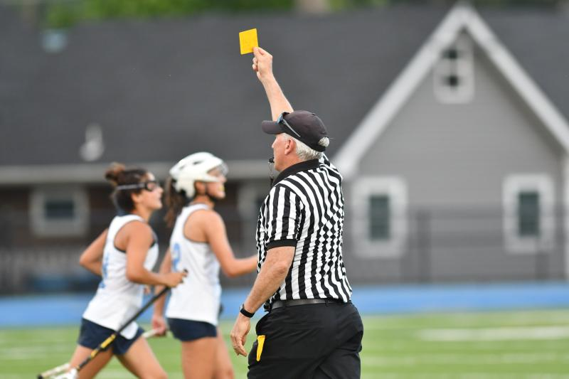
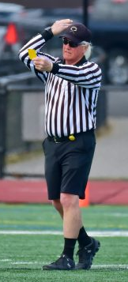
Yellow Card (INF)
Referee signal
Clock stops
Field Player must leave field
Goalie does not have to leave the game if your team does not have a backup goalie
Alternate player chosen by coach to sit out
Yellow card still goes to goalie
2 yellows for player = out of the game
4 yellows for team= permanent man down
Please also note Coach
And spectator cards

Slide 25
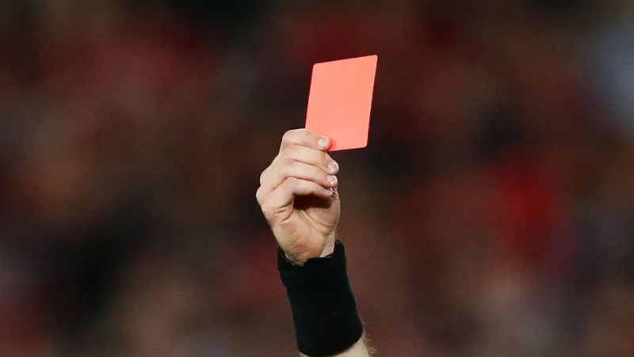
(PIM)
Red Card
-Referee will hold up card , clock stops, player will not be allowed to return to game
- Strange scenarios depending on if you have a backup goalie- but card goes to goalie if they commited the foul

Slide 26
OPTIONAL STATS NOT IN SE
Below is a list of stats that many teams may record during a game for internal team use but these are not reported or tracked in SportsEngine
Fouls not resulting in a card
Free Position Shots on Goal (FPSOG)
Good Clears
Broken Clears
FPSOG Attempts vs Saves
Opponent Ground Balls

Slide 27
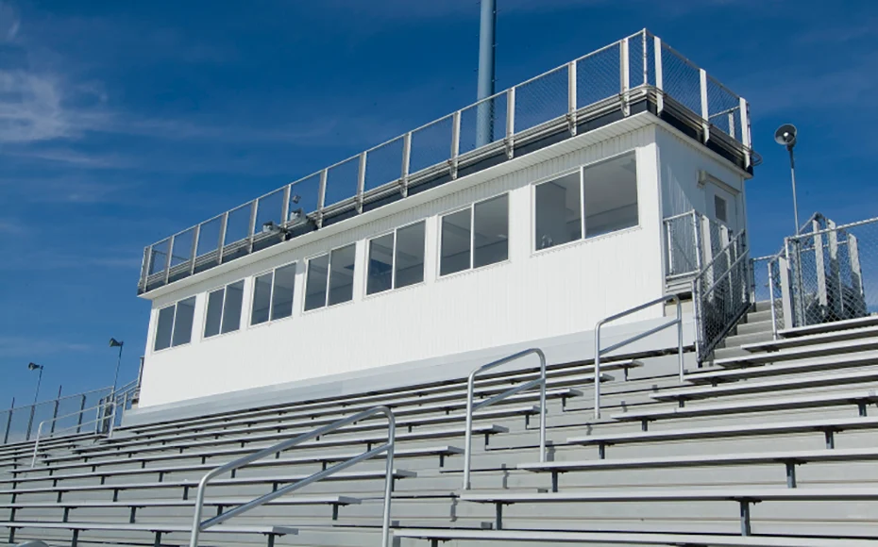
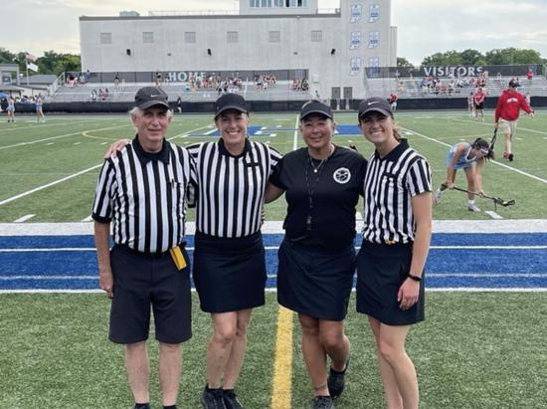
After the game
Return book to the coach
Get referee signature if required
Confer with other team stats person
to agree on score

Slide 28
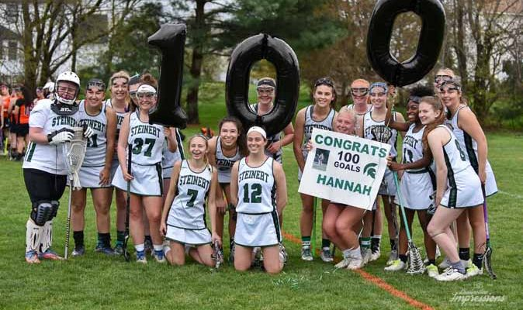
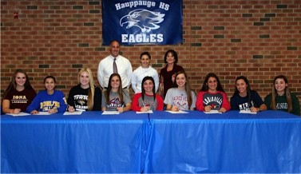

Why do we do this?

Slide 29
THANK YOU!

