Slide 1
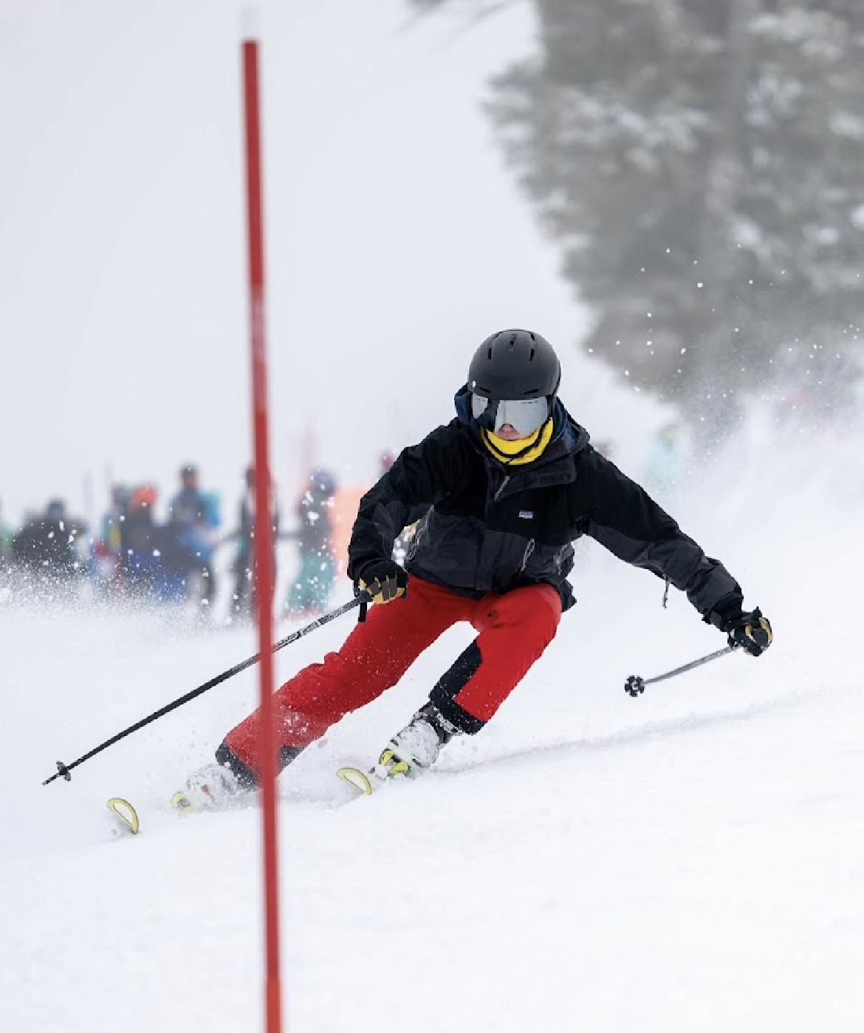
Welcome Back!
Bogus Basin School Race Program 2024

Slide 2
The program’s philosophy has 3 goals:
Provide a safe environment on the slopes in which to participate.
Encourage students to represent and compete for their school in a life sport activity. This provides a venue for many students to represent their school that might not otherwise.
Provide a level of competition in which the maximum number of students can participate.

Slide 3
Advisor Responsibilities:
Online Registration:
Student Registration Deadlines:
    1st Race registration deadline is December 10th, 2023
    All add-ons will be done online via student registration. If a racer needs changes to be made to their category, it must be emailed to their advisor by 10:00 PM on the Wednesday before their first race.
    If a Student registers after December 10th they will be eligible to participate in the second race.
Online Liability Forms
    All Liability and Concussion Protocol forms will be on-line and a part of the Adviser and Student registration forms. Parents registering a student will not be able to move to the next section of the form without viewing and agreeing to the Liability, Concussion Protocol and Release of information forms.

Slide 4
Parent Responsibilities:
Online Registration
    Go to the Bogus Basin website
    Go to: Your Mountain
    Go to: About Bogus
    Go to: Competitive Education
    Go to: Bogus Basin School Race Program
    Scroll down to Middle School or High School Registration
    You must respond to each question to move on
    Parents must fill out the registration unless the student is 18 years of age or older.

Slide 5
2024 Schedule for all race days
12/10/23 Last Day to register to be eligible for the 1st race
      Registration for the 2024 Season will close on 1/31/23
Saturday, January 13th, 2024, Race #1
Saturday, January 20th, 2024, Race #2 Snow Dance Party
Saturday, January 27th, 2024, Race #3
          Nordic HS 11:30 AM start MS 12:00 PM start
Saturday, February 3rd, 2024, Race #4
Saturday, February 10th, 2024, Race #5 St. Luke's Helmet Contest
Saturday, February 17th, 2024, Race #6
    Nordic HS 11:30 AM start MS 12:00 PM start
Thursday, February 22nd, 2024, High School Dotty Clark
Friday, February 23rd, 2024, Middle School Dotty Clark

Slide 6
2024 Schedule of events
Competition Time Location
Nordic 10:00 Frontier Point Lodge (Nordic Center)
Snowboard Expert MS/HS 10:30 B-3
Freestyle HS -11:00 MS -11:45 Front Side
High School Slalom 12:30 Bitterroot Basin
Middle School Slalom 1:30 Bitterroot Basin

Slide 7
2024 Dotty Clark Daily Schedule
9:00 AM – Morning Star Chair opens to all Dotty Clark Advisors & Kids
9:00 AM – Bitterroot Chair opens to all Dotty Clark Advisors & Kids
9:30 AM – Freestyle (SBE Competitors go first)
10:00 AM - Snowboard Expert (SBE)
10:30 AM – Slalom Races
12:30 PM – Nordic Races
2:00 PM – Awards will be hosted in the flats out front of Simplot Lodge
RACERS WILL NEED TO RACE A MINIMUM OF 3 SATURDAY RACES TO QUALIFY FOR THE DOTTY CLARK.
RACERS CAN COMPETE IN ALL FIVE DISCIPLINES AT DOTTY CLARK IF THEY QUALIFIED IN ALL FIVE DISCIPLINES. 3 races in INT, 3 in SBN, 3 in NEX, 3 EACH in FREESTYLE SKI and SNOWBOARD

Slide 8
Disciplines and Categories
Ski Slalom
EXP – Expert Ski
ADV- Advanced Ski
INT – Intermediate Ski
NOV – Novice Ski
Freestyle Ski
FSE – Freestyle Skier Expert
FSI – Freestyle Skier Intermediate
Snowboard Slalom
SBE – Expert Snowboarder
SBI – Intermediate Snowboarder
SBN – Novice Snowboarder
Freestyle Snowboard
FBE – Freestyle Snowboarder Expert
FBI – Freestyle Snowboarder Intermediate
Nordic
NEX – Nordic Expert
NIN – Nordic Intermediate
NNO – Nordic Novice

Slide 9
Add-ons
(racers and categories to current racers)
A student must register online to join the program.
If a racer wants to add a category, this must be emailed to advisors by 10:00 PM on the Wednesday before their first race.
Advisers can make changes up until December 12th at 10 PM. Changes will need to be e-mailed to Patty Hamon.
Online add-on registration must be completed by Wednesday, 10:00 pm before they race.
(For example, Mikaela Shiffrin wants to race January 20th, 2024 and submits her registration at 9:59 pm Wednesday, January 17th, 2024. She is good to go!)
NO add-ons will be allowed to race if they did not complete the online registration by Wednesday, 10:00 pm before they race.
(For example, Bode Miller wants to race January 27th, 2024 and submits his registration at 10:01 pm Wednesday, January 24th, 2024. Sorry Bode, you are not eligible for the January 28th race but are eligible for the following weeks race.

Slide 10
Team Scoring System
The Saturday races will be divided into 2 Divisions again this year. Each racer can earn up to 10 points for their school for each race: The more racers, the more points. Points are awarded for Saturday Races by the following criteria:
      10 pts – 100% > 90% of the fastest time
      9 pts – 89% > 80% of the fastest time
      8 pts – 79% > 70% of the fastest time
      7 pts – 69% > 60% of the fastest time
      6 pts – 59% > 50% of the fastest time
      5 pts – 4 9% > 40% of the fastest time
      4 pts – 39% > 30% of the fastest time
      3 pts – 29% > 20% of the fastest time
      2 pts – 19% > 10% of the fastest time
      1 pt – Finished race or Disqualification

Slide 11
Team Scoring System
The Dotty Clark Championships will also be split into Large & Small School Divisions. A team trophy for the champion and individual medals will be awarded for 1st, 2nd & 3rd places in each division and for each category.
School size is decided according to roster. Small School is defined as any school with 25 or less student categories (a student in two categories counts as two students) and Large School is any school with 26 or more student categories.
School Size is not defined by racers but by your roster at the end of week 4 of the season.
Team Trophy Determination
Dotty Clark School Championship
  Total points earned at Dotty Clark will determine large and small school winners.
Bogus Basin School Race Program Champion
  The highest average points per race for the entire season:
    Determined by total points for the season earned by all racers in all categories divided by the number of racers on your roster after week 4.
  To be eligible for this award a school must have a minimum of 5 race entries for small school and 15 for large school trophies.
*Download the Brower Timing App and get live times if you are within 30 feet of the finish line.

Slide 12
Bogus Basin Trophy
Monza High | Race 1 | Race 2 | Race 3 | Race 4 | Race 5 | Race 6 | Dotty Clark | Tota Points | Students On Roster at the end of the 4th Race | Total Points divided by # of Racers on Roster after Race #4 | Team Average
Points | 110 | 97 | 115 | 95 | 114 | 102 | 124 | 757 | 18 | 757/18 = 42.05 | *42
Racers | 17 | 16 | 19 | 18 | 14 | 17 | 17
Silverstone High | Race 1 | Race 2 | Race 3 | Race 4 | Race 5 | Race 6 | Dotty Clark | Total Points
Points | 481 | 513 | 453 | 463 | 419 | 433 | 458 | 3220 | 74 | 3220/77=41.8 | 42
Racers | 80 | 88 | 76 | 74 | 77 | 73 | 69
Max Verstappen competes in EXP, SBI and FSI = 3 on Roster
Fernando Alonso competes in SBN and NNO = 2 on Roster *Monza HS wins 42.05 vs 41.8

Slide 13
Discounts
Mountain Passes → IF THEY RACE! $29.00/day (plus tax) $30.74 including tax
This day pass is good from Open to Close on the mountain
Rental packages (not individual pieces of equipment) $4.00 off.
Rental Pricing is listed on the Bogus Basin website
Students with financial difficulties can get free rental gear. Contact John Foley
Nordic
    Season Pass holders can add Nordic for $25.00
    $5.00 per race on individual race basis.
    Rental gear is free for race only
    We have plenty of Nordic gear this year

Slide 14
Miscellaneous Information & Racer Discounts
HELMETS ARE REQUIRED FOR SLALOM & FREESTYLE.
(Not required for Nordic)
Lift Tickets will not be sold after 1:00 PM
Purchase lift tickets at:
      Bogus Basin Downtown Office aka DTO
      Simplot ticket windows
      Pioneer Lodge
If a student purchases a discounted race day pass and does not participate in the Saturday race, THEY WILL NOT BE ELIGIBLE TO PURCHASE ANOTHER DISCOUNTED PASS FOR THE REST OF THE SEASON

Slide 15
Buses
$10.00 per person round trip or one way (CASH ONLY)
  Locations to be determined – go to the Bogus Basin website for locations and times
  First come first served
  Anyone riding the bus can purchase a lift ticket
    A parent would not need to make a reservation for that weekend to purchase a lift ticket
    Bogus Basin probably will sell out during Saturday races.

Slide 16

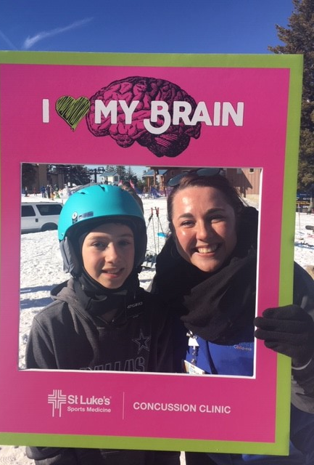
Helmets for Students
Notes:
Now if you have athletes or students in need of a helmet. If buying a helmet is a barrier for their participation you can contact St. Luke's children's hospital and they can provide a helmet.

Slide 17
Nordic Timing
Zone 4 timing for Nordic
    We will use Zone 4 again this season at Nordic
      Each racer will be assigned a permanent number
      They will pick up that chip each week and return it when they complete the race.
      No need to write down times
      Times can be viewed live on the Zone 4 app or on-line.

Slide 18
Bogus Basin Essay Contest
Win a Season Pass for 2024-2025
Bogus Basin School Race Program Essay Contest
High School and a Middle School Winners
Question TBD, Last years essay was: What does Bogus Basin mean to me?
One essay per student racer submission allowed
Must compete in at least 3 races and Dotty Clark to be eligible.
Email essay to: schoolraceprogram@bogusbasin.org
  Subject line: Essay Entry 2024
If the subject line is incorrect the emails will not be delivered to the Essay Team
Name, Grade, School you attend and question at top of page
No more than 500 words, 12-point Arial or Times New Roman font, double spaced.
  Students must follow the format criteria to be eligible to be judged
Deadline for submission is 2/10/24.
Winners will be announced at The Dotty Clark Championship race
Contact your school Adviser if you have questions

Slide 19
Bogus Basin Racer Meal Deal
Where 3rd Floor Pioneer Lodge
What: 2 Tacos, beef or chicken and a drink
Cost: $12.00 including tax
Must have a helmet sticker
One deal per student
Race Days only

