Slide 1


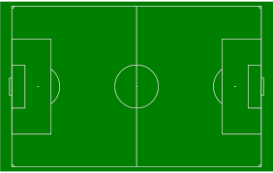
Plainedge Park
314 North Idaho Massapequa NY 11758
LIJSL MANDATED FIELD LAYOUT - FALL 2020
FULL SIDED FIELD LAYOUT
U11/12 FIELD LAYOUT
Guest
Players
PSC
Players
PSC
Spectators
PSC
Players
U13+
U11/12
Note: Plainedge Parents SHOULD be on the bleachers behind the protective netting giving the AR space
Guest
Players
Guest
Spectators
Guest
Spectators
PSC
Spectators
ALL PLAYERS AND SPECTATORS ARE TO REMAIN 10 FT OFF OF THE TOUCHLINE / SIDELINE

Slide 2
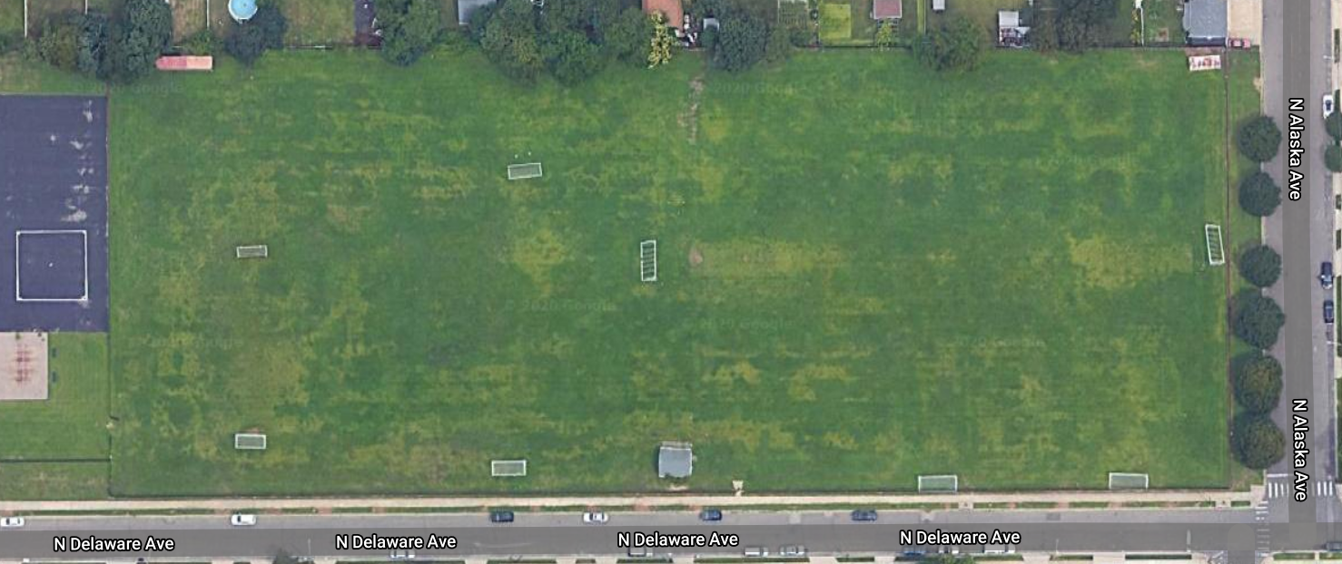

East Plain Elementary School
301 N Delaware Ave, North Massapequa, NY 11758
LIJSL MANDATED FIELD LAYOUT - FALL 2020
PSC
Spectators
PSC
Players
PSC
Players
Guest
Spectators
Guest
Players
PSC
Spectators
U9/10
U13+
U11/12
PSC
Spectators
Guest
Players
Guest
Spectators
PSC
Players
Guest
Players
Guest
Spectators
ALL PLAYERS AND SPECTATORS ARE TO REMAIN 10 FT OFF OF THE TOUCHLINE / SIDELINE

Slide 3
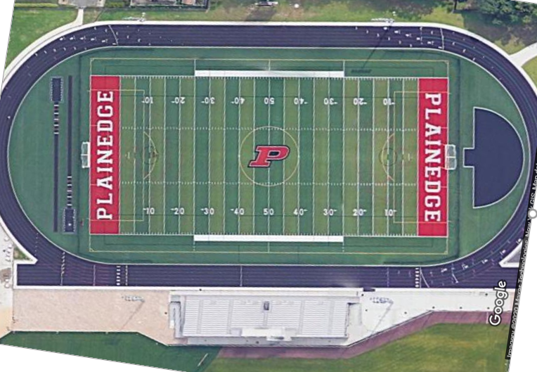
Plainedge High School
241 Wyngate Drive Massapequa NY 11758
LIJSL MANDATED FIELD LAYOUT - FALL 2020
Note: Parents must remain in bleachers and are not allowed inside field fence
PSC
Players
U13+
ALL PLAYERS ARE TO REMAIN 10 FT OFF OF THE TOUCHLINE / SIDELINE
Guest
Players
PSC
Spectators
Guest
Spectators

Slide 4
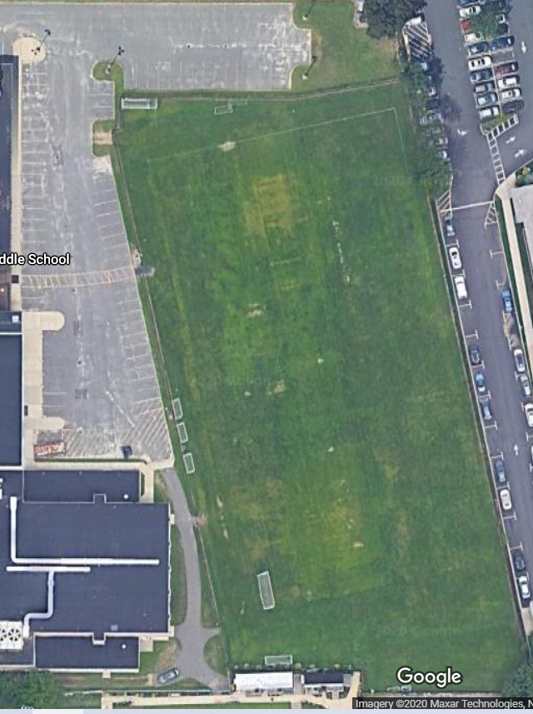
Plainedge Middle School
200 Stewart Ave Bethpage NY
LIJSL MANDATED FIELD LAYOUT - FALL 2020
PSC
Players
Guest
Spectators
U9/10
PSC
Spectators
Guest
Players
ALL PLAYERS AND SPECTATORS ARE TO REMAIN 10 FT OFF OF THE TOUCHLINE / SIDELINE

