Slide 1
Manufacturing Offense
Jim Scanlan
Head Women’s Hockey Coach
Bemidji State University

Slide 2
Habits and skills
1. Under handle
2. Quick release
3. Puck protection
4. Net front
5. Stick on ice
6. Deception
7. Shooting from uncomfortable positions
8. Changing angle of your shot
9. Attack Mindset- get to the middle of the ice
10. Setting yourself up to be a support option when you don’t have puck.

Slide 3
Offensive Zone Habits
Don’t Dump ---- Deposit
Always playing with a purpose
Moments you can give the other team the puck or maintain possession
Drive Far Post
Attacking the net causes chaos
Driving far post forces teams on their heels
If opposing D attack, they are attacking into their net
Key skill for this is puck protection. Using body, especially front leg and reaching/extending puck away from defender
Dot Lane Drive
Aim for D’s heels, then drive to net
Attacking the D’s Lane
Challenges the weakside D to decide who to cover, leaving someone open
Successful if everyone is filling lanes

Slide 4
Offensive Zone Play 10 Key Points to creating offense
Transition with speed to offense. It’s a race to offense
Make the right decision. Carry it in, chip to support or dump it in. Eliminate TO’s
Stick to terminology (coach speak) and execute routes on entry
Have a plan…on wide entries, on chip and support, on the forecheck. What is your plan?
When you are jammed up or in trouble, look to use the back of the net and come out the other side
Inside of your plan, use cycles, cutbacks, scissors, and back of the net. Move it low to high, side to side and create confusion and space
Speed, speed, speed! Don’t be playable, move your feet, move to support, move the puck.
You need a shot mentality, it creates chances and 2nd chances, shots, screens, tips, rebounds. Bring it to the net!
Be quick to recover pucks when you lose possession. Have a dog on a bone mentality!
You must practice your identity every day. If you work on it, you can become unstoppable in the offensive zone.

Slide 5

Offensive Zone Play Identity
When in trouble use the back of the net
Speed
Shot Mentality
Traffic, Screens, Tips, 2nd Chances
Recovery

Slide 6
Attacking the Offensive Zone
3 Types of Entries
CARRY IT IN, POSSESSION
CHIP WITH SUPPORT, CHIP TO POSSESSION
DUMP IT IN, FORE-CHECK TO RECOVERY

Slide 7
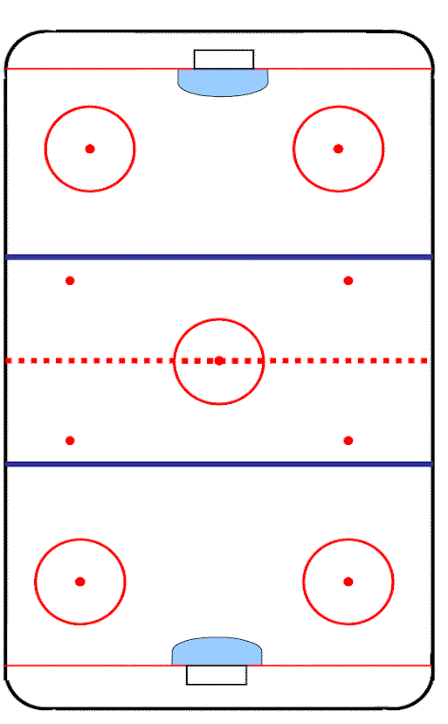
Carry Carry in with possession
WIDE SPEED
On Breakouts or possession changes, SPRINT TO OFFENSE
Transition with SPEED. Look to beat opposition defense 1v1 wide with speed
MIDDLE LANE DRIVE OPTIONS
C attack middle ice with speed & distribute puck to wingers
C become middle lane drive (puck side of 2nd D)
WSW dot lane drive (Step behind)
D add to rush (4th person)
- Shoot puck, get it back
- pass of pads
D
D
LW
C
RW
D
D

Slide 8
Chip t Chip to support & Possession
When Challenging wide, the puck carrier must:
MAKE THE RIGHT READ/SMART DECISION. Don’t force a play to middle.
Chip to middle lane forward driving through – MAINTAIN POSSESSION.
Hard rim also an option
WSD should be 4th player into zone.
D
D
LW
C
RW
D
D

Slide 9
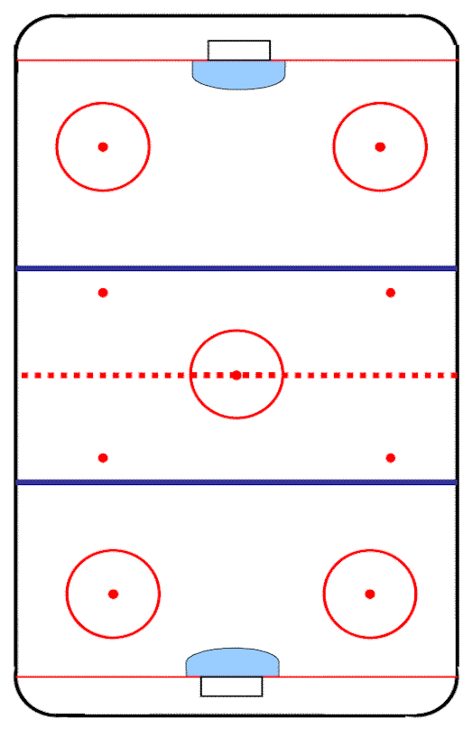
OFFENSIVE ZONE PLAY
Chip & Retrieve, Change sides, Relieve Pressure
F1 Recover the puck & look to change sides
F2 read and be ready to support with puck retrieval.
F3 move from side to side to find a hole or add to the cycle
Both D shift from strong-side to weak-side.
Once we establish possession, look to establish offense with:
QUICK LOW TO HIGH PUCK MOVEMENT – pass to F3 or Defense
LOW CYCLES – support, scissors, cutbacks, wraps
HIGH CYCLES – d down wall, d dive
D dive cycle to WSD
WD
SD
F3
D
F2
D
F1

Slide 10
OFFENSIVE ZONE PLAY
THE GRIND & CYCLE OPTIONS
Take space in the other corner & turn up weak side.
F3 go side to side, above the circles to find a hole.
Use cutbacks & picks when you can
Puck carrier leave the wall open to create a scissors play with a teammate.
Pass pucks low to high & side to side.
Be fast and unpredictable.
WD accepts pass of cycle down the wall
Using hash marks as a guideline.
D dives & D dive cycles to WD will also be available.
SHOOT THE PUCK AT THE NET EVERY
OPPORTUNITY WE CAN!
Screens, tips, and rebounds are needed.
SD
WD
F3
F2
F1

