Slide 1

NWBA Webinar Series
presented by ABC Medical
“Registering as a NWBA Team and Member”
Notes:
Moderator: CLICK RECORD ;)​
Welcome to the NWBA Webinar Series Presented by ABC Medical! We are very excited to have you participating in tonight’s session on Registering as a NWBA Team and Member!
Before we get started tonight, I want to share a few housekeeping items:​
Everyone attending is asked to mute your audio during the presentation to reduce background noise for the presenters.​
If you have any questions, please use the chat box. We will be monitoring this throughout the presentation, and we have time reserved at the end for Q&A.​
If you cannot stay for the entire presentation, we will provide a recording of tonight’s session on the NWBA website.​

Slide 2
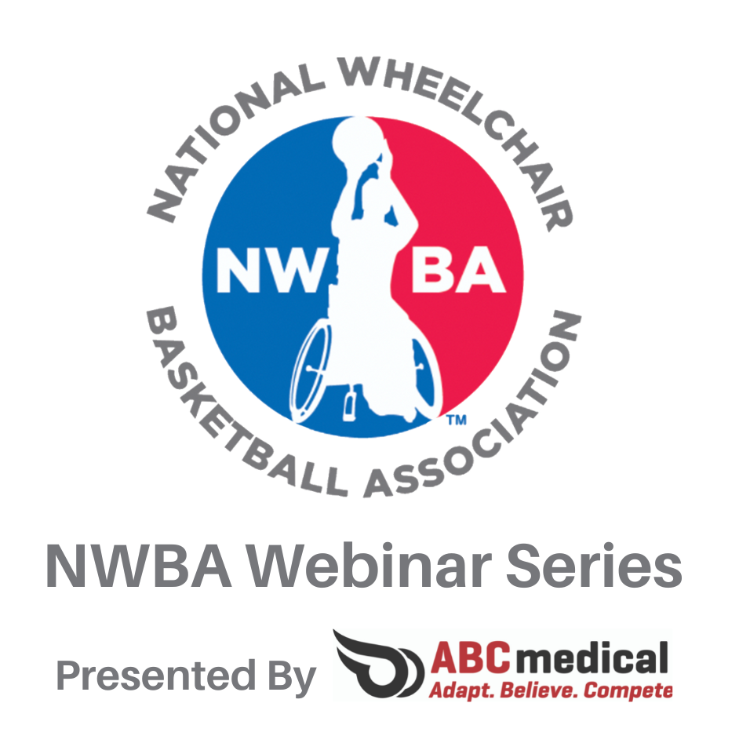
ABC Medical
Thank you to ABC Medical for supporting the NWBA!
Notes:
Moderator:
Thank you to ABC Medical for being a long-time partner of the NWBA and presenting this webinar series! ABC Medical serves to provide NWBA members and more a comprehensive line of medical supplies. Thank to ABC Medical for continued support of the NWBA!

Slide 3
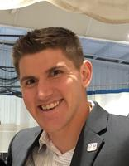
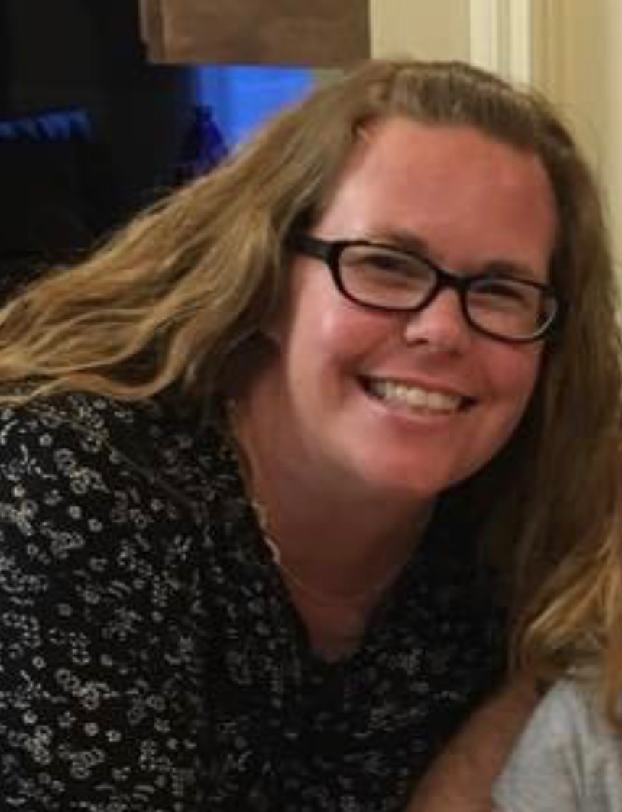
Presenters
Brandon McBeain, Director of Membership Services and Programs for NWBA
Kerrie Macudzinski, assistant coach and Team Representative for Detroit Wheelchair Pistons (formerly the Detroit Diehards). Recreational Therapist at the Rehabilitation Institute of Michigan and also the Director of the RIM Foundation Adaptive Sports program.
Notes:
Moderator:
Our presenter's tonight are Brandon McBeain and Kerrie Macudzinsk
Read slide
Transition to Brandon

Slide 4
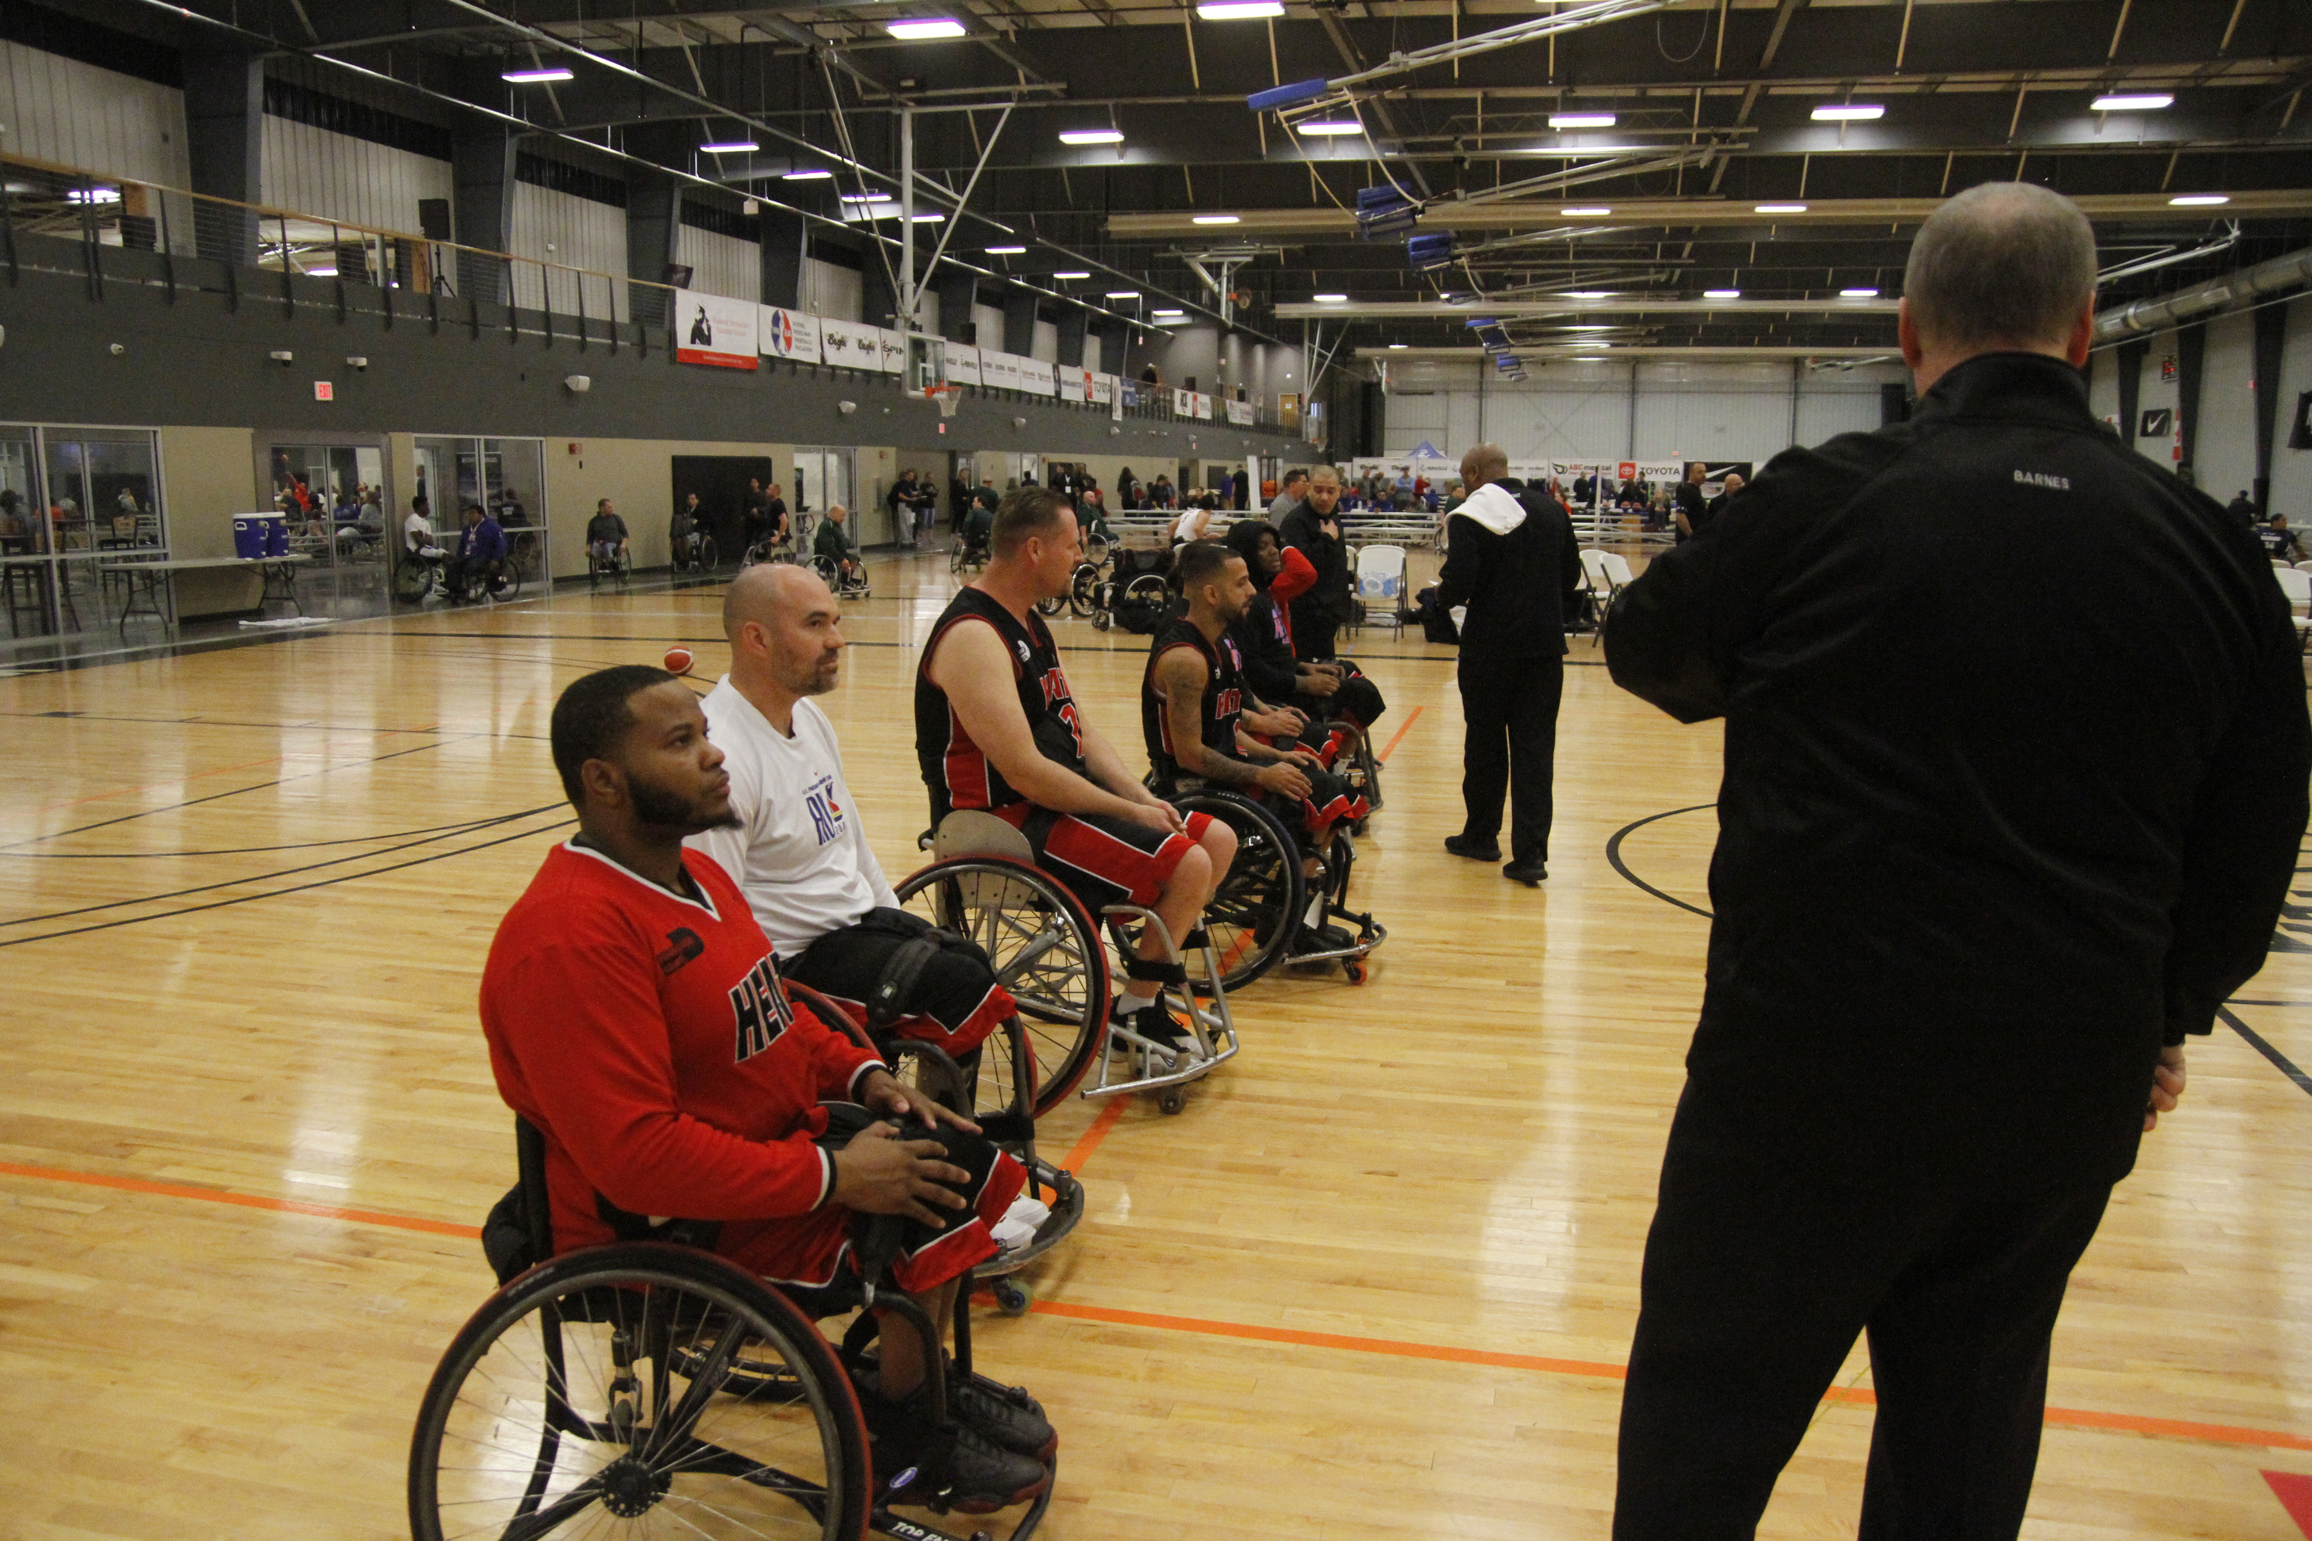
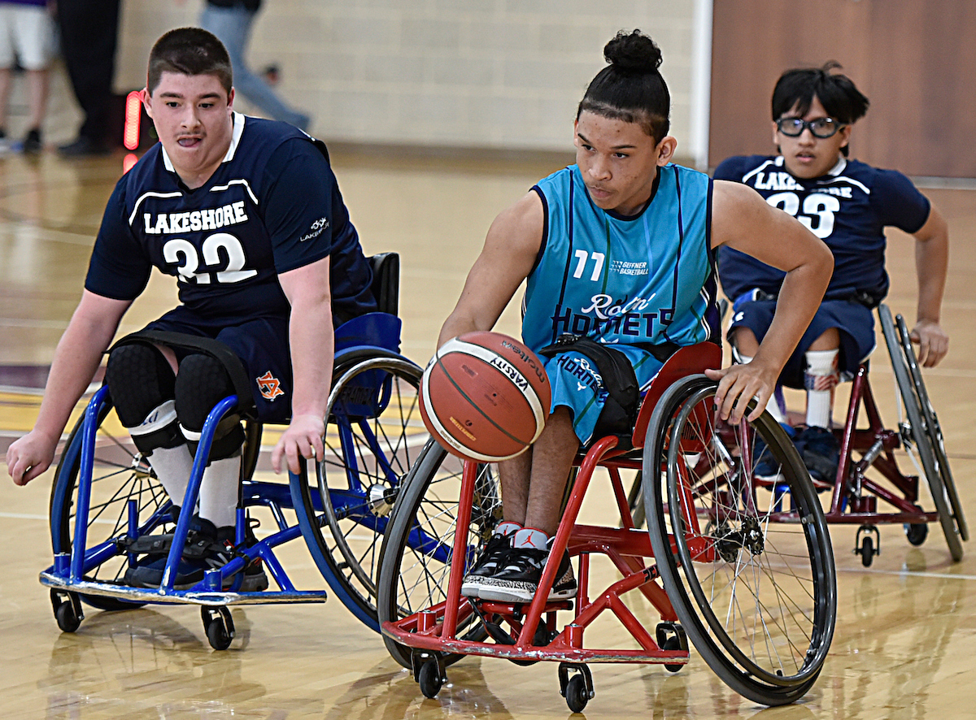
Session Objectives
This webinar is designed to help participants understand:
Better understand the NWBA structure and operations from a team and individual member.
The importance and planning for team compliance areas of registration, trainings/certification, athlete safety, divisional requirements, and postseason eligibility.
Develop a plan and take necessary action to ensure you and your team are a member in good standing with the NWBA.
Notes:
Brandon
Touching on wide array of topics; applicable to wide range of teams and membership categories
Cover topics as best as we can or provide you the location/resources to reference to educate yourself
Team Representatives on the call or those still looing to confirm theirs for the season should understand this role is the most critical administrative role in the NWBA; your are our ambassadors of our sport and organization within your team, facility and community.
Team and Individual administration can be a distraction for a team on the court; handling things accordingly can ensure focus can remain on play for coaches, athletes and more!

Slide 5
Governance
NWBA Bylaws
The NWBA Bylaws are an outline of the organization leadership, structure and operations that are approved by NWBA membership and can be viewed by visiting http://www.nwba.org/bylaws.
NWBA Policies & Procedures
The NWBA Policies & Procedures provide an overview of the policies and procedures for the organization and are approved/governed by the NWBA Board of Directors. Available by visiting http://www.nwbaorg/policiesprocedures.
Division Guidelines
The NWBA Division Guidelines are guidelines set for specific operations for each division of play within the NWBA. The Division Guidelines are set by delegates of a division and approved by the Executive Committee of each division. Available by visiting http://www.nwba.org/divisioninfo
NWBA Governance Chair – Dug Jones
Notes:
Brandon
Read Slide

Slide 6
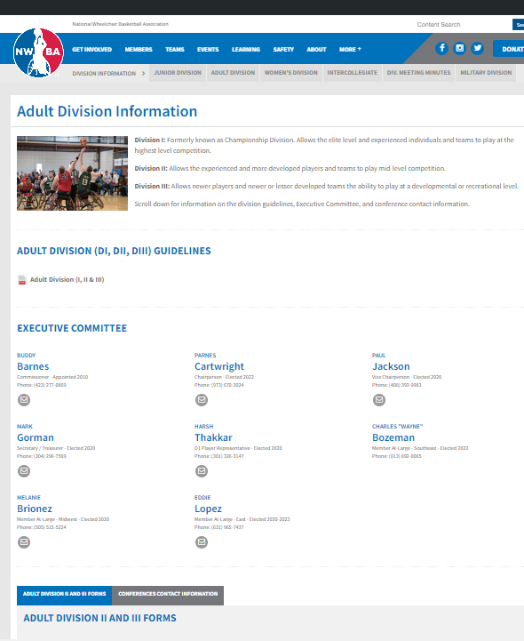
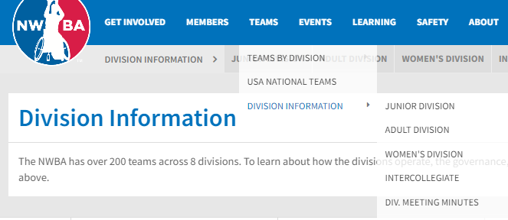
Governance – Division Info
Visit Divisional Webpage for guidelines, contact info and specific divisional info/ forms.
http://www.nwba.org/divisioninfo
Notes:
Brandon
Read Slide

Slide 7
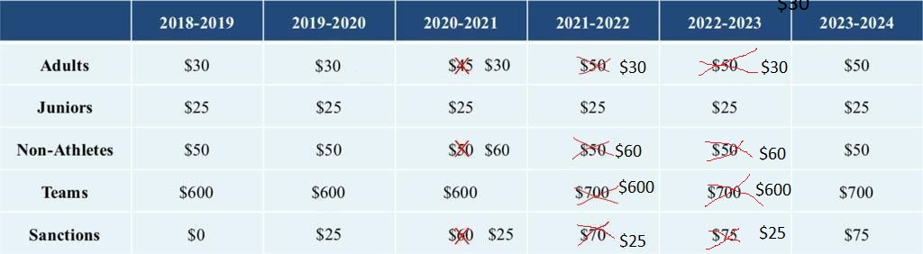
Membership Dues
All athletes, non-athletes and teams are subject to membership dues to register, recognized and in good standing as a member with the NWBA.
All dues are captured during the specific registration process.
Notes:
Brandon
Previous Multi-Year Dues Structure Approved by BOD and shared in June 2018
Board of Directors Approved Changes/Freezes in 2020 & 2021
As shared during the 2022 NWBA Annual Assembly the BOD will be freezing dues for 2022-23. This was again shared during the June 2022 Town Hall Meeting.

Slide 8
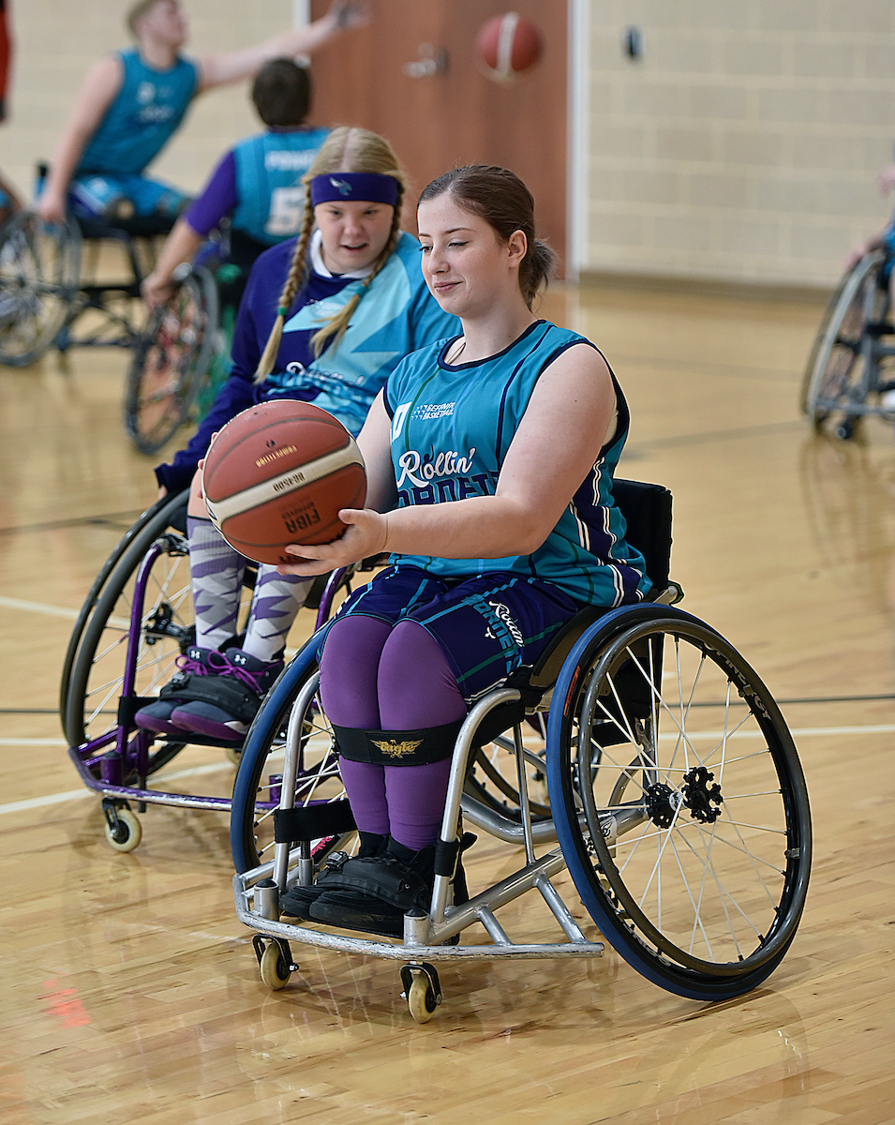
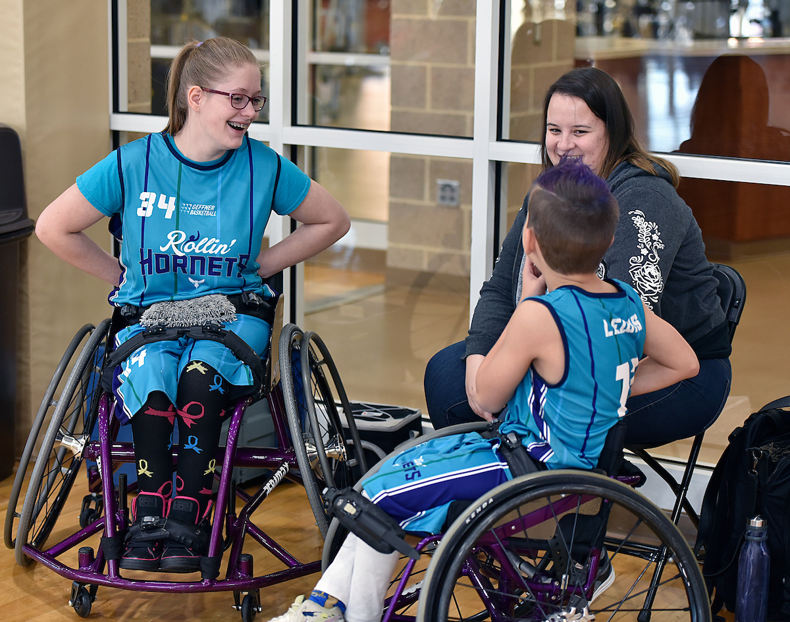
Membership Dues – Payment Options
Team payment options include the following:
Pay in full during registration
To make payment by check, you must contact the NWBA prior to completing an entry for 2022-23 Team Registration.
Athlete & Non-Athlete payment options include the following:
Pay in full during registration
To make payment by check OR purchase a bulk number of individual members, you must contact the NWBA prior to completing an entry for any 2022-23 Individual Registration Session (Adult Athlete, Junior Athlete or Non-Athlete).
Notes:
Brandon
Option to pay in full during registration for team and individual exist
Option to pay by check requires one to contact the NWBA prior to registration
Option to pay for bulk number of individual memberships is available.

Slide 9
Membership Dues – Early vs. Open
Discounted rate for teams and individuals during “Early Registration”.
Pre-COVID19 an increase fees were adopted during “Open Registration”.
Team Dues during Open Registration
2018-19 = $150 increase per team
after Friday, August 31
2019-20 = $200 increase per team
after Thursday, September 11
Individuals Dues during Open Registration
2018-19 = $10 increase per entry
after Thursday, September 13
2019-20 = $10 increase per entry
after Thursday, September 25
2022-23 Team Dues
Early Registration
Register by September 20
$600 per team
Open Registration
Register September 21 and after
$800 per team
2022-23 Individuals Dues
Early Registration
Register by October 4
$25 for Junior Athlete, $30 Adult Athlete, $60 Non-Athlete
Open Registration
Register October 5 and after
$35 for Junior Athlete, $40 Adult Athlete, $70 Non-Athlete
Notes:
Brandon
Read Slide
Late Fees Help Drive Participation in Registration = Helps Drives Compliance/Safety

Slide 10
Membership Dues – Divisional & Conference
Divisions and Conferences in the NWBA have established dues for its operations. The NWBA does not determine the dues set by a Division and/or Conference. These funds are held in reserve for use by the Division or Conference. To streamline the registration process for teams the NWBA will collect dues during Team Registration.
Most divisional dues, conference dues and regional qualifying fees (Junior Division only) were waived or reduced 2020-21/2021-22 seasons by applicable divisional leadership. Reinstitution of full dues has been exercised by divisional/conference leadership.
Junior Division Division Dues - $75.00
Conferences Midwest - $75.00 Regional Qualifying Fee - $75.00
Women's Division Division Dues - $200
Intercollegiate Division Division Dues - $1,000
Adult Division Division III Dues - $50.00 per team
Conferences Arkansas Valley $0 Carolina $275 (conference to invoice directly)
Eastern $0 Florida $0 Gulf Coast $0 Mid-American $0 Midwest $0 Southern California $0 Independent Team - No Conference Affiliate $0
Notes:
Brandon
Read Slide
Transition to Kerrie

Slide 11
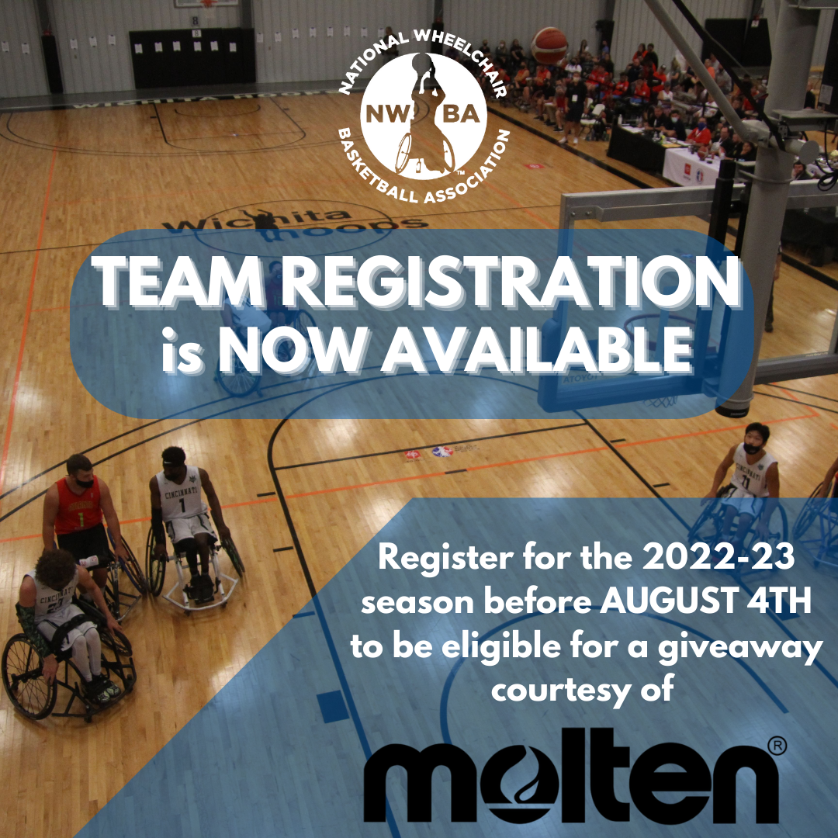
Team & Individual Registration Giveaway
Teams who have completed their team registration and have paid team dues in full during the registration period of July 19th – August 4th will be eligible to win one of the following prize packet giveaways. Nine winners will be selected at random. The prize packs that will be awarded are listed below.
Prize Package #1 (Quantity of 2)
-6 Molten Basketballs and ball bag
Prize Package #2 (Quantity of 3)
-4 Molten Basketballs
Prize Package #3 (Quantity of 4)
-2 Molten Basketballs
Details announced today on Individual Registration Giveaway
Notes:
Kerrie -Read slide on Team Registration Giveaway
-Register by August 4 with your team to be eligible!
-Details on the individual registration giveaway were announced today on the NWBA website.

Slide 12
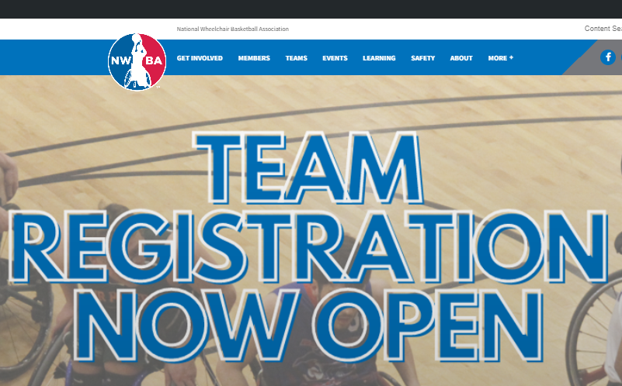
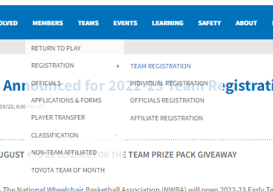
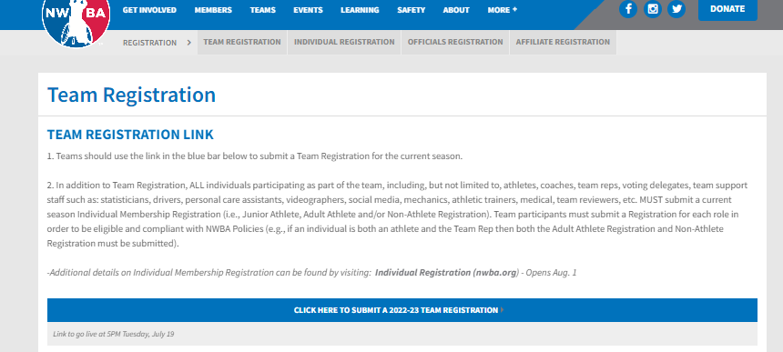
Team Registration
Click on any of the following locations to view information visit webpage on team registration
https://www.nwba.org/teamregistration
Notes:
Kerrie -Read slide on locations of team registration links and webpage
-Access team registration link from this webpage

Slide 13
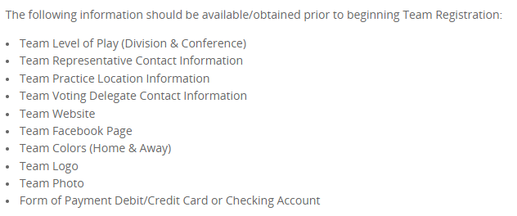
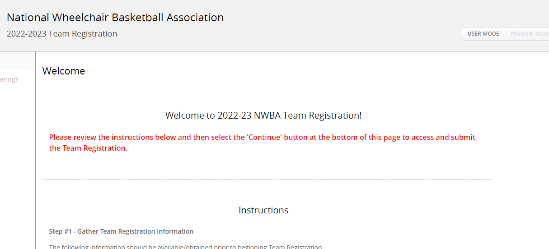
Team Registration – Registration Steps
Step 1 Gather Team Registration Information
IF PAYING DUES VIA CHECK CONTACT NWBA PRIOR TO REGISTRATION
Step 2 Complete entry for 2022-23 Team Registration
CAN COMPLETE ENTRY FOR MULTIPLE TEAMS AT ONE TIME
Notes:
Kerrie -Read slide on 2022-23 Team Registration

Slide 14
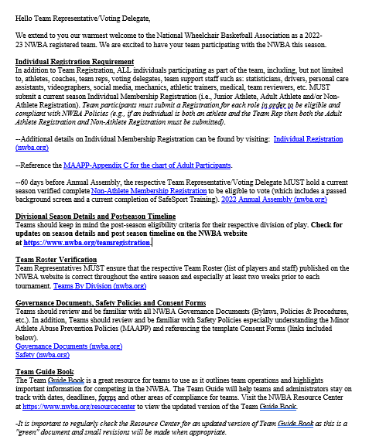
Team Registration – Registration Steps
Step 3 Check email for confirmation email and automatic reminders
ADULT DIVISION II/III TEAMS ONLY ON SECOND EMAIL NOT SHOWN (SEE NEXT SLIDE)
Notes:
Kerrie -Read slide on 2022-23 Team Registration

Slide 15
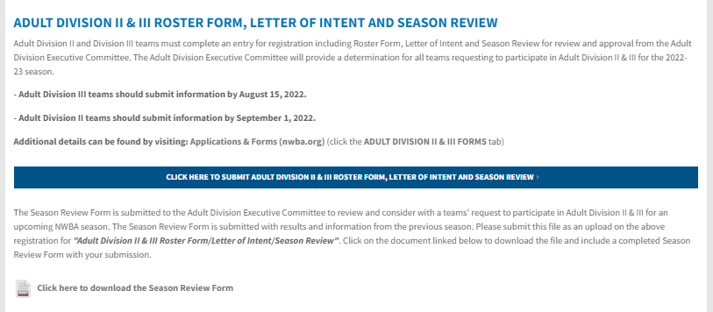
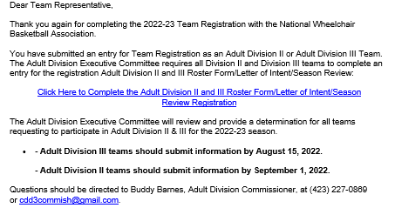
Team Registration – Registration Steps
Step 4 – ADULT DIVISION II & III TEAMS ONLY Complete Roster Form/Letter of Intent/Season Review
Notes:
Kerrie -Read slide on 2022-23 Team Registration

Slide 16
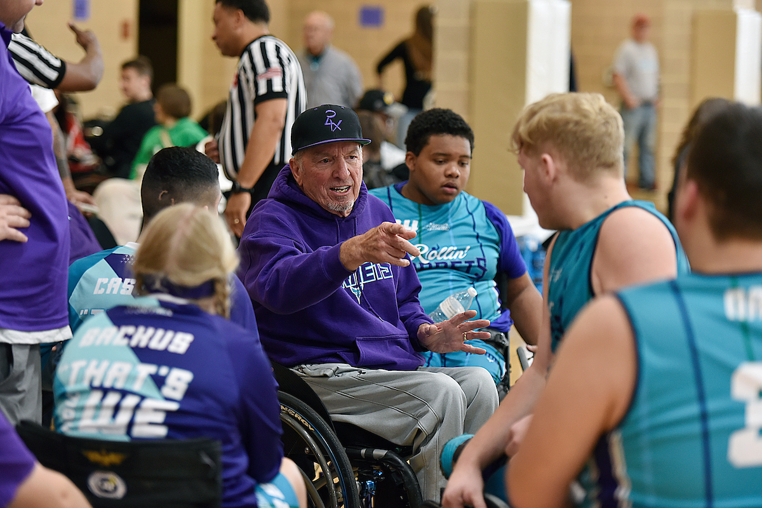
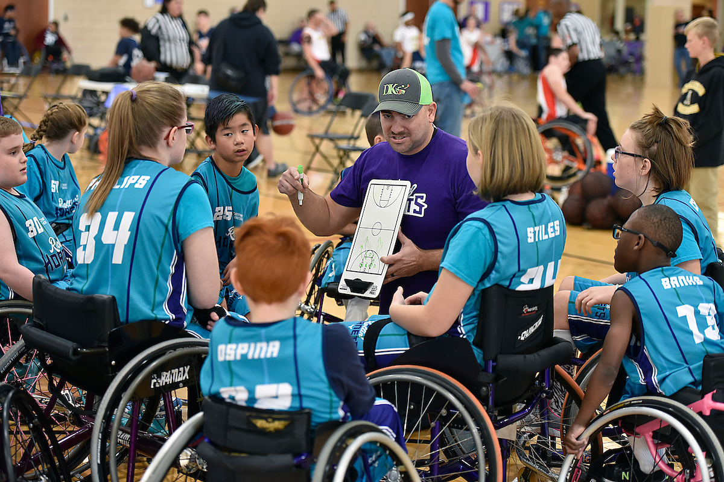
Team Registration – Governance/Voting
At least 60 days prior to the NWBA Annual Assembly, Teams must be registered for the current season AND the respective team representative/voting delegate must have a verified, complete current season NWBA Non-Athlete Individual Membership Registration (which includes a Passed Background check and current completed SafeSport Training) to be eligible to vote.
Notes:
Kerrie -Register your team early in the season to ensure you have voting privledges at the NWBA Annual Assembly for any business put forth for a vote (bylaw amendments, board of director elections, etc.)

Slide 17
Team Forms
Certificate of Insurance Request
All NWBA registered members, individual/team/affiliate, are eligible for insurance coverage. Insurance coverage is necessary for practice location, fundraising events and competition (games/tournaments).
UPDATE: NWBA insurance coverage will not include liability and accident claims related to COVID-19 regardless of timing, return-to-play protocols or government mandate.
NWBA Incident & Injury Form
Please complete the following form if an incident and/or injury occurs at an NWBA practice, event or competition. Please return completed forms to Team Rep or Event Sanction Holder AND Brandon McBeain at brandonmcbeain@nwba.org.
For more info and accessing the forms visit https://www.nwba.org/generalappsforms
Notes:
Kerrie -Read Slide

Slide 18
Team Forms – Classification
Classification Forms
The Team Reviewer should use the following forms to follow procedures for the classification process for their athletes and team. All forms below are available at https://www.nwba.org/classificationform.
Classification Roster
All certified Team Reviewers must fill out a Classification Roster Form for their team. Team Reviewers must obtain approval and signatures of Team Reviewers from the first two opposing teams. A third Team Reviewer may be consulted if approval/signature is not received from one of the first two Team Reviewers.
Completed and signed Classification Rosters should be submitted to Brandon McBeain, at brandonmcbeain@nwba.org within 72 hours of approval, at such time as two Team Reviewers have agreed to the proposed classification for each player on the roster. Team Reviewers that do not submit approved rosters may be fined $200 and/or deemed ineligible for postseason play (NWBA Policies & Procedures 5.3 (6.)).
Classification Worksheet
The Classification Worksheet can be used by team reviewers to organize their players classifications and rationales for discussion with other team reviewers or notes on why they chose a specific classification for a player.
Classification Roster – Game Format
This Classification Roster – Game Format can be used to keep track of your team and opposing team's classification points during games.
Notes:
Kerrie -Read Slide

Slide 19
Individual Registration – Membership Categories
Individual registration includes the following Individual Membership Categories per Article IV of the NWBA Bylaws:
Athlete Members. Athlete members are those individuals who register as competitive athletes and are eligible for competition in wheelchair basketball.
b. Coach Members. Coach members are those individuals who register as active coaches and who are certified by the NWBA or are certified as active coaches by the NWBA.
c. Official Members. Official members are individuals who register as officials with the NWBA, and who are certified as officials to officiate wheelchair basketball games.
e. Team Representative/Voting Delegate Members. Team Representative/Voting Delegate members are those individuals who are a team leader, the liaison to NWBA National Office / Leadership and/or recognized as the voting delegate for their team.
f. Team Support Staff Members. Team Support Staff members are individuals that support NWBA teams in at least one of the categories: i. Statistician, ii. Medical Professional, iii. Team Classification Reviewer, iv. Equipment Manager, v. Administrator, vi. Personal Care Attendant, vii. Other.
j. Hall of Fame Members. Hall of Fame Members are individuals who have
been inducted into the NWBA Hall of Fame.
k. Event Directors / Sanction Holder Members. Event Directors / Sanction
Holder members are those individuals who host an NWBA event.
Notes:
Kerrie - Read slide
- Important to note individuals commonly serve in various membership categories within the NWBA; and should register for all those roles they serve in.
- There are other membership categories that could be applicable to you (divisional leadership, etc.); more information can be found on the individual registration website and in the NWBA bylaws

Slide 20
Individual Registration – Info & Process
Registration Notes and Required Information
The option for registering someone else is ONLY for parents registering a minor participant (under 18 years of age).
Individuals who have more than one responsibility (i.e., Coach and Player, Team Representative and Team Reviewer, Committee member and player, etc.) should include all the roles and positions that apply during Non-Athlete Registration. Athletes that also serve in Non-Athlete roles should complete both Adult Athlete Registration and Non-Athlete Registration.
Only one entry for Athlete Registration is required for athletes rostered on multiple teams. For example:
-Athletes participating with an Adult Division AND Women's Division teams should submit one (1) Adult Athlete Registration and include both teams
-Athletes participating with a Prep AND Varsity teams should submit one (1) Junior Athlete Registration and include both teams
-Athletes participating with a Junior Division AND an Adult Team should submit one (1) Junior Athlete Registration and include both teams.
Select the appropriate team or select "No Team" if not affiliated with a team (Note: If your team is not listed, contact your Team Representative).
Notes:
Kerrie -Read slide on 2022-23 Individual Registration

Slide 21
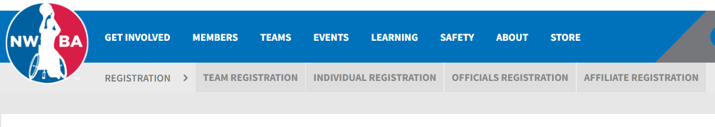
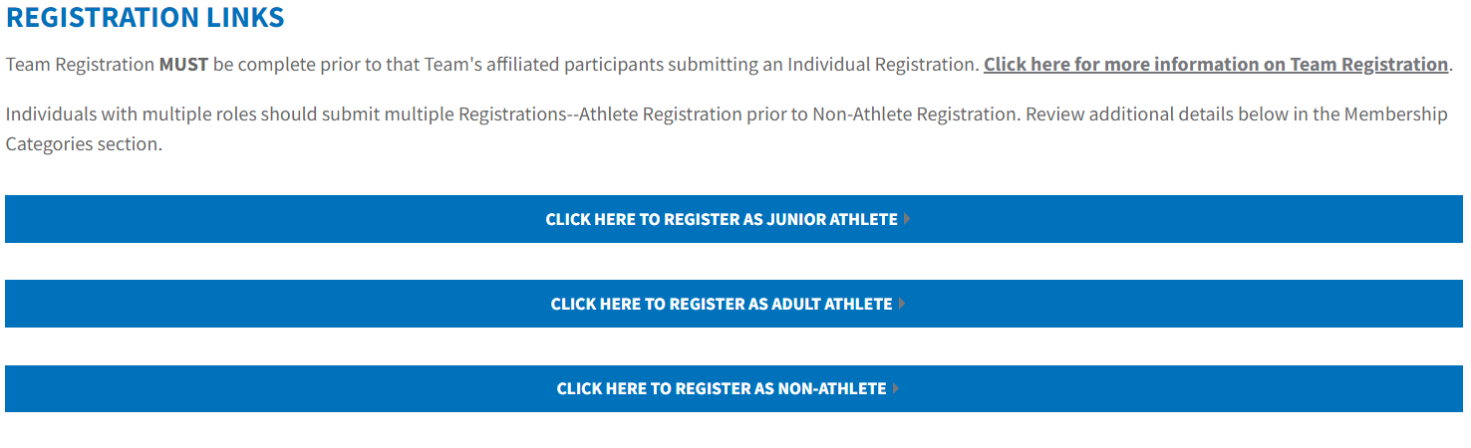
Individual Registration – info & links
Accessing Individual Registration Info & Direct Registration Links
Notes:
Kerrie
The photos included on this slide outline how to navigate the NWBA website to find the Individual Registration webpage and direct registration links.
Registration won’t be available until August 1; the NWBA runs on a annual membership calendar of August 1 to July 31 (of the following year)

Slide 22
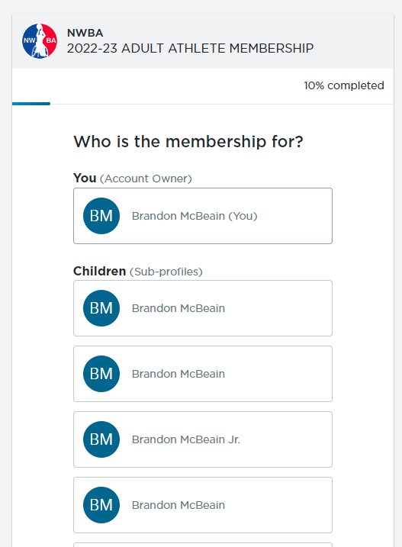
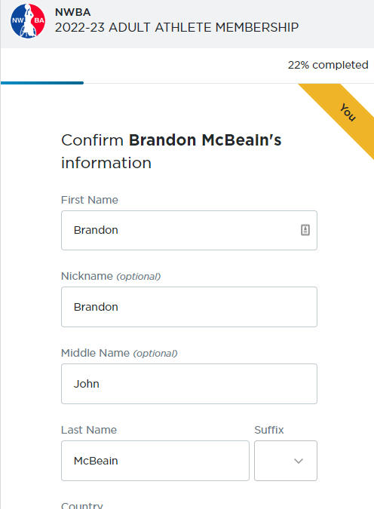
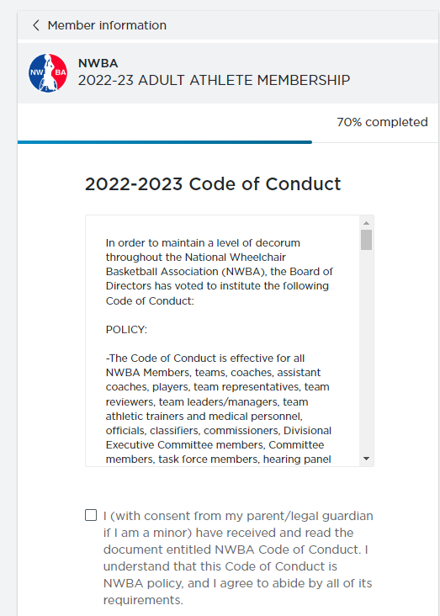
Individual Registration – Activate Membership
Step 1 Select Individual Activating Membership
ONLY ALLOWED TO SELF REGISTER
(Minors – Parent or Guardian)
Step 2 Enter Basic Contact Info
WILL BE SAVED TO SPORTSENGINE PROFILE & ASSIST WITH PREPOPULATING INFO ON REGISTRATION
Step 3 Complete NWBA Waiver/Code of Conduct/SafeSport& Concussion Info/Training Acknowledgement
IMPORTANT INFO PLEASE READ, UNDERSTAND OR ASK QUESTIONS AS NEEDED
Notes:
Kerrie -Read slide on 2022-23 Individual Registration
-Process used for all individual registration sessions: Adult Athlete, Junior Athlete & Non-Athlete

Slide 23
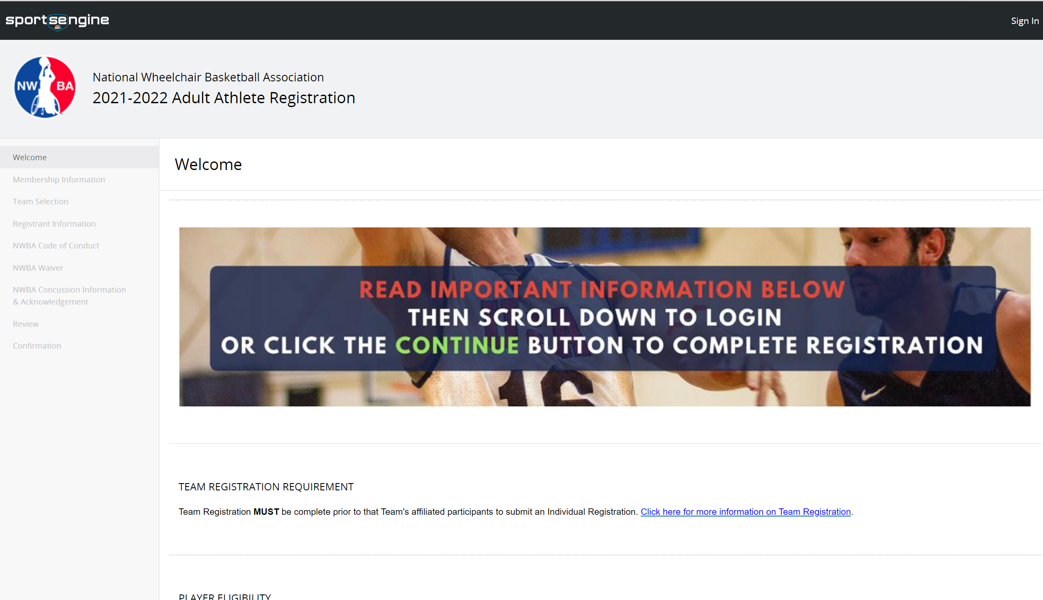
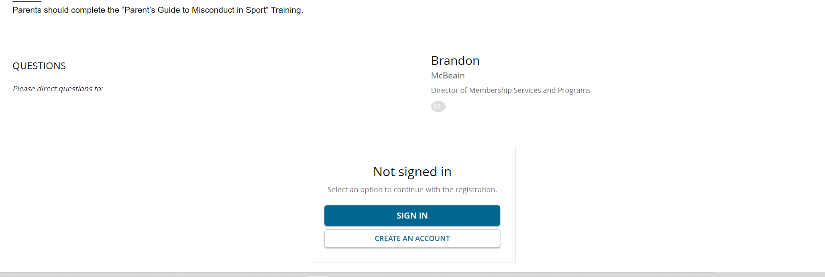
Individual Registration – Complete Registration
Notes:
Kerrie -Read slide on 2022-23 Individual Registration
-You will need a SportsEngine account to complete any individual registration sessions: Adult Athlete, Junior Athlete & Non-Athlete
-DO NOT CREATE A NEW ONE IF YOU PREVIOUSLY HAVE REGISTERED WITH THE NWBA; Brandon will be covering if you have forgotten your information this later in the webinar

Slide 24
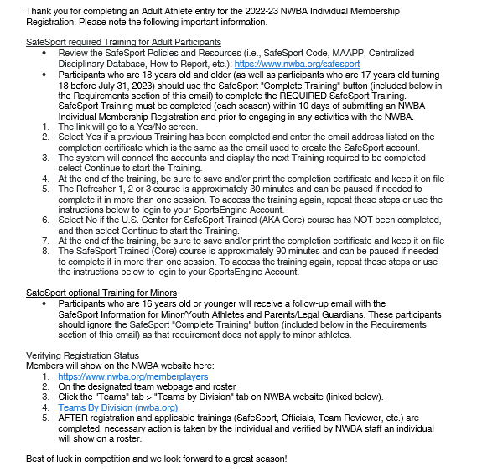
Individual Registration – SafeSport
Step 3 Check email for confirmation email and automatic reminders
EMAILS SHARED SLIGHTLY DIFFERENT FOR MEMBERSHIP TYPE/AGE
Notes:
Kerrie Read Slide

Slide 25
Individual Forms
Consideration of Eligibility
Please ensure you have reviewed and completed the necessary information and processes for player eligibility with the NWBA. This information and processes should be completed PRIOR to completing Athlete Registration. Please visit http://www.nwba.org/playereligibility for more information on player eligibility.
Player Transfer
An Application for Player Transfer is required for any player considering playing on a different team than the one they played on last season. You must complete this application to submit Player Transfer Request, no other forms will be considered. You will be contacted via email once your transfer has been reviewed and a decision has been made.
Visit https://www.nwba.org/playertransfer for more info or complete a player transfer request.
Please also review the NWBA Policies & Procedures and Division Guidelines for more information on player transfers (also divisional season details presented for 2022-23 season when available).
Notes:
Kerrie Read Slide

Slide 26
Individual Forms – Junior Division
Junior Division
The forms listed below are used for operations within the Junior Division of the NWBA. These forms are needed to complete an entry for Junior Athlete Registration. Please visit http://www.nwba.org/juniordivision for more information on Junior Division forms.
High School Verification Form – Annual Update
All Athletes in High School
Only new athletes (did not participate in 2021-22 season)
Junior Minimum Disability Form – One-time submission
Birth Certificate – One-time submission
These athletes will be reviewed by the Junior Division Executive Committee for consideration of eligibility within the division:
Prep Exemption Form – Annual Update
All players 13 and up (still in high school) with significant neurological (i.e. muscular dystrophy, cerebral palsy) and/or cognitive disabilities (i.e. cerebral palsy, traumatic brain injury, spina bifida with hydrocephalus/shunt malfunctions) which affect mobility, coordinated movement, strength, and endurance.
Player Exemption Application – Annual Request
The following is application for Player Exemption Application for the NWBA Junior Division. This application allows athletes of the Junior Division to submit petitions and exemptions for consideration of additional year of eligibility and team placement.
Notes:
Kerrie Read Slide

Slide 27
Education & Training
Team Reviewer
All teams for all divisions of play must have at least one person certified as a Team Reviewer, except Prep teams in the Junior Division. There is no cost to become a team reviewer. For more information on Team Reviewer position please visit http://www.nwba.org/teamreviewer or view slide on Educational & Training.
UPDATE FORTHCOMING ON HOST LEARNING MANAGEMENT SOFTWARE
Floor Officials Test Any individual wanting to register as a Floor Official, must complete all requirements of the Non-Athlete Membership/Registration process, AND the annual Floor Officials Test. The information for this test will be shared by the Rules Committee and NWBA when available/and directly to those registering as floor officals.
NWBA Level I Coaches Certification
Head Coaches are required to complete the Level I Coach Certification; Assistant Coaches are encouraged to complete. Visit http://www.nwba.org/coachcertification to complete.
Valid for two years from date of completion
Complete no later than September 30 or within 45 days of registering
UPDATES FORTHCOMING ON COACHING CERTIFICATION* Old course and materials still available at https://www.nwba.org/coachcertification
Notes:
Kerrie Read Slide

Slide 28
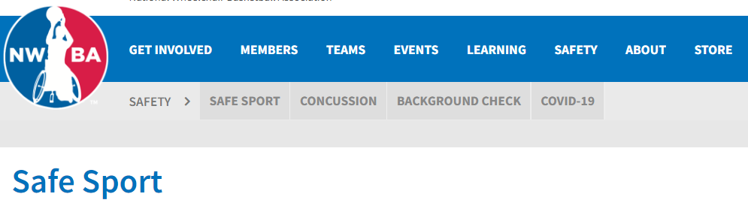
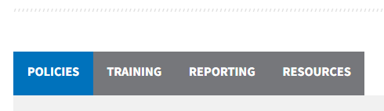
Safety
Policies – Minor Athlete Abuse Prevention Policy (MAAPP) and Background Screen
NWBA Safety Policies & Information: https://www.nwba.org/safety
Policies
U.S. Center for SafeSport’s Centralized Disciplinary Database (CDD)
Training info – required and optional
Minor Consent Form Templates: Per the Minor Athlete Abuse Prevention Policies (MAAPP), teams inclusive of minor athletes should collect appropriate consent forms. Each team can use their own, but templates are posted on the NWBA website
Notes:
Kerrie
Safety is number one priority for any member of the NWBA; we are fostering a culture of safety in our organization
Read slide
Photo here shows how to navigate the Safety section of our website

Slide 29
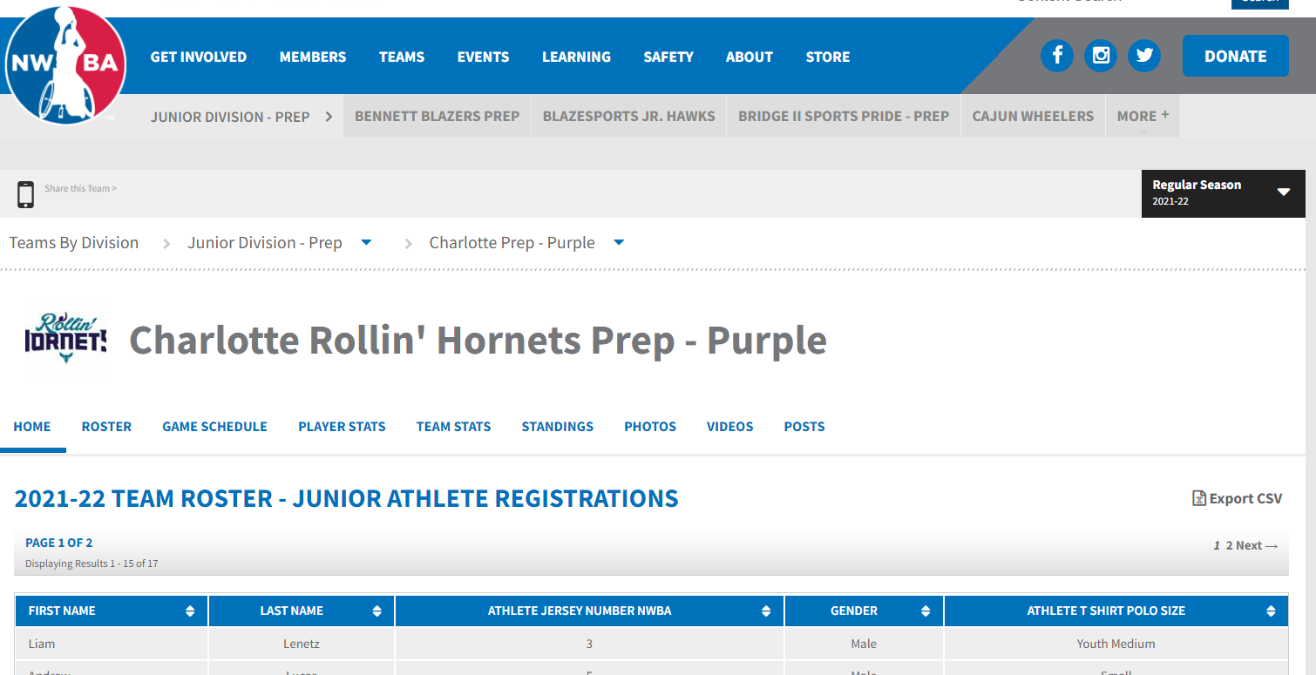
Safety - Quality Control System
Confirm that only current season NWBA registered and rostered Junior Athletes, Adult Athletes and Non-Athletes are involved with your team and/or NWBA sanctioned event you are attending:
Members that are Non-Team Affiliated
https://www.nwba.org/nonteamaffiliated
Teams that are registered
https://www.nwba.org/page/show/7334493-teams-by-division-2022-23
Registered floor officials
https://www.nwba.org/officials
Notes:
Kerrie
Team Representatives are critical to upholding the Quality Control System of the NWBA.
The rosters posted on the NWBA website are how to confirm that the Participants required to submit a membership registration, complete SafeSport training and/or background screens are in fact compliant with all of the requirements.
Read slide
Screenshot on the bottom shows and example of a Team Roster page and how to navigate to that section of the website.

Slide 30
Safety - Quality Control System
Participants
Adult Participants required to have a verified complete NWBA Athlete and/or Non-Athlete Registration 10 days prior to their first competition at a NWBA sanctioned event:
NWBA Staff (Employees, Interns)
NWBA Members: Junior Athlete, Adult Athlete and Non-Athlete (age 18+) including:
Board of Directors
Coaches
Officials
Team Support Staff (Administrator, Statistician, Medical Professional, Equipment Manager, Team Classification Reviewer, Personal Care Attendant)
Classifier
Team Representative
Committee Leadership (Standing, Ad hoc, Task force)
Divisional and Conference Leadership
Event Director / Sanction Holder
Local Organization Committee
USA National Team Staff
NWBA Independent Contractors w/Regular Contact or Authority
Vendors w/Regular Contact (i.e., vendors invited by the NWBA to be at an event especially if it is more than one event)
Notes:
Kerrie
The QCS identifies the various types of event Participants
The group outlined on this slide are: read slide
It is VERY important that we encourage individuals to submit their NWBA Membership Registration as early in the season as possible

Slide 31
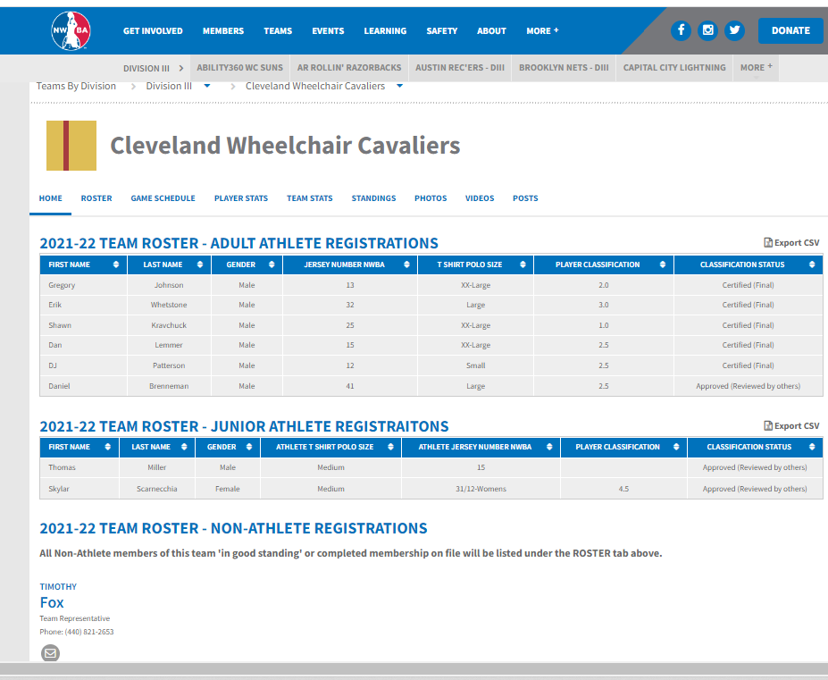
Active Roster – Athletes
Notes:
Kerrie
Visit your team’s webpage to view the Adult Athletes, Junior Athletes and Non-Athletes that are compliant and fully registered
Starting in 2022-23 Non-Athletes will be listed on the team’s “Home” tab; the roster tab will not be utilized or listing the compliant/registered Non-Athletes
Transition to Brandon

Slide 32
Resource Center
Teams and individual members are encouraged to visit the Resource Center at https://www.nwba.org/resourcecenter for valuable information and resources.
How To Videos On The NWBA Website
Event Resource Guide
Team Guide Book
NWBA Style Guide and Logos
Request for Use to NWBA required
Promotional Partner Offerings – (including Molten basketball discounts)
Fundraising Tools
Other Resources
Notes:
Brandon
Read Slide

Slide 33
Important Reminders
Only athletes and non-athletes (coaches, etc.) listed on the team webpage on the NWBA website are registered members of the NWBA and will be listed on an active roster (on team webpage).
Only NWBA registered athletes may participate in competition in any portion of NWBA sanctioned events.
Only NWBA registered coaches and team representatives can sit on the bench of a team during a competition. Registration status is dependent on completing necessary training and certifications.
Only games played at NWBA sanctioned events will be considered as official NWBA games and part of team’s seasonal records.
Only games played between NWBA registered teams count towards NWBA standings and records.
Please make sure to complete an entry and review guidelines for the Event Sanction Application for all NWBA competition.
Notes:
Brandon
Read Slide

Slide 34
Membership - FAQ
How do I reset my SportsEngine Password?
1. From the sign-in screen, input your email address.
2. Click Next.
3. On the "Password" page, click Forgot your password?.
4. Input your email address again.
5. Select Reset Password or Email Magic Link.
Why am I seeing a blank screen while purchasing a membership?
Please make sure your internet browser is updated. SportsEngine preferred browser is Google Chrome or FireFox.
How do I complete SafeSport Training?
SafeSport Training information is emailed to each participant after submitting an NWBA Individual Membership Registration. Additional information can be found on the Safety tab of the NWBA website
Why am I not showing up on my team's roster?
Team Rosters include participants who have completed all of the requirements of the NWBA Individual Membership Registration (i.e., completed current SafeSport Training, passed background check for Non-Athletes, etc.) Make sure that you have completed all of the requirements and that you selected the appropriate team in your registration.
Notes:
Brandon
Read Slide

Slide 35
Questions?
Contacts
Reference Divisional Leadership Info on NWBA webpage
Brandon McBeain: brandonmcbeain@nwba.org
Notes:
Moderator: ​Thank you to our presenters for sharing that information. We will now move to the general questions and answer portion of the webinar. Please feel free to unmute yourself to ask a question or type it in the chat.​

Slide 36
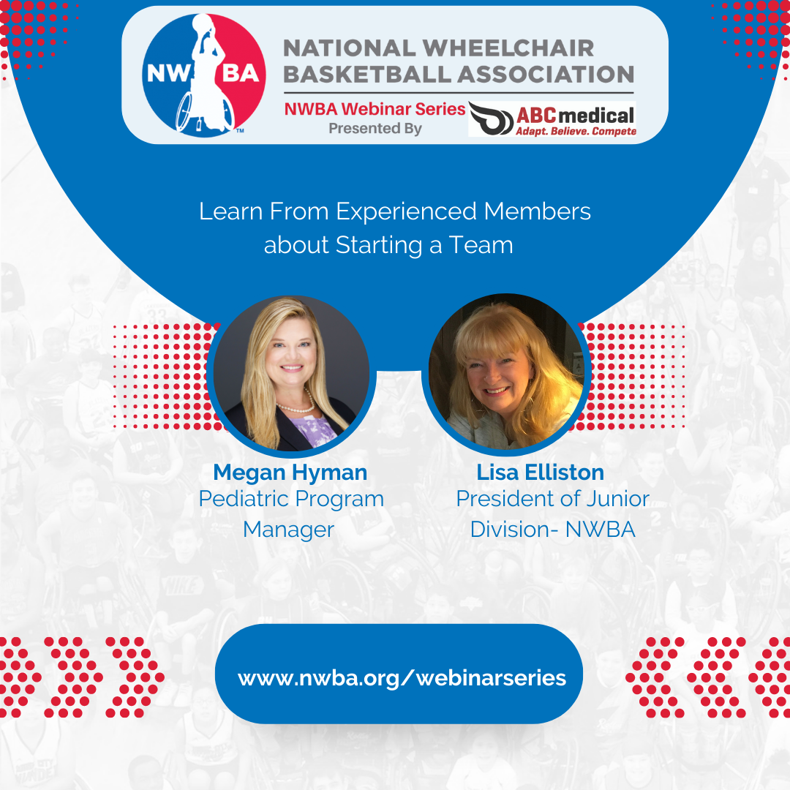
Next Up – NWBA Webinar Series
Notes:
Moderator: ​
Thank you to all of you for taking time out of your busy schedules to participate in this installment of the NWBA Webinar Series Presented by ABC Medical.
The video recording of tonight’s session will be posted on the link listed here by the end of this week
Our next webinar titled ‘Navigating Team and Individual Membership Registration’ will be hosted on Wednesday, July 27 at 6:30pm MT.
We hope you have a great evening and a successful season!

