Slide 1



Mission
Mission Statement
To provide high-quality soccer training that develops skilled players and strong character through discipline, teamwork, and integrity—while instilling Christian values for success in soccer and life."
Vision Statement
To set the standard for youth soccer development through a values-driven environment where every player grows in skill, character, and leadership.

Slide 2
Alliance Futbol Club
Player Development Curriculum
          Club Values
GRATEFULNESS
COMMUNITY
INTEGRITY
IMAGINATION
RELENTLESS
ACCOUNTABILITY
CHARACTER
SELFLESSNESS
COMPETITIVENESS
LEADERSHIP
COURAGE

Slide 3

Alliance Futbol Club
Player Development Curriculum
          Club Values
Club Values
Accountability: Being responsible for our actions. Holding ourselves, team, coaches, parents, and club to a high level. Not accepting mediocrity. Taking care of what we can control.
Character: Character is defined and determined in our lives not by what we want, say or think, but by what we do.
Community: Community is about becoming something larger than one person or one group. It is about belonging and finding a place to call home.
Competitiveness: Respecting the game, yourself, your opponent, giving 100% effort and leaving everything on the field.
Courage: Courage doesn’t mean you don’t feel fear. Courage means that you feel the fear and keep on going.

Slide 4

Gratefulness: Being thankful for what we have and showing it. Even though the conditions are not the greatest, we are thankful for the chance to be a part of the game.
Imagination: The ability of the mind to be creative or resourceful.
Integrity: Integrity is always doing the right thing even when it is easier and more convenient to do something else.
Leadership: Leadership is about creating an environment which others choose to unleash their human potential toward a common goal or vision.
Relentless: Showing or promising no abatement of severity, intensity, strength, or pace. Persevering in the face of adversity.
Selflessness: If you’re selfless, you think less about yourself and more about others- you’re generous and kind. Being selfless is similar to being altruistic- another word for giving to others without looking for personal gain.

Slide 5

Phase
FOUNDATION
DEVELOPMENT
IMPLEMENT
PERFORM
PRE-ACADEMY
ACADEMY
SELECT
Pre-Pro
Age U6 U7 U8 U9 U10 U11 U12 U13 U14 U15 U16 U17 U18 U19+

Slide 6
Objective: The objective of the Alliance FC Youth Player Development Curriculum is to outline the path that a player should take from the beginning of their playing career at Alliance FC from U8 through the conclusion as they go off to college. In order for players to develop to their maximum potential, we must ensure that the player is given instruction in specific topics at the proper moment in their developmental continuum. Each year of the player’s growth is equally critical in their overall progress. We must ensure that each and every player is taught and masters certain concepts and skills before moving on. Moving on too quickly will hinder rather than help a player’s development. Players that are not technically sound will rarely be able to catch up and reach their potential if these areas are not mastered early.
Train the AFC Way!!
The Alliance FC Youth Player Development Curriculum addresses the development of each player through the four dimensions of a player. (Technical, Tactical, Physical, and Psychological)
Technical Dimension: The technical component is simply the ability of a player to manage the ball individually, and is vitally important to the proper progression of the player (Me and the ball). It is incumbent for our coaches to emphasize that our youngest players develop a relationship with the ball, one where successful manipulation and retention of the ball becomes second nature. If this relationship is not developed by the time a player enters their early teens, there will be major limitations in the ability of that player to progress beyond a certain point. Technical facility doesn’t mean that every player needs to be a 1v1 Messi. How they play will be a function of the style and system the coach implements. However, 1v1 and 2v2 play during training, produces a confidence on the ball, in the form of intensive and repetitive situations that can only help to foster a command of the moment.

Slide 7

Tactical Dimension: The tactical dimension becomes the ability of the player to begin to make decisions with relation to the environment of the game. The idea of tactical development is something of a double-edged sword. If introduced too soon, to the exclusion or subversion of the technical element, players can begin to rely too much on unsophisticated tactical play in the pursuit of winning relatively meaningless games at the early ages. Alternatively, even proper tactical instruction, if introduced too early, can prove frustrating to players who lack the technical foundation to carry it out. The advantage of focusing on technical work early, and then only introducing the most basic tactical ideas ( the “real” game- movement, finding and creating space, etc.), is that ball mastery and a general understanding of the game itself, not a specific system, opens up a much larger range of tactical possibilities later.
Physical Dimension: The physical dimension relates to a player’s movements, stamina, injury prevention, and strength. This dimension is important throughout the player’s growth as a player and as their body changes over time. The early ages are mostly about psychomotor function, meaning, teaching the player how to move in athletic ways. This will be mostly about balance and motor coordination. As the athlete progresses and achieves puberty, the physical dimension evolves to endurance, strength, agility, and explosiveness. Injury prevention is always a key element of this area.
Psychological Dimension: The psychological dimension relates to a player’s “mentality and attitude”. A player’s psychological profile will include such considerations as confidence, self-awareness, motivation, competitiveness, empowerment, persistence, and more. In addition, a player’s psychological development is about using and understanding child psychology to empower and teach players. For example: until age 10, children are “ self-absorbed” and are looking mainly internally. Using this quality as an advantage can teach players to love the ball and develop technical mastery and confidence. Teaching sportsmanship and how to "Train the AFC Way" are important aspects of imprinting the type of soccer player and individual we want at Alliance Futbol Club. technical mastery and confidence. Teaching sportsmanship and how to “ Train the AFC Way” are important aspects of imprinting the type of soccer player and individual we want at Alliance Futbol Club.

Slide 8
Alliance Futbol Club
Player Development Curriculum
Core Playing Values
Core Playing Values
Creativity: Creativity and freedom to be a personality on the field should be a staple of our AFC players. We want players that are willing to take risks; willing to play the game with flair and style. We must protect and cultivate this quality in our players.
Work Ethic/Effort: Most elite players do not become elite by accident. They typically work harder than most and develop their skill and technique through repetition. Leonel Messi and Mia Hamm are known for creativity and goal scoring, but what makes them more special is their work rate on the field and desire to continue to improve.
Determination: Truly special players have a certain quality that sets them apart. They have a desire and determination to get the job done. No matter what the core is, no matter if there is anyone watching at all, their desire never lets up. Adversity fuels their inner fire and they get better when the environment around them gets worse. These are special players.
Risk Taking: Imagine if a baby, when about to take his/her first step, thought about falling down. Do you think the baby would still take that step? We need to encourage our players to be willing to ignore negative consequences at times so that they can get out of their comfort zone and grow. Michael Jordan missed more than 9,000 shots in his career. Imagine if he stopped shooting.

Slide 9
Alliance Futbol Club
Player Development Curriculum
Core Playing Values
Possession with Purpose: Alliance FC should be about playing the game in an enjoyable way. We want to develop our players and teams to value the ball and play a possessional style, keeping the ball moving quickly on the surface. However, we also want our teams to possess with the idea of stretching defensive lines and breaking lines to attack.
Playing out of the Back: In line with our possession-based philosophy, we expect teams to build attacks starting from the goalkeeper and backline. Modern soccer demands that defenders play an active role in initiating play, not just stopping it. Training our defensive players to remain composed on the ball, break lines, and draw opponents out of shape is essential for intelligent, dynamic soccer. Simply encouraging “safe” plays or clearing the ball under pressure limits development and misses opportunities to grow technically confident, tactically aware players.
Cerebral Soccer Players: The best players see the game before it happens—they anticipate, solve problems, and make smart decisions under pressure. At our club, we aim to develop thinkers, not just athletes. That means teaching players the why behind their decisions, helping them recognize patterns, and encouraging them to read the game in real time. When players understand the game, they don’t need constant direction from the sideline—they become confident, autonomous decision-makers. Soccer moves too fast to rely on reaction; we must prepare our players to think ahead.
Confidence on the Ball: Confidence on the ball is one of the most critical aspects of player development. Without technical comfort and control, a player cannot reach their full potential. Mastery of basic skills—and the confidence to use them under pressure—is the foundation for everything else. Players who lack this foundation will eventually be exposed, regardless of their athleticism or tactical awareness. Our focus must be on building technical ability early and reinforcing it often

Slide 10
Alliance Futbol Club
Player Development Curriculum Attacking Characteristics
Attacking Characteristics
Score lots of goals
1v1 personality is encouraged and expected
Look for the most penetrating option first
Fast speed of play (1 and 2 touch unless going 1v1)
Make play unpredictable – every attack looks different
Unbalance the defense – attack spaces that were just vacated
Maintain possession
No shot is a bad shot
Attack the opposing team’s penalty area (box organization, frame the goal)
Be dangerous and take advantage of set pieces

Slide 11
Alliance Futbol Club
Player Development Curriculum Defensive Characteristics
Defensive Characteristics
COMMUNICATION!!!
Immediate High Pressure on the ball
PRESSURE- Deny Penetration
Make play predictable – Funnel play away from goal and to cover
COVER – Provide good cover around the ball
BALANCE – Provide good shape away from the ball
WIN THE BALL!!!
Show Relentless Work and be Fearless
Punish the other team for having the ball
Shutouts

Slide 12
Alliance Futbol Club
Player Development Curriculum
Attacking Moves and Skill Names
U6–U8 "Foundational Movers"
Attacking Moves (1v1):
  Inside-Outside
  Rake/ Sole role + Push (Drag Matthews)
  Scissors (single)
  Step Over (single)
  Stanley Matthews (inside-outside feint)
Turning Moves:
  Inside Turn
  Outside Turn
  Pull back
  Cruyff Turn (Intro)
  Spin Turn / "Zidane Turn" (Intro)
Bonus Skills:
  Sole Rolls (side to side)
  Pull-push (with sole and laces)
  Ball Stops (sole)
  Basic change of pace after move

Slide 13
Alliance Futbol Club
Player Development Curriculum
Attacking Moves and Skill Names
U9 ""Developing into Danger"
Attacking Moves (1v1):
  Scissors (double)
  L Move variations (L & V shapes)
  Step Over (double)
  Feint + Go
  Body Feints (with pause/change of pace)
  Drag/Rake and push
Turning Moves:
  Cruyff Turn (clean and explosive)
  Outside Cut
  Pull Back + Turn Combo (add move after pull back)
  Stop-Start (sole stop then explode)
  Half Cruyff (plant then turn away)
Ball Mastery Enhancers:
  Figure 8 dribbling (tight turns)
  Ball rolling + movement coordination
  Combo moves (scissors into push)

Slide 14
Alliance Futbol Club
Player Development Curriculum
Attacking Moves and Skill Names
U10 "Personality & Purpose"
Attacking Moves (1v1):
  Triple Scissors
  Feint + L Move
  Ronaldo Chop
  Elastico (Intro)
  V-Move (sole inside push)
  Stop-Hesitate-Explode
Turning Moves:
  Pull Turn (pull across body)
  Double Inside Turn (turn inside Right then Turn with inside Left)
  Sole Roll into Turn (sole roll then Outside, inside, sole turn)
  Cruyff into drive to space
  “Hook Turn” (passive defender)
Ball Mastery Focus:
  Moves under pressure
  Combo moves with change of speed
  Left & right side balance

Slide 15
Alliance Futbol Club
Player Development Curriculum
Attacking Moves and Skill Names
U11 "Combining Moves with Speed"
Attacking Moves (1v1):
  Elastico (advanced)
  McGeady Spin (Cruyff + outside foot tap)
  Double Scissors → L Move combo
  Ronaldo Scissor + Chop (scissor + chop)
  Feint-turn-explode (explode with different parts of your foot)
Turning Moves:
  Cruyff to sole roll (Cruyff turn then sole roll back)
  Pull Back + Cut (Pedro’s Favorite)
  Zidane Turn at speed (roulette)
  Sole Roll + Chop
Advanced Ball Work
  Moves to escape pressure
  Moves to beat a player in tight space
  Transition dribble to pass/shoot

Slide 16
Alliance Futbol Club
Player Development Curriculum
Attacking Moves and Skill Names
U12 "Creativity with Intent"
Attacking Moves (1v1):
  Rivelino Fake (step over & push with same foot)
  Neymar Scissor Fake Turn
  Okocha Step Over (Rake & Step over)
  Advanced L-Move Combinations
  Fake Pass + Turn
Turning Moves:
  Inside Hook into a change of direction
  Sole Roll Fake Turn
  Drag Cruyff Combo
  McGeady Turn under pressure (Cruyff + outside foot tap)
Game-Based Skill Development:
  1v1s in tight channels
  Wall/passive defender pressure
  Move + Decision → Pass/Dribble

Slide 17
Alliance Futbol Club
Player Development Curriculum
PRE-ACADEMY
U3-U8

Slide 18
Player Development Curriculum
U6-U8 Curriculum Summary
TECHNICAL TACTICAL PHYSICAL PSYCHOLOGICAL TRAINING FOCUS
Objectives: Introduce young players to the game through fun, high-touch, ball-centric activities that develop general technical skill, ball mastery, and comfort under pressure. At this age, everything should be taught through games, repetition, and encouragement of creativity.
Dribbling Skills/ Running with the ball:
Dribble with all foot surfaces: inside, outside, sole, laces.
Dribbling while changing direction and speed.
1v1 attacking – Encourage boldness and freedom to take players on.
Promote personality and flair — it's OK to make mistakes!
Turning Moves: Should be taught in fun, unopposed settings at first, then with passive pressure:
Inside Cut (Chop)
Outside Cut
Inside Turn
Outside Turn
Drag Back Turn
Cruyff Turn
Spin Out Turn (“Zidane/Rolled Pivot”)
Step Over Turn
Pull-Push Turn (added: teaches redirection with control)
  Tip: Call moves fun names (e.g., “Pirate Turn,” “Shark Spin”) to boost engagement
Attacking Moves:
Inside/Outside – “The L”
Stanley Matthews (Inside/Outside)
Scissors (both feet)
Drag Matthews
Body Feint / Shoulder Drop
Simple Stop-and-Go (added: change of pace move young players can master fast)
Control and Receiving:
Control ground balls with inside/outside/laces.
Begin receiving balls out of the air with thighs or feet.
Teach “receive” or “control” — eliminate the word "trap" entirely
Passing:
Use inside of foot for short passes (focus on technique, not distance).
Encourage passing to a partner’s foot.
Introduce passing gates or targets to keep it fun and visual.
Shooting:
Striking ball with laces
Keep the focus on technique, not power or goal count
Juggling:
Start with simple: 1–2–3 and catch.
Use feet, thighs, and hands if needed for coordination.
Objectives: Build player confidence to apply technical skills in real game situations. Tactical learning at this stage is individual and small-group focused, centered around understanding space, making simple decisions, and playing with purpose.
Individual Attacking Tactics:
Dribble with Intent – Move toward goal with control and purpose.
1v1 Attacking – Recognize opportunities to take on a defender.
Change of Direction and Pace – Use moves and turns learned in training to beat pressure.
Protect the Ball – Begin learning how to shield when needed.
Small Sided Games: Use game formats like 1v1, 2v2, 3v3, and 4v4 to:
Encourage frequent 1v1s and dribbling
Create chances to pass and move.
Begin recognizing open space and attacking it.
Start to feel team vs. opponent dynamics (pressure/support)
Emphasis
Ball contact and confidence with the ball are the priority.
Players should learn through play, not over-coaching.
Always encourage creativity, risk-taking, and effort — not results.
Objectives: Ensure all players are developed in a positive, safe, and encouraging environment where emotional growth, enjoyment, and character-building are emphasized alongside soccer.
Fun:
Training must be engaging, energetic, and joyful.
Smiles and laughter are just as important as touches on the ball!
Concentration:
Keep players active and focused through short, dynamic activities.
Avoid waiting in lines — kids should always be moving.
Limit instructional time — show, then play.
Co-operation:
Promote teamwork, even when focusing on individual development.
Encourage players to support, count for, and cheer each other on
How to train the AFC Way
Develop grit, resilience, and effort early:
  Hard Work & Hustle
  Commitment to the Team
  Being Coachable
  Positive Attitude
Sportsmanship:
Teach players how to:
  Be positive and encouraging
  Compete with joy and fairness
  Celebrate humbly and lose with grace
  (No tantrums! No finger-pointing!)
Basic Rules:
Learn to:
Follow instructions from coaches
Respect the basic laws of the game (e.g., throw-ins, kickoffs, no hands)
Objectives: Improve each player’s overall movement quality and coordination, both with and without the ball. Build foundational psychomotor skills to support technical development, while ensuring movement is fun, varied, and game-like.
Psychomotor Coordination:
Develop balance and agility through bodyweight movement, jumping, turning, and landing.
Use quick movements with a ball to encourage coordination in soccer-specific contexts.
Combine multiple movement patterns at once (e.g., running + dribbling + reacting).
Integrate soccer-like movements: stop/start, shuffle, sprint, decelerate
Add reaction-based exercises using visual or verbal cues to build focus and timing
Movement:
Players should always be in constant motion — no lines, no standing.
Emphasize:
  Movement with the ball – dribbling, carrying, chasing.
  Movement off the ball – finding space, checking in/out, supporting play.
Movement should be dynamic and playful, never rigid or forced.
CORE:
Build each player's joy, creativity, and comfort on the ball through high-repetition, age-appropriate, and FUN technical training. This phase should ignite a love for the game and establish core motor and ball skills.
At this stage, repetition, freedom, and engagement matter far more than tactics or structured play. Players must fall in love with the ball. Sessions should look more like organized play than traditional training. Mistakes are learning opportunities — praise effort and bravery over correctness.
Training Concepts and Topis:
Dribbling Skills
Turning Moves
Attacking Moves
Ball Control
Juggling
Creativity
Key components to include in practice:
Games-Based Learning:
Every session should have lots of small-sided games (1v1 to 3v3) to apply learned skills in fun, chaotic environments. Rotate partners and keep sessions fast-paced.
Ball for Every Player:
Every child should have a ball at all times for 70–80% of practice. This maximizes touches and eliminates standing.
Use of Imagery & Imagination:
At these ages, story-based coaching (e.g., dribbling through lava, collecting treasure) helps learning stick and keeps attention high.
Final Message to Coaches & Parents:
Repetition without pressure is how players become technically comfortable. Encourage risk-taking and praise brave attempts, not just success. Celebrate mistakes made at full speed. At this stage, your job is to create independent, joyful, confident dribblers.

Slide 19
Alliance Futbol Club
Player Development Curriculum
SYSTEMS OF PLAY
4V4

Slide 20
Alliance Futbol Club
Player Development Curriculum
1-2-1 FORMATION
#9
CENTER FORWARD
#11
LEFT MIDFIELD
#7
RIGHT MIDFIELD
#4
CENTER BACK

Slide 21
Alliance Futbol Club
Player Development Curriculum
ACADEMY
U9-U12

Slide 22
Player Development Curriculum
U9 Curriculum Summary
TECHNICAL TACTICAL PHYSICAL PSYCHOLOGICAL TRAINING FOCUS
Objectives: General technical skill development, ball mastery, and comfort on the ball.
Dribbling Skills/ Running with the ball:
Use all surfaces of the foot (inside, outside, sole, laces)
1v1 Attacking – beating defender with control
Dribbling at speed, under pressure
Shielding & Dribbling to scape in tight spaces
Be a personality! Encourage expressive, creative dribblers
Turning Moves:
Continued work on previous moves
Emphasize changing pace after the turn.
Introduce turning under pressure and shielding the turn.
Attacking Moves:
Continued work on 1v1 moves
Add more complex 1v1 moves- changes of direction and speed
Control and Receiving:
Proper foot selection (away from pressure).
Receiving on the ground (inside/outside) and from the air (thigh, foot, chest).
Receiving with purpose — first touch into space.
Avoid using the word “trap” – emphasize “receive” or “control.”
Passing:
Short-range passing with all surfaces
Pass accuracy to correct foot (support foot pointing, follow-through).
Volleys (introductory level)
Control and accuracy of 5-10 yard 1- touch pass
Shooting:
Striking ball with laces (for power)
Standing foot placement and body mechanics.
Striking on the move (dribble then shoot)
Juggling:
Juggle with all surfaces (foot, thigh, head).
Encourage progressive challenges (dominant foot → weak foot → alternating)
Target goal: 25-50 juggles with both feet
Objectives: Build confidence in applying technical skills within the game. Players should begin understanding how and when to use their abilities to help the team attack, defend, and keep possession.
Attacking Tactics:
1v1 attacking: Take initiative to beat defenders.
Encourage creativity and personality on the ball.
Introduce the concept of the second attacker (support and combination play).
Begin recognizing moments to pass vs. take players on — "Is it on to beat, or is help better?“
Defending Tactics:
Hard Work – Defend with pride
Press with intensity — introduce the idea of immediate pressure after losing the ball.
Understand basic individual defending (close down, delay, don’t dive in)
Relentless Effort- Celebrate defensive wins
Possession Tactics:
Emphasize keeping the ball under control, especially in small spaces.
Introduce basic support play: showing for the ball, angles of support
Shaping & Spatial Awareness
Introduce Basic 7v7 Shape
Teach height, width, and depth as concepts — using the whole field
Introduce Expanding in the Attack
Introduce Getting Compact Defensively
Small Sided Games:
1v1, 2v1, 2v2, 3v1, 3v2, 3v3, 4v4
Use small numbers to focus on individual decisions and basic team tactics.
Emphasis on dribbling, passing and receiving. Introduce supporting the ball
Objectives: To develop players' movement, coordination, and agility through constant ball-involved activities. With limited weekly training time, all physical development should reinforce soccer-specific skills while keeping players actively engaged with a ball.
Psychomotor Coordination:
Balance and Agility activities
Quick movements with a ball involved.
Multitasking: Ball control + movement (e.g., dribble while reacting to color or voice command).
Soccer movement patterns (cutting, accelerating, decelerating) with the ball under control.
Reaction drills: players respond to a signal by performing a ball action (e.g., “yellow” = turn, “blue” = change pace
Movement:
No standing still — use rondos, ball tag, or dribble gates to keep everyone moving.
Movement with the ball: dribble at speed, turn away from pressure, change direction.
Movement off the ball: pass & move activities, support runs after passing, overlapping games
All movement should mirror game actions (not fitness lines or isolated sprints).
Objectives: Create a positive, supportive training environment that encourages confidence, focus, and emotional growth. Players should enjoy training, develop healthy habits, and learn how to be coachable, respectful, and resilient — all within a fun, team-first atmosphere.
FUN & JOY
Training should be energetic, positive, and engaging — soccer should be the best part of their day!
Celebrate effort and creativity — not just goals and wins.
Games, challenges, and smiles are essential to long-term development.
Concentration:
Keep all players engaged — no lines, no long lectures, no standing around.
Use quick transitions between activities
Build focus through fun — small-sided games, timed competitions, reaction-based challenges.
Co-operation & Team Mentality
Teach players to support each other — even when doing individual skill work.
Use pair or group activities where players:
  Count goals for partnet
  Cheer each other
  Problem solve
The AFC Way: Habits & Mindset
Hard Work – Effort is the standard.
Commitment – Show up, be ready, give your best.
Coachability – Eyes on coach, ready to try, willing to improve.
Positive Attitude – Respond to mistakes with confidence and energy.
Sportsmanship:
Teach players to support teammates, not criticize.
each them to win with humility and lose with grace — no tantrums, no blaming
Basic Rules:
How to follow instruction and coaching
Introduce basic laws of the game (throw-ins, fouls, offsides simplified).
Core Belief:
It is the responsibility of every player to take ownership of their technical growth. Individual skill work is the foundation of long-term success, and the habits built at this stage will define each player's ceiling
Why individually training maters:
Repetition is the key to mastery. Players who consistently work on their own—outside of team training—build the confidence, creativity, and technique required to impact games. At this age, every touch matter
Training Concepts and Topics:
These are the areas all U9 players should regularly work on both in and outside of team training:
Dribbling Skills – Use all surfaces, keep close control, develop both feet.
Turning Moves – Master pull-backs, inside/outside turns, Cruyff, etc.
Attacking Moves – Practice 1v1 feints: scissors, stepovers, shoulder fakes.
Ball Control – Control ground balls, bounces, and aerial balls with comfort
.Juggling – Use feet, thighs, head; build rhythm and concentration.
Creativity – Encourage freedom to experiment and express personality with the ball.
OUR EXPECTATION:
Players who can beat defenders 1v1 change games. Developing that ability through constant ball contact and solo repetition is non-negotiable in the AFC development model.
Coaching Note:
Make space for individual skill reps every session — even 5 minutes of high-rep ball work creates long-term impact. Players should be encouraged to practice at home and take pride in personal progress.
REPEAT SKILLS OVER AND OVER AGAIN!!!

Slide 23

U10 Curriculum Summary
TECHNICAL TACTICAL PHYSICAL PSYCHOLOGICAL TRAINING FOCUS
Objectives: Build on each player’s technical foundation by improving ball mastery under pressure and increasing confidence with the ball in game-like situations. Players should begin executing skills at higher speeds and with more opposition.
Dribbling Skills/ Running with the ball:
Dribble with all surfaces of the foot
Take players on in 1v1 situations with confidence.
Dribble at speed into space or on the break.
Emphasize creativity — encourage freedom and risk-taking.
Shielding and escaping pressure using body shape and dribble turns
Turning Moves:
Continue mastery of key turns: pullback, inside/outside, Cruyff, hook, etc.
Introduce change of pace immediately after turning to separate from defender
Attacking Moves:
Build on U9 1v1 moves — now apply in live pressure
Use change of direction and acceleration to beat defenders more consistently.
Begin introducing combination moves (e.g., stepover + push, scissors + inside cut).
Ball Control and Receiving:
Receive with proper foot (furthest from pressure).
Comfort with both feet on ground balls and aerial balls.
Teach “receive to play,” not stop — control should set up the next action.
Still eliminate “trap” from vocabulary — use "receive" or "control."
Passing:
All surfaces (Both feet)
Emphasize accuracy and weight of pass
Pass to correct foot based on pressure
Introduce and refine volleyed passes and 1-touch combinations.
Finishing:
Strike with laces, inside, and outside of the foot.
Begin using both feet regularly for finishing.
Focus on composure and timing in front of goal
Juggling:
Regular juggling with feet, thighs, and head.
Combine surfaces in sequences.
Target: 100 consecutive juggles using feet only, alternating feet.
Objectives: Increase players’ tactical awareness and help them apply their individual skills within a team context. Begin introducing structured team principles while maintaining the freedom and confidence to express themselves during games.
Attacking Tactics:
1v1 Attacking- take players on when appropriate
Creativity and Personality - Create players who are unpredictable and bold on the ball.
Creating Triangles – Begin recognizing and creating passing angles for combination play.
Support in Numbers – Encourage 2–3 players around the ball for options and combinations (e.g., give-and-go, third man run).
Defending Tactics:
Pressure – Introduction of the 1st defender role (who presses the ball).
Closing Space Quickly – Reduce time for the attacker to think/play.
Communication – Start using simple cues: "I got ball", "Cover", "Man on“
Containment – Teach players to delay or keep play in front of them — not just dive in
Smart vs. Reckless – Recognize when to challenge, when to contain
Mentality – Foster a “win the ball back” mindset — relentless pursuit.
Possession Tactics:
Support the Ball – Emphasize body shape, angle, and distance of support.
Value Possession – Keep the ball with purpose.
Multiple Options – Players should always try to provide 2+ passing lanes.
Body Shape – Shoulders open to the field when receiving.
Playing Out of the Back – Begin applying possession principles from the goalkeeper or defenders.
Shaping Tactics:
Continue to teach 7v7 Shape
Spatial Awareness (Height, Width, Depth)
Expanding in the Attack – stretch the field
Compactness in defense- stay organized and tight
Small Sided Games:
1v1, 2v2, 3v3, 4v4
Focus areas: dribbling, passing, receiving, and off-ball support.
Begin teaching the 4 Moments of the Game:
  In possession
  Out of Possession
  (Introduce Transitions u11-u12 +)
Objectives: Enhance each player’s overall movement quality and begin integrating higher-level psychomotor coordination. Players should become more agile, balanced, and responsive as they learn to change direction and pace fluidly — always with and without the ball.
Psychomotor Coordination:
Balance and Agility Drills – Promote control and athleticism during turns, stops, and starts.
Quick Movements with the Ball – Include a ball in footwork drills to ensure technical alignment.
Multi-Movement Challenges – Combine jumping, turning, reaching, etc. to build coordination.
Game-Like Movement Patterns – Mimic actual game demands: shuffles, accelerations, lateral movement.
Reaction-Based Training – Add visual or verbal cues to improve responsiveness and decision-making under pressure.
Movement Epectations
Always in Motion – Players should be actively engaged at all times during training.(NO STANDING or waiting in lines)
Movement with the Ball – Encourage ball manipulation and movement while dribbling or shielding.
Movement off the Ball – Begin teaching players to move with intent: checking in, moving away, finding space.
Objectives: Create a positive and growth-focused training environment where players are encouraged to take risks, develop strong habits, and begin understanding their roles and responsibilities within a team setting.
FUN:
Fun must be a priority — it drives effort, engagement, and retention.
Foster a joyful, encouraging culture that makes players want to come back.
Concentration:
Keep players focused and involved at all times.
Keep sessions fast-paced and dynamic — avoid over-coaching or excessive explanation.
Avoid long lines or standing; use games and constraints to teach.
Co-operation:
Promote team-first behaviors, even when working on individual skills.
Encourage positive peer feedback — cheering each other on, counting reps, and recognizing good effort.
How to Train the AFC Way:
Hard Work & Grit
Consistency & Commitment
Coachability
Positive Attitude
Game-Like Mindset — players should train the way they want to play.
Sportsmanship:
Promote humility in success and grace in failure.
Teach players to:
  Stay positive and support teammates.
  Compete with passion and respect
  Learn from setbacks without frustration or tantrums.
Basic Rules/Law of the Game:
Continue building knowledge of the basic rules of soccer.
Emphasize respect for referees, coaches, and teammates.
Teach players how to listen and respond to instruction in a game setting
Core Belief:
It is the responsibility of every player to take ownership of their development by continually improving their individual technique and skills both at training and on their own.
Repetition creates excellence. Repeat the right habits—over and over again.
Training Concepts and Topics:
Dribbling Skills & Creativity – Encourage freedom and unpredictability on the ball.
Attacking Moves & Turning Moves – Learn how and when to beat defenders.
Ball Control – Emphasize receiving and passing under pressure with all surfaces.
Support of the Ball – Begin teaching how to move and position to help teammates.
Spatial Awareness – Help players understand their location relative to the ball, teammates, and space.
Defending Fundamentals – Introduce Pressure/Cover principles and individual defending habits.
Juggling – Reinforce comfort with the ball across all surfaces, working toward consistency and composure.
WHY IT MATTERS:
Players with strong 1v1 attacking skills can break games open.
A solid technical base is required for team coordination, possession play, and problem-solving under pressure
.Ball mastery and confidence are foundational to progressing through the AFC Player Development Curriculum
REPEAT SKILLS OVER AND OVER AGAIN!!!

Slide 24
Player Development Curriculum
U11 Curriculum Summary
TECHNICAL TACTICAL PHYSICAL PSYCHOLOGICAL TRAINING FOCUS
Objectives: Develop and refine players’ technical foundation with an emphasis on ball mastery, comfort under pressure, and individual confidence with the ball. Encourage players to take initiative on the ball, make creative decisions, and execute skills with increasing speed and precision
Dribbling Skills/ Running with the ball:
Use all surfaces of the foot
Develop change of direction and speed while dribbling
Dribble with purpose: toward space, at defenders, or to maintain possession
1v1 attacking: Encourage risk-taking and flair in 1v1 scenarios
Shielding and protecting the ball under pressure
Escape pressure with turns (See age appropriate turns)
Promote personality on the ball – creativity, bravery, and self-expression
Heading:
Basic heading technique using forehead
Proper body posture and timing
Introduction through fun and controlled activities (e.g., throw-ins, soft balls)
Emphasis on safety and body mechanics, no heading in crowded/competitive situations
Attacking Moves:
Reinforce 3–4 signature 1v1 moves (e.g., scissors, step-over, L-move, body feint)
Change of pace and direction after beating a defender
1–2 combo play and wall passes in the attacking third
Encourage using moves both in isolation and under defensive pressure
Ball Control and Receiving:
Receive with the correct foot depending on pressure and direction
First touch into space or away from pressure
Control of ground passes with all surfaces (inside, outside, sole)
Control of aerial balls (thigh, foot, chest)
Introduce ball control from goal kicks, punts, and bounces
Emphasize the difference between receiving to possess and receiving to play
Passing:
One-touch and two-touch passing under pressure
Pass accuracy and weight (5–10 yards) & (15–25 yards)
Passing with various surfaces (inside, outside, laces)
Pass to correct foot depending on positioning
Emphasize volley passes (from the air or bounce)
Shooting
Finishing 1 & 2 touch with different surfaces & angles
Finish off the dribble
Juggling:
Juggling with all body surfaces
Juggling in groups with limitations
Objectives: Strengthen players’ ability to apply their technical skills in game situations by developing fundamental tactical understanding in attack, defense, and transition. Focus on building confidence, decision-making, and awareness of space and teammates within small-sided and full-team contexts.
Attacking Tactics:
Encourage 1v1 attacking with confidence and purpose
Foster creativity and personality – players should express themselves on the ball
Develop understanding of triangles and support angles for passing options
Encourage multiple attackers (2–3) working together to support the ball
Introduce combination play: wall passes, overlaps, third-man runs
Promote forward-thinking decisions and recognizing moments to penetrate
Defending Tactics:
1st Defender (Press): Close down quickly, angle run
2nd Defender(Cover): Provide depth and balance; support
Introduction to defending as a unit, not just individually
Emphasize communication as essential for organized defending
Introduce zonal defending, especially within a back 3 or 4
Teach closing space intelligently without overcommitting
Instill habits of smart defending: patience, timing, anticipation
Reinforce the idea of team defending: working together with urgency and effort
Develop a relentless defending mentality while maintaining control and discipline
Possession Tactics:
Encourage players to support the ball (angles & distances)
Teach the value of possession: maintaining the ball with purpose
Develop body positioning (open hips to play forward)
Introduce concepts of playing out of the back using support and movement
Emphasize decision-making under light pressure and within tight spaces
Encourage scanning the field before receiving for options
Shaping Tactics:
Introduce the 9v9 team shape
Build understanding of spatial principles (W,D,H)
Expand in attack
Compact defensively
Begin teaching transitions – expanding quickly when winning the ball, recovering quickly when losing it
Small Sided Games:
1v1, 2v2, 3v3, 4v4
4 movements of the game (Focus on 2- Possession and Lack of Possession)
Objectives: Improve each player’s movement efficiency, physical habits, and coordination through soccer-specific activities that emphasize agility, balance, and spatial awareness. Foster movement both with and without the ball while building the psychomotor foundation necessary for long-term athletic development
Psychomotor Coordination:
Develop body control and coordination by combining technical work with athletic movement. Activities should be dynamic, fun, and game-like.
Balance and agility drills (e.g., cones, hurdles, ladders)
Quick reactions and direction changes, especially in response to visual or verbal cues
Multi-tasking movement patterns (e.g., dribble and scan, jump and catch, shuffle and pass)
Use soccer-relevant movements both with and without the ball to simulate game demands
Lateral agility and quick feet exercises (zig-zags, shuffles, ladder side steps)
Ball-involved coordination (e.g., footwork patterns while dribbling, juggling while moving)
Movement:
Instill positive physical habits that are transferable to match situations.
Promote constant, purposeful movement – discourage standing still during play
Encourage movement with the ball at all times during drills and games
Teach intelligent movement off the ball: finding space, supporting teammates, checking in/out
Use small-sided games and rondos to reinforce movement patterns naturally
Objectives: Foster a training environment that supports each player’s emotional and psychological growth. Encourage strong character traits, develop mental habits for learning, and reinforce a positive team culture where players understand their roles, take responsibility, and embrace the game with joy and resilience
FUN:
Ensure every session includes joy, laughter, and enthusiasm
Celebrate small wins and personal growth
Use competitive games and challenges to maintain energy and motivation
Reinforce the idea that fun and effort go hand-in-hand with improvement
Focus & Concentration:
Keep players engaged and mentally present through dynamic activities
Avoid long explanations – keep exercises moving to sustain attention
Use variety and clear goals to keep training stimulating
Help players develop focus habits: eye contact, ready position, listening cues
Co-operation & Team Values
Promote teamwork even in individual drills (e.g., counting reps, cheering teammates)
Encourage peer support and shared responsibility
Teach players how to communicate positively and give encouragement
Reinforce the message: “We grow better together.”
How to Train the AFC Way:
Hard Work & Grit
Consistency & Commitment
Coachability
Positive Attitude
Game-Like Mindset- Train with the intensity, focus, and decisions you’d use in a real game
Sportsmanship & Emotional Control
Model and teach humility in success and grace in failure
Help players:
  Stay positive and support teammates, win or lose
  Compete fiercely but respect opponents
  Manage emotions: bounce back from mistakes without frustration or tantrums
Basic Rules/Law of the Game:
Continue teaching the laws of the game appropriate for)
Emphasize respect for referees, opponents, and all coaches
Train players to:
  Listen to instruction mid-game
  Understand roles and positions during different game moments
  Take ownership of their behavior and decisions on the field
CORE:
Empower each player to take personal ownership of their growth by emphasizing repetition, consistency, and technical precision through focused individual training. Players must build a solid foundation of skills in order to thrive in team-based systems and tactical environments.
Why Individual Training Matters:
Developing individual skill sets is the cornerstone of long-term player success. Repetitive training at home or before/after practice builds:
Muscle memory
Confidence on the ball
Creativity and independence
Adaptability under pressure
"Repetition is the mother of mastery." — The more often a player trains their craft, the sharper and more game-ready they become
Training Concepts and Topics:
Dribbling Skills/Creativity- Mastering all surfaces of the foot, changes of pace/direction, and improvisation
Attacking Moves, Turning Moves-
Ball Control- Passing/Receiving - Develop sharp first touches and precision passing using various surfaces
Support Play Concepts- Learn how and where to move to help teammates (angles and distance of support)
Emphasis on Spatial Awareness
Defending-Principles- Practice body shape, pressure, and cover roles in 1v1 and 2v2 scenarios
Juggling for Mastery
Key Messages to Players:
Players who consistently train on their own will gain the confidence and ability to change games.
Strong 1v1 attacking players can create chances and unlock defenses.
You must first develop individual mastery before you can play in coordination with others.
REPEAT. REPEAT. REPEAT. Do not fear doing the same drills—it is how greatness is built.
Train with intent: “How I train is how I will play.”

Slide 25
Player Development Curriculum
U12 Curriculum Summary
Objectives: Further develop each player’s technical ability by enhancing ball mastery, comfort under pressure, and execution at increased game speed. Encourage creativity, consistency, and intentional technical work across all core areas of the game.
Dribbling Skills/ Running with the ball:
Dribble using all surfaces
Develop confidence in 1v1 attacking scenarios
Emphasize dribbling at speed in open space and toward goal
Encourage creative expression: use feints, stop-and-start moves, changes of direction
Shield the ball and dribble to escape pressure
Begin to teach when and where to dribble based on game context
Heading:
Emphasize safe & proper heading
Defensive & attacking headers
Attacking Moves:
Continue to refine 1v1 take-on moves
Focus on change of pace and direction after executing a move
Introduce perfect timing and angles for 1–2 passing combinations
Teach decision-making: when to go alone, when to combine
Ball Control and Receiving:
Receive with the correct foot based on pressure and direction
Master first-touch control of:
  Ground balls (inside, outside, sole)
  Aerial balls (foot, thigh, chest)
Prepare to play on the first or second touch with intention
Practice receiving while moving into space
Begin to control and clear under pressure defensively
Passing:
Emphasize first-touch movement to create passing options
Develop ability to pass to the proper foot
Practice one-touch and two-touch passing with pressure
Train for accuracy and weight
Introduce volleyed passes and bouncing ball technique
Shooting
Finishing with different surfaces & composure
Power, Placement, Head (1v1,1st time, from crosses)
Juggling:
Juggling in groups with limitations
5 Long Juggles with both feet
Objectives: Strengthen each player’s ability to apply technical skills in game settings by building tactical understanding of attacking, defending, transition, and team shape. Reinforce confidence, decision-making, and spatial awareness through both small-sided and full-team play, laying the groundwork for smart, purposeful soccer
Attacking Tactics:
1v1 Attacking: Continue developing confidence in isolated duels
Encourage creativity and personality – expressive play in the final third
Introduce attacking with speed and numbers in transition moments
Emphasize 2–3 player support combinations (overlaps, give-and-go, third-man runs)
Work on movement off the ball to create space for self and teammates
Improve decision-making on when to dribble, pass, or shoot
Defending Tactics:
Reinforce 1st & 2nd defender
Introduce 3rd Defender (Balance): awareness of team shape and backside threats
Constant emphasis on communication between defenders
Improve zonal defending understanding, especially in a back 3 or back 4
Teach how to close space without overcommitting
Promote smart, disciplined defending vs. reckless tackling
Encourage collective defending: pressing as a unit, recovering as a team
Build a relentless defensive mindset: never stop tracking or applying pressure
Possession Tactics:
Improve angles and distances of support for teammates on the ball
Develop players’ understanding of valuing possession – keeping the ball with purpose
Focus on body positioning to receive the ball (hips)
Expand on playing out of the back with composure
Introduce changing the point of attack:
Shaping Tactics:
Continue building awareness of 9v9 formations
Teach roles and responsibilities by position in both attack and defense
Reinforce the 3 principles of team shape (W,D,H)
Teach players to expand in attack and compact defensively on transition
Build awareness of how to move as a unit in various game moments
Small Sided Games:
1v1, 2v2, 3v3, 4v4
4 movements of the game (Focus on 2- Possession and Lack of Possession)
Objectives: Enhance players’ overall physical literacy by improving coordination, balance, agility, and functional soccer movements. This phase focuses on building psychomotor function, movement efficiency, and reaction capability to support technical and tactical development. Players should begin developing athletic habits that translate directly into game scenarios.
Psychomotor Coordination:
Balance & Agility Training
One-leg stability tasks
Dynamic balance while moving or changing direction
Quickness with Ball Involvement
Short bursts and stops with a ball
Dribbling through cones with rapid changes
Motor Coordination Activities
Jumps + arm movement patterns (e.g. jumping jacks while tapping knees)
Skipping, hopping, and ladder drills with layered commands
Game Specific Movements
Short sprints to press, drop, or support a teammate
Body feints and shoulder drops without the ball
Reaction & Response Drills
Colored cone reactions
Mirror tag
Coach cue sprints or direction changes
Lateral Speed & Agility Work
Shuffle + sprint combinations
Side-to-side dribble & pass relays
Movement Development
Constant Movement Emphasis
Transition between roles (attack, defend, support) with intent
Small-sided games with movement incentives (e.g., 3 seconds to find space)
Movement With the Ball
Dribble-relocate activities (change of pace/direction under pressure)
Progression from static dribbling to dynamic 1v1s
Movement Without the Ball
Creating space (checking away and checking to)
Supporting angles after passing
Shadow movements and runs into open channels
Objectives: Foster a positive and supportive environment that encourages individual confidence, team responsibility, and emotional growth. Players at this age should develop awareness of their roles, learn how to handle success and failure, and grow in self-discipline and sportsmanship.
Concentration & Focus
Keep sessions fast-paced and varied to minimize mental drop-off
Use exercises with clear objectives and outcomes
Promote active listening and reinforce focus through coach/player feedback
Use brief “reset moments” (e.g. team claps, huddles, refocus calls) to regain concentration
Co-operation:
Design tasks that require teamwork, even during individual skill stations
Have players count reps for each other, track partner success, or give peer feedback
Encourage positive peer communication — clapping, cheering, supporting
Reinforce empathy and celebrating others’ success
How to Train the AFC Way:
Hard Work/Work Ethic
Commitment
Being Coachable
Great Attitude
Make it Game-Like
Take Risks
Sportsmanship:
Teach how to be positive teammates and opponents
Discuss the balance of trying to win and having fun
Celebrate effort and improvement, not just results
Teach how to win with humility and lose with class
Encourage reflection: “What did you learn today?”
Basic Rules/Law of the Game:
Reinforce the habit of listening carefully to instructions
Use visual aids or demonstrations to help players understand expectations
Introduce or reinforce the basic Laws of the Game (offsides, fouls, throw-ins, etc.)
Use referees or mock situations to simulate game behavior and emotional control
Build strong technical fundamentals through high-quality, high-repetition training that empowers players to become confident, creative, and intelligent with the ball. At this age, the focus remains on individual mastery while laying the foundation for team coordination and game understanding.
Core Philosophy:
Every player is responsible for their own growth. Individual training—with and without the team—is critical to long-term development. Repetition sharpens skills, builds confidence, and prepares players for real game challenges.
Training Concepts and Topics:
Dribbling Skills/Creativity
Attacking Moves, Turning Moves
Ball Control- Passing/Receiving
Teaching Support of the Ball
Emphasis on Spatial Awareness
Defending- Pressure/Cover
Ball Mastery & Juggling
Training Emphasis
Repetition of key technical skills
Positive, high-energy environment
Game-like exercises that replicate real situations
Clear purpose for every drill: what, why, how
Encourage players to train on their own outside of practice

Slide 26
Alliance Futbol Club
Player Development Curriculum
SYSTEMS OF PLAY
7V7

Slide 27
Alliance Futbol Club
Player Development Curriculum
1-2-3-1 FORMATION
#9
CENTER FORWARD
#11
LEFT MIDFIELD
#7
RIGHT MIDFIELD
#8
ATTACKING CMF
#5
CENTER BACK
#4
CENTER BACK
#1
GOALKEEPER

Slide 28
Alliance Futbol Club
Player Development Curriculum
1-3-1-2 FORMATION
#9
CENTER FORWARD
#10
CENTER FORWARD
#8
CENTER MIDFIELD
#3
LEFT BACK
#2
RIGHT BACK
#4
CENTER BACK
#1
GOALKEEPER

Slide 29
Alliance Futbol Club
Player Development Curriculum
1-3-2-1 FORMATION
#9
CENTER FORWARD
#8
CENTER MIDFIELD
#6
DEFENSIVE CMF
#3
LEFT BACK
#2
RIGHT BACK
#4
CENTER BACK
#1
GOALKEEPER

Slide 30
Alliance Futbol Club
Player Development Curriculum
SYSTEMS OF PLAY
9V9

Slide 31
Alliance Futbol Club
Player Development Curriculum
1-3-2-3 FORMATION
#9
CENTER FORWARD
#11
LEFT FORWARD
#7
RIGHT FORWARD
#10
ATTACKING CMF
#6
DEFENSIVE CMF
#3
LEFT BACK
#2
RIGHT BACK
#4
CENTER BACK
#1
GOALKEEPER

Slide 32
Alliance Futbol Club
Player Development Curriculum
1-3-4-1 FORMATION
#9
CENTER FORWARD
#11
LEFT MIDFIELD
#7
RIGHT MIDFIELD
#10
ATTACKING CMF
#6
DEFENSIVE CMF
#3
LEFT BACK
#2
RIGHT BACK
#4
CENTER BACK
#1
GOALKEEPER

Slide 33
Alliance Futbol Club
Player Development Curriculum
1-4-1-3 FORMATION
#9
CENTER FORWARD
#11
LEFT MIDFIELD
#7
RIGHT MIDFIELD
#8
CENTER MIDFIELD
#3
LEFT BACK
#2
RIGHT BACK
#5
CENTER BACK
#4
CENTER BACK
#1
GOALKEEPER

Slide 34
Alliance Futbol Club
Player Development Curriculum
1-4-3-1 FORMATION
#9
CENTER FORWARD
#11
LEFT MIDFIELD
#7
RIGHT MIDFIELD
#8
CENTER MIDFIELD
#3
LEFT BACK
#2
RIGHT BACK
#5
CENTER BACK
#4
CENTER BACK
#1
GOALKEEPER

Slide 35
Alliance Futbol Club
Player Development Curriculum
1-3-3-2 FORMATION
#10
ATTACKING CMF
#9
CENTER FORWARD
#11
LEFT MIDFIELD
#7
RIGHT MIDFIELD
#8
CENTER MIDFIELD
#3
LEFT BACK
#2
RIGHT BACK
#4
CENTER BACK
#1
GOALKEEPER

Slide 36
Alliance Futbol Club
Player Development Curriculum
OLDER AGE GROUPS
U13-U18

Slide 37

Alliance Futbol Club
ANNUAL TRAINING PERIODIZATION PLAN
MACROCYCLE I (AUGUST-DECEMBER)
AUGUST |  |  |  | SEPTEMBER |  |  |  | OCTOBER |  |  |  | NOVEMBER |  |  |  | DECEMBER
PRE-SEASON |  | COMPETITION |  |  |  |  |  |  |  |  |  |  | REGENERATION/RECOVERY |  |  |  |  | BREAK
WEEK1 | WEEK2 | WEEK 3 | WEEK 4 | WEEK 1 | WEEK 2 | WEEK 3 | WEEK 4 | WEEK 1 | WEEK 2 | WEEK 3 | WEEK 4 | WEEK 1 | WEEK 2 | WEEK 3 | WEEK 4 | WEEK 1 | WEEK 2 | WEEK 3 | WEEK 4
2-3 Sessions | 2-3 Sessions | 2 Sessions | 2 Sessions | 2 Sessions | 2 Sessions | 2 Sessions | 2 Sessions | 2 Sessions | 2 Sessions | 2 Sessions | 2 Sessions | 2 Sessions | 2 Sessions | 2 Sessions | 2 Sessions | 1-2 Sessions | 1-2 Sessions | Off | Off
PHASE l |  |  |  | PHASE ll |  |  |  | PHASE lll |  |  |  | PHASE lV |  |  |  | PHASE V
Foundation + Fitness Block 1 |  |  |  | Combination Play + Possession |  |  |  | Transition + Final Third |  |  |  | Tournament Prep + Sharpening |  |  |  | Recovery + Individual Development
Week 1 Roles & Principles of Defending Lateral Speed and Agility Aerobic Conditioning Week 2 1v1 Attacking with Personality Defending in Layers Motor Coordination Week 3 Pressure/Cover/Balance Numbers Down Defending Anaerobic Conditioning Week 4 Combination Play (Wall Pass, Overlaps) Back Line Defending Explosiveness & Power |  |  |  | Week 1 Possession & Rhythm Changing Point of Attack Motor Coordination Week 2 1v1 Attacking + Counterpressing (Transition Moment) Building out of the Back Anaerobic + Aerobic Conditioning Week 3: Flank Attacking Defending from Front to Back in 11v11 Lateral Speed & Motor Coordination Week 4: Combination Play in Final Third Finishing from Wide Areas Power/Explosiveness |  |  |  | Week 1 Counter-Attacking with Numbers Defensive Recovery Moderate Fitness + Coordination Week 2 When to Possess vs. Penetrate Combination Play around the Box Anaerobic Intervals Week 3 High Press vs Mid Block (Team Shape in Transition) Finishing in Different Ways Speed/Agility Week 4 Defensive Set Pieces Offensive Set Pieces Reaction Time + Explosiveness |  |  |  | Week 1 Team Shape in Attack & Defense Small-sided decision-making games Regeneration & Recovery Week 2 Tournament-style Finishing Sessions Fast Break to Goal Technical Skill Tune-up Week 3 Review: Possession + Pressing Team Scrimmage Focus Reduced Fitness Load Week 4 Tournament Preparation Matches Injury Prevention + Light Motor Coordination Recovery Techniques |  |  |  | Week 1 Regeneration and Recovery Injury Rehab Work Light Technical Skill Circuits Week 2 Ball Mastery + Weak Foot Work Coordination & Mobility 1v1, 2v2 games (low intensity) Weeks 3–4 Optional Futsal/Indoor Play Tactical Film Review / Game Analysis Complete Recovery

Slide 38
Alliance Futbol Club
Player Development Curriculum
U13 Curriculum Summary
TECHNICAL TACTICAL PHYSICAL PSYCHOLOGICAL TRAINING FOCUS
Objectives: Development of player’s individual technical skill. Players put in environment that adds the pressure of time and space vs. an opponent.
Dribbling Skills/Running with the ball:
1v1 Attacking, Dribbling at speed
Creative Dribbling, Be a Personality
Dribbling to get out of Pressure /Shielding
Heading:
Heading the ball properly and safely
Defensive Heading/ Attacking Heading
Attacking Moves:
Work on 1v1 Moves vs. Pressure
Change of pace to beat defender
Perfect 2 take-on moves
Control and Receiving:
Receive with the proper foot/Body Shape
Balls on the ground
Balls out of the air
Clearances
Dynamic movement with 1st touch
Passing:
Focus on passing to the proper foot
Volleys
Control and accuracy of 10 yard 1- touch pass
Longer Passing/ Long Service
Shooting
Finishing with different surfaces
Power, Placement, Head
Juggling:
Juggling in groups with limitations
10 Long Juggles with both feet
Objectives: Introduce concept of thinking within the game rather than reacting to the game.
Attacking Tactics:
1v1 Attacking/Creativity/Personality
2-3 Attackers supporting the ball
Playing through layers
Combination play
Beginning to play in Final Third
Attacking Coordination (moving defenders)
Defending Tactics:
Pressure/Cover/Balance
Communication!!!
Zonal Defending (Back 4, Back 3)
Closing Space
Smart Defending vs. Reckless Defending
Working Together
Relentless
Reading Visual Cues
Possession Tactics:
Building from the Back
Angles and Distance of Support
Value Possession
Body Shaping
Changing the Point of Attack
Shaping Tactics:
Introduce 11v11 Shape/Positions
Focus on Spatial Awareness
(Height, Width, Depth)
Emphasizing Width
Attacking Shape vs. Defensive Shape
4 Moments of the Game
(Focus on 2-Possession and Lack of Possession)
Objectives: Imprint player’s training and playing habits and movement on and off the ball. Continue to gain strides in Psychomotor Function and Coordination in player as they move through changes of direction and pace. Develop basic fitness program and very basic strength training program.
Psychomotor Coordination:
Balance and Agility activities
Quick movements with a ball involved
Multiple movements at the same time for motor coordination
Soccer-like movements with and without the ball to mimic the demands of the game
Reaction exercises
Lateral Speed and Agility
Movement:
Constant movement of the player
Movement with the ball
Movement off the ball
Fitness Training:
Introduce Basic Fitness Training Program
Teaching basic demands and differences of Energy Systems. (Aerobic, Anerobic, Power, Recovery)
Strength Training:
Introduce Very Basic Strength Training Program ( Body Weight only)
Objectives: Ensure players are trained in a positive and encouraging environment for their optimal growth while learning his/her roles and responsibilities on and off the field.
Concentration:
Players are always engaged
Keep exercises moving ( Do not spend too long on one exercise)
Keep exercises fresh and exciting
Co-operation:
Working together with team and individual development
They can count for each other and cheer each other on
How to Train the AFC Way:
Hard Work/Work Ethic
Commitment
Being Coachable
Great Attitude
Make it Game-Like
Take Risks
Developing life-Style Choices
Developing Winning Mentality
Sportsmanship:
Learning how to be positive and to support others
Learning how to succeed with humility and fail with class
Basic Rules/Law of the Game:
How to follow Instruction/Coaching
Laws of the game of soccer
Self Evaluation:
Learning how to self evaluate
Taking coaching feedback and incorporating it into one’s game
It is the responsibility of every player to improve their own individual techniques and skills.
The importance of training individually should never be underestimated, as the repetitive training will undoubtedly reap vast rewards.
Training Concepts and Topics:
Dribbling Skills/Creativity
Attacking Moves, Turning Moves
Ball Control- Passing/Receiving
Defending- Pressure/Cover/Balance
Introducing Positional Demands and Responsibilities
Finishing
Reestablish training the AFC WAY
Players with good 1v1 attacking ability can and will make a difference in a game.
Players must have a strong technical base to begin playing in coordination with one another.
Players will need to have a mastery and comfort on the ball individually to progress in our AFC Player Development Curriculum.
REPEAT SKILLS OVER AND OVER AGAIN!!!

Slide 39
Alliance Futbol Club
Player Development Curriculum
U14 Curriculum Summary
TECHNICAL TACTICAL PHYSICAL PSYCHOLOGICAL TRAINING FOCUS
Objectives: Development of player’s individual technical skill. Players put in environment that adds the pressure of time and space vs. an opponent.
Dribbling Skills/Running with the ball:
1v1 Attacking, Dribbling at speed
Creative Dribbling, Be a Personality
Solving Pressure/Shielding Technically
Heading:
Heading the ball properly and safely
Defensive Heading/ Attacking Heading
Attacking Moves:
Work on 1v1 Moves vs. Pressure
Change of pace to beat defender
Perfect 2-3 take-on moves
Control and Receiving:
Receive with the proper foot/Body Shape
Balls on the ground
Balls out of the air
Clearances
Dynamic movement with 1st touch
Passing:
Focus on passing to the proper foot
Volleys
Control and accuracy of 10-15 yard 1- touch pass
Longer Passing/ Long Service/Different types of Service
Shooting
Finishing with different surfaces
Power, Placement, Head
Long Range Shooting
Juggling:
15 Long Juggles with both feet
Objectives: Introduce concept of thinking within the game rather than reacting to the game.
Attacking Tactics:
1v1 Attacking/Creativity/Personality
3-5 Attackers supporting the ball
Playing through Layers
Playing in the Final Third/Target
Attacking Coordination (moving defenders)
Flank Play
Introduce Transition Attacking
Attacking Box Organization (N/F/S)
Defending Tactics:
Pressure/Cover/Balance
Communication!!!
Zonal Defending (Back 4, Back 3)
Passing on Players
Relentless
Reading Visual Cues
Introduce Transition Defending
Team/Large Group Defending
Possession Tactics:
Building from the Back
Support Angles/Distance/Body Shape
Possession with Purpose
Changing the Point of Attack
When to Possess vs. Attack Quickly
Shaping Tactics:
Teach 11v11 Shape/Positions
Emphasizing Width, Height, Depth
Attacking Shape vs. Defensive Shape
4 Moments of the Game
(Attacking, Defending, Introduce Attacking Transition and Defensive Transition)
Playing in 2 Systems
Set Pieces
Objectives: Imprint player’s training and playing habits and movement on and off the ball. Continue to gain strides in Psychomotor Function and Coordination in player as they move through changes of direction and pace. Enhance fitness program and basic strength training program.
Psychomotor Coordination:
Balance and Agility activities
Quick movements with a ball involved
Multiple movements at the same time for motor coordination
Soccer-like movements with and without the ball to mimic the demands of the game
Reaction exercises
Lateral Speed and Agility
Movement:
Constant movement of the player
Movement with the ball
Movement off the ball
Fitness Training:
Incorporate Fitness Training Program
Teaching demands and differences of Energy Systems. (Aerobic, Anerobic, Power, Recovery)
Teaching player’s responsibility outside of training to deepen fitness basing
Strength Training:
Introduce Basic Strength Training Program (Basic-Some Resistance)
Objectives: Ensure players are trained in a positive and encouraging environment for their optimal growth while learning his/her roles and responsibilities on and off the field.
Concentration:
Players are always engaged
Keep exercises fresh and exciting
Co-operation:
Working together with team and individual development
They can count for each other and cheer each other on
How to Train the AFC Way:
Hard Work/Work Ethic
Commitment
Being Coachable
Great Attitude
Make it Game-Like
Take Risks
Developing life-Style Choices
Developing Winning Mentality
Sportsmanship:
Be positive and to support others
Succeed/Fail with humility and class
Basic Rules/Law of the Game:
How to follow Instruction/Coaching
Laws of the game of soccer
Self Evaluation:
Learning how to self evaluate
Taking coaching feedback and incorporating it into one’s game
Social Media:
Learning how to use social media appropriately and the dangers.
It is the responsibility of every player to improve their own individual techniques and skills.
The importance of training individually should never be underestimated, as the repetitive training will undoubtedly reap vast rewards.
Training Concepts and Topics:
Dribbling Skills/Creativity
Attacking Moves, Turning Moves
Attacking in Combination
Ball Control- Passing/Receiving
Defending- Pressure/Cover/Balance
Positional Demands and Responsibilities
Transition Play
Finishing
Emphasize training the AFC Way
Introduce dangers of social media
Players with good 1v1 attacking ability can and will make a difference in a game.
Players must have a strong technical base to begin playing in coordination with one another.
Players will need to have a mastery and comfort on the ball individually to progress in our AFC Player Development Curriculum.
REPEAT SKILLS OVER AND OVER AGAIN!!!

Slide 40
Alliance Futbol Club
Player Development Curriculum
U15 Curriculum Summary
TECHNICAL TACTICAL PHYSICAL PSYCHOLOGICAL TRAINING FOCUS
Objectives: Development of player’s individual technical skill. Players put in environment that adds increased demands of pressure of time and space vs. an opponent.
Dribbling Skills/Running with the ball:
1v1 Attacking, Dribbling at speed
Creative Dribbling, Be a Personality
Solving Pressure/Shielding Technically
Heading:
Heading the ball properly and safely
Defensive Heading/ Attacking Heading
Attacking Moves:
Work on 1v1 Moves vs. Pressure
Change of pace to beat defender
Perfect 2-3 take-on moves
Control and Receiving:
Receive with the proper foot/Body Shape
Balls on the ground
Balls out of the air
Clearances
Dynamic movement with 1st touch
Make 1st Touch Productive ( What’s Next?)
Passing:
Precision Passing to/with proper foot
Volleys
Control and accuracy of 10-15 yard 1- touch pass
Longer Passing/ Long Service/Different types of Service
Shooting
Finishing with different surfaces
Power, Placement, Head
Long Range Shooting
Objectives: Introduce concept of thinking ahead within the game rather than reacting to the game.
Attacking Tactics:
1v1 Attacking/Creativity/Personality
3-5 Attackers supporting the ball
Playing in the Final Third/Target
Attacking Coordination (moving defenders)
Flank Play
Transition Attacking
Player Interchange through layers
Attacking Box Organization (N/F/S with framing the goal)
Defending Tactics:
Pressure/Cover/Balance
Communication!!!
Zonal Defending (Back 4, Back 3)
Passing on Players
Reading Visual Cues
Transition Defending
Team/Large Group Defending
Introduce Restraining Line
Possession Tactics:
Building from the Back
Support Angles/Distance/Body Shape
Possession with Purpose
Changing the Point of Attack
When to Possess vs. Attack Quickly
Drawing out defenses (create gaps)
Shaping Tactics:
Teach 11v11 Shape/Positions/HT,WDTH,DP
Attacking Shape vs. Defensive Shape
4 Moments of the Game
(Attacking, Defending, Attacking Transition and Defensive Transition)
Playing in 2 Systems, Analyzing Opponent
Set Pieces
Objectives: Imprint player’s training and playing habits and movement on and off the ball. Continue to gain strides in Psychomotor Function and Coordination in player as they move through changes of direction and pace. Enhance fitness program and basic strength training program.
Psychomotor Coordination:
Balance and Agility activities
Quick movements with a ball involved
Multiple movements at the same time for motor coordination
Soccer-like movements with and without the ball to mimic the demands of the game
Reaction exercises
Lateral Speed and Agility
Movement:
Constant movement of the player
Movement with the ball
Movement off the ball
Fitness Training:
Incorporate Fitness Training Program
Teaching demands and differences of Energy Systems. (Aerobic, Anerobic, Power, Recovery)
Teaching player’s responsibility outside of training to deepen fitness basing
Strength Training:
Incorporate Strength Training Program (Resistance)
Explosiveness
Injury Prevention
Objectives: Ensure players are trained in a positive and encouraging environment for their optimal growth while learning his/her roles and responsibilities on and off the field.
Co-operation:
Working together with team and individual development
They can count for each other and cheer each other on
Sportsmanship:
Succeed/Fail with humility and class
Mentality:
Develop a mentality through fitness
Becoming a Personality
Hunger to Compete
Coping with Distractions/Opportunities
Teach “How to Train the AFC Way”
Hard Work/Work Ethic
Commitment
Being Coachable
Great Attitude
Make it Game-Like
Take Risks
Developing life-Style Choices
Developing Winning Mentality
Self Evaluation:
Learning how to self evaluate
Taking coaching feedback and incorporating it into one’s game
Social Media:
Learning how to use social media appropriately and the dangers.
College Recruiting:
Begin the College Recruiting Process
It is the responsibility of every player to improve their own individual techniques and skills.
The importance of training individually should never be underestimated, as the repetitive training will undoubtedly reap vast rewards.
Training Concepts and Topics:
Attacking Skills/Creativity
Attacking in Combination
Larger Group/ Team Defending
Positional Demands and Responsibilities
Transition Play
Finishing
Emphasize training the AFC Way
Introduce dangers of social media/lifestyle choices
Fitness/Strength Programs
Players with good 1v1 attacking ability can and will make a difference in a game.
Players must have a strong technical base to begin playing in coordination with one another.
Players will need to have a mastery and comfort on the ball individually to progress in our AFC Player Development Curriculum.
REPEAT SKILLS OVER AND OVER AGAIN!!!

Slide 41
Alliance Futbol Club
Player Development Curriculum
U16 Curriculum Summary
TECHNICAL TACTICAL PHYSICAL PSYCHOLOGICAL TRAINING FOCUS
Objectives: Development of player’s individual technical skill. Players put in environment that adds increased demands of pressure of time and space vs. an opponent.
Attacking Moves:
Perfect 1v1 moves vs. game pressure
1v1 Attacking, Dribbling at speed
Creative Dribbling, Be a Personality
Solving Pressure/Shielding Technically
Control and Receiving:
Receive with the proper foot/Body Shape
Balls on the ground/ air
Clearances
Explosive Movement with 1st touch to create separation from opponent
Make 1st touch productive (What’s Next?)
Passing:
Precision Passing to/with proper foot
Volleys
Control and Accuracy of 10-15 yard 1- touch pass
Longer Passing/ Long Service/Different types of Service
Shooting
Finishing with different surfaces
Power, Placement, Head
Long Range Shooting
Heading:
Heading the ball properly and safely
Defensive Heading/Attacking Heading
Position-Specific Technical Training:
Focusing on the technical demands of each position on the field
Objectives: Emphasize concept of thinking ahead within the game in coordination with teammates.
Attacking Tactics:
1v1 Attacking/Creativity/Personality
Many attackers working in combos
Attacking Coordination (moving defenders)
Box Org. w/ Recycle & Dribble end line
Player Interchange through layers
Free-flowing movement of players
Creating #’s up/Flank Play
Defending Tactics:
Pressure/Cover/Balance
Communication!!!
Zonal Defending (Back 4, Back 3)
Passing on Players
Reading Visual Cues
Transition Defending
Team/Large Group Defending
Compression and Compaction
When to press vs. when to drop off
Double Teaming
Possession Tactics:
Building from the Back
Possession with Purpose/Value Poss.
Changing the Point of Attack
When to Possess vs. Attack Quickly
Drawing out defenses (create gaps)
Body Shaping
Shaping Tactics:
11v11 Shape/Positions/HT,WDTH,DP
Attacking Shape vs. Defensive Shape
4 Moments of the Game
(Attacking, Defending, Attacking Transition and Defensive Transition)
Playing in 2 Systems, Analyzing Opponent
Set Pieces
Objectives: Imprint player’s training and playing habits and movement on and off the ball. Continue to gain strides in Psychomotor Function and Coordination in player as they move through changes of direction and pace. Enhance fitness program and basic strength training program.
Psychomotor Coordination:
Balance and Agility activities
Quick movements with a ball involved
Multiple movements at the same time for motor coordination
Soccer-like movements with and without the ball to mimic the demands of the game
Reaction exercises
Lateral Speed and Agility
Movement:
Constant movement of the player
Movement with the ball
Movement off the ball
Fitness Training:
Comprehensive Fitness Training Program
Teaching demands and differences of Energy Systems. (Aerobic, Anerobic, Power, Recovery)
Player’s develop fitness plan for own training to deepen fitness basing
Strength Training:
Incorporate Strength Training Program (Resistance)
Explosiveness
Injury Prevention
Objectives: Ensure players are trained in a positive and encouraging environment for their optimal growth while learning his/her roles and responsibilities on and off the field.
Co-operation:
Working together with team and individual development
They can count for each other and cheer each other on
Sportsmanship:
Succeed/Fail with humility and class
Mentality:
Develop a mentality through fitness
Becoming a Personality
Hunger to Compete
Coping with Distractions/Opportunities
Teach “How to Train the AFC Way”
Hard Work/Work Ethic
Commitment
Being Coachable
Great Attitude
Make it Game-Like
Take Risks
Developing life-Style Choices
Developing Winning Mentality
Self Evaluation:
Learning how to self evaluate
Taking coaching feedback and incorporating it into one’s game
Social Media:
Learning how to use social media appropriately and the dangers.
College Recruiting:
Begin the College Recruiting Process
It is the responsibility of every player to improve their own individual techniques and skills.
The importance of training individually should never be underestimated, as the repetitive training will undoubtedly reap vast rewards.
Training Concepts and Topics:
Attacking Skills/Creativity
Advanced Attacking
Advanced Defending
Positional demands and responsibilities
Possession and Transition Play
Finishing
Emphasize training the AFC Way
Introduce dangers of social media/Lifestyle choices
Fitness/Strength Programs
Players with good 1v1 attacking ability can and will make a difference in a game.
Players must have a strong technical base to begin playing in coordination with one another.
Players will need to have a mastery and comfort on the ball individually to progress in our AFC Player Development Curriculum.
REPEAT SKILLS OVER AND OVER AGAIN!!!

Slide 42
Alliance Futbol Club
Player Development Curriculum
U17/U18 Curriculum Summary
TECHNICAL TACTICAL PHYSICAL PSYCHOLOGICAL TRAINING FOCUS
Objectives: Development of player’s individual technical skill. Players put in environment that adds increased demands of pressure of time and space vs. an opponent.
Attacking Moves:
Perfect 1v1 moves vs. game pressure
1v1 Attacking, Dribbling at speed
Creative Dribbling, Be a Personality
Solving Pressure/Shielding Technically
Control and Receiving:
Receive with the proper foot/Body Shape
Balls on the ground/ air
Clearances
Explosive Movement with 1st touch to create separation from opponent
Make 1st touch productive (What’s Next?)
Balance 1-2 touch rhythm with creativity and flair
Passing:
Precision Passing to/with proper foot
Control and Accuracy of 10-15 yard 1- touch pass
Longer Passing/ Long Service/Different types of Service
Shooting
Finishing with different surfaces
Power, Placement, Head
Long Range Shooting
Heading:
Defensive Heading/Attacking Heading
Position-Specific Technical Training:
Focusing on the technical demands of each position on the field
Objectives: Emphasize concept of thinking ahead within the game in coordination with teammates.
Attacking Tactics:
1v1 Attacking/Creativity/Personality
Many attackers working in combos
Attacking Coordination (moving defenders)
Box Org. w/ Recycle & Dribble end line
Free-flowing movement of players
Creating #’s up/Flank Play
Defending Tactics:
Pressure/Cover/Balance
Communication!!!
Zonal Defending (Back 4, Back 3)
Passing on Players
Reading Visual Cues
Team/Large Group Defending
Compression and Compaction
When to press vs. when to drop off
Double Teaming
Playing with High Line vs. Deep Line
Possession Tactics:
Building from the Back
Possession with Purpose/Value Poss.
Changing the Point of Attack
When to Possess vs. Attack Quickly
Drawing out defenses (create gaps)
Body Shaping
Shaping Tactics:
11v11 Shape/Positions/HT,WDTH,DP
Attacking Shape vs. Defensive Shape/System
4 Moments of the Game
(Attacking, Defending, Attacking Transition and Defensive Transition)
Playing in 2 Systems, Analyzing Opponent
Shape based on score/time remaining
Set Pieces
Objectives: Imprint player’s training and playing habits and movement on and off the ball. Continue to gain strides in Psychomotor Function and Coordination in player as they move through changes of direction and pace. Enhance fitness program and basic strength training program.
Psychomotor Coordination:
Balance and Agility activities
Quick movements with a ball involved
Multiple movements at the same time for motor coordination
Soccer-like movements with and without the ball to mimic the demands of the game
Reaction exercises
Lateral Speed and Agility
Movement:
Constant movement of the player
Movement with the ball
Movement off the ball
Fitness Training:
Comprehensive Fitness Training Program
Teaching demands and differences of Energy Systems. (Aerobic, Anerobic, Power, Recovery)
Player’s develop fitness plan for own training to deepen fitness basing
Strength Training:
Incorporate Strength Training Program (Resistance)
Explosiveness
Injury Prevention
Objectives: Ensure players are trained in a positive and encouraging environment for their optimal growth while learning his/her roles and responsibilities on and off the field.
Co-operation:
Working together with team and individual development
They can count for each other and cheer each other on
Sportsmanship:
Succeed/Fail with humility and class
Mentality:
Develop a mentality through fitness
Becoming a Personality
Hunger to Compete
Handling Distractions/Opportunities
How to Train the AFC Way”
Hard Work/Work Ethic
Commitment
Being Coachable
Great Attitude
Make it Game-Like
Take Risks
Developing life-Style Choices
Developing Winning Mentality
Self Evaluation:
Learning how to self evaluate
Taking coaching feedback and incorporating it into one’s game
Social Media:
Learning how to use social media appropriately and the dangers.
College Recruiting:
The College Recruiting Process
Preparing for College Soccer
Coping with “The Senior Year”
It is the responsibility of every player to improve their own individual techniques and skills.
The importance of training individually should never be underestimated, as the repetitive training will undoubtedly reap vast rewards.
Training Concepts and Topics:
Attacking Skills/Creativity
Advanced Attacking
Advanced Defending
Advanced Team Tactics/Systems
Positional demands and responsibilities
Possession and Transition Play
Finishing
Emphasize training the AFC Way
Social Media/Lifestyle choices
Fitness/Strength Programs
Players with good 1v1 attacking ability can and will make a difference in a game.
Players must have a strong technical base to begin playing in coordination with one another.
Players will need to have a mastery and comfort on the ball individually to progress in our AFC Player Development Curriculum.
REPEAT SKILLS OVER AND OVER AGAIN!!!

Slide 43
Alliance Futbol Club
Player Development Curriculum
SYSTEMS OF PLAY
11V11

Slide 44
Alliance Futbol Club
Player Development Curriculum
1-4-3-3 FORMATION
#9
CENTER FORWARD
#11
LEFT FORWARD
#7
RIGHT FORWARD
#10
ATTACKING CMF
#8
ROVING CMF
#6
DEFENSIVE CMF
#3
LEFT BACK
#2
RIGHT BACK
#5
CENTER BACK
#4
CENTER BACK
#1
GOALKEEPER

Slide 45
Alliance Futbol Club
Player Development Curriculum
1-4-2-3-1 FORMATION
#9
CENTER FORWARD
#11
LEFT FORWARD
#7
RIGHT FORWARD
#10
ATTACKING CMF
#8
DEFENSIVE CMF
#6
DEFENSIVE CMF
#3
LEFT BACK
#2
RIGHT BACK
#5
CENTER BACK
#4
CENTER BACK
#1
GOALKEEPER

Slide 46
Alliance Futbol Club
Player Development Curriculum
1-4-1-2-3 FORMATION
#11
LEFT FORWARD
#9
CENTER FORWARD
#7
RIGHT FORWARD
#10
ATTACKING CMF
#8
ATTACKING CMF
#3
LEFT BACK
#6
DEFENSIVE CMF
#2
RIGHT BACK
#5
CENTER BACK
#4
CENTER BACK
#1
GOALKEEPER

Slide 47
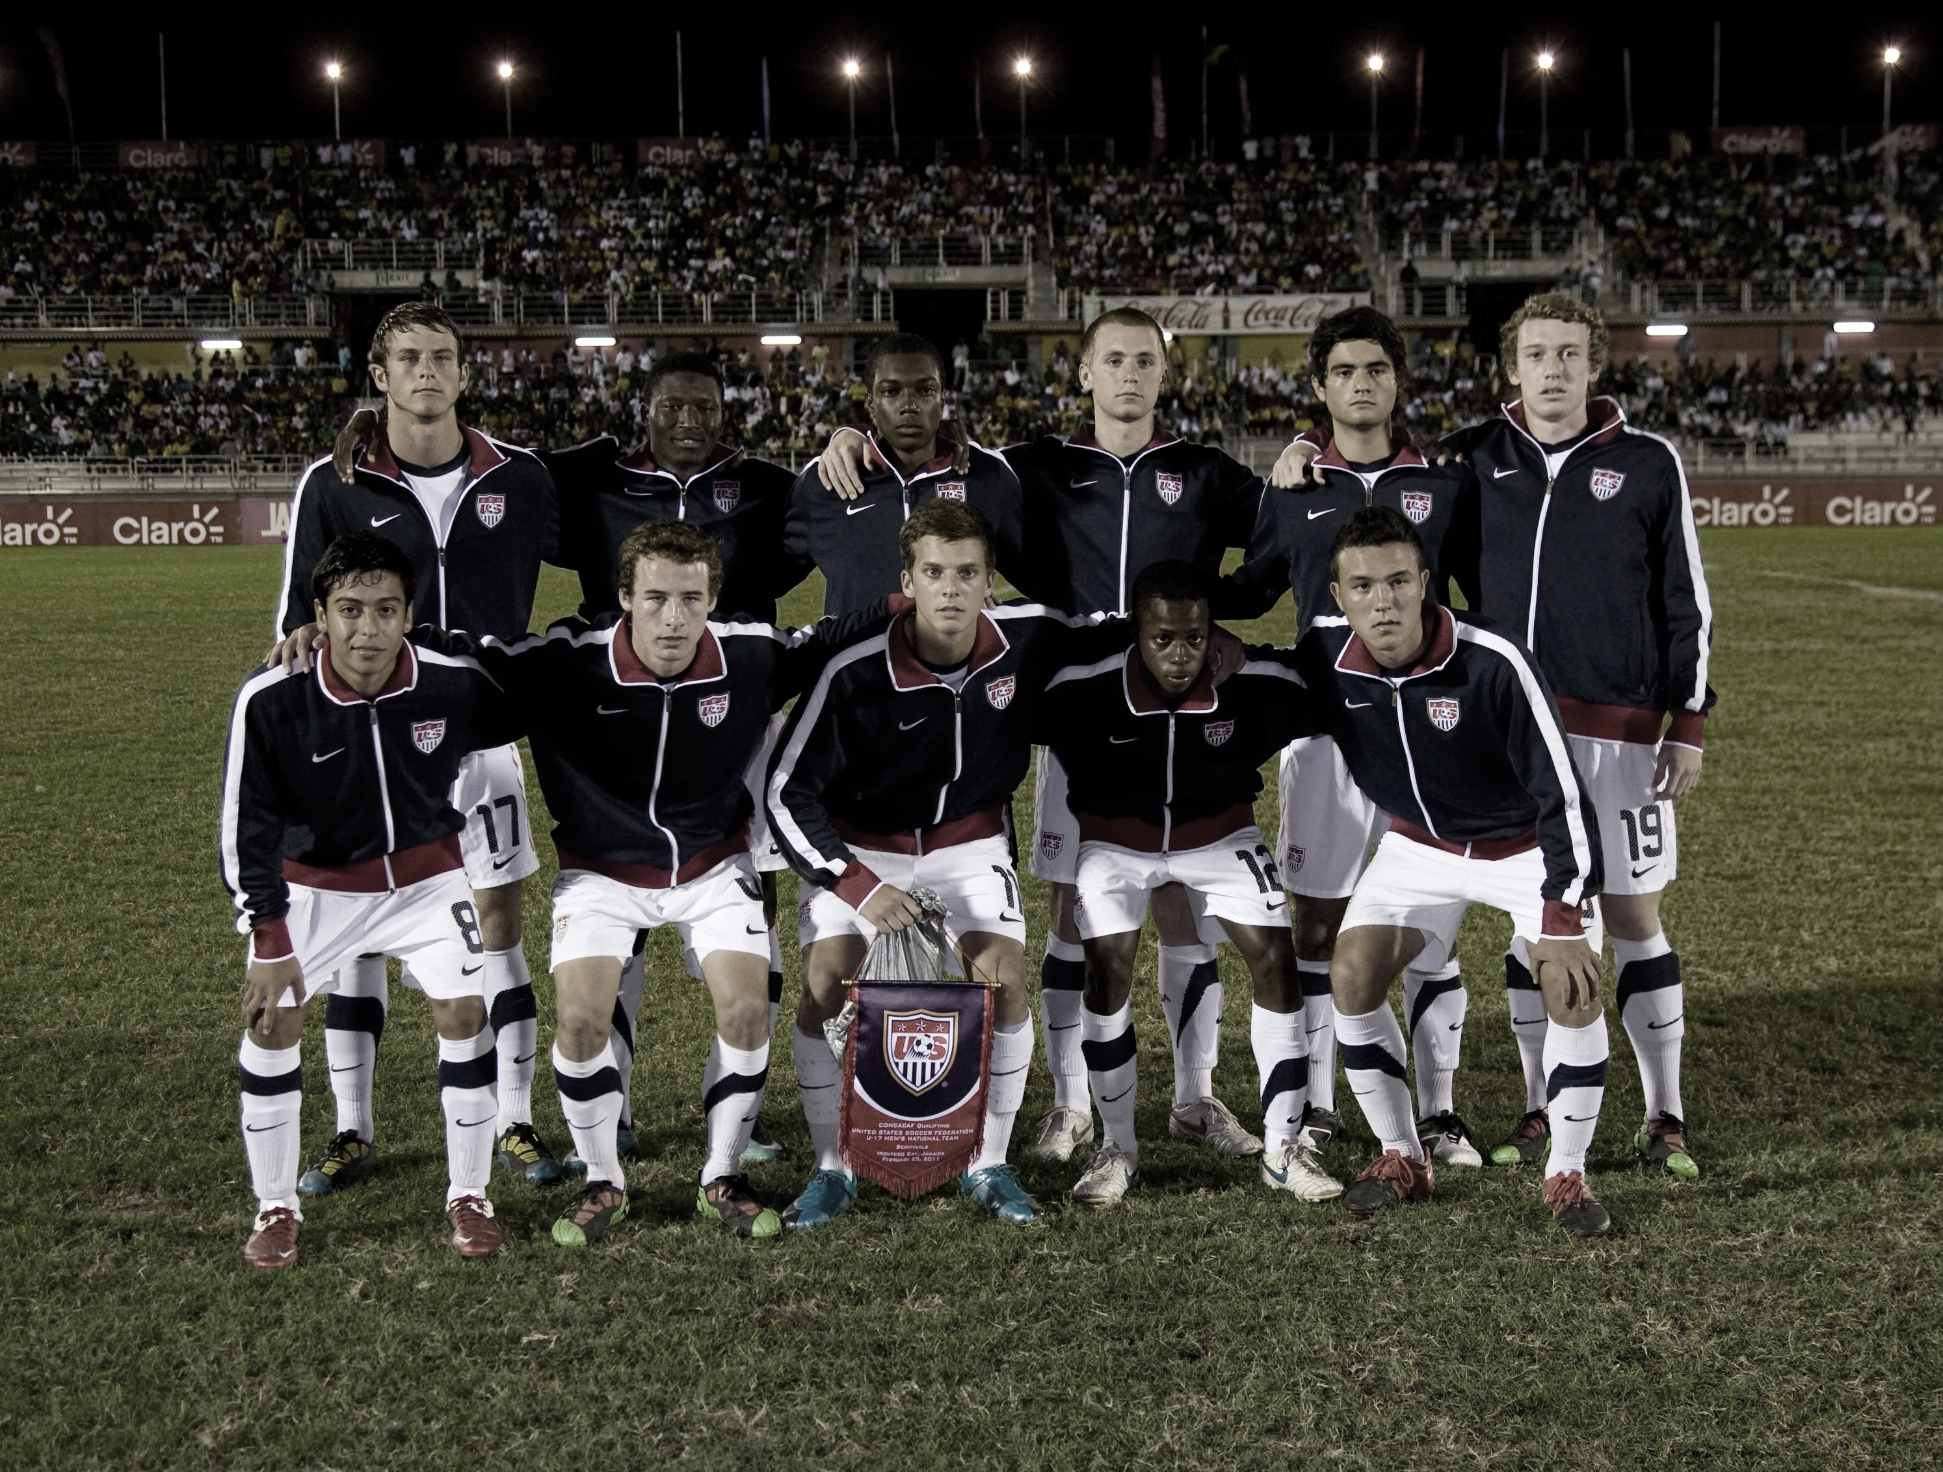
Alliance Futbol Club
Player Development Curriculum
THE GOALKEEPER- #1
Goalkeeper #1
Roles
Shot Stopping- Keep the ball out of the back of the net
Be Clean- Be clean with hands to prevent rebounds and inspire confidence
Dealing with Crosses- Command the penalty area by owning crosses
Sweeper-Keeper- Manage and patrol the space behind the back line, help solve balls that get played behind the back line
Distribution- Start our attack by either trying to spring a quick counter-attack, or start with building out of the back (punt, drop-kick, throw, roll, goalkick, free kick)
Organizing- Communicate and organize, see the field, see and organize the far post
Communication- Communicate primarily to the backline, communicate pressure, cover, balance, be demanding.
uTraits
Leading defensive organization
Dominating 1v1 situations (heading, tackling and intercepting)
Zonal marking, anticipation and preventive actions (shifting, stepping, dropping, and covering movements)
Reading and breaking pressure (calm and decisive) •
Range of passing (through, over and around defensive block)
uPhysical
Strength and power in duels (jumping), speed and agility

Slide 48
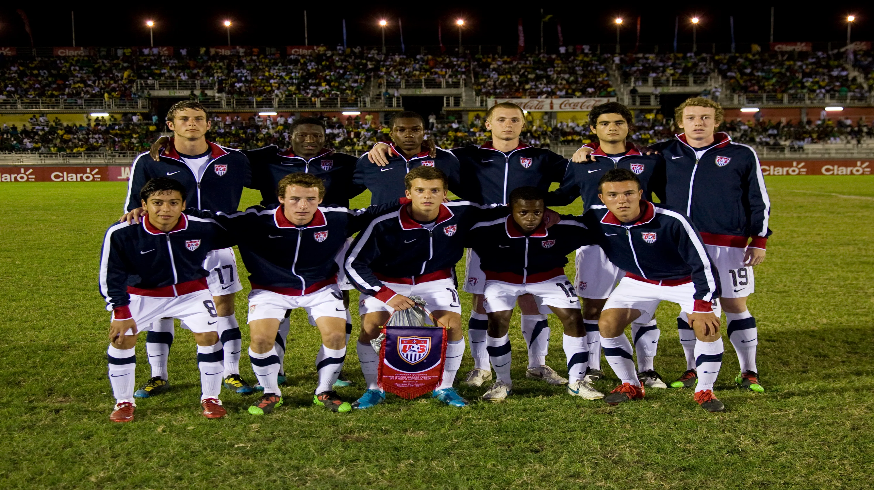
Alliance Futbol Club
Player Development Curriculum
THE OUTSIDE BACK- #2 & #3
Outside Back #2 & #3
Roles
Organize the Back Line- Must communicate and get everyone on the same page. In charge of organization for outside backs and defensive center midfielders
Deny Penetration- Keep the ball in front of you. ( Don’t get Beaten!!)
Make Play Predictable- Funnel play away from the goal, make it obvious what the attacker is going to do
Win the Ball- Only when 100% sure you are going to get the ball, step when in shooting range
Get into the Attack- Get forward into the attack by pass, dribble, or off the ball run
Gain Width- Get in a wide and advanced position in the attack
Transition- Defensively stay connected with center backs while getting into the attack
Balance- Provide balance to protect weakside space
uTraits
Continuously adjusting body shape and position to provide support and cover (height and width)
Dominating 1v1 duels to create or regain the ball
Receiving, dribbling and making quick combinations to create chances & break pressure (crossing and shooting)
Inverting or Making overlap and underlap runs to create advantage
uPhysical
Speed, quickness, agility and endurance

Slide 49
Alliance Futbol Club
Player Development Curriculum
THE CENTER BACK- #4 & #5
Center Back #4 & #5
Roles
Organize the Back Line- Must communicate and get everyone on the same page. In charge of organization for outside backs and defensive center midfielders
Deny Penetration- Keep the ball in front of you. ( Don’t get Beaten!!!)
Make Play Predictable- Funnel play away from the goal, make it obvious what the attacker is going to do
Win the Ball- Only when 100% sure you are going to get the ball, step when in shooting range
Keep Possession- Help transition from defending to attacking by calming down the game and finding a simple option to maintain possession
Change the Point of Attack- Use the numerical advantage of the back line to constantly switch play from side to side
Compress and Compact Play- Move the back line both vertically and horizontally to squeeze play for the opposing team
uTraits
Leading defensive organization
Dominating 1v1 situations (heading, tackling and intercepting)
Zonal marking, anticipation and preventive actions (shifting, stepping, dropping, and covering movements)
Reading and breaking pressure (calm and decisive) •
Range of passing (through, over and around defensive block)
uPhysical
Strength and power in duels (jumping), speed and agility

Slide 50
Alliance Futbol Club
Player Development Curriculum
THE DEFENSIVE CENTER MIDFIELDER - #6
uTraits
Dominating positionally and individually, controlling and protecting central area
Positioning between lines (spatial awareness and body orientation) and quick decision making
Technically advanced-receiving and turning in tight spaces, passing range including final pass
Recognizing when to play forward, switch play and keep possession
Breaking down compact defenses and finishing the attack
Reading and initiating pressing moments, closing space with speed and intensity
Denying penetrations and assisting fullback in wide areas
uPhysical
Agility, endurance, quickness and use of body to protect ball
Defensive Center Midfielder #6
Roles
Ball Winner- Win balls and disrupt opposition attack
Organizer- Organizes other central midfielders, communicates with center backs, and helps organize all over the field
Sits in front of the back line- stays connected with center backs and protects the shape in front of the back line. Shields balls from finding the opposing center forward(s)
Balance MF Shape- Keeps a sense of defensive responsibility in preparation for defensive transitional moments
Get forward at times- Joins attack when appropriate (100% sure that there is no counter-attack possibility)
The Engine- Set possession and play in fast 1-2 touch rhythm to run the game
Starting position is 7-10 yards in front of center back. In line with the ball and the center of the goal.

Slide 51
Alliance Futbol Club
Player Development Curriculum
THE CENTER MIDFIELDER - #8
Center Midfielder #8
Roles
Cover Ground- Box to box midfielder. Get into the attack and help defensively
Playmaker- Be creative in the attack. Be available as an option as much as possible
Get Forward- Joins the attack as much as possible
High Work Rate- Constantly moving and working hard to support the attack and help defensively.
Combination Play- Quick passing combinations with forwards and other midfielders to attack spaces in front of and behind defenses
Set Possession- Win and keep possession of the ball. Play in a fast 1-2 touch rhythm.
Change the Point of Attack- Move balls around from side to side to open up defenses
Ball Winner- Win balls and disrupt opposition attack
Balance MF Shape- Keeps a sense of defensive responsibility in preparation for defensive transitional moments
uTraits
Dominating positionally and individually, controlling and protecting central area
Positioning between lines (spatial awareness and body orientation) and quick decision making
Technically advanced-receiving and turning in tight spaces, passing range including final pass
Recognizing when to play forward, switch play and keep possession
Breaking down compact defenses and finishing the attack
Reading and initiating pressing moments, closing space with speed and intensity
Denying penetrations and assisting fullback in wide areas
uPhysical
Agility, endurance, quickness and use of body to protect ball

Slide 52
Alliance Futbol Club
Player Development Curriculum
THE ATTACKING CENTER MIDFIELDER - #10
uTraits
Dominating positionally and individually, controlling and protecting central area
Positioning between lines (spatial awareness and body orientation) and quick decision making
Technically advanced-receiving and turning in tight spaces, passing range including final pass
Recognizing when to play forward, switch play and keep possession
Breaking down compact defenses and finishing the attack
Reading and initiating pressing moments, closing space with speed and intensity
Denying penetrations and assisting fullback in wide areas
uPhysical
Agility, endurance, quickness and use of body to protect ball
Attacking Center Midfielder #10
Roles
Creativity- Be a personality!! Create havoc in the attack
Playmaker- Be creative in the attack. Be available as an option as much as possible
Attack 1v1- Run at the back line and take on defenders
Combination Play- Quick passing combinations with forwards and other midfielders to attack spaces in front of and behind defenses
Work Rate- Constantly moving and working hard to support the attack and start the midfield layer of defending
Be Elusive- Float and find spaces in the gaps of the midfield. Try and find the ball between the opponent’s midfield layer and their back line
Finisher- Be a goal scorer!! Shoot often from different distances. Get into the attacking box as much as possible.

Slide 53
Alliance Futbol Club
Player Development Curriculum
THE OUTSIDE FORWARD- #7 & #11
Outside Forward #7 & #11
Roles
Attack 1v1- Run at the back line and take on defenders. Willingness to take on 1v1 at all times!!
Finisher- Be a goal scorer!! Shoot often from different distances, get into the attacking box as much as possible, & get to the back post consistently.
Creativity- Be a personality!! Create a havoc in the attack
Playmaker- Be creative in the attack. Be available as an option as much as possible.
Combination Play- Quick passing combinations with other forwards and center midfielders to attack spaces in front of and behind the defense
Flank Service- Deliver high quality service from flank spaces (bending-flighted, driven, slotted, etc.)
High Defensive Pressure- Start the defensive shape by high pressuring opposition and doubling when possible
Be a Danger- Find wide spaces and look for gaps in the back line and demand the ball!!
uTraits
Dominating 1v1, dribbling and running with the ball to take-on opponent, creating chances and scoring
Shooting and crossing (early, cut-back, etc.) off the dribble, coming inside or wide
Making aggressive runs with and without the ball
Reading and initiating pressing moments, closing space with speed and intensity
Denying penetrations and assisting fullback in wide areas
uPhysical
Speed, change of direction and body feints
Ability to make repeated accelerations

Slide 54
Alliance Futbol Club
Player Development Curriculum
THE CENTER FORWARD- #9
Central Forward #9
Roles
Attack 1v1- Run at the back line and take on defenders. Willingness to take on 1v1 at all times!!
Finisher- Be a goal scorer!! Shoot often from everywhere. Get into the attacking box
Creativity- Be a personality!! Create a havoc in the attack
Playmaker- Be creative in the attack. Be available as an option as much as possible.
Combination Play- Quick passing combinations with other forwards and center midfielders to attack spaces in front of and behind the defense
Flank Service- Deliver high quality service from flank spaces (bending-flighted, driven, slotted, etc.)
High Defensive Pressure- Start the defensive shape by high pressuring opposition, doubling when possible, and funneling play to one side
Be a Danger- Find wide spaces and look for gaps in the back line and demand the ball!!
Demand the Ball- Constantly ask for the ball (Posted up, in front of defense, and behind defense)
uTrait
Creating chances and scoring goals
Receiving and holding the ball under pressure
Making varied runs (movements and timing) to get behind opposition back line and create space for self and teammates
Anticipating and moving into dangerous positions, untracking from opponent
Receiving and passing under pressure
uPhysical
Strength to hold off opponent, explosiveness to separate from opponent

Slide 55
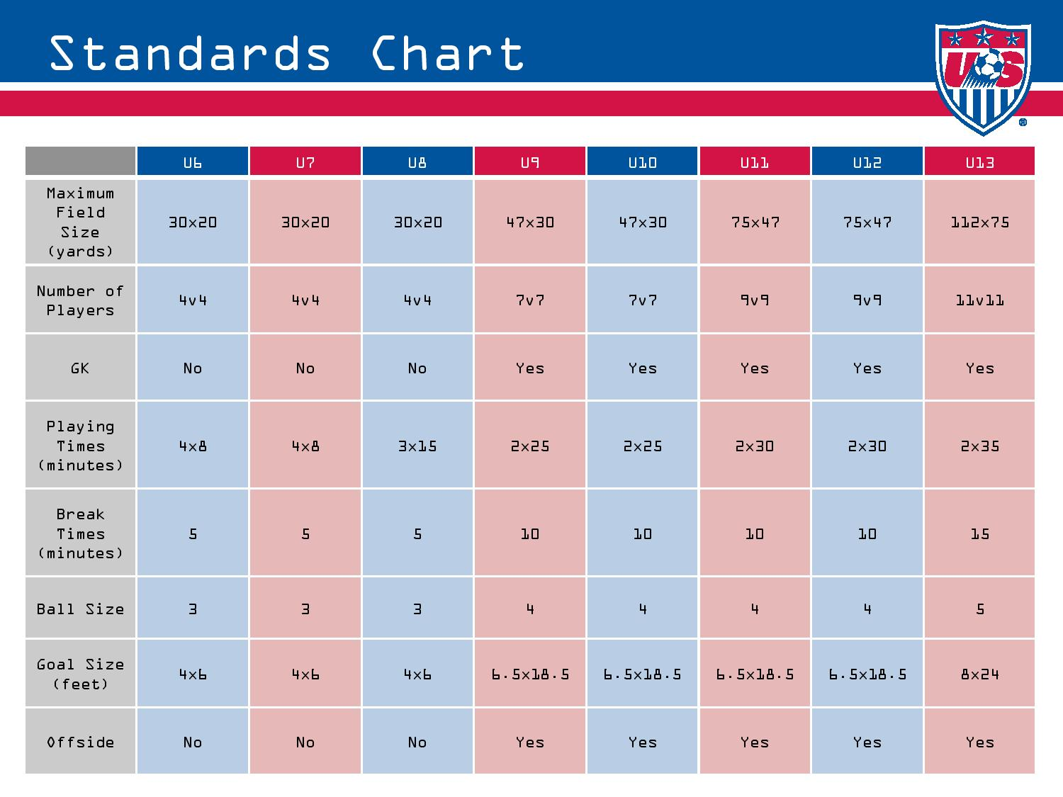

Slide 56
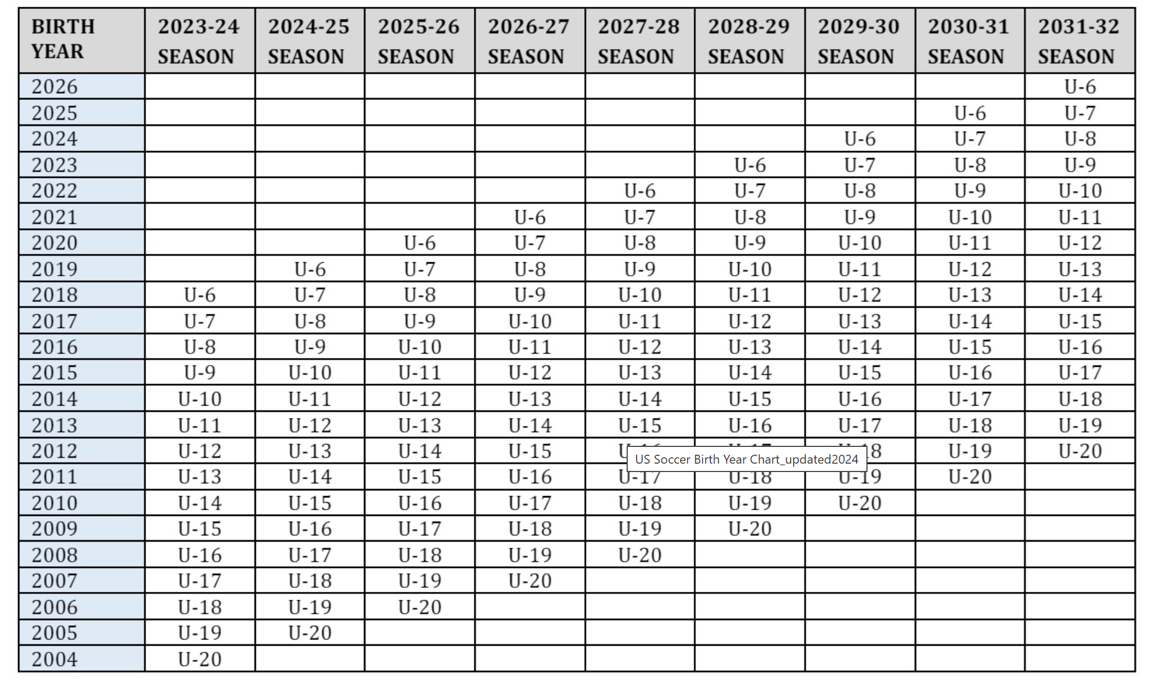



















Slide 57
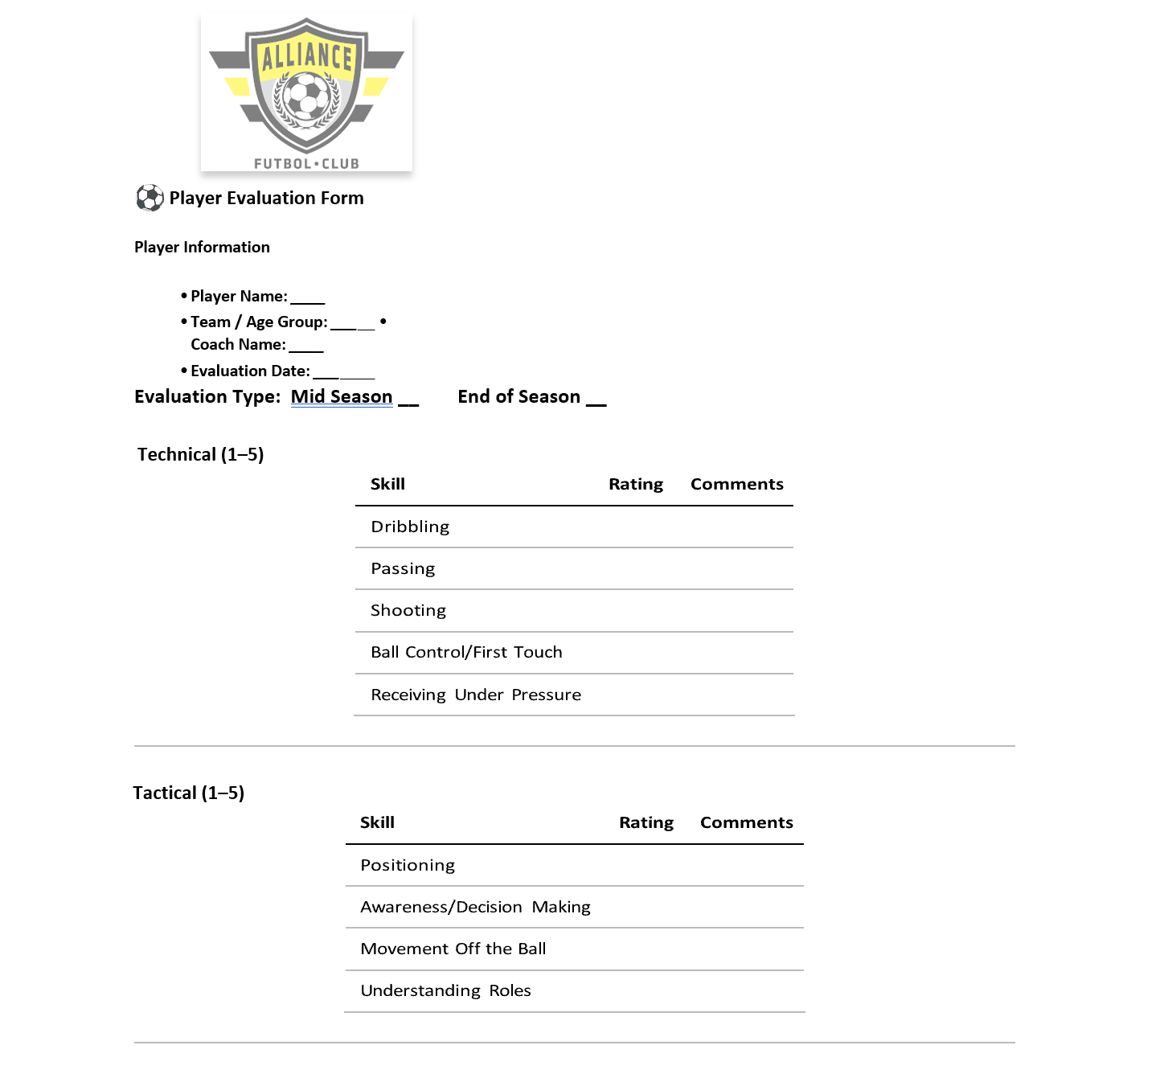
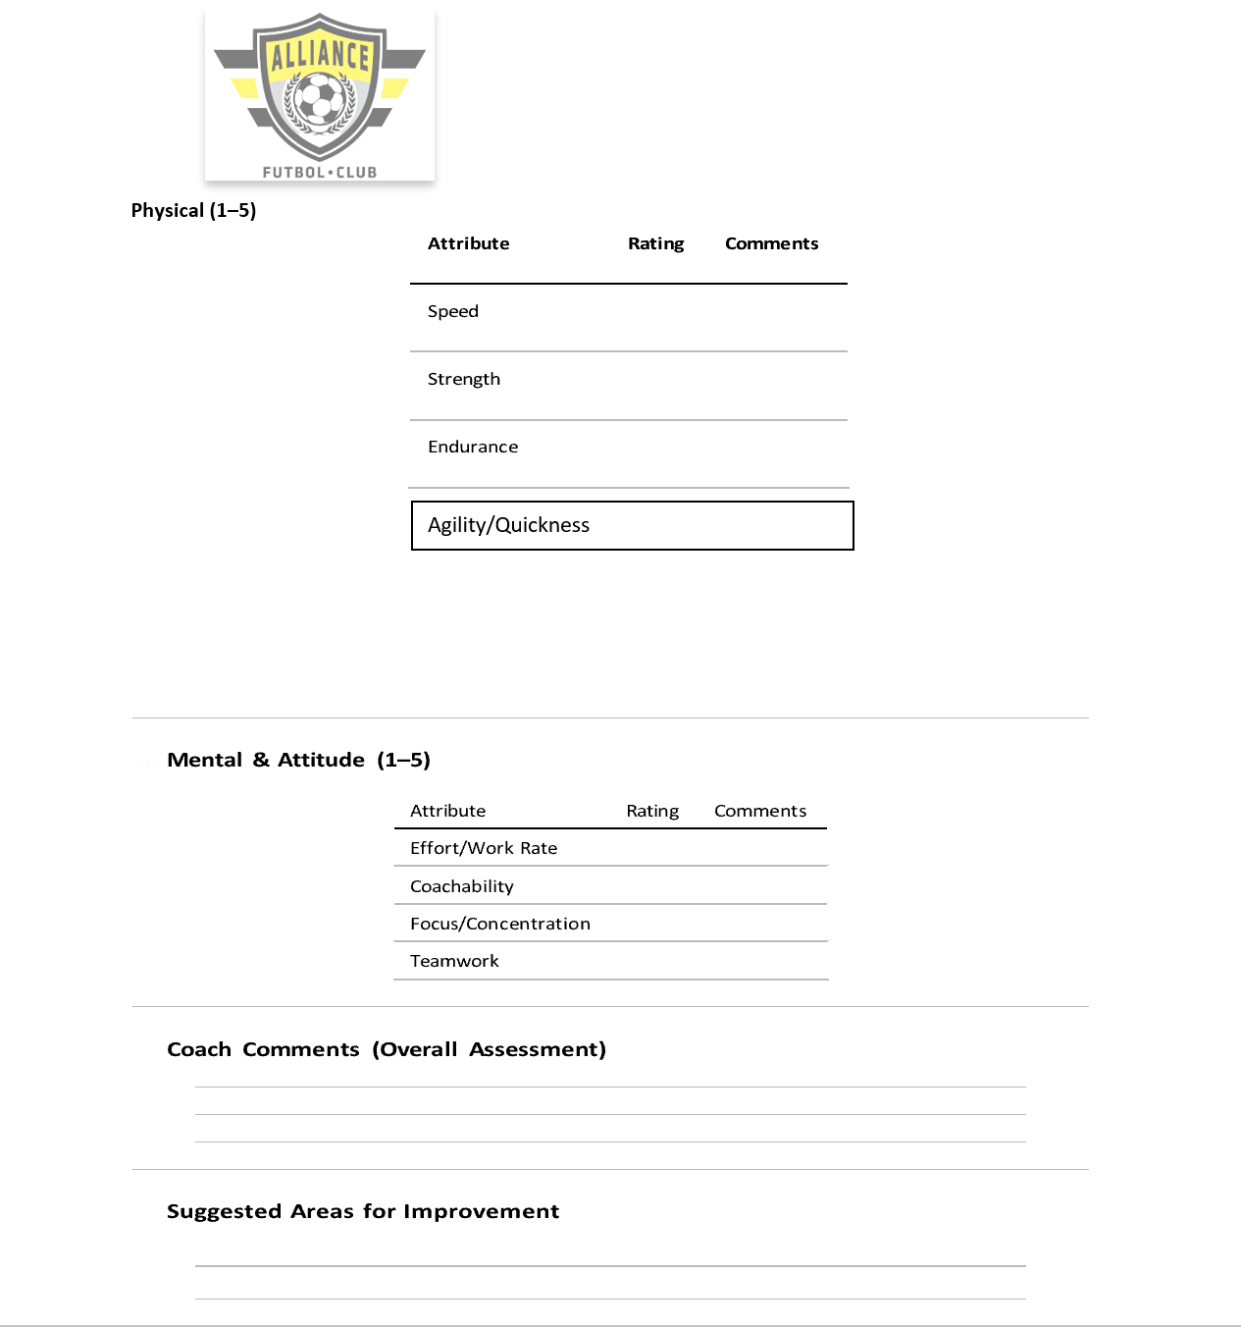

Slide 58
PPP
Activities
Variations
Constraints
Conditions
Perform
The Training Session
Warm up: Free Play
Activity #1 : Technical
Activity #2 : Tactical (Session’s Topic)
Activity #3 : Play
Numbers
Neutrals
Direction
Non-Directional
Time
Rules
Work/Rest Ratios
Grid Size
Zones within pitch
# of Goals
Size of Goals
Targets
Zones
Scenario
Teams

Slide 59
The Training Session
PRE & POST SESSION
DURING SESSION
PLAN
Learning Objective
PREPARE
Field Set up
PERFORM
Coaching Point
REFLECT
Check for Understanding
INTRODUCE
Simple and Clear
OBSERVE
Allow Players to experience each activity
ADJUST
Make adjustments to bring out principle
APPLY
Effective Transition
Organized

Slide 60
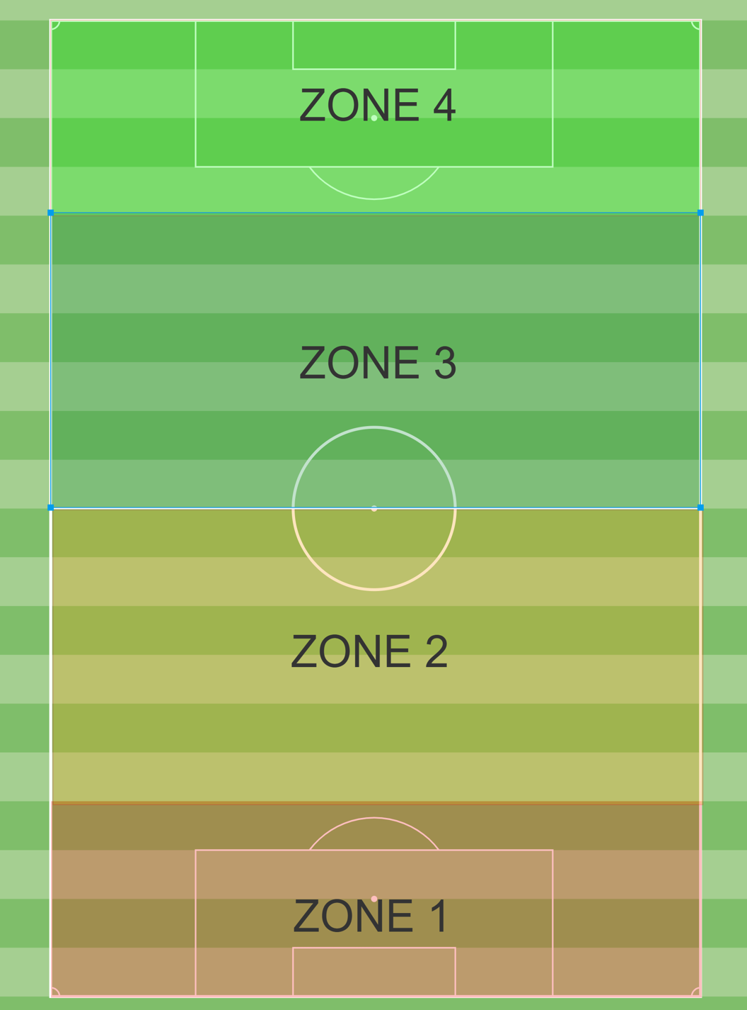

Slide 61
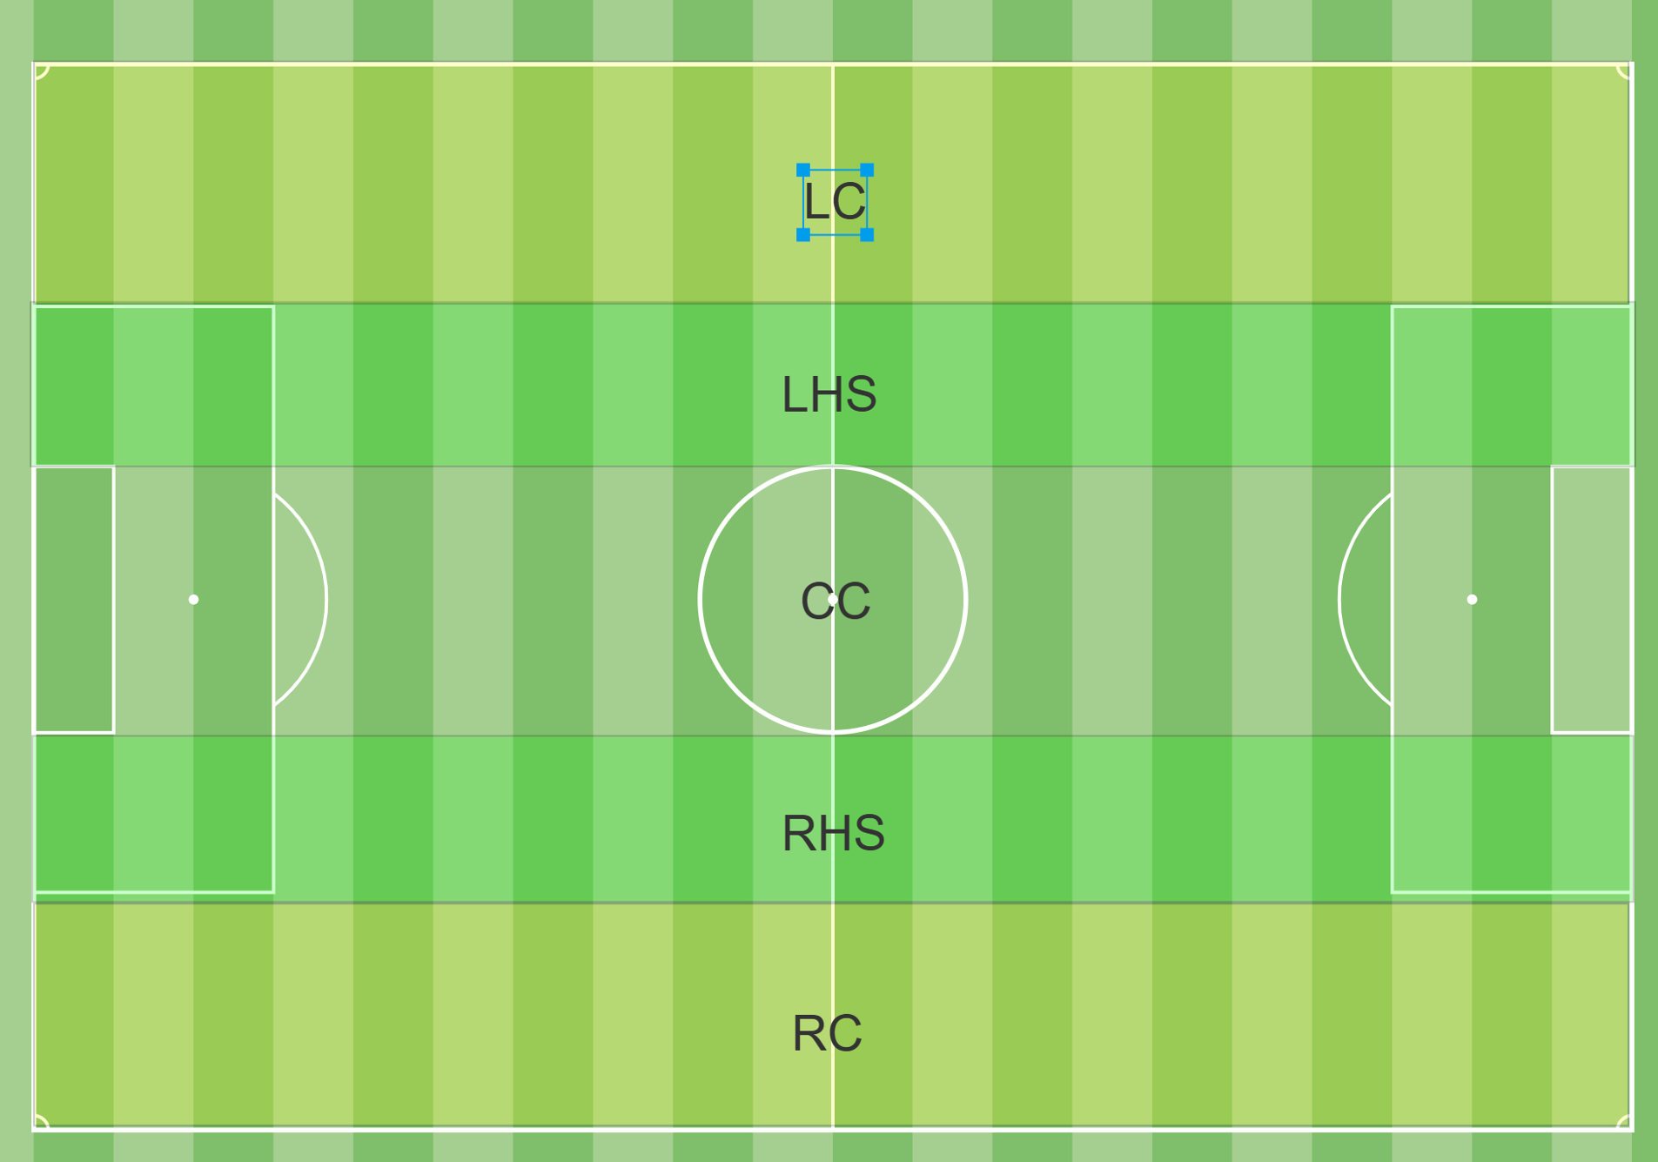

Slide 62
Topic: Defending from the front
Date: N/A
Session Objective: Prevent opposition from building out. Win ball & score
Session Duration: 90 Min
Phase of Play: Defending in Zone 4 &/or 3
Player Actions: Pressing, Intercepting, Challenging, Scanning, Covering, Marking
Coaching Point: Will vary depending on Age (less coaching points for younger ages and/or lower quality)
- CP1: Being Vertically & Horizontally Compact
        Are our lines compact?
        What are the distances between each teammate?
        Is our shape good enough to initiate the press?
- CP2: Pressing & Closing down player on the ball
        How are you pressing the ball?
        Where are you forcing?
        Show me the angle in which you press
-CP3: Provide cover to disallow penetration through a pass
        Who are we covering? Space? Passing lanes? Player?
        As the ball gets played, are you close enough to apply pressure & Intercept, Disrupt or Contain?

Slide 63
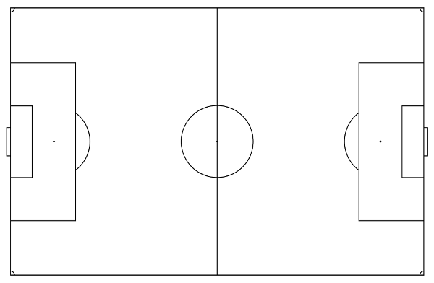
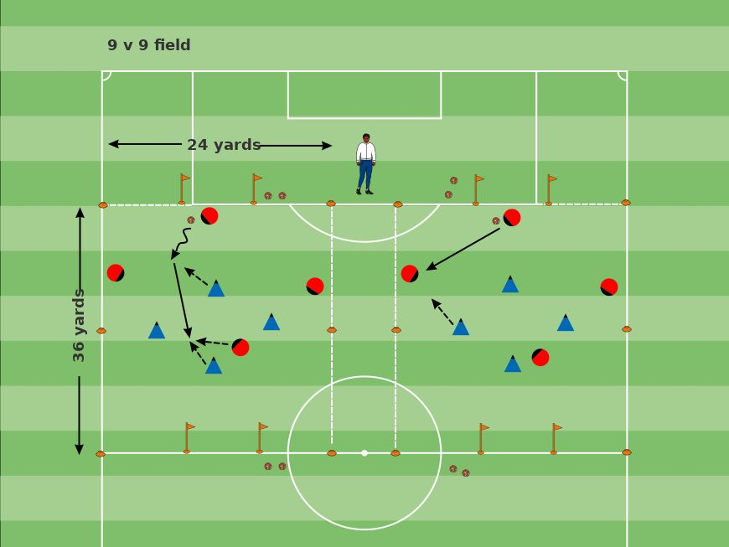
Session Structure
WARMUP ACTIVITY: 4v4 Free play
 | Activity Objective | To prevent the opponent from building up, win the ball and score.
 | # of players/Opponent | 4v4
 | Size/Shape of Field | 36L 24W
 | Ways of Scoring | Score on small goal or gate
 | Active/Recovery Duration | 2 min on , 1 min off
 | Repetition/Sets | X4 reps x 2 sets (3 min off b/t sets)
 | Total Activity Duration | 30 min
 | Rules | Goal scored after winning the ball on att half counts as 2
 | Constraints/Restraints
 | Rotations (Substitutions) | none
Coaching Interactions (What>When>How): WHAT are you going to coach? (session objective & Coaching points) WHEN are you making the coaching points HOW are you making the coaching points? (direct, GQ, showing them)

Slide 64
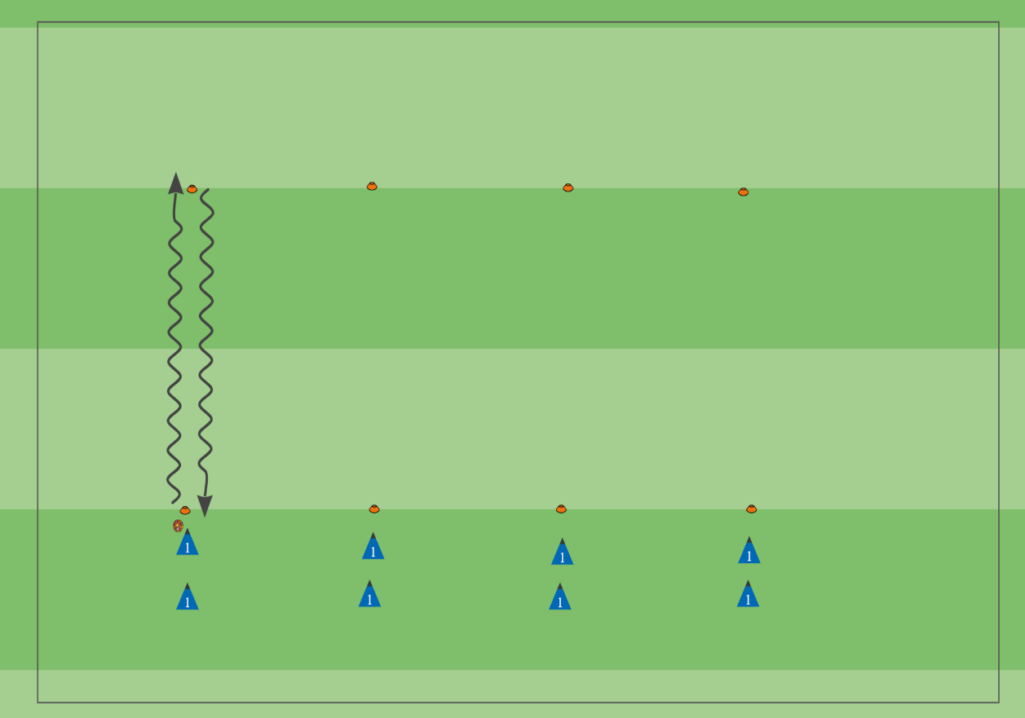
Session Structure
ACTIVITY 1: Technical Drills – Dribbling Series
 | Activity Objective | Improve dribbling technique
 | # of players/Opponent | n/a
 | Size/Shape of Field
 | Ways of Scoring
 | Active/Recovery Duration
 | Repetition/Sets
 | Total Activity Duration | 15 minutes
 | Rules
 | Constraints/Restraints
 | Rotations (Substitutions)
Coaching Interactions (What>When>How):

Slide 65
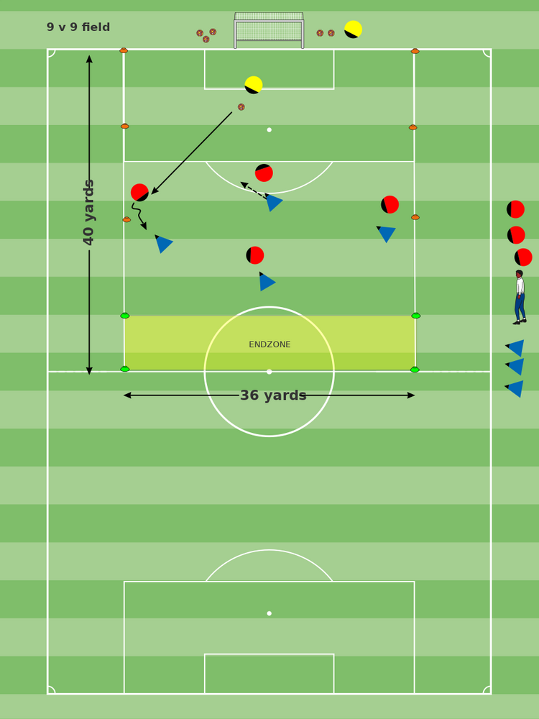
Session Structure
ACTIVITY 2: 5v4 to an Endzone
 | Activity Objective | To Prevent Build up into zone 2 (endzone)
 | # of players/Opponent | 5v4 (with GK)
 | Size/Shape of Field | 40L 36W
 | Ways of Scoring | Non Focus group: scores by dribbling into the endzone Focus Group: Score on big goal
 | Active/Recovery Duration | 2 min on , 1 min off
 | Repetition/Sets | X4 reps x 2 sets (3 min off b/t sets)
 | Total Activity Duration | 30 min
 | Rules | Ball starts from GK.
 | Constraints/Restraints
 | Rotations (Substitutions)
Coaching Interactions (What>When>How): CP1: Being Vertically & Horizontally Compact CP2: Pressing & Closing down player on the ball CP3: Provide cover to disallow penetration through a pass

Slide 66
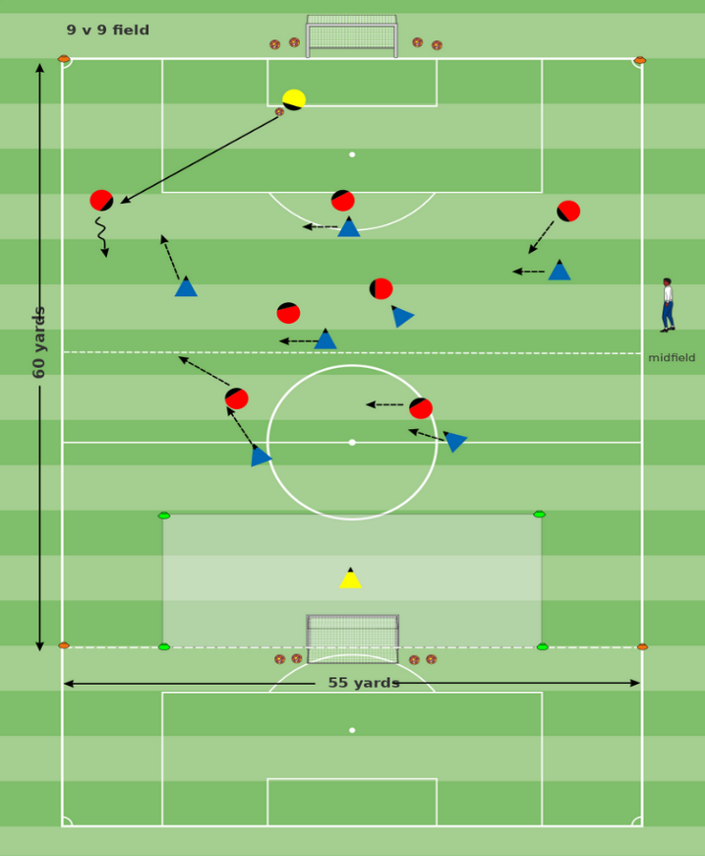
Session Structure
ACTIVITY 3: The Game
 | Activity Objective | Disrupt opp build up, win ball and score
 | # of players/Opponent | 8v8
 | Size/Shape of Field | 60L 55W
 | Ways of Scoring | Score on Goal
 | Active/Recovery Duration | 7 min / 1 min rest X2
 | Repetition/Sets | X2 reps
 | Total Activity Duration | 15min
 | Rules | Fifa rules
 | Constraints/Restraints | - Can add incentives to press high
 | Rotations (Substitutions)
Coaching Interactions (What>When>How):

