Slide 1

Minnetonka
Youth Hockey Association
Annual Meeting 2019

Slide 2
Minnetonka Youth Hockey Association
Annual Meeting, 2019
Agenda:
Call to Order
Welcome!
Success on the ice
Introduction of Board, Roles and Updates
Charitable Gambling Overview
Candidate Introductions and Elections
Adjourn

Slide 3
Success on the ice: Here, Near & Far!
RECORD fourteen teams qualify for Regions
Nine teams to State: JGA Warriors (Champions), 19UB (Champions), 15A Black (2nd), 12A Black (2nd), Peewee AA (3rd), JG16 Blue, JGB Blue, JGB Black, 15UB
Alumni Highlights
NCHC Player of the Year, Hobey Baker Hat Trick Finalist, NHL Debut with Las Vegas Knights: Jimmy Schuldt
WCHA Student-Athlete of the Year: Max Coatta
NWHL Isobel Cup Champions: Julie Friend, Sydney Rossman
Mr. Hockey Finalists: Josh Luedtke, Grant D0cter
Frank Brimsek, HS Goalie of the Year: Charlie Glockner
Girl’s State HS Tournament, 3rd Place: Minnetonka Skippers
US Women’s National Team: Sidney Morin
NCAA National Champion: Presley Norby, Wisconsin
Wes Barrette, Metro Hockey League Award: Posthumously awarded to David Aanenson

Slide 4
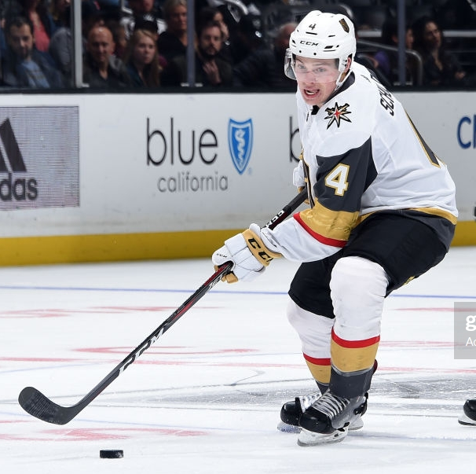
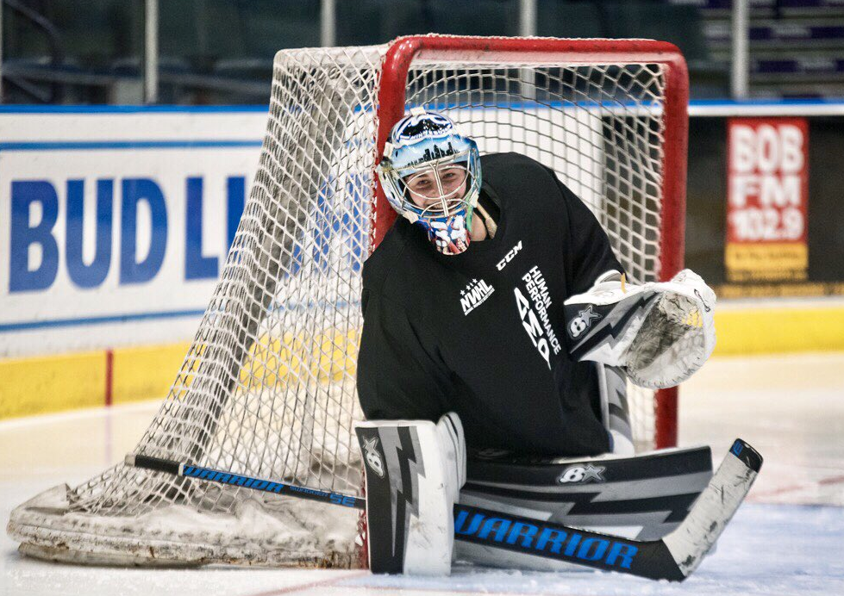
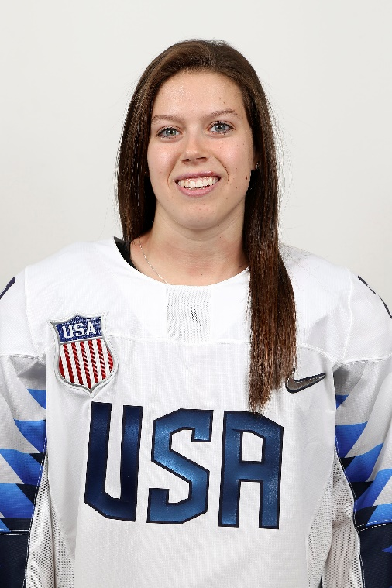
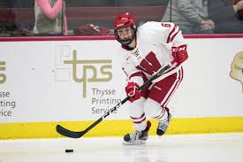
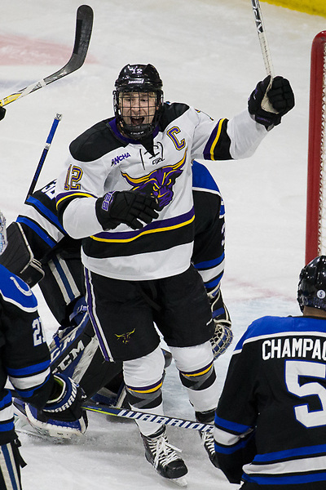
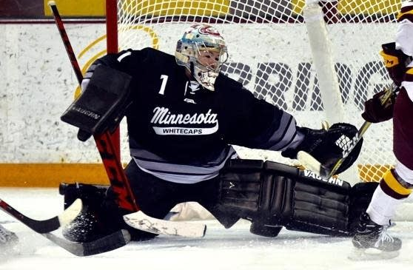
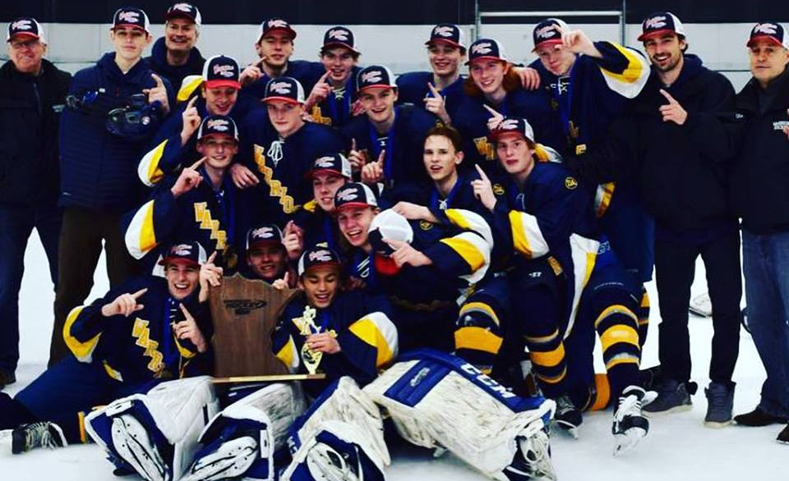
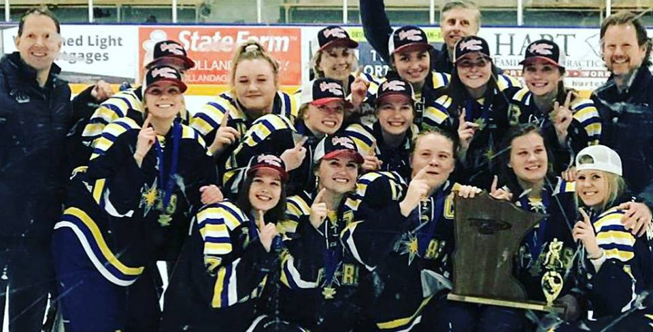

Slide 5
Board Member Positions and Highlights
President: Jim van Bergen
Vice President: Mike Mann
Secretary: Nicole Zapzalka
Treasurer: Steve McDonald
Boy’s Director: Matt Quinn*
Girl’s Director: Rick Helling*
Boy’s Mite Director: Jamie Kendall
Communications Director: Cara Albrecht-Ostrom
Sponsorship Director: Hope Holler*
Fundraising Director: Chris Jerdee
Volunteer Director: Stacy Sand*
Equipment Director: BJ Klinck
Tournament Director: Jason Butterfield*
Registrar: Ann Moss*
Girl’s Mite Director: Vacant*
Non-Voting Roles: Ice Director, HDC Director, Gambling Manager, Office Manager, Arena Manager, Controller, IT Director
* 2-Year Term Completed

Slide 9
Charitable Gambling Overview
Began in June of 2012
To date total of $338,500 has been raised
  Annual average is $48,ooo with low in 2013 of $28,000 and high in 2018 with $90,000.
Current YTD: $55,000 to MYHA
MYHA only operates at Haskell’s Port in Excelsior
  Site offers Pull Tabs, Tip Boards & Bingo
  Players must be 18 years old to play
City of Minnetonka does not allow charitable gambling.
Beneficiaries of MYHA charitable Gambling:
  10% City of Excelsior, net less expenses: $50,320
  Escalating 9% - 36% Tax to State of MN: $169,217
  10% Haskell’s rent receipts: $97,452.70
  100% of proceeds goes to MYHA (501c3)
Gambling is highly regulated by the GCB & State of MN
  Gambling Manager is licensed with State of MN.
  Overall responsibility & continuing education requirement. Duties include: handling money, ordering, inventory, payroll, bingo and Board reports.
  Ratings and audits are recorded with required checks and balances in place.
Expenses for Charitable Gambling:
  Payroll, Accountant (monthly & annual audits),
  Games, Bingo, Tip Board supplies, Equipment, Repairs, Licenses & fees
Board and MYHA members are eligible to play excluding those who have any role in gambling operations (Sales, inventory, auditing, signing authority)
Interested in learning more? Go to the GCB website: http://mn.gov/gcb/index.htm

Slide 10
Minnetonka Youth Hockey Association
Annual Meeting, 2019
Elections:
Election Process
Candidate Introductions
One vote per family
Vote for up to seven candidates
New Board member introductions
Set May, monthly meeting
Adjourn

