Slide 1
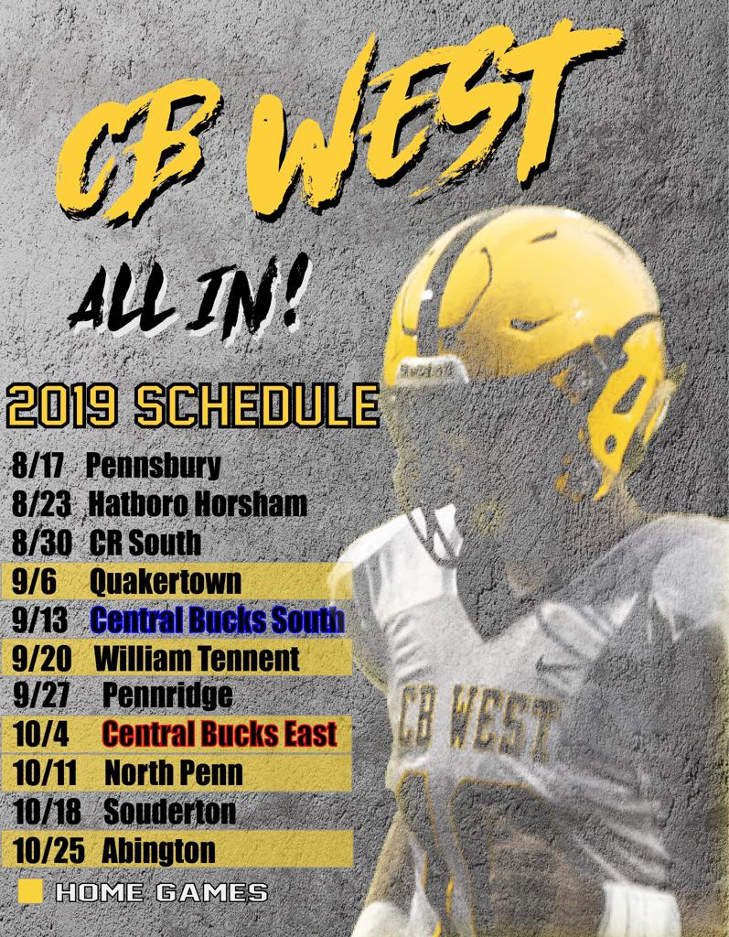

Slide 2



CB West Football
July 22,, 2019 Mandatory Information Meeting
@westcbfootball

Slide 3


Agenda
01
Summer Update and Physicals
02
Uniform Reveal and Guidelines
03
Camp schedule and Important Dates
04
Methods of Communication

Slide 4
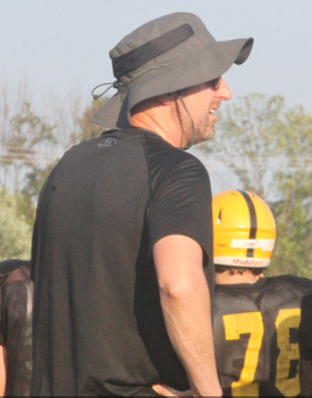
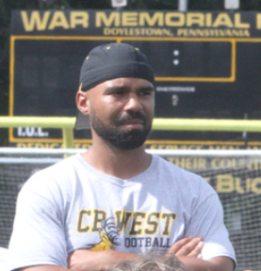
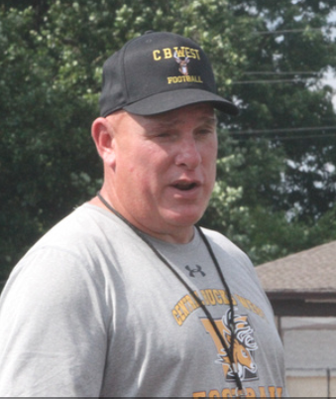
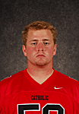
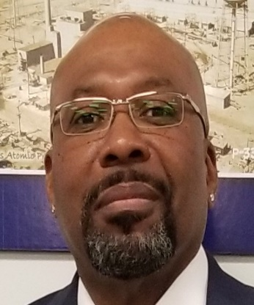
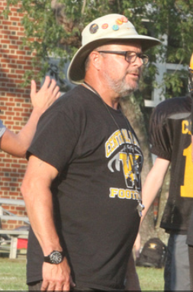
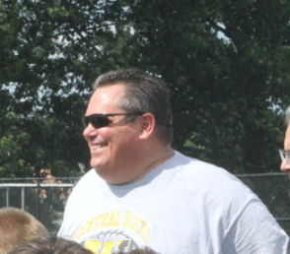
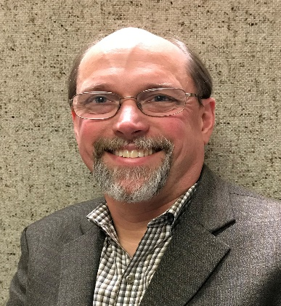
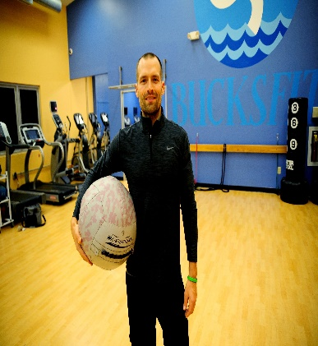
Coaching Staff
Chris Goldrick
James West Jr.
Vic Olear
Jim Geringher
James west sr.
Name Here
Tom Rowan
Chris McGuire
Cory Amsler
Will Eagles

Slide 5
Uniform reveal
Black Cleats with white outline
White mid-shin socks or tights
Speed top and White compression if showing
Black gloves
Black or white mouth piece
@westcbfootball

Slide 6
Program staples
Commitment……What does it mean anymore
Accountability….if not you then who
Sacrifice….are you willing to swim upstream
Teamwork…Being apart of something bigger then just you
Thank you for all that you do in allowing your sons to prepare for a life that isn’t going to give them everything on a silver spoon
@westcbfootball

Slide 7
Up to Speed
Gold Card fundraiser a rousing success- with 15000 raised
Incredible week at youth camp 85+ campers
West Deptford Camp massive success
7 on 7 growth
Pennsbury
Cheltenham
Del Val
One last event planned for tomorrow
@westcbfootball

Slide 8
Physicals
July 23rd
@westcbfootball

Slide 9
Camp information
August 5th start date
Two- a day schedule 6-to 8 am and 5 to 7pm
Report back to west by 345
One a day schedule 4-to 7 pm
Report at 345
Saturday August 10 from 9- to 11:30 will be JV Varsity only
Freshman will be participating in a gold card fundraiser at local wawa’s
August 16th picture day seniors and parents will report at 7:AM everyone else at 8AM
August 17th scrimmage at Pennsbury at 10am. Neri’s hosting a BBQ following the scrimmage
@westcbfootball

Slide 10
Camp information
Importance of rest recovery, hydration and nutrition
Encourage minimum of 8 hours of sleep. Most recovery happens during sleep
Ice and stretching in between practices will enhance recovery
Constant hydration and pee monitoring is critical especially during camp
Properly fueling your body with highly nutrient dense foods is a must
You must eat before morning practice
@westcbfootball

Slide 11
communication
Continue to reach me at remind or through email regarding questions concerns
If you know you are not going to make practice the player must message or email me prior to the practice beginning…….Accountability
Individual performance is always an acceptable conversation to have but playing time or player comparison is not
24 hour rule after a game….ask my wife
Continue to see the calendar and remind for schedule changes
@westcbfootball

Slide 12
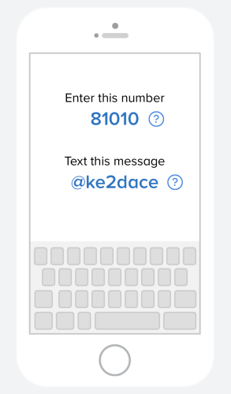
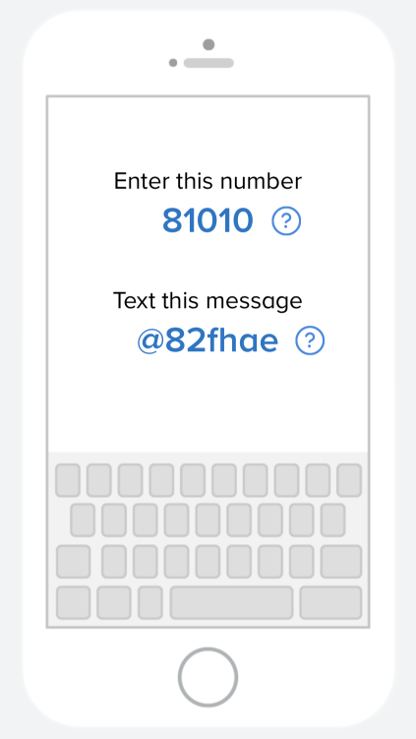
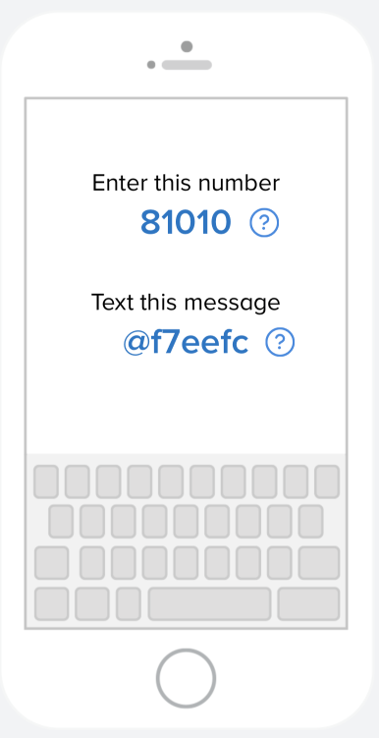
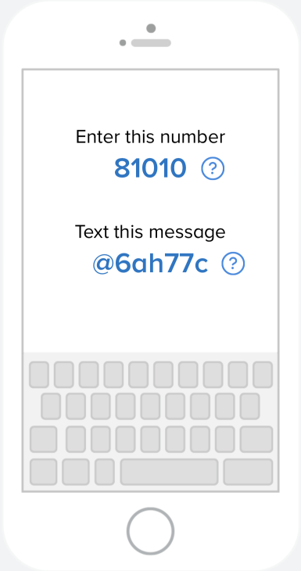
9th grade
10th grade
11th grade
12th grade

Slide 13
Important game dates
Youth night September 6th Quakertown
Sponsorship Night October 4th East
Home coming October 11th North Penn
Senior night October 25th Abignton
@westcbfootball

Slide 14
reminders
October 1st fundraiser at chipotle 4- to 8
Program ad’s for players is due by second week of august. It is a hard deadline
@westcbfootball

Slide 15
Last thoughts
we don’t have a lot, but we love the ones we got
Special group who we believe has the potential to do special things
Thank you for your support and everything you do to make this experience one that your sons will remember for a lifetime
@westcbfootball

Slide 16
Parents club
Introduction
Upcoming dates
positions
@westcbfootball

Slide 17
Board members
Senior Presidents
Jocelyn Tumolo and Nancy Hickman
Junior Presidents
Denise Young and Bonnie Kuller
Sophomore Presidents
Jennifer McGuire and Vanessa Riggi-Cimino
Freshman Presidents
Stephanie Charran and Kirsten cochran
Treasurer
Deborah Parker
Secretary
Lisa Laatsch
Teasurer shadow position (for 2020-2021 season) open now
@westcbfootball

Slide 18
What We do
Fundraising
Gold Card MAJOR fundraiser
Drive 4 Your School – fall
Flip flops and slides
Support the program
HUDL packages
Coaches apparel
Player incentives for gc’s
Cb west Youth Camp
Organize special events
Picture day August 16
Pre-game meals
Senior hosted dinners
Post-game meals
Yard signs and Parent jerseys
@westcbfootball

Slide 19
Upcoming dates
*Player ads for programs, deadline is July 31
*Business ads for programs
*Flip flops /slides orders open through July 28
*Yard signs will be available for order, details coming soon
*Picture day, August 16: 7 am for Seniors and parents; 8 am for all other players
*Chipotle night, October 1
@westcbfootball

Slide 20
Help welcomed
* Sign up geniuses will be sent for half time snack donations
* Help at pre-game meal set up, serving, clean up
* Help set up and sell at apparel table during games
* Help sell programs at games
* EVERY little bit helps support our players and this team and Coaches for a great season
* There is something for everyone!
@westcbfootball

Slide 21
Final reminders
Our communications will be sent through Remind.
We look forward to a great season!.
Apparel team now accepts credit card
Please stop by the apparel sales table to secure some Football
apparel and get started showing your FOOTBALL pride! We will be
available if you have any questions or want to talk about helping out.
GO BUCKS!!!!!!!!!!!
@westcbfootball

