Slide 1
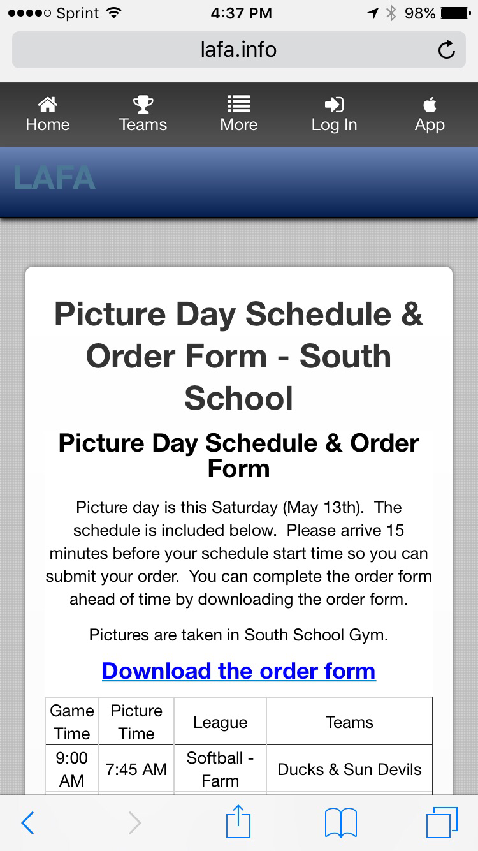
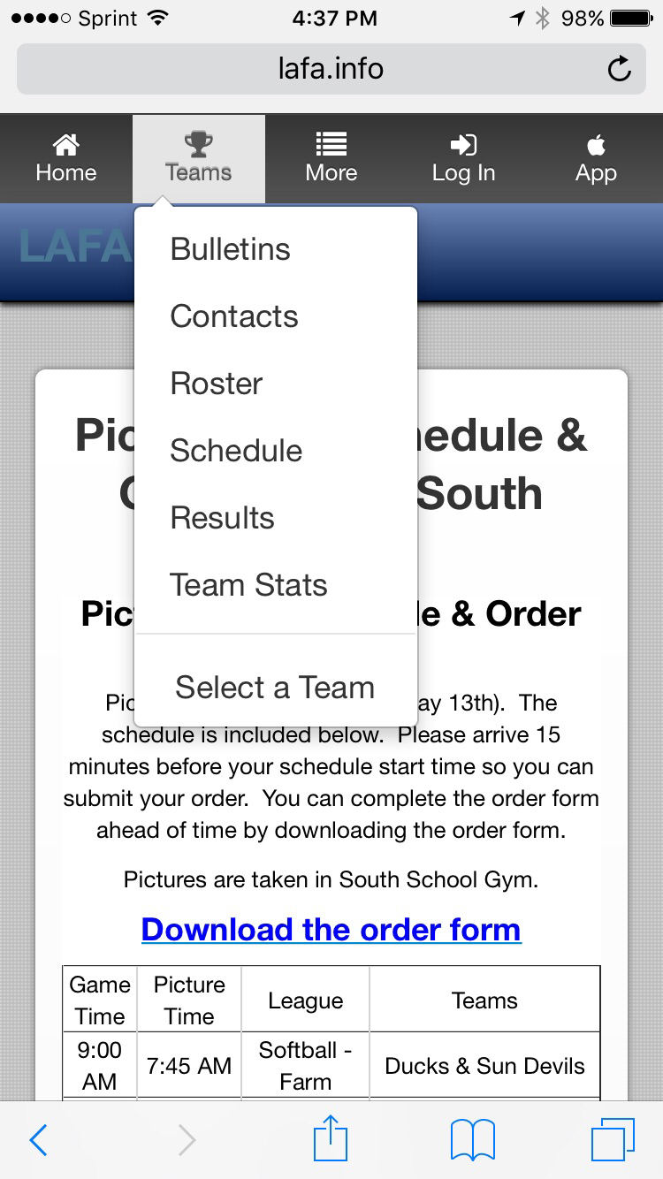
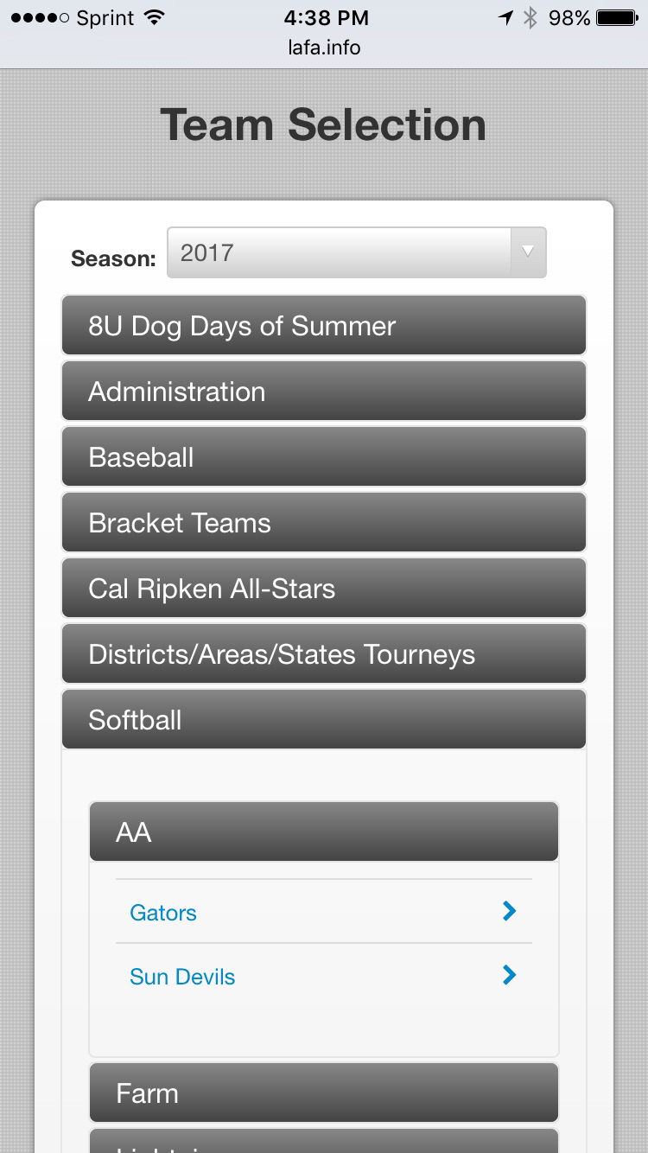
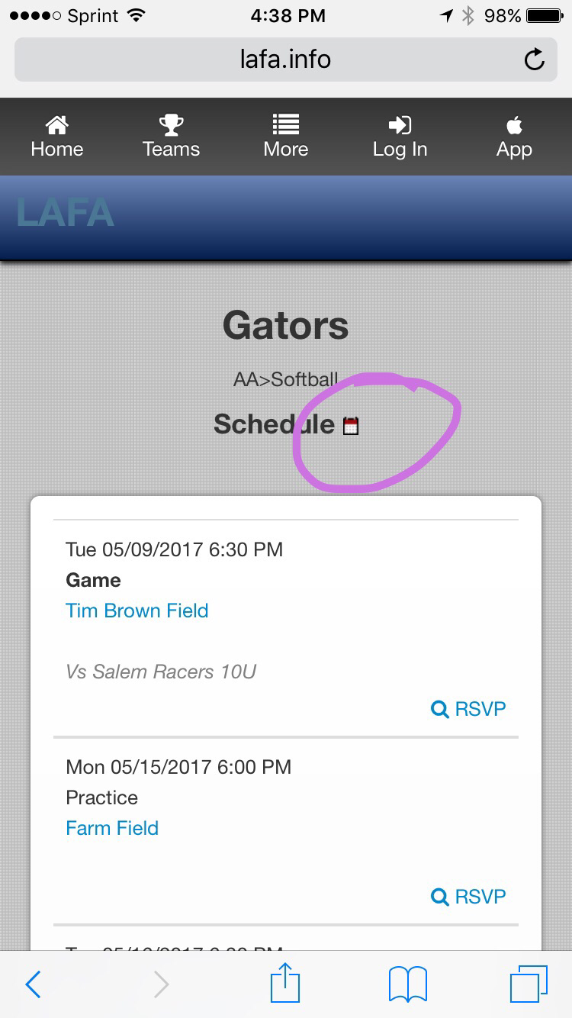
Go to www.LAFA.info from your mobile phone, select your team, select Schedule and tap the icon
Step 1. Step 2. Step 3. Step 4. Step 5

