Slide 1


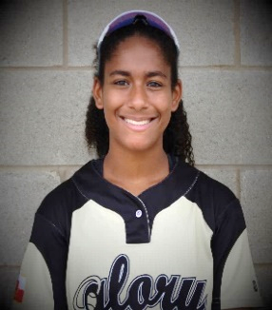
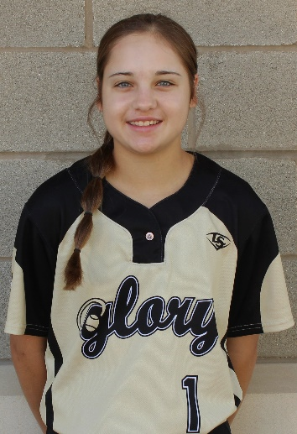
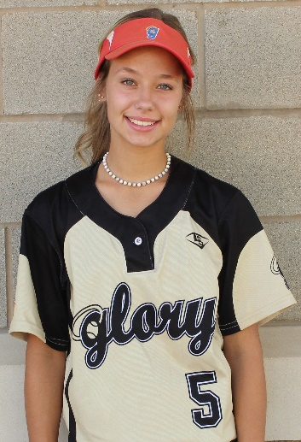
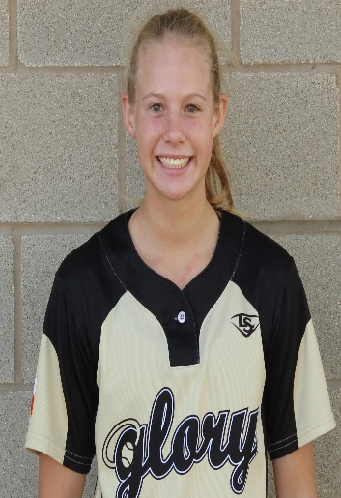
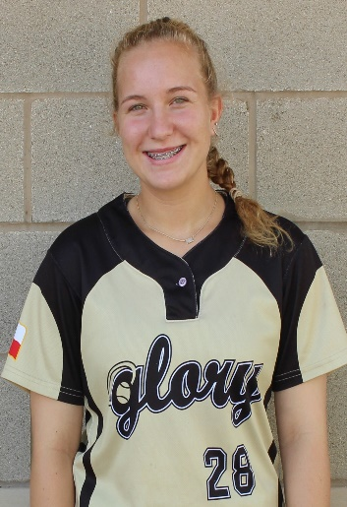
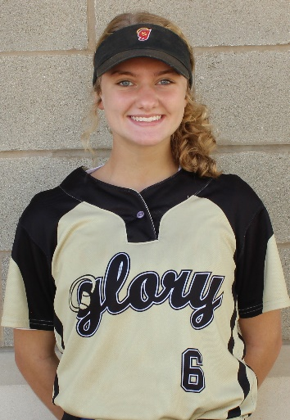
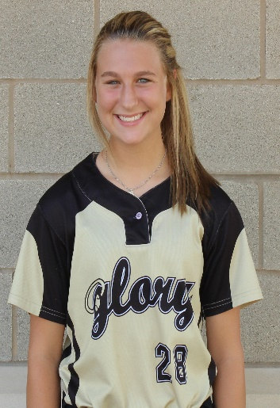
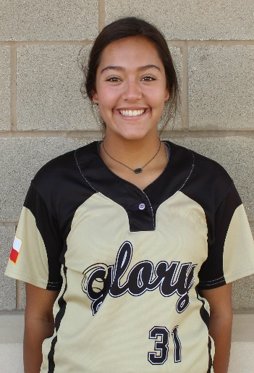

Glory Adkins 16U Gold
Head Coach Jack Fultz
214-557-7722 jsfultz@txglory.com
#29 Dori Brown
2021 - CF , OF
Lefty Hitter
Ht: 5' 5" GPA: 3.9/4.0 (W)
doribro11@gmail.com
#1 Devin Chaky
2022 2B, UTL, OF
A Honor Roll 1210 PSAT
Ht: 5' 6" GPA: 4.0/4.0
devinmchaky@gmail.com
#5 Sydney Olschefski
2022 CF, 2B, SS, OF
Lefty Slapper / Hitter
Ht: 5' 3" GPA: 3.9/4.0
SydneyOlschefski2022@gmail.com
#20 Kelsie Adams
2022 - 1B, 2B, OF, UTL
A Honor Roll
Ht: 5' 8" GPA: 4.0/4.0
KelsieAdams2022@gmail.com
#23 Annie-Klein Allgood
2022 - P, 1B
Lefty -NJHS– A Honor Roll
Ht: 5' 8" GPA: 3.8/4.0
annie.klein.allgood2022@gmail.com
#26 McKenna Andrews
2022 - 2B, SS, OF
LEAP – NJHS
Ht: 5' 7" GPA: 4.7/4.0 W
McKennaGAndrews@gmail.com
#28 Lindsay Davis
2022 - P, 1B
Class Rank #9
Ht: 5' 10" GPA: 3.9/4.0 W
lindsayadavis2022@yahoo.com
#31 Alex Aguilar
2022 - P, 1B
Ht: 5' 6" GPA: 4.00/4.00 alexaguilar2022@gmail.com
#12 Shelby Nelson
2022 - C, 3B, 1B
NFCAAll-American Scholar
Ht: 5' 7" GPA: 4.0/4.0
shelbynelson2022@gmail.com
Notes:
_________________________
_________________________
_________________________
_________________________
_________________________
_________________________
_________________________
_________________________
_________________________
_________________________

Slide 2
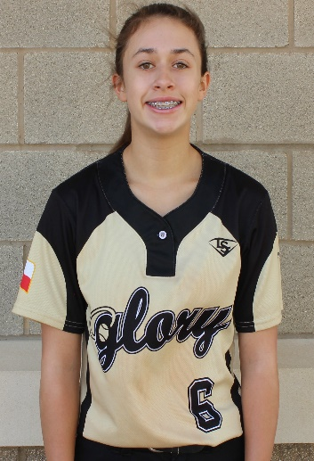
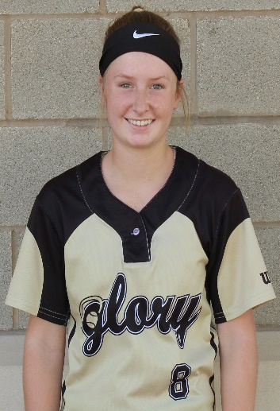
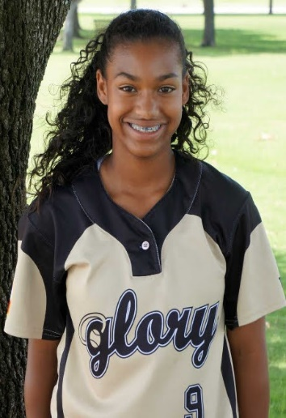
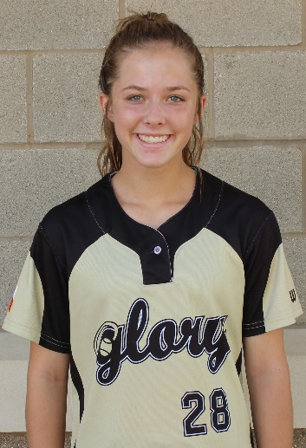
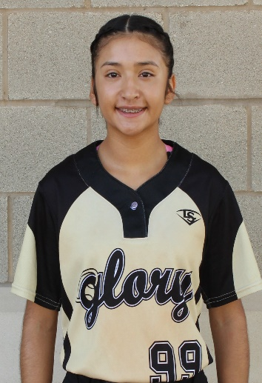
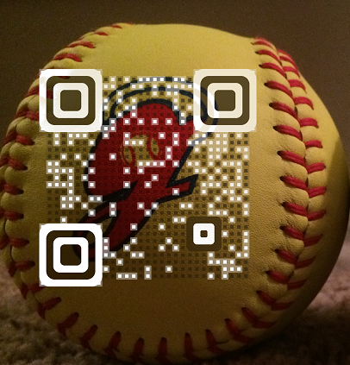
Glory Adkins 16U Gold
Head Coach Jack Fultz
214-557-7722 jsfultz@txglory.com
#6 Rylee Brice
2023 - 2B, SS, OF
LEAP- A Honor Roll
Ht: 5' 4" GPA: 4.00/4.00
ryleebrice2023@yahoo.com
#8 Rylee Moore
2023 - P, CF, UTL
Lefty Slapper A Honor Roll
Ht: 5' 4" GPA: 4.00/4.00
ryleemoore2023@gmail.com
#9 DeNae Dickson
2023 - CF, OF
Lefty Hitter
Ht: 5' 2" GPA: 4.0/4.0
denaedickson2023@gmail.com
#13 Breigh Houser
2023 - C, SS, 3B
Ht: 5' 3" GPA: 4.0/4.0
breighhouser2023@gmail.com
#99 Gabrielle Briones
2023 - SS, 3B, 2B
A Honor Roll
Ht: 5' 3" GPA: 4.00/4.00
gabbri2309@gmail.com
Notes:
____________________________________________________________________________________
____________________________________________________________________________________
____________________________________________________________________________________
____________________________________________________________________________________
____________________________________________________________________________________
____________________________________________________________________________________
____________________________________________________________________________________
____________________________________________________________________________________
Fall 2019 Schedule
09/21/2019 Dallas - Tracy Beard Invite
10/05/2019 Dallas North Texas Fall Shootout
10/18/2019 Houston - Ronald McDonald
11/09/2019 Houston - Bombers Jamboree
11/15/2019 Houston - Texas Gold Cup

