Slide 1
Cocoa Beach Lacrosse
Practice Wall and Training Area Project

Slide 2

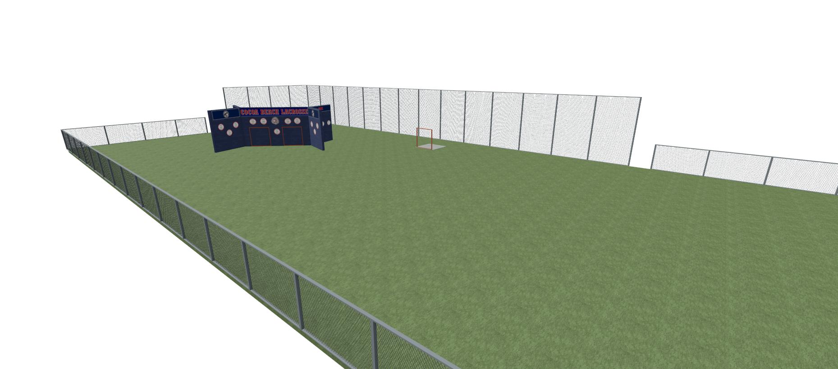
Cocoa Beach Lacrosse
Practice Wall
A lacrosse wall is at the center of every successful, longstanding lacrosse program. It provides endless opportunity for players to develop their stick skills before, during, and after practice. An initiative to build a wall (first in the county) at Cocoa Beach High School has been in planning for several years and is close to becoming a reality. The final missing block is funding. This is where you can help.
Accomplishments to Date
Wall design is complete
including structural
engineering approved drawings.
Location has been sited and
the project has been approved by
CBHS principal.
Contractor has been retained and can break
ground in approximately 4 weeks after authority
to proceed.
Kiwanis club is engaged and has tentatively agreed to support fundraising activities (similar to “Get on Track”).

Slide 3
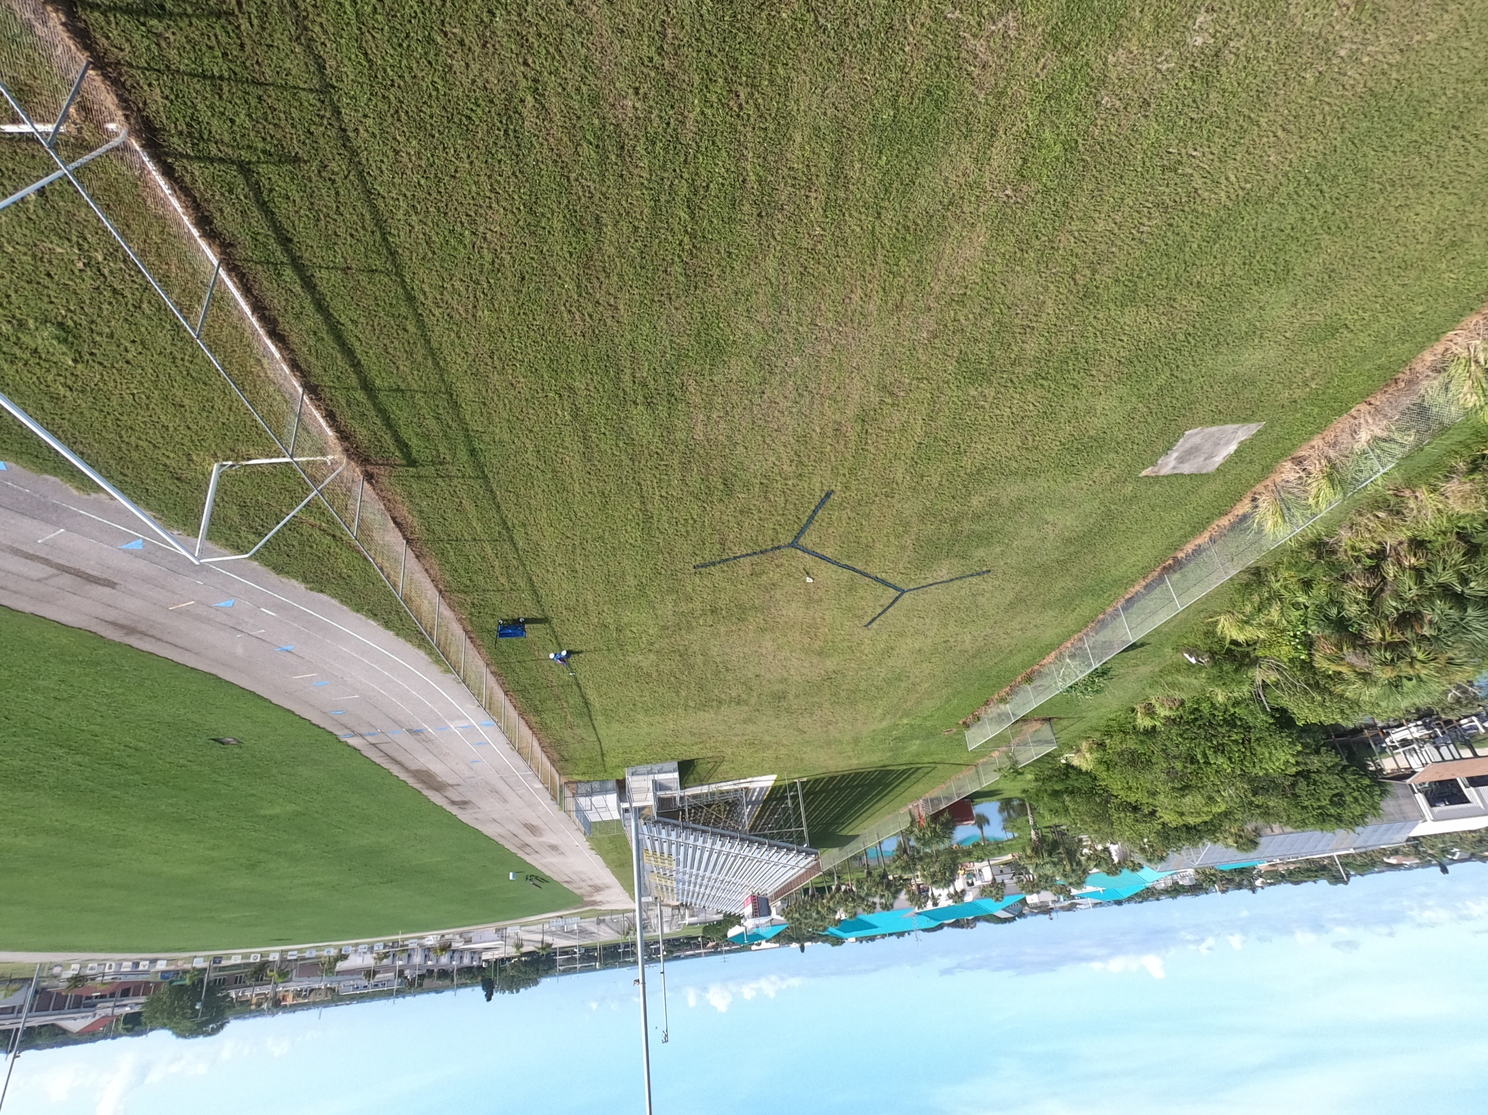
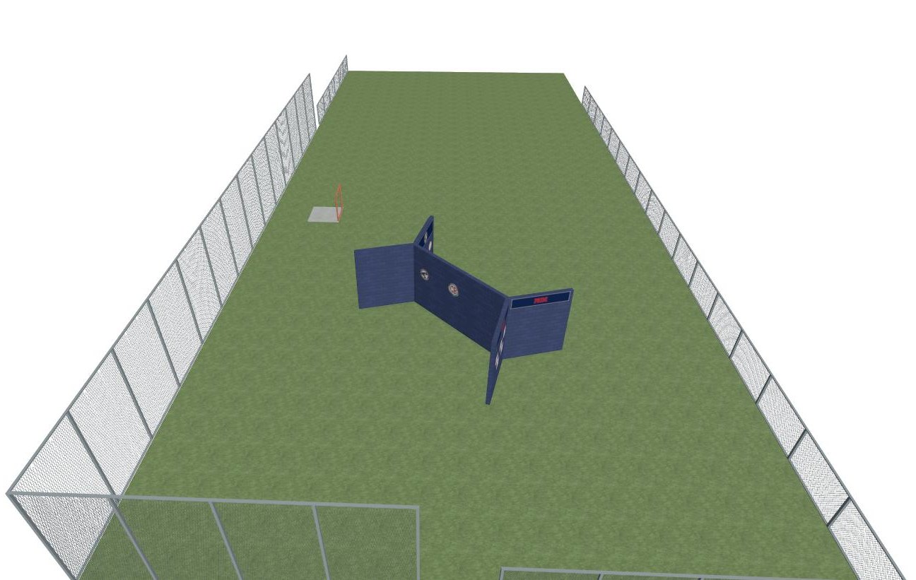
Cocoa Beach Lacrosse
Cocoa Beach Lacrosse
Location and Description
The practice wall will be located south of the home side viewing stands.
The wall stands 12 ft tall with a 20 ft long main wall and two 10 ft long wings.
Wall will be constructed of concrete reinforced cinder blocks rated for hurricane force winds.
The wall will be open to the public.
Future proposals include a shooting area, elevated
backstop fence or netting, and equipment storage facility.

Slide 4
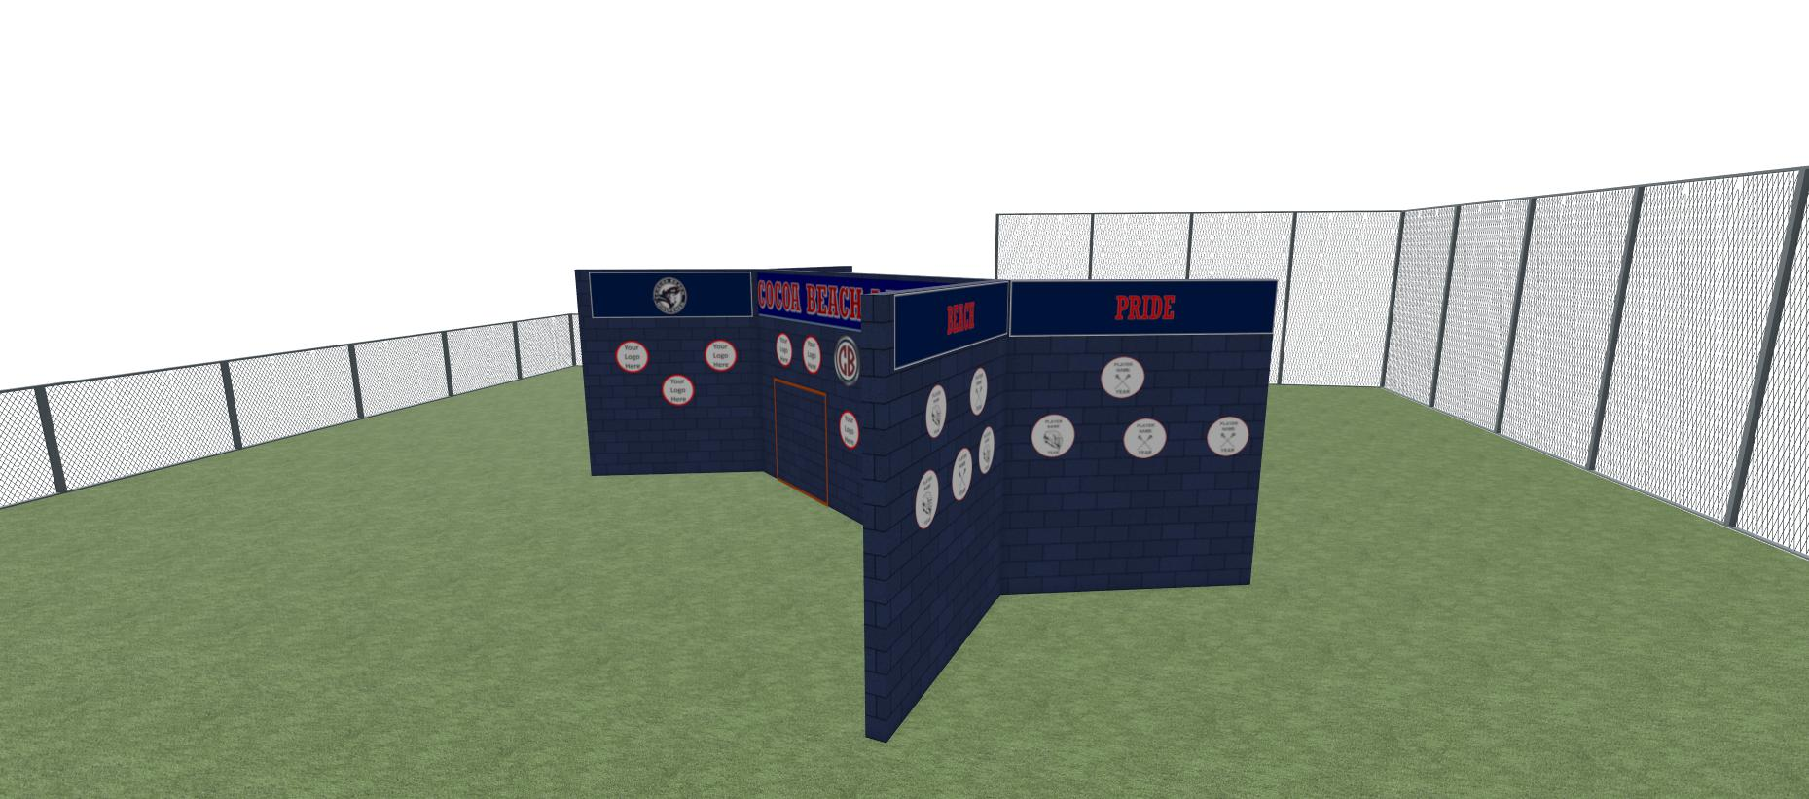
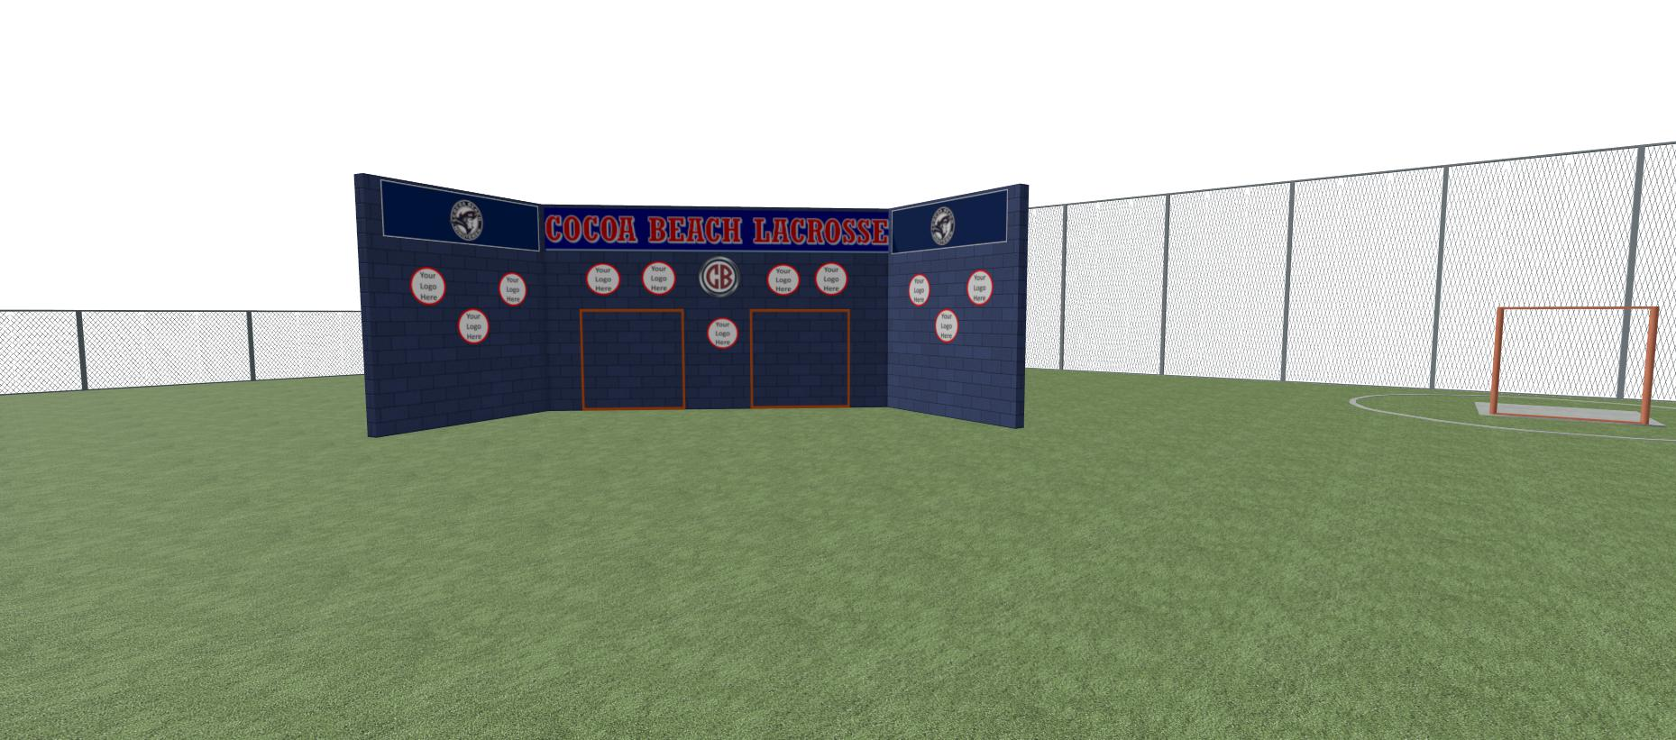
Cocoa Beach Lacrosse
Cocoa Beach Lacrosse
Sponsorship Opportunities
Businesses, friends, family, players, alumni, there is a sponsorship opportunity for everyone no matter your budget.
Main / Front Ads $500 - $2500
Northwest Wings Ads $300 - $500
Player Helmets or Sticks $100
Family Blocks $100
Block Donations $25
Logos
Graphic images of logos are reference only. Actual logo design and placement may vary.
Sponsor provided logos can be applied to round or square targets.
Not all plots will be sold. Unless specified by sponsor, placement of logo on specified wall section will be determined at installation.

Slide 5
Cocoa Beach Lacrosse
Cocoa Beach Lacrosse
Front Wall
1
2
3
4
5
6
7
8
9
10
11
12
13
14
15
16
24” Round or Square Logo
$500
18
17
72” Round or Square Logo
(inset in goal outline)
$2500

Slide 6
Cocoa Beach Lacrosse
Cocoa Beach Lacrosse
Left Front Wing
Right Front Wing
Right Front Wing
19
20
21
22
31
32
33
34
23
24
25
26
35
36
37
38
27
28
29
30
39
40
41
42
24” Round or Square Logo
$500
24” Round or Square Logo
$300

Slide 7


Cocoa Beach Lacrosse
Cocoa Beach Lacrosse
NorthWest Facing Wings
44
45
46
47
59
60
61
62
48
49
50
51
52
63
64
65
66
67
53
54
55
57
68
69
70
72
20” Helmet/Stick/Sponsor Logo
$100

Slide 8
Cocoa Beach Lacrosse
Cocoa Beach Lacrosse
SouthEast Facing Wings
74
75
76
77
89
90
91
92
78
79
80
81
82
93
94
95
96
97
83
84
85
87
98
99
100
102
20” Helmet/Stick/Sponsor Logo
$100

Slide 9
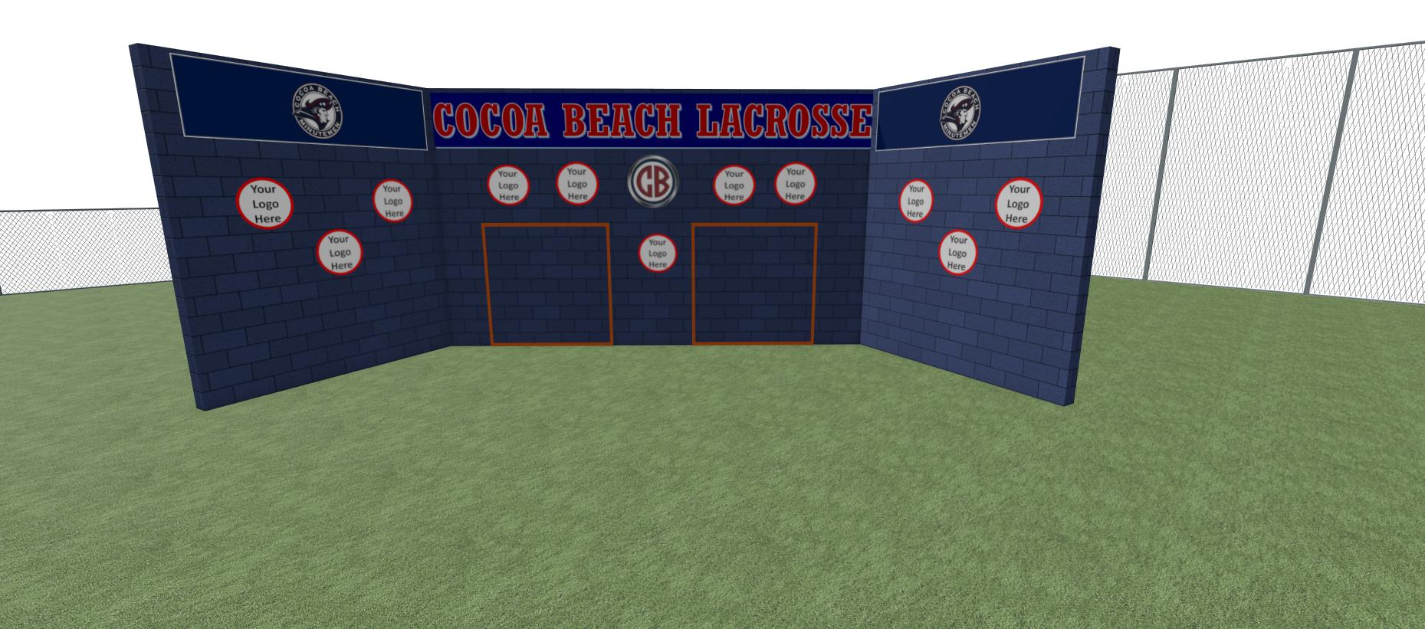
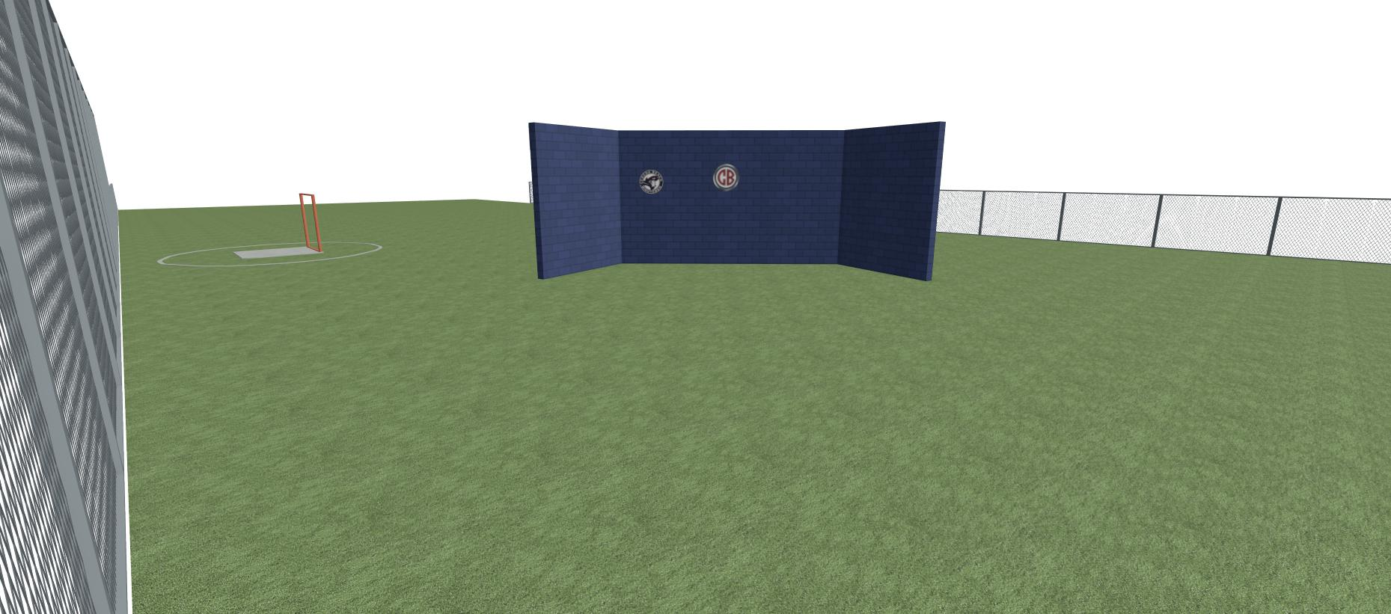
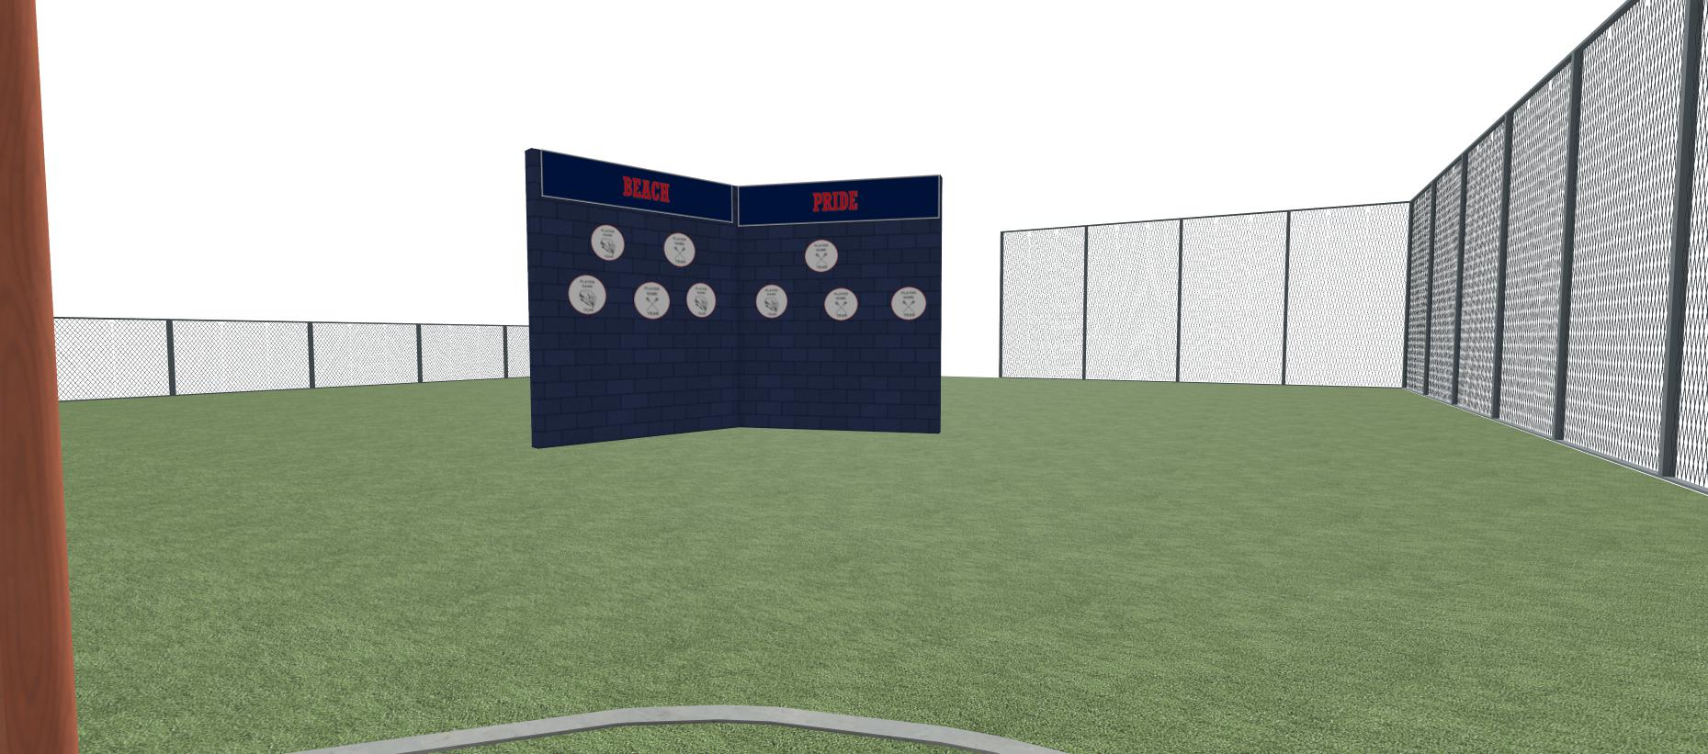
Cocoa Beach Lacrosse
Cocoa Beach Lacrosse

Slide 10
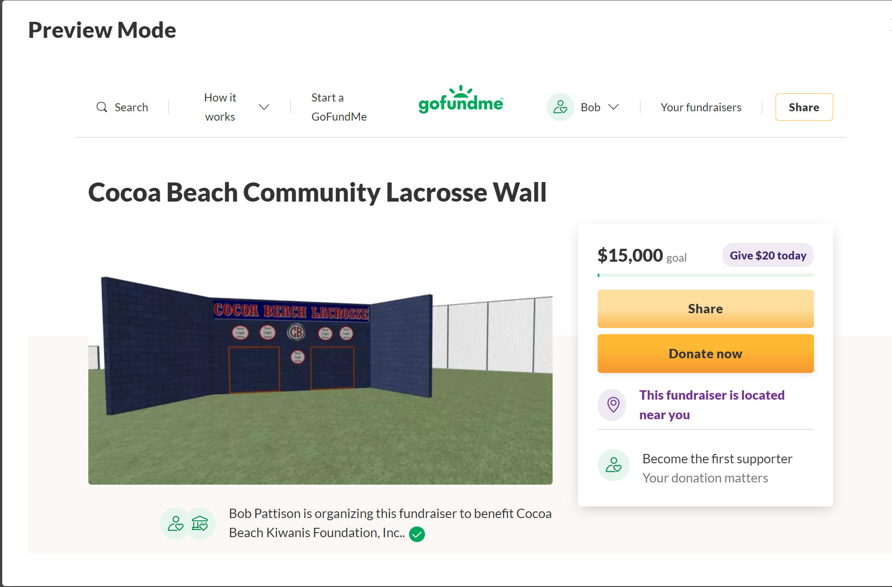

Slide 11
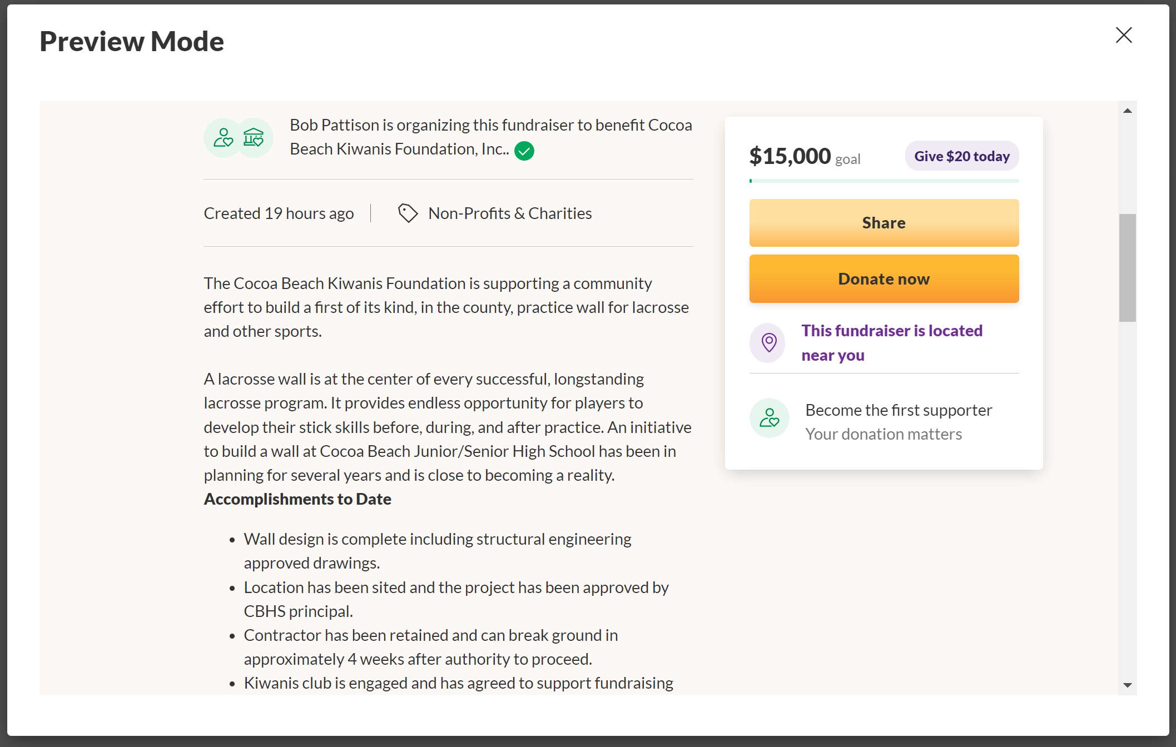

Slide 12
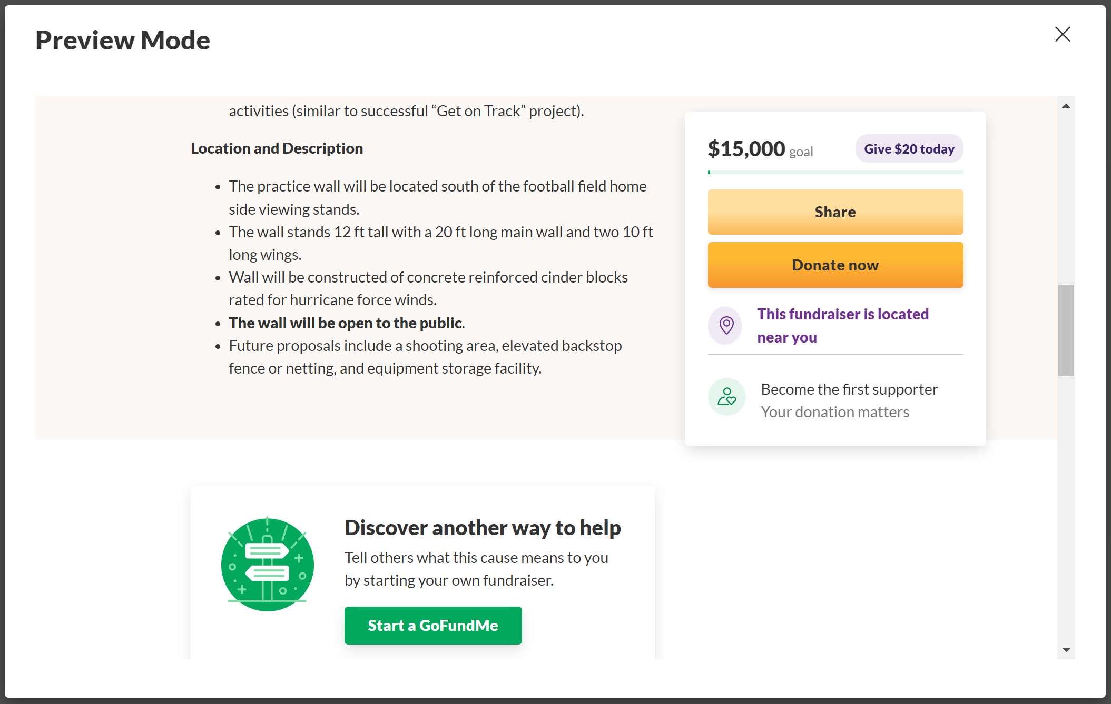

Slide 13
