Slide 1

Dewitt Junior Panthers Sideline Cheer Information Meeting
April 7, 2026 @6:00pm

Slide 2
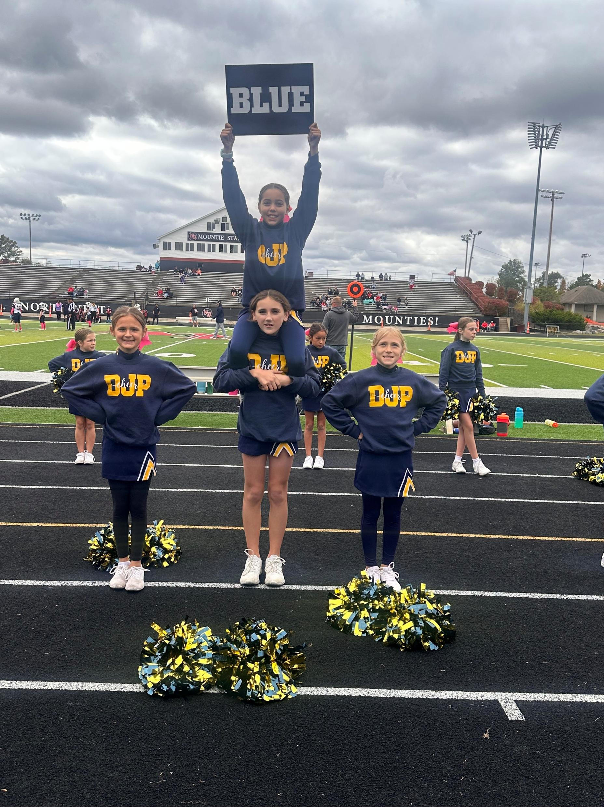
Introductions
President – Corey Feldpausch
Vice President – Bruce Gallagher
Treasurer – Tara Miller
Secretary – Kristen Hampton
Board Members
Heidi Lenneman April Babb Krista Cornell
Kristi Coe Leah Clark Tyler Thelen Whitney Cichocki
Jafi Roskey Stephanie Elliot Amber Shoemaker

Slide 3
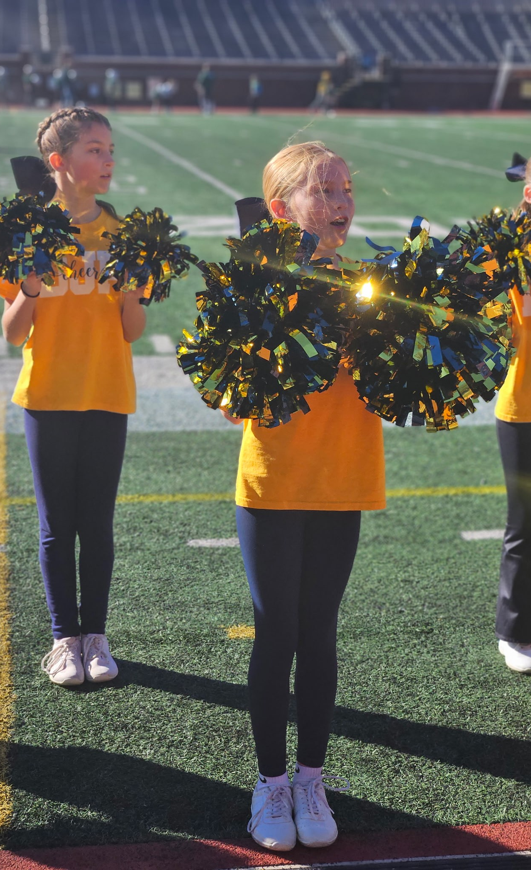
Overview of DJP
Established in 1995 to promote organized and structured football and cheerleading within the community of DeWitt.
A feeder program to prepare athletes for the DeWitt High School Football and Cheer teams.
Encourage all those who desire and are able to participate.

Slide 4
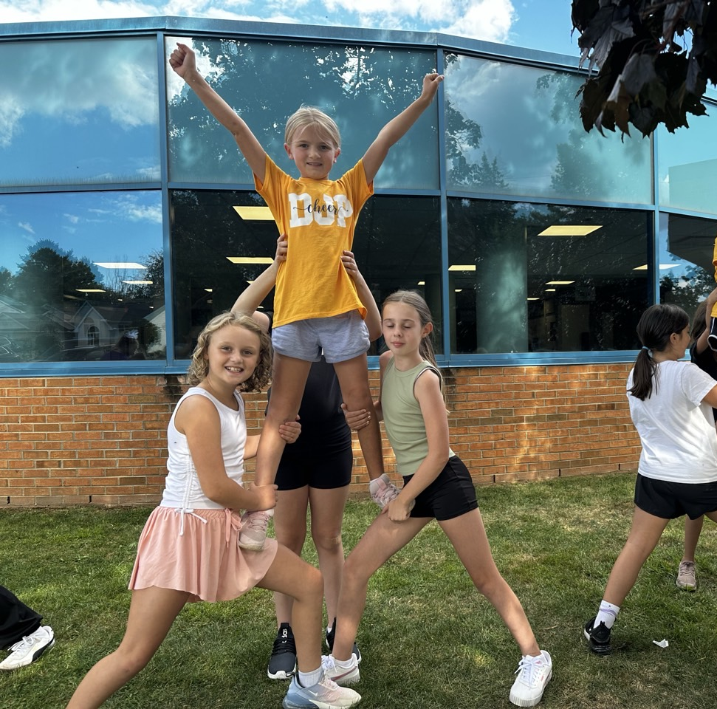
Cheer Parent Expectations
Parents should refrain from staying at cheer practices. Parents should expect to drop their cheerleader off at practice and pick them up afterward.
DJP’s primary focus during practice is to provide cheerleaders an opportunity to develop their skills, focus on learning, and work together as a team in an environment free from distractions.
Allowing cheerleaders to engage fully in practice fosters independence, responsibility, and concentration, while also ensuring that our coaching staff gives their full attention to player development without external interruptions.

Slide 5
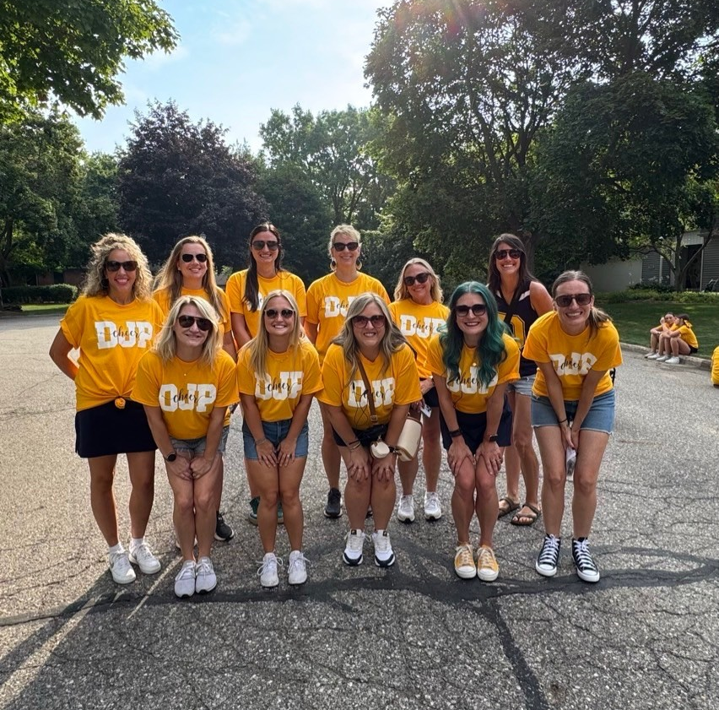
Cheer Parent Volunteer Expectations
**Games cannot happen without game day parent volunteers**
Parents are expected to volunteer a minimum of 6 hours each season
Typical game day volunteer needs:
  Concessions (2-3)
  Announcer (1)
  Game Clock (1)
  Spotter (1)
  Chain Gang (2)
Parent Representative (Team Parent)
Assist with Fundraising

Slide 6
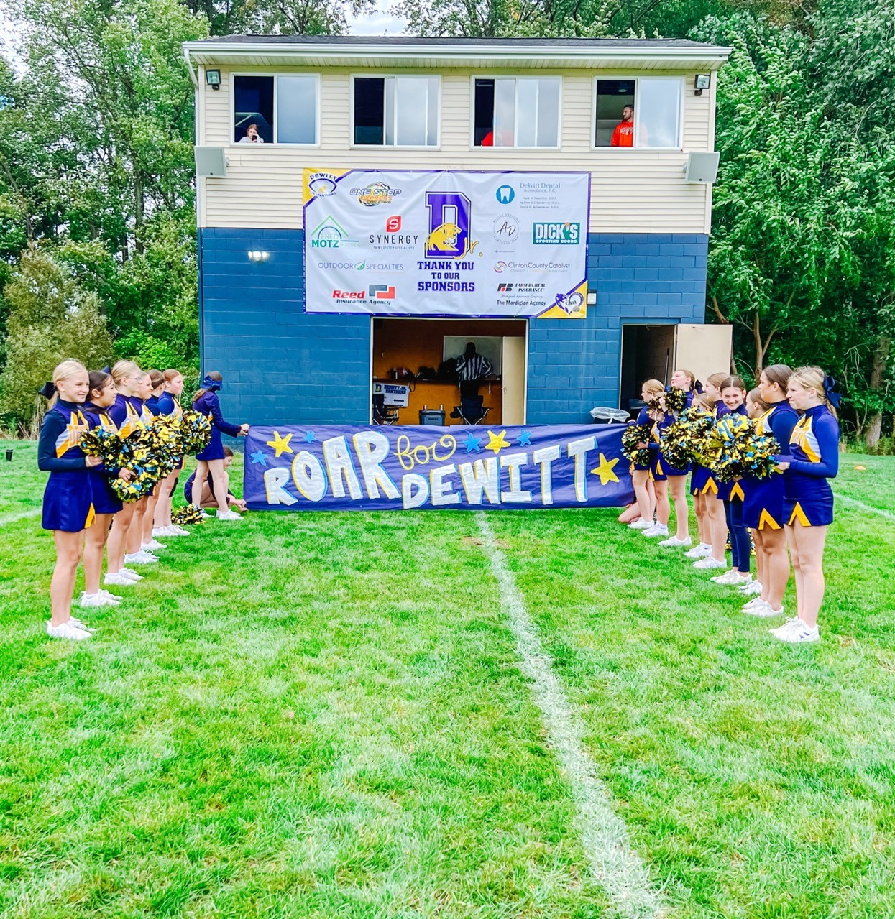
What’s DJP’s Structure and How does it function?
DJP is independently supported and is 100% Self-Funded.
DJP is not financially supported by DeWitt Public Schools (DPS)
DJP pays annual player fee to DPS *AND* Pays DPS for indoor and outdoor space usage.

Slide 7
2025 DJP Budget Expenditures
Notes:
We’re learning that other community football programs offer pads and helmets with their program for similar pricing. However, those programs do not pay their respective schools to use school facilities, nor do they pay to maintain any of their facilities themselves.

Slide 8

How does DJP Generate Income?
Athlete Registration
Personal Donations
Corporate Sponsorships
Fundraising
Concession Stand Sales
50/50 Raffles (when we have the volunteers!)
**New for 2026** Spirit Wear & Vintage Uniform Sales

Slide 9
How does DJP Generate Income?

Slide 10
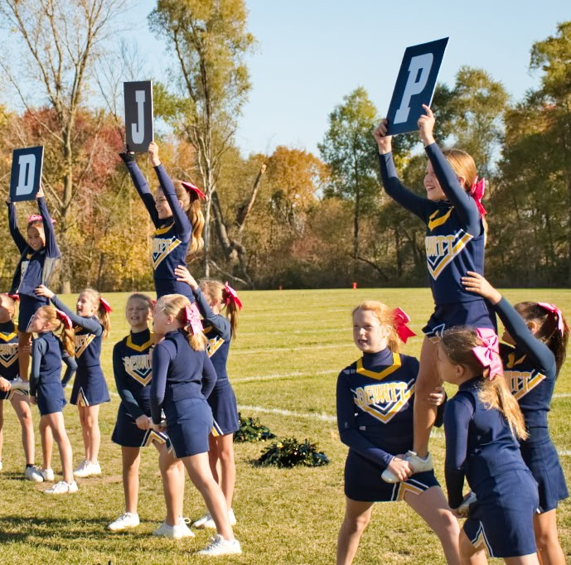
2026 DJP Fundraising
**New for 2026**
Mrs. Fields Cookie Dough Sales
**New for 2026**
Team – Fi Calendar Fundraiser

Slide 11
2026-2028 DJP Fundraising Plan
2-Year Phase In Approach for New Athlete Uniforms
Football Jerseys – 2 Year Phase-In Approach
  2026 – 7th & 8th Grade
  2027 – 4th – 6th Grade
  Estimated Total for New Football Uniforms = $17,500
New Cheer Uniforms – 3 Year Phase-In Approach
  2026 – Replenishment of 4th – 6th Grade
  2027 – Remainder of 4th – 6th + Replenishment of 7th & 8th Grade
  2028 – Remainder of 7th & 8th
  Estimated total for New Cheer Uniforms $35,000
2026 Fundraising NEED = $17500 GOAL = $20,000
2027 Fundraising NEED = $20,000 GOAL = $22,000
2028 Fundraising NEED = $15,000 GOAL = $17,500

Slide 12
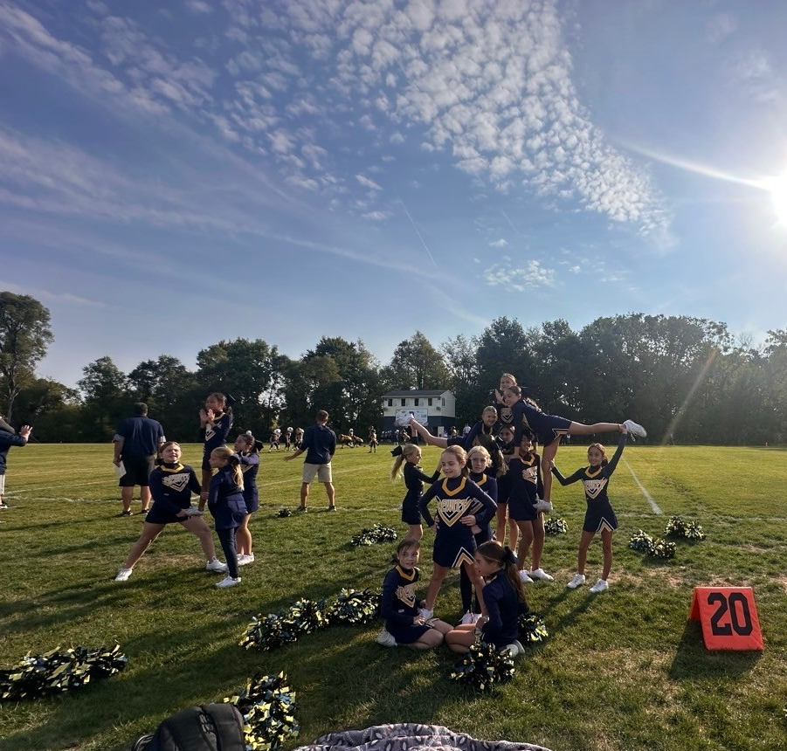
How does DJP Use It’s Funds?
2026 – Concession Stand Repair & Maintenance
2027 – Press Box Roof Repair & Maintenance
Football Practice Pads, Sleds, Footballs and other Equipment
Accessibility plan (with DPS?)

Slide 13
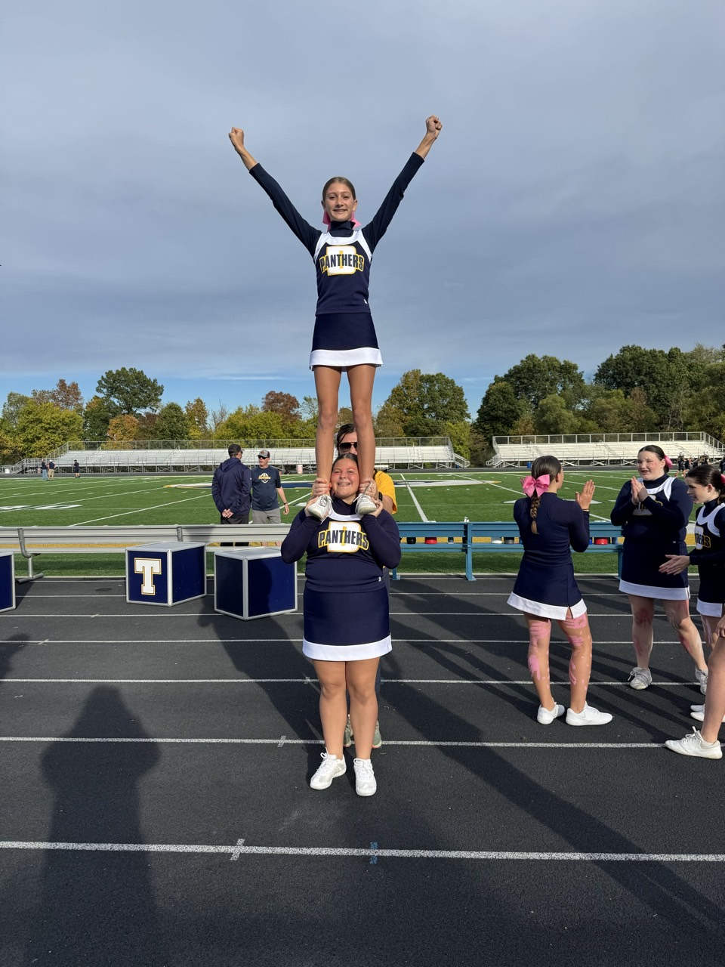
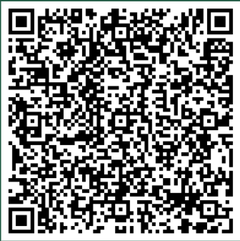
DJP Registration
Early Bird Registration (NOW – April 30) Cost = $175
Registration (May 1 – May 31) Cost = $200
Late Registration (June 1 – June 30) Cost = $250
Payment is due in full at time of registration OR via payment plan with a down payment.
Scholarship Assistance – Please contact us at:
  Dewittjuniorpanthers@gmail.com
  Subject: Scholarship Assistance
  Attn: Tara Miller - Treasurer
Register Here!

Slide 14
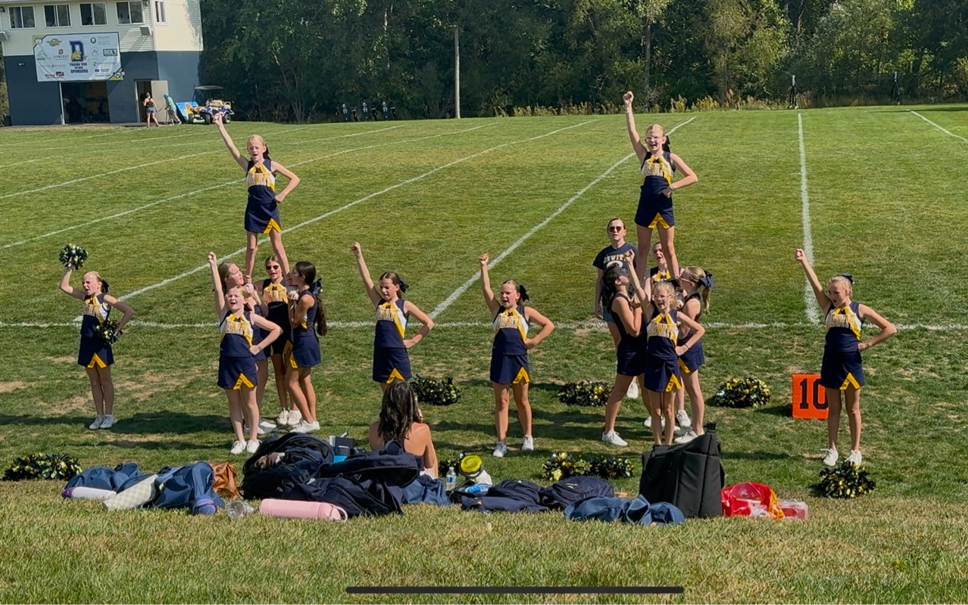
Cheer Required Equipment – Cheerleader Provided:
Navy Bodysuit
Navy Lollies
Navy Tank Top
Navy Legging
White Cheer Shoes
White No Show Socks
Poms (order during registration)
Donations Welcome
Assistance Available

Slide 15
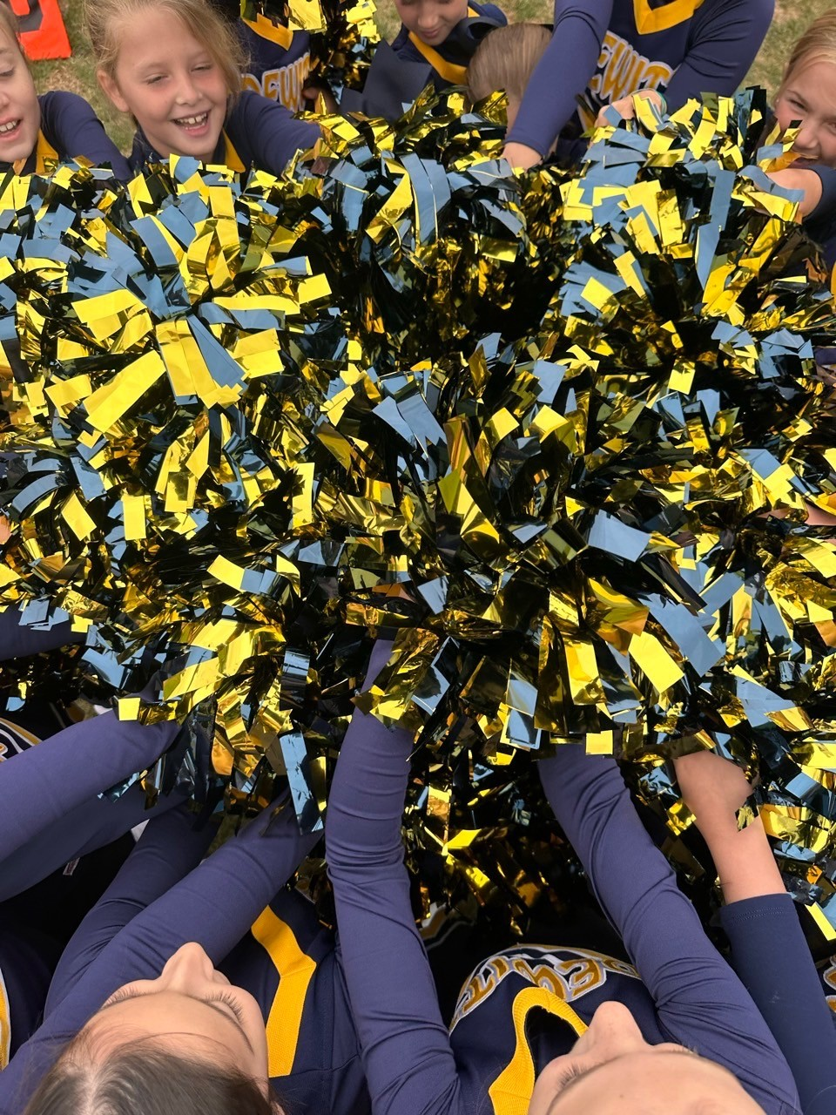
Cheer Uniforms
Vest
Skirt
Bow
Cheer T-Shirt
Duffle (As Available)
Sweatshirt
Gloves
Headband

Slide 16
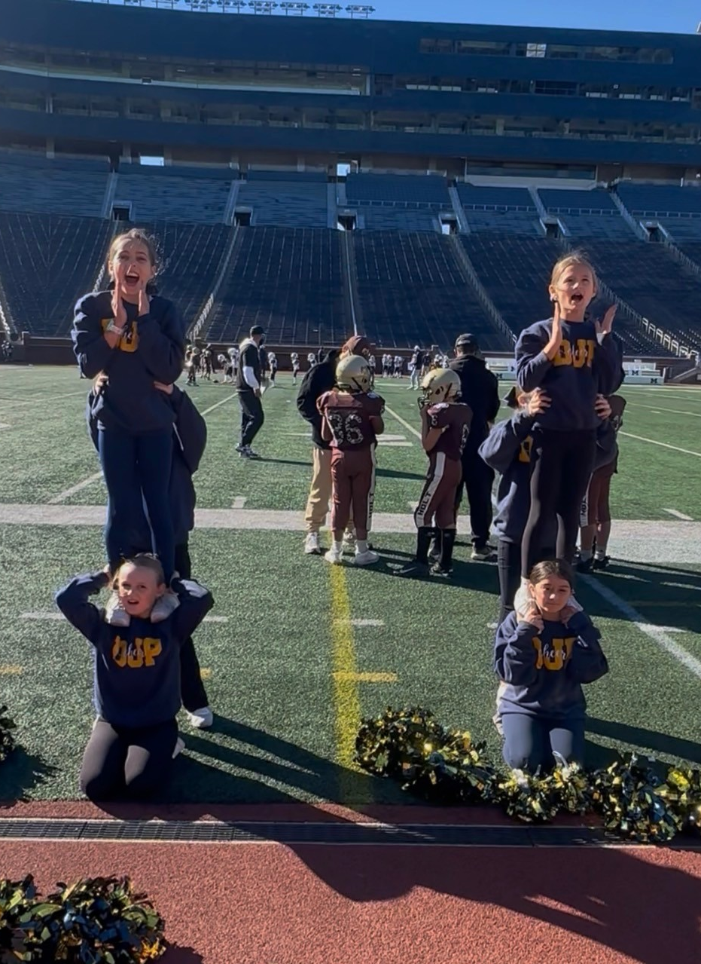
Sports Physicals
DJP will follow MHSAA policy dates for 2026-2027 Season.
Must have a recent physical dated on or after 4/15/2026.
DJP will need a copy of both sides of your child's physical form.
Players will not be allowed to start practicing if a copy of their physical is not turned in.

Slide 17
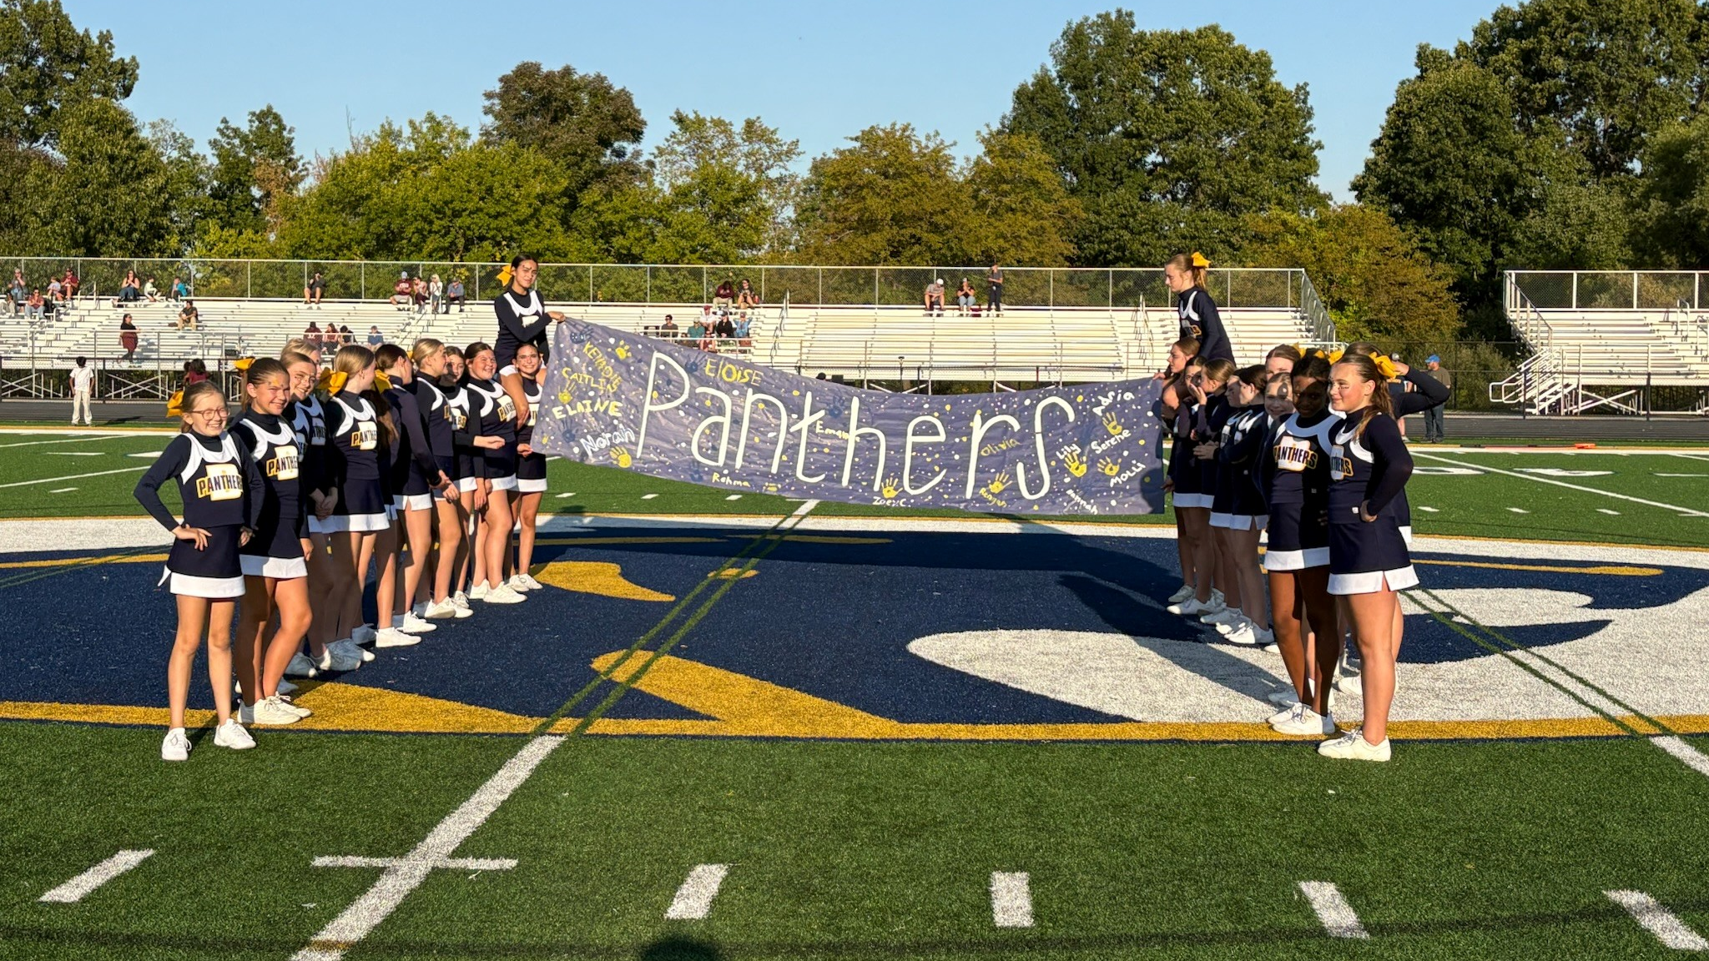
Important Dates
Dead Periods (No coach/cheerleader contact)
Grades 4th-6th
  June 29 – July 5
  August 3 – August 9
Grades 7th -8th
  June 29 – July 5
  August 10 – August 23
First week of practice(s)
Grades 4th – 6th : Week of August 10th
Grades 7th – 8th : Week of August 24th
First Games:
Grades 4th – 6th : Saturday, September 5th
Grades 7th – 8th: Wednesday, September 9th

Slide 18
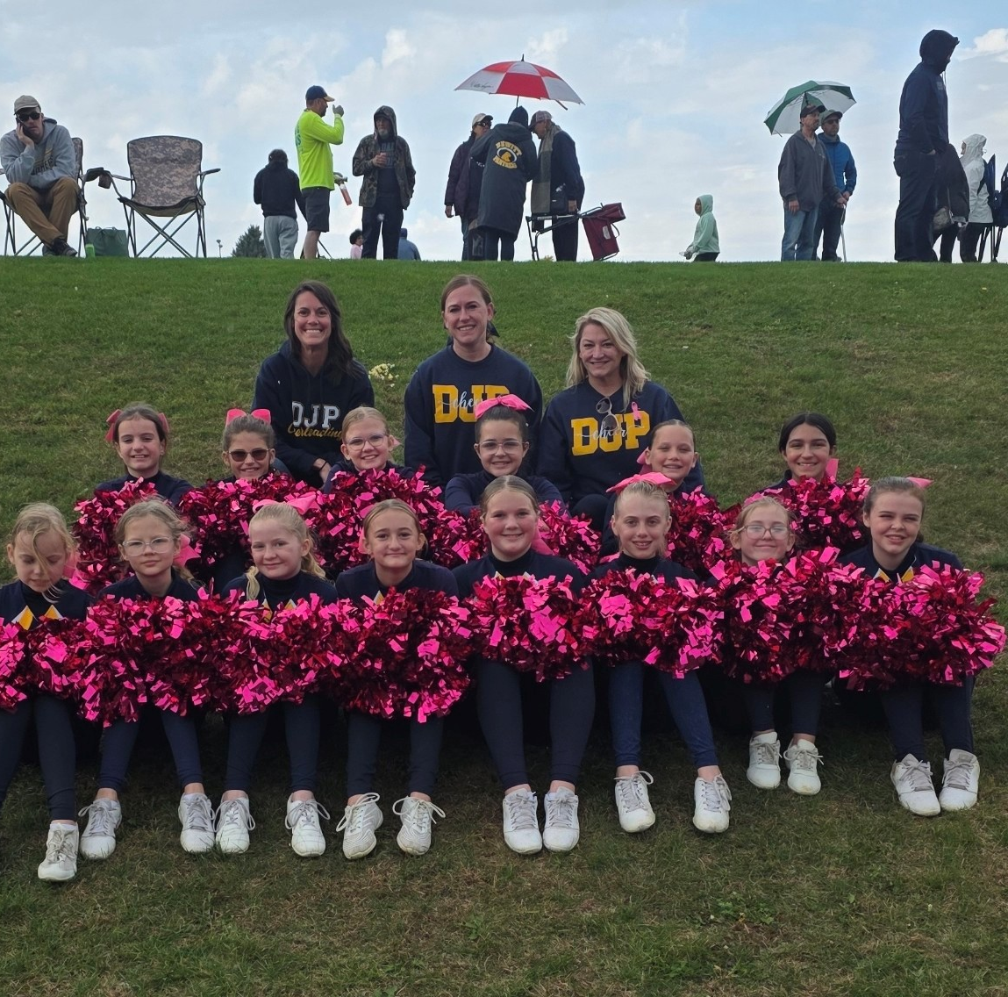
Typical Practices/Games
2-3 Days a week for 1-2 Hours
Warm up (running, Stretching, Sit Ups, etc)
Stunting as appropriate per grade and skill
Schedule TBD

Slide 19
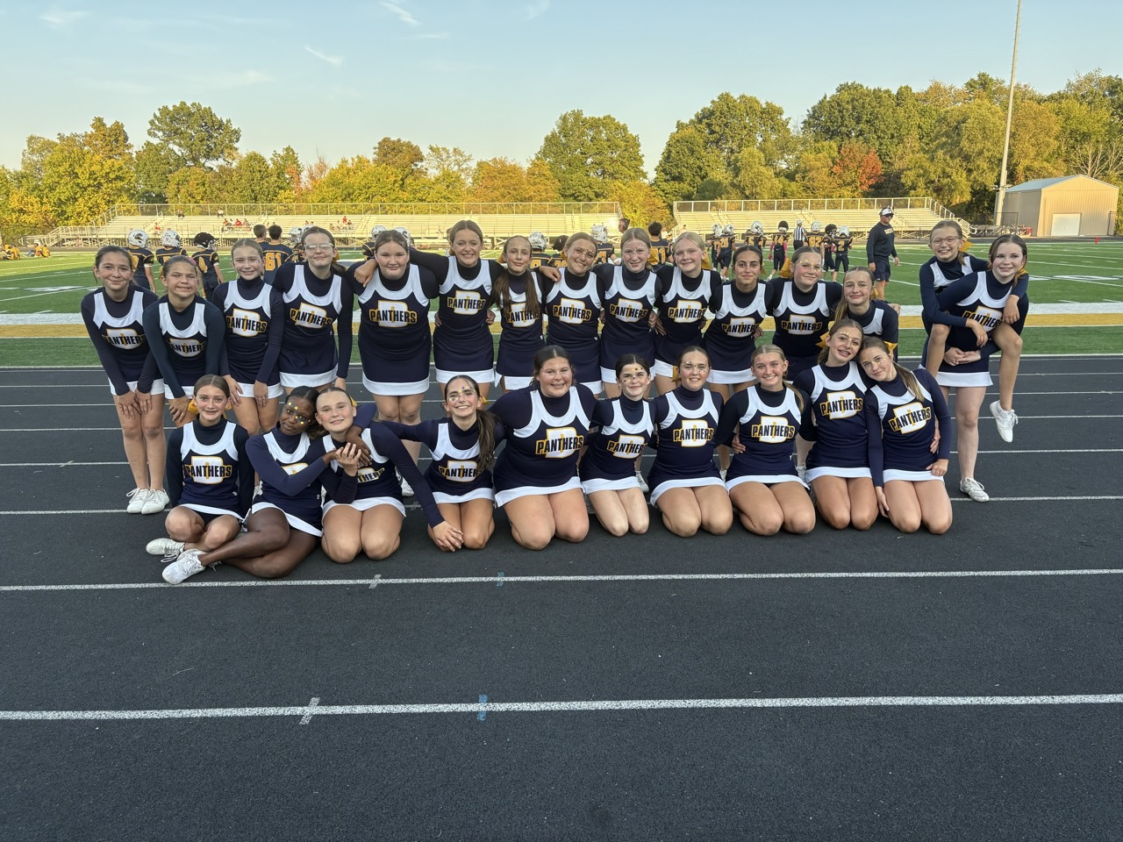
Activities
Parade Prep Practice
Ox Roast Parade
Homecoming Parade
End of Season Showcase

Slide 20
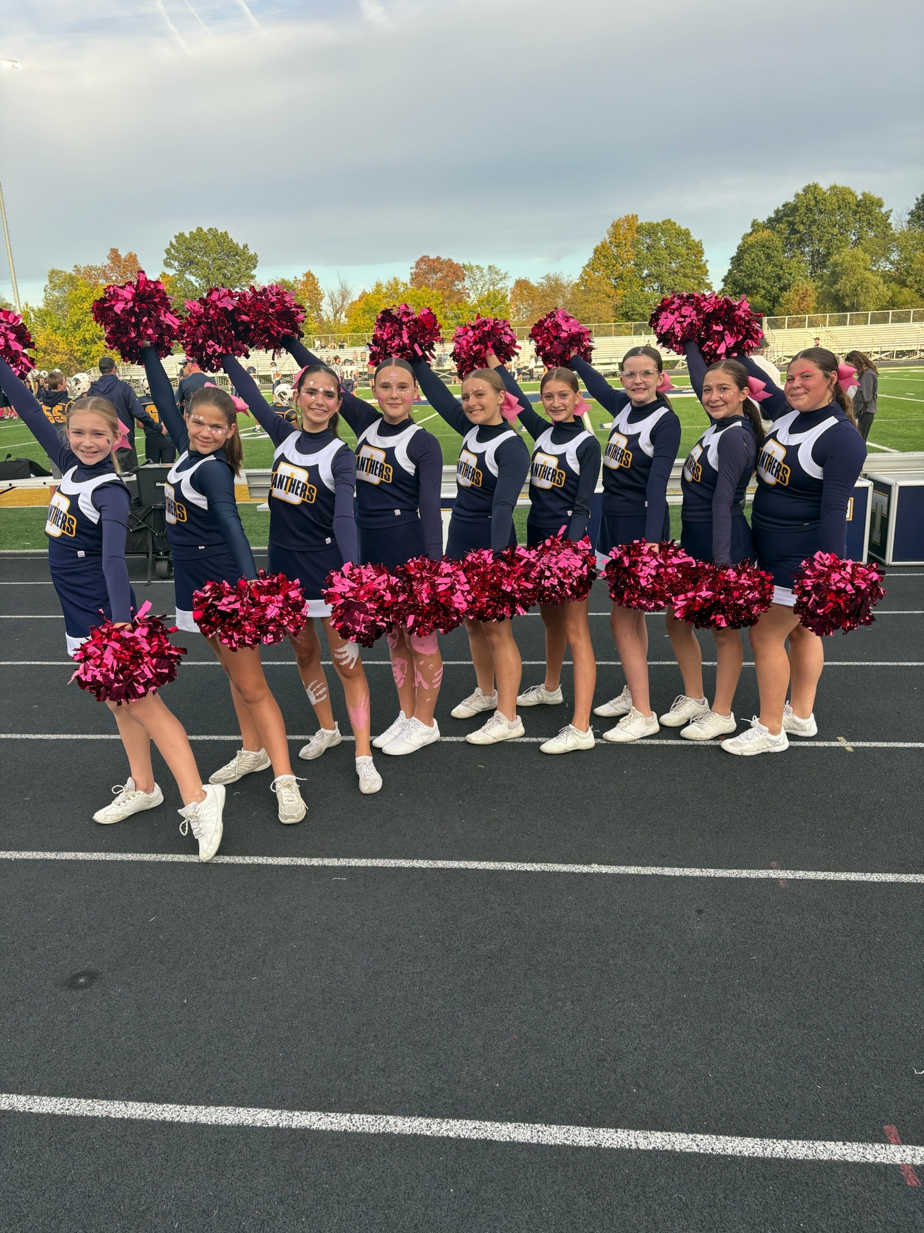
Grade Checks for 7th & 8th Grade:
We are required to check grades for eligibility for our 7th & 8th grade cheerleaders.
Grades will be reported on Fridays. If a student is failing one class they will be ineligible to cheer for the next week’s game.
They can attend practice. They are expected to attend the game, but they are not allowed to be in uniform.

Slide 21
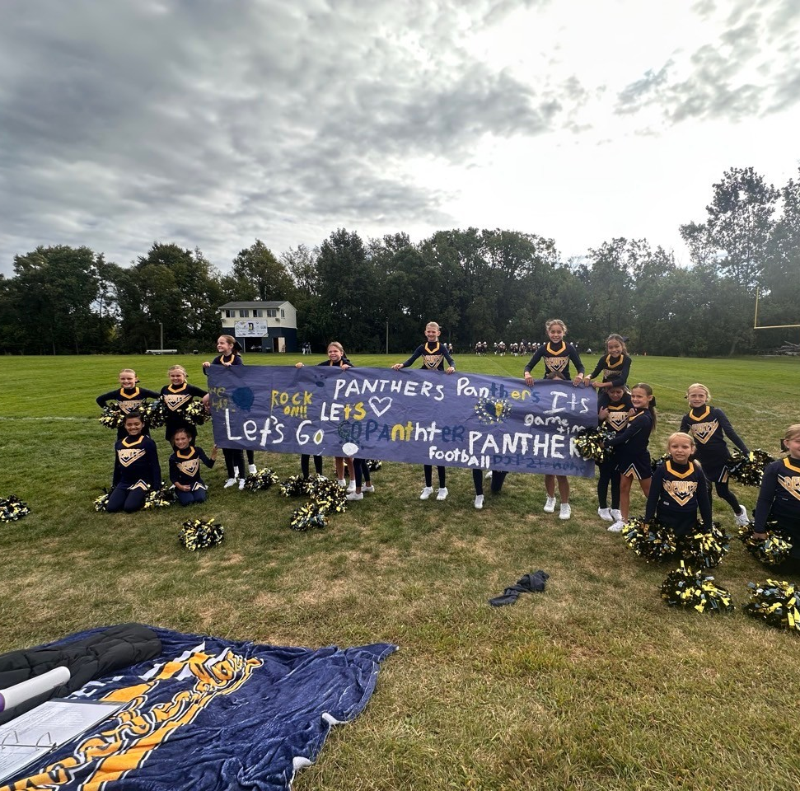
Equipment Swap & Vintage Uniform Sale
DJP will be selling old Football and Cheer Uniforms during the summer months.
Will be Available for purchase during respective uniform fitting.
Football:
$30 – Home & Away Jersey Kit
$20 per individual piece
Cheer:
$30 Shell and Skirt Kit
$20 per individual Piece

Slide 22
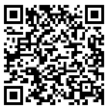
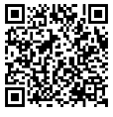
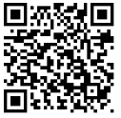

Communication
DJP Facebook Page
DJP Website – www.dewittjrpanthers.org
Join our Facebook Page!
Instagram
  Dewitt Cheer has an Instagram
  **New for 2026** DJP Instagram Page – Coming Soon
Join our Facebook DJP Equipment Buy and Sell Page
Coach or Team Parent Representatives
If you have a concern:
  24- hour rule
  Contact Coach
  A Formal Complaint Form is available on the DJP Website. These will be reviewed by the board
DJP Buy and Sell
Facebook Page
Website
DJP Cheer
Instagram Page

Slide 23
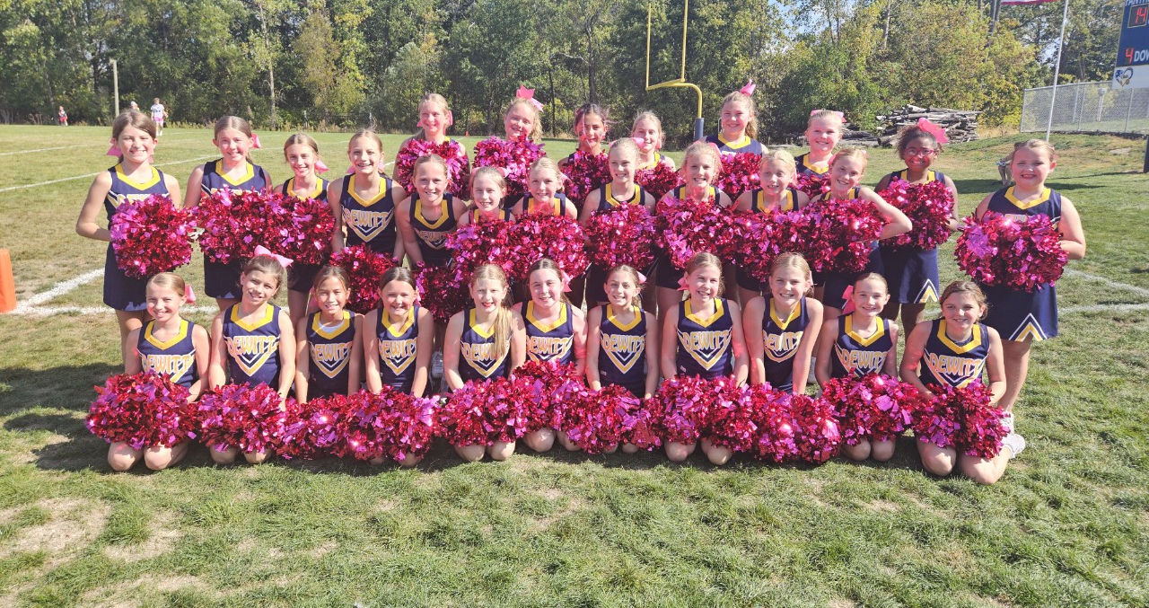
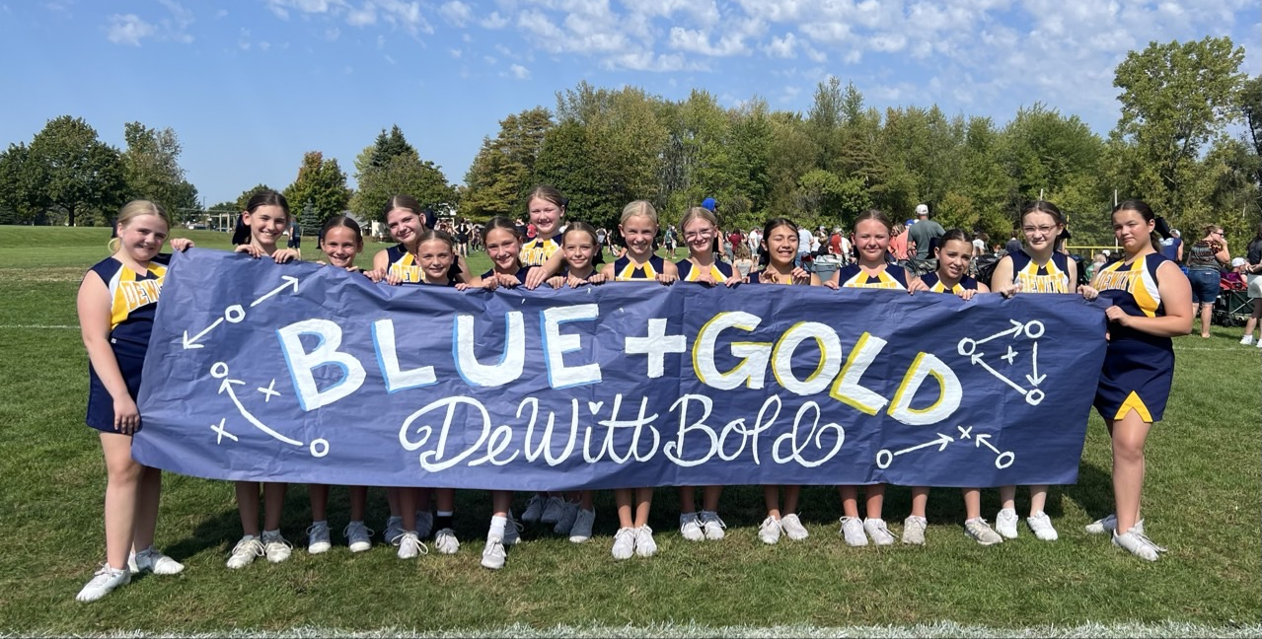
Questions?

