Slide 1
Westonka Youth Basketball Association Coaching Tips & Guidance

Slide 2

The WYBBA does not exist without you volunteering your time!

Slide 3
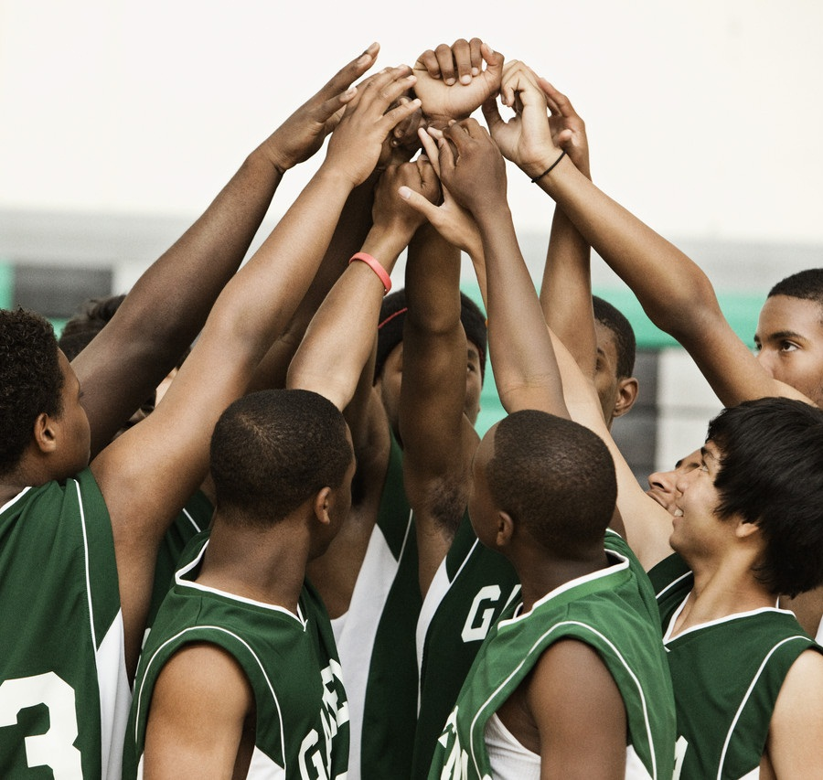
WYBBA Coaching Philosophy _________________
NOTE:
To change images on this slide, select a picture and delete it. Then click the Insert Picture icon
in the placeholder to insert your own image.
This is a fun kid’s game!
Positivity Encourages Growth
Development Over Wins
Basketball can be taught like any subject!

Slide 4
Season in a Nutshell
20 teams, 140+ players, 40+ coaches
October to late-March
2-3 practices/week
Up to 10 travel tournaments (regional)
White Hawk Classic in early January
Saturday Pick-Up Game (schedule TBD)
Play on the Timberwolves’ Court and attend Twolves game!
State Tourney in March
So much fun you’ll want to change careers!

Slide 5
Practices
All scheduling for practice court time will be coordinated through LeAnn James (jamesl@277apps.org).
Practices can start October 24th (but feel free to get together before)
LeAnn will reach out to you to get your practice day/time preferences very soon!
Practices are scheduled by LeAnn two weeks at a time.
Plan on at least 2-3 practices/week (coach’s preference)
Locations will vary and times – but cannot go later than 9pm
PRACTICE SCHEDULE HERE

Slide 6
Tournaments
Each team will have up to 10 regional tournaments/year
Weekends only
Each team has the option to have an out-of-town tournament but would be at the team’s own costs (registration fees, hotel, etc.)
Schedule provided to each coach – please enter into Sports Engine and communicate to parents asap
Tourney Schedule is HERE
Questions: Contact Sara Schwartz (saraschwartzy@gmail.com)

Slide 7
State Tournament
End of year tournament
Seedings based on team’s yearly performance (mid-February)
Locations vary
Girls Tourney: Feb. 25/26
Boys 3rd -6th grades: March 4/5
Boys 7th -8th grades: March 11/12
All teams will be registered.
Once registered, each team will be seeded – more info HERE
More info HERE

Slide 8
Parent Communications
Intro letter/email
Introduce yourself, coaching philosophy, etc.
Explain playing time philosophy
Provide information on league, practices, etc.
Email consistently to give updates on season/practices/skills learned and micro-goals achieved
More info is better than lack of info – parents will assume and fill in the gaps (sometimes in a negative way!)
Samples Provided (see “Coaches Corner” on WYBBA site)

Slide 9
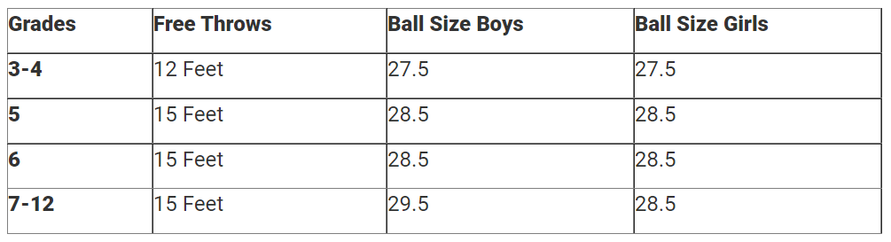
Basketball Sizes/Free Throw Line
MYAS Ball Size HERE

Slide 10
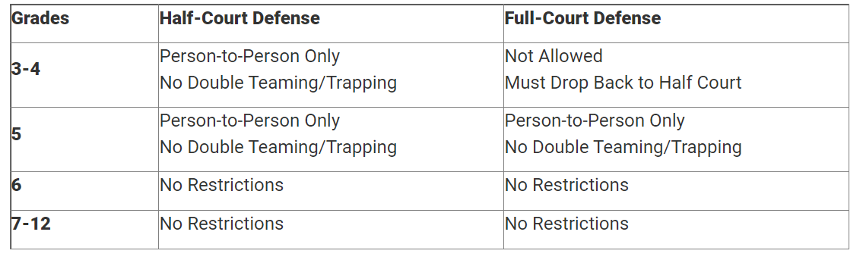
Full Court Press and Zone Rules
MYAS Rules: HERE
Full Court/Defense Rules: HERE

Slide 11
Other Admin Stuff
SportsEngine App
Everyone will have access
Coach’s Shirts
Molly Carlson will reach out for sizes
Coach’s Bags
Josh Johnson will reach out to you for pick-up times (josh.johnson@cbre.com)
MYAS Coaching Clinic
(October 15th – 9am-3pm, Nat’l Sports Center, Blaine)
“Coaches Corner”
For all docs and info on WYBBA Website
My info:
Shawnseileresq@gmail.com
612.819.8211

Slide 12
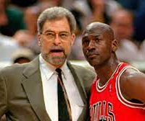
Your Role As “Coach”
Teacher
Facilitator
Positive Role Model

Slide 13
WYBBA Coaching Responsibilities
Be reliable and on time
Communicate with parents often
Ensure semi-equal playing time (end of game exception)
Player safety is paramount
Conduct yourself in a professional manner with parents, officials, coaches, and players
Be encouraging, positive & patient
Leave each facility better than you found it

Slide 14
Overall Coaching Tips
Be an educator first!
We expect the kids to become students of the game, try to lead by example and become a student too!
Meet with other coaches to plan season and develop practice plans
Recruit volunteers for scorekeeping and other administrative items
Have a team theme – what is your brand?:
“Tough & Together…TEAM!” “Build up, Build Together”
“Hustling is our Trademark” … “No one out hustles us!”
“Focus leads to Success” “Details lead to Development”
“Focus, Attitude, & Hustle Never Slump” “Clear eyes, full heart…can’t lose!”
Try to find what motivates each player and the team as a whole

Slide 15
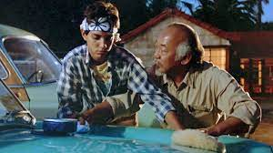
Psychology of Teaching
Everyone learns differently (doing, visual/reading, listening, observing)
Studies show that best learning for anything comes from combo of all the above
Start with the Mimic Method
Watch me do it
Listen to me as I do it
Copy me and do it on your own
Lessons: Slow to Fast
Use memorable phrases that trigger big ideas
“Wax on, wax off”
“Small to tall”
“Put it on a platter”
“Pigeon Eyes”

Slide 16
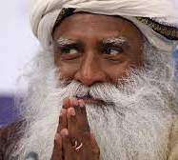
Mistakes
“You cannot suffer the past or the future because they do not exist. What you are suffering is your memory and your imagination.”
- Sadhguru

Slide 17
Psychology of Recovering from Mistakes
Mistakes = failure in a kid’s brain = lack of self-worth and confidence = no motivation or giving up = self-fulling prophecy of making mistakes (“I suck, I’m horrible so I’m going to mess up”) = more mistakes = vicious circle
All professional coaches and sports psychologists: The #1 differentiating factor between “good” and “great” is the ability to deal with mistakes
RRR Method:
Reset – Take a breath and brush off the mistake.
Reflect – What info did you gain? What is the solution for next time.
Refocus – Take a breath and live in the now and next play. Ask: where is the ball? What am I doing?
Have a Catchphrase:
“Flush it” …. “Wipe if off” … “What’s Next?” … “Play in the Present” … “Just keep swimming”

Slide 18
Using Positivity With Mistakes
PPP Method:
Praise a Positive -> Prompt and Correct Mistake -> Peace Out (leave room to learn on own)
“I like how you _____. Keep doing that and try to _________ next time.”
Mistakes are okay – giving up is not!
F.L.I.T.E. Passes (3rd/4th Graders) (on Coaches Corner) for Reward System

Slide 19
Psychology of Improvement
What are your strengths? Start here first!
Use self-assessment sheet (on Coaches Corner)
Set Micro-Goals
Should not be driven by stats (i.e., “I want to score 20 pts.)
Focus on the attainable and items that improve overall play (stats don’t improve play!):
I’m going to:
Face the basket more
Protect the ball more
Box out on shots more
Improvement of self is the goal! (Not scoring points, not winning)
Reminder: “Do not concern yourself with being better than someone else”
Shot tracker every two weeks (optional)

Slide 20
Practice Tips
Have a plan before every practice. Write it down, share it, discuss it and execute it.
Fundamentals first and part of every drill
Keep drills short (10-15 min. at most)
Stress “focused reps” not just reps
Make drills competitive (“who can make the most?”)
Work in fun games at end of practice
Scrimmages: Let them play, but call timeouts to guide and diagnose…repeat.
Free throws are essential!
Physical Fitness Challenge

Slide 21
General Practice Plan
Warm-Up (5%)
Individual Fundamental Skills (50%)
Defense! (10%-15%+)
Team Strategy (10%+)
Scrimmages and Competitive Games (10%+)
Conditioning/Free Throws/Positive End Note (5%)
*Leave room for water breaks (~5%)

Slide 22
Fundamentals Training
All training starts here!
Try to focus on the small details of each fundamental and coach to that level of detail (i.e., “use fingertips when dribbling” vs. “dribble better”)
Review the material to refresh your memory on the details before practicing. Become a student of the game you old timer!!
This is the time to stop frequently and guide them on proper technique
Remind them that “boring” leads to the fun
Keep it positive and reward them for focusing or achieving micro-goals

Slide 23
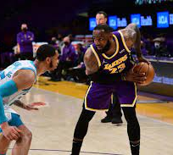
Triple Threat Fundamentals
At all ages – start first practice with Triple Threat drills.
Most underrated skill
Make sure they understand triple threat is used to face basket and protect ball.
Ball should be near the back of the “pocket”
Protected near back hip from defense
Should be able to manipulate ball and use pivot foot to avoid pressure

Slide 24
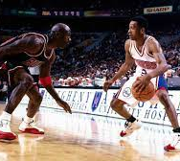
Dribbling Fundamentals
Using fingertips
No slap
Control the ball with the fingertips and make it go where you want it to go!
Eyes up – except when in congested areas
Dribble low and fast in traffic – smooth and loose in space
Use the offhand and elbow to protect from defense
Practice crossovers, behind the back, between legs early and often!

Slide 25
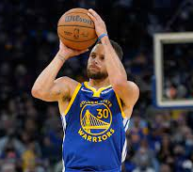
Shooting Fundamentals
Stress BEEF method
Balance
Eyes on basket (back, middle, or front)
Elbow (high)
Follow through
Ball starts near waist or “pocket” then moves to shooting “pocket” while “on a platter”
Use entire body and “get small to tall”
Middle finger aims at middle of rim and last to touch ball (creates spin)
No shot-putting the ball!

Slide 26
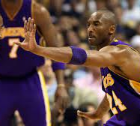
Defense Fundamentals
Low stance like Spiderman
Hands mirror ball (one high for block, one low for crossover)
Push-slide and squeaky feet
Win with Feet, not hands
Team “Shell” Defense
Learn to help
Have “pigeon eyes” or “point pistols” on ball
Protect the lane
Deny, Help, or Ball
Talk, talk, talk…

Slide 27
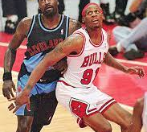
Rebounding Fundamentals
BBBB Method
Butt
To a Body
Box (Out)
Find Ball
“2 to 2 to Chin” Method
Jump off of 2 feet
Grab ball with 2 hands
Ball goes to chin with elbows out
Outlet pass
Run-N-Gun

Slide 28
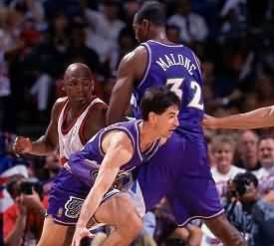
Offensive Concepts
Concepts vs. Plays:
Resist set plays at early ages.
Teach offensive concepts and reading defense instead starting at early ages
Pick-N-Rolls, Pick-N-Pops, Off-ball screens
Back doors & Give-N-Gos
Communication is key!
Break the “shell”
Stress ROBOT Method
In your RANGE?
Are you OPEN?
Are you on BALANCE?
Feet, hands, ball ready for a ONE-COUNT before you shoot?
Does a TEAMMATE have a better shot?

Slide 29
Resources
Go to Coaches Corner on WYBBA site HERE for guides, this PPT
Books:
Basketball Skills & Drills (4th Edition), Jerry V. Krause and Craig Nelson (AMAZON)
1 on 1 with yourself: The Mind Game of Basketball, Nico Bourgade (AMAZON)
Websites/Social Media:
Coaches Clipboard (plays and drills) HERE (My go-to choice!)
Close the Gate Basketball HERE
PureSweat on Facebook
Basketball Drills on Facebook
HoopsKing Blog HERE
Bball Breakdown YOUTUBE

Slide 30


