Slide 1


WELCOME TO THE
NORTHFIELD HOCKEY ASSOCIATION
FAMILY ORIENTATION

Slide 2


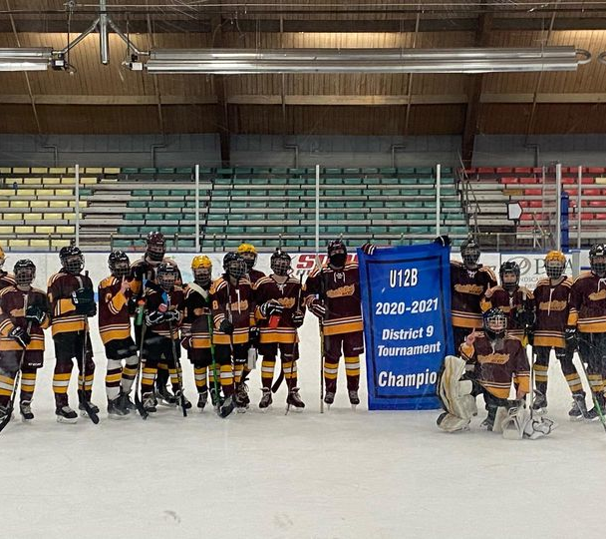
WELCOME!
WE’RE SO GLAD YOU’RE PLAYING WITH NORTHFIELD HOCKEY ASSOCIATION!

Slide 3
OVERVIEW
BOARD MEMBERS, COACHING COORDINATOR, TEAM MANAGER (WHO TO CONTACT)
NHA Mission Statement
QUICK START-OF-THE-SEASON FAQ
EQUIPMENT – RENTAL AND PURCHASE
NORTHFIELD ARENA
SPORTS ENGINE
CALENDAR – PRACTICE AND GAME SCHEDULE
DIBS
APPAREL ORDER
FUNDRAISING
FUTURE OF OUR ICE ARENA

Slide 4
NHA BOARD MEMBERS
PRESIDENT: Sarah Belcourt
VICE PRESIDENT: Jon Paulson
TREASURER: Nichole Schmidt
SECRETARY: Victoriya Lemke
REGISTRAR: Teresa Sparks
FUNDRAISING: Heather Poepping
BOYS PROGRAM COORDINATOR: Derek Docken
GIRLS PROGRAM COORDINATOR: Steve Murray
COACHING COORDINATOR: Michael Gilomen
ICE CHAIR: Matt Tschida
DIBS/CONCESSIONS: Jamie Jindra
MARKETING/RECRUITING: Brittany Ellerbusch
EQUIPMENT: Maegen Storm
TOURNAMENT DIRECTOR: Adam Steffl
SOCIAL MEDIA/WEB MASTER: Rachel Trnka
GAMBLING MANAGER: Dan Belcourt
AT LARGE: Brittney Hubbard
The Northfield Hockey Association is a VOLUNTEER organization. While we do compensate our coaches, there are no employees.

Slide 5
Our Mission Statement …
MISSION STATEMENT: The Northfield Hockey Association will provide a positive, competitive and learning experience for all players, and teach the virtues of athletics such as discipline, hard work, teamwork and individual sacrifice.
COACHES are responsible to teach the skills and concepts at each level and adhere to the Mission Statement, instructional methods, and progression guidelines of the Association.
PARENTS can greatly influence their children’s hockey experience in a positive manner by supporting and understanding the Mission Statement and providing encouragement.
PLAYERS will take pride in being a Northfield hockey player. They will put forth their best effort at all times, representing themselves, their families and the NHA in a positive manner. They will demonstrate the virtues of athletics such as hard work, discipline, teamwork and individual sacrifice for the betterment of the team.

Slide 6
Parent:
Code of Conduct
● Encourage your child to play by the rules; remember, children learn best by example, so applaud the good plays of both teams
● Do not embarrass your child by yelling at players, coaches or officials; showing a positive attitude toward the game and all its participants, your child will benefit
● Emphasize skill development and practices and how they benefit your young athlete; de-emphasize games and competition in the lower age groups
● Recognize the importance of volunteer coaches since they are important to the development of your child and the sport; communicate with them and support them
● If you enjoy the game, learn all you can about hockey – and volunteer
● All complaints regarding coaching staff are to be directed only to the Coaching Coordinator; no emails, texts, or etc. are to be sent directly between coaches and parents involving a complaint
● If NHA is fined for any poor parent behavior, the parent/family will be responsible for paying NHA back for said fine.

Slide 7
Player:
Code of Conduct
● Work hard to improve your skills
● Be a team player – get along with your teammates
● Learn teamwork, sportsmanship and discipline
● Be on time
● Learn the rules and play by them; always be a good sport
● Respect your coach, your teammates, your parents, opponents and officials
● Never argue with an official’s decision

Slide 8
Misbehavior will NOT be tolerated
BOTTOM LINE: We are ALL representing the NHA - be your best - ALWAYS!
NHA will not tolerate any of the following behaviors, and anyone exhibiting any of these behaviors should be reported to the appropriate Official, Coach, Team Manager or Level Coordinator, or to any NHA Board Member:
● Swearing at anyone
● Violating NHA, MHA, or USA Hockey rules Page - 31
● Fighting or dangerous horseplay
● Damage to property of others.
● Any threatening or physical behavior towards a coach, another player, parent, or official will result in immediate suspension for player or parent. The offending individual will not be able to return to any event until that individual (and parent if a minor) appears before the disciplinary committee at which time the consequences will be determined.
Officials, Coaches, Team Managers and NHA Board Members have the responsibility and authority to ask that a player, coach, spectator or other individual be removed or be asked to leave an activity because of unacceptable behavior

Slide 9
Northfield Hockey Assn & Northfield Skating School
Technical Power Skating Clinics

Slide 10
Skating Objectives & Focus Areas
Regular clinics develop foundational skating skills as building blocks over the season
Each session includes a warm-up progression and specific skating focus area
Not every skill/drill will be used directly in a game, but all have a developmental purpose aimed at improving elements of athleticism and game play
Consistent attendance and effort are key for results. All the pros drill their skating regularly!
Examples of focus areas:
  Stance and stride mechanics
  Balance and control on all 8 edges (including forward and backward)
  Transitions and pivoting
  Linear, lateral, forward, and backward crossovers
  Quick starts
  Power and explosiveness
  Agility, strength, and quickness
  Technique, efficiency, and correct blade use throughout

Slide 11
Professional NSS Instructors
Carey Tinkelenberg (“Coach C”) and Karri Nachtigal (Coach K”) are full-time skating professionals with over 50 years of combined experience. They have designed skating development programs for youth, high school, college, and semi-pro hockey players at six associations and professional agencies in the Twin Cities and Southern MN. Coach C and Coach K are both driven by the NSS philosophy of building skills and confidence for skating and for life and are excited to kick off the third season of NHA clinics.
Carey Tinkelenberg
Founding Director of Northfield Skating School (est. 2005)
Skating Instructor at Shattuck-St. Mary’s since 2015
Triple Master Rated Professional; National presenter and leadership author for U.S. Figure Skating
Member of design and launch team for Learn to Skate USA, sanctioned by USA Hockey, U.S. Figure Skating, & U.S. Speedskating
Trained skating coaches on six continents as a Coach Developer for the International Skating Union’s Worldwide Coaching Framework
B.A. in Psychology, Carleton College.
Karri Nachtigal
Head Coach for the District 196 Figure Skating team
Career skating professional at four organizations in the South Metro area
Guided District 196 to top 3 finishes at the International Skating Institute National Competition for past 5 years
B.S. in Education with a minor in Psychology, University of North Dakota

Slide 12
Locker Room Monitor :
USA Hockey requires that at least one same sex adult be present to monitor the locker room during all team events. This adult is known as a Locker Room Monitor and is responsible for:
Ensuring that only approved team personnel, family members, and participants are in the locker room
Supervising conduct in the locker room
Preventing, reducing, and eliminating harmful behavior
Upholding a safe environment
Locker Room Monitors must: Be screened and trained, Appear on the team's USA Hockey roster, Complete SafeSport Training, and Complete a background check.
Step 1: Register with USA Hockey
Step 2: Complete Background Screening- Note- There is a $30 fee but the association will reimburse.
Step 3: Complete SafeSport Training
For complete instructions, please visit our website under “Home” then “Parents” tab and contact your team manager for any questions.

Slide 13
NORTHFIELD ARENA
A FEW THINGS TO NOTE ABOUT USE OF THE NORTHFIELD ICE ARENA:
Please utilize the assigned locker room for putting on and taking off gear. Help us keep our small lobby open and accessible.
Locker room assignment can be found on the larger screen inside the sliding entry door.
Never allow your child on the ice if the Zamboni is out for a resurface.
All players should wait near the ice door for the coach to enter first.
There is a lost-and-found barrel near the concessions stand.

Slide 14


START-OF-THE-SEASON FAQ
When will I find out what team my child is on and who the coaches are?
How will I find out what team my child is on and who the coaches are?
When will I find out what team my child is on and who the coaches are?
  Bantam & PeeWee Teams will be posted on October 9th @ 4pm.
  Squirt Tryouts: October 21st and 23rd: Teams will be posted on October 24th.
  Coaches and Managers (if not already posted) will be determined after tryouts and when teams are formed.
Team Pictures
Squirt, PeeWee and Bantam pictures will be held at the ice arena on October 29th. More details on the website under “Teams”
Squirt A- 5:30-5:50pm | Squirt B- 5:50-6:10pm | Squirt C- 6:10-6:30pm | Bantam A- 6:35-6:55pm | Bantam B- 6:55-7:15pm | PeeWee A- 7:20-7:40pm |PeeWee B- 7:40-8:00pm | PeeWee C- 8:00-8:20pm
When will I find out what team my child is on and who the coaches are?
Stay Informed with NHA Emails
To keep everyone informed and up-to-date, we will now be sending out weekly informational emails. Please make sure to check your inbox regularly for the latest updates and important announcements. You can also visit the "Email Communications" tab on our website to access all emails sent to our members.

Slide 15
Equipment Updates
Remember that neck guards are REQUIRED for all players and referees under age 18 at all practices and games.
Referees have the right to check that they are certified neck guards.
Starting the 2025-2026 season, Raider gold helmets will be a part of the standard uniform for the NHA players in squirts, peewees and bantams. There will be an opportunity to reserve a helmet late in the season through Champion Sports.
Starting the 2025-2026 season, maroon breezers/breezer covers will be part of the standard uniform for the NHA players in squirts, peewees and bantams.
Co-op with Cannon River Royals will continue with black helmets and breezers.

Slide 16
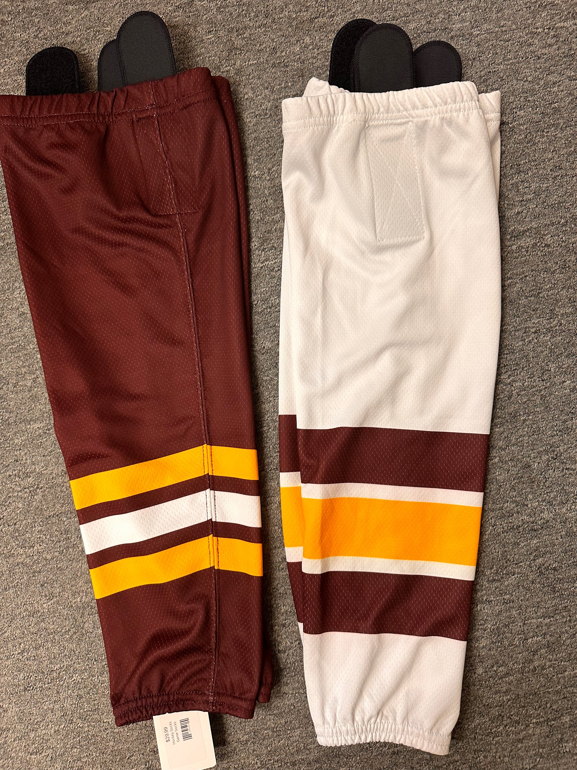
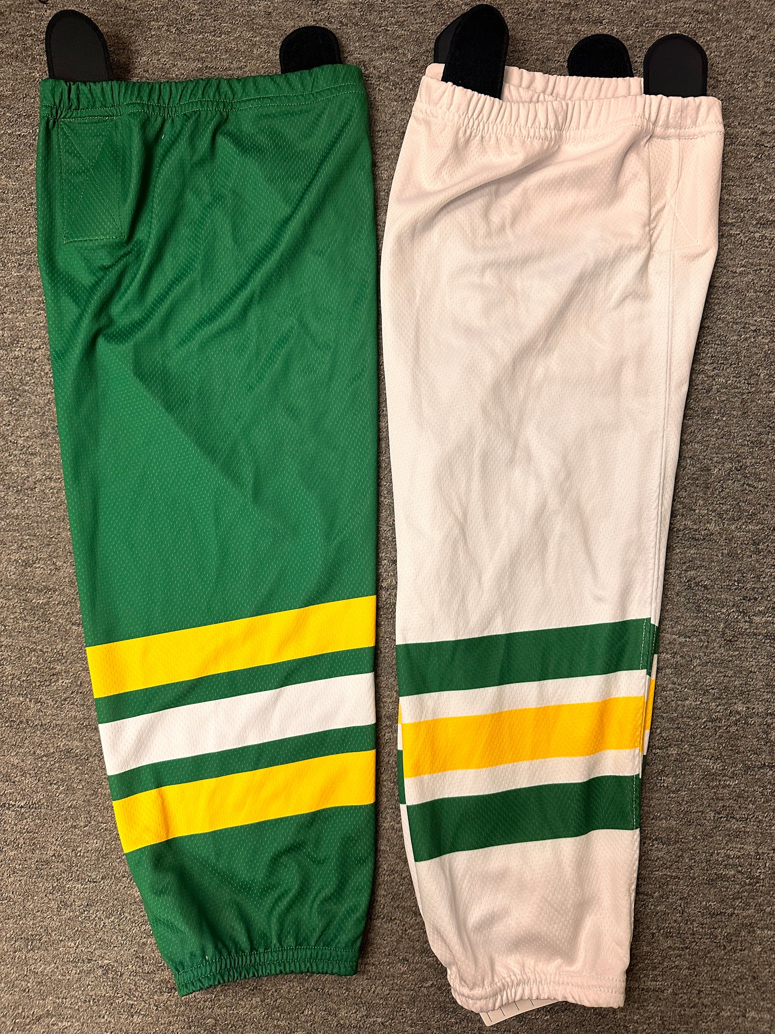
Hockey Socks
Squirt & PeeWee
U10, U12, U15
Bantams
Sponsored by VFW
Socks are provided
Team jerseys will be distributed
after tryouts

Slide 17
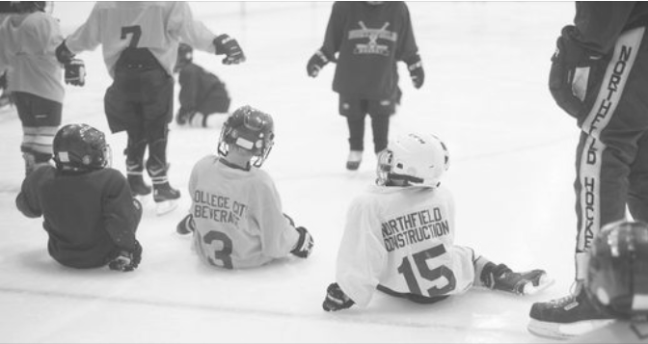


EQUIPMENT RENTAL
Rental: Equipment rental is available and can be selected when registering your player. Included in the rental bag is:
helmet
gloves
elbow pads
chest/shoulder pad
shin pads
breezer (hockey pants)
Equipment Bag
Not included but necessary:
skates (sharpen every 8-10 hours)
neck guard
hockey socks
stick and stick tape
jock/jill shorts or pants – most have velcro to attach the hockey socks
Please direct any rental questions to Maegen Storm: equipment@northfieldhockey.net
A mouthguard is available for free after completing a waiver.
Thank you to our sponsors –
Minnesota Orthodontics & Schieck Orthodontics!
Optional:
Sock tape
Skate Guards
Base layer

Slide 18
Caring for Equipment
-After every use:
Dry skate blades with a soft cloth
Allow gear to air dry
-Regularly:
Wash base layer, jersey, socks
-1-2 times a season
Machine wash: Gloves, elbow pads, shoulder pads, breezers, shin pads, neck guard
Cold or warm water. DO NOT PUT IN DRYER. Allow to thoroughly air dry.
Best to mix with other clothes and secure all velcro
Use a detergent made for synthetics like WIN, Sweatx, Sportswash, Tide Sport, HEX, Arm and Hammer Free and Clear
Or soak in bathtub with a little detergent and 1 cup plain vinegar
Helmet can be wiped on the inside with an antibacterial cloth
Skates can be sprayed with antibacterial spray

Slide 19

FREE Mouthguard Options:
Schieck Orthodontics option:
What: SISU moldable mouthguard w/ tether
When: Bring in completed/signed waiver and player info form to Schieck facility during regular business hours and exchange for a mouthguard to mold at home
Where: Schieck Orthodontics facility at 1531 Clinton Lane
MN Orthodontics option:
What: Custom made mouthguard to be molded at facility
When: Saturday, October 26th 9am-12pm
Where: MN Orthodontics Northfield office at 2019 Jefferson Road

Slide 20
ICE SCHEDULE
While ice time is challenging to schedule and things can change, you can expect approximately the following amount of practice time and games/scrimmages and tournaments per level:
Mini Mites: 30 practice hours, one jamboree
Senior Mites/U8: 60 practice hours, 16 scrimmages, 1-2 jamborees
Squirt/U10: 85 practice hours, 25-30 season games, 3-4 tournaments
Peewee/U12: 110 practice hours, 35-40 season games, 3-4 tournaments
Bantam /U15: 145 practice hours, 40-50 season games, 3-4 tournaments
**Majority of Squirt/U10 and higher level teams’ practices will be away from Northfield Ice Arena (NIA) starting Nov. 1 (St. Olaf or SSM). We have 211 total home game slots for Squirt/U10 and above, and 244 total ice slots available at NIA from Nov. 1 through Feb. 14.
Please notify the coach if your child will miss a practice. If your child will miss a game, tournament or jamboree, please let the coach know as early as possible to make sure they have enough players.

Slide 21
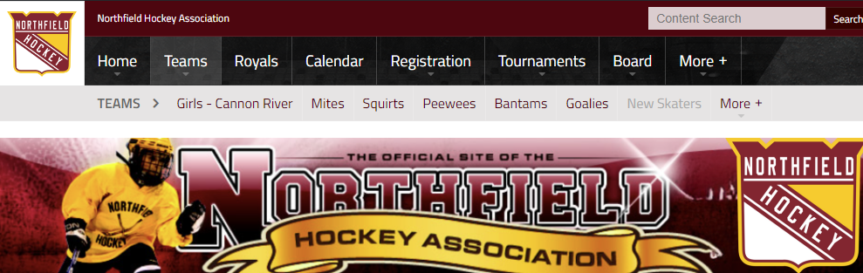
CALENDAR
To view your team’s calendar, click on the “Teams” tab and select your team.
Then, you can download it to your personal calendar using the links at the bottom of the page.
U8 Girls calendar is on the Cannon River Royals webpage

Slide 22
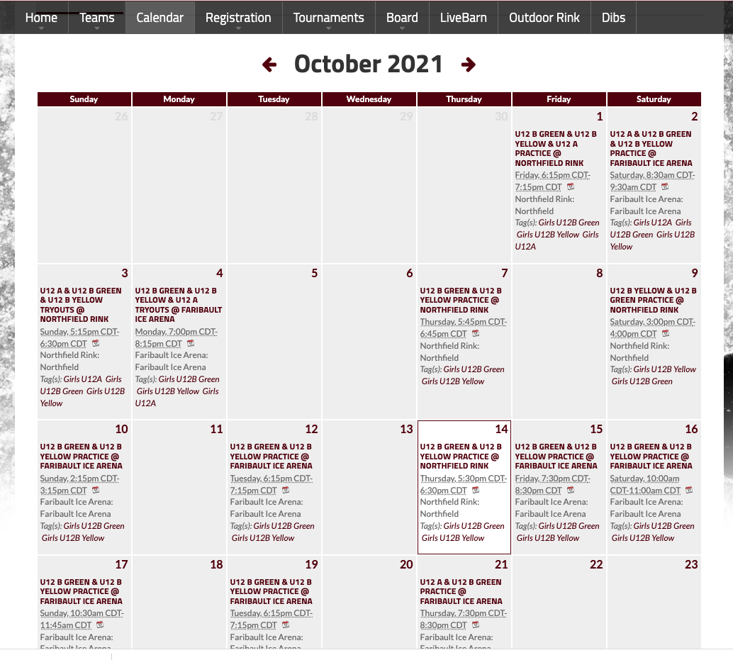
CALENDAR
Be sure to look closely at which ice rink is listed for practices and games. We may schedule ice time at other arenas such as Faribault, Shattuck or St. Olaf.

Slide 23

DIBS
Dibs is an online tool that allows NHA to track the volunteer hours that are required for each family.
Dibs hours can be done in the concessions stand or helping with bingo at Carbone’s.
Senior Mites/U8 and above: 20 hours is required for each family, unless the family chooses to buy-out their hours for $1,000.
Mini Mites/U6: 10 hours is required for each family, unless the family chooses to buy-out their hours for $500.
Only parents or siblings 18 years or older are allowed to work or be in the concessions stand.
Look for hours on the website and login to claim them.
If the 20-hour minimum (10 hours for Mini MItes/U6) is not met, your dibs deposit check of $1,000 ($500 for Mini Mites/U6) will be cashed.

Slide 24
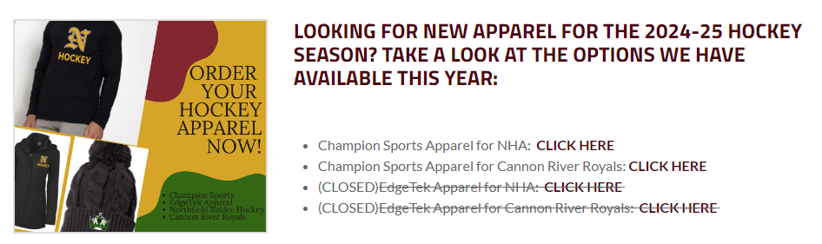
APPAREL OPTIONS THIS YEAR:
See NHA website Home page for info
Champion store has now closed - anyone that ordered will be notified when the order is in.
EdgeTek store is open again as of 10/1/24 and will remain open until: Thursday, October 31st

Slide 25
GENERAL FUNDRAISING INFO
Fundraising is the key to keep the cost of hockey down for you and all our members!
1 hour of ice time = between $185-245, varies by rink and time of day
Our ice bill for the 2023-24 season was $154,000
Main expenses for NHA are: ice time, coaches and tournament fees, equipment and officials costs and insurance
Our parent coaches and Board members are all volunteers
NHA will be responsible for helping to fundraise $2+ million towards the new Northfield Ice Arena.
With this responsibility, we will not be giving money back to families that fundraise over the required amounts this year.
NHA fundraising goal for 2024-25 is ~$45,000.

Slide 26

FUNDRAISER #1: CASH RAFFLE
See NHA website under the “Sponsors/Fundraising” tab for all info
IMPORTANT DATES:
10/1/24-10/29/24: Selling window
TUESDAY, 10/29/24 6pm:
All ticket stubs, unsold tickets and money collected must be returned to the Northfield Ice Arena entryway dropbox. May be dropped off earlier but will NOT be accepted after this date!
SATURDAY, 11/9/24 12pm:
Raffle drawing will take place at the Northfield Ice Arena. Winners will be contacted by NHA and posted on the NHA website.
$20/ticket with a max of 2,500 tickets sold.
Recommended ticket sales:
  Mini Mites/U6 = 5 tickets/player (max 20 tickets/family)
  Sr. Mite/U8 and above = 10 tickets/player (max 20 tickets/family)
You MUST collect money when raffle tickets are sold - you may collect cash or checks (NO credit cards)
A waiver will need to be signed upon picking up tickets to cover any lost or stolen tickets
25 winners and over $5,000 in prizes:
5 - $500
5 - $250
15 - $100
(Note: Winner is responsible for any applicable fees or taxes)

Slide 27

FUNDRAISER #2: HEGGIES PIZZA
See NHA website under the “Sponsors/Fundraising” tab for all info
IMPORTANT DATES:
12/14/24-1/16/25: Selling window
THURSDAY, 1/16/25 6pm: All order forms with pizza totals and money/checks (written out to NHA) due at NHA dropbox.
WEDNESDAY, 2/5/25 5-7pm: Pizza pick up at the Northfield Ice Arena. YOU MUST GET PIZZAS PICKED UP TODAY!
Order forms will be available online and in the arena front entryway on 12/14/24
Recommended pizza sales: 10 per family
You MUST collect money when pizzas are sold - you may collect cash or checks. Please have checks made out to NHA.
Top 2 selling families will earn a $100 gift card to Slumberland Furniture.

Slide 28

FUTURE Fundraiser: DRIVEN COFFEE ROASTERS
Plan for Summer 2025 sales
More INFO to be sent out at the end of this season and information will be on NHA website under Sponsors/Fundraising
Virtual fundraiser with coffee, tea, snacks, etc.
Fundraiser earns 40% profit back on all orders with ALL profits to be tracked and plan to be given back to seller or can be used to lower registration costs for the upcoming season.
All orders shipped directly to the person placing the order

Slide 29


OTHER NHA FUNDRAISING EVENTS
NHA GOLF TOURNAMENT
HOCKEY DAY NORTHFIELD

Slide 30
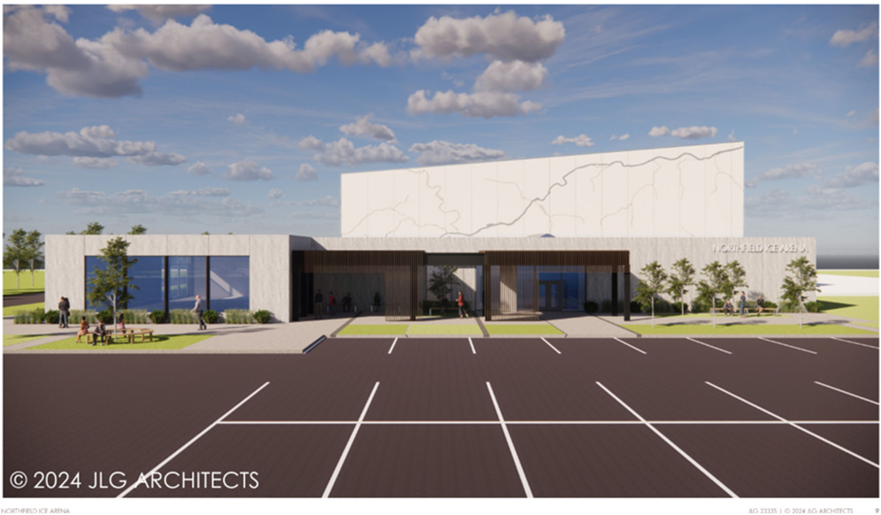
The Future of our Ice Arena

Slide 31
The Future of our Ice Arena
City Council in process of selecting the Construction Manager for project.
EDA voted 6-1 in favor of conduit bond financing.
$1.2 / $2 Million raised in pledges and donations so far.
When $2 Million reached, goal moves to $6 Million to include:
  Concrete Cast Stadium Seating
  Dryland training area
Questions? Want updates? Email:
arena@northfieldhockey.net

Slide 32
Future Ice Arena FAQ
Is there any possibility that the new arena project will not move forward?
Is it possible to add 2 sheets to the arena?
Will there be a donor recognition wall?
Will there be matching opportunities?
When the $2 Million is raised, what’s next?
How can we help?
Questions? Want updates? Email:
arena@northfieldhockey.net

Slide 33

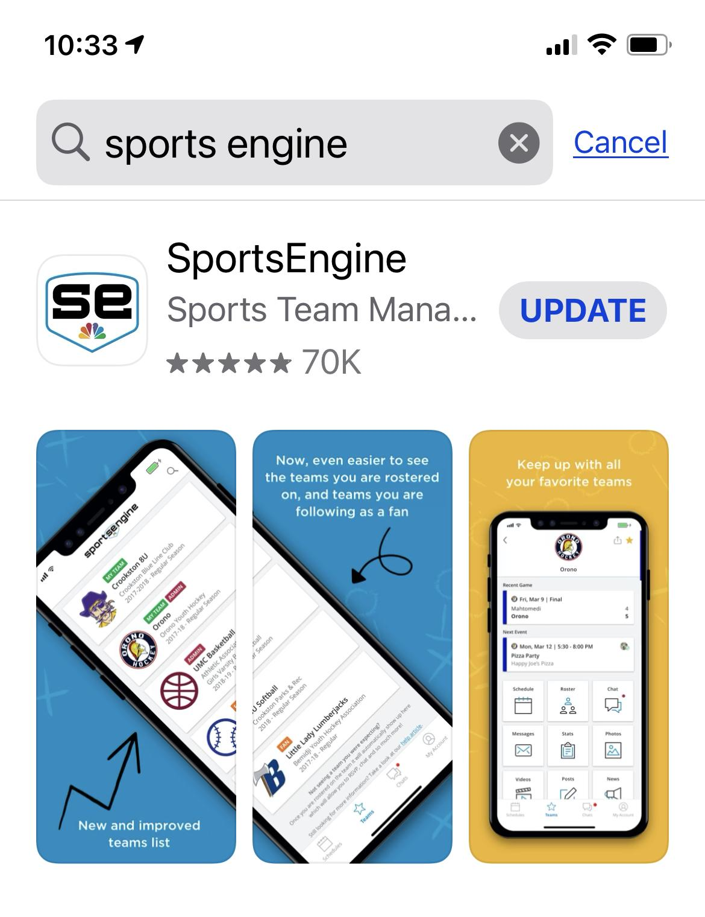


SPORTS ENGINE
In order to register for hockey, claim dibs hours and follow your team, you will need to create an account with Sports Engine.
Download the app to track your team through the season!

Slide 34

THANK YOU!
Parent Meeting Exit Ticket items:
DIBS check paid and turned in
Equipment needs addressed
Fundraising raffle tickets collected
Sports Engine App downloaded
Questions? Please ask!
HAVE A GREAT SEASON!

