Slide 1


2026 KICKOFF MEETING

Slide 2

2026 KICKOFF MEETING AGENDA
Introduction to PL Staff & Captains
Purpose, Mission, & Philosophies
Tryout Information & Expectations
Practice & Game Uniform Information
Practice Schedules & Spring Break
PL Softball Handbook – Parents & Players
Fundraising / Sponsorships
Miscellaneous
Closing & Northern Life Wellness

Slide 3
2026 PL SOFTBALL STAFF
VARSITY COACHING STAFF
HEAD COACH | Erika Smyth | softball.plhs@gmail.com
ASSISTANT COACH | Taylor Elasky | telasky28@gmail.com
ASSISTANT COACH | Katie Young | kyoung@plsas.org
JUNIOR VARSITY COACHING STAFF
HEAD COACH | Jon Tolbert | jtolbert@plsas.org
B-SQUAD COACHING STAFF
HEAD COACH | TBA | TBA
9TH GRADE COACHING STAFF
HEAD COACH | Beth Fuller | bfuller@plsas.org
PROGRAM PLAYER DEVELOPMENT COACH
PD COACH | Taylor Krapf | taylorkrapf21@outlook.com

Slide 4
2026 PL CAPTAINS
2026 PRIOR LAKE SOFTALL CAPTAINS
Ada Joy Gerhardt | 612-356-7546 | adajoygerhardt@gmail.com
Brynn Liddle | 612-353-7963 | liddlebrynn@gmail.com
Lily Hopkins | 651-274-3331 | lilyahopkins@gmail.com
Peyton Chambers | 612-400-3564 | peytonraechambers@gmail.com
If players have not done so already, please make sure to contact a PL softball captain to get into the PLHS Softball GroupMe for any important updates.
Captains Practices: Please make sure to attend these as it is the best way to prepare for tryouts.
  Monday nights from 7:00 PM – 9:00 PM in the Activities Center

Slide 5
PURPOSE & MISSION
2026 PL SOFTBALL PHILOSOPHIES
PURPOSE: To help navigate student-athletes unlock their potential in both sport and life in a way that inspires and demonstrates empathy, authenticity, and hardwork.
MISSION: To create and maintain a positive softball environment that encourages teamwork & development mentally, physically, and academically.
PHILOSOPHY: Our coaching staff will always prioritize building outstanding people first and foremost.
  We will be honest and build relationships through positive leadership.
  We will create an open line of communication between staff, athletes, and families.
  We will teach the highest level of softball knowledge, fundamentals, and strategies.

Slide 6
2026 PLGSB TRYOUTS
WHAT TO EXPECT & WHAT TO GET DONE
All athletes must have the following documents in the Activities Office before our first tryout date. Failure to do so will result in the player not being able to participate.
  Current athletic physical
  Completed health questionnaire
  Signed MSHSL eligibility statement
  Athletic fee paid or arrangements made
Tryouts are open to all positions 8th grade – 12th grade, and pitchers & catchers in 7th grade.

Slide 7
2026 PLGSB TRYOUTS
WHAT TO EXPECT CONTINUED
Tryouts begin on Monday, March 9th from 3:30 PM – 5:30 PM in the AC & are open to 8th-12th grade athletes and 7th grade pitchers and catchers ONLY.
  Check-in begins ASAP.
  Roster formation & cuts (if necessary) will be on Thursday, 3/12.
  Some athletes will be placed on lower-level teams with opportunity to join Varsity over the weeks leading up to our first game.
Registration opens February - we will be sending a player survey over to get important information for each player before tryouts begin, please register right away!

Slide 8
2026 PLGSB TRYOUTS
WHAT TO EXPECT CONTINUED
T-Shirt Colors for Tryouts – the following age groups will need to wear these colored t-shirts for each day of tryouts:
  7th Grade: Gray
  8th Grade: Navy
  9th Grade: White
  10th Grade: Yellow
  11th Grade: Black
  12th Grade: Pink

Slide 9
PRACTICE/GAME UNI’S
NECESSARY UNIFORM ITEMS
NECESSARY PRACTICE UNIFORM ITEMS:
  NO Club Softball or outside Prior Lake Apparel Allowed (Softball Bags OK)
  PL Gear or PL Colors ONLY:
    Navy, Gold/Yellow, White, Gray, etc.
    Special game day PL shirts
    Black Pants Allowed
  T-Shirts, Softball Pants, & Socks Required, unless stated otherwise.

Slide 10
PRACTICE/GAME UNI’S
NECESSARY UNIFORM ITEMS
NECESSARY GAME UNIFORM ITEMS:
  Navy & White: Socks, Belts, Softball Pants, Undersleeves
  Navy WristCoaches Wrist Band – Amazon WristCoaches Football Play Wristbands
  White Matte Helmet – Navy/White helmets are grandfathered in
  Stirrups – these will be for purchase through boosters
*Prior Lake Softball uniforms are to be tucked in and worn as intended during games.

Slide 11
PRACTICE & GAME SCHEDULES
2026 PL SOFTBALL PRACTICE SCHEDULE:
Days: Monday – Friday (Non-Game Days)
Times: 3:30 PM – 5:30 PM
Location: PLHS Activities Center & Daggit Field/JV Field
  Times remain the same on early release dates unless otherwise notified.
There will be days where teams will practice together, especially inside, but once we are outside and games begin we typically practice separately.
2026 PL SOFTBALL GAME SCHEDULES:
All games will continue to get updates on South Suburban Conference Website – southsuburbanconference.org
All levels of games are almost fully up to date online – 9th & B-Squad games will continue to be adjusted in the case that a team is unable to be formed from other schools.

Slide 12
2026 SPRING BREAK
INFORMATION & UPDATE
Prior Lake High School Spring Break begins Monday, 3/30 and concludes on Friday, 4/3.
There will be no 9th, 10th/B-Squad, and JV practices throughout this period of time.
Varsity ONLY:
  There will be no practices for Varsity from Monday, 3/30 – Tuesday, 3/31.
  There will be OPTIONAL practices (time TBD) on Wednesday, 4/1 - Friday 4/3.
  There will be a varsity scrimmage vs. EP on either Thursday, 4/2 or Friday 4/3 @ Eden Prairie Dome
    We will form this team with those that are in town
    This is the best opportunity to showcase your skillset and earn you an opportunity to be on the Varsity roster
    Not attending does not have a negative impact on your playing time, but participating does have a potential positive impact on your Varsity opportunities.

Slide 13
IN-SEASON TRANSPORTATION
All athletes are required to ride the bus to away games. If there are conflicts with this, the exception must be submitted to the Activities Office and approved.
Players are expected to ride the bus back to PLHS but are welcome to submit requests to ride home with parents/guardians ONLY. Head coaches must be notified and must approve beforehand.
  Players that choose to ride home with parents/guardians are required to help bring equipment back onto the bus before leaving.
Any inappropriate behavior on the buses will be met with disciplinary action including, but not limited to, suspension from team, game, and/or practices.
Phones are expected to be put away into individual bags before we exit the bus and get to the field – no phones allowed in the dugout.
Middle school pick-up will be communicated for away games beforehand. Typically, pick up will be at TOMS. It is required for middle school athletes to use the Activities bus for transportation to the high school for game days.

Slide 14
ABSENCE DEFINITIONS
Excused Practice Absences - If there is an excused absence, the player's coach must receive an at least 24 hours in advance, and ASAP in the case of illness.
  School events (ie. choir or band concert)
  Funerals
  Religion obligations
  Extreme illness
Unexcused Practice Absences
  Vacation
  Homework
  Other sport/team practices
  Work
  Other events that could be rescheduled around practice or games

Slide 15
UNEXCUSED ABSENCES
Missing practices and/or games, without prior notification to the coaching staff, will be treated the same as missing a school day on game days.
  1st Offense: 3 inning suspension, meeting with athlete & coaching staff
  2nd Offense: 1 game suspension, meeting with athlete, parent/guardian, & coaching staff
  3rd Offense: 3 game suspension, meeting with athlete, parent/guardian, Activities Director & coaching staff
  4th Offense: Dismissal from program
Players may not participate in practice or games if they have an unexcused absence from a class. Exceptions can only be approved by the Activities Office.
Athletes will be held accountable with grades and attendance in classes. Class and grade checks will be frequent, please make sure any absence is excused.

Slide 16
VARSITY ROSTER FORMATION
Please take the time to read our 2026 PL Softball Handbook that will be sent out after this meeting along with this PowerPoint.
Varsity Roster Expectations: Our Varsity coaching staff will be making final decisions on player placement onto the roster. Our staff will prioritize skill, leadership, and quality of teammate first. If there is an athlete that is viewed of the same caliber as another athlete in all three of those facets, our staff will then prioritize the older athlete for our Varsity team for roster selection.
Varsity Playing Time: This will be at the entire Varsity coaching staff’s discretion and by the following criteria: skill level, in-game & practice performance, work ethic, attitude, and off-field conduct. The players who have earned it will play. We are playing to win – age/grade does not play a role in playing time. There is no guarantee of playing time when you are on the Varsity roster and in the dugout. Roster numbers on the Varsity team will vary by game. A select group of players will share time on both JV and Varsity.
All ages of athletes (7th grade – 12th grade) are eligible to be a Varsity player AND play/start on our roster.

Slide 17
PLAYER TEAM ASSIGNMENTS
There will no longer be any players labeled as ”bubble” that move from one team to another.
All athletes will be assigned to a team after tryouts conclude. Athletes will be asked individually, if necessary, to help a need on any of our teams due to injury, position need, players missing, etc.
The 2026 Sections Roster will be selected based on coaching staff recommendations, performance, position needs (specifically pitchers, catchers, and baserunners), and attitude/effort/leadership on your respective teams.

Slide 18
24 HOUR RULE & LOC
It is required that a player and/or parent wait a total of 24 HOURS from the conclusion of a tournament, doubleheader, or game/competition to contact the coaching staff on issues or questions surrounding playing time. This includes contact in person, by phone, or by email.
LINE OF COMMUNICATION: It is required and essential that our line of communication is followed by players, family members, and coaching staff.
  Athlete and Head Coach
  Athlete, Coaching Staff, and Parents
  Athlete, Coaching Staff, Parents, and Activities Director

Slide 19
PLAYER & FAMILY EXPECTATIONS
It is required that all players respect their parents/family members, coaches, teammates, officials, and the competition. We have ZERO tolerance for any unsportsmanlike behavior or bullying.
All players are required to help with equipment. If coaches or staff see the same players picking up or helping with equipment each practice or game, we will be implementing an equipment schedule for athletes. Leave facilities better than you found them!
Players are expected to follow all MSHSL and Prior Lake High School rules & regulations – this includes and is not limited to: drug & alcohol policies, grade requirements, attendance requirements, etc. Failure to do so will result in suspension and/or dismissal from the softball program.
Teamwork is not a preference; it is a requirement – encourage one another.
Expect the most from yourself, your teammates, and coaches – hold each other accountable.
Do your best. When you fail, fail HARD! Learn, adjust, and grow from failure.
Players are asked to stay in the dugout during games and competitions – only communicate with family members to grab water, snacks, etc.
No cell phone use or connected watch use allowed during practices and games.

Slide 20
PARENT
EXPECTATIONS
THANK YOU for all you do in your involvement and supporting your daughter, her team, our coaching staff, and our program. We ask all our families to understand our following expectations for parents/guardians as well as family members:
Support your athletes at home and at the field.
We will only tolerate positive comments and cheering for our team, opponents, and officials.
No parents allowed in the dugout – let our coaches coach.
Respect the 24 Hour Rule and Line of Communication
Get involved – volunteer opportunities and creating community.
Let athletes address their coaches first before you step in.
Be positive role models and advocates for academics and athletics at PLHS.
Any parent working GameChanger has ZERO authority to change statistics.

Slide 21
RAINOUTS/SCHEDULE CHANGES
Minnesota Springs are unpredictable! We strongly recommend that parents and players follow Prior Lake Softball on a social media outlets. This is where the first reports will be shared with families, and we will follow up via email. Any game cancellations are typically decided by noon day of. The information will be shared on the message boards at school.
Players will be added to their team specific GroupMe’s, we will also provide updates immediately via GroupMe text to them on any changes we may receive.
Please follow us on the following social media platforms for immediate updates:
X (formerly Twitter): @pl_softball
Instagram: @pl_softball
Facebook: www.facebook.com/priorlakegirlssoftball
Games can be downloaded to your calendar and notify you on changes at www.southsuburbanconference.org

Slide 22
FAN / TEAM STORE
Our PL Softball Fan Apparel / Team Store will be open early February.
We will be releasing the link onto our PL Softball website.
Delivery will be about 2-4 weeks after the store closes.
All items from each store will be picked up by the boosters and then pickup will be arranged at PLHS.
A second ordering window will open after tryouts and teams are made in case you miss this round!

Slide 23
BOOSTER CLUB
2026 PRIOR LAKE SOFTALL BOOSTER MEMBERS
President | Lisa Thurk | thurkjl@gmail.com
LABC Representative | Eric Duchene | e.duchene@yahoo.com
Treasurer (OUTGOING) | Jim Erickson | jim.a.erickson1@gmail.com
Sponsorships | Tyler Chambers | chambers.plsoftball@gmail.com
Marketing | Tiffany Olson | tiffanyolson12@hotmail.com
We are looking for a Treasurer to shadow and take over for the 2026-2027 season – please contact Booster President Lisa Thurk if you are interested!
We will need volunteers for all our special nights:
  Wednesday, 5/13: Senior Night vs. Rosemount
  TBD – Strike Out Cancer & PLAY Youth Night @ PONDS
  TBD – Teacher Appreciation Night
  TBD – Mental Health Awareness Night
  TBD – Banquet

Slide 24
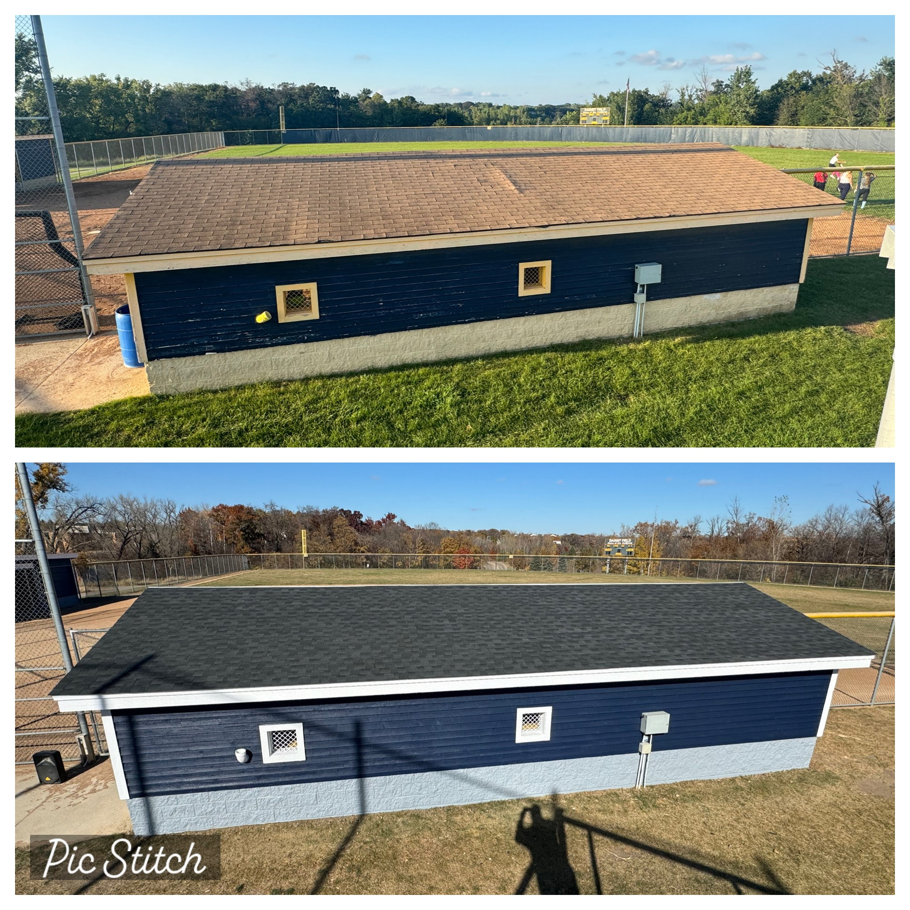
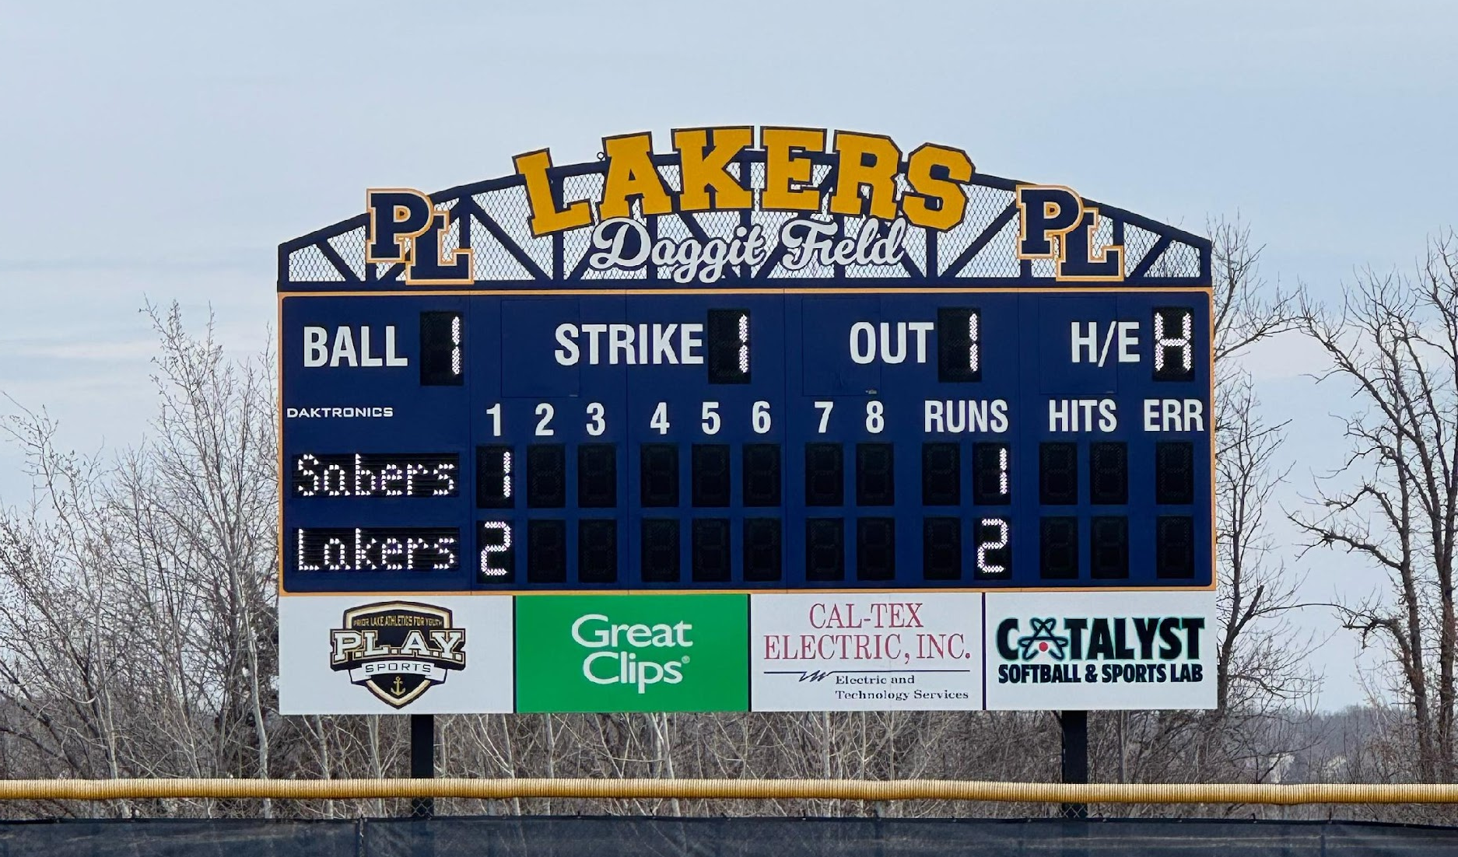
FIELD IMPROVEMENTS
Fall Clean up
  Dugout refresh, new paint
  Wind screen roll up
  Field clean up

Slide 25
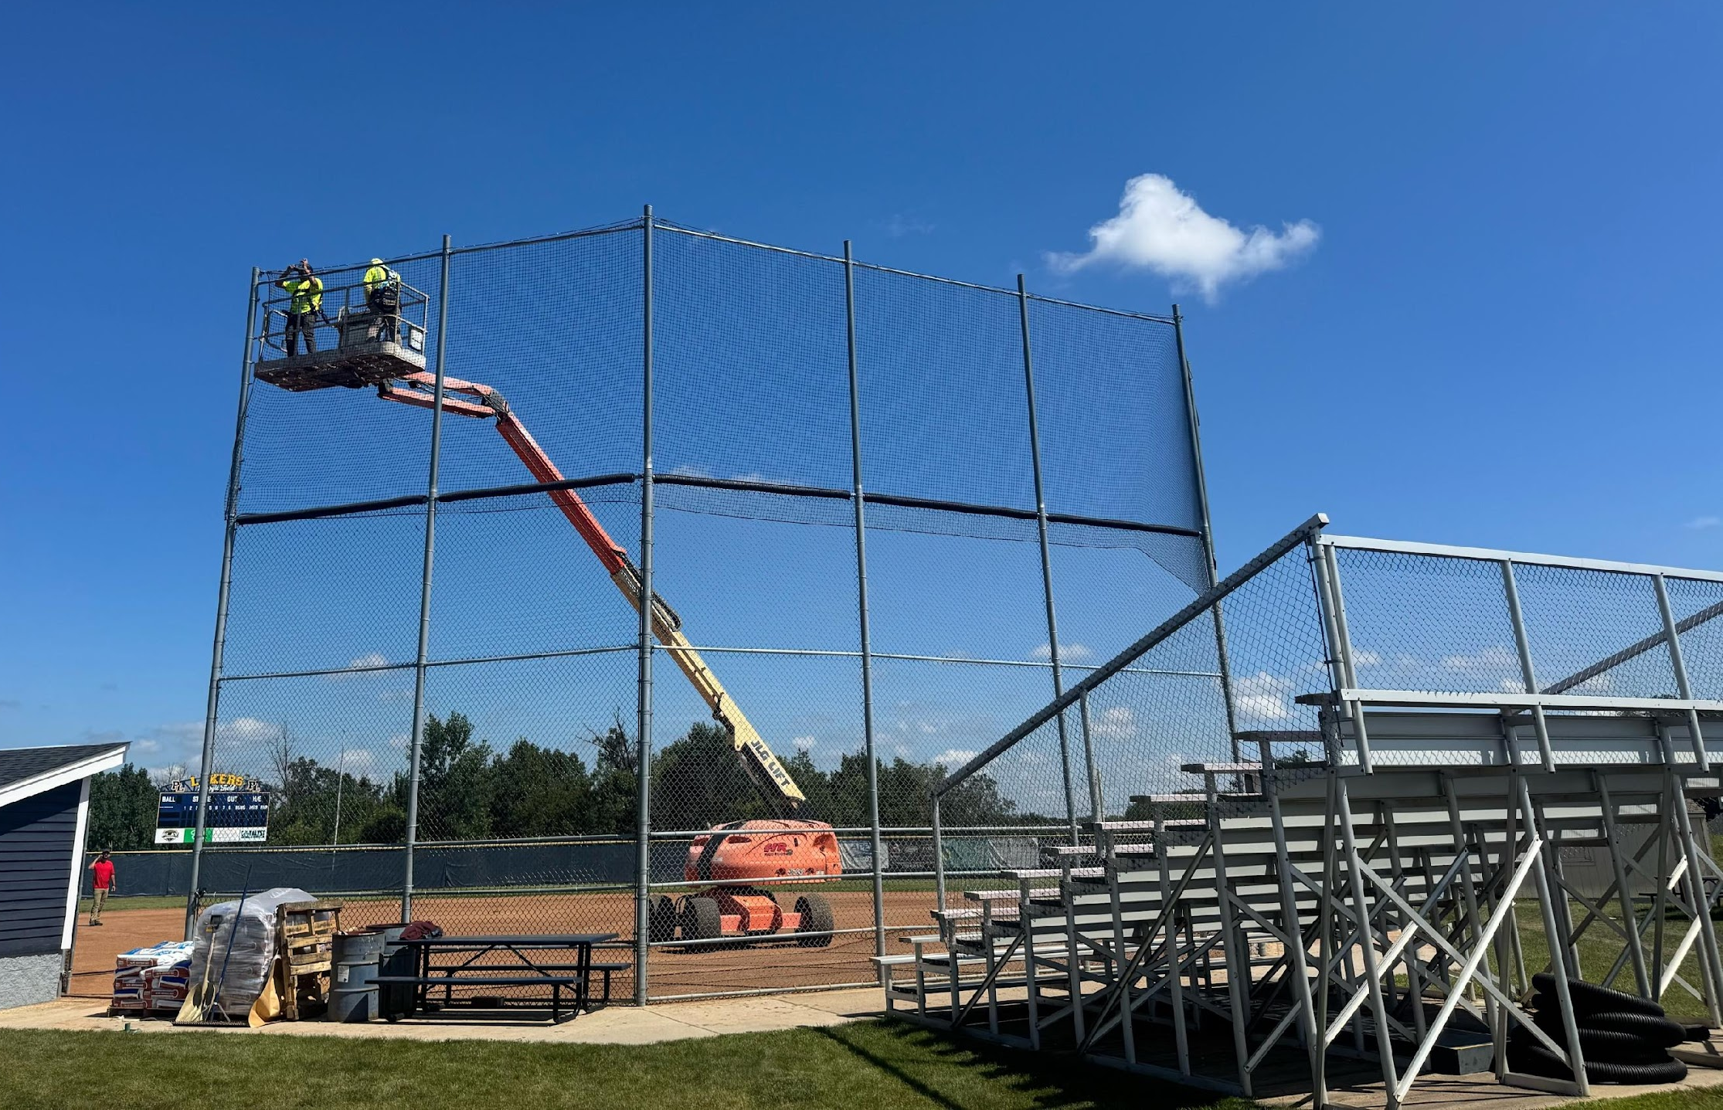
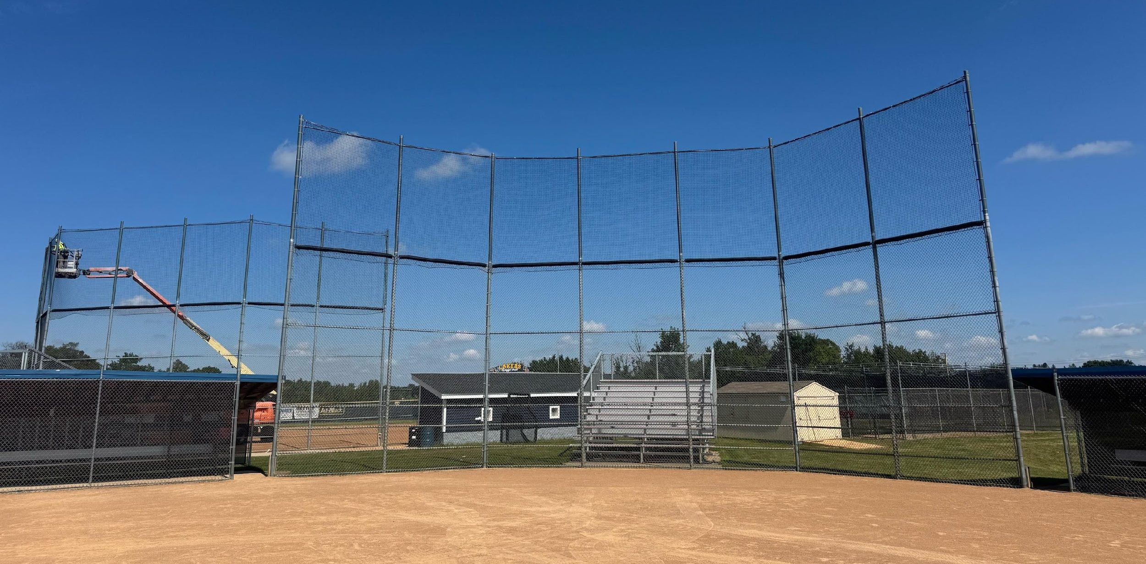
FIELD IMPROVEMENTS
Windscreen Upgrade
  Full replacements on JV & Varsity fields

Slide 26
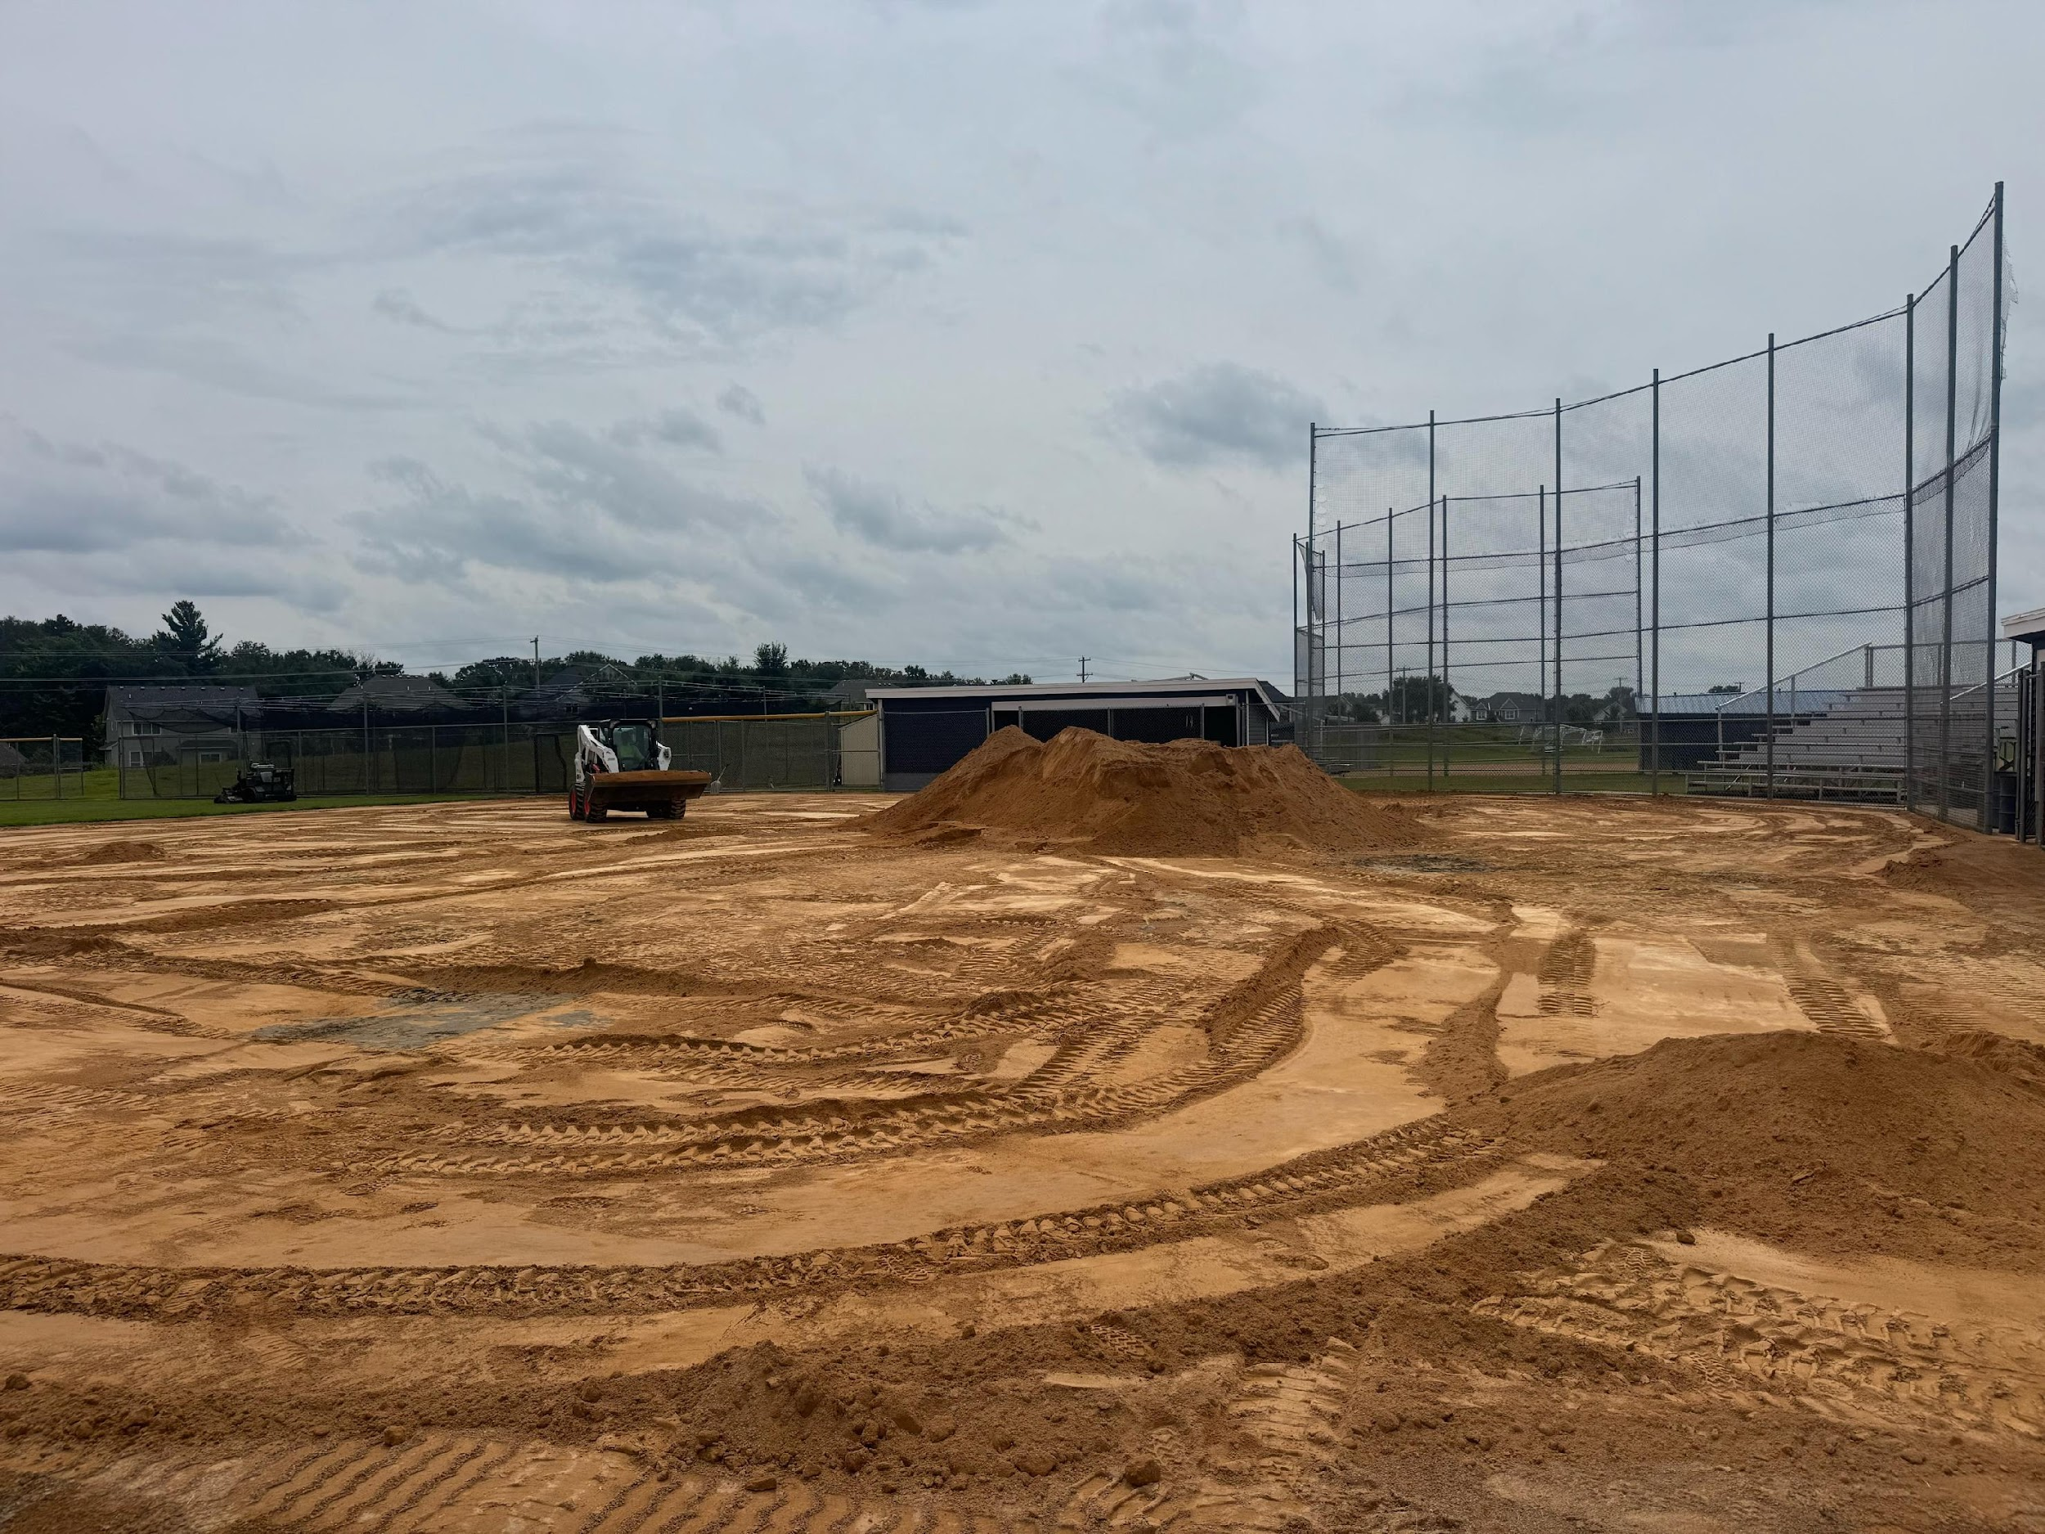
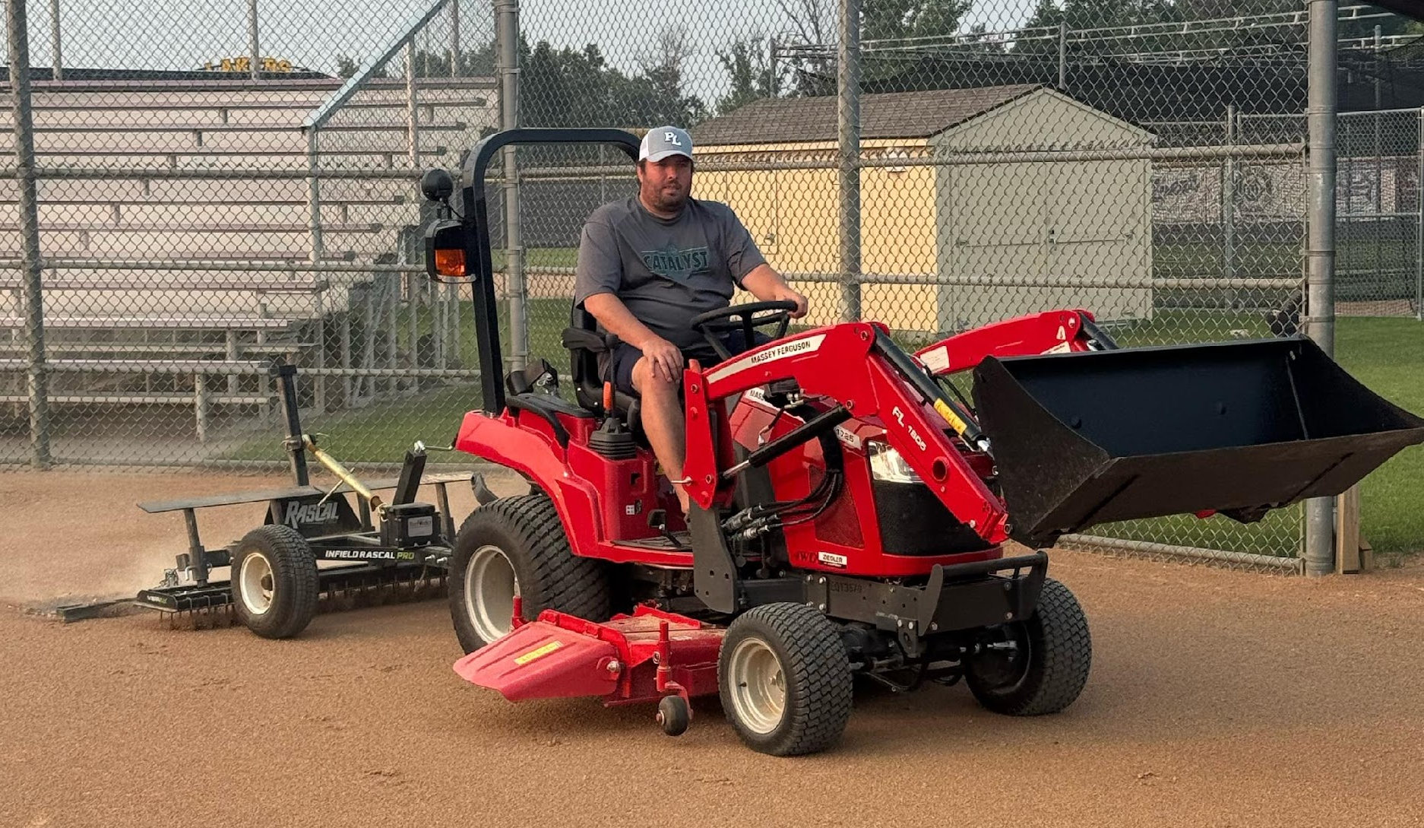
FIELD IMPROVEMENTS
Complete infield reset
  JV & Varsity dirt
  New Tractor & Drag

Slide 27
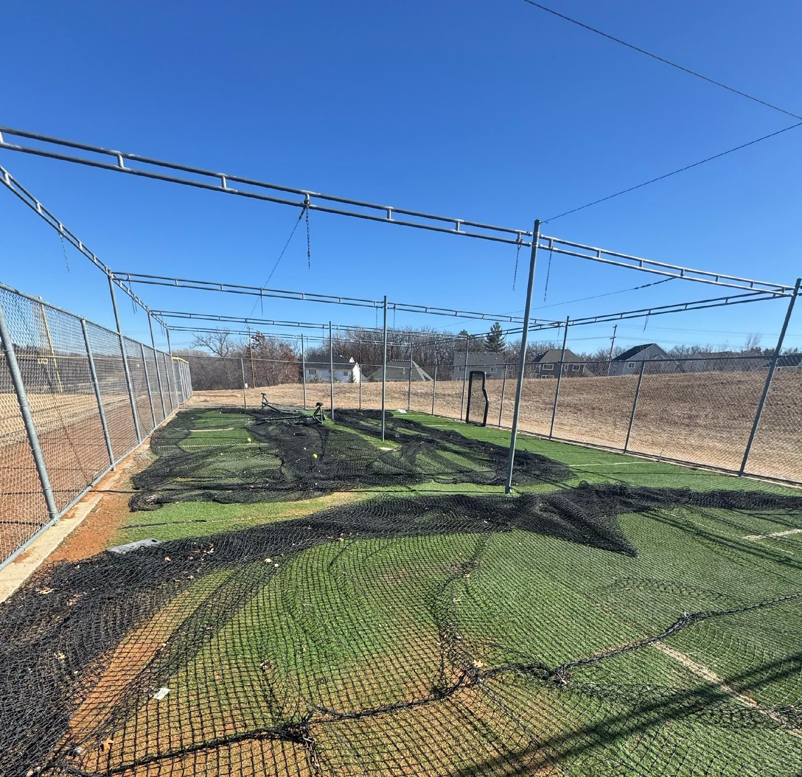
OUR FUTURE GOALS & PLANS
New Batting cages/bullpen ($60K+)
Field Lights ($200K)
New Softball Equipment
Additional coaches

Slide 28




SCOREBOARD SPONSORS

Slide 29

FENCE SIGN SPONSORSHIPS
We are looking for additional sign sponsors
  Do you own a business?
  Do you know a local business owner?
  Does your company do sponsorships?
All donations are tax deductible
  LABC is a 501c3

Slide 30











FENCE SIGN SPONSORS
The Barkleys /

Slide 31
FUNDRAISING GOAL:
$300,000
Current Financial Standing
Basketball Tournament: estimated $10,000-$12,000
Score Board Sponsors: $24,000 over 3 year
Fence Signs: $11,000 Currently (max would be $45,000)
BBQ & Brews Event: TBD

Slide 32

BBQ & BREWS
Mandatory for returners to our PLHS softball program – highly encouraged for newcomers!
  Date: Sunday, 2/22
  Time: 12:00 PM – 4:00 PM
  Location: Savage Tap
  Players are required to purchase and sell 10 tickets to the event
  Ticket Cost: $15
Silent Auction, Meet the Lakers, and specialty brew crafted just for PLHS Softball!

Slide 33
FINAL THOUGHTS
PLEASE REVIEW OUR 2026 PL SOFTBALL HANDBOOK – UPDATED ONE WILL BE LOCATED ON OUR WEBSITE FOR IN DEPTH INFORMATION ON OUR PROGRAM NEXT WEEK.
Please email softball.plhs@gmail.com with any questions.
Volunteering for the basketball tournament is mandatory for your player and one parent!
BBQ & Brews ticket sales are mandatory for returning players – 10 tickets must be purchased at $15.
PLEASE REGISTER IN FEBRUARY! It is so important for us to know what numbers we are looking at so we can best determine our tryout planning and team planning.

Slide 34

WELCOME

