Slide 1

2025 FALL-WYSA ALL REFEREE MEETING
Assigning via Arbiter – Introducing John O’Kane
WYSA Referee Fee - increased
Minors VS Majors-Review the modification for each age group
LOTG Changes – How does this effect WYSA?
Flag mechanics
Whistle etiquette
Pregame
Suiting up for Success
Handling Conflict – USSF increase consequences for referee abuse – Introducing Scott Hevel, WYSA V. P. A&D
Game Day Procedures
Match/Game Sheet Example
Field conditions/Field Marshalls
Lightning Delay
Referee Mentors
WYSA Referee Contacts

Slide 2
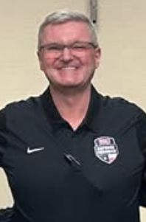
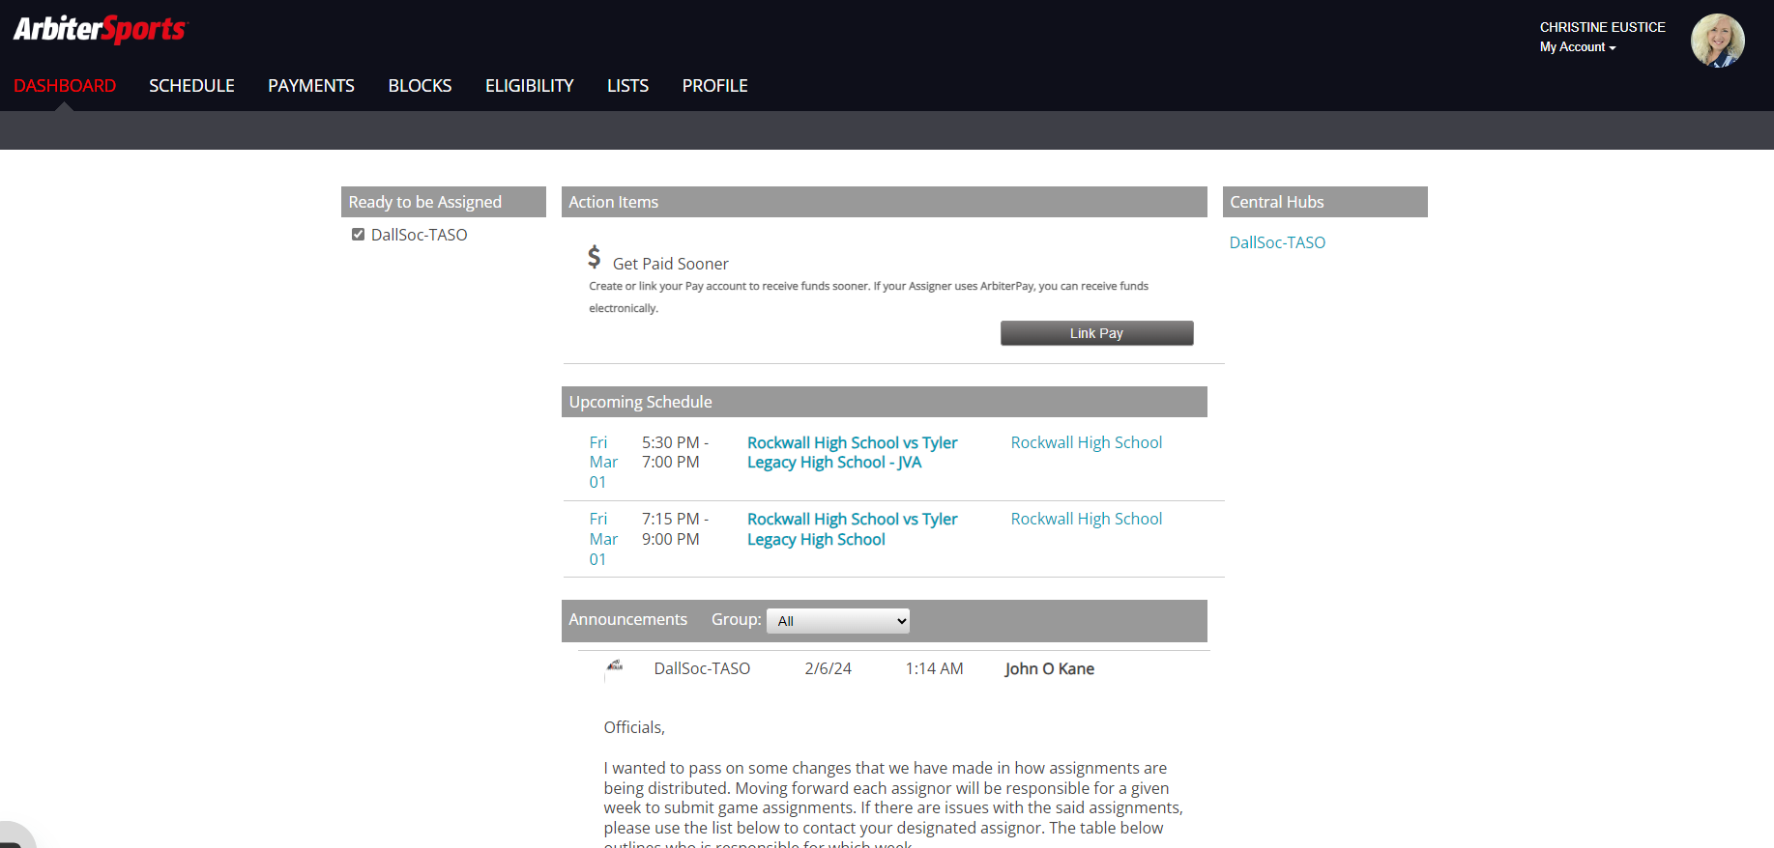
Assigning Via Arbiter and Arbiter payment
New WYSA Assignor: John O’Kane
Wylie Youth Soccer: Recreational Youth League: Assigning now
Use this line to send in availability status: https://forms.gle/UnbAckKx1T2RJ6oY6https://forms.gle/UnbAckKx1T2RJ6oY6
Arbiterpay Tutorial Links: How to set up an arbiterpay account:
https://www.youtube.com/watch?v=9cm3uRNCSuU

Slide 3
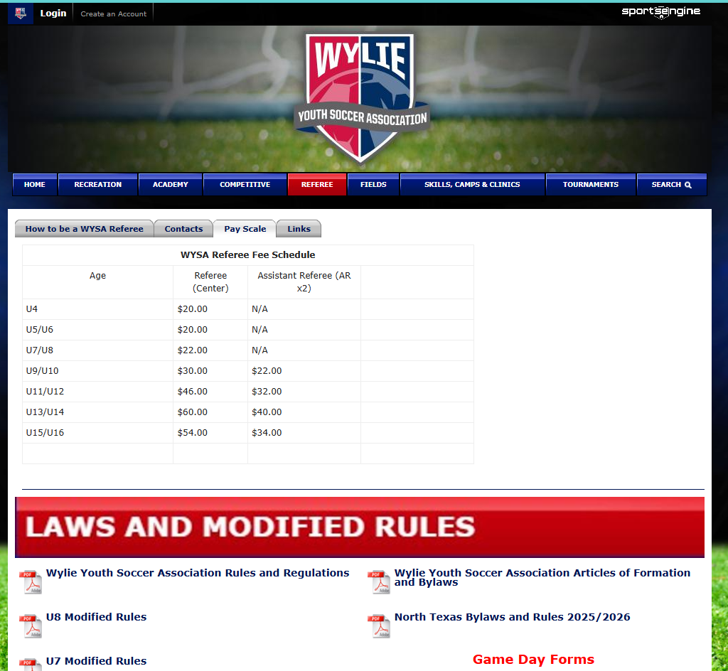
WYSA Referee Fees Increase – beginning during start of regular season
Referee pay scale can be found on WYSA website at:
Referee Information
Edit in process for U15/U16

Slide 4
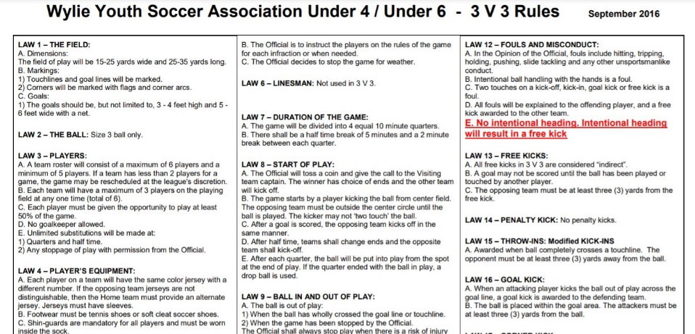
Minors VS Majors
Visit: www.wyliesoccer.com
Review the law modifications for the game (U4 and up) you’ll be officiating
Modified rules are located on the WYSA website under Referee Tab → Links Tab

Slide 5
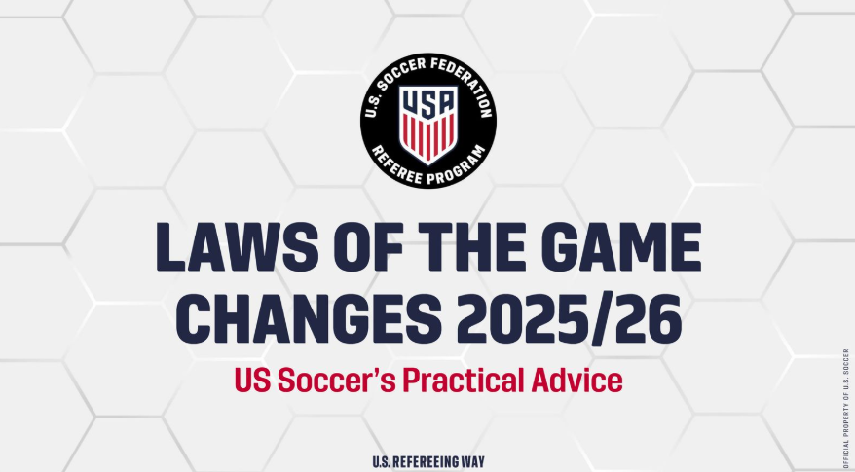
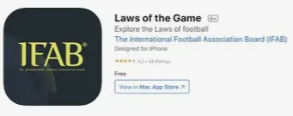
2025/26 Laws of the Game Changes
U.S. Soccer video for 2025/26 changes:
Laws of the Game Changes - 2025/26 | U.S. Soccer Official Website
2025/26 IFAB LOTG PDF:
laws-of-the-game-2025-26
Download the IFAB APP
Go to app store on your phone
Notes:
Be sure to verify this is the correct version

Slide 6
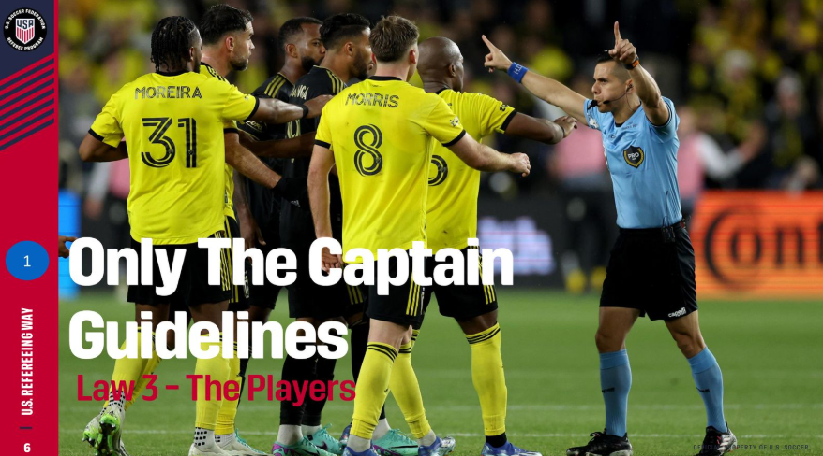
LOTG Changes – How do they effect WYSA
Law 3: The Players - Captain Interaction: Only one player from each team, usually the captain, is allowed to approach the referee.
For WYSA – does not apply.
Continue to help young players learn the game with communication when needed.
Keep constructive communication with rostered coached open.
Relay any communication with spectators through the coaches, unless there is an immediate safety issue (i.e.: potential heart attack, stroke, etc.)

Slide 7
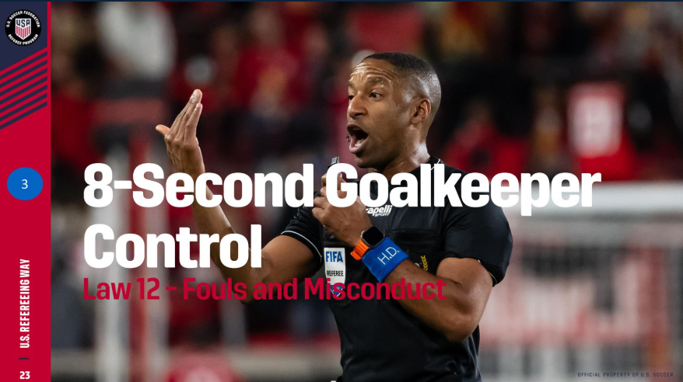
LOTG Changes – How do they effect WYSA
Law 5&12: The Referee & Fouls and Misconduct: Goalkeepers who control the ball with their hands/arm(s) for more than eight seconds the opposing team will be awarded a corner kick.
For WYSA – does apply for U9/U10 – communicate before the game what the LOTG changes are. Help prepare young players for the new rule. U11 and above, the rule applies.
Keep in mind U9/U10 Build Out Line and keeper possession.
See video from REFS NEED LOVE TOO:
Instagram
Notes:
Pull over

Slide 8
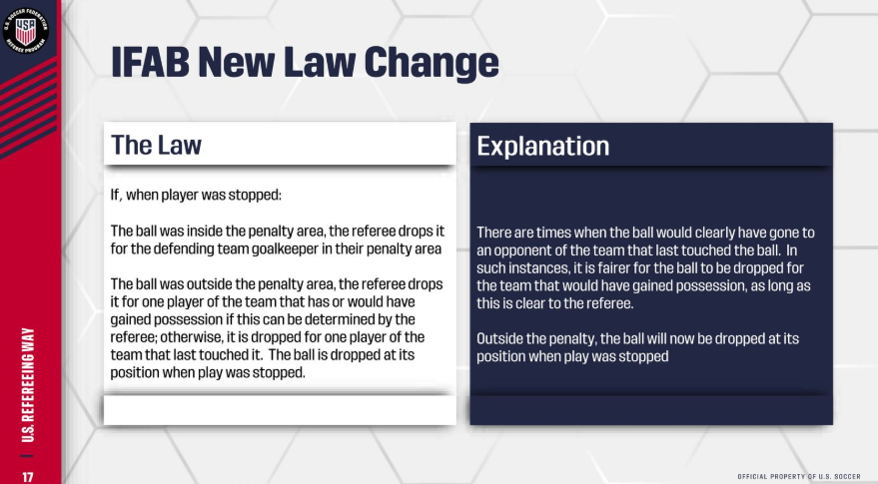
LOTG Changes – How do they effect WYSA
Law 8: The Start and Restart of Play - Dropped Ball
For WYSA: this will apply

Slide 9
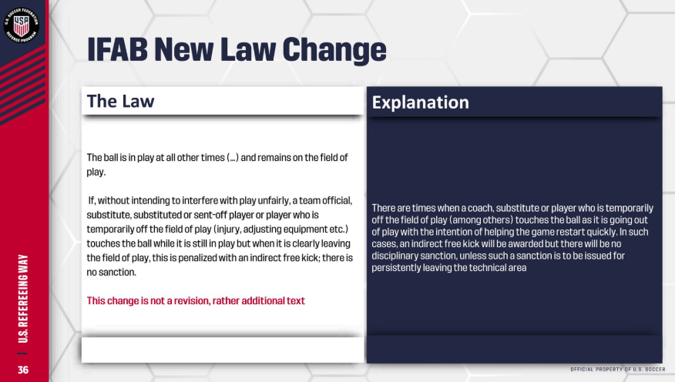
LOTG Changes – How do they effect WYSA
Law 9: The Ball in and out of Play – Ball In Play/Indirect Free Kick
For WYSA: This is just additional text you need to be aware of.

Slide 10
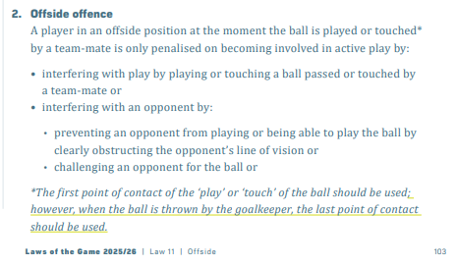
LOTG Changes – How do they effect WYSA
Law 11: Offside - Offside Position: When the goalkeeper throws the ball, the last point of contact should be used for determining an offside position.
For WYSA: This is just additional text you need to be aware of.

Slide 11
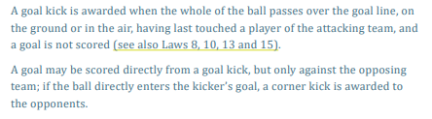
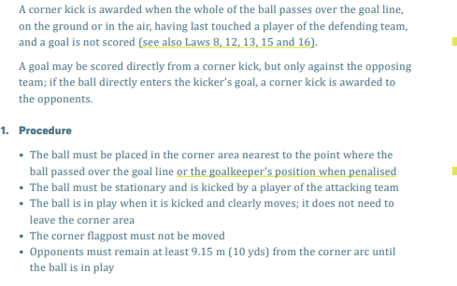
LOTG Changes – How do they effect WYSA
Law 16&17: The Goal Kick and Corner Kick
For WYSA: This is just additional text you need to be aware of.

Slide 12
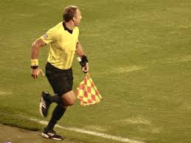
Flag Etiquette-AR (Assistant Referee)
Be sure your flag is always on the field side-center referee needs to see it
Keep your flag rolled up until game time. Unrolled flag signals to center referee you are ready to begin.
Keep your flag by your side unless you’re signaling to the center (no propelling your flag)
AR should be a few steps to the outside of the touch line to allow AR to see via peripheral vision the touch line (left and right). If you cannot see the touch line via peripheral vision while looking toward the second to the last defender, take a step back from the touch line until the touch line comes into your peripheral vision site.

Slide 13
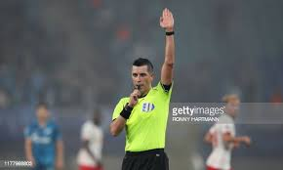
Whistle mechanics-C (Center Referee)
Only use your whistle to stop play or on certain restarts (name a few)
When not to use your whistle (name a few)
Be sure you practice with your whistle-be confident and consistent
Green whistles would be effective for referees under 18 to match the green referee badges. Helps to create a visual for coaches and spectators
Fox40 or any whistle that is loud and easy to use
Notes:
John O’Kane has them on order

Slide 14
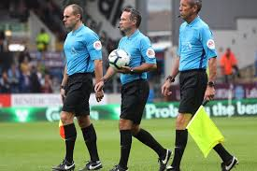
Pregame-Center and AR Team
Be at the field you are to officiate on at least 30 minutes prior to the start of the game
If you are the 1st referee at the field you are officiating on, be sure to get 4 corner flag from the back of the concession stands. If you are the last referee at the field you are officiating on, be sure to put the flags back.
Introductions
Go over responsibilities
Go over any modifications to the game (time, number of players, build out-line rules, offsides, etc.
Referee Team: look professional, after all this is your job.

Slide 15
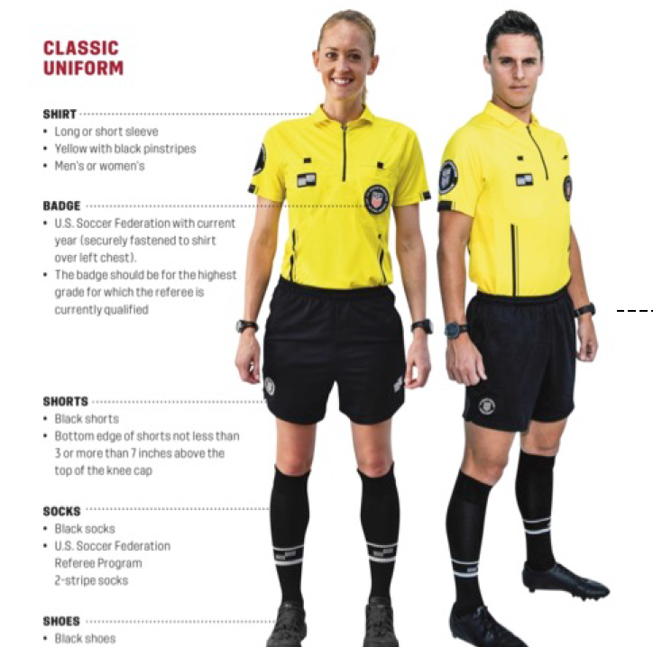
What to wear
Yellow is primary
Green is secondary
Make sure you’re wearing the correct uniform
Socks should have 2 stripes at the center (not at the top). NO SHORT BLACK SOCKS PLEASE
Have everything you need for each game (what do you need?)
Be sure to have your USSF badge on your uniform (for 2026: black for adults, green for minors)
Look professional

Slide 16
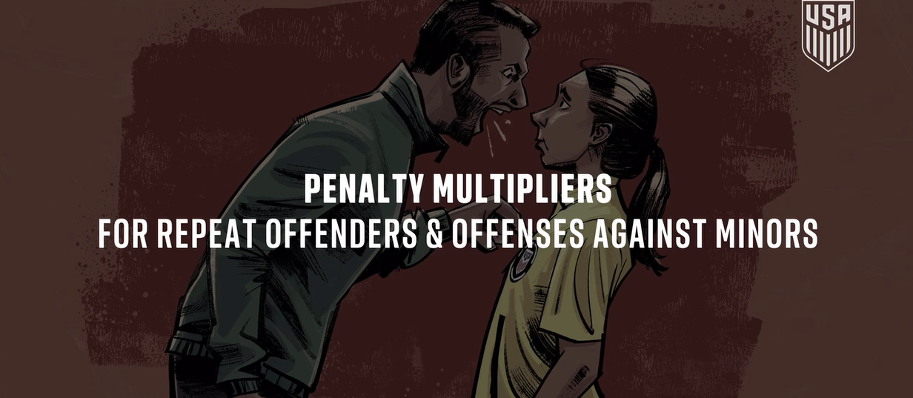

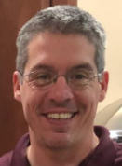
Handling conflict
Be confident when making calls
Be sure to introduce yourself to coach before the game
Be polite and courteous, even if the coaches are not
Use field marshals/WYSA board members
US Soccer have increased penalties for referee abuse
USSF minor referees will wear a green badge
Scott Hevel
WYSA VP A&D

Slide 17
Game Day Procedures
Referee(s) first up at the field must put the corner flags out. Last referee at the field at the end of the day must put the corner flags up. Corner flags are located behind the conssession stand.
U4 –U19 Game Reports – Gotsport roster
Coaches from each team MUST give a hard copy with players and numbers to referee before game. Players may not be penciled in. Coaches must be on the roster. If they are not, they need to be on the spectator side of the field.
Check in players to be sure they are on the roster. If the players are not on the roster, the player is not sactioned to play.
Be sure all players have a jersey number, no jewlery-no expections, shoes are either soccer cleats or tennis shoes-no front cleat.
Check with coaches regarding players with medical conditions.
When game is over complete the game reports, including having BOTH coaches sign BOTH game reports and place in game report box behind concession stand before leaving Founders (NEW: for all games, record score on game reports).
If you are center referee, be sure to enter game scores in ARBITER. This will be for ALL games and this is how WYSA will know you officiated the game. Please be sure to note any changes for the referee team as pay is different for a center vs. an AR. John O’Kane will not validate your game until you have sent in a report. This is the way you will get paid.
Any misconducts including yellow or red cards need to be marked on the game report AND entered on ARBITER.
All coaches and assistant coaches must have a visible badge and be listed on the Gotsport roster. No exceptions!

Slide 18
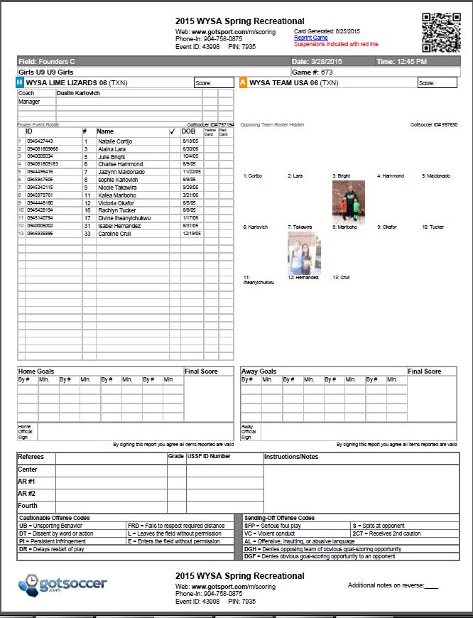

Slide 19
FIELD, FLAGS AND FIELD MARSHALS, OH MY!!
Field inspection –
Before each game, be sure to check field conditions
Check goals to be sure the goals are anchored-contact a board member if the goals are not anchored (usually in a maroon polo shirt)
Corner Flags –
First referee at each field will pick up 4 corner flags for the field.
Last referee at each field will put the 4 corner flags for the field back.
Corner flags are behind the concession stands
Field Marshals -
Home coach is responsible for providing a field marshal/responsible/reasonable parent for each game
Field Marshals are one of the tools you can use during the game
Field Marshals will get a board member is needed (usually in a maroon polo shirt)

Slide 20
LIGHTNING DELAY, Team/Referee no show
Lightning Detector –
If the lightning detector by the volleyball court light flashes, go seek shelter immediately-car is the best choice, but if you do not have a car go to the concession stand.
Board member on duty would make the call for restart or cancelations.
Keep information in Arbiter – John will update in Arbiter for any delays or cancelations.
Team forfeit/Team no show –
For pay for no-show team - Fill out information in Arbiter. Do not put score in. Enter in as notes (click on big RED R – stands for results) and indicate a no show for the team.
Collect the roster of the team that did show up. Fill out roster with no score and a note across the no show team – NO SHOW and turn into forms box at the back of the concession stands.
Follow up with an email to wysa.ref@wyliesoccer.com
Referee Director will review and WYSA will proceed with payment.
Referee no show –
In Arbiter under notes, you can indicate a no show in drop box.
If a sub referee is added to the match – Call John O’Kane to let him know about the change.
Any additional issues -
CONTACT THE BOARD MEMBER ON DUTY!!!! There is usually someone at the concession stand.
You are not alone!!!

Slide 21
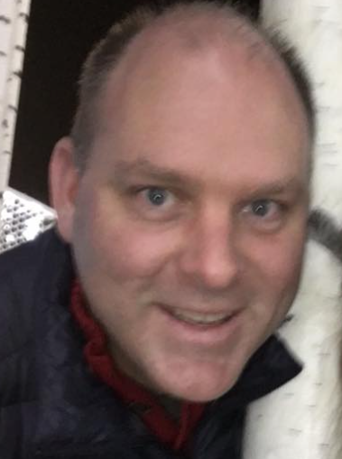
Referee Mentors
Referee Mentors will be walking Founders and evaluating referees while they are officiating.
These individuals are here to help you improve your referee mechanics and are a valuable resource for you if you have any questions or issues.
Jason Coker
Mike Emmert
Jeff Murray
Bryan Turquette
Todd Wheeldon

Slide 22
IMPORTANT CONTACTS
Please do not give coaches or spectators cell phone numbers for fellow referees, referee mentors, assignors or referee directors.
Thanks so much for your time and see you on the pitch!
Contacts:
Christine Eustice
John O’Kane
Referee Director
Referee Assignor
972
-
841
-
9388
469
-
688
-
0434
wylie.ref@wyliesoccer.com
okanesassigning@gmail.com

