Slide 1
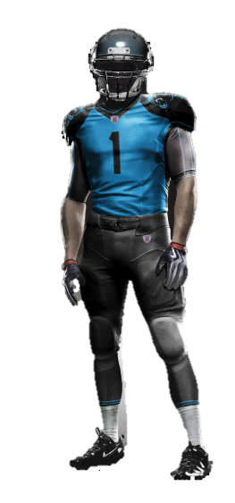

Mandatory to Play
Optional Player Choice
Helmet WITH Chinstrap
Visor
Breathe through mouth piece
Mouth Piece
Armored Chin Strap
Equipment listed in BLACK is mandatory for players to have for tackle football. Brand, quality, type is left to player and parents.
Shoulder Pads
Equipment listed in BLUE is optional for players.
Practice Jersey
(Color optional)
Back plate for shoulder pads
Football Gloves
Practice Pants
(Color optional)
Cleats

