Slide 1

Boys Traveling Tryout Plan
2025/2026 season

Slide 2

Tryout Schedule PW & Bant
Goalies – Monday, Sept. 29, 2025
Thaler (60 min., 2 sessions)
Day 1 – Tuesday, Sept. 30, 2025
Skills (PW 95 min. session, BA 100 min. session)
Day 2 – Thursday, October 2, 2025
3 on 3 Cross Ice (PW 95 min. session, BA 100 min. session)
Day 3 – Saturday, October 4, 2025
Outside Scrimmage vs. Waconia
Bantam Group 1 vs. Waconia Bantam A
Bantam Group 2 vs. Waconia Bantam B2
Peewee Group 1 vs. Waconia Peewee B1
Peewee Group 2 vs. Waconia Peewee B2
Day 4 – Sunday, October 5, 2025
Inside Scrimmage (drop outliers, high & low)

Slide 3
Tryout Schedule Squirts
Goalies – Monday, October 6, 2025
Thaler (60 min. session)
Day 1 – Tuesday, October 7, 2025
Skills (2 sessions)
Squirts A-K and L-Z Groups
Day 2 – Thursday, October 9, 2025
3 on 3 (Squirts Cross Ice) (2 sessions)
Day 3 – Saturday, October 11, 2025
Outside Scrimmage Versus Waconia
Squirt Group 1 vs. Waconia Squirt A/B1
Squirt Group 2 vs. Waconia Squirt B1/B2
Squirt Group 3 vs. Waconia Squirt B2/C
Day 4 – Sunday, October 12, 2025
Inside Scrimmage (drop outliers, high & low)

Slide 4
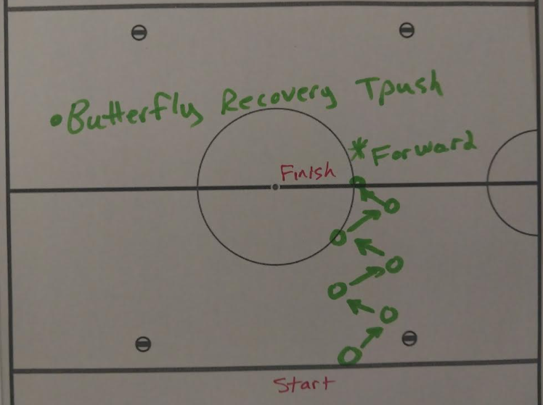
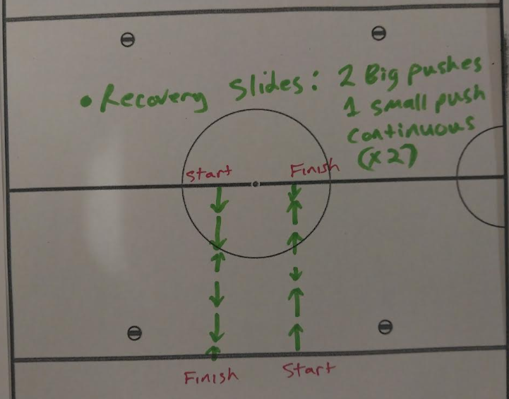
Goalie Skills 1-2
60 mins. sessions for BA / PW / SQ
Skill 1 - Recovery Tpush Forward/ Backward Skating
The Goaltender will start on the blueline and start the skating pattern with a butterfly followed by a recovery T-push moving forward. They will continue this movement in a zig zag pattern until they reach the redline. Once every goalie has gone, they will repeat the drill again but moving backwards in the opposite direction.
Skill 2 – Recovery Slides
The goaltender will start on their knees on the blueline facing the bleachers. They will stay down during the drill, performing recovery slides and repeating the pattern of two long slides in a row (to their right) followed by a shorter slide in the opposite direction (to their left) until they reach the redline. Once each goalie has gone through, they will repeat the drill going back in the opposite direction.

Slide 5
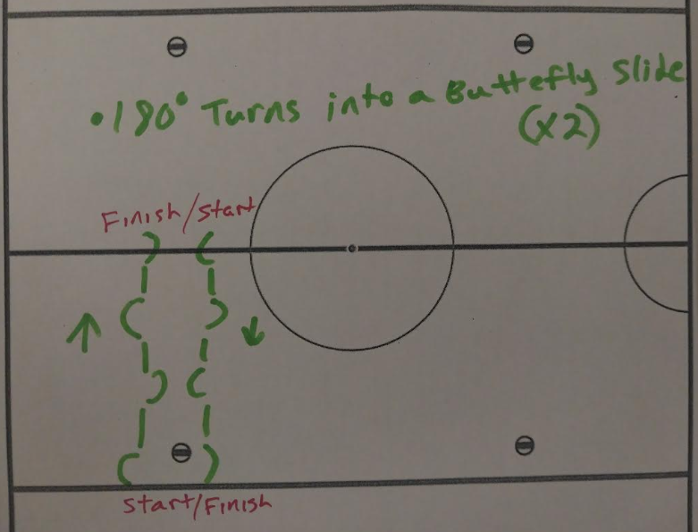
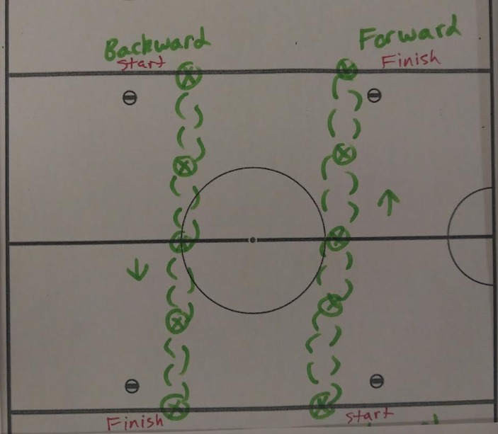
Goalie Skills 3-4
60 mins. sessions for BA / PW / SQ
Skill 3 – 180 Spin Butterfly Slide Skating
The Goaltender will start on the blue line facing the bleachers. They will start the drill by performing a butterfly slide (starting on their feet, sliding down onto their knees and recovering back up to their stance) followed by a complete turn (180 degrees) facing the other side. They will repeat this pattern continuously until they reach the redline. Once every goalie has gone, they will repeat the drill back in the other direction from the red line to the blue line.
Skill 4 – C-Cuts w/ Butterfly FB Skating
Goaltenders will start on the blue line facing up ice. They will start the skating drill by butterflying and recovering back up to their feet. They will then perform forward C-Cuts in their stance down to the opposite blue line while butterflying and recovering to their feet on each blue line, center redline, AND in between each line in the neutral zone. Once each goalie has gone, they will repeat the drill while skating backwards.
*Squirt adjustment: A butterfly will only be performed on the 2 blue lines and center red line

Slide 6
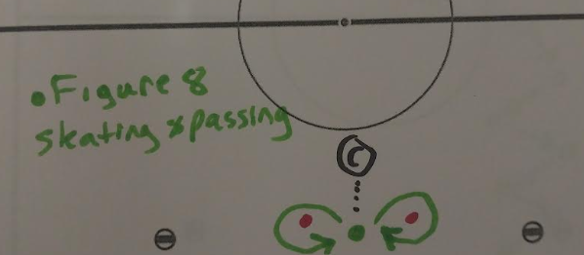
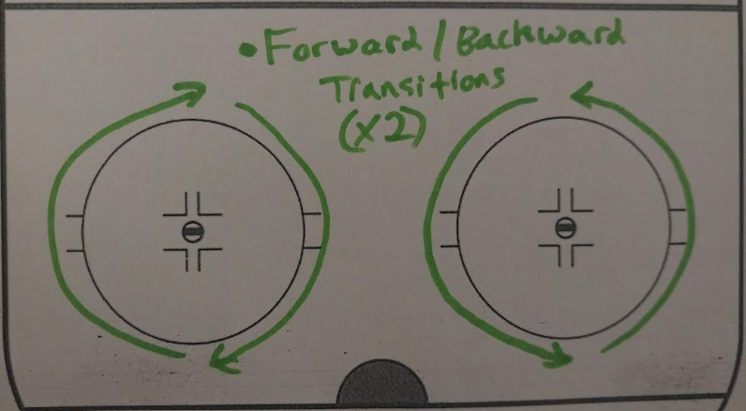
Goalie Skills 5-6
60 mins. sessions for BA / PW / SQ
Skill 5 – Figure-8 Passing & Skating
The goaltender will receive and make passes to a coach and skate with a puck around 2 cones in a figure 8 pattern (transitioning between forward and backward, keeping their chest up ice towards the coach).
The goalie will start between 2 cones in a "Passing" position (2 hands on their stick). A coach will have the puck and start the drill by passing to the goaltender. When the goaltender receives the pass, they will skate with the puck to their right around the cone. Once they get back between the cones they will then stop and pass the puck to the coach. Once the coach receives the pass, they will pass the puck back to the goaltender who will then repeat the pattern to the cone on their left. They will continue to alternate skating around each cone for 3 total laps.
*Squirt adjustment: Once the coach passes the puck to the goaltender, the goaltender will immediately pass the puck back to the coach. They will perform the same skating pattern around the cone, but without carrying the puck.
Skill 6 – Crossover FB Transitional Skating
Starting at the bottom of the circle on the goal line, goalies will perform forward crossovers around the outside of the circle and transition to backwards skating at the top of the circle and continue this pattern for 2 full laps. Once every goalie has gone, they will repeat the skating drill in the other direction.

Slide 7
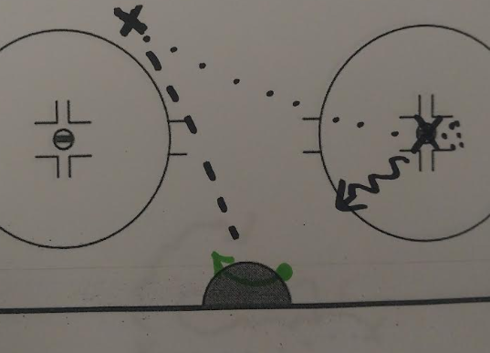
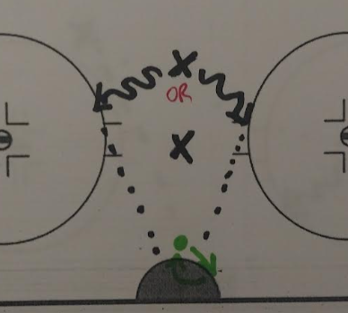
Goalie Skills 7-8
60 mins. sessions for BA / PW / SQ
Skill 7 – T-Push Shooting Drill
The goaltender will be in their butterfly, lined up on the face-off dot to their right, where the player passing will be located with the puck. They will then pass the puck across to the top of the opposite circle to the player that will be shooting. The player passing will then skate towards the net in case of any rebounds given up by the goaltender. When the puck is passed, the goaltender will then try to recover across, up to their feet in position for the shot, with a recovery T-push. After 5 repetitions, the goaltenders will switch. When every goalie has gone, the drill will then be repeated on the other side, with the shooters switching passing/ shooting positions.
Skill 8 – High Cut Across Shooting
The goaltender will start on top of the crease. On the coach’s que, they will pivot and shuffle to the face off dot angle to their right and immediately T-push back to the top of the crease. The player shooting will start with the puck in the slot. Once the goalie has performed the movement, the shooter will go left OR right a few strides and shoot anywhere on net (shooting from inside the slot area). The 2nd skater is located between the goaltender and the 1st shooter acting as a screen and close to the net to play rebounds near the crease. The goaltender will alternate, shuffling to their right and left each rep. The drill will be done for a total of 8 reps/8 shots.
Sidenote: Have shooters switch spots after 4 reps

Slide 8
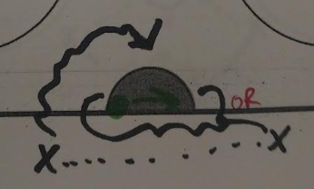
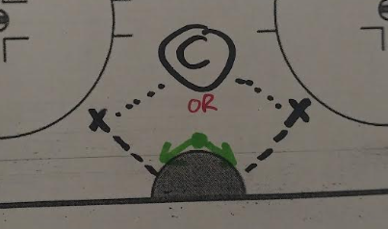
Goalie Skills 9-10
60 mins. sessions for BA / PW / SQ
Skill 9 – BTN Jam or Wrap
The player passing the puck will start with the puck to the goaltender’s left, behind the net, while the goaltender will start on their left post. The drill will start once the player passes across to their partner on the other side. After the pass, the player who passed the puck will then skate in front of the net in case of any rebounds. When the pass is made, the goaltender should then shuffle post-to-post to their right side. Once the 2nd player receives the pass, they then have the option to skate and wrap the puck around on the far side post or try to jam the puck and score on the near side post. After 5 repetitions, the goaltenders will switch. When every goalie has gone, the drill will then be repeated on the other side, with the shooters switching passing/ shooting positions.
Skill 10 – Backdoor Pass Shooting
The goaltender will start in their stance on top of the crease, lined up with the coach, who will be located inside the hash marks of the slot with the puck. The coach will then pass to either shooter, who will be located near the bottom corners of the circle (on the goaltender’s left and right). When the pass is made, the shooters will then try to get a shot off as quickly as possible. The goaltender will react to the pass with a butterfly slide and try to get in position for the backdoor play. If there is rebound, the shooter who shot the puck is allowed to play the rebound. After a total of 10 reps completed, the goaltenders will switch.

Slide 9
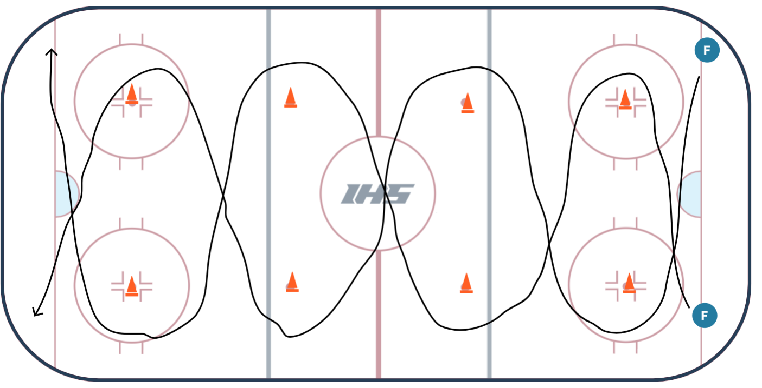
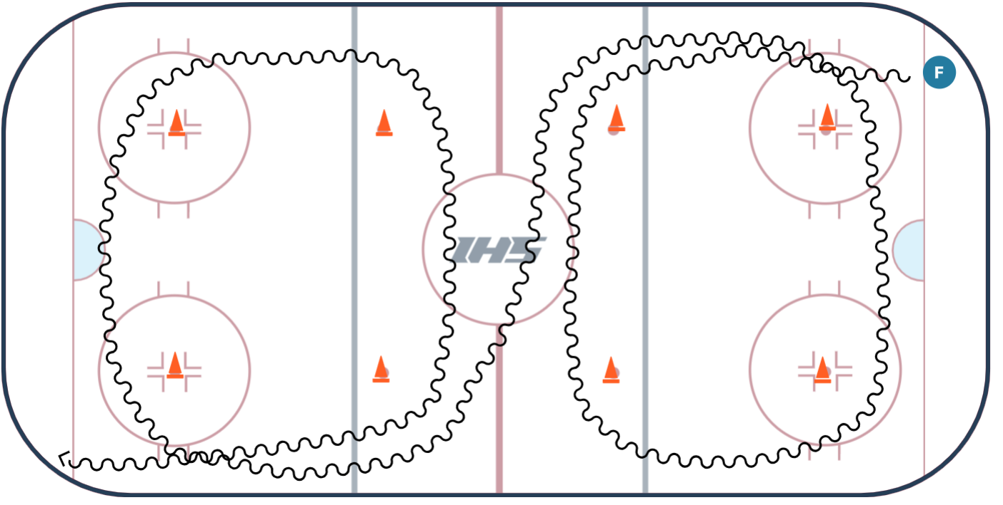
Tryout Skills – Day 1a
Power Turns – 1x
Stops & Starts – 1x
Transitions – 1x
Figure-8 Overspeed w/ pucks – 1x (2x if time)
BA/PW: 25 mins
SQ: 15 mins
Organize by Pinny #

Slide 10
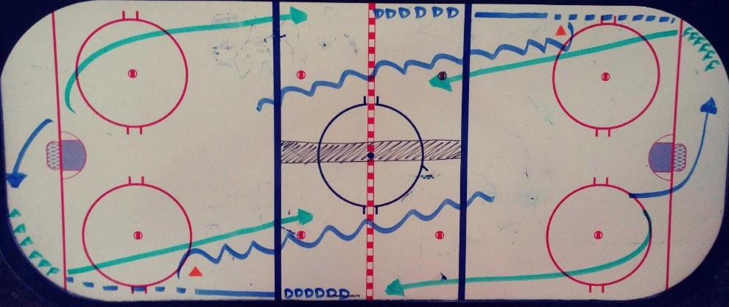
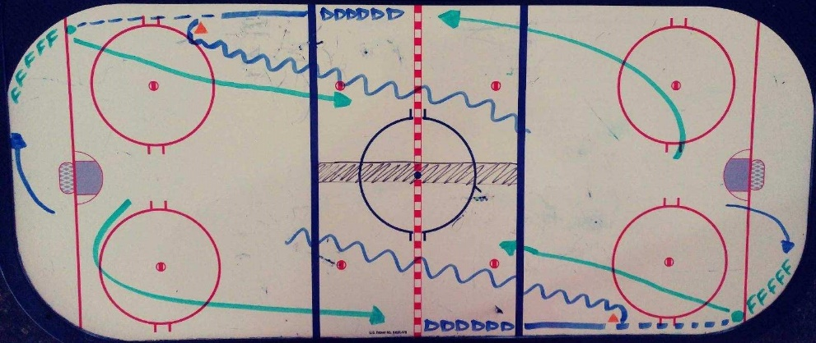
Tryout Skills – Day 1b
1 on 1 Full Ice
Defense Skates With Puck & Passes To Forward Waiting On Goal Line, Once D Gets To Cone, D Transitions Around Cone (After Pass) Towards The Center & Plays 1 On 1.
Player On Offensive Rush Rotates To D After Offensive Rush & D Rotates To Forward Each Time
BA / PW: 25 mins
SQ: 15 mins
Organize by Pinny #

Slide 11
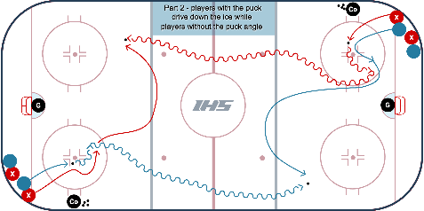

Tryout Skills – Day 1c
Circle Puck Protection to 1v1
On first whistle, 2 players from corner battle for the loose puck inside the face-off circle
On second whistle, the player with possession takes the puck down the ice, while the player w/o the puck gets up ice and looks to angle the other puck carrier coming down the ice
Puck carrier cannot cut to the middle of the ice until crossing center line
BA/PW: 25 mins.
SQ: 15 mins.
Organize by Pinny #

Slide 12
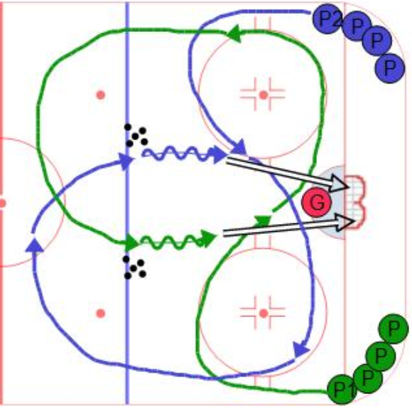
Tryout Skills – Day 1d
Criss-Cross Overspeed
The players will start in the corner and sprint up the boards and around the top of the face off circle, around the bottom of the other face off circle, up the boards and around the neutral zone face off dot, then pick up a puck near the blue line, then skate in for a shot on net. Try to get the players to shoot from about the top of the circles while keep their feet moving through the shot.
BA/PW: 25 mins.
SQ: 15 mins.
Organize by Pinny #

Slide 13
Tryout Schedule All Levels - Day 2
Day 2
Snake Draft To decide Teams
3 on 3 Cross-Ice
Horn Every Minute
PW 95 min
BA 100 min
SQ 60 mins (2x)

Slide 14
Tryout Schedule All Levels - Day 3
Day 3
Outside Scrimmage vs. Waconia (60 min.)
Bantam Group 1 vs. Waconia Bantam A/B1
Bantam Group 2 vs. Waconia Bantam B1/B2
Peewee Group 1 vs. Waconia Peewee A/B1
Peewee Group 2 vs. Waconia Peewee B1/B2
Squirt Group 1 vs Team Squirt A/B1
Squirt Group 2 vs Team Squirt B1/B2
Squirt Group 3 vs. Team Squirt B2/C

Slide 15
Tryout Schedule All Levels - Day 4
Day 4
Internal Scrimmage (60 min.)
Peewee
Bantam
Squirt Group 1
Squirt Group 2
Not all players will attend Day 4 of tryouts.

Slide 16
Session Weighting & Evaluators
Skater Sessions Weight %
Tuesday Skills 22%
Thursday 3v3 25%
Saturday External Scrimmage 28%
Sunday Internal Scrimmage 25%
Skaters: Charlie Hales, Alec Skar, Cooper Curti, Trent Bowe
Goalies: Derek Bishop, Nick Graves, Chris Esposito
Goalie Sessions Weight %
Sunday Goalie Skills at Thaler 28%
Tuesday Skater Skills 0%
Thursday 3v3 24%
Saturday External Scrimmages 24%
Sunday Internal Scrimmages 24%

