Slide 1

RECRUITING 101
Understanding the Recruiting Landscape
#DestinationHamilton

Slide 2
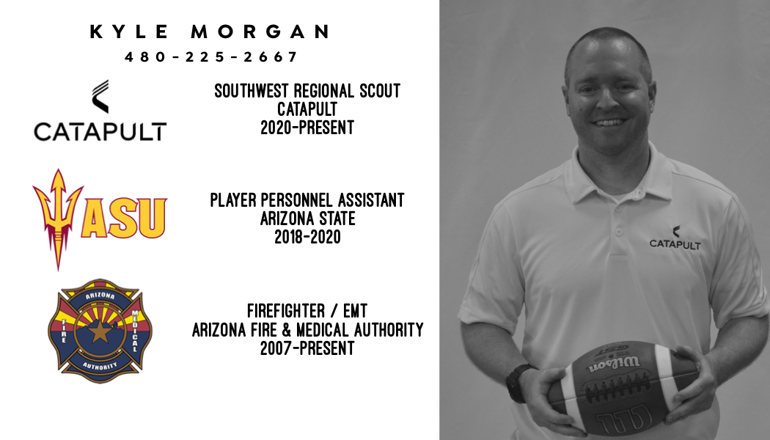

Slide 3
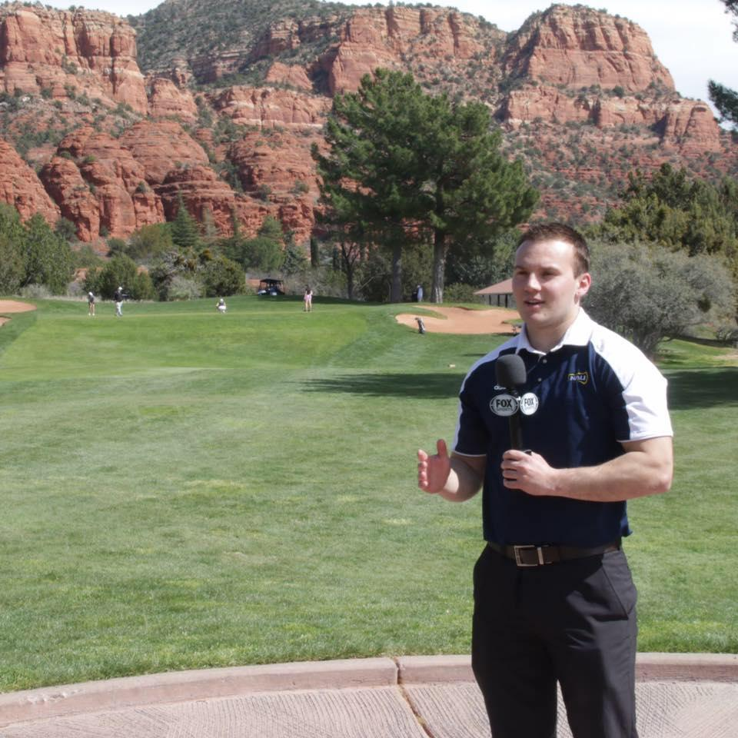
Cody Cameron
@codytcameron
NAU Football sideline TV reporter for Fox Sports Arizona 2015 -2016
Rivals Network Arizona recruiting analyst 2018 - present
Content on www.arizonastate.rivals.com www.ArizonaVarsity.rivals.com
American Youth camp coordinator

Slide 4
THE RECRUITING CALENDAR

Slide 5
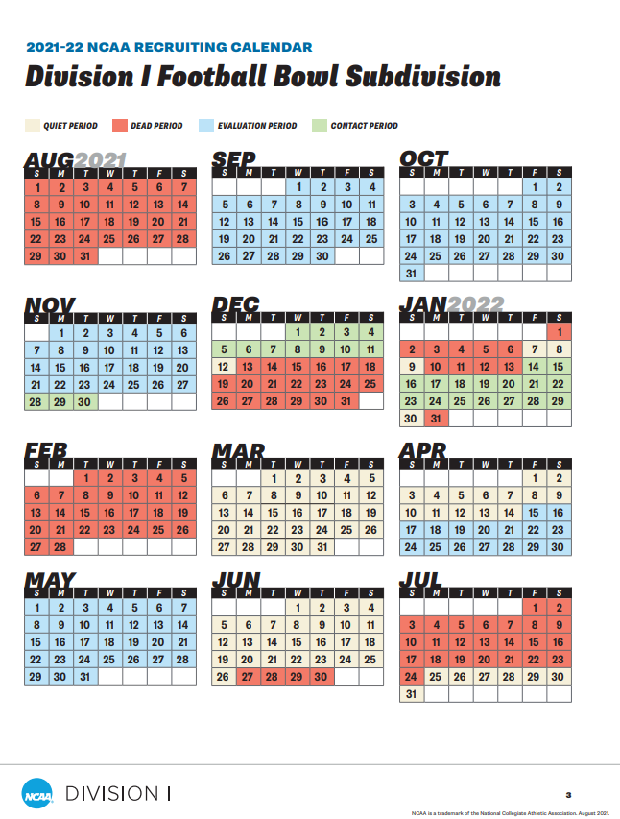
Evaluation Period
  Off-Campus/School Visits
  Limited days on road as staff
  “Bump Rule”
Contact Period
  In-person and off-campus contact
  “In-Home visits”, School visits/Games
  Early December and Late January
Quiet Period
  In-person contact only on-campus
  Camps, Passing Leagues, OV/UV
  CANNOT attend camps off campus
Dead Period
  No in-person contact on/off campus

Slide 6
Early Signing Period
  Dec 15 - 17 2021
National Signing Day
  Feb 2 - Apr 1 2022

Slide 7
SCHOLARSHIP NUMBERS:
UNDERSTANDING THE NUMBERS CRUNCH
Super Seniors
3-year correction
Smaller Signing Classes
Changes to Transfer Portal
  One-time transfer without penalty
  1400+ in portal since December 1st

Slide 8

OFFERS
2022 OFFERS
Arizona State (453)
Arizona (189)
Northern Arizona (76)
--------------------------
Stanford (85)
Rice (37)
Find out where you stand
Ask if offer is committable
Committable Offer
vs
Managed Offer
(Who Is Offering You?)

Slide 9
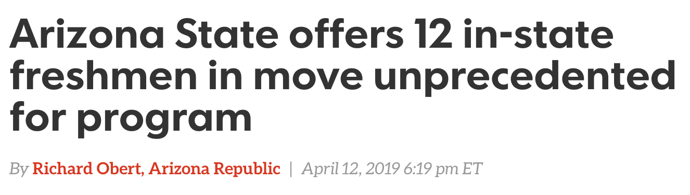

Slide 10
2022 Early Signing Class
Arizona State (453)
  7 signed early (2 JUCO)
  3 Transfers (Jan. 4th)
  0 In-state
Arizona (189)
  21 signed early (0 JUCO)
  4 Transfers (Jan. 4th)
  4 In-state
NAU (76)
  20 signed early
  6 In-state
High School vs JUCO vs Transfer Portal
Up to 32 (25+7) can be signed

Slide 11

FBS
85 Scholarships
  25 Limit/32 Total (7 transfers)
  Smaller Signing Classes
  Renewed Each Year
125 Roster Limit
  5 years to play 4
  Redshirt
    Practice, Can play in up to 4 games
  Grayshirt
    Delay enrollment to following semester
    Counts against future class
  Blueshirt
    Late in the cycle
    Initial Walk-on but placed on scholarship after 1 season
Football Bowl Subdivision

Slide 12


FCS
63 Scholarships
  Partial Scholarships
  85 max on athletic aid
110 Roster Limit
  Redshirt
  Grayshirt
  Blueshirt
Lumberjack Scholarship
Football Championship Subdivision

Slide 13

Division II/III
DII
  Partial Scholarships
  36 Scholarships
  85 Roster Limit
DIII
  Non-athletic aid
  Grant packages
  Larger Classes
  JV Teams

Slide 14
PWO
Non-Athletic Aid
Practice with Team
Play in games
Gear
High Character/Low Maintenance
Great Teammate
Team First
Special Teams Mentality
YOU WILL BE REWARDED IN TIME!!
Preferred Walk-On

Slide 15

Transfer Portal
One-time transfer rule
  Can play immediately
Roster needs
  Experience
  Depth
  “Free-Agency”
Desirable- Cannot Transfer Again Without Penalty

Slide 16
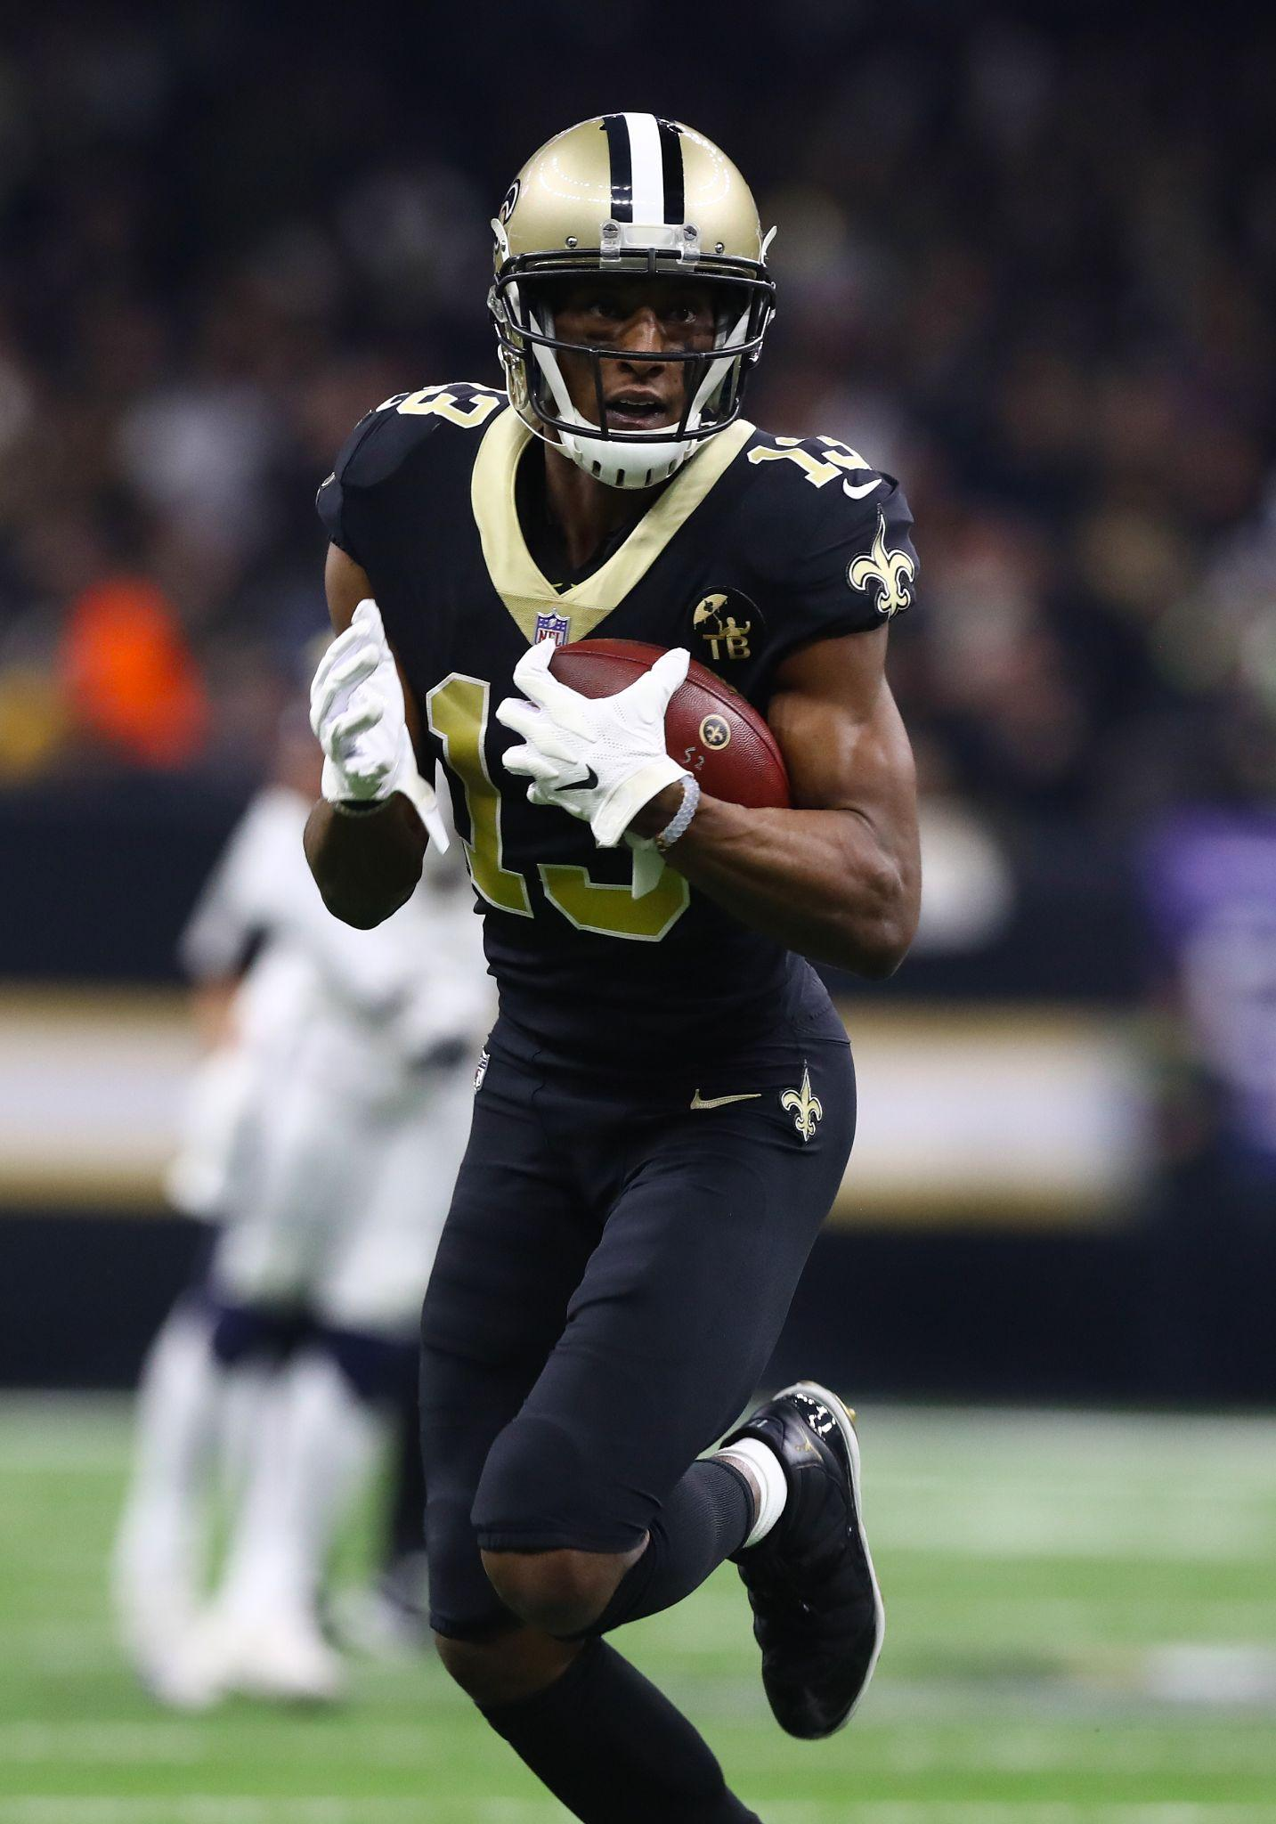
POST-GRAD “PG Year”
Few Reputable Programs:
  IMG Academy
  Palmetto Prep
  Myrtle Beach Prep
  Fork Union Military Academy
Full academic year of study/One-semester
  Improve academics/ACT or SAT Test Prep
  Partner with local Community College/University
  DO NOT start eligibility clock (Not Full-Time)
Allowed to attend College prospect camps
College programs visit PG programs to recruit

Slide 17
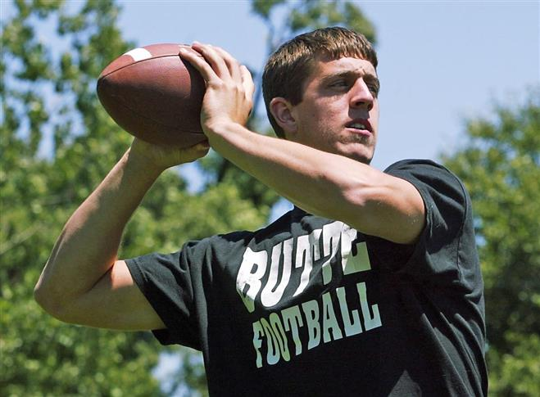
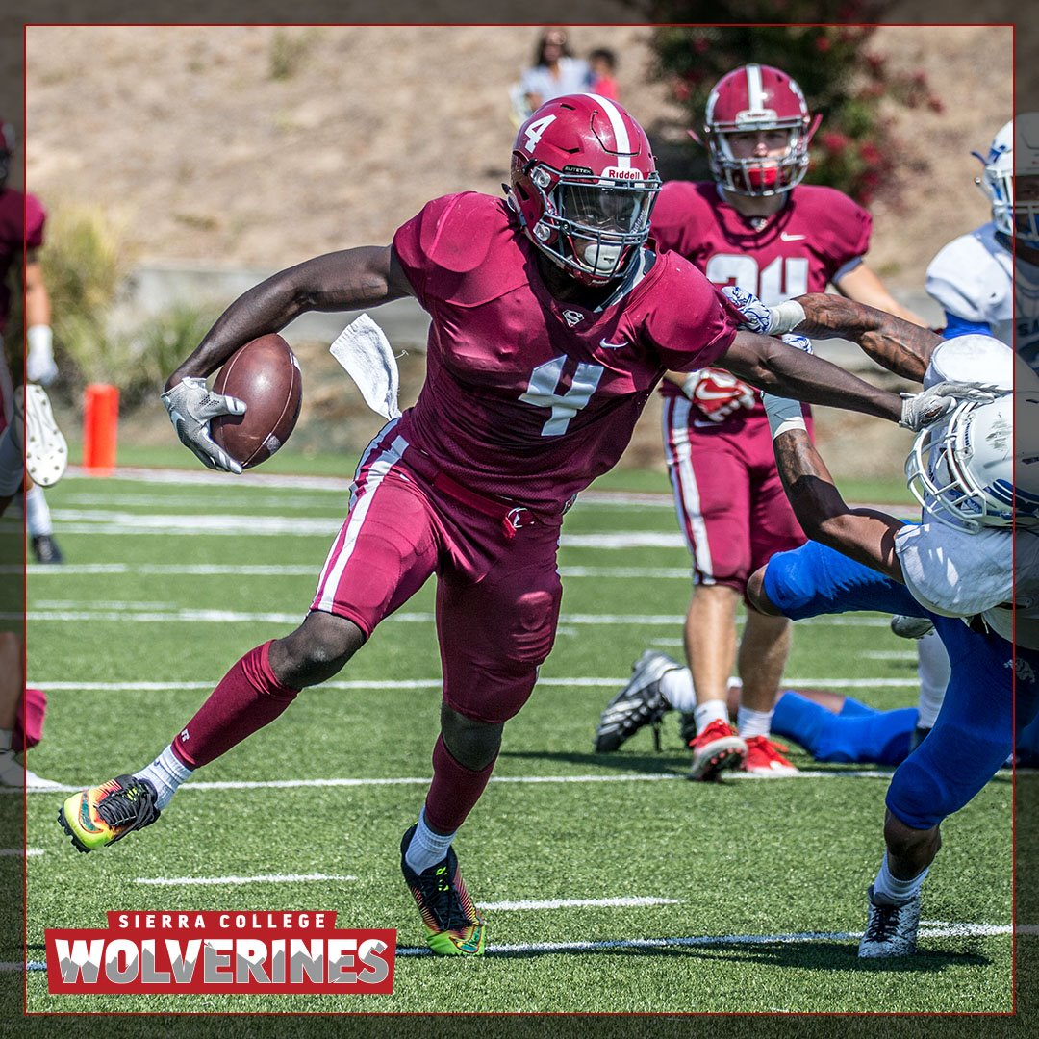
JUCO
More Established Programs than Post Grad:
  Iowa (ICCAC 4-team conference)
  Kansas (KJCCC 8-team conference)
  Mississippi (MACCC 15 teams)
ONE scholarship JUCO out West
  Snow College-Utah
Research!
  Placement to 4-year programs
College programs visit JUCO programs to recruit

Slide 18
“CHANCE FAVORS THE PREPARED MIND” -Louis Pasteur

Slide 19
HOW TO MAXIMIZE YOUR RECRUITING PROFILE

Slide 20

SCOUTING SERVICES
SCOUTING SERVICE
College Programs Pay For Data
Products Already In Facility
  Tracker
  Film
Attend Events
    In-Person Eval (not only gameplay)
  Practices
  Camps
  Showcases
  7v7
  Games

Slide 21
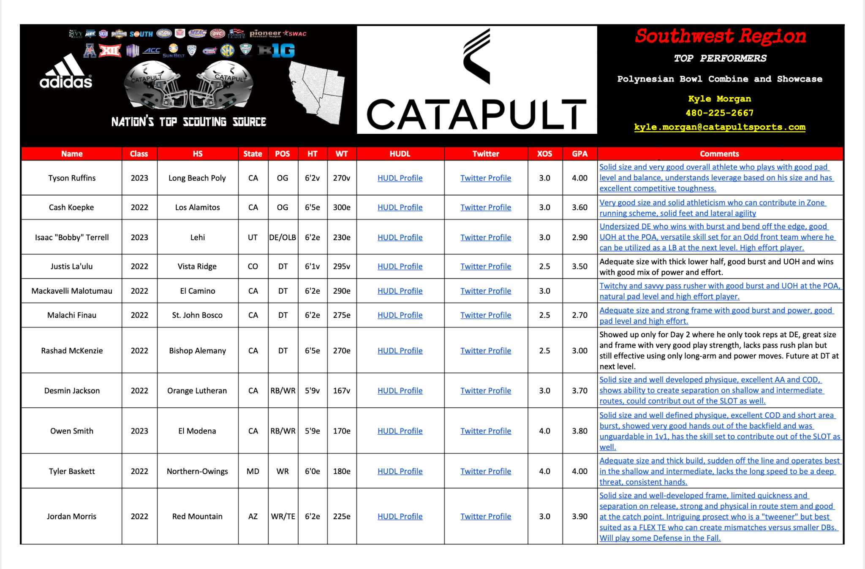

Slide 22
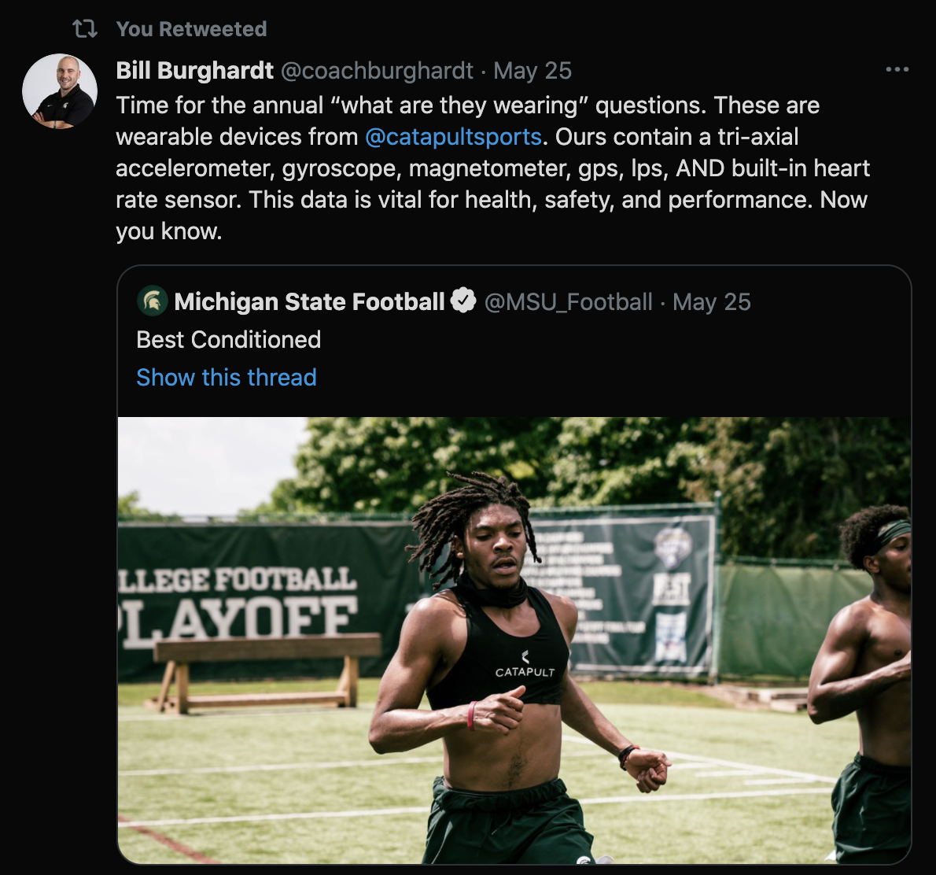
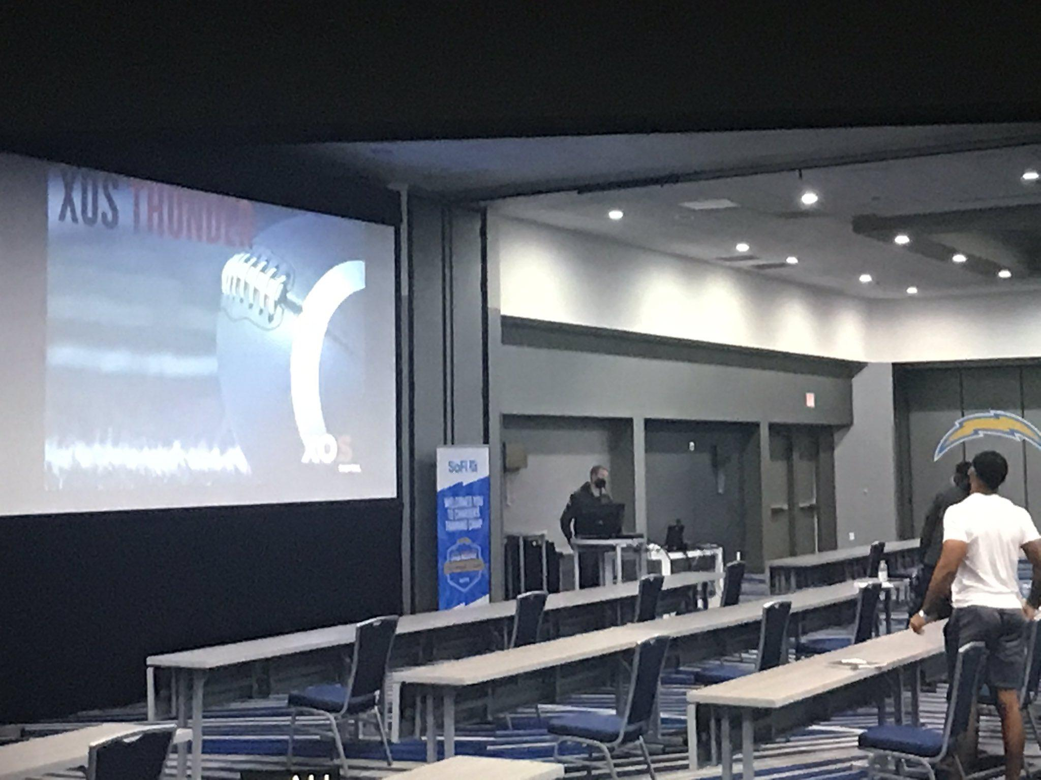
CATAPULT at Every Level Of Football
Michigan State Football
Los Angeles Chargers (Hard Knocks)

Slide 23

RECRUITING SERVICES
RECRUITING SERVICE
Kids/Families Pay for Profile
  Initial fee/monthly fee
Lack of Trust Within Program
  “Handler”/About Them
  Only push “their” guys
Level of Athlete
  DII/DIII/NAIA
    Lack funding
    Questionnaires
  DI/FCS
    Already evaluated

Slide 24

James Franklin
Head Coach
Penn State

Slide 25

TAKE CONTROL OF YOUR RECRUITING
Be Realistic
WHAT LEVEL BEST FITS YOUR SKILL SET?
  Target correct programs
Grades
  Start/Finish process
  Do NOT limit opportunity
EXPOSURE
  Camps
  7v7
  HS Coaching Staff
    Best Advocate
  Twitter

Slide 26

Link to every NCAA recruiting questionnaire and coach contact.
Credit: Andrew Morgan
Twitter: @AJMorganFB

Slide 27

SOCIAL MEDIA
TWITTER
Real Name
High School
  No “HHS”
Class (2022, 2023, etc.)
  Sept 1 JUNIOR year
GPA
  Own it/Already known
HT/WT/SPD
Other Sports Played
Stats/Accolades
HUDL Link

Slide 28
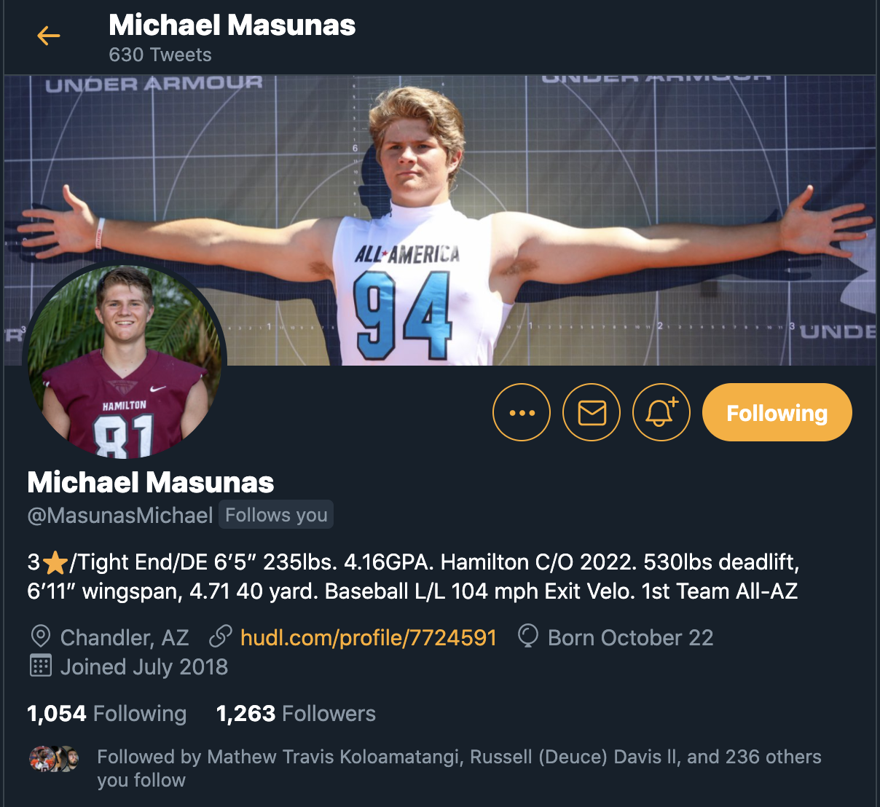
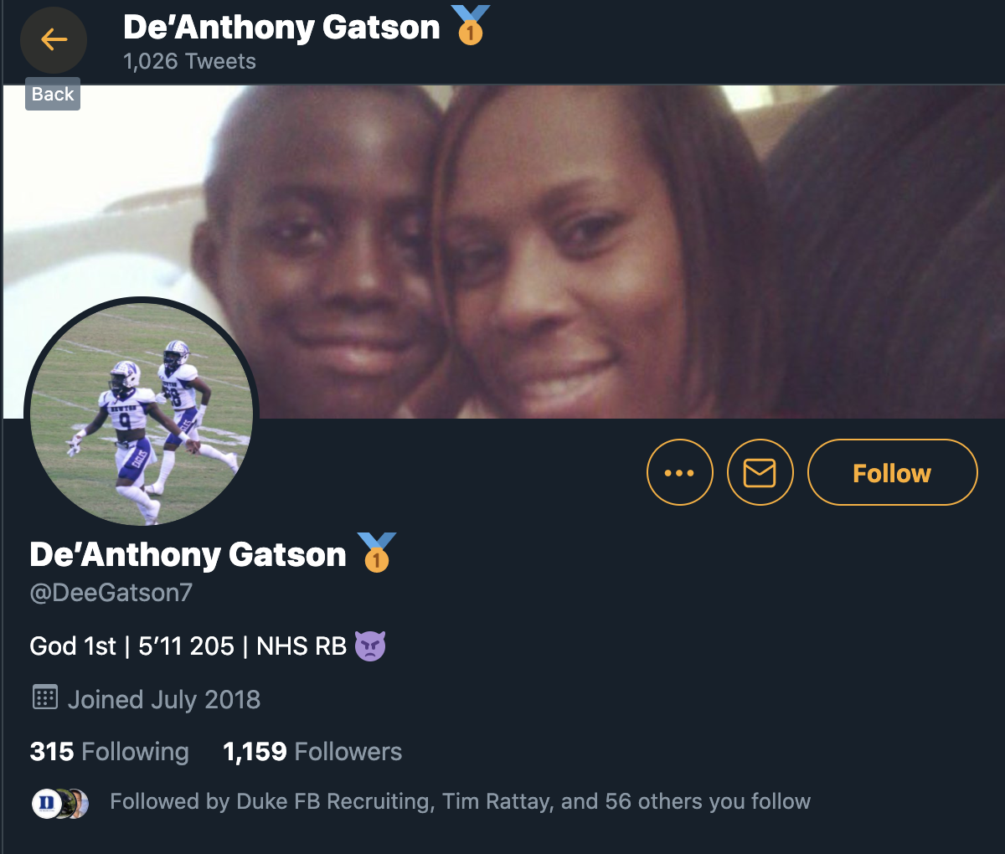
TWITTER PROFILE

Slide 29

HOW TO USE TWITTER TO YOUR ADVANTAGE
Who To Follow
  Coaches/Recruiting Staff
  “Like”, “Retweet” posts
What To Share
  Recruiting Graphics
  Offers
  Camp Invites
  HUDL Highlights
    Weekly/Mid-Season
  Workout Videos
  Press/Media Coverage
DM Introductions
  Do NOT Copy and Paste!
Remember, you are a BRAND….
MARKET YOURSELF!!

Slide 30


HOW TO BUILD YOUR HUDL HIGHLIGHTS

Slide 31
HUDL
Best plays up front
Highlight yourself PRE-SNAP
Quick cuts/edits - no wasted seconds
Make it short - No 10 Minute Highlight films, 3-5 Minutes is perfect.
No average high school football plays / No penalties

Slide 32
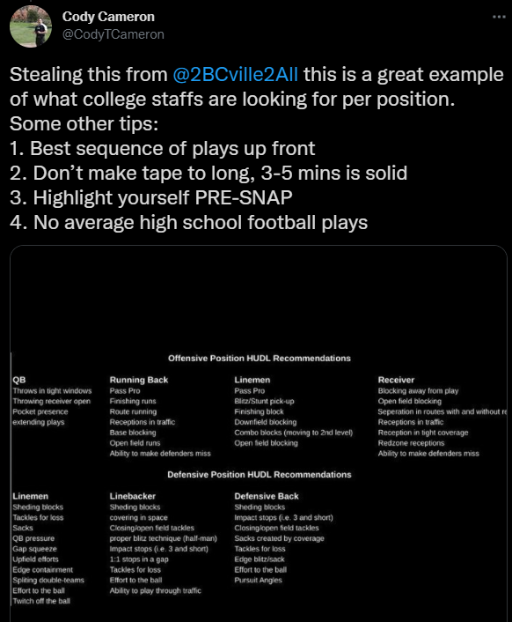
HUDL
What makes an above average high school football play -
per position

Slide 33
OFF-SEASON: What Should I be doing?
Get your grades up!!! Seek tutoring for classes you struggle with.
Lift with your team. Off-season is won in the weight room!!
Run Track - Skilled players, college coaches want to see 100 Meter times. Linemen compete in discuss and shot put.
Extracurriculars - Stay Busy!!

Slide 34
DESIRED MEASURABLES
DEFENSE
POSITION | IDEAL | NGE
DE | 6’6” | 6’2”
DL | 6’4” | 6’0”
SAM | 6’3” | 6’1”
MIKE | 6’1” | 5’11”
WILL | 6’2” | 5’11”
CB | 6’1” | 5’11”
SAF | 6’1” | 5’11”
OFFENSE
POSITION | IDEAL | NGE
QB | 6’3” | 6’0”
RB | 6’0” | 5’9”
WR | 6’2” | 5’10”
TE | 6’5” | 6’3”
OC | 6’3” | 6’1.5”
OG | 6’4” | 6’2”
OT | 6’5” | 6’3”

Slide 35
Don’t just be a guy,
Be the right guy.

Slide 36
Kyle Morgan
Email: Kyle.Morgan@catapultsports.com
Twitter: @KyleMorgan_XOS
Cody Cameron
Email: codytcameron20@gmail.com
Twitter: @codytcameron

Slide 37


Catapult FREE Profile

Slide 38


X

