Slide 1

Wrestling 2025 Financials

Slide 2
Agenda
2024-2025 ISWA Budget to Actual
2024-25 Budget to Actual Bridge
August 31 statement of financial position
24-25 Financial Highlights
25-26 Summary Budget
Prior year Actual to Plan Bridge

Slide 3
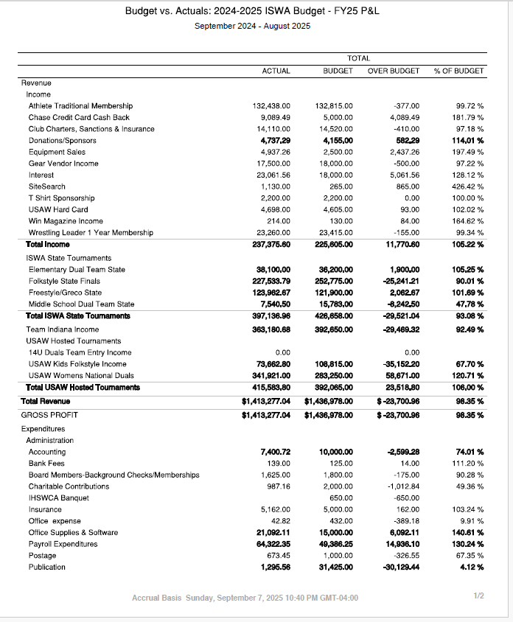
24-25 Financial Summary page 1

Slide 4
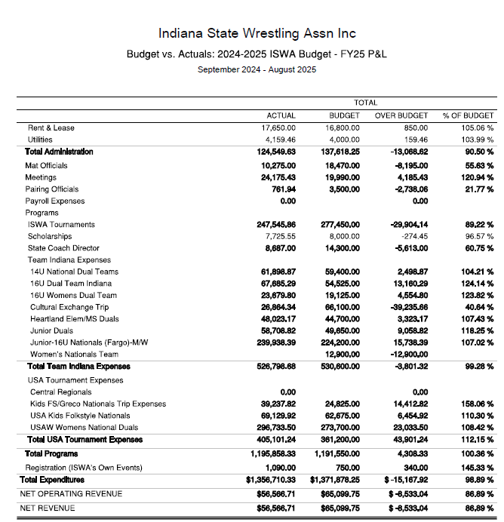
24-25 Financial Summary page2

Slide 5
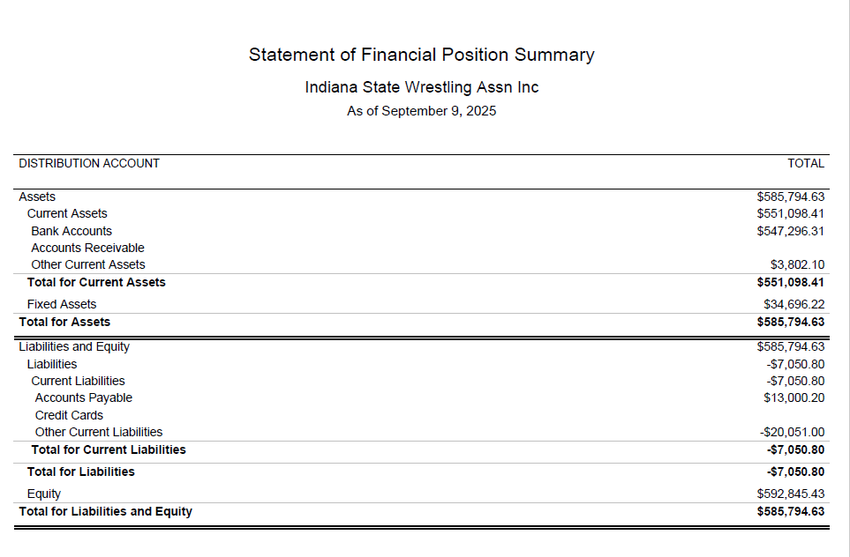

Slide 6
ISWA 2024 -2025 Highlights
Indiana wrestler Support 2025
Net Indiana Teams Support $155K
Net Fargo Support $47K
Net Scholarship Support $8K
Net Camps and Awards $14K
Total $224K
ISWA State Tournament Net Gain/Loss
Elementary Duals $18K
Middle School Duals $4K
Folkstyle State $86K
Freestyle/Greco State $41K
Total $149K
USAW National Tournament Net Gain/Loss
Kids Folkstyle Nationals $5K
Women’s National Duals $45
Total $49K
USAW Operational performance to plan ($8.5K)
Overall increase in Funds +$56K
$23k additional interest from CDs contribution

Slide 7
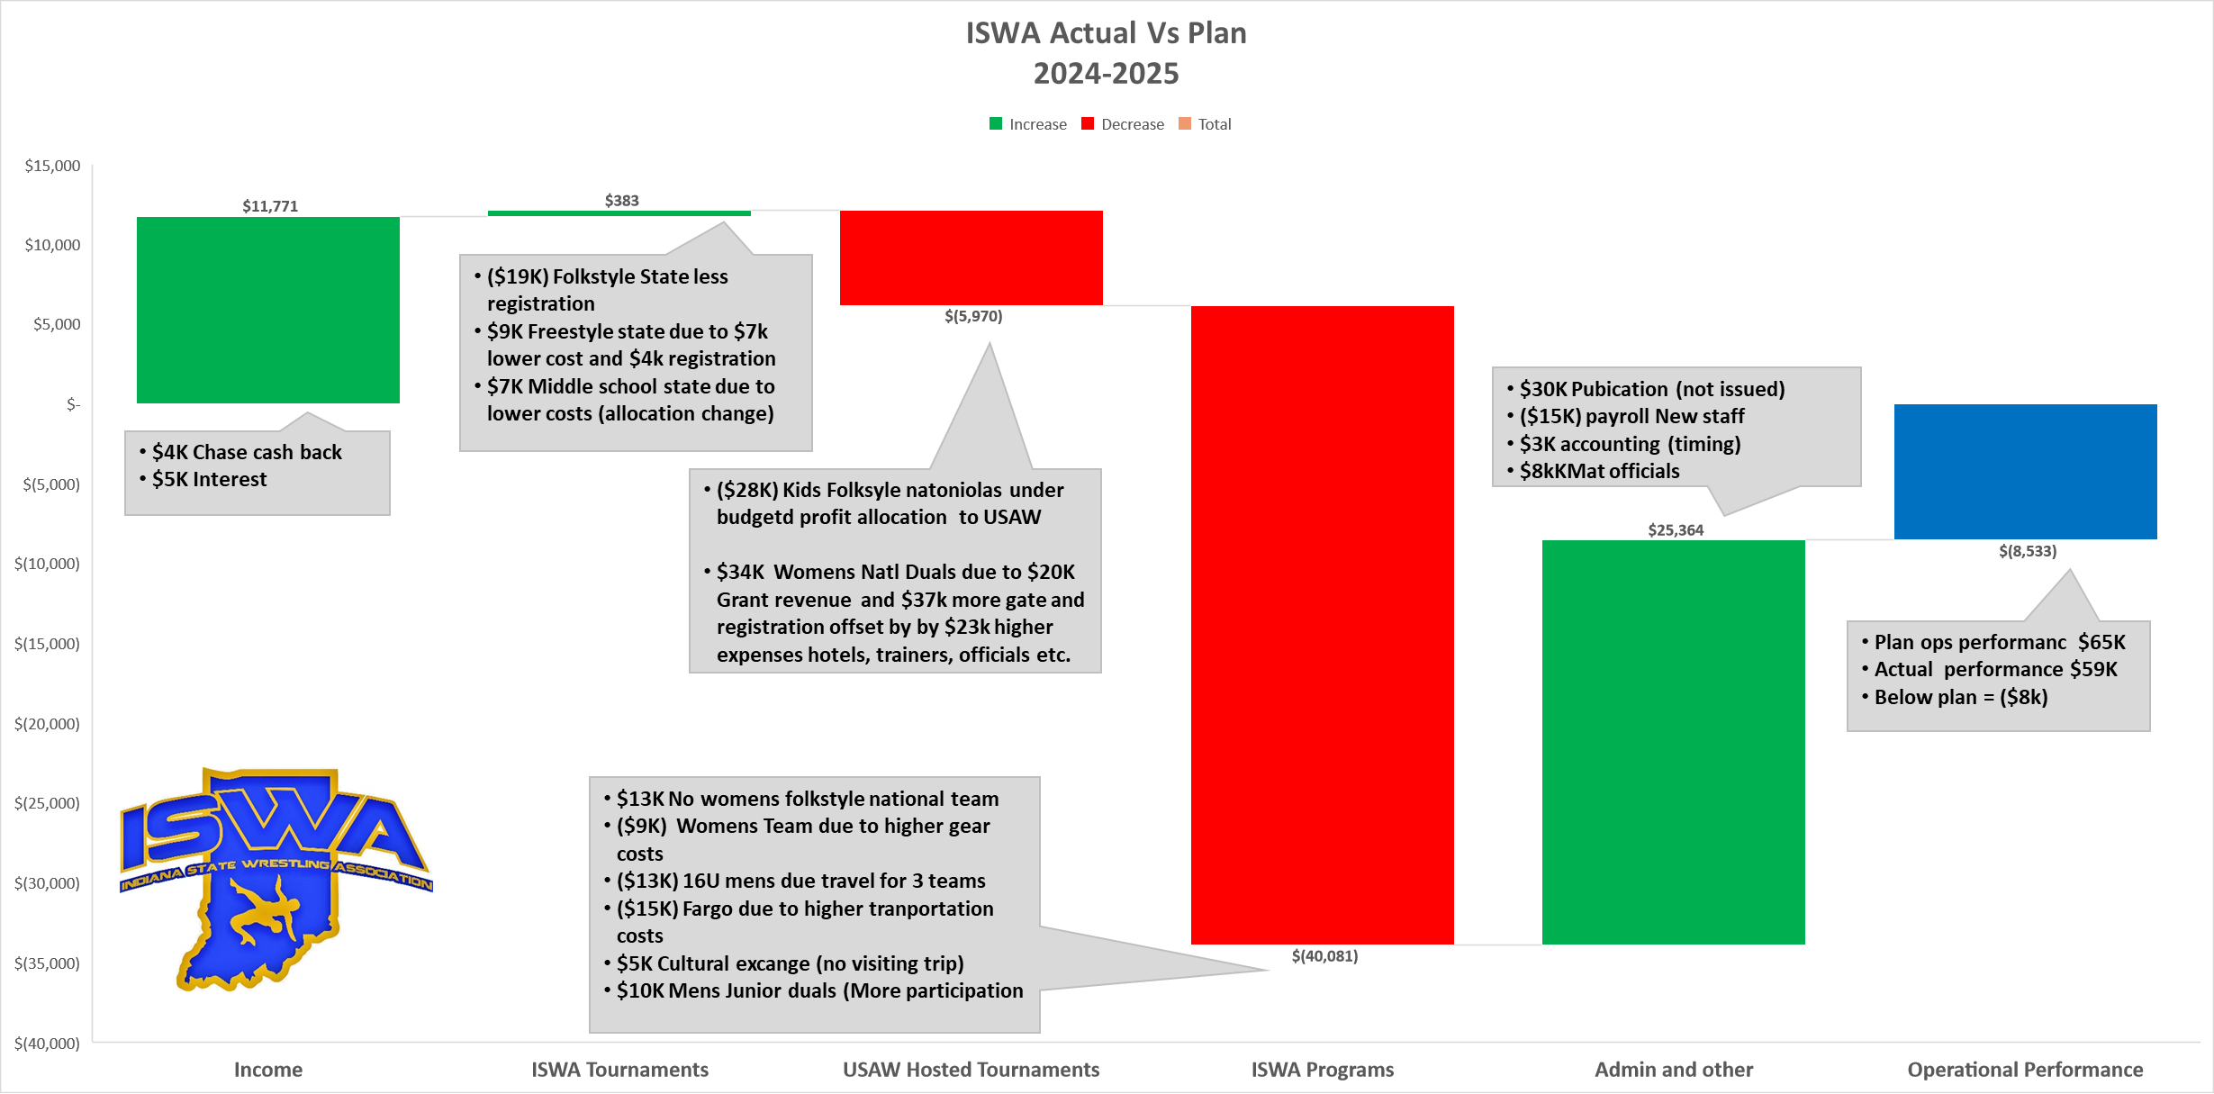

Slide 8
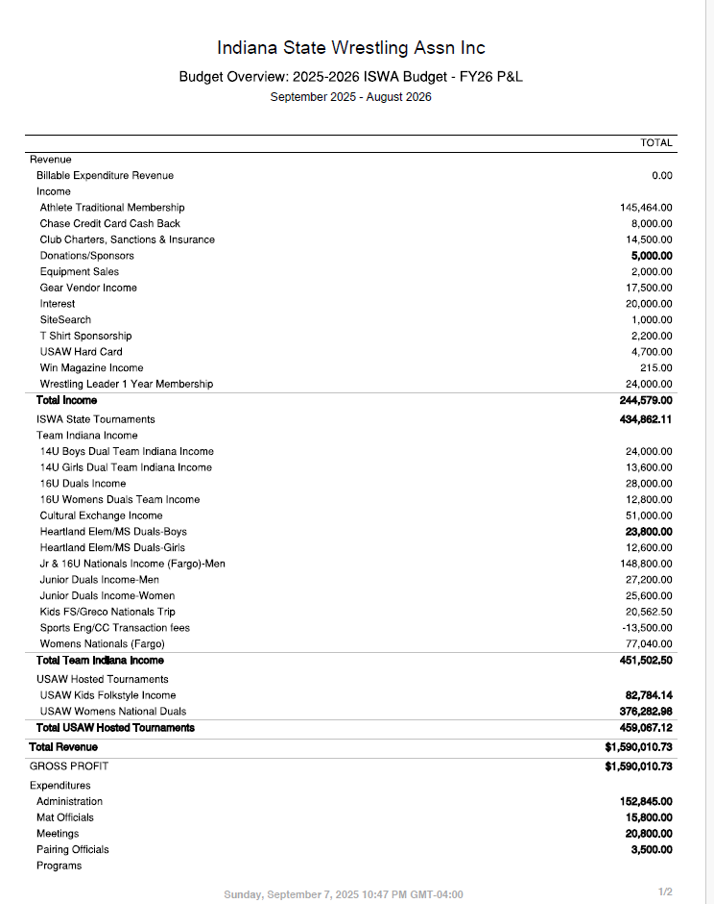

Slide 9
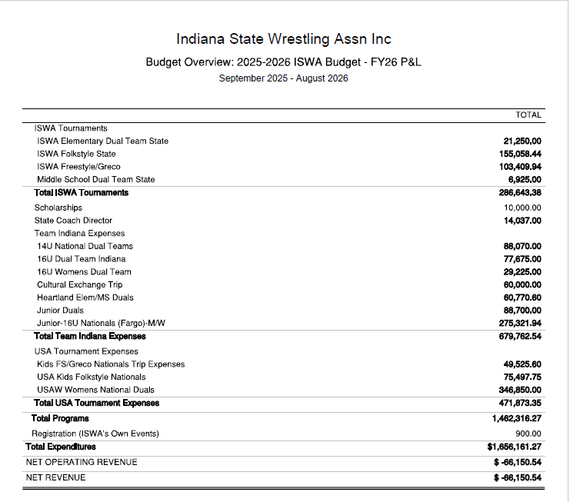

Slide 10
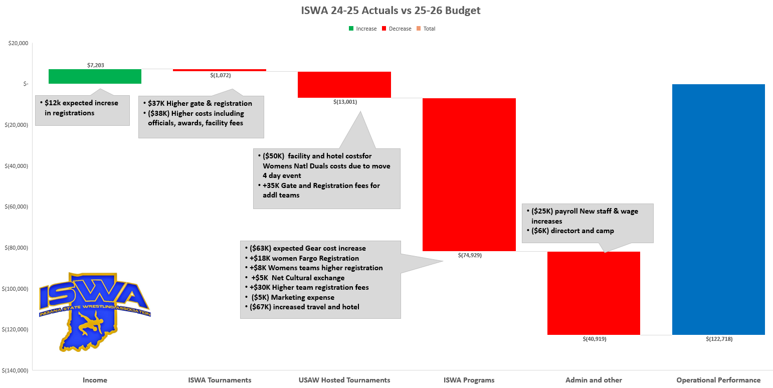

Slide 11
Thank you
Stephen Mathis
ISWA Treasurer
Steve.Mathis@ISWA.com
765-588-7367

