Slide 1
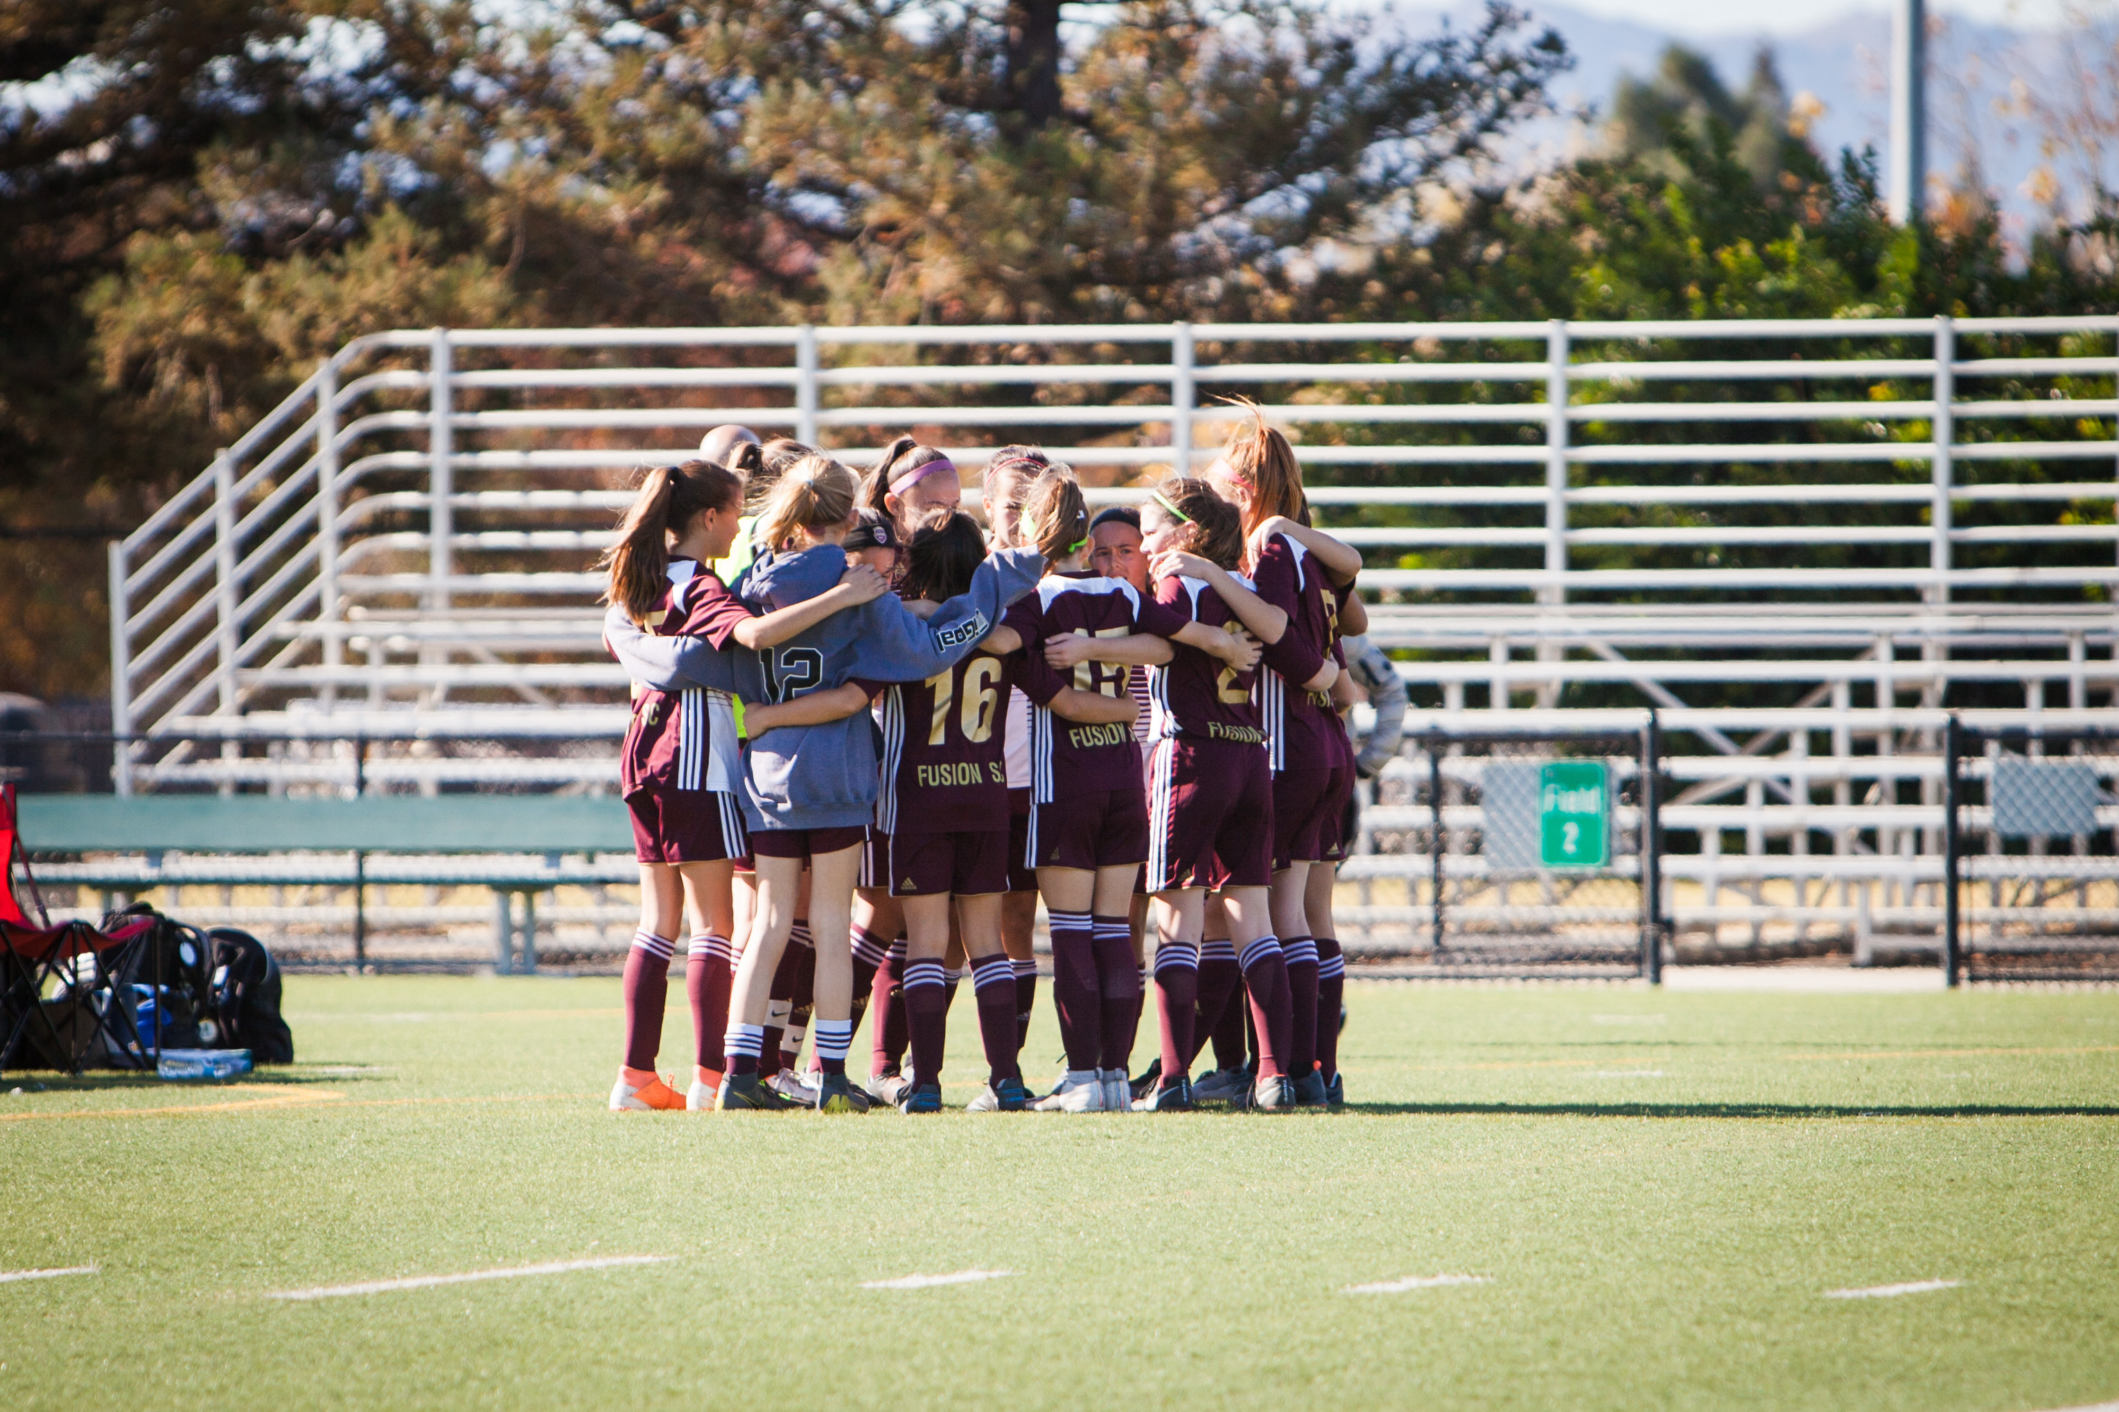

Livermore Fusion
Positional profile
Players positional profile in (4-3-3)

Slide 2
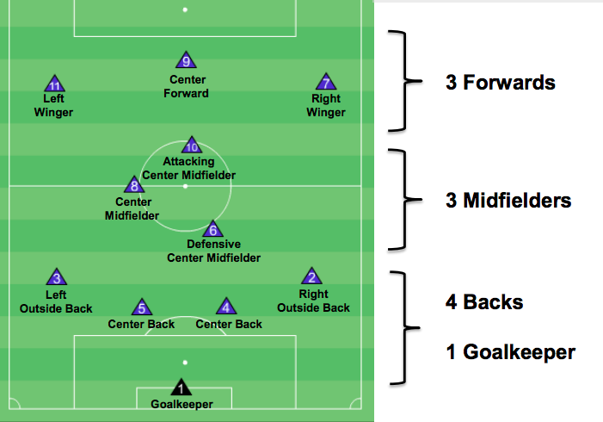

Slide 3
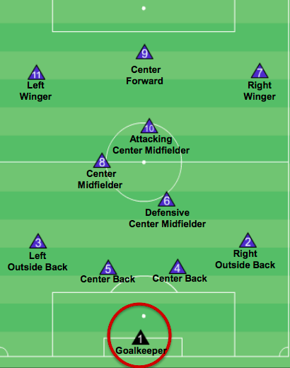
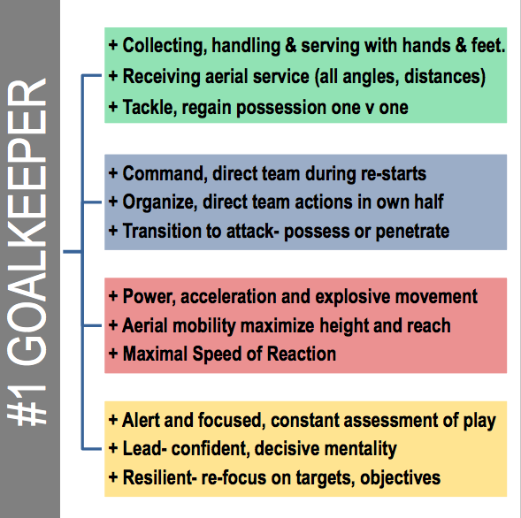
Goalkeeper – #1
Can you name two professional goalkeepers?
The Fusion Play Model supports a variety of possessional and penetrating passes from the Goalkeeper #1 when WE have the ball (throw, roll, pass, chip, drive and drop-kick). The first pass to start an attack will directly influence our opponents defensive positioning; a short pass will invite high pressure and create space behind our opponents, long pass will force them back and create space in front of our opponents, the same can be expected from passing left or right, space will be created opposite of the opponent’s lateral shift to the ball-side.

Slide 4
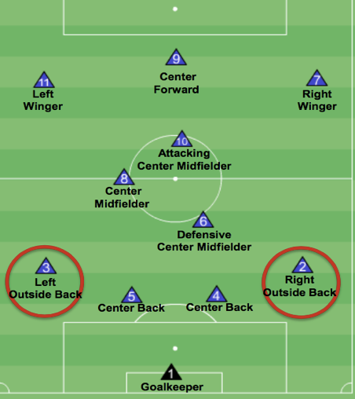
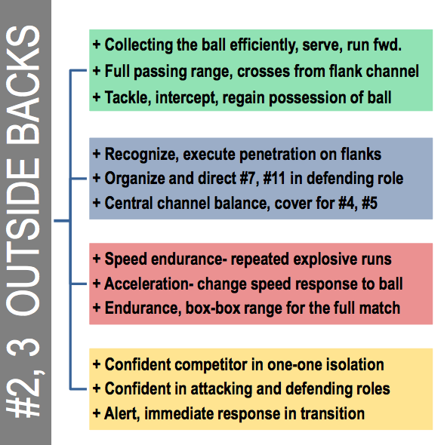
Outside Back – #2(Right) & #3 (Left)
Can you name one professional outside back who plays on the left and on the right?
The Fusion Play Model demands that outside backs have good mobility and accurate service while Running With the Ball to create goal scoring opportunities when WE have the ball. When we lose the ball and Transition WE>THEY have ball, #2 and #3 need competency for Tackling - poke, block, slide, shield and head. Pressure and 1v1 defending - face-on, side-on and from above the ball. Recovery runs - angle and speed.

Slide 5
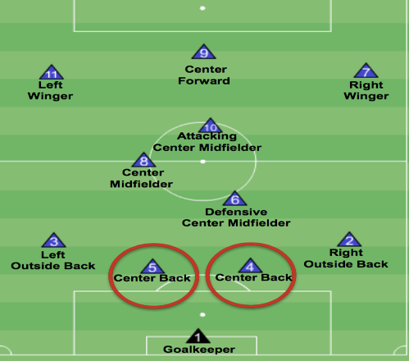
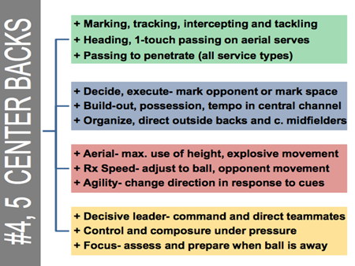
Center back – #4 (Right) & #5 (Left)
Can you name two professional center backs but with different strengths for the position?
The Fusion Play Model supports a variety of possessional and penetrating passes from the Goalkeeper #1 when WE have the ball (throw, roll, pass, chip, drive and drop-kick). The first pass to start an attack will directly influence our opponents defensive positioning; a short pass will invite high pressure and create space behind our opponents, long pass will force them back and create space in front of our opponents, the same can be expected from passing left or right, space will be created opposite of the opponent’s lateral shift to the ball-side. The modern GK #1 is exemplified below:

Slide 6
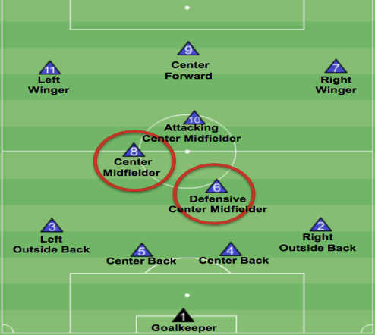
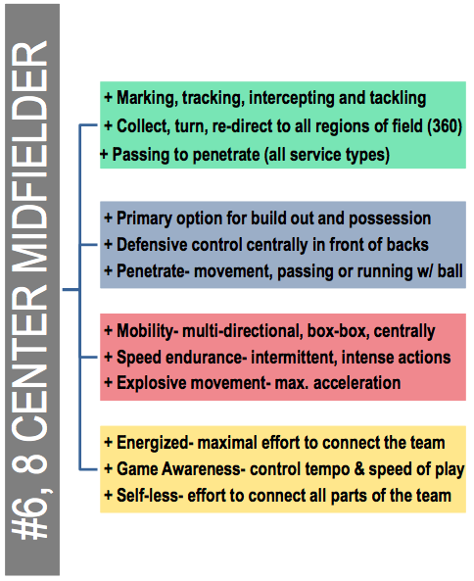
Center midfielder – Defensive #6
Who do you think is the best #6 in the world for men's soccer and for women's soccer?
The Fusion Play Model demands that the holding center midfield #6 have technical abilities for passing in tight space and decision making for ball retention in the critical moment of transition THEY>WE. Spatial awareness and mobility are key for the #6, the following video exemplifies the effectiveness of 1 or 2 touch passing in critical areas of the field. The #6 is sometimes to referred to as the conductor of the team: Tempo, Rhythm and Game Management.

Slide 7
Center midfielder – #8
Who do you think is the best #8 in the world for men's soccer and for women's soccer?
The central midfield #8 position has high demands for tactical positioning and mobility in transition WE>THEY and THEY>WE from goal box to goal box. The #8 shares the defensive responsibility of making the team Compact the middle of the field with the #6 but is also encouraged to play up the field to create goal scoring chance and offer ball service to #7, #11 and #9.

Slide 8
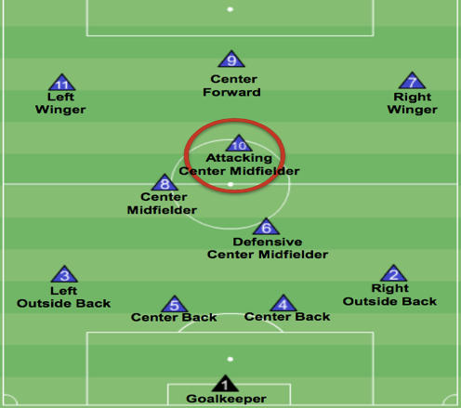
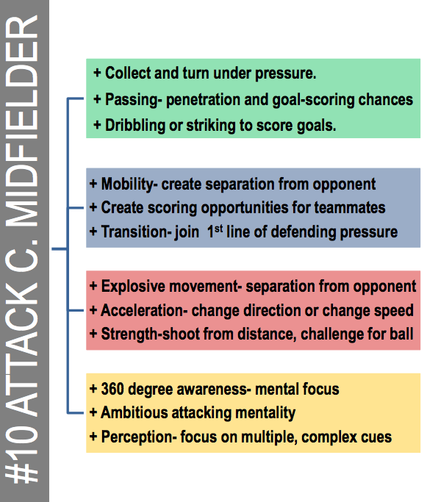
Center midfielder – Attacking #10
Who do you think is the best #10 ever??
Attacking center midfield #10. The Creativity, Flare and Technique are the characteristics sought after for this position, primary defensive responsibility is Covering the front as they set a Line of Confrontation and attempt win the ball back with group concepts; Force, Funnel, Trap and Collapse.

Slide 9
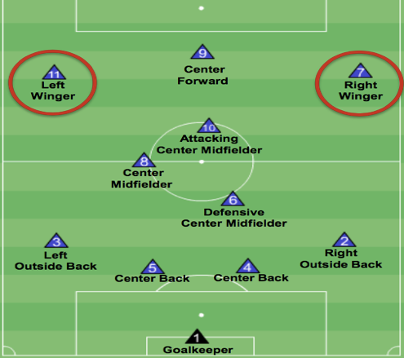
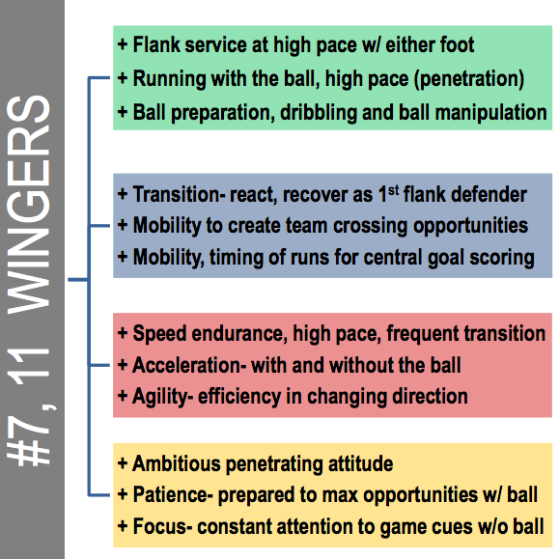
Winger – #11 (Left) & #7 (Right)
Not many more exciting positions than winger but who is the fastest? And the most tricky?
A winger needs Speed, Agility, Balance and the technique to run with the ball beyond defenders, score goals and provide service from wide or central locations. Dribble penetration in the attacking third of the field is expected based on but not limited to the strong sided dribble

Slide 10
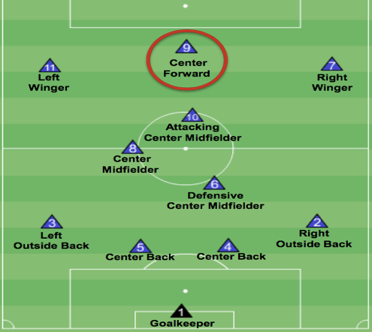
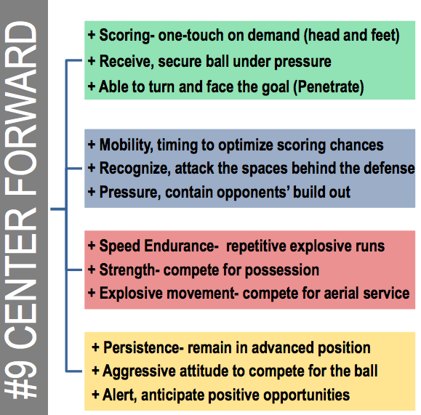
Striker – #9
Who has scored the most goals in a world cup (Men’s & women’s), MLS season, Premier league season and EVER?!
The center forward #9. Like the #10 Creativity, Flare and Technique are the characteristics sought after for this position. The center forward also needs mastery of techniques for scoring goals; Finish, Shoot, Head and Volley. Primary defensive responsibility is to set a Line of Confrontation and attempt win the ball back with group concepts; Force, Funnel, Trap and Collapse.

