Slide 1

DYBSA Baseball Coaches Clinic

Slide 2
Meeting Objectives
Part One
DYBSA Coaching Philosophy
Coaching Resources
Coordination with Varsity Program
Part Two (optional) – Review Common Topics

Slide 3
Part One – DYBSA Coaching Philosophies

Slide 4
DYBSA Coaching Objectives
Have fun
Respect the game
How to conduct players on and off the field
Win or lose with class
Hustle
Be a positive influence on your team (applies to coaches, players and parents)
Stress team success over individual success
Build skills and experience

Slide 5

DYBSA Coaching Philosophies
Build upon the enjoyment of the game
Realize the importance of practice
Positional rotation
Player safety is always priority
Adhere to league rules and pitch counts
http://myas.org/baseball/gopher-state-baseball-league/
Teach the Delano way
Sportsmanship and Class
Team Focus
Attitude, Hustle, Controllables
Prep for higher levels
Respect facilities

Slide 6
Competitive Balance
Instruction level and intensity appropriate for level
1A 2A 3A
Tee Coach Willie
Ball Pitch Mays 9U 10U 11U 12U 13U 14U
Recreation
Basic Instruction
Focus on Fun
Competition
Advanced Instruction
Focus on Improvement

Slide 7
Competitive Balance
Bad Examples
Minimal positional rotation
Unbalanced playing time
Not protecting pitchers and catchers
Players in unsafe positions

Slide 8

Varsity Program Coordination
Long Term Development vs. Short Term Success
Mechanics Shortcuts
Right time, right objective
Bunting
Pitching Windup
Curveballs
Others…
Shared resources
Absolutes of Hitting
Defense Philosophy
Pitching Plan and Philosophy
Skills Program
Coaching Manual

Slide 9

Sample Practice Plan
Balance development and fun for level
Focus on fun at lower levels
Push new skill development and limits on higher levels
High reps for fundamental skill development at each level
Hitting reps at every practice
Proper throw/catch session at every practice
Sample Project Outline (90 min)
Part 1 – Warmup and Fundamental Skills (25 min)
Part 2 – Skills and Situational Development (45 min)
Part 3 – Game focused on the day’s skill (15 min)
Part 4 – Review on lesson, rules, homework (5 min)

Slide 10
DYBSA Coaching Survey Feedback (negative examples)
My kid is not sure they want to play next year
My kid didn’t get enough playing time
Coach didn’t teach enough
Team not competitive enough
Coach had favorites
*Feedback changes with age and level
Best Approach - Focus on development for every player (at their level)

Slide 11
Parent Meeting Sample
Chance to level set expectations for coaches, players and parents
Game and practice schedules
Communication plan (text, email, GroupMe, etc.)
Regulations (bat type, birth certificates, etc.)
Expectations on position rotation and competition levels
Volunteer Requirements
Note requirements for check amount and tournament hours
Note requirements regarding assistant coaches and team managers
Help with keeping book

Slide 12
Coaching Resources
https://www.dybsa.com/page/show/8441834-policies
Parent Meeting Presentation
Team Formation Policy
Family Expectations
Coach Expectations
Note guidelines and expectations on player rotation, instruction, skill development
https://www.dybsa.com/page/show/253719-coaches-corner
Absolutes of Hitting
Defense Philosophy
Pitching Plan and Philosophy
Skills Program
Coaching Manual
DYBSA Contact – Skills and Instruction Committee
adam.wortz@gmail.com
jrmagee1114@gmail.com

Slide 13
Part Two – Common Topics

Slide 14
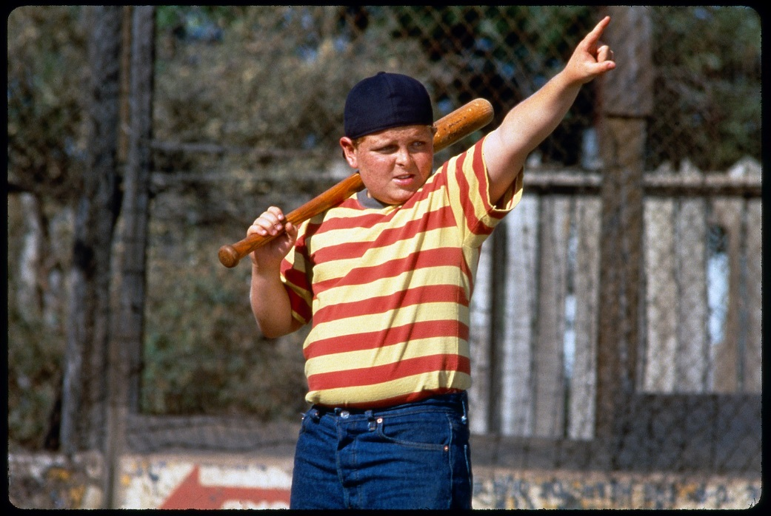
Hitting
Top problems of contact issues
Proper stance – balanced and ready to fire
Hand casting – swing usually looks late
Lack of “Here comes my pitch” mentality
Stride timing
No hip rotation – power leak

Slide 15
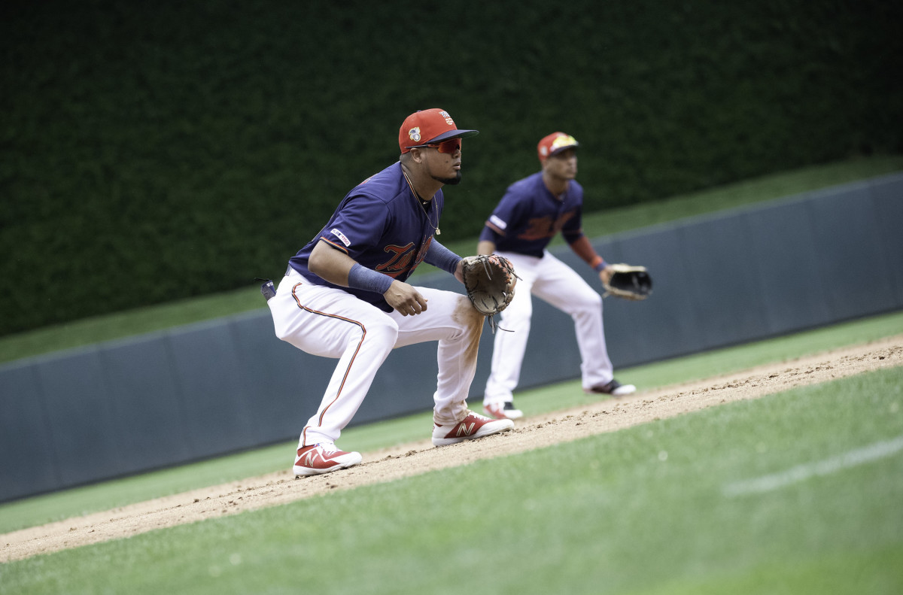
Fielding
Step, step, athletic ready position
Glove down after set
Offset “Alligator”
Through the ball

Slide 16
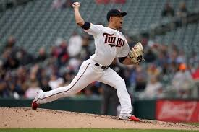
Pitching
Throwing Strikes
Balance and consistency
Focus on target – spot on spot
Power Leak
Closed front side
Leg and hip drive
Aiming vs throwing
Fluidity focus after step-by-step
Safety
Warmups
Pitch counts
Consider other leagues, practices and positions
Take any soreness seriously
Windup at 12U+

Slide 17
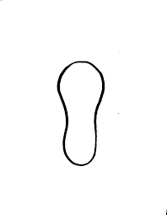
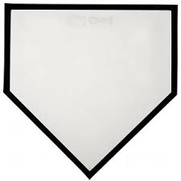
Skills Practice Recommendations
Close Toss Whiffle (front toss)
Focused Throwing Progression – rotation, legs, front side, long toss, etc.
Tee Work – Inside, Middle, Outside position, Low, High

Slide 18
Additional Coaching Recommendations
Additional Tips
Short Talks – turn their back to the action
Individual Routine – good or bad, I do my routine
Create practice competition (games)
Continue to increase challenge in fundamental reps
Video – can solve communication issues
Talk with parents first
Attempt to coordinate with parents and instructors
Start with the base (legs, hips) on addressing mechanics issues.
Most issues originate there
Also spend time on the mental aspect of the game

Slide 19


