Slide 1
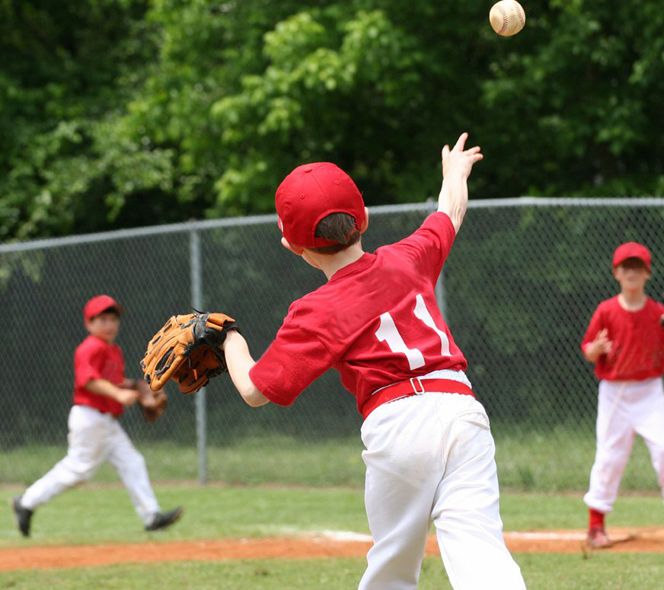
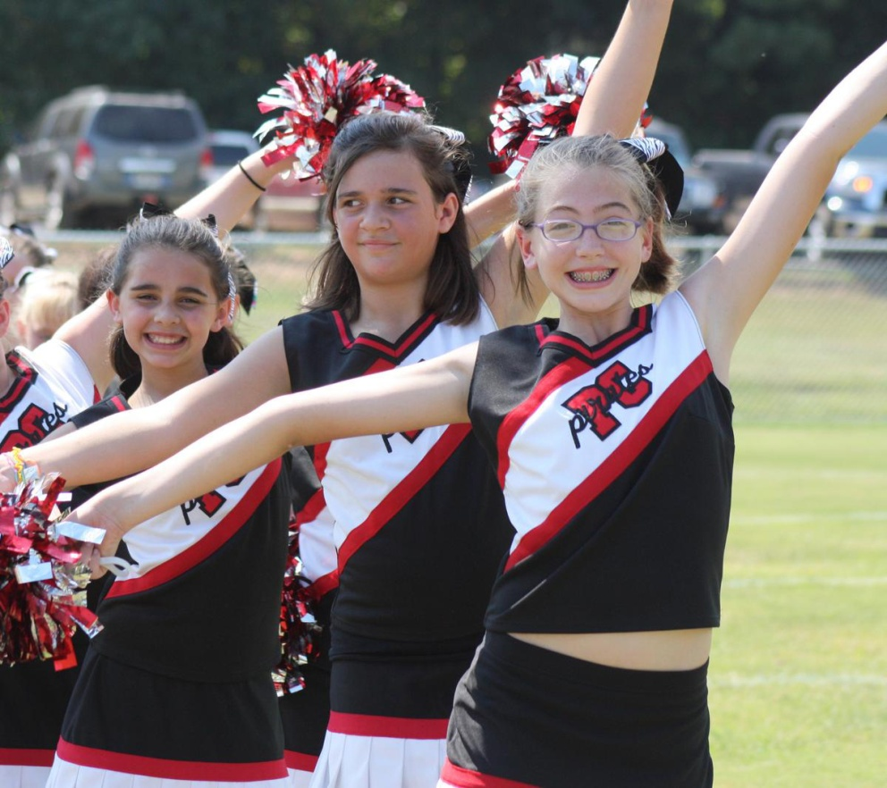


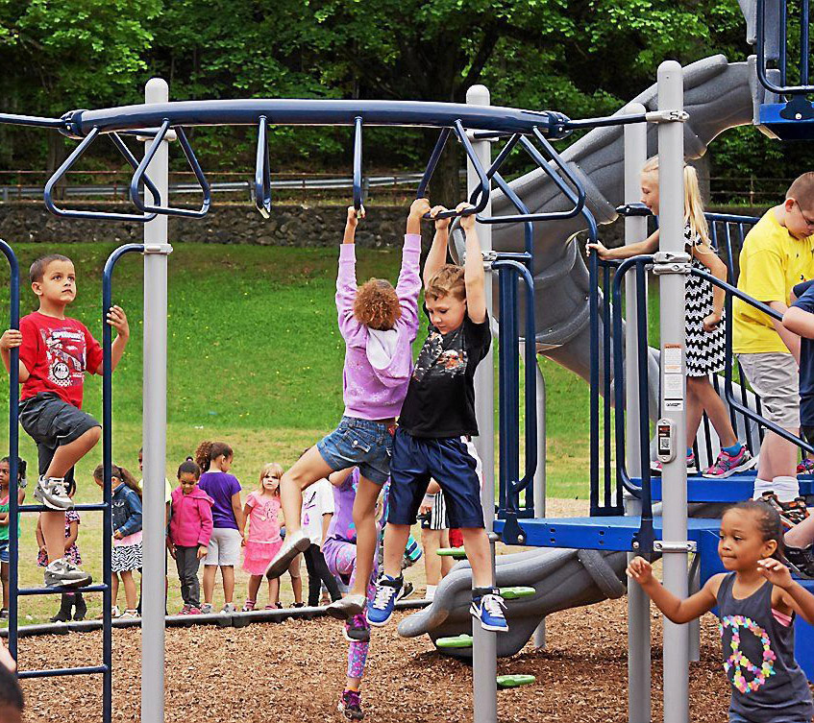

Pike County Recreation Complex
TEN YEAR MASTER PLAN
August 19, 2019

Slide 2
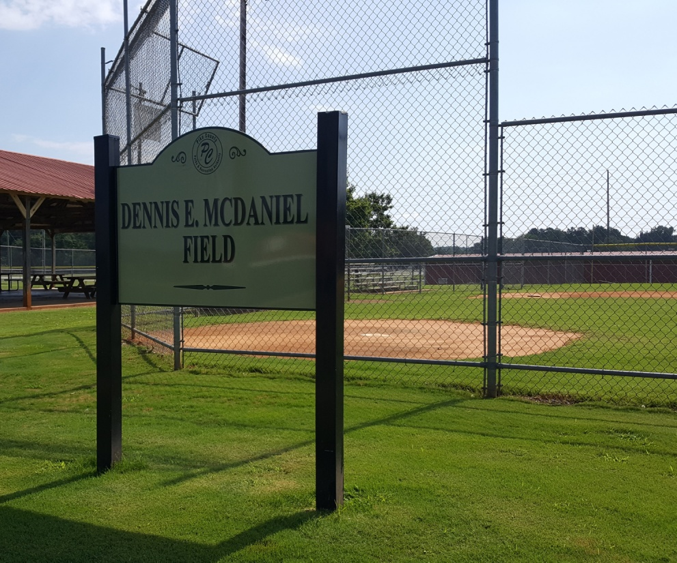
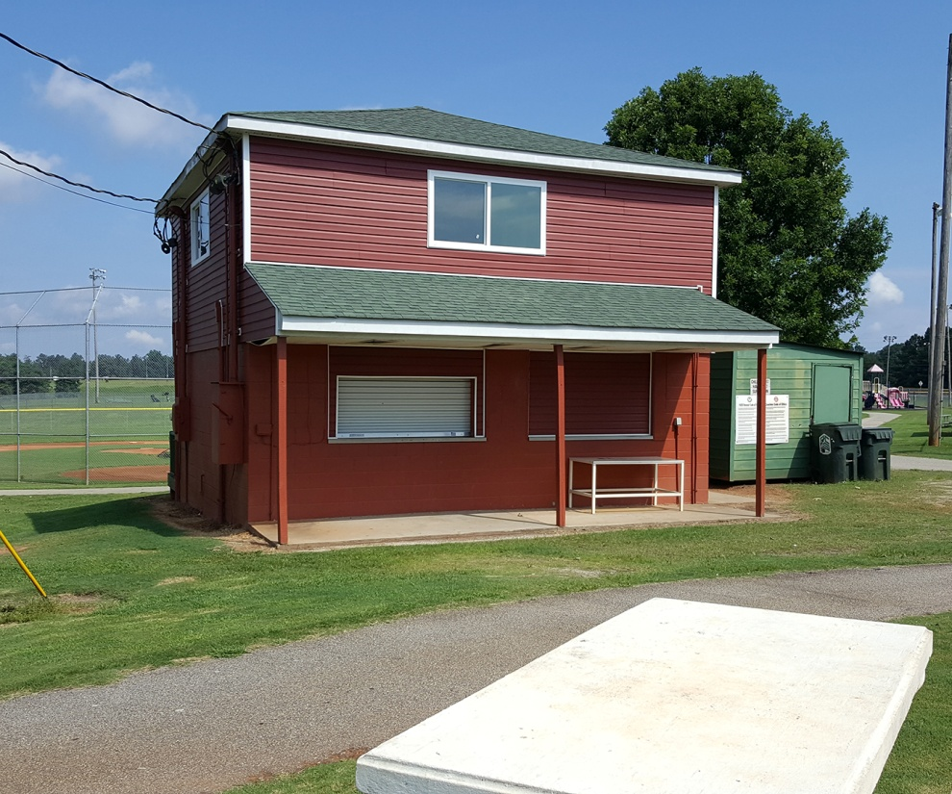
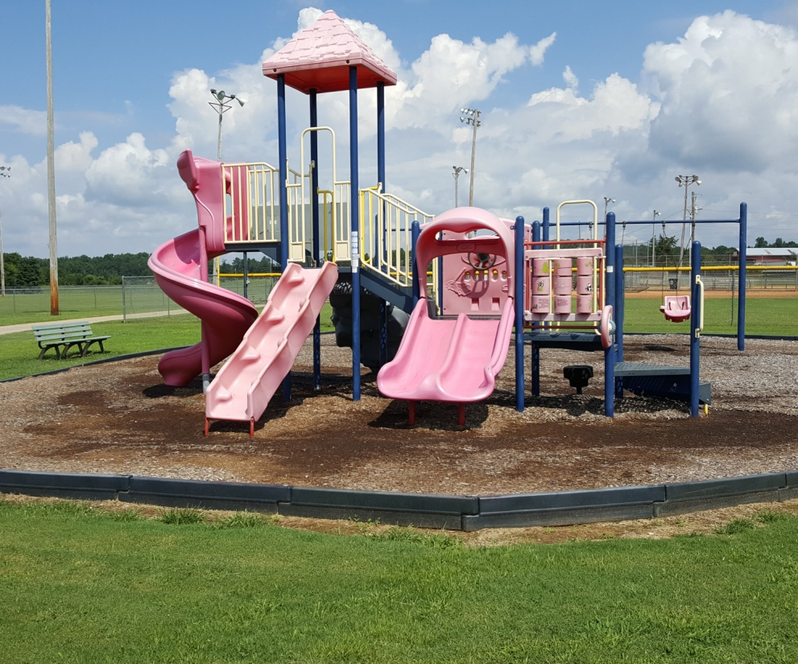
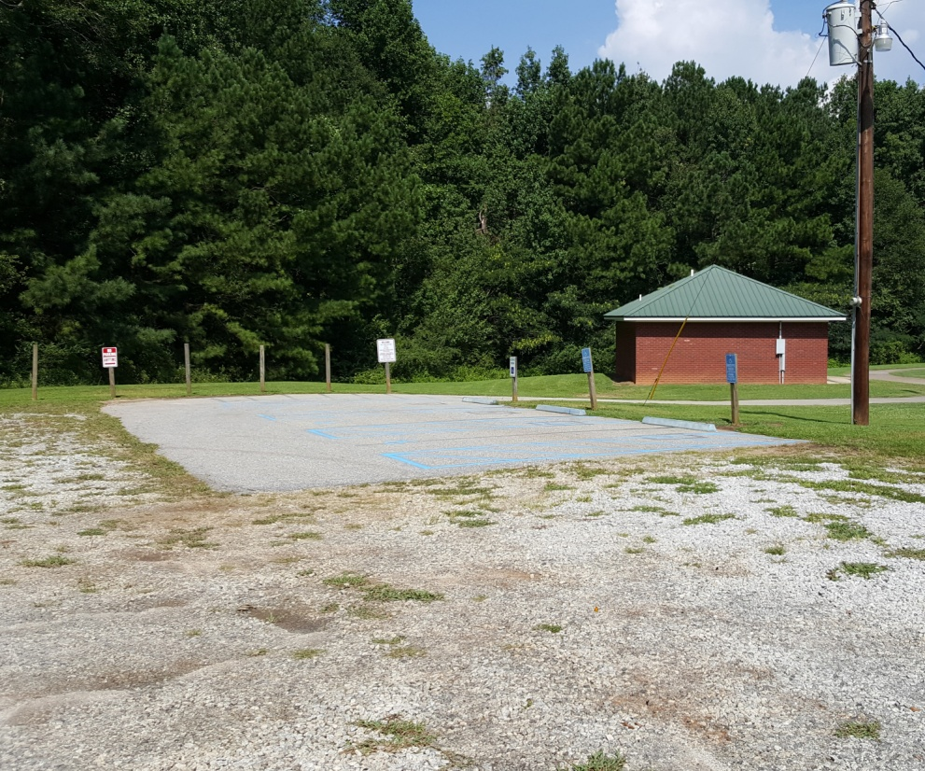
EXISTING CONDITIONS
Fields (Baseball, Softball, Football, Soccer)
Facilities (Restrooms, Concessions, Maintenance)
Amenities (Playgrounds, Pavilions, Trails, etc.)
Parking, Access, Safety

Slide 3

NEEDS ASSESSMENT
Park Acreage
Indoor Facilities
Outdoor Facilities

Slide 4
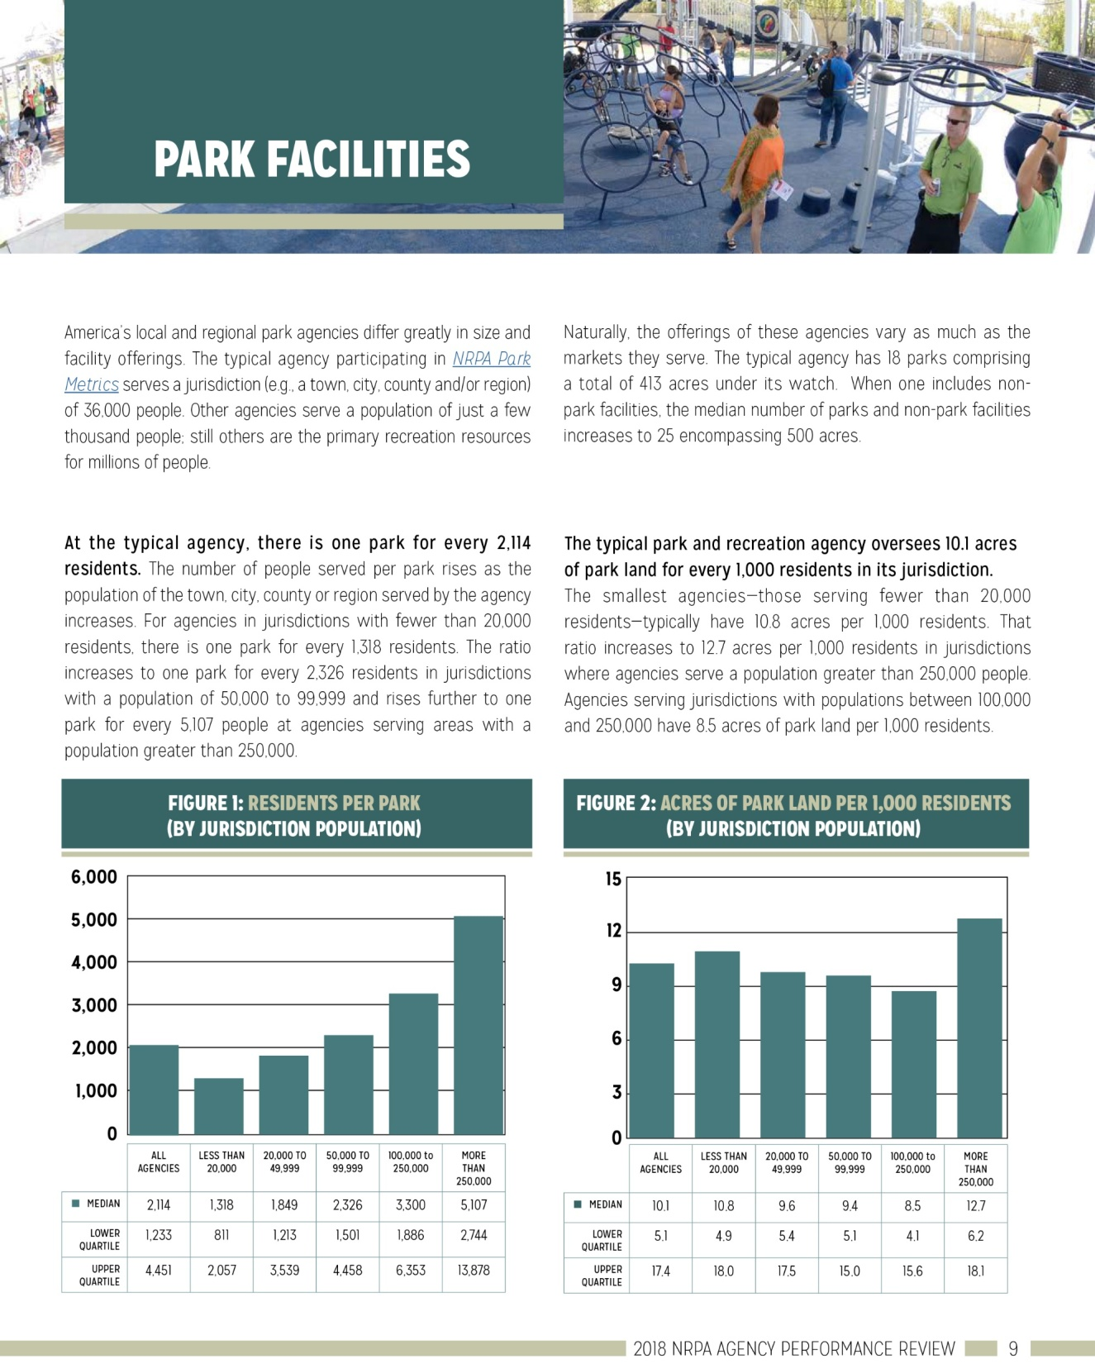
NEEDS ASSESSMENT
Park Acreage
Indoor Facilities
Outdoor Facilities

Slide 5
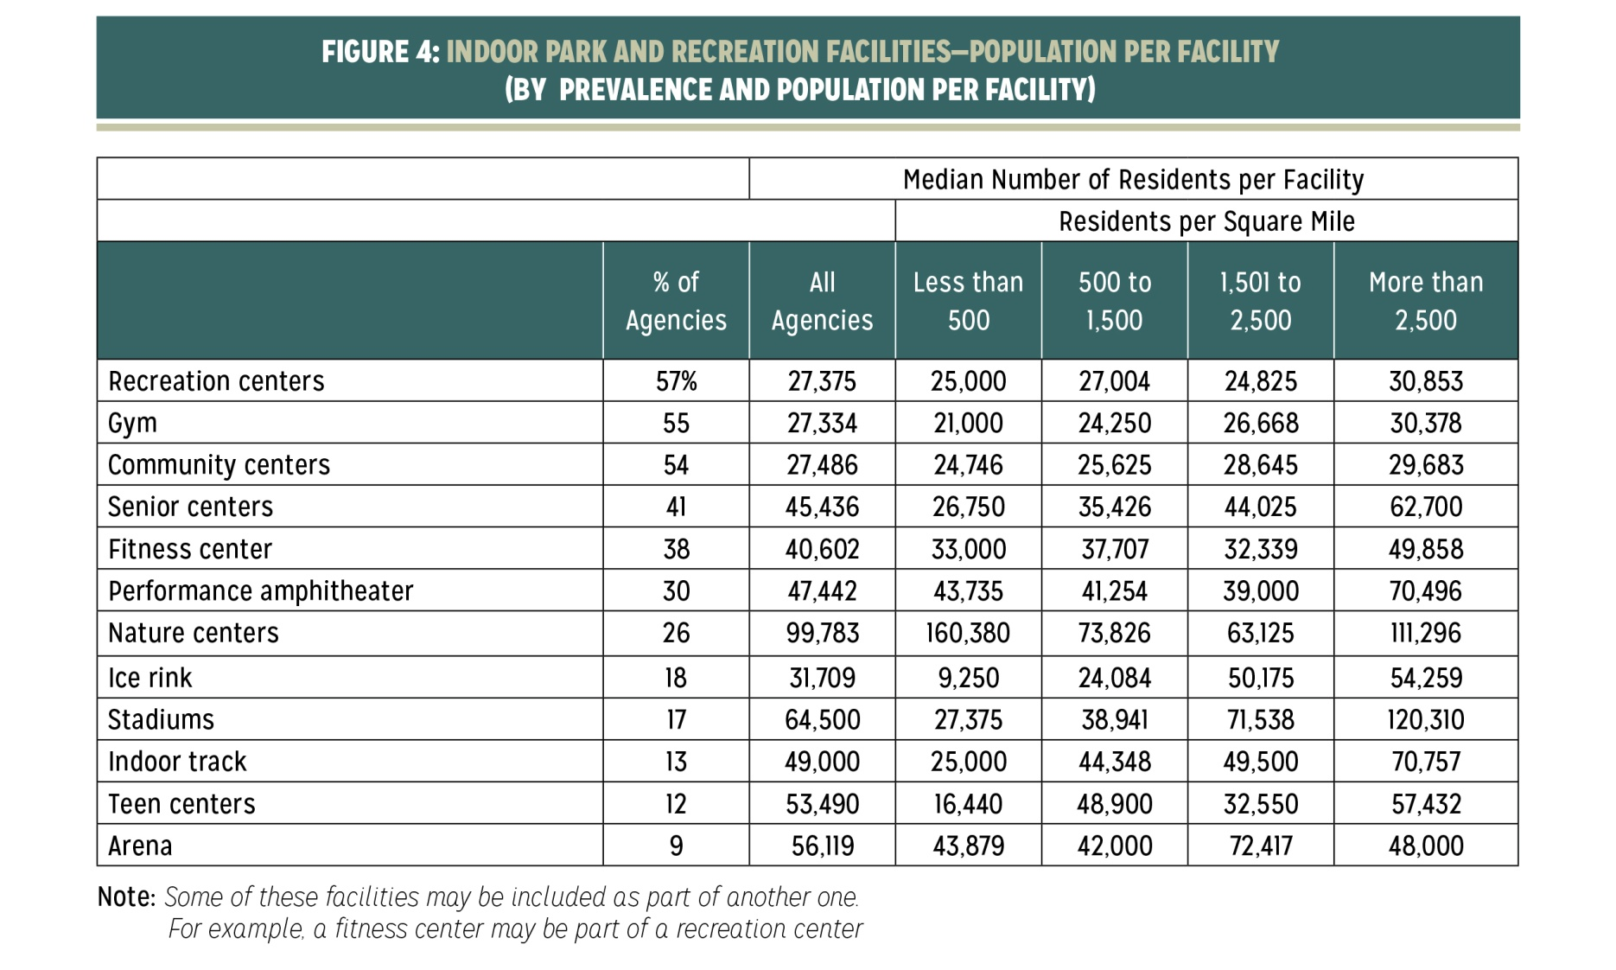
NEEDS ASSESSMENT
Park Acreage
Indoor Facilities
Outdoor Facilities

Slide 6
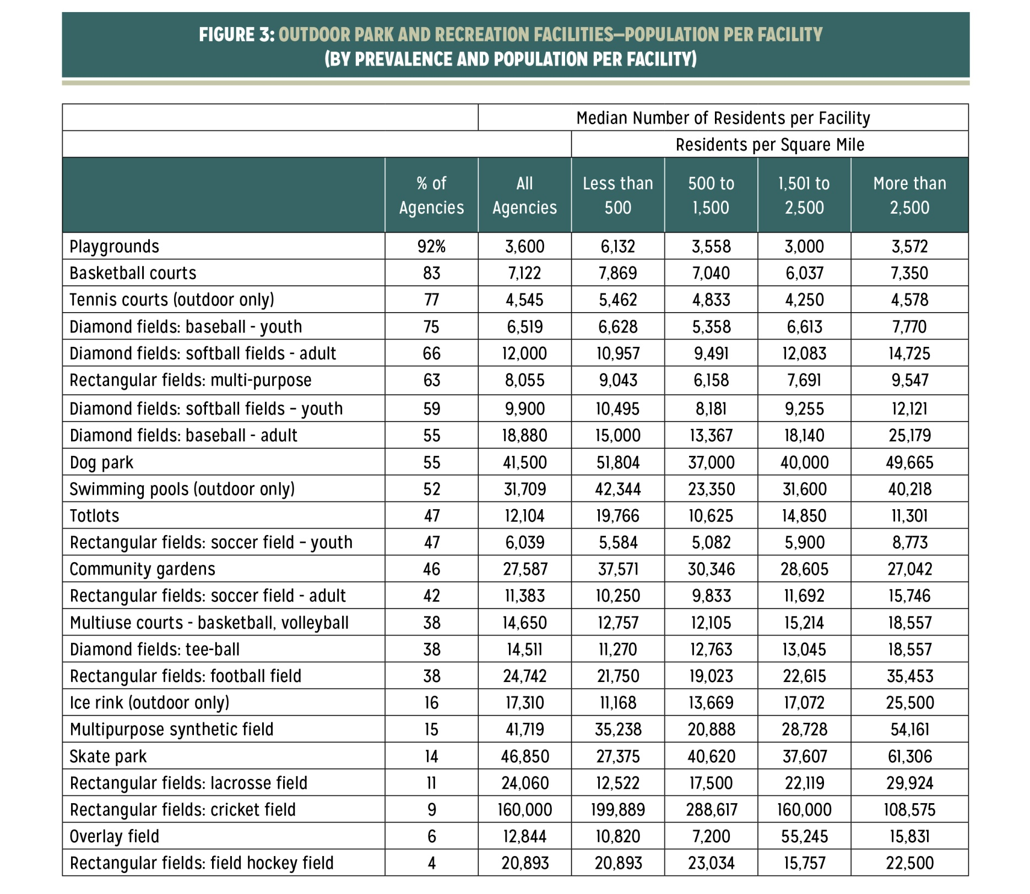
NEEDS ASSESSMENT
Park Acreage
Indoor Facilities
Outdoor Facilities

Slide 7
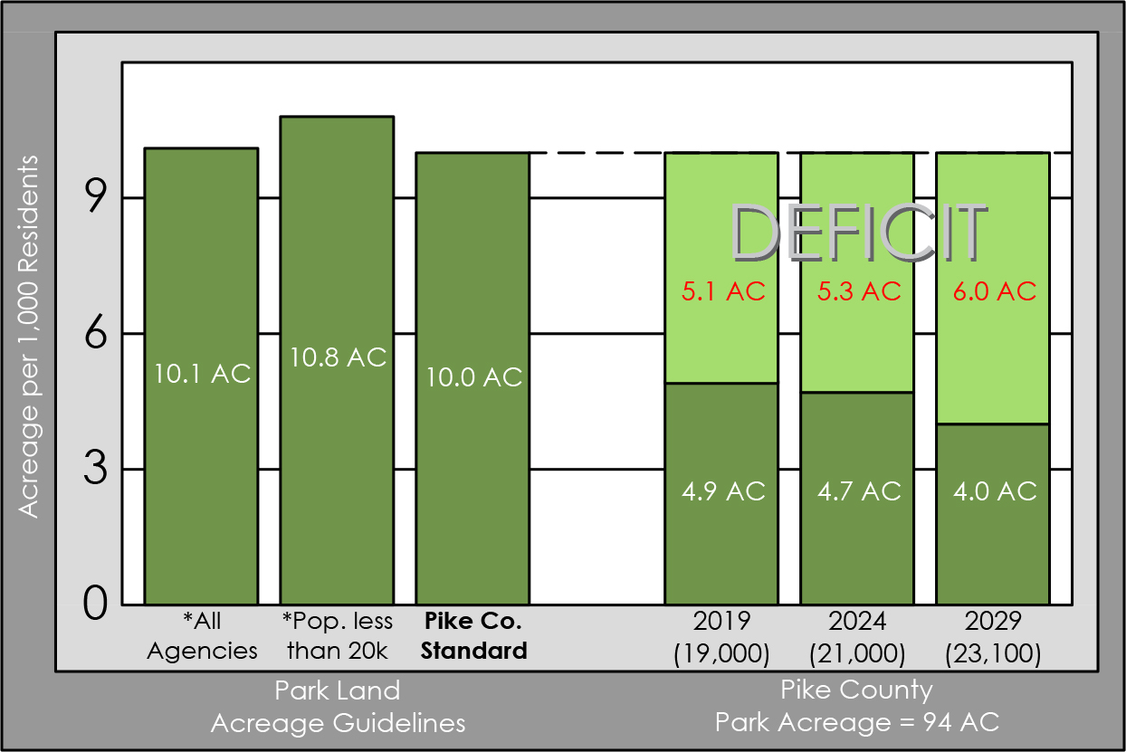
NEEDS ASSESSMENT
Park Acreage (50% deficit)

Slide 8
NEEDS ASSESSMENT
Indoor Facilities
  Existing Level of Service

Slide 9
NEEDS ASSESSMENT
Outdoor Facilities
  Existing Level of Service

Slide 10
NEEDS ASSESSMENT
County Specific Planning Standards
  Indoor Facilities

Slide 11
NEEDS ASSESSMENT
County Specific Planning Standards
  Outdoor Facilities

Slide 12
NEEDS ASSESSMENT
Pike County
  Indoor Facility Needs
  (Rec Center)

Slide 13
NEEDS ASSESSMENT
Pike County
  Outdoor Facility Needs

Slide 14

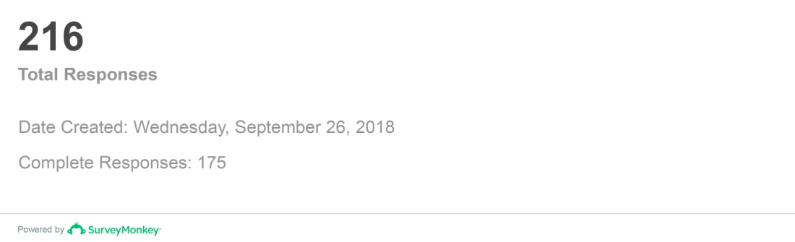
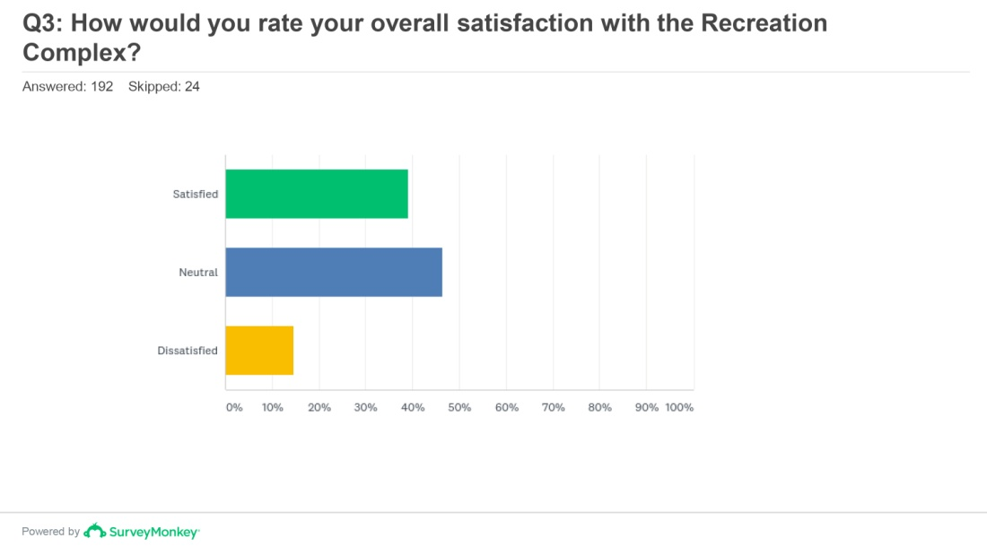
COMMUNITY OUTREACH
Stakeholder Interviews (Baseball, Softball, Football, Basketball, Soccer, Art’s Council, City and County Elected Officials, Local School Representatives, Seniors Groups, Adult Rec, Local Business and Sponsors)
Community Survey (22 questions, distributed online via PCPRA web site and email distribution lists)

Slide 15
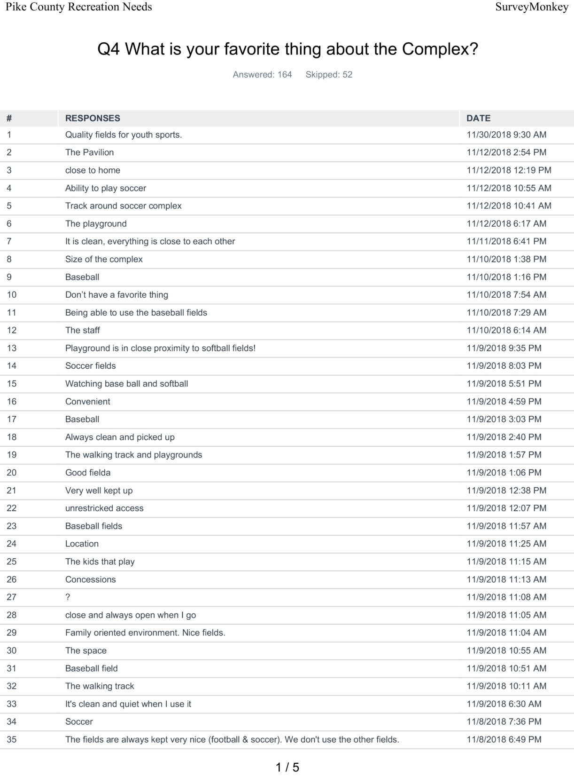
COMMUNITY OUTREACH
Stakeholder Interviews (Baseball, Softball, Football, Basketball, Soccer, Art’s Council, City and County Elected Officials, Local School Representatives, Seniors Groups, Adult Rec, Local Business and Sponsors)
Community Survey (22 questions, distributed online via PCPRA web site and email distribution lists)

Slide 16
MASTER PLAN RECOMMNEDATIONS
Summary
Parking Improvements
Shade & Seating
Pedestrian Trails
Indoor Recreation Center
Baseball Field Improvements
Basketball
Picnic Shelters
Fishing/Camping
Concerts/Music
Playgrounds
Splash Pad
Combination of information from the Needs Assessment and Community Outreach

Slide 17
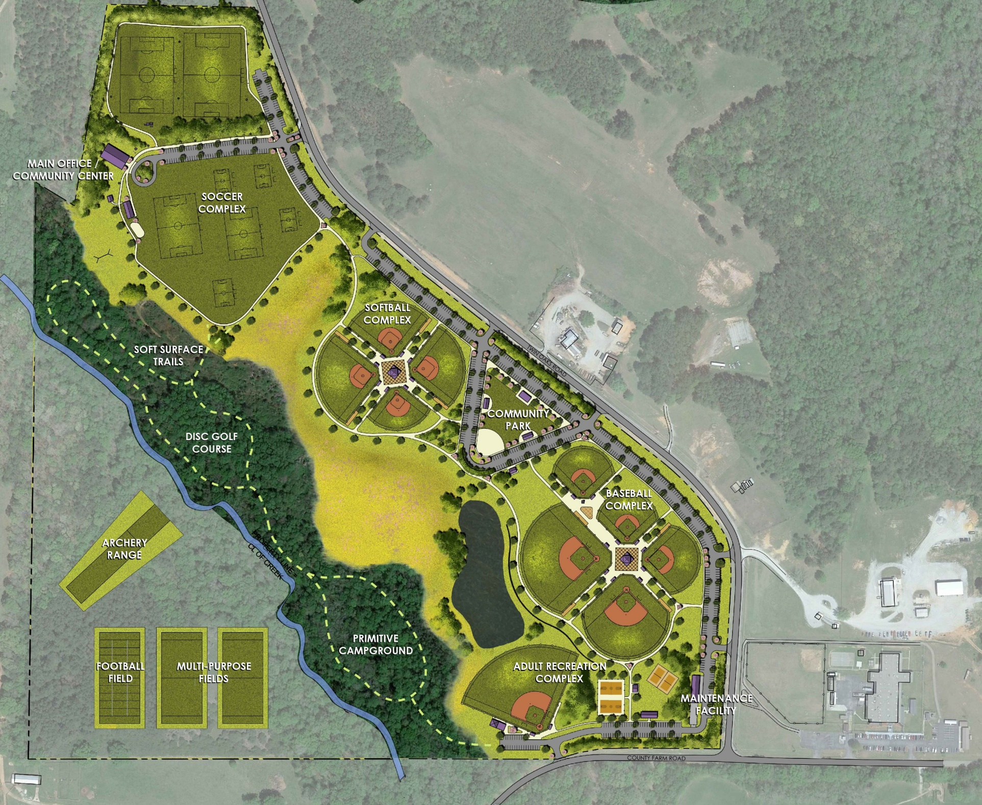
MASTER PLAN RECOMMENDATIONS
Programming
Soccer Improvements
Softball Complex
Community Park
Baseball Complex
Adult Recreation Complex
Maintenance Facility
Trails
Disc Golf
Camping
Indoor Recreation Center
Archery Range
Football Complex

Slide 18
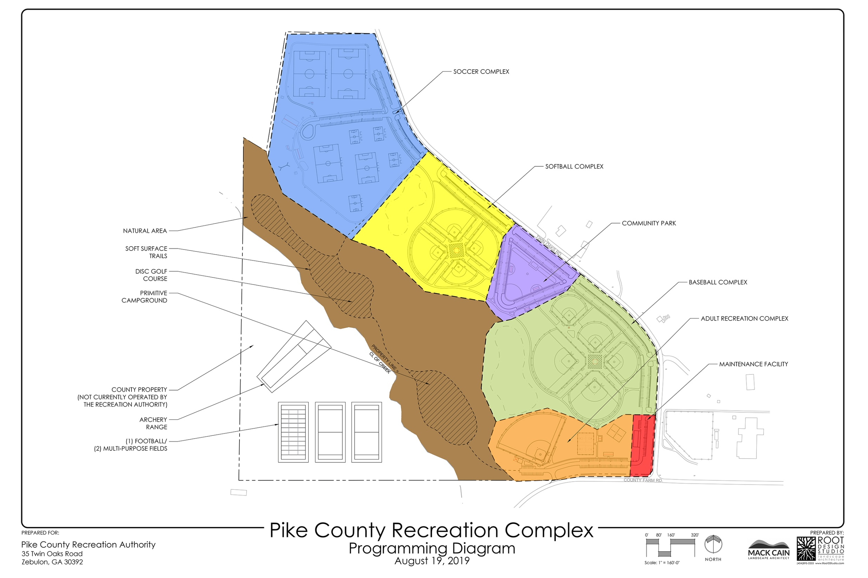

Slide 19
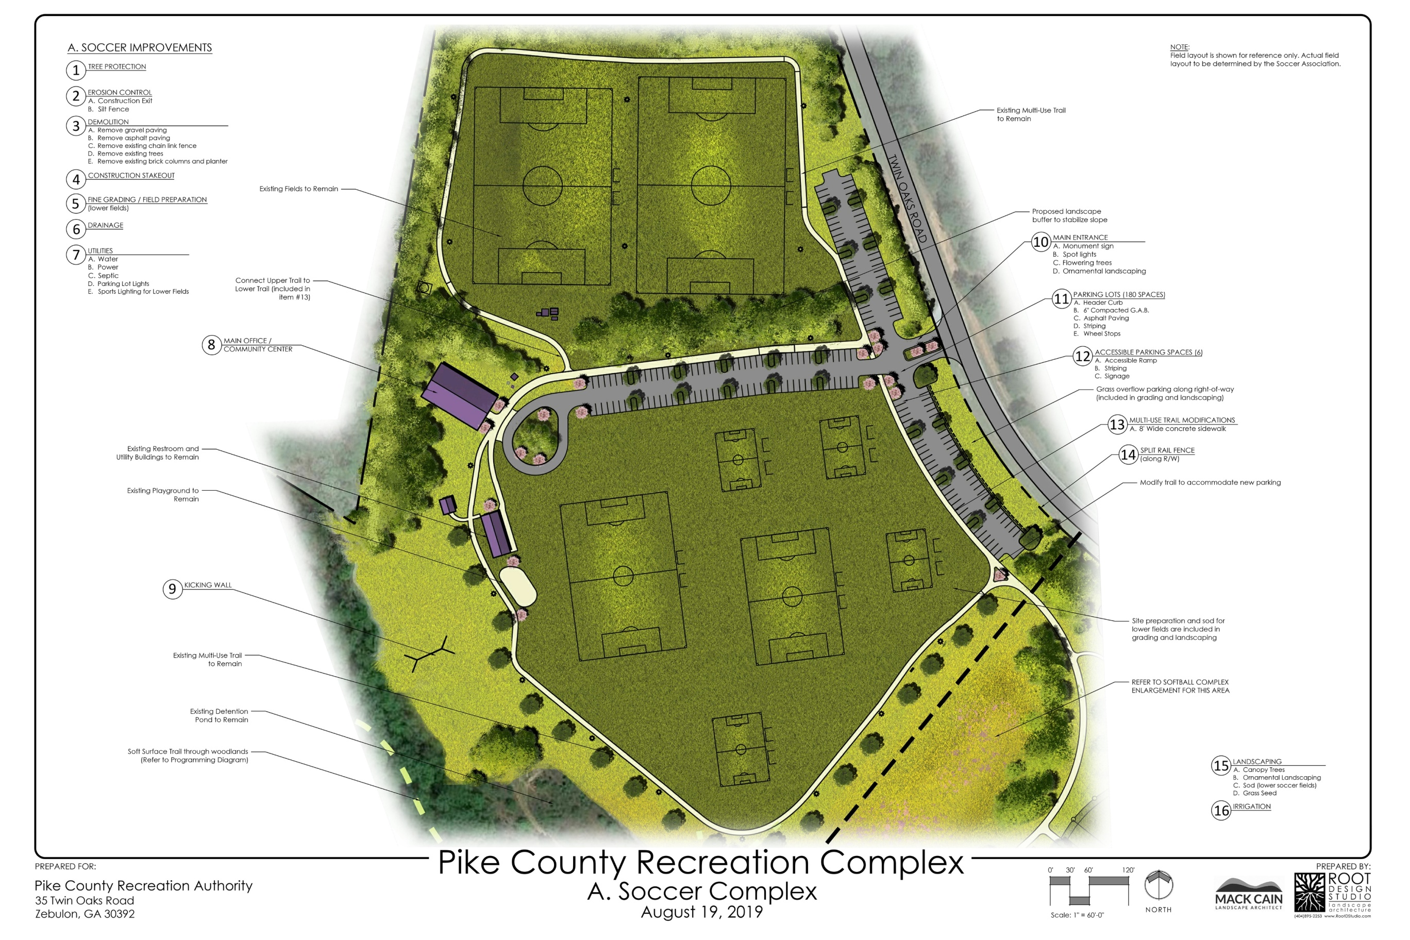

Slide 22
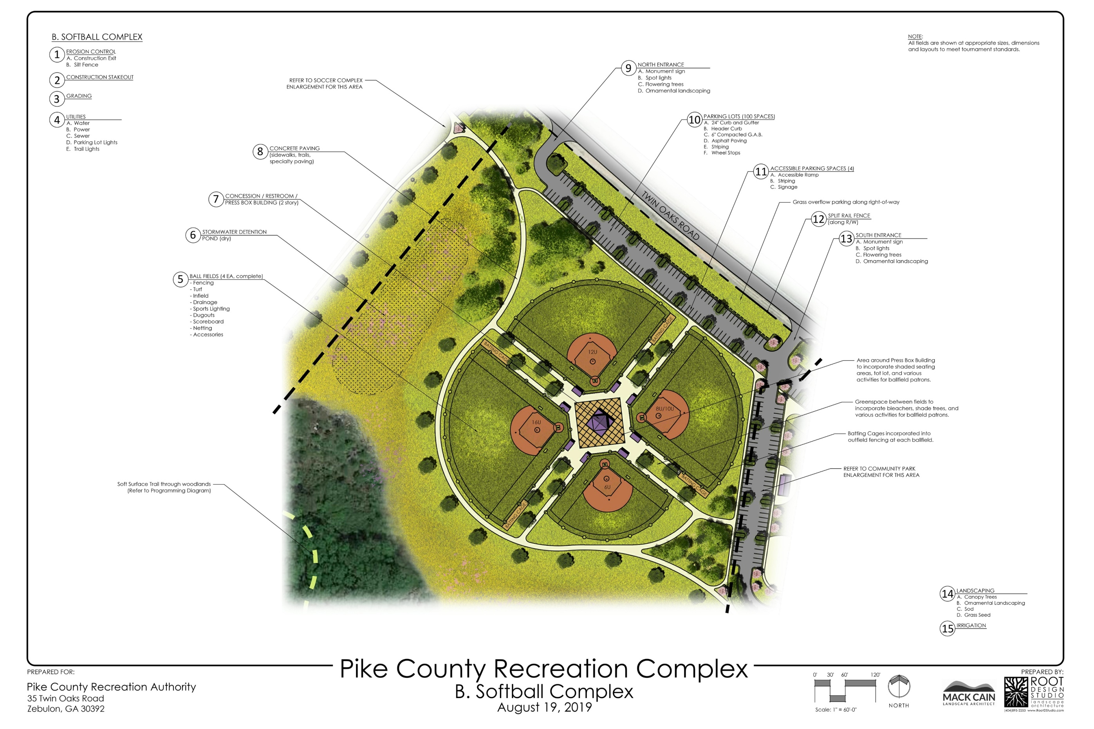

Slide 25
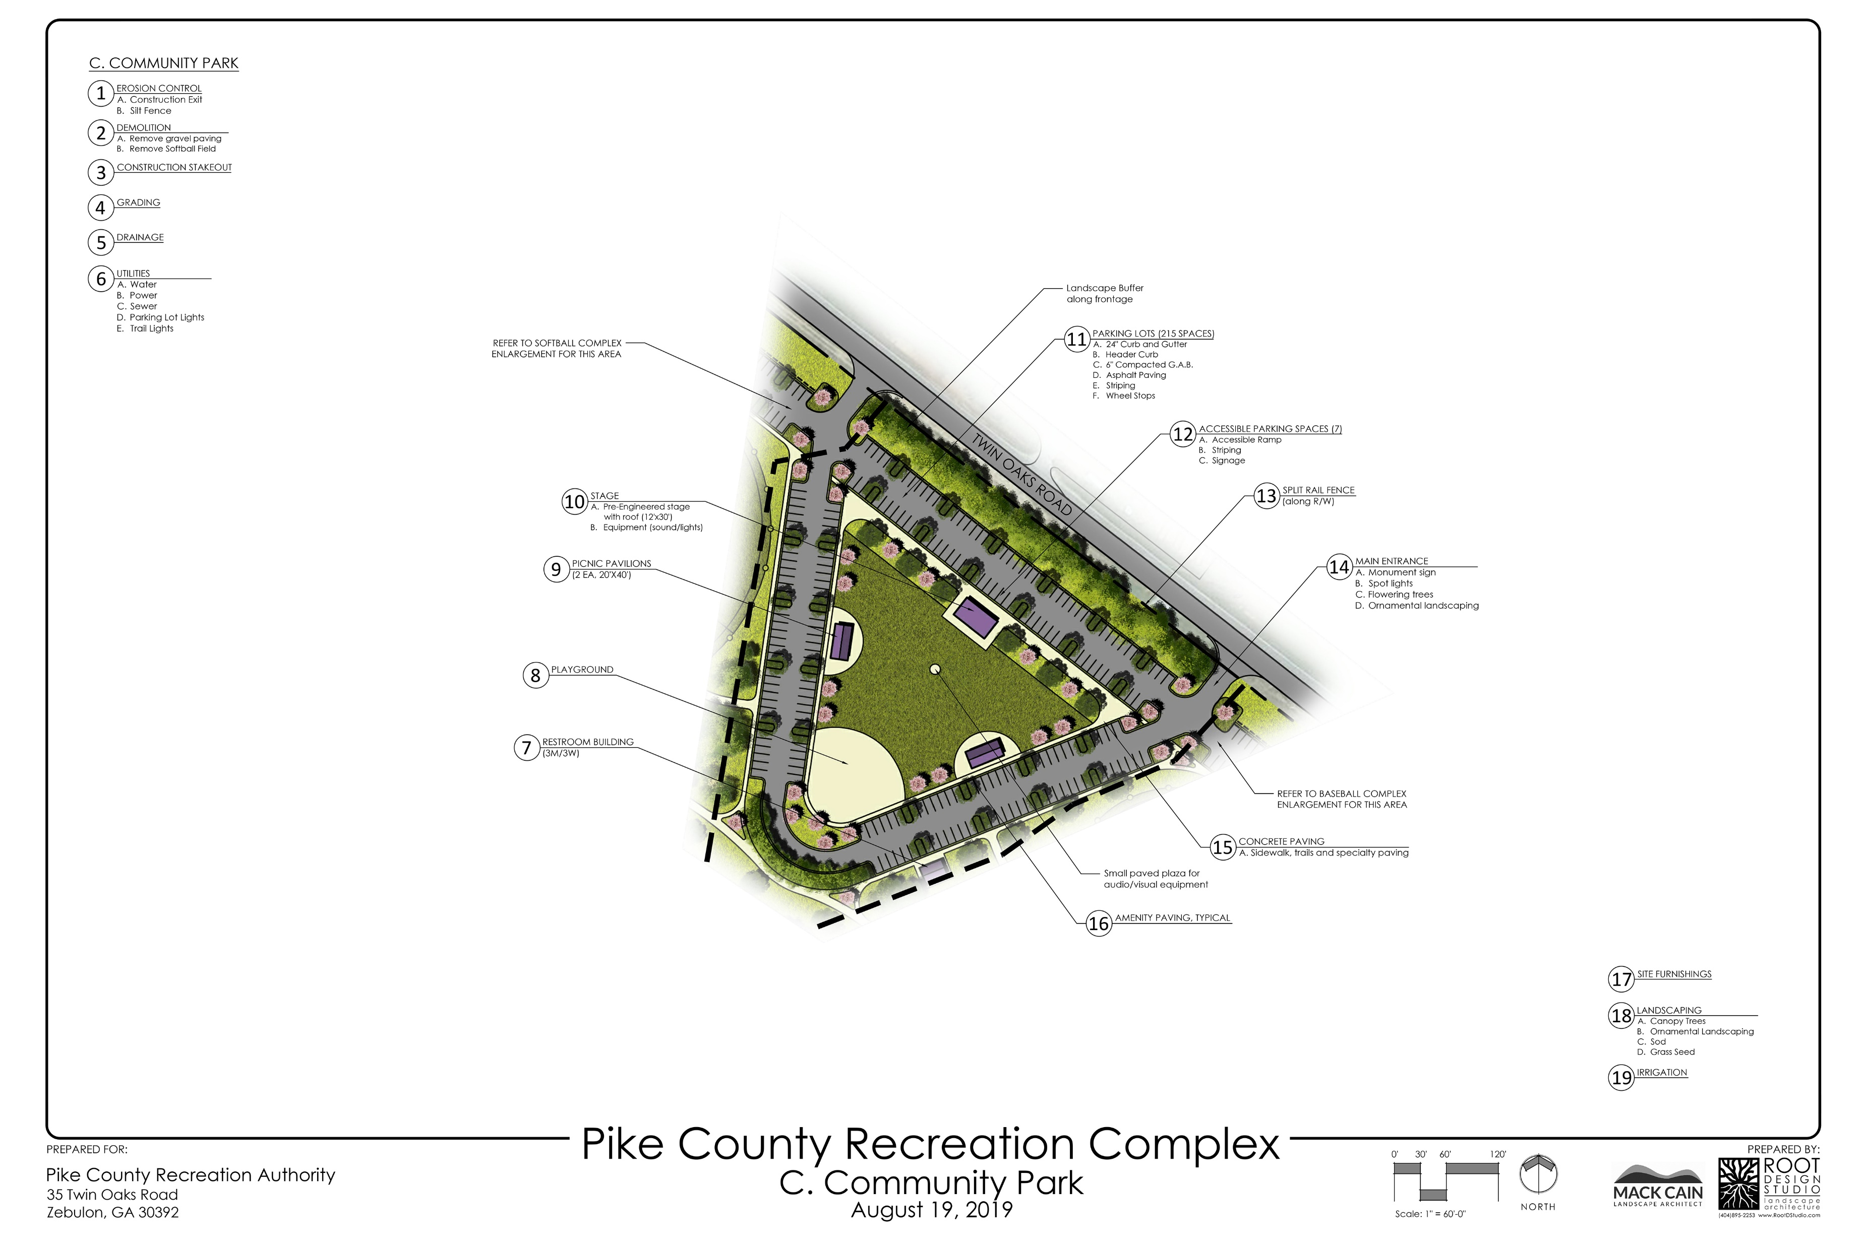
C. Community Park

Slide 28
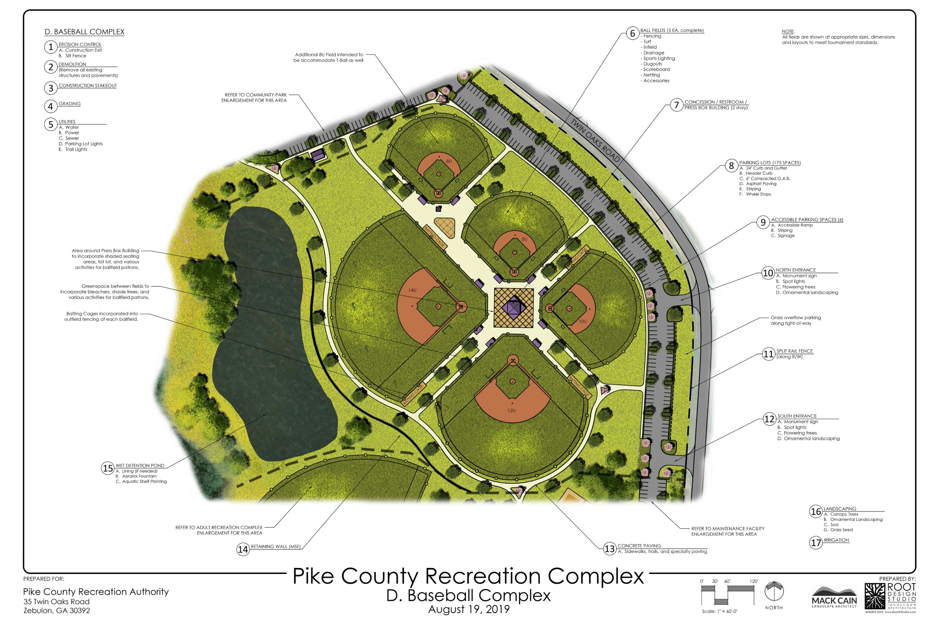

Slide 31
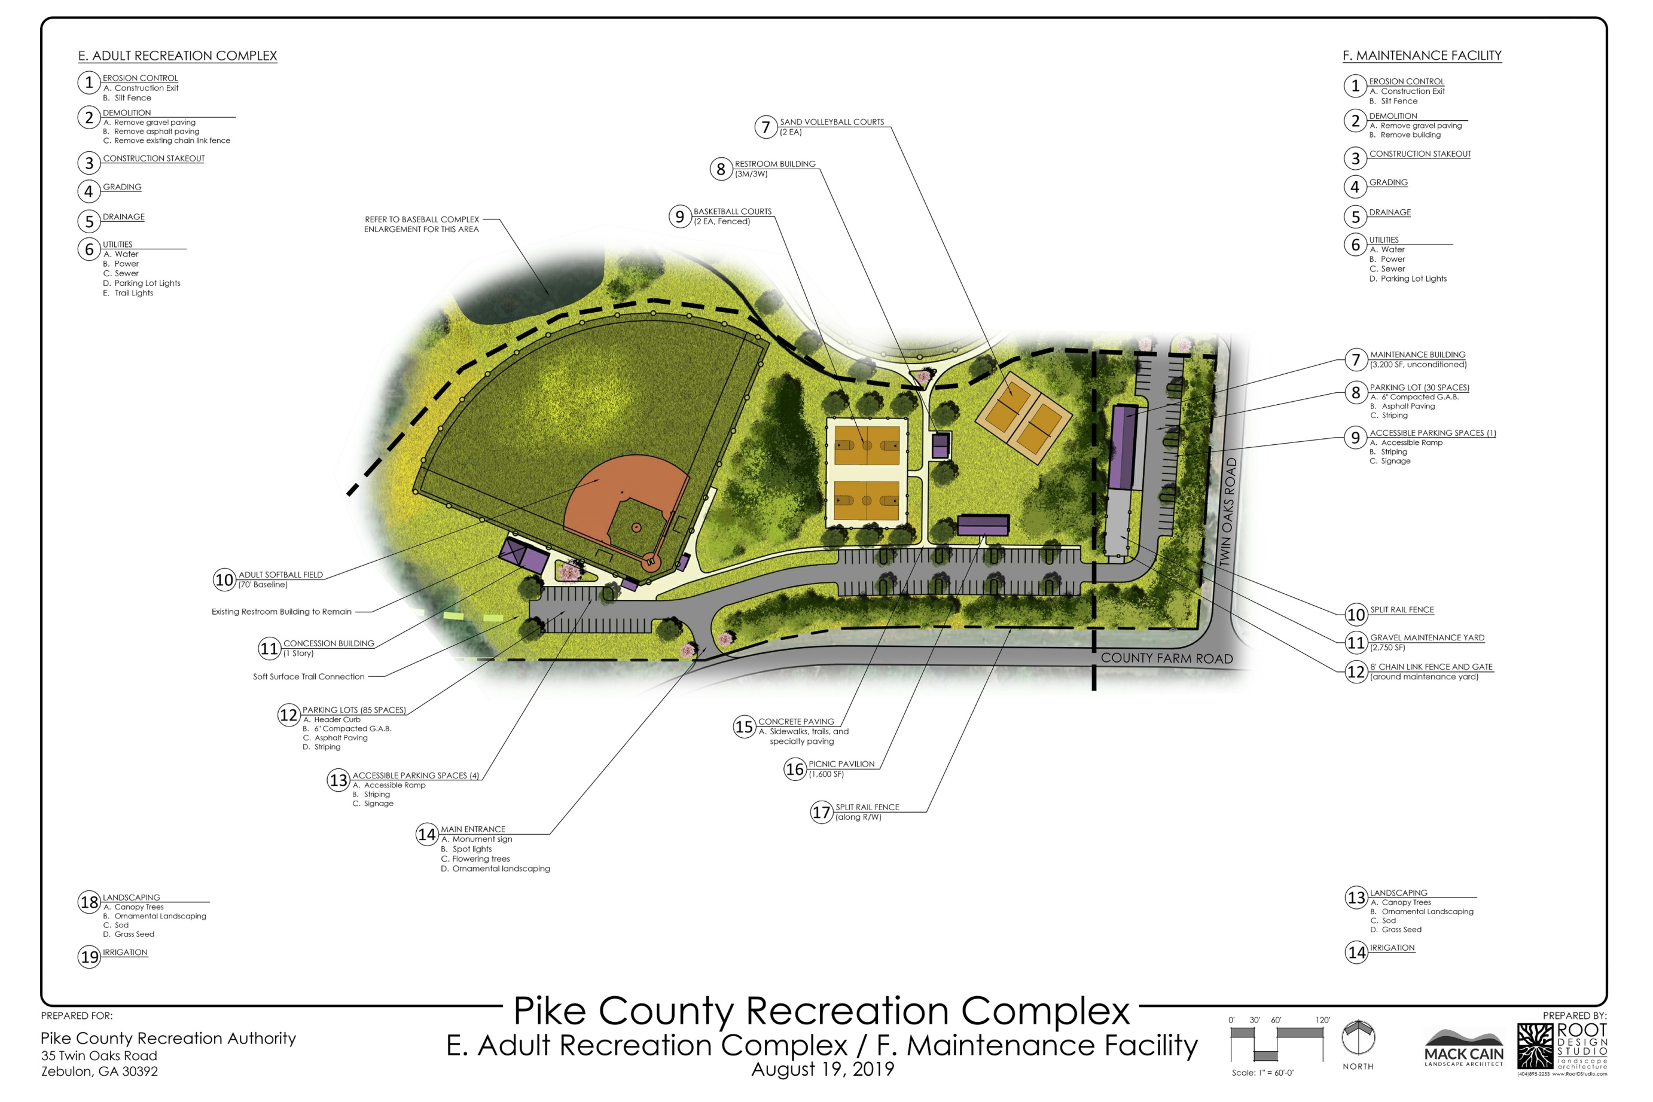

Slide 34
MASTER PLAN RECOMMENDATIONS

Slide 35

Questions & Answers

