Slide 1
Module #3 Mechanics & Rules - Fouls

Slide 2
Principles & Concepts
NOT ALL CONTACT IS A FOUL
Freedom of Movement
Disrupt, Dislodge, Displace
Rhythm, Balance, Speed, or Quickness

Slide 3
“CONTACT” Rule 10, Section 7
ARTICLE #1: A player shall not hold, push, charge, trip, impede, the progress of an opponent by extending arm(s), shoulder(s), knee(s), hip(s), or bending body into other than normal position; nor use rough tactics.

Slide 4
General Provisions
Typically, an official should rule fouls in his/her PCA
Any foul observed shall be ruled a foul (especially non-basketball contact)

Slide 5
“Clean Game”
Protect Ball Handler/Dribbler
Protect the Shooter
Protect the Rebounder

Slide 6
COMMON FOULS –Hand checking
Ball Handler/Dribbler (Rule 10.7.12)
The following acts constitute a foul when committed against a ball handler/dribbler:
a. Placing two hands on the player.
b. Placing an extended arm bar on the player.
c. Placing and keeping a hand on the dribbler.
d. Contacting the player more than once with the same hand or alternating hands.

Slide 7
COMMON FOULS (review signals)
Holding
Pushing
Illegal Use of Hands

Slide 8
COMMON FOULS –Block/Charge
Blocking is illegal contact which impedes the progress of an opponent with or without the ball
Charging is illegal personal contact caused by pushing or moving into an opponent’s torso

Slide 9
COMMON FOULS –Block/Charge
Was the defender in legal guarding position?
Was verticality a factor on the play?
Did the offensive player make contact and stop, or continue progress through the defender “to or through”
Did the offensive player head or shoulder get by the defender?

Slide 10
C – N – N- C
COLOR – “Blue, 24”
NUMBER
NATURE “Hold, end line”
CONSEQUENCE

Slide 11
C – N – N- C
COLOR – “RED, 12”
NUMBER
NATURE “Push, Two”
CONSEQUENCE

Slide 12
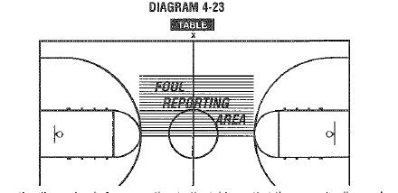
Reporting Area

Slide 13
Reporting
Move around players and proceed quickly to the reporting area
Come to a complete stop in the reporting area
Don’t allow substitutes or questions before reporting
Report Color – Number – Nature (signal) – Consequence

Slide 14
Non-Ruling Official
FREEZE his/her field of vision
Ignore the ball
Know number of fouls, status of clock, number of free throws, number of the free thrower

Slide 15
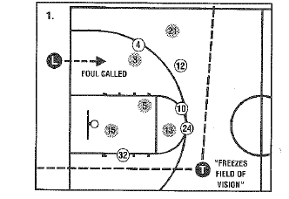
Switching

Slide 16
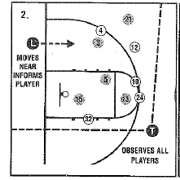
Switching

Slide 17
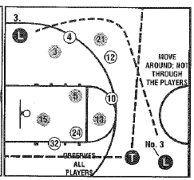
Switching

Slide 18
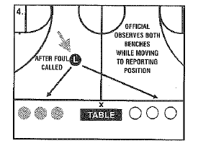
Switching

Slide 19
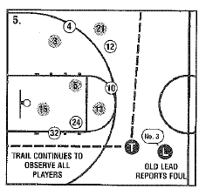
Switching

Slide 20
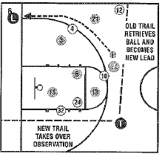
Switching

Slide 21
Held Ball
PCA Official most likely make the ruling (either may recognize)
Give signal with firm blast of the whistle
Closest official moves in (don’t turn back to players to look at the possession arrow)
Non-ruling monitors players
Check with partner and signal direction

Slide 22
Technical Foul
Ruling official reports foul and stays table side
(ruling official has option of going to lead)
Each official must be in position and the lanes cleared before administering the free throw
Trail will administer the ball at the division line opposite the table

Slide 23
Intentional Foul
Ruling official reports foul and stays table side
(ruling official has option of going to lead)
Each official must be in position and the lanes cleared before administering the free throw
Ball will be administered at the end line or side line nearest the personal foul location (aka point of interruption)

Slide 24
Disqualification Procedure
Ruling official notifies the head coach of player’s 5th foul & requests the timer to begin replacement interval (15 seconds), then notify the disqualified player (Coach-Timer-Player)
Non-ruling official takes position with the ball where the play will be resumed
Ruling official takes position at division line halfway between sideline and center circle
(ruling official has option of going away from table)

