Slide 1

Tournament Operations Presentation

Slide 2

Registration Check-In
At the host hotel: Comfort Suites Arlington – Entertainment District. 411 W Road to Six Flags Street, Arlington, TX 76011.
Check-In will be on Thursday, July 22 from 6 p.m. to 10 p.m.
The coach of each team must provide either proof of a COVID-19 vaccination or a negative COVID-19 test for all athletes and non-athletes part of their team at registration check-in.

Slide 3
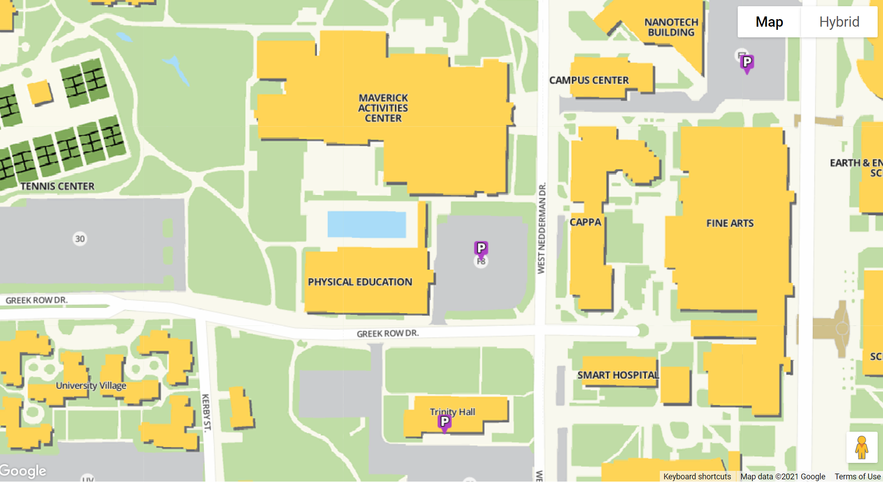
Parking
Individuals may park in lot F8 and the Trinity Lot.
All guests must register their vehicles for the weekend and pay the daily $6 parking rate.
Here are the steps to register your vehicle:
Follow the link https://utarlington.aimsparking.com/permits/?cmd=new_event
Select “Department-Hosted Event”
Select “Women’s National WCBB Championships”
Enter voucher code if applicable or select “I don’t have an event voucher code”
Select the permit type >>(will have only one option to pick from)
Select date(s)
Add vehicle info
Lot F8
Trinity Lot

Slide 4

Credentials
Entry into the competition area:
Credential or Event Ticket
Coaches and athletes must wear credential into venue.
Coaches – Credential worn at all times, including the bench.

Slide 5
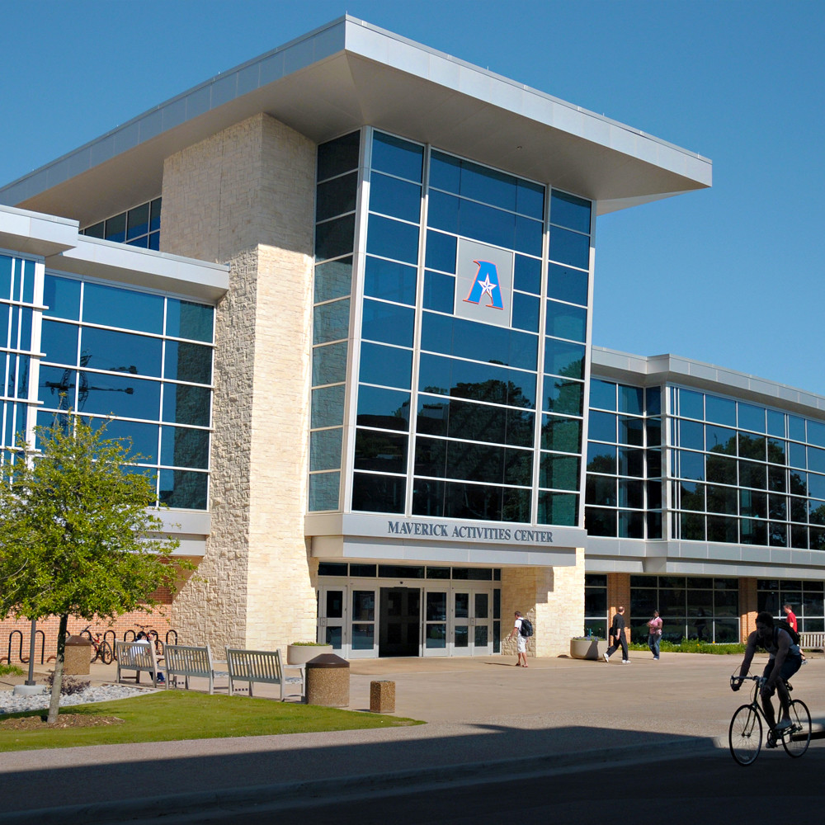
Venue
Maverick Activity Center
500 W Nedderman Drive
Arlington, TX 76013
Doors Open 7AM each Day

Slide 6
Wheelchair Storage
Wheelchair storage will be in the Maverick Activity Center. There will be signs that give direction to the specific area.

Slide 7
Jersey Colors
Pool Play: Team on the right is the home team and must wear light jerseys.
Bracket Play: Higher seed is the home team and must wear light jerseys.

Slide 8
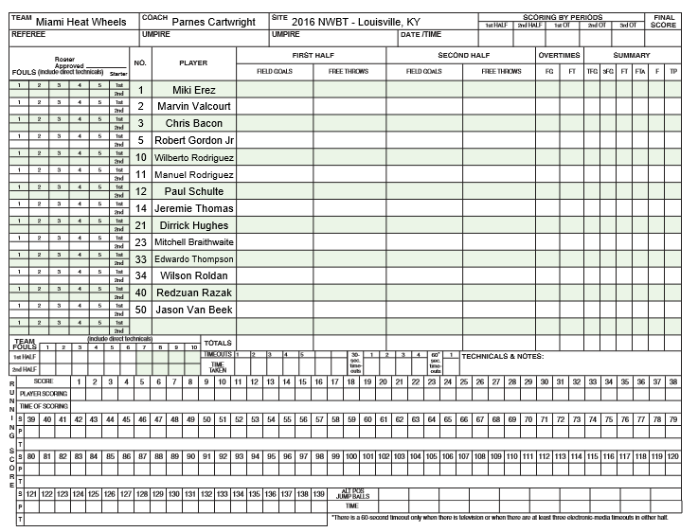

Score Sheets
Coaches must mark starters review and initial/sign their score sheet before each game.
No changes to classification or jersey numbers may be made during games. This is verified at “Team Registration” with a Team Rep signature on a Roster Verification Form to assist Classification Panels in reviewing/monitoring players based on rosters confirmed at check-in.

Slide 9
Referee/Floor Officials
Official evaluations will be available at the scorer’s table. Please take the time to evaluate the floor officials after every game.
Please direct all other referee/floor officials matters to Buddy Barnes, Lead Official for the Tournament.

Slide 10
Code of Conduct
Sportsmanship and adherence to NWBA Code of Conduct is expected from coaches, players and/or spectators.
Play hard. Play Clean. Have Fun.
Cheer hard. Cheer Clean. Have Fun.

Slide 11
Start Times
All games will start on scheduled start time. We will do our best to accommodate for warm up time.
At the end of the game, please move post game team meeting off the court so the next teams can have access to the bench area ASAP.

Slide 12
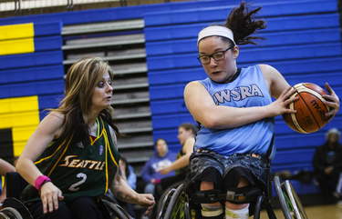
Sports Medicine
Report all injuries to the athlete trainers in the venue.

Slide 13
All-Tournament Ballot Process
Ballots will be given out at check-in.
Please submit your ballot to the NWBA Operations Room at the Maverick Activity Center by 8 p.m. Saturday, July 24. All individual awards will be presented after the corresponding championship game.

Slide 14
COVID-19
Masks Required at all times in the venue.
Masks required by athletes and officials during competition as well.
We encourage all to practice social distancing and remain in their team/family pods during the event.

Slide 15
Meetings
No Annual Meeting will occur. The Women’s Executive Committee will provide information at a later date.

Slide 16
Live Stream & Social Media
All games will be livestreamed.
  Facebook- (@NWBA70)
  Twitter-@NWBA
  Instagram- @NWBA
We would like people to use these # and tag NWBA when posting or sharing National’s news on social media:
#RollWithUS #NWBAWomensNationals

Slide 17
If you have any questions, please email nationals@nwba.org

