Slide 1

2022 CAA Softball Parent Meeting
Travel and League teams
K/1/2, 8U, 10U, and 12U

Slide 2

Agenda
CAA Mission & Values
CAA Board / Job Descriptions
Program Update and Changes
Programs – Overview
Evaluation Overview
Key Dates
Volunteering & Coaches
Equipment & Safety
Storm Fastpitch Apparel
Dugout Club
CAA Golf Tournament

Slide 3
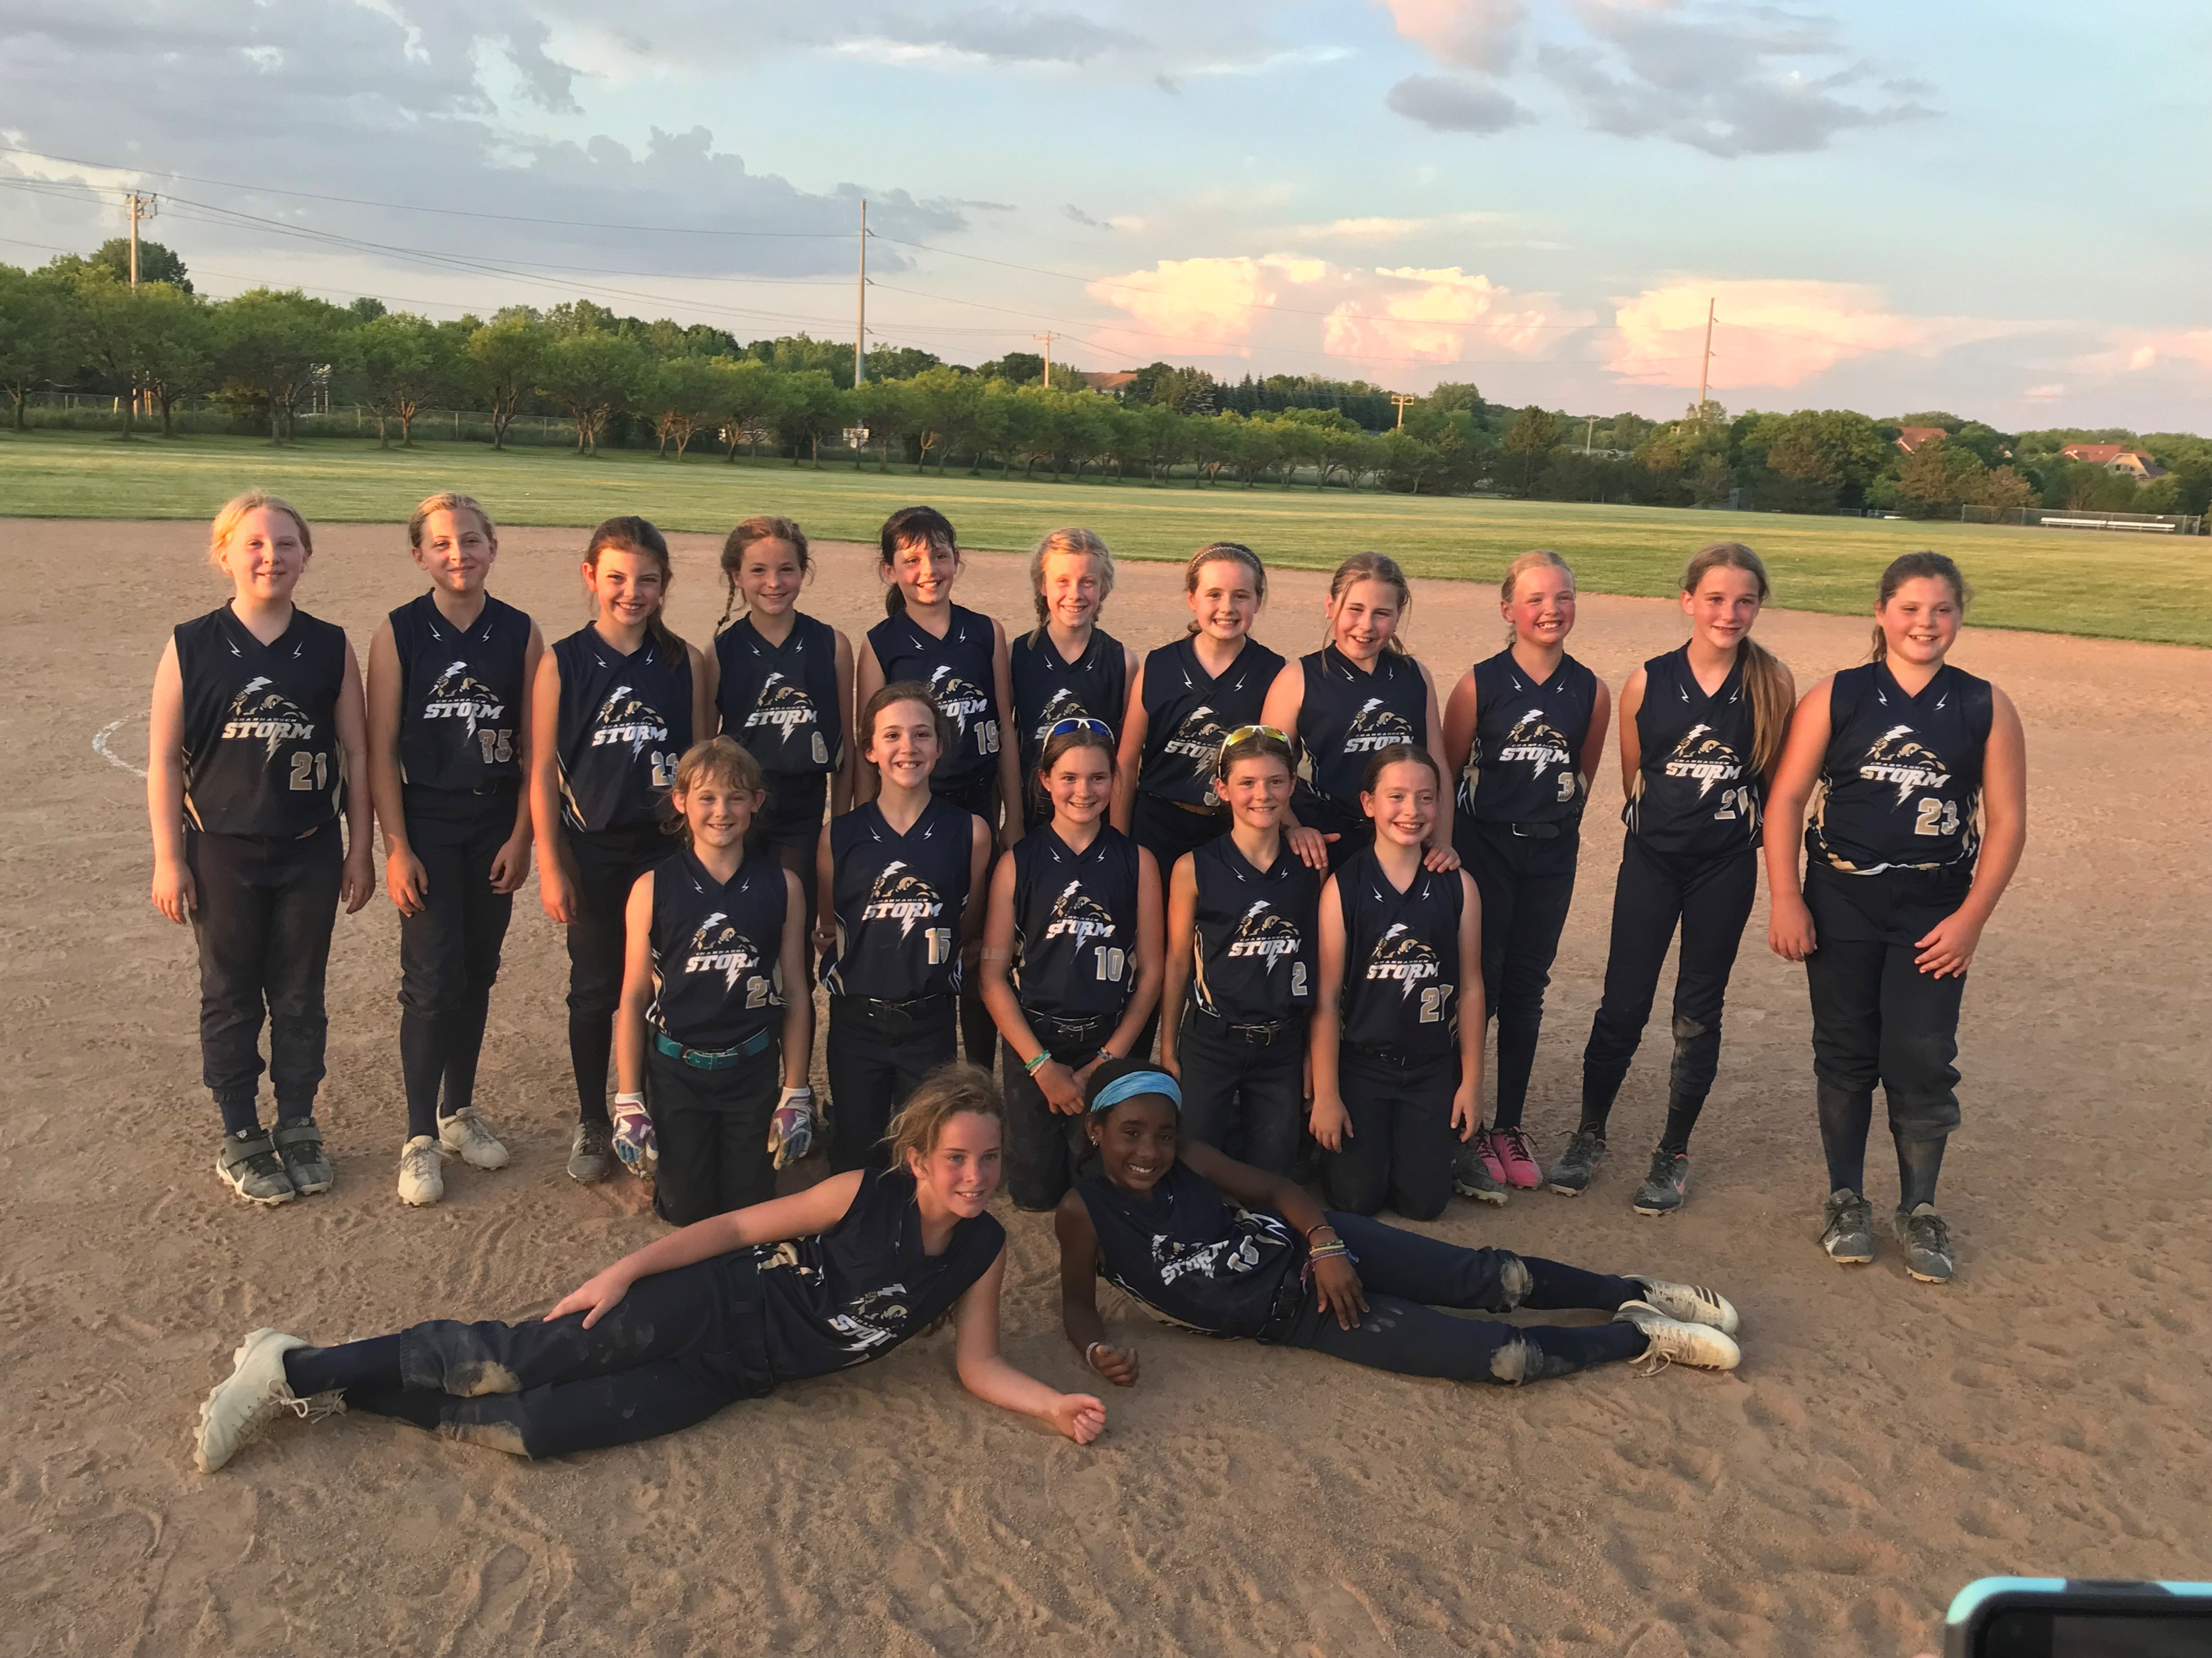

CAA Softball Mission & Values
Mission Statement:
To provide girls in the Chanhassen-Victoria area a place to play the great game of softball while developing lifelong physical and interpersonal skills, learning to compete and be a good teammate, and most importantly, having fun.
Core Values:
Team work - We work together to achieve more
Hard work - We give our all in everything we do
Pride - We are proud to represent our team, association and our communities
Respect - We treat ourselves and others with dignity, kindness and respect
Fun - We have a positive attitude and enjoy being with our team on and off the field

Slide 4
CAA Softball / Baseball Mission & Values
CAA Softball / Baseball is committed to:
Quality instruction and positive coaching that teaches fundamental skills, tactics and strategies for the game
Preparing players for the next level of play
Establishing standards of participation for all volunteers, board members, coaches, officials, athletes and spectators
Creating a positive environment in which we all work together to achieve our mission
Developing character, encouraging personal responsibility, fostering the quality of good citizenship and encouraging the growth of our players

Slide 5
Softball Operating Committee (SOC)
Mark Stay – VP Softball
Kelli Strauss – Travel Director
Katie Recker– Player Agent and Tryouts Director
Matt Birkenholz – Director of Player Development
Julie Vasatka – Uniforms Coordinator ***
Jamie Bruemmer – Equipment Coordinator ***
Julie Jost – Team Coordinator ***
Ron Johnson – Offseason Clinics and Development Coordinator ***
Open – K/1/2 Coordinator ***
Open – Softball Event Coordinator ***
***=Non-Voting Board Member

Slide 6
Openings – Job Descriptions
K/1/2 Coordinator
Coordinate with Chaska and Carver programs
Reserve fields
Coordinate parent volunteers for coaching
Ensure positive learning environment
Softball Event Coordinator
Represents CAA softball community and teams in putting together Opening Day and End of Season celebrations
Works with CAA Baseball to coordinate scheduling of events, details for merchandise and distribution at events.
Communication to softball families of details, schedule, expectations, etc.

Slide 7
Program Updates / Changes
Code of conduct updates
Parent and Coach behavior
Umpires update – MN Elite Umpires supplies our umps, this year two per game will be provided
Driven by Parent and Coach behavior
Equipment Purchases:
We have the opportunity this year to purchase some new equipment! CAA is a non-profit organization with all revenue going towards league fees, umpires, tournament registration, many administrative fees (insurance, etc), and equipment.

Slide 8
Off Season Happenings
Pitching and Catching clinics in dome over winter break
High School Varsity Players were instructors
Batting time in dome
10U and 12U teams
Pitching, Catching and Hitting clinics to be held in March/April
Held at Mission Fastpitch in Eden Prairie
Small player : instructor ratio
Great value $$$
6 week session < 2 private lessons
Registration to open this week
Coach training
More information to come

Slide 9
Program Overview: K-2 Coach Pitch
Girls entering K/1/2 Fall 2022
Nights of Play – Monday & Wednesday
Season typically runs beginning of May and ends around the 4th of July
Idea is to get girls playing, build confidence and have fun with shorter games
Use 11” soft-sided ball
NO evaluations
Casual / CAA uniforms (Indicate size at time of registration, no need to attend uniform fitting session)
Neighboring Communities (Chaska, Carver)

Slide 10
Program Overview – 8U
Girls with birth years of 2013 or 2014
Idea is to get girls playing, build confidence and have fun with shorter games
NO evaluations – same as last year
Same uniforms as League/Travel (be sure to attend uniform fitting on March 16th or March 24th)
Wednesday night games start on May 4th
65 minutes (last 2 weeks will be double headers)
Part of Big West League (same as 10U and 12U teams)
State Tournament – July 9-10
Additional tournaments will be up to each team to consider and pay for individually – there are great options available. Most 8U tournaments are 1 day only.

Slide 11
COMMON QUESTION: My daughter is in 2nd grade, should she play 8U or K-2?
ANSWER: IT DEPENDS….
Experience?
Friends?
Familiarity with softball or baseball?
Athleticism?

Slide 12
Program Overview – Travel – 10U & 12U
10U: Birth years 2011 and 2012
12U: Birth years 2009 and 2010
10U Season Timing: April - June
Double Headers Tuesdays, Practice Thursdays
Double headers Tuesdays and Thursdays in June
12U Season Timing: April - June
Double Headers Mondays and Wednesdays
Practice another weeknight (determined by coach)
Weekend tournaments:
3 weekend tournaments (included in registration fee)
Teams may opt for additional tournaments
League Qualifier (June 25 and 26)
State Tournament (July 9 and 10) (must qualify)
Nationals (must qualify)
Be sure to attend uniform fitting on March 16th or March 24th

Slide 13
Travel Expectations
It is expected that participants in the Spring/Summer program dedicate to Softball as their main in-season sport and attend all practices, weeknight games and weekend tournaments
Practice and game absences should be communicated to the coach as soon as possible
Please play catch with your daughter! It’s fun, it’s the best thing you can do to improve her confidence and it’s fun

Slide 14
Program Overview – 10U League (Rec)
10U: Birth years 2011 and 2012
NO player evaluations required
Be sure to attend uniform fitting on March 16th or March 24th
Same Rules as Travel – Big West League
Season Timing: April - June
Double Headers on Tuesdays, Practices Thursdays
Double Headers Tuesdays and Thursdays in June
Optional Tournaments
Metro Tournament Options (team must cover the cost)
State Qualifier
State Tournament (if qualifies)

Slide 15
MAIN Difference between 10U League and 10U Travel…..
# OF GAMES:
10U Travel will play at least 20 MORE games over the course of the Summer (at a higher level of competition) than 10U League
Lower cost due to no tournaments included in registration fee

Slide 16
Total Participants
It looks like there could be over 150 girls playing softball for CAA this summer. We would love to see it keep growing! Thank you for spreading the word about our amazing program!

Slide 17
Player Evaluations Overview
2022 Evaluations:
August 3rd - 4th
Pitchers and Catchers should plan on separate evaluation
ALL Travel 10U and 12U players should plan on attending
Why August?
Cost
Players “in season”
No “perfect time”
Continuity of team from fall season to summer season
Why have player evaluations?
To place player at the best skill level to have fun and also be competitive

Slide 18
Player Evaluations Overview cont.
Independent evaluators
Athletes will be scored on the following:
Hitting
Bunting
Grounders
Fly Balls
**arm strength & accuracy are also reviewed during Grounders and Fly Balls
Pitchers
Velocity, accuracy, form, multiple pitches and command
Catchers
Set up, catching, blocking, throwing to bases, tossing back to pitcher on a wild pitch

Slide 19
Team Selection Process
Team Selection Process
Top 8 athletes evaluated make the 1st team
Top 2 pitchers and catchers make the 1st team
IF there is a volunteer coach that has registered amongst the top 8, the head coach is selected.
Final roster spots are filled by 3-4 of the next highest 6 scored athletes. This is done by agreement of the team selection committee (Head Coach, Player Agent & Travel Director)
Team is approved by Player Agent and Tryouts Director, Travel Director, Softball VP, and Director of Player Development

Slide 20
Uniform Fitting
Wednesday 3/16 5-8pm OR Thursday, 3/24 5-7pm
Chanhassen High School cafeteria
Sample merchandise for parents and players
Players will be able to use the girl’s locker room

Slide 21
Key Dates – K / 1/ 2
K / 1/ 2 (Monday and Wednesday nights)
Week of May 9 – Start practice
Week of May 23 – Start games
League Games (versus Chaska, Carver or other Chan teams)
NO GAMES on May 30th or July 4th
End of Year Bash - July 8th or July 15th – location TBD

Slide 22
Key Dates – 8U
8U (Monday and Wednesday nights)
Practices Start – mid April (whenever fields dry out)
Practices Mondays, Games Wednesdays
May 4 - June 29 – League Games (last 2 weeks will be double headers)
State Tournament – July 9 – 10 (all teams are in; location TBD)
Other Optional Local Tournaments Are Available (typically they are 1 day events)

Slide 23
Key Dates – 10U and 12U
10U (typically on Tuesday and Thursdays**) | 12U (typically on Monday and Wednesday**)
Practices Start – early April | Practices Start – early April
May 3– June 21 League Double Headers (Tuesdays in May, Tuesdays and Thursdays in June) Practices Thursday nights in May | May 2– June 22 League Double Headers (Mondays and Wednesdays) Practices Tuesday or Thursday nights
3 tournaments – TBD | 3 tournaments – TBD
League Qualifier – June 24-26 | League Qualifier – June 24-26
State Tournament – July 9-10 (Must qualify) | State Tournament – July 9-10 (Must qualify)
Nationals: Must Qualify | Nationals: Must Qualify
** = NOT SET DAYS OF THE WEEK. PRACTICES AND GAMES COULD BE ADDED ON ANY DAY

Slide 24
Volunteering
WE CAN’T DO IT WITHOUT YOU
CAA is a parent volunteer organization
Volunteers are CRITICAL to making our kids’ programs a success
Each family must complete 8 hours of volunteer time by July 31, 2022.
$400 volunteer check required.
No player will be placed on a roster unless there is a check on file
Head Coach, 3 Assistant Coaches and Team Manager meet volunteer requirement
Other key positions also meet requirement (and some don’t) – need official signup
Please talk to a Board member if you have questions
All volunteer sessions will be posted on Dibs
https://www.chanathleticassociation.com/dib_sessions

Slide 25
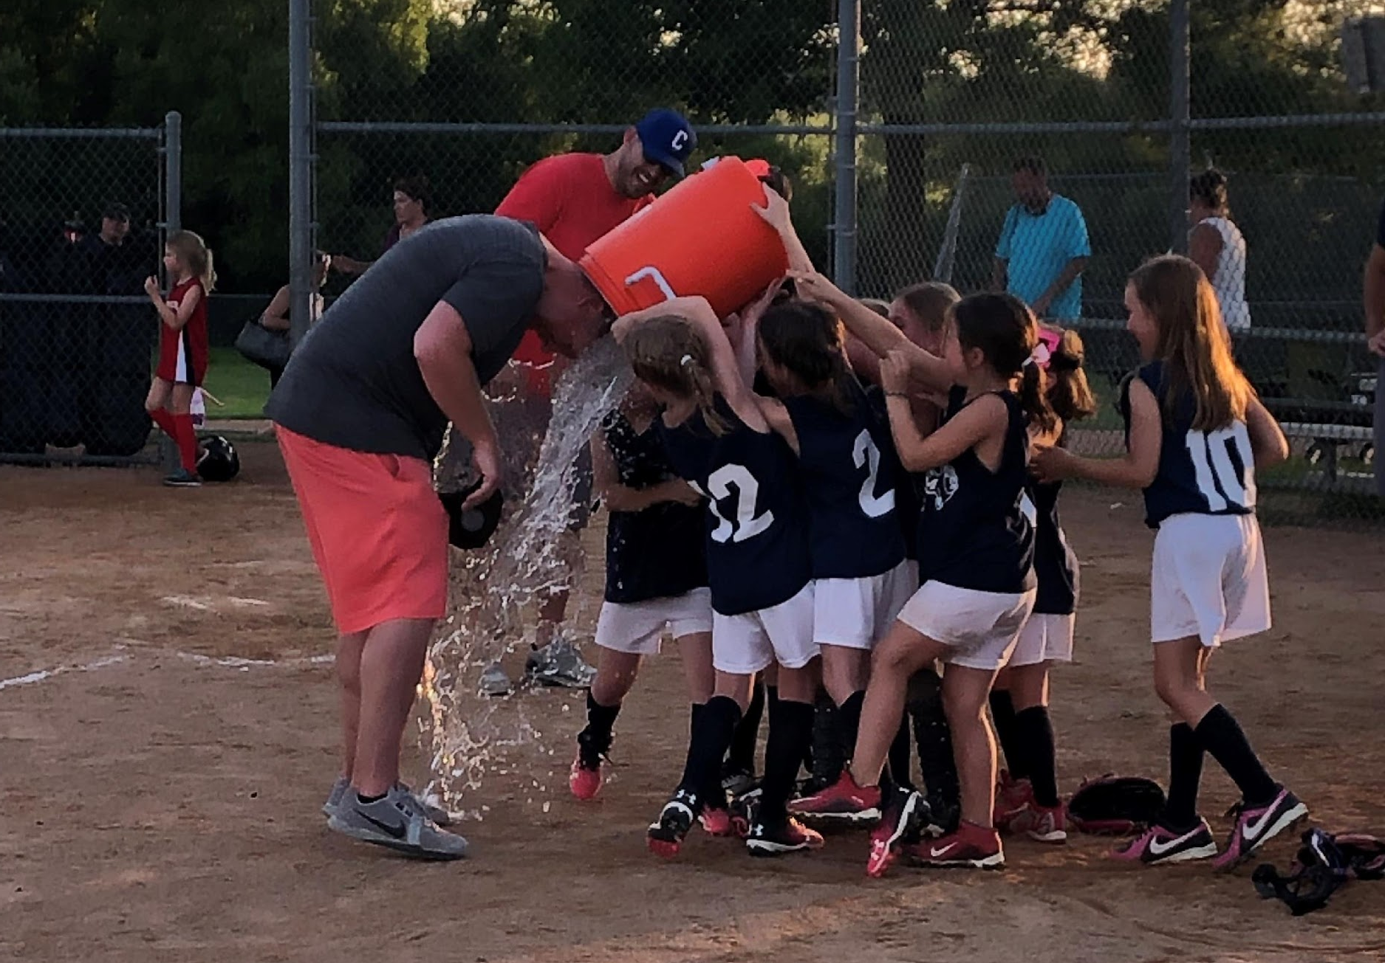
Coaches…..WE NEED YOU!!!
Coaches Registration:
Register on same site as softball registration

Slide 26
Equipment
Each player must provide their own batting helmet w/ cage, fielder’s mask, glove and bat
Yes, fielder’s masks ARE required up through 12U
Catching gear and other coach’s equipment provided by CAA
Nice to haves:
Batting gloves
Equipment bag (made for softball)
Cleats (must be molded plastic)

Slide 27


Player Safety
Abuse Awareness Training and Concussion Certification:
All on-field officials and coaches must complete concussion training and Adult Abuse Awareness Training
See safety information at:
https://www.chanathleticassociation.com/baseball-safety
Should take about 30-60 minutes to complete
For safety issues, contact Safety Officer (Shane Wasserman)
Proud to partner with TCO and OSR as Diamond Sponsors:
TCO offers sports performance, sports chiropractic services, physical therapy, and nutrition solutions in 39 locations across the Twin Cities (https://tcomn.com)
OSR offers free 15 minute injury consults, physical therapy (including throwers programs), concussion rehab, and ACL prevention programs (https://www.osrpt.com/)
Both organizations supply athletic trainers for all Chanhassen hosted tournaments

Slide 28

Fastpitch Apparel
BIG Athletics – local Chanhassen business
CAA Softball receives 10% of sales as a fundraiser
Store will be opened end of February thru mid March. Delivery of items would be mid April.

Slide 29

Dugout Club
The Dugout Club is a booster club created to support diamond sports within the Chanhassen High School boundaries. It’s primary objectives include maintenance and improvement of the stadium complex at Chanhassen High School as well as additional community development projects to provide safe, playable fields and practice facilities and equipment for the baseball and softball teams within our member communities.
In 2019 – New dugouts for Diethelm and Lake Susan Baseball and continued improvement to Bandimere Batting Cage
New Targeted Projects – indoor bathrooms at Lake Ann!!!
NEED MORE SOFTBALL PARTICIPATION (covers Volunteer Requirements)
http://www.dugout-club.org/

Slide 30
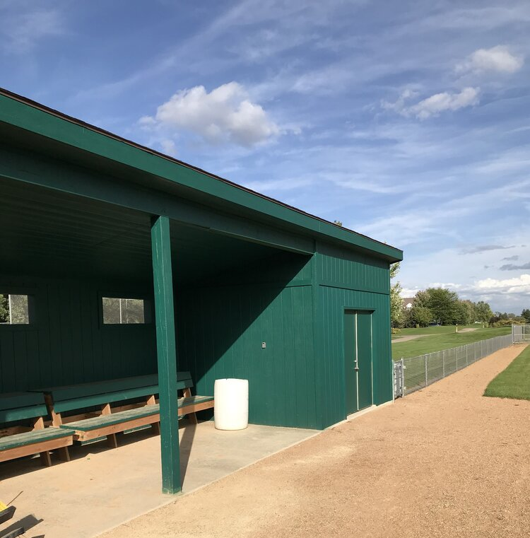
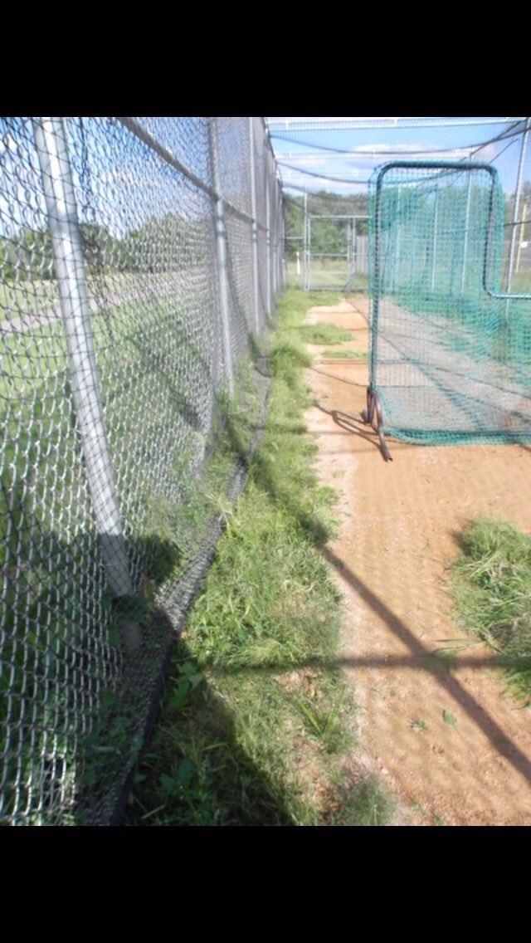
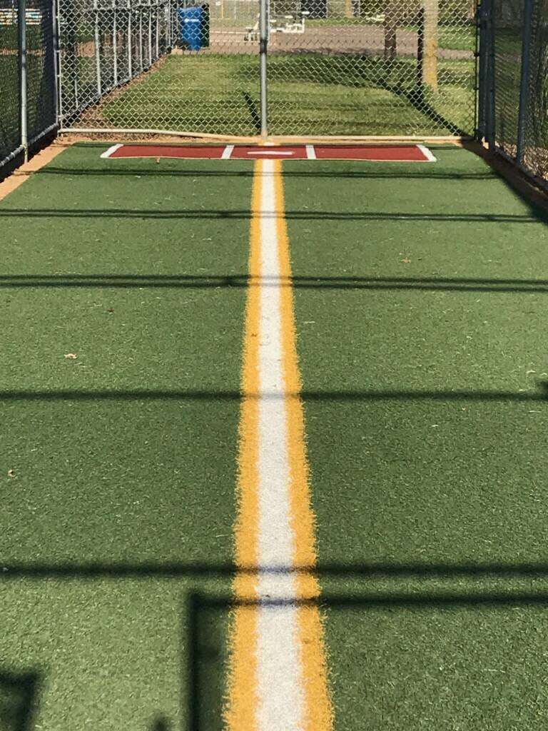
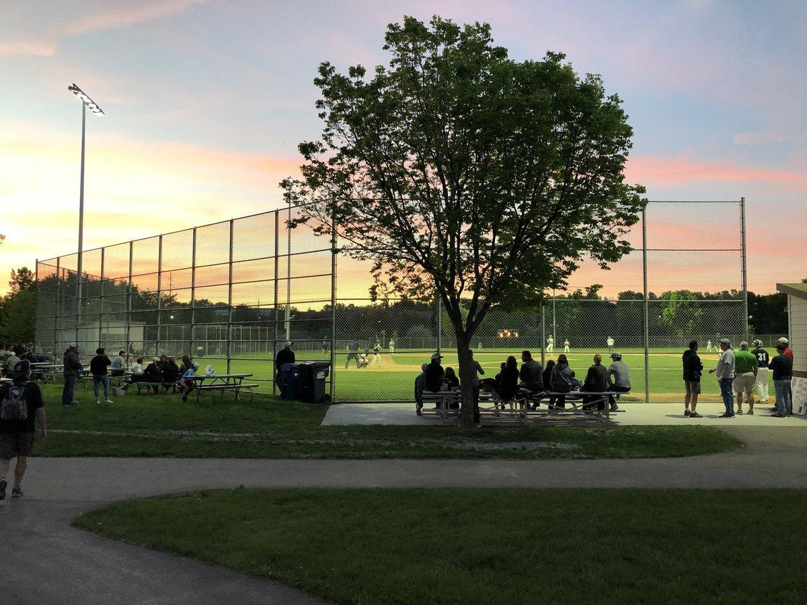
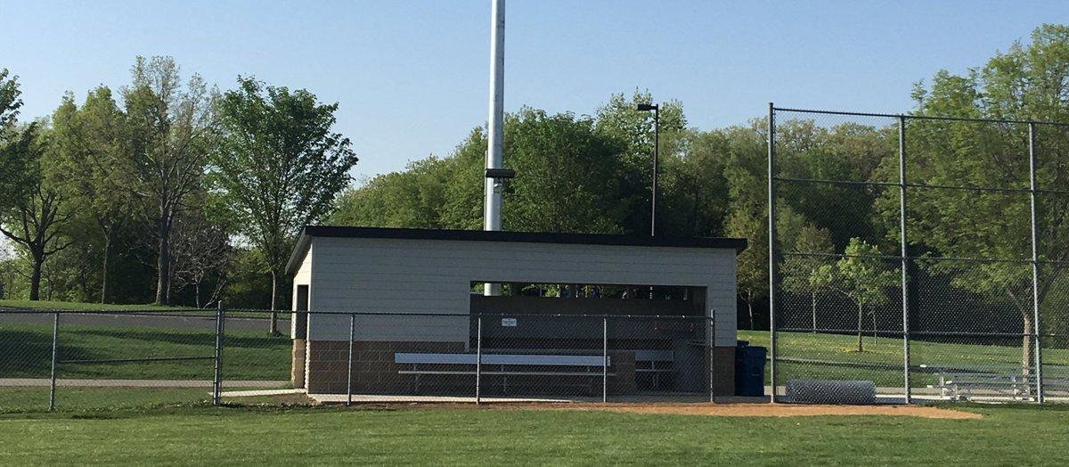
Dugout Club
https://www.dugout-club.org/ Follow on Twitter @club_dugout
Bandimere Batting Cage
New Dugouts (Diethelm & Lake Susan)
BEFORE
Lake Susan Lights

Slide 31

Diamond Sports Golf Tournament
May 2, 2022 at Deer Run Golf Club
12pm event start
$150/player includes box lunch, driving range time, 18 holes of golf, swag, silent auction and dinner
Funds raised goes towards scholarships and field improvements
Visit https://www.chanathleticassociation.com/baseball-registration to register or become a sponsor
For questions on golfing and/or sponsorship opportunities, email Jessica Hansgen (hansgenfamily@gmail.com)

Slide 32
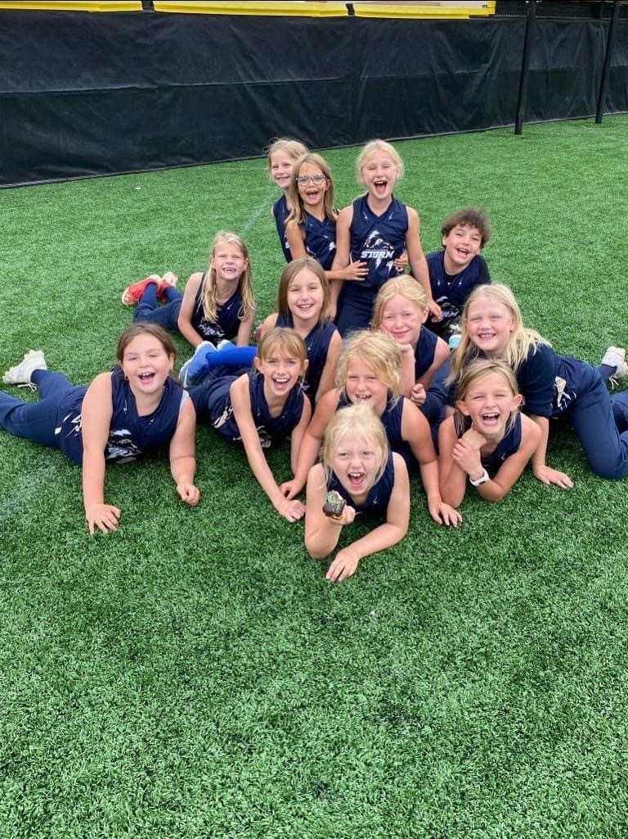
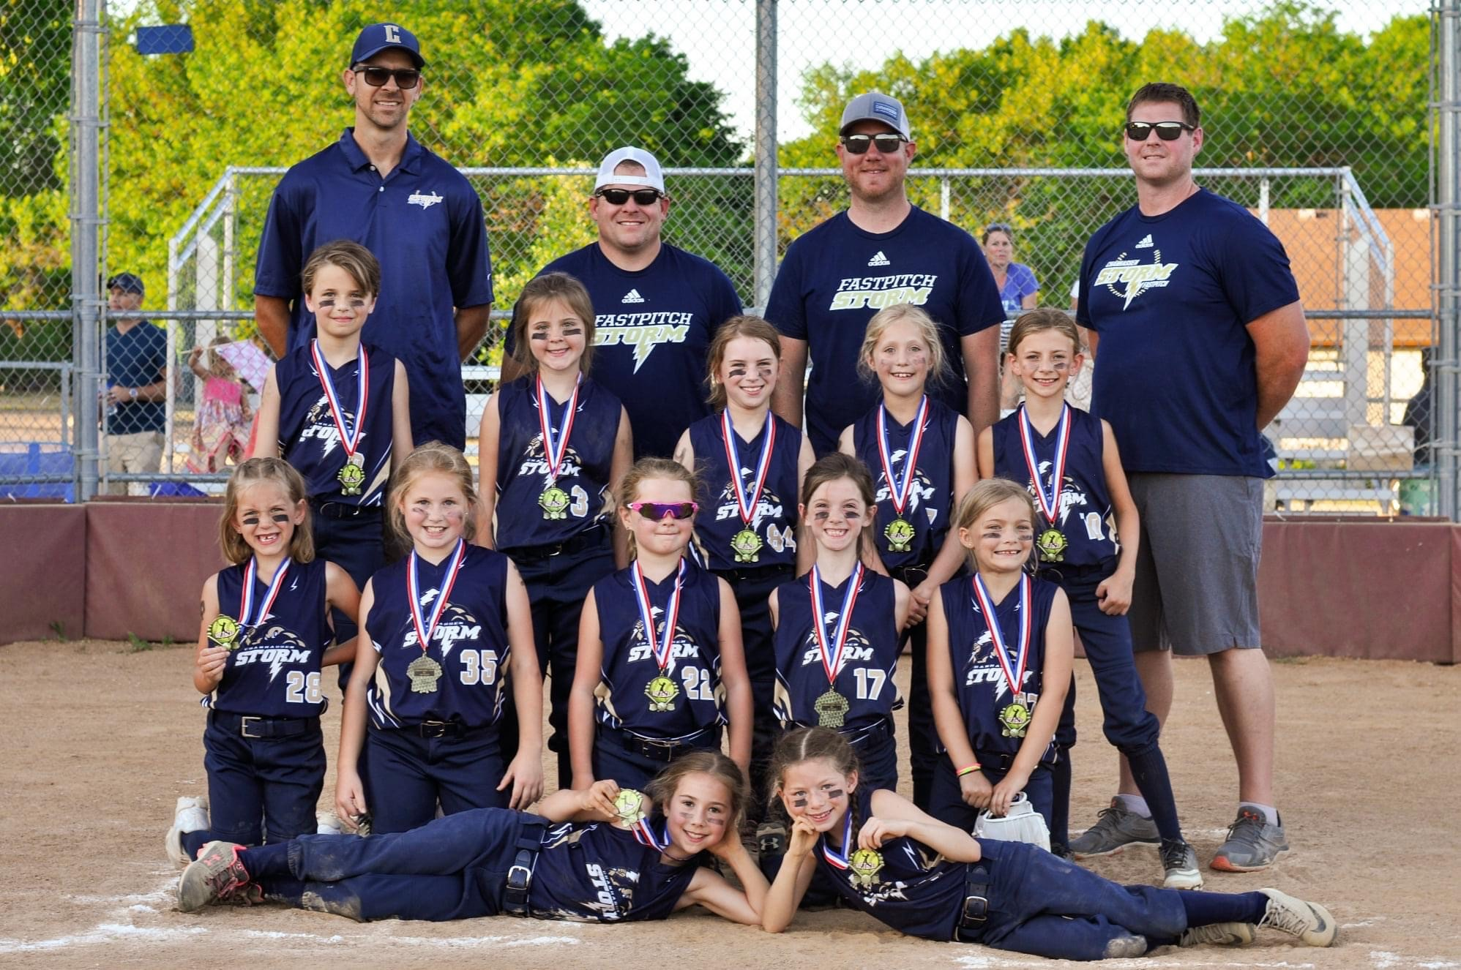
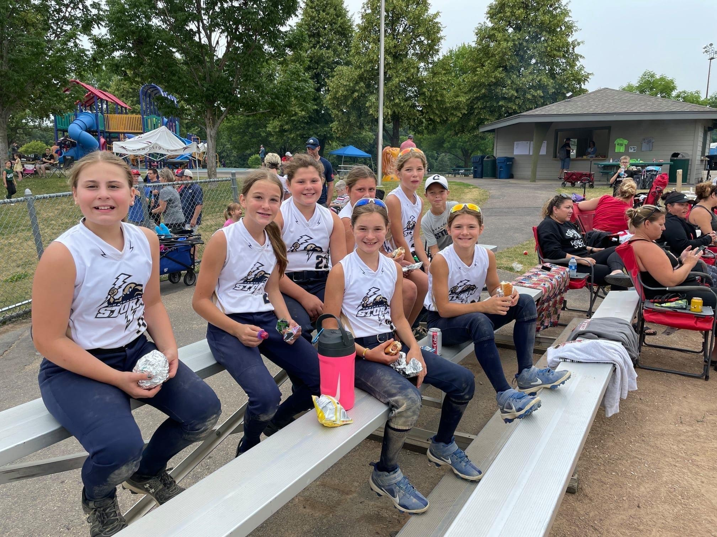
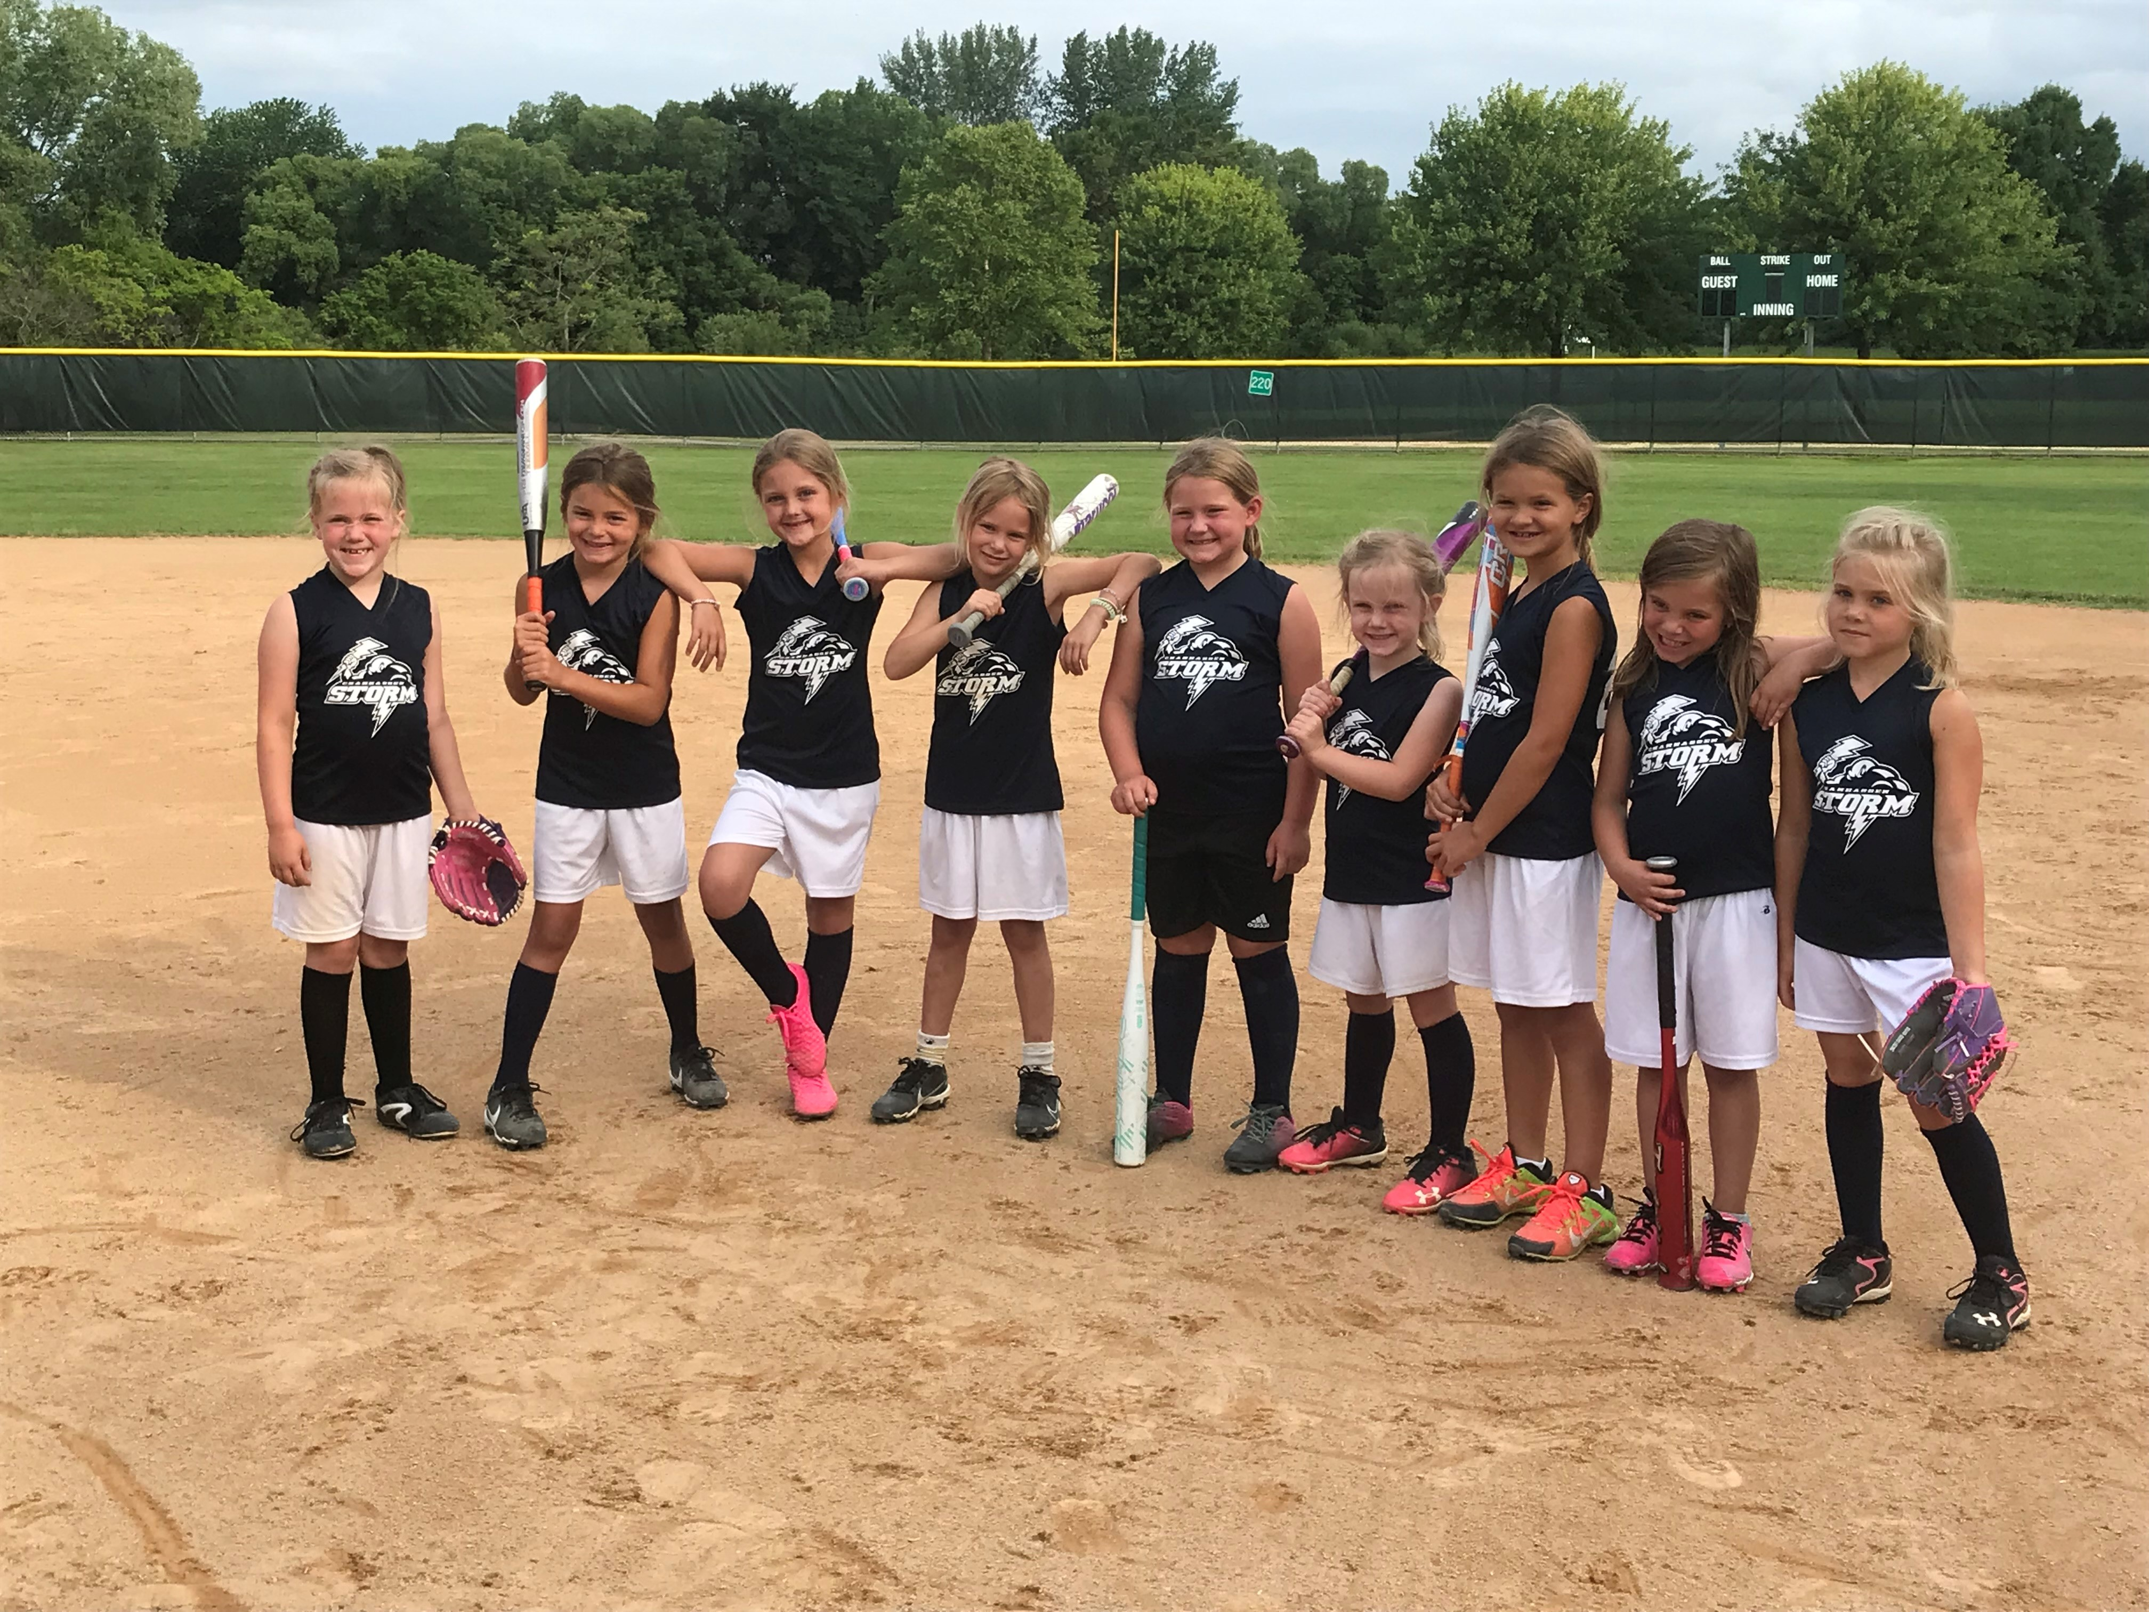
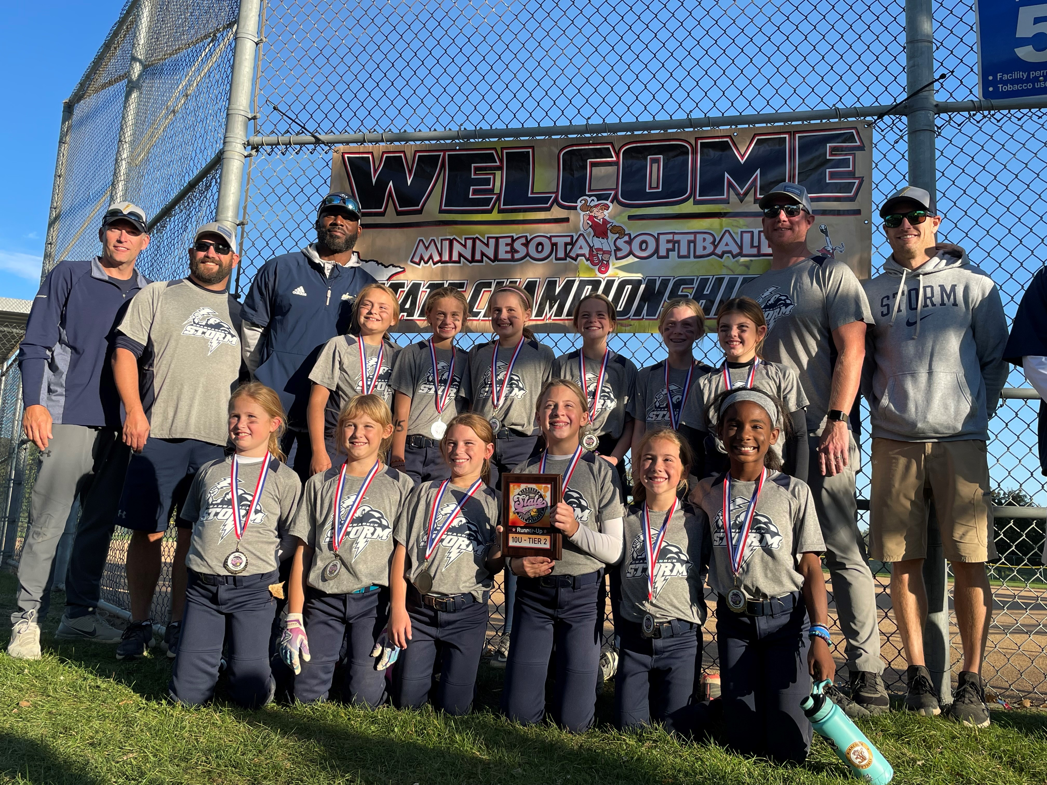
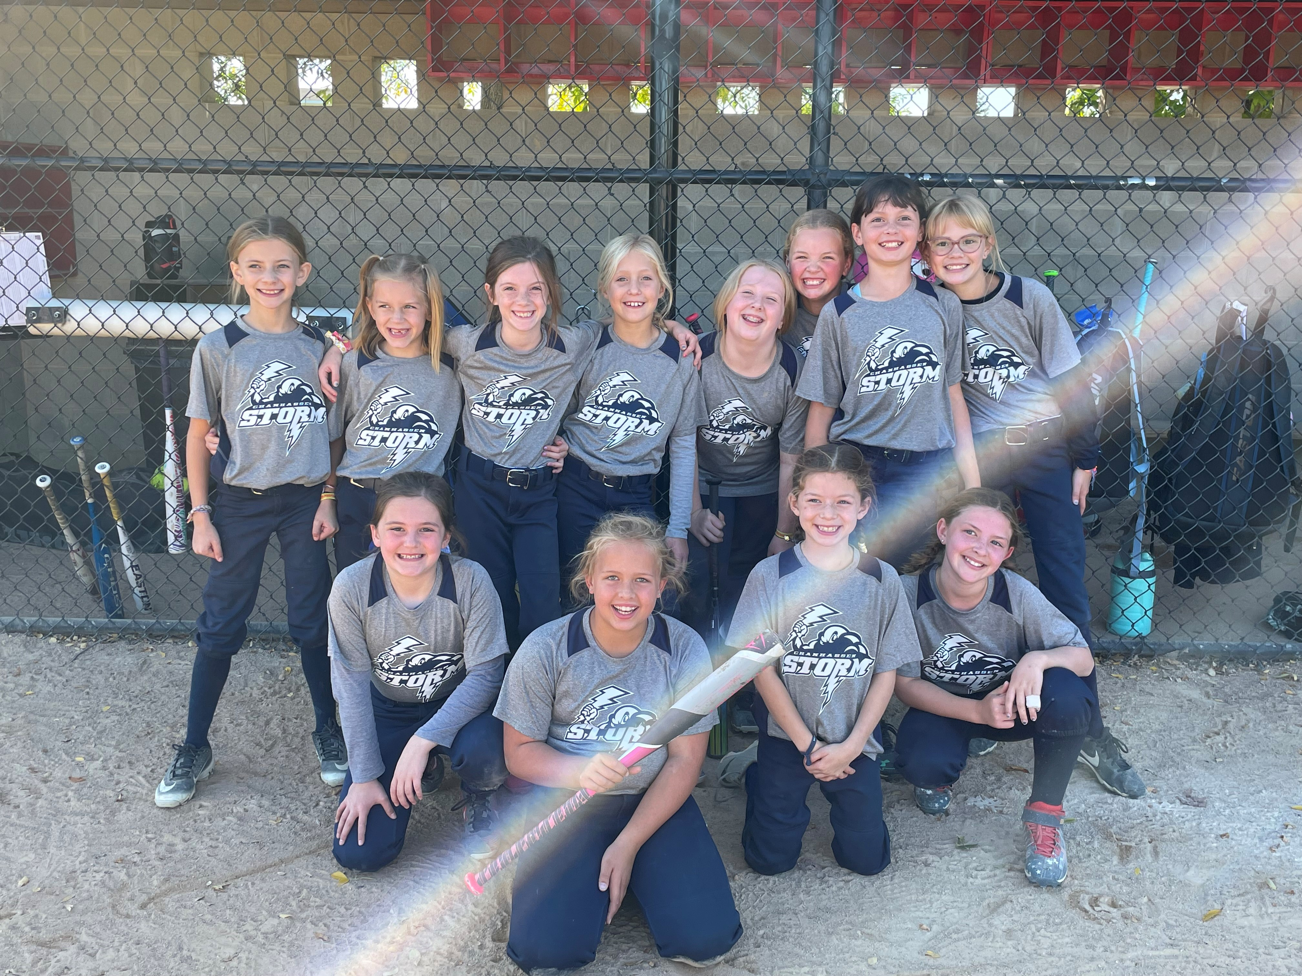
2021 Memories

Slide 33


