Slide 1

USA Hockey New England District
New Hampshire Level 1 and 2 referee seminar

Slide 2
welcome
Appearance
Registration requirements for 2022
Safe sport update
Online education modules
Open and closed book exams
Background screening
Checking online status
Curriculum

Slide 3
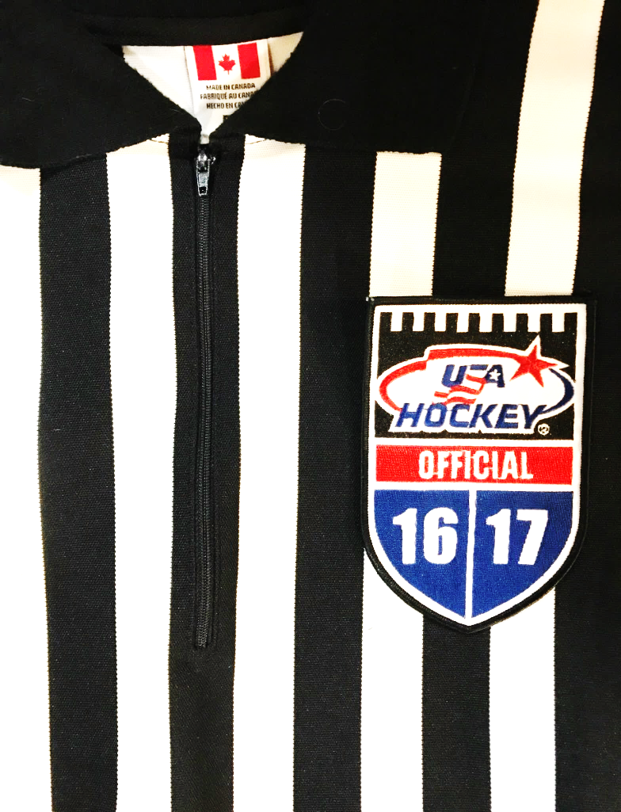
appearance
Take pride
Velcro is acceptable
Clean and proper fitting
Remove excess stickers from helmet
White laces
Proper fitting, hemmed pants
USA Patches for USA sanctioned events

Slide 4
registration
  USA Hockey Registration
  Classroom Seminar or ZOOM session
  Safe-sport Training (if 2004 birth year or older)
  Online Education Modules
  Open Book Exam
  USA Hockey Background Screen

Slide 5
Safe sport update
Starting next year will expire every 365 days.
Colorado is working on how to handle this
Have one year exemption to the rule
Those who recertify their USA Hockey may end up with expired Safe Sport certification.
No clear answers as of yet, more to come

Slide 6
On-line education modules
Each module is 3-5 minutes long
  Some as long as 15 minutes
Shorter for returning officials
You have 45* days to complete the modules
Returning L3 & L4 officials will have the option to ‘test out’ of the elective portion of their online seminar.

Slide 7
Open book test
Available 24 Hours After Registration
  Immediate feedback
    Correct v. incorrect answer
Level Specific Questions
Must attain a score of 45/50
  Retake after 7 day waiting period
  Only 1 retake allowed
  Must be completed within 30 days
  Retake of just the questions you got wrong
  Same Rule Reference, different question

Slide 8
Background screening
All officials who are 18 years-old (or older) by June 1 of the current year, must submit to a USA Hockey sanctioned criminal background screen.
USA Hockey Background Screens are valid for two seasons, and no screening process performed by an outside entity will be accepted.
$35.00 fee

Slide 9
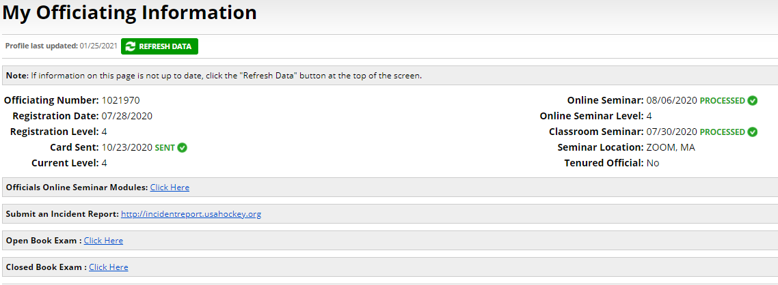
Checking online status
https://courses.usahockey.com/public

Slide 10
questions
If not, then onto the curriculum.

