Slide 1

JERSEY PROJECT
Board Proposal – February 14th, 2024
Subcommittee:
Josh Holte, Jared Roe, Salena Russell, and Sam Schroeder

Slide 2

Team Project Scope
Research the purchase of new jerseys.
Maintaining Lakers Brand Identity across the Organization.
Review companies and select one for jersey purchase
Develop a cost structure and Communication Plan.
Create a process to replenish jerseys in the future.

Slide 3
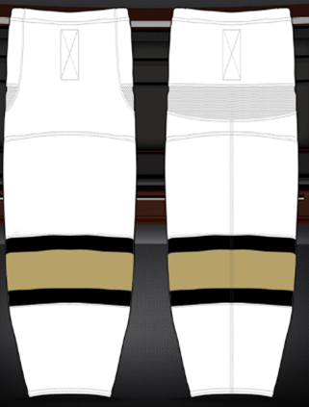
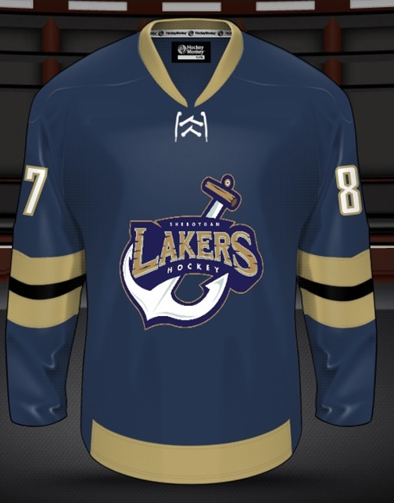
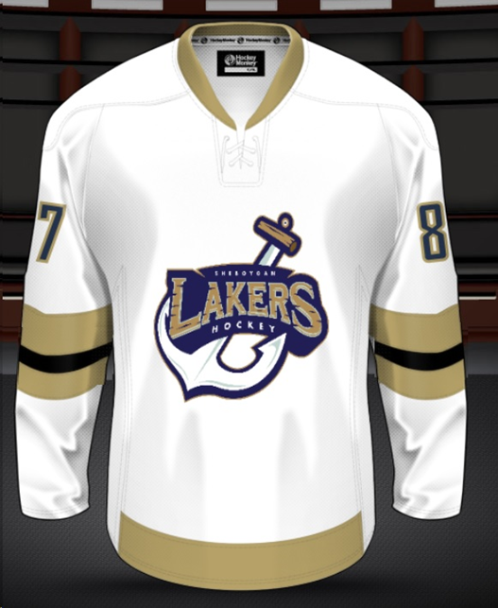
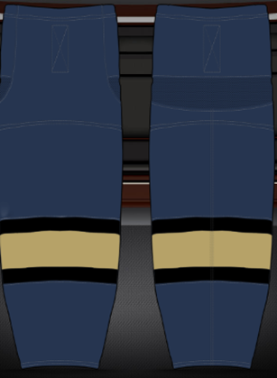
Jersey Design

Slide 4
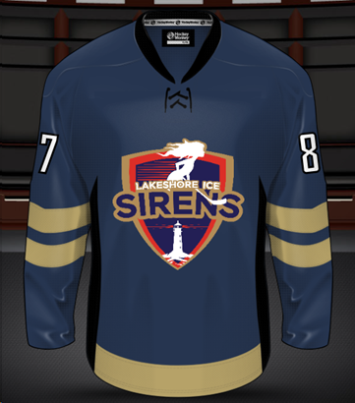
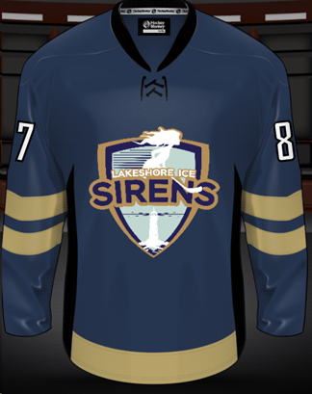
Jersey Design - Sirens

Slide 5
Jersey Style Options
#1 Cut & Sew
– Similar to the current “Team” jersey
#2 Sublimination
– A printed version of a jersey
#3 Screen Printed
– Current “First Ice” Jerseys

Slide 6
First Ice <U6
Player Levels:
First Ice <U6
Jersey Type - #3 Screen Printed Jerseys
*The will be the same as Practice Jerseys and would be provided to the skater by the Lakers Organization as part of their fees.

Slide 7
Mite Level U8
Player Levels:
Mite Level U8
Jersey Type - #2 Sublimination
$42 x 2 colors Home and Away
* Practice Jerseys and would be provided to the skater by the Lakers Organization as part of their fees.

Slide 8
Competitive Levels
Player Levels:
Competitive U10 / U12 / U14
Cut and Sew Jersey – (Home and Away)
$92 each, includes Front Logo, Back Number and Sleeve Number
* Practice Jerseys and would be provided to the skater by the Lakers Organization as part of their fees.

Slide 9
Company Selected
Hockey Monkey Package:
- $20 sponsorship per player to be distributed as you see fit.
- Team VIP weekend Online which would provide the member of your organization a code to be used to get 15% most products online.
- Online Team store set up with uniform and apparel if you would like.
- If your organization decides to buy the rest of their team items through us including but not limited to Apparel, gear, bags etc.. we will explore and even bigger sponsorship.

Slide 10
Custom Hockey Socks
Competitive Level
$25 dollars

Slide 11
Vote for Proposal Plan:
Plan A:
#1 Cut & Sew – Competitive Level
#2 Sublimination – Mites
#3 Screen Printed – First Ice
**Screen Printed – Practice Jersey for Every Skater

