Slide 1

2025
DeWitt Junior PantherS
Football
Parent Meeting

Slide 2
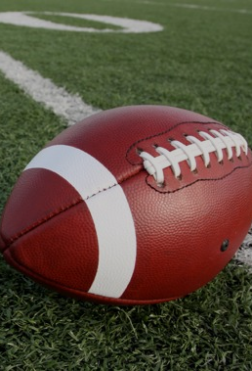
Introductions
President – Brian Brown
Vice President – Jody McKean
Treasurer – Tara miller
Secretary – Kristen Hampton
Board Members
Heidi Lenneman April Babb todd jorns
Krista Cornell Ron Slater Kristi coe
bruce Gallagher Corey Feldpausch leah clark
Matt brege

Slide 3
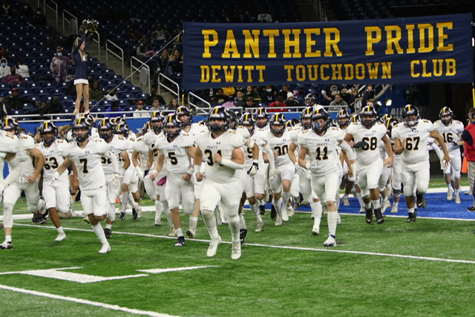
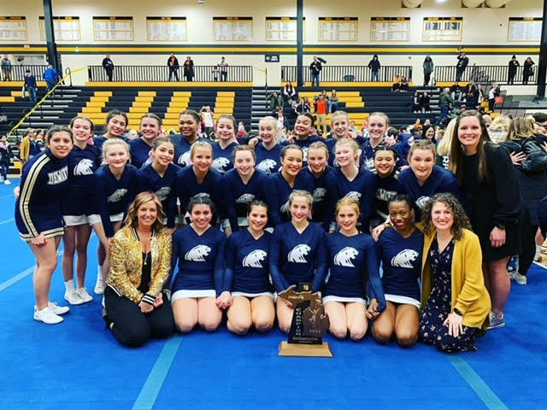
Championship Programs all start somewhere...
“It's unbelievable," Debri said. "'Ever since fourth grade, we've been dreaming about this moment right here. We've got one more game to go, but ever since fourth grade this team has said we're going to Ford Field and we're going to win a state championship. I couldn't be more proud of the guys. It's a surreal moment.” Lansing State Journal (January 2021)
Tommy McIntosh would stay after games to talk with kids in the DeWitt Junior Panthers football program.
“Growing up, I really idolized the football team … when those kids come up to us, I just try to put myself into their shoes and what kind of interaction I would want to have if I was a kid meeting my varsity football idol,” said McIntosh. “I have a lot of fun with those experiences.”
Congratulating the 2021 Football and Cheer State Champs!

Slide 4

Overview of DJP
Established in 1995 to promote organized and structured football and cheerleading within the community of DeWitt.
A feeder program to prepare athletes for the DeWitt High School Football and Cheer teams.
Encourage all those who desire and are able to participate.

Slide 5
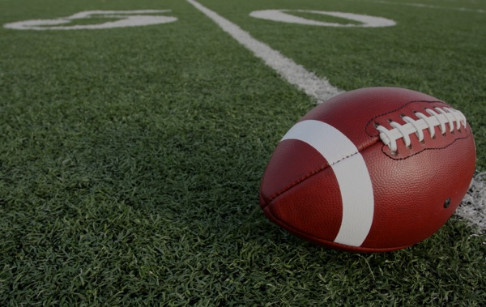
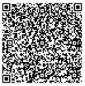
Registration
Early Bird Registration (NOW- April 30) Cost = $175
Registration (May 1 - May 31) Cost = $200
Late Registration (June 1 – June 30) Cost = $250
Payment is due in full at time of registration OR via payment plan, with down payment & installments made in April, May & June (paid in full).
Scholarship assistance – Please contact us at:
dewittjuniorpanthers@gmail.com
Subject: Scholarship Assistance
Attn: Tara Miller - Treasurer
Register Here!

Slide 6

Football Equipment
Equipment provided by players/parents
Helmet
Shoulder pads
Girdle (hip, tailbone, thigh pads)
Knee pads
Practice pants (integrated pants may include girdle and knee pads all-in-one)
Football Cleats
Knee-high socks
Mouth guard
Water bottle
Athletic Supporter - suggested
Provided by DJP
2 game day jerseys (1 home & 1 away)
Game pants
Belt
Practice Jersey

Slide 7
Sports Physicals & Conditioning
Physicals – DJP will follow the MHSAA policy dates for 2025-26 season.
Must have a recent physical dated on or after 4/15/2025
DJP will need a COPY of both sides of your Child’s physical form.
Players will not be allowed to start conditioning if a COPY of their physical is not turned in.
First week of practice
Grades 4th – 6th : Week of August 11th
Grades 7th – 8th : Week of August 25th
Conditioning – Mandatory 8 hours with helmets, cleats, mouth guards prior to practicing with pads
** NO pads until after the 8 mandatory conditioning hours are met for each player. Physicals must be on file before players can begin conditioning.

Slide 8
Football – Important Dates
Dead Periods (No coach/player contact)
Grades 4th – 6th
June 30 – July 6
August 4 – August 11
Grades 7th – 8th
June 30 – July 6
August 11 – August 24
First Games
Grades 4th – 6th (Mid-Michigan Pony Football - MMPFL): Saturday, September 6th
Grades 7th – 8th (Middle School League – MMMSFL): Wednesday, September 10th

Slide 9

Important Dates – Summer Football Camps
The DeWitt High School Football Program is offering football camps this summer for our Junior Panthers!
These camps are hosted by DeWitt High School Football Coaches, Current DeWitt Varsity Football Players and some Alumni DeWitt Varsity Football Stars.
REGISTRATION IS LIVE!
You can register your athlete at www.pantherfootballcamps.com
Football Camp - Grades 4th – 6th
$91 - June 18th – 20th (8:30am – 10:30am)
Football Camp - Grades 7th – 8th
$91 - June 18th – 20th (2:00 pm – 4:00 pm)
Quarterback/Receiver Camp (GRADES 7 & 8 ONLY)
$106 - June 23rd – 26th (5:30 pm – 8:00 pm)
** MUST REGISTER BY 6/9 TO RECEIVE A CAMP TSHIRT

Slide 10
Football Parent Volunteer Expectations
**Football games cannot happen without game day parent volunteers**
Parents are expected to volunteer a minimum of
6 hours each season
Typical Game Day volunteer needs
Concessions (2-3)
Announcer (1)
Game Clock (1)
Spotter (1)
Chain Gang (2)
Parent representative (Team Manager)
Assist with Fundraising

Slide 11
Football Parent Expectations - practices
Parents should refrain from staying at football practices. Parents should expect to drop their players off at practice, and pick them up afterward.
DJP’s primary focus during practice is to provide players an opportunity to develop their skills, focus on the game, and work together as a team in an environment free from distractions.
Allowing players to engage fully in practice fosters independence, responsibility, and concentration, while also ensuring that our coaching staff gives their full attention to player development without external interruptions.

Slide 12

How Does DJP Generate Income?
Registration Fees
Spirit Wear
Concession Stand
50/50 Raffle
Personal Donations
Corporate Sponsorships
Fundraising

Slide 13
What does djp use raised funds for?
Required Program Insurance for all DJP Athletes
Annual School Property & Field Use
Year-round Football Game and Practice Field(s) Maintenance
Press Box & Concession Stand/Snack Shack Maintenance
Athlete Practice Jerseys
Practice Pads, Sleds, footballs, & other equipment
Referee & Official Payments

Slide 14
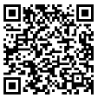
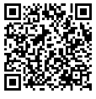

DJP Communication
DJP website – www.dewittjrpanthers.org
Join our Facebook Page!
Join our Equipment buy and Sell Page
Coach or Team Parent Representatives
If you have a concern:
24-hour rule
Contact the coach
A formal complaint form is available from all coaches and on the DJP website. These will be reviewed by the Board.
DJP Facebook Page
DJP Buy and Sell Facebook Page
DewittjrPanthers.org

