Slide 1
In-House Basketball Boys & Girls Parent Meeting
K-2nd Grade
2025 Season
Notes:
WELCOME to your parent meeting of 2024-2025 for In-House Boys & Girls Basketball.

Slide 2
BOYS In-House Basketball Point of Contacts
NOTE:
To change images on this slide, select a picture and delete it. Then click the Insert Picture icon
in the placeholder to insert your own image.
GRADE LEVEL COORDINATORS
K: Jessica Heckman (boysinhousebasketballK@playinfo.org)
1st: Tim Charbonneau (boysinhousebasketball1stgrade@playinfo.org)
2nd: Jackie Scheele Groth (boysinhousebasketball2ndgrade@playinfo.org)
Notes:
Boys Grade Level Coordinators

Slide 3
GIRLS In-House Basketball Point of Contacts
GRADE LEVEL COORDINATORS
K/1: Nick Ehret (girlsinhousebasketball2ndgrade@playinfo.org)
2nd: Nick Ehret (girlsinhousebasketball2ndgrade@playinfo.org)
Notes:
Girls Grade Level Coordinators

Slide 4
Directors
BOYS IN-HOUSE DIRECTOR
Kelly Sykora
boysinhousebasketball@playinfo.org
GIRLS IN-HOUSE DIRECTOR (Open position 2025-2026 year)
Melissa Lamusga
girlsinhousebasketball@playinfo.org
**PLEASE CONTACT GRADE LEVEL COORDINATORS FIRST FOR QUESTIONS**
Notes:
Current Directors and then note that parents and coaches should contact grade level coordinators first before emailing the directors.
Note: Girls In House Director position is open next season and if you are interested in shadowing this year to transition into the role next year, please reach out Melissa Lamusga or Aaron Arterbury, VP PLAY Basketball

Slide 5
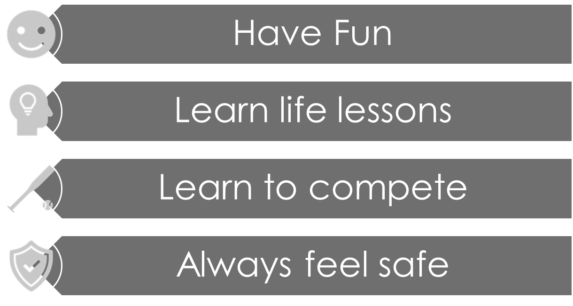
PLAY ORGANIZATION
PRIMARY GOAL OF P.L.A.Y. PROGRAMS
FUN FACT ABOUT PLAY
PLAY IN-HOUSE BASKETBALL IS 100% RAN BY VOLUNTEERS
PLEASE
Be Kind, Respectful, and Patient
Notes:
- For the athletes to have fun - The primary goal of our coaches and players should be to have the athlete enjoy their experience so much they want to keep playing the sport.
- For athletes to learn life lessons - Every success or failure is an opportunity for learning.
- For athletes to learn to compete - Knowing how to compete is not innate, it is learned. This includes handling adversity, competing under pressure, reacting to failure/losses in constructive ways and competing with integrity and sportsmanship.
- For athletes to always feel safe - Feeling safe has multiple dimensions. It means knowing athletes have proper equipment and training to keep their bodies safe. It means being confident that a coach will protect their athlete's best interest any time there is a possible head injury (concussion concern) . It means being safe from bullying, racism or any other hateful speech (zero tolerance!). It means not being afraid to make mistakes in practice.
- For athletes and coaches to always follow ROOTS (respect for Rules, Opponents, Officials, Teammates and Self). Any cheering should always be in support of our team and for these grade levels we are all Lakers!

Slide 6
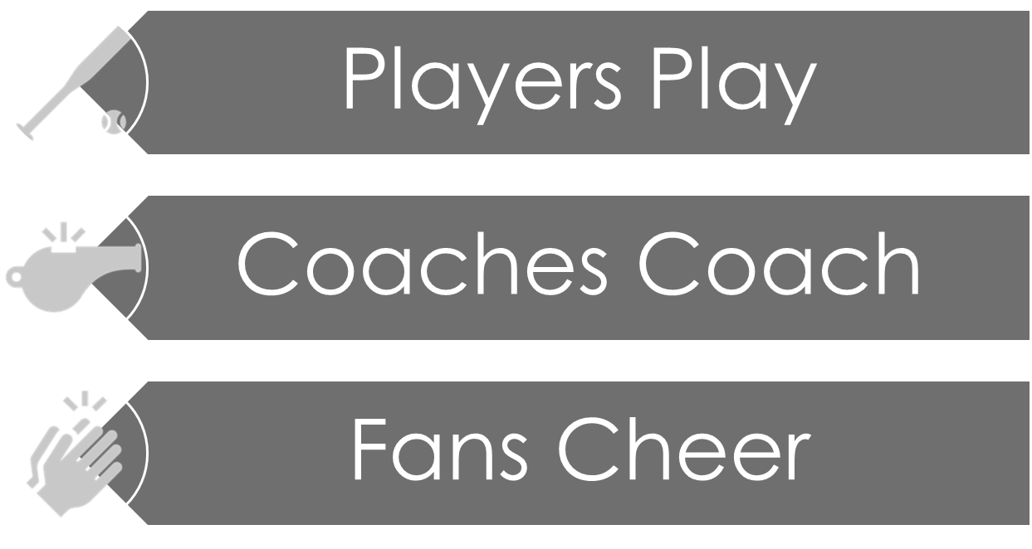
P.L.A.Y. CODE OF CONDUCT
**Parents must observe a 24-hour rule with any concerns or complaints. **
It is NOT acceptable to criticize, yell or confront a coach, parent, fan during or after and event.
Notes:
Read the slide Highlight the 24-hour rule and again that we are all volunteers.
**Parents must observe a 24-hour rule with any concerns or complaints. **
It is NOT acceptable to criticize, yell or confront a coach, parent, fan during or after and event.

Slide 7


FEELING ILL
*PLEASE DO NOT COME TO BASKETBALL*
STAY HOME- GET SOME REST
THERE IS ALWAYS NEXT WEEK
Notes:
Read Slide
If a coach is sick and or unable to make it, please parents step up and help.

Slide 8
SEASON DETAILS
K-2
Season Start→ January 6th, 2025
Season End→ March 16th, 2025
K/1
Sat AM: 45 min stations followed by 30 min scrimmage
First Day: January 11th, 2025
2nd grade Practice and Games
First Game Saturday January 11th, 2025 (times vary morning/afternoon)
4v4
Referred games (our PLHS students)
Practice 1 time a week at a PL district facility or Aspen Academy

Slide 9
TEAMS and # of PLAYERS
BOYS
GIRLS
GRADE | # of Players | TEAMS
K | 51 | 8
1 | 93 | 12
2 | 104 | 16
GRADE | # of Players | TEAMS
K/1 | 73 | 12
2 | 51 | 6
Notes:
READ SLIDE AND REVIEW PRACTICES
These will be scheduled at a variety of times on Saturdays every week unless otherwise communicated.
PLEASE DO NOT ASK US WHAT TIMES PRACTICES WILL BE AS WE DO NOT KNOW.
PRACTICES WILL VARY from during the week and times will vary.
Once our volunteer scheduler has the schedules completed, we will communicate this to all grade levels, and it will be update on the PLAY website and coaches or team parent will update SE
TEAMS ARE FORMED AND WE ARE IN THE PROCESSES BEHIND THE SCENES OF UPLOADING ALL INFORMATION TO SPORTS ENGINE AND MAKING PROVIDING COACHES THEIR TEAM CONTACTS. ONCE EVERYTHNIG IS COMPLTED, WE WILL UPDATE YOU! You will receive an email and you will be able to see your teams in Sports Engine.
Please do not request any changes as we have worked extremely hard behind the scenes to from teams.

Slide 10
Important Dates
Jersey Pick Up Wednesday 12/18 5:30-8pm
Equipment Pick Up **Coaches Only**
Twin Oaks Middle School (Cafeteria Entrance/doors facing 160th Street/Bridges Learning Center)
Only pick up a jersey if your player is NEW to PLAY or the jersey from last year DOES NOT FIT
We cannot accommodate number requests or jersey exchanges to get a different number
This will be the ONLY jersey pick up dates before Van Go Photos
January 2nd 4:30-6:30p @ PLAY basketball Shed (16000 Main Ave SE, Prior Lake MN 55372)
Only 1 coach needs to pick up the equipment bag so communicate with each other as to who will pick up (small space with limited parking)
Pick up your coaches shirt at jersey pick up 12/18. If you can’t pick up your shirt, coordinate with another coach and they can pick up for you
Notes:
There will be no additional jersey pick up dates before Van Go Photos 11/12 and 11/14. If you are not able to make a jersey pick up date then coordinate with your coach, neighbor, friend etc.

Slide 11
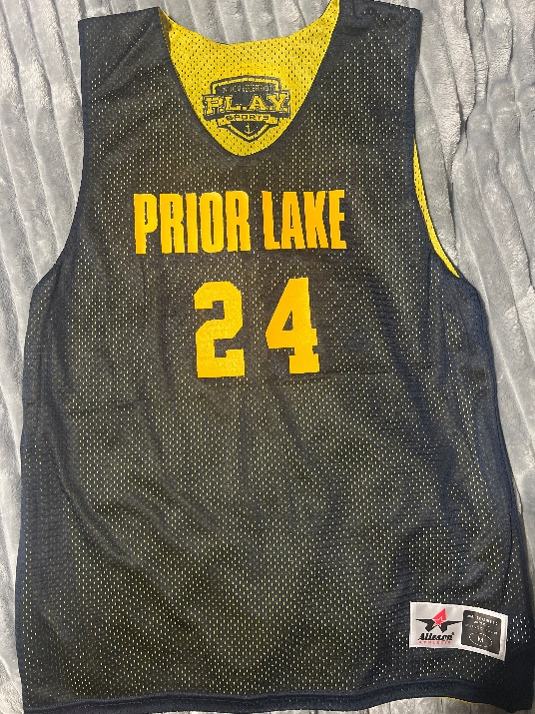
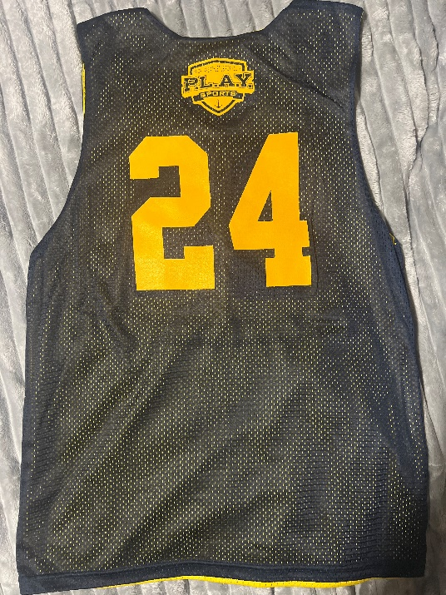
PLAY In-House Jersey
This is the current PLAY In-House Jersey. If this fits you should not come pick up a new one
Jersey Front Jersey Back
No # requests or exchanges

Slide 12

Picture Day K-2 with Van Go Photo January 11th and January 18th
Specific date, times and location will be communicated as information becomes available.
Notes:
READ SLIDE
Mark your calendars for picture day!!
We have the dates set for pictures and will announce a progression of what teams and which location you will be going to in order to get your players picture taken. Once we have this information you will be notified by the grade level coordinators, and coaches will upload this information in Sport Engine.

Slide 13
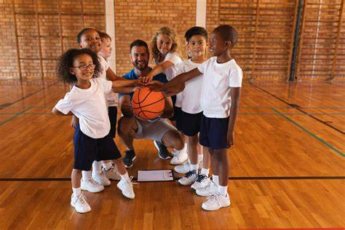
Important Date Cont.
Teams will be rostered in SE by 12/17/24
Practice schedule is being worked on and coaches will get notified when it is posted on the website so practices and games can be uploaded to SE
Practices can’t be set dates and/or times due to facility limitations (note: This is standard for all PLAY basketball)
Think about volunteering to be a team parent to help assist coaching with loading information in SE (practices, games etc). Let’s play our part to support our coaches and player

Slide 14
EQUIPMENT FOR BASKETBALL PRACTICES
WHAT IS PROVIDE TO YOU
Coaches will be provided Basketballs for their team and equipment to run practices
Equipment Pick Up for all K-2:
1/2 4:30-6:30p@ PLAY basketball Shed (16000 Main Ave SE, Prior Lake MN 55372)
WHAT YOU NEED TO BRING
P.L.A.Y reversable jersey (used for practice and games)
GOOD RUNNING SHOES (No Black bottom sole shoes, as they scuff up the gym floors)
WATER BOTTLE
GOOD ATTITUDE for COACHES
WHAT YOU SHOULD NOT BRING
SNACKS - Although very fun for teams to bring and share snacks, please remember that there are a lot of people that have food allergies, so please refrain from bringing snacks to help us keep our gym spaces clean as we will have many teams in and out of the gyms
Notes:
Read Slide.

Slide 15
COMMUNICATION & SPORTS ENGINE
COMMUNICATION WILL COME FROM COORDINATORS, COACHES and DIRECTORS.
SPORT ENGINE – DOWNLOAD APP
PLAY IN-HOUSE BASKETBALL WEBPAGE
Notes:
Communication and Sport Engine
Your primary source of communication will be SPORT ENGINE. This will be your friend throughout the season. Please download the app and get familiarized with this tool as PLAY uses this app for almost all sports for coaches to communicate with parents surrounding events, scheduling, or cancelations. PLEASE DO YOUR PART to be informed.
PLAY WEBSITE- Everything we have covered in this meeting IS ON THE WEBSITE. Please make sure that you look first at the website
, then partner with your grade level coordinator or coaches to assist you with any questions.

Slide 16
LAKER PLAY PASS
FREE EVENTS FOR YOUR PLAYER with paid Adult.
Girls/Boys Varsity Basketball
Wrestling
Hockey
Must wear their PLAY jersey to get in
Notes:
Players love to go to games with their parents, friends or together as a team. Have your player wear their In-House jersey to get in free with a paid adult!

Slide 17

Notes:
Thank you and we will open it up for a few questions. If there are no questions, we will conclude this meeting. Thank you!
This meeting presentation will be sent out to all parents

